Slide 2
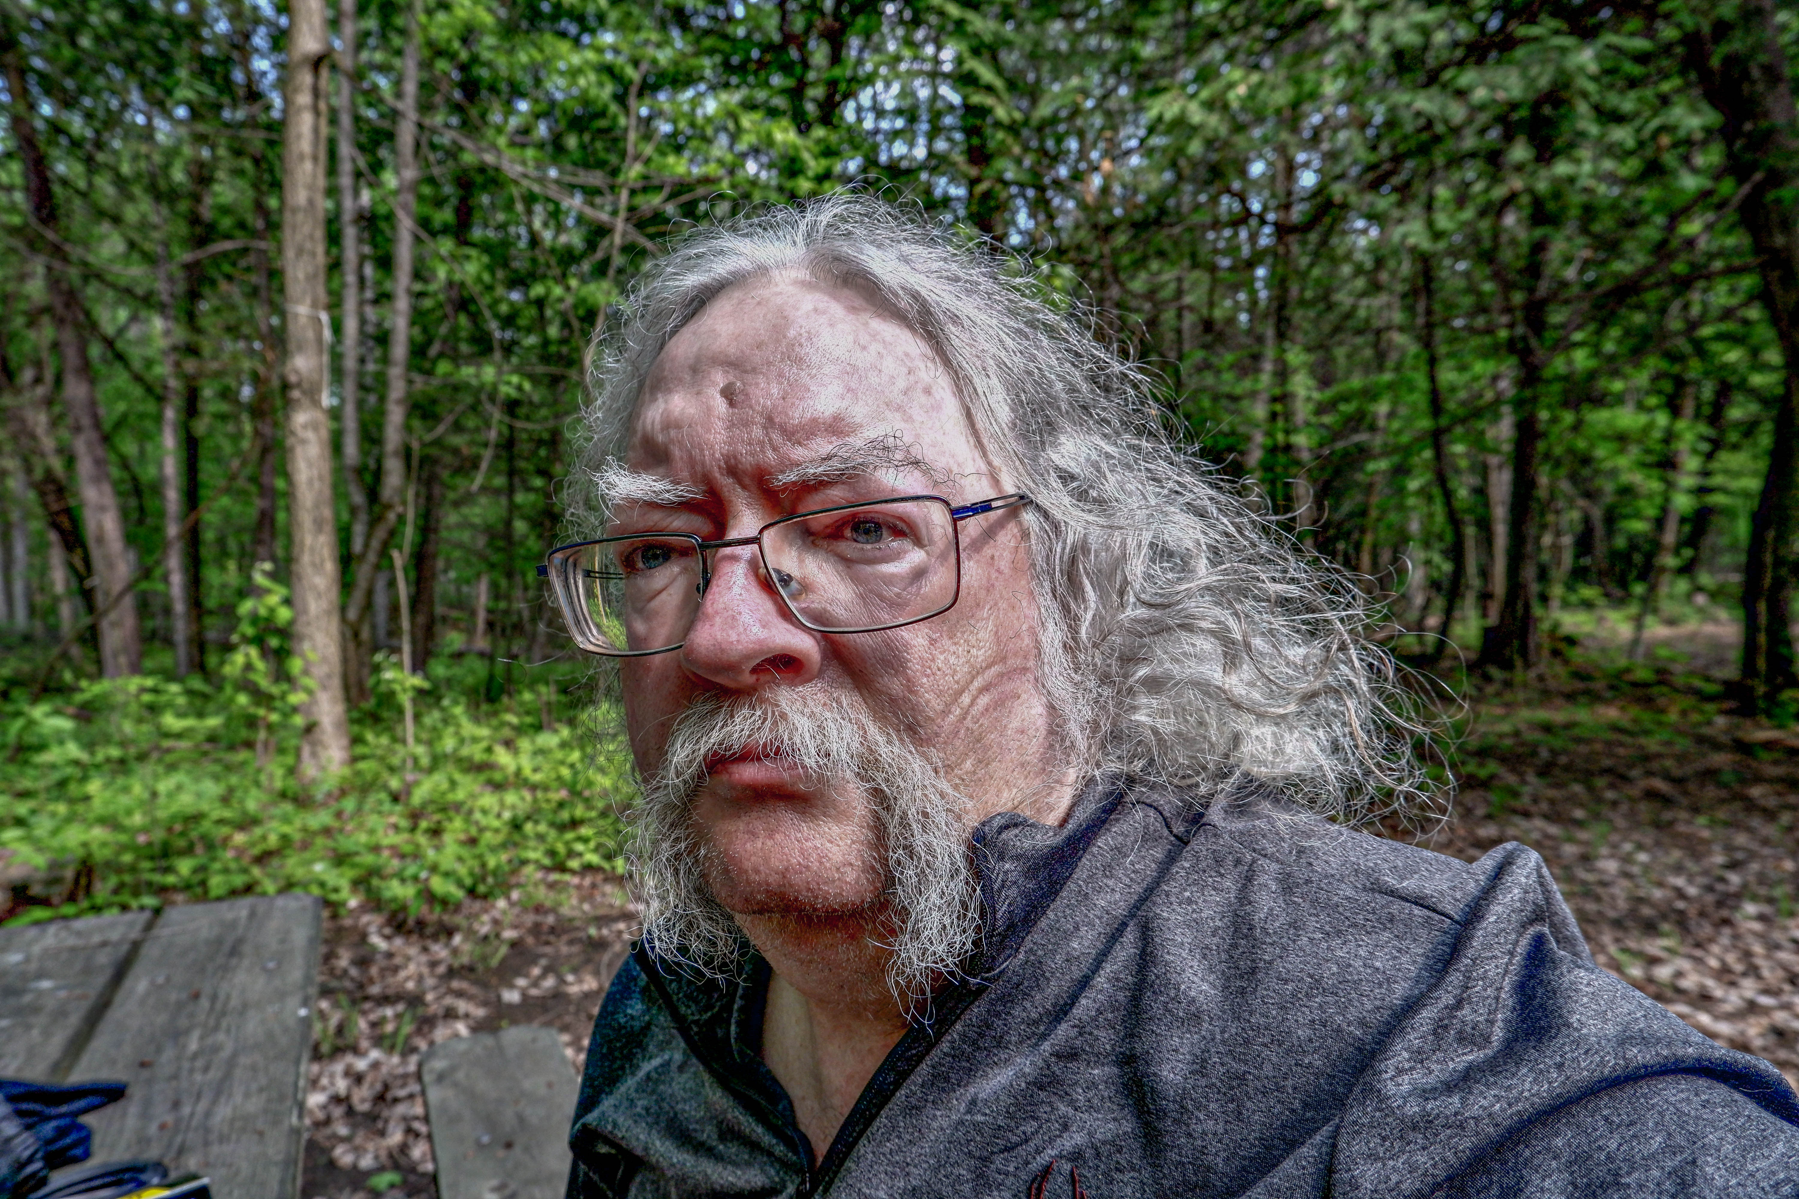
Philosophy
BA, MA University of Calgary
PhD (All But Dissertation) U. of Alberta
Stephen’s Guide to the Logical Fallacies
Connectivism & Connective Knowledge
Ethics, Analytics & the Duty of Care
Member, NRC Research Ethics Board
Computing
Texas Instruments: C, Pascal, Fortran
Web: HTML, Perl, CSS, Javascript
CGI Websites, LMS, Mailing List
Using VS Code, Git, Docker, Blockchain
Syndication: XML, RSS, JSON, API
Massive Open Online Course design
Publications
Repository
Education
Arusha Intl. Development Centre
Taught at Athabasca, Calgary & Alberta, Grande Prairie and Assiniboine Colleges
Learning Objects, Personal Learning
Open Educational Resources
Was member, U of A Board of Governors
Journalism
Student journalist, editor for 5 years
OLDaily e-learning newsletter, 20 years
Founded Moncton Free Press news coop
Hacking Memes, Speaking in LOLCats
Half an Hour blog, Leftish blog
YouTube, TikTok, 37000 photos on Flickr
Presentations
Articles
Stephen Downes

