Slide 1
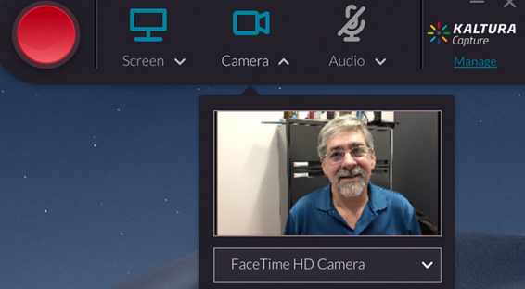

Tools that Support Agency
Write, draw, design and create content and services to support learning
Blogging, Websites & Publishing
Drawing, Design and Photos
Multimedia and Recording
Repositories and Library
Coding ands Development
Example: Kaltura provides storage, management and access to video resources.
Assessment: Although not specifically designed for educational applications, vendors may measure their use in education and how a video library impacts access to learning
Knowledge and resilience

Slide 2
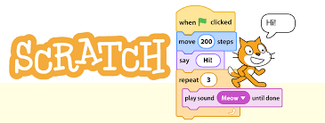

Tools that Support Interactivity
Tools that facilitate the exchange of content and data across platforms and institutions
Feed Readers
Messaging, Email, Social Media
Collaboration and Sharing
Teams and Classrooms
Labs and Simulations
Example: Scratch is a high-level block-based visual programming language for children 8–16 as an educational tool for programming
Assessment: Interactivity can be measured by engagement, inclusivity, and efficiency in achieving learning outcomes
Character and judgement

Slide 3


Tools that Build Community
Organize activities around a share event or theme, bring groups and cohorts together through learning activities
Event Management Tools
Discussion and Conferencing
Engagement Tools
Online Communities
LMSs and MOOCs
Example: Badgr offers technology and platforms for digital credentials awarded for successful learning outcomes
Assessment: Can be assessed for use by platforms and institutions, impact on alternative learning paths, and efficiency in helping employment outcomes
Social awareness and responsible citizenship

