Slide 1
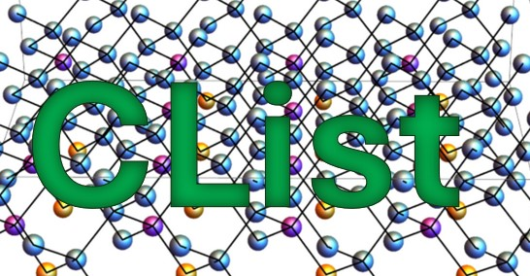
It’s time to redefine how we connect
Announcement and Demo
Monday, January 27, 12 noon EST
No this is not an AI thing (though some AI is involved)
No, this is not a MOOC thing (though the first FediMOOC is involved)
Join Stephen Downes for on this live webcast
https://youtube.com/live/0StXpYjhHeI

Slide 2
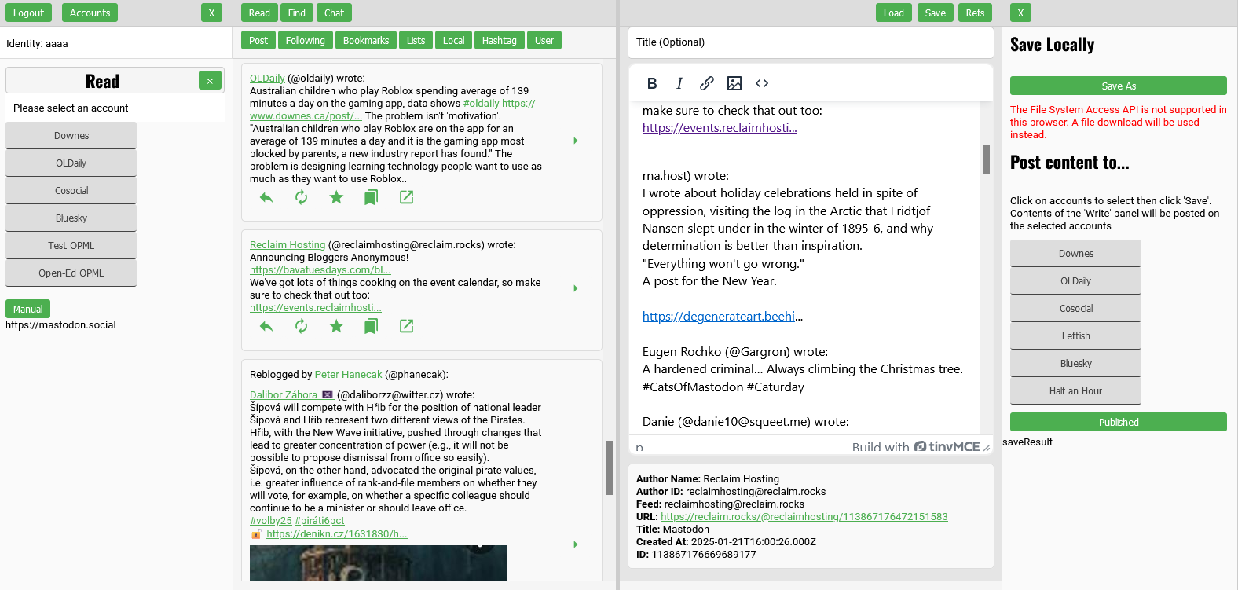
What This Is

Slide 3
Caveats
This is a prototype, not a completed application
This is a live demo, so some things might not work
Yes, other people have done some of the same things
No, it’s not fully secure against all possible attacks
I know that other people could have coded it better

Slide 4
Design Considerations
This is a single user application, not a multi-user platform
It’s completely open source CC-by to be used by anyone
As a whole it is designed to be distributed and decentralized
It is as simple as possible, so anyone can use it
The ideal is that it can run anywhere (still working on that)
Mostly plain HTML-JS-CSS (no Node, no React, no crazy installs)

Slide 5
OK Let’s Get Started

Slide 6
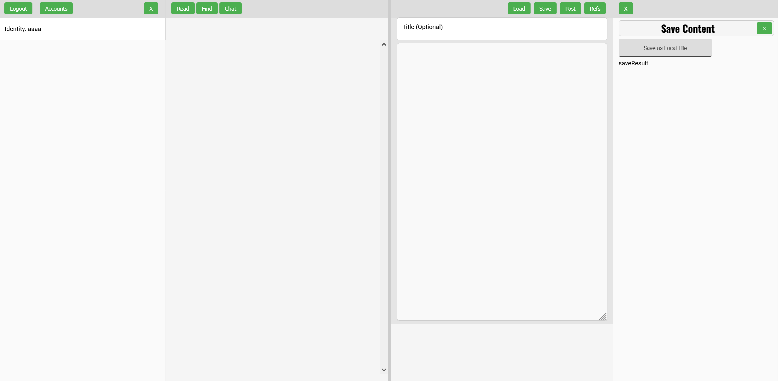
Flow
Left Read Write Right
Pane Pane Pane Pane
Aggregate Remix Repurpose Feed Forward

Slide 7
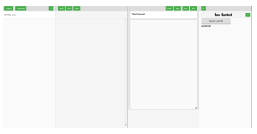
Identity Server and Accounts
KVStore
Each service is enabled by a standalone JS, in this case, kvstore.js
Scripts provide information to Clist in a standardized format, in this case an accounts array with values in a JSON object
Obviously, we would like a more robust identity server for the future.
kvstore.js
Flasker
Identity server and accounts
Simple Flask key-value store
let flaskSiteUrl = 'https://datastore.downes.ca’;
// Base URL of your identity server

Slide 8
Identity Server and Accounts
KVStore
Each service is enabled by a standalone JS, in this case, kvstore.js
Scripts provide information to CList in a standardized format, in this case an accounts array with values in a JSON object
Obviously, we would like a more robust identity server for the future.
kvstore.js
Flasker
Identity server and accounts
Simple Flask key-value store

Slide 9
Mastodon
KVStore
Post
Read
mastodon.js
Mastodon
Mastodon
Mastodon
Accounts from multiple servers
Multiple accounts from the same server

Slide 10

Feed Section
div id=feed-section
div id=feed-menu
div id=feed-container
class status-box
class status-box
…

Slide 11
div id=feed-container
Status Box
class status-box
class status-content
class clist-actions
class reblog-info
div id=“113544856986932095”
class status-image-container
class image-item
class image-item
class image-item
class status-actions
…

Slide 12
Auto-Translation
KVStore
Google AI
translate.js
Post
Read
tr
Mastodon
Mastodon
Translation
Account from AI translation service
Optional and need not be used

Slide 13
Bluesky
KVStore
Google AI
Post
Read
tr
Mastodon
Mastodon
Bluesky
Bluesky
bluesky.js
Bluesky
Accounts from multiple servers (if we ever get multiple servers)
Multiple accounts from the same server

Slide 14

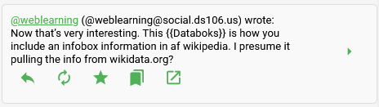






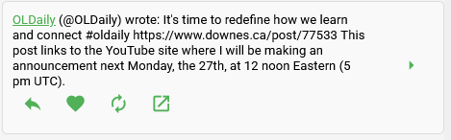
Feed and Status Actions
Mastodon
Reply
Boost
Thread
View Original
Favorite
Like
Bookmark
Repurpose
Bluesky

Slide 15

Thread Summary
KVStore
Google AI
Post
Read
tr
Mastodon
Mastodon
Bluesky
Bluesky
summarize.js
OpenAI
Thread Summarizer
Account from AI translation service
Thread (or whatever) fed to summarizer service
Summary becomes new feed item

Slide 16
OPML and RSS
KVStore
Google AI
Post
Read
tr
Mastodon
Mastodon
Bluesky
opml.js
Bluesky
RSS
OPML2JSON
OpenAI
Retrieving and Reading RSS
Standalone https://opml2json.downes.ca deployed
OPML URLs are entered as accounts

Slide 17

Podcast Player
KVStore
Google AI
Post
Read
tr
Mastodon
Mastodon
reader.js
Bluesky
Bluesky
RSS
OPML2JSON
OpenAI
Create and Play Podcast List
RSS reader detects audio enclosures in feed
Builds playlist in audio player

Slide 18
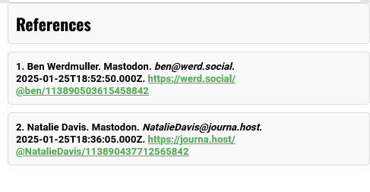
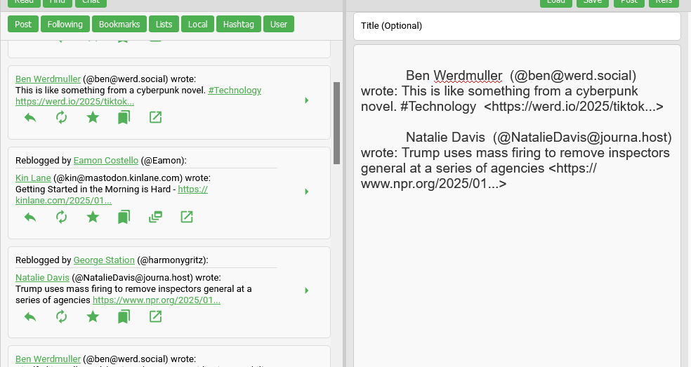
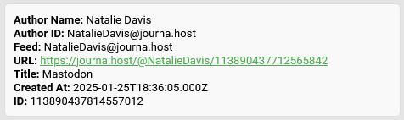
Convergence
Convergence = Reply to Multiple Posts at Once
Place content from any feed into the editor
Clist keeps track of each source for reply notifications
Click ‘Refs’ to toggle the full list of references

Slide 19
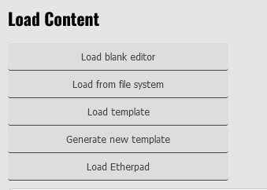
Preloading Content
Load
File
Template
Cloud
KVStore
Load
editors.js
Google AI
Post
Read
tr
Mastodon
Mastodon
Bluesky
Bluesky
RSS
OPML2JSON
OpenAI
Loading Content
Editing area can be preloaded with content
Context may be stored locally, generated, or cloud-based
Feed content then loaded in editing context

Slide 20
Loading Files
files.js
Load
File
Template
Cloud
KVStore
Load
Google AI
Post
Read
tr
Mastodon
Mastodon
Bluesky
Bluesky
RSS
OPML2JSON
OpenAI
Loading Files
CList files include editor content plus references
Any other file in filesystem may be loaded
Loaded file type may determine editor selection

Slide 21
Write Pane
write-pane
write-pane-command
write-title
write-load
write-pane-content
textEditorDiv
etherpadDiv
write-load-header
tinymceEditorDiv
write-column
text-column
padListSection
padContentSection
or
or
write-content
currentReferences
or
padShareSection
tinymce-references
texteditor-references
and

Slide 22
Editors
Text
HTML
Load
tinymce.js
File
Template
Cloud
KVStore
Load
Editors
editors.js
Google AI
Post
Read
tr
Mastodon
Mastodon
Bluesky
Bluesky
RSS
OPML2JSON
OpenAI
Selecting Editors
After content load is selected, editor is selected
Editor selection may be based on content type
Future: image editors, games, applications

Slide 23
Templates
OpenAI
Text
HTML
chatgpt.js
Load
tinymce.js
File
Template
Cloud
KVStore
Load
Editors
Google AI
Post
Read
tr
Mastodon
Mastodon
Bluesky
Bluesky
RSS
OPML2JSON
OpenAI
Predefined or Generated Templates
Select template from template library (not yet available)
Generate template on demand from generative AI
Templates can be editor-specific

Slide 24

Collaboration
OpenAI
Text
HTML
Etherpad
Load
File
Template
Cloud
KVStore
Load
Editors
Proxyp
editors.js
Google AI
Post
Read
tr
Mastodon
Mastodon
Bluesky
Bluesky
RSS
OPML2JSON
OpenAI
Collaborative Editing
Editors can support multiple users
Current configuration supports EtherPad
In this case, Etherpad is access through proxy server

Slide 25
Chat and Share
OpenAI
Text
HTML
Etherpad
Load
dynamicp2p.js
peerjs.js
File
Template
Cloud
Chat
Load
Editors
Proxyp
KVStore
Google AI
Post
Read
tr
Mastodon
Mastodon
Bluesky
Bluesky
RSS
OPML2JSON
OpenAI
Peer to Peer Chat
Discussions are discovered via KVStore
No central chat server required
Chat insertion of, e.g., link to join etherpad

Slide 26
Search and Find
OpenAI
Text
HTML
Etherpad
Load
File
Template
Cloud
Chat
Load
Editors
Proxyp
KVStore
Google AI
Post
Read
tr
Mastodon
Mastodon
Bluesky
Bluesky
RSS
OPML2JSON
OpenAI
Find
reader.js
Resource Discovery
Search results via open APIs
Proxy also usable for search
Future: people, courses, open data, etc
DuckDuckGo
Proxyp
Google
OASIS

Slide 27
Save
OpenAI
Text
HTML
Etherpad
Load
File
Template
Cloud
Chat
Load
Editors
Proxyp
KVStore
Save
Google AI
files.js
Filesystem
Read
tr
Cloud
Mastodon
Bluesky
Post
OpenAI
Mastodon
RSS
OPML2JSON
Bluesky
Find
Save Editor Contents
Save to local file system (download for Firefox)
Planned: save as selected file type
Cloud save (e.g. AWS, Dropbox) not yet implemented
DuckDuckGo
Proxyp
Google
OASIS

Slide 28
Post Articles
OpenAI
Text
HTML
Etherpad
Load
File
Template
Cloud
Chat
Load
Editors
Proxyp
KVStore
Save
Google AI
Filesystem
Read
tr
Cloud
Mastodon
publish.js
Bluesky
Post
OpenAI
Mastodon
RSS
OPML2JSON
Bluesky
Find
Create Blog Posts
Wordpress, Blogger supported
Future: Ghost, web pages
Multi Post+Link Publishing
wordpress.js
DuckDuckGo
Wordpress
Proxyp
blogger.js
Google
Blogger
OASIS

Slide 29
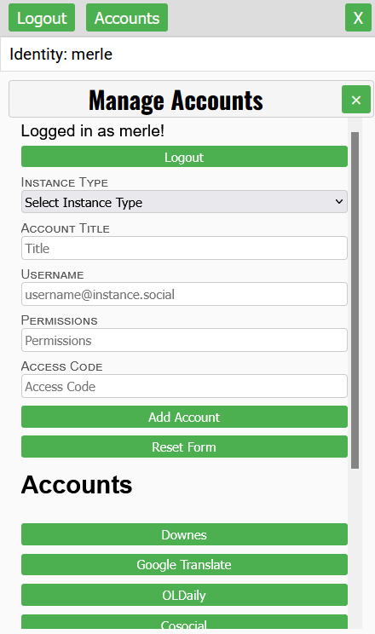
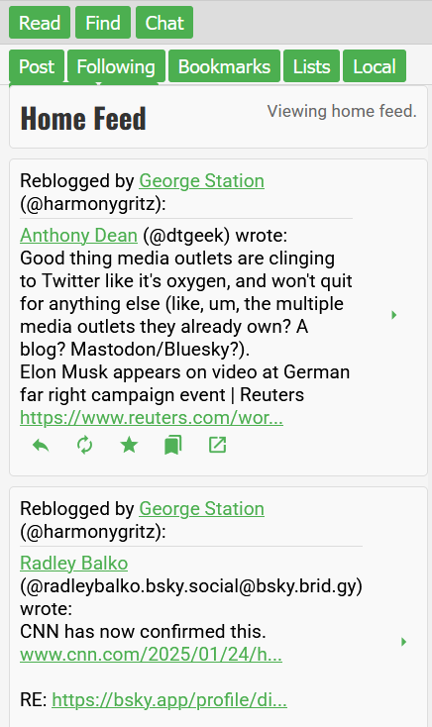
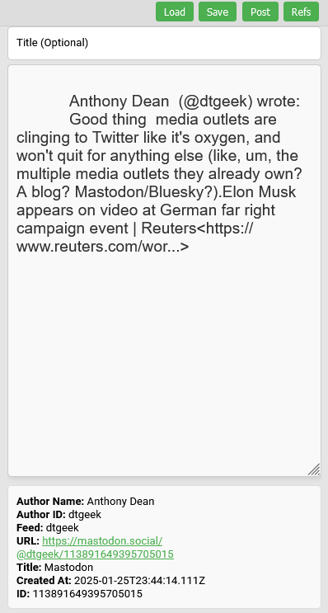
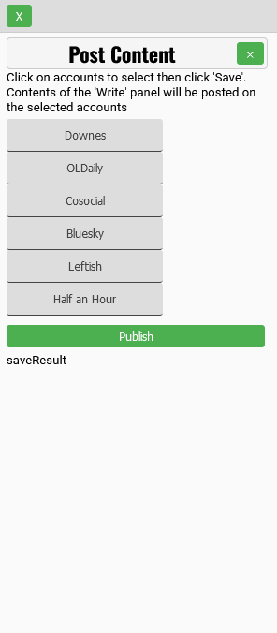
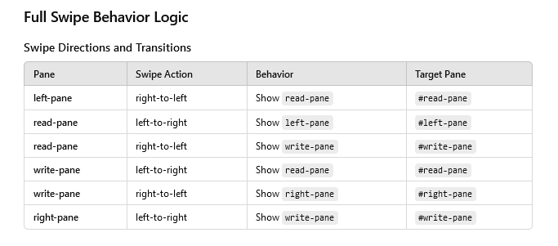
Mobile

Slide 30
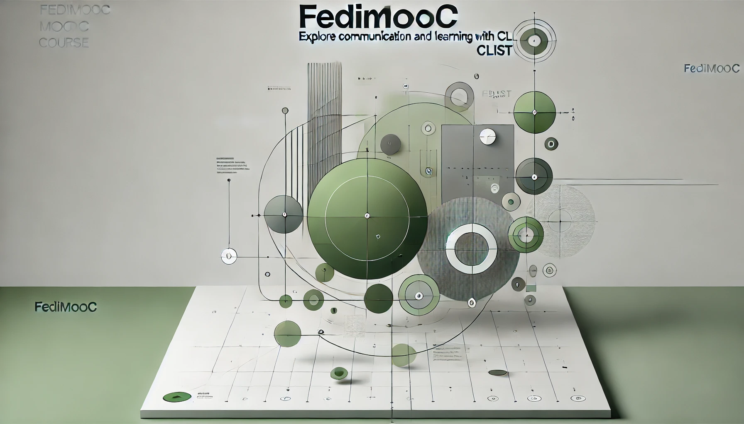
FediMOOC
February 17- https://fedi.mooc.ca/

Slide 31
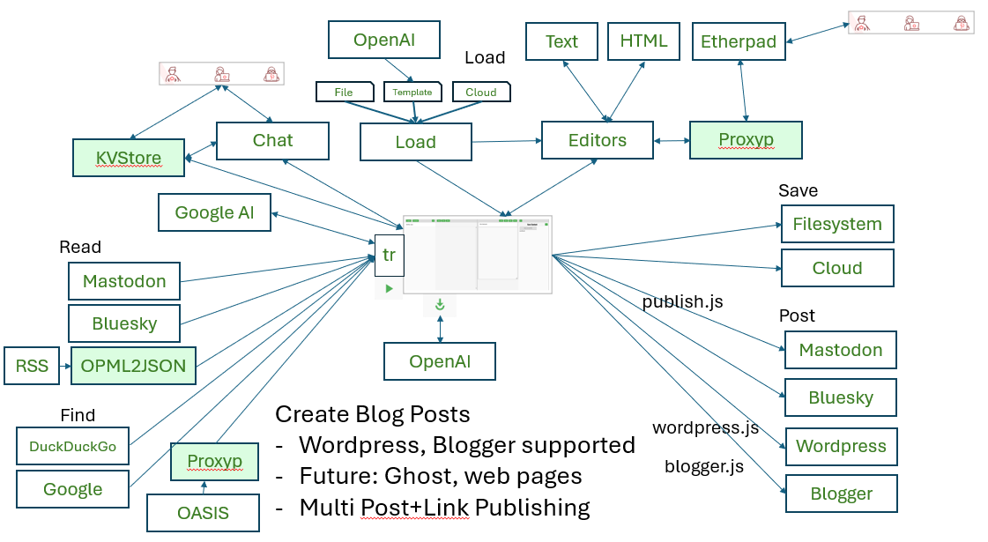
The Future…?
Simulations
VR
Discourse
Open Data
H5P Editor
Project Mgmt
Spreadsheets
Graphing
Simulations
Games
Jobs
Diagrams
Mahara
Competencies
Trilium
DID
Mattermost
Calendar
Content Addr.
Publish IPFS
Cloud Storage
Live Events
Ghost
Peertube
Publications
Lemmy
Podcast
DOAJ
Assessment
Remixer
Web Page
Course Library
Badges
More OERs
Other AI
Slides
Mailgun
Devices
AI Agents
Shared Bookmarks
xAPI LRS
Zotero
Skills Profile

Slide 32
What’s Next
Testing – people try it and report what’s not working
Features – what things do people want most? Roadmap.
Applications – stories describing what it’s used for
Development – people suggest fixes and improvements on Github
Documentation – make it easy for people to use
Security – experienced developers lock it down
Services – other people (not just me) host supporting applications
Expansion – other people (not just me) write JS support apps
Publicity – we let people know what’s possible
Governance – so this belongs to the community, not just me

Slide 33
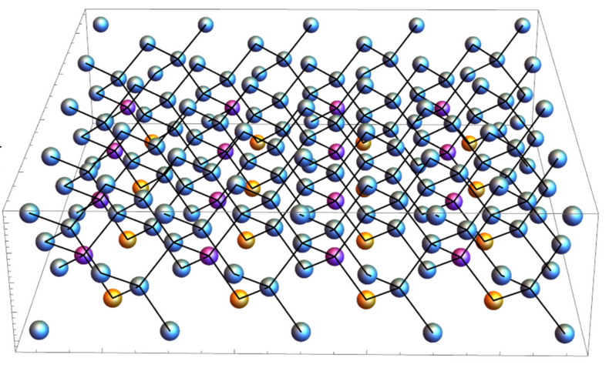
Thanks
CList
Stephen Downes ~ stephen@downes.ca ~ https://www.downes.ca

