Slide 1
AI Ethics in a research context: current approaches and future challenges
Kathleen Fraser, AI Researcher, NRC Digital Technologies
Terrence Stewart, Senior Research Officer, NRC Digital Technologies
Stephen Downes, Senior Research Officer, NRC Digital Technologies
Margaret McKay, Program Leader Digital Privacy & Security, NRC
CAREB 2024

Slide 2
Part 1(c)
Overview of leading AI ethics approaches and perspectives

Slide 3
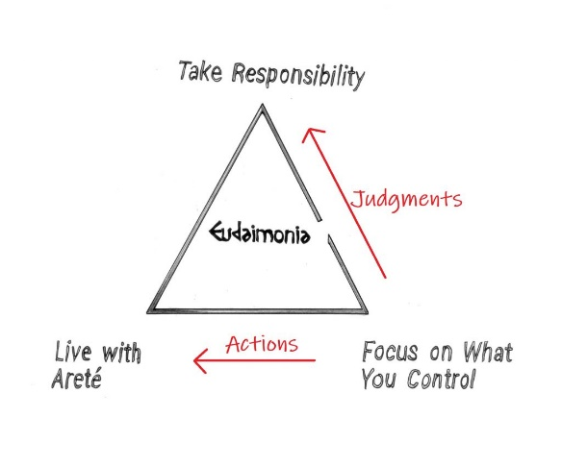
Leading AI ethics approaches and perspectives
Character and Virtue
Cultivation of inherent ethical qualities such as honesty
Arete “Be all you can be”
Between deficiency, excess
Character and Virtue in AI Ethics:
Issues around the impact on the individual, for example, loss of skills, loss of critical reflection, loss of sense of right and wrong
Virtue-based responses: standards of professional conduct (e.g. CFA Institute, ACM code, Nolan principles, AMA)
Values-based: “values are academic freedom, scholarly excellence, mutual respect, collaboration, integrity” (Folan, 2020)
Notes:
Image: https://www.reddit.com/r/Stoicism/comments/bq1njj/easy_way_to_explain_stoicism_the_stoic_happiness/

Slide 4
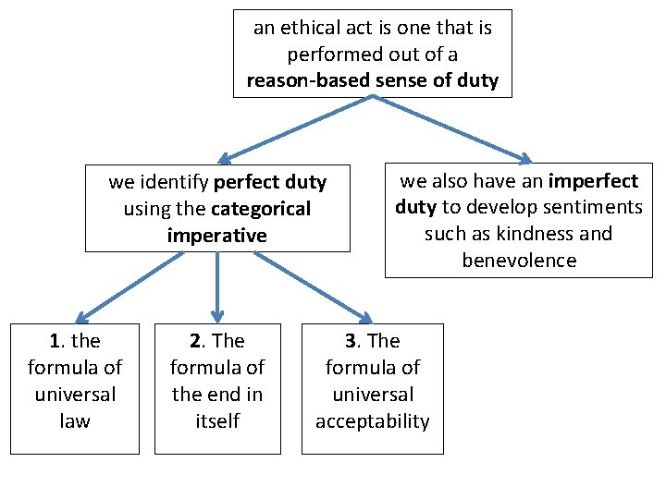
Leading AI ethics approaches and perspectives
Duty and Deontology
Inherent value of humans
Categorical Imperative – “What is everyone did that?”
Duty and Deontology in AI Ethics:
Issues based on rights and agency, including surveillance, tracking, anonymity, and privacy generally, human decisions
Response based on worth & dignity of each human (NEA, 1975)
Role and responsibility, e.g. duty to “the pursuit and dissemination of knowledge…” (SFU Code)
Informed consent (eauchamp and Childress, Helsinki, Belmont)
Notes:
Image: https://slidetodoc.com/ethics-theory-and-business-practice-3-2-kantian/

Slide 5
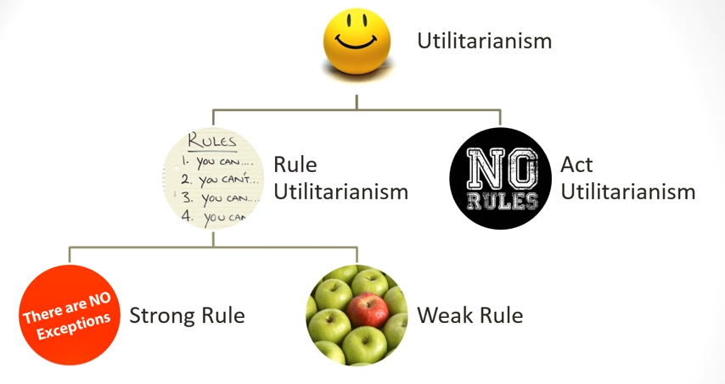
Leading AI ethics approaches and perspectives
Consequentialism
The greatest good for the greatest number of people
The happiness principle
Comparing acts versus rules
Consequentialism in AI Ethics:
Issues related to undesirable outcomes, including bias and prejudice, misinterpretation
Benefit-based response: “safety, health, and welfare of the public” (IEEE Code)
Reduction of Harm (HHS Common Rule)
Risk-based approaches
Notes:
Image: https://www.youtube.com/watch?v=GrZp12isYb4

Slide 6
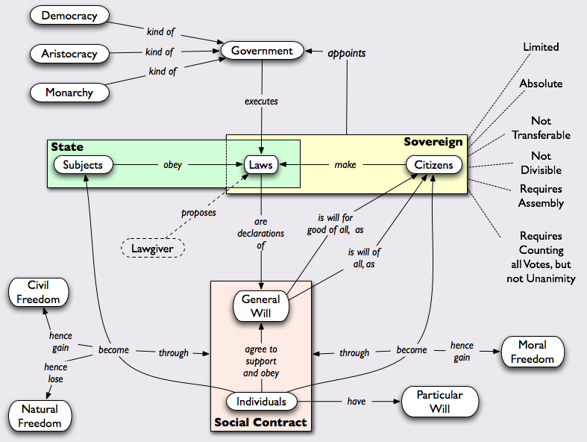
Leading AI ethics approaches and perspectives
Social Contract Theory
Ethics as agreement for the greater good
Rawls: ‘original position’
Justice as fairness
Social Contract Theory in AI Ethics
Issues that undermine decision-making and democracy, for example, content manipulation, micro-targeting, discrimination,
Society-based responses based in responsibility (Code Soleil)
Promotion of public trust (Ontario College of Teachers)
Constitutional and rights-based approaches
Notes:
Image: https://www.pinterest.it/pin/39688040449977807/

Slide 7
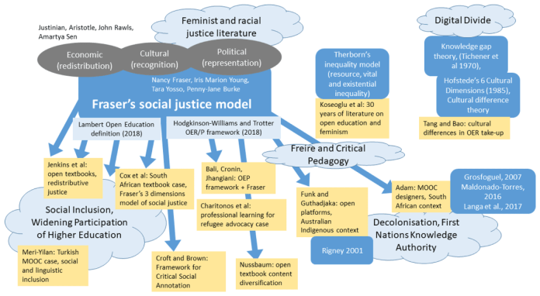
Leading AI ethics approaches and perspectives
Care and Community
Ethics as based in personal relationships, interaction
Based in a sense of ethics rather than rules & principles
Care and Community in AI Ethics:
Issues of alienation and dehumanization, including the creation of a climate of mistrust, fear and anxiety, loss of social cohesion
Relationship-based response: ““a privileged relationship exists between members and students” (BC Teachers Federation)
Benefit to subject as perceived by the subject (Cdn Nurses Assn)
Notes:
Image: https://jime.open.ac.uk/articles/10.5334/jime.584/

Slide 8
Leading AI ethics approaches and perspectives
Summary of Issues - https://ethics.mooc.ca/all_issues.htm
Approaches to ethics https://ethics.mooc.ca/cgi-bin/page.cgi?module=9
The Ethical Codes Reader https://docs.google.com/document/d/1mv9VxbIyGvBaFwHSvtyN1a3iwAKws6SZDGuDTlYMZ48/edit
MetaEthics https://ethics.mooc.ca/cgi-bin/page.cgi?presentation=41

Slide 9
Part 2(b)
Current and future AI ethics challenges for REBs

Slide 10
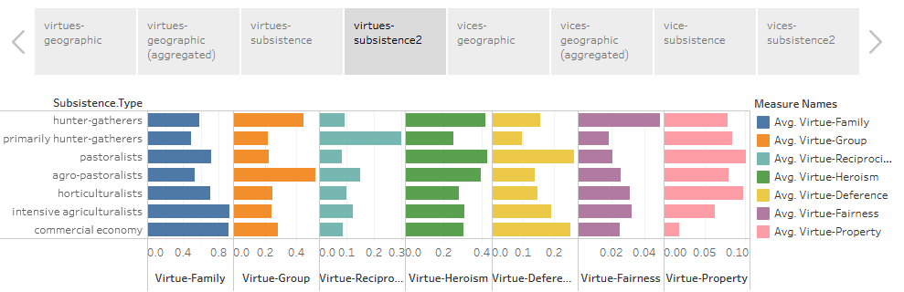
Current and future AI ethics challenges for REBs
Challenging some oft-held ideas about ethics
Universalism – the idea that there is (or should be) one set of ethics that applies to all
Normativity – the idea that ethics is prescriptive and describes attitudes we should have or how we should behave
Cognitivism – the idea that moral principles can be expressed as a series of knowable rules
Virtues and vices around the world
https://public.tableau.com/profile/mark.alfano#!/vizhome/Virtuesandvicesfromtheperspectivesof256cultures/Virtuesandvicesaroundtheworld

Slide 11
Current and future AI ethics challenges for REBs
MetaEthics
What is the basis for ethics?
Types of ethics: descriptive, normative, analytic
Relativism
  Cultural, agent, speaker
  Descriptive, metaethical, normative
Non-cognitivism – “views moral discourse as a way to express attitudes towards certain actions.”
Realism: naturalism and non-naturalism, objectivism
Rational choice vs intuition vs sentiment
  emotivism, prescriptivism, expressivism
Basis (motivation): deity, power, reason, agreement, sentiment

Slide 12
Current and future AI ethics challenges for REBs
Who Owns Ethics
Scientific Virtues
  “scientists invoke theoretical virtues explicitly, albeit rather infrequently, when they talk about models”
Business Ethics
  “real concerns and real-world problems of the vast majority of managers”
Silicon Valley Ethics
  Metcalf, Moss & boyd: “broader and longer-standing industry commitments to meritocracy, technological solutionism, and market fundamentalism”
https://philpapers.org/archive/MIZTVI.pdf
https://hbr.org/1993/05/whats-the-matter-with-business-ethics
https://datasociety.net/library/owning-ethics-corporate-logics-silicon-valley-and-the-institutionalization-of-ethics/

