Slide 1

Agora

Slide 2
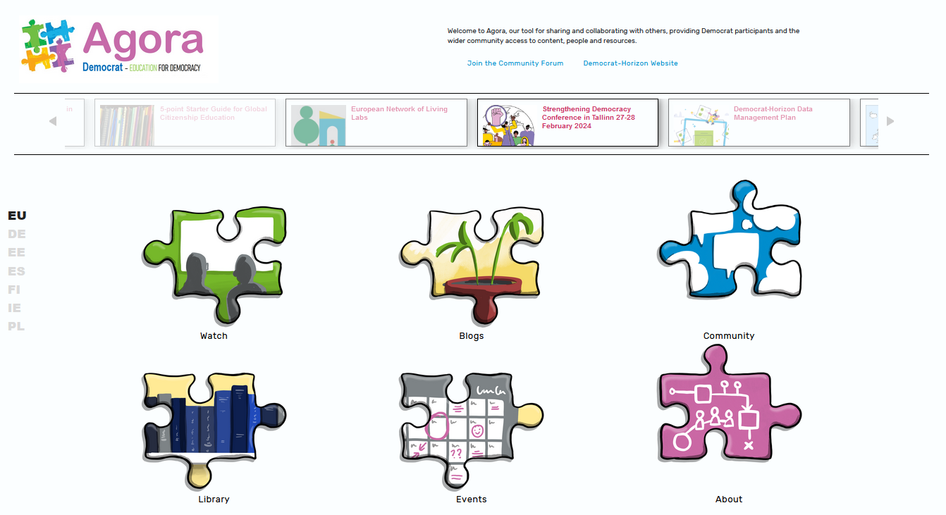

Slide 3

Agora Internal
Nextcloud, plus
Agora Inside Blog/Newsletter/Private Discussion
https://blogs.democrat-horizon.eu/internal/

Slide 4

Agora Public
Agora Public Webpage - https://agora.democrat-horizon.eu/
  Blog / Newsletter subscription
  Public Discussion
  Videos and/or Podcasts
  Events Calendar
  Library
    Upload to Zenodo

