Slide 1
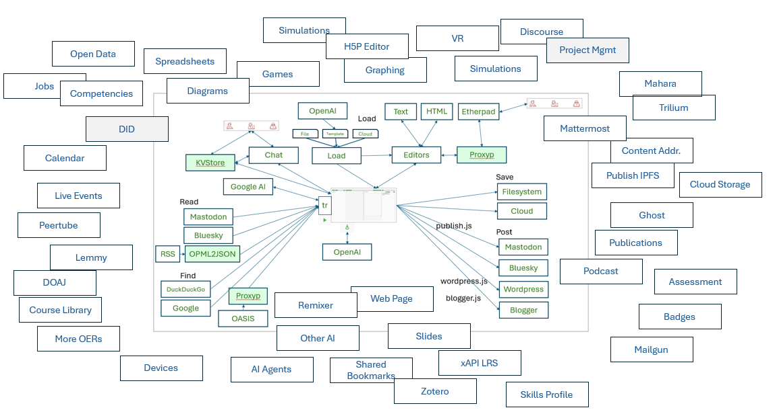
Reframing Togetherness: Advances in artificial intelligence and the intersection of open learning
Stephen Downes
Presented to
Open/Technology in Education, Society, and Scholarship Association (OTESSA)
Toronto, Ontario, Canada
June 4, 2025

Slide 2
Promises I Made in the Abstract
Outline some recent advances in artificial intelligence, highlighting in particular their potential to impact open education, both positively and negatively.
This means far more than online instruction and adaptive learning.
It means more than open content and automated assessment.
Focus on how AI is shaping and will transform how we understand ourselves as interactive, purpose-based and open learning communities.
Offer a framework based on agency and care to work with the new technology to support genuinely emancipatory open learning for everyone.

Slide 3
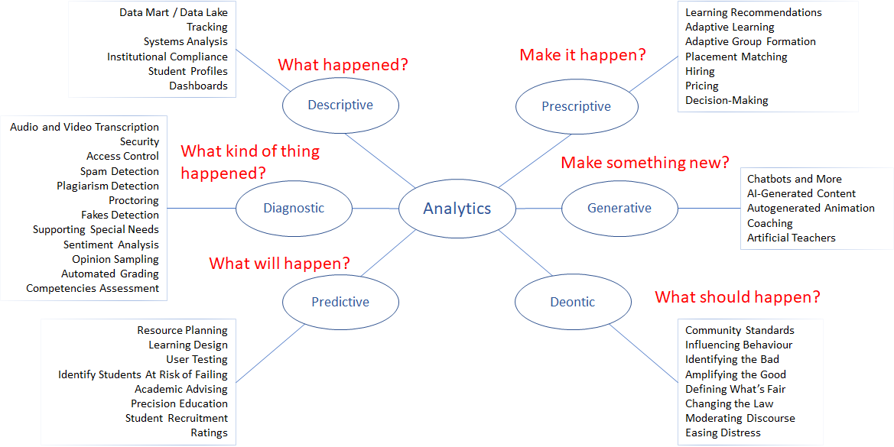
Applications of AI - A Taxonomy
https://ethics.mooc.ca/cgi-bin/page.cgi?presentation=12

Slide 4
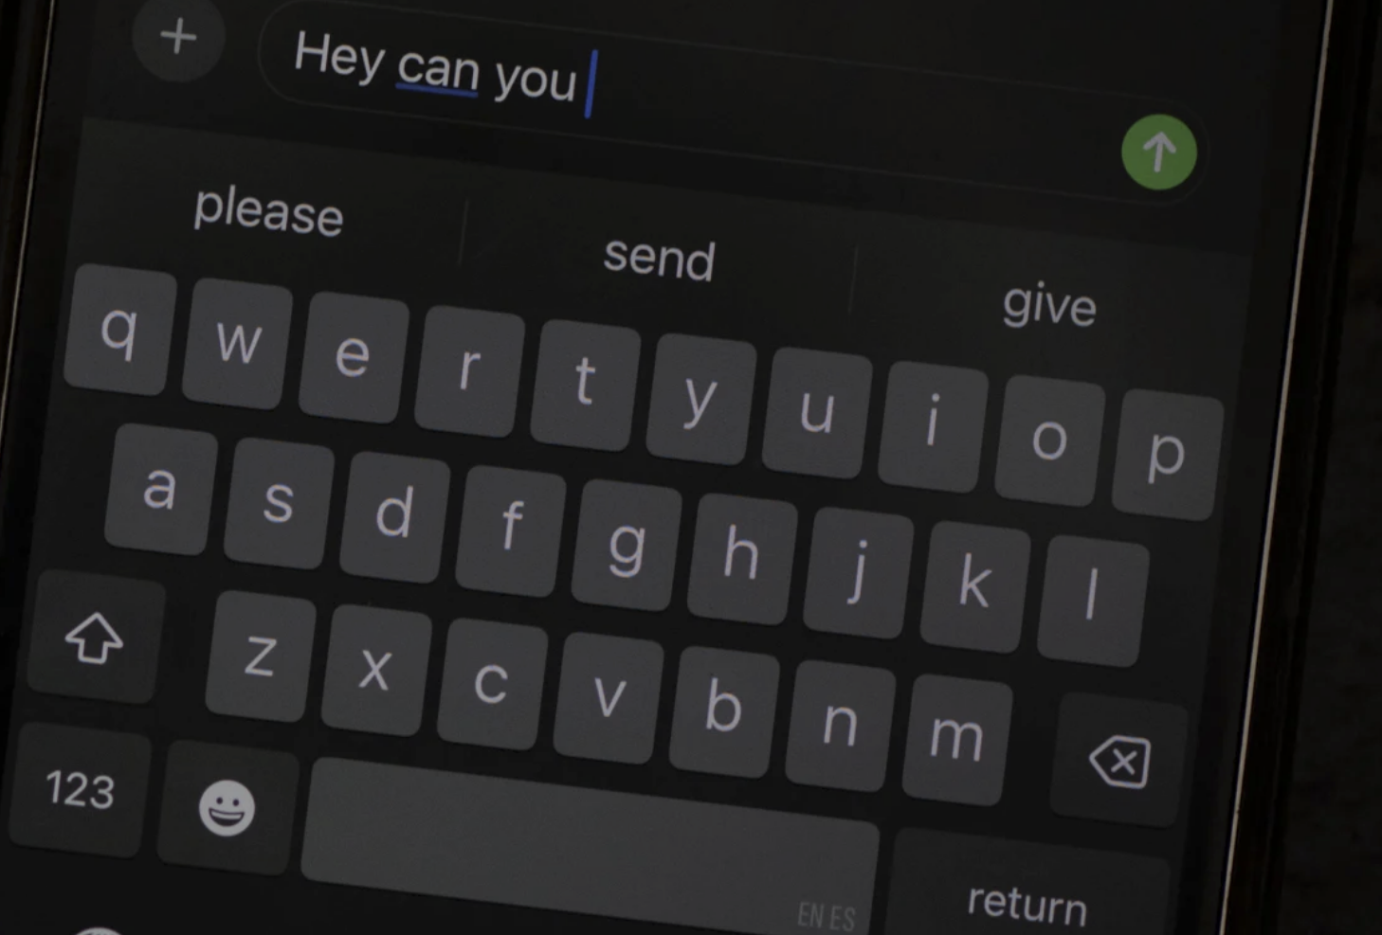
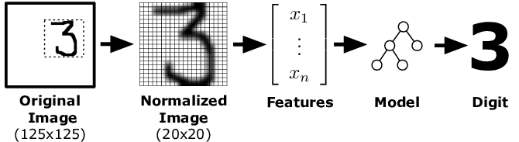
Advances in Artificial Intelligence
Large Language Models
The completion Game 21
Which of these Things Does Not Belong
What number is this?
Duck-Rabbit / Gestalt
See Carl T. Bergstrom, Jevin D. West. 2025. Autocomplete in Overdrive. https://thebullshitmachines.com/lesson-1-autocomplete-in-overdrive/

Slide 5
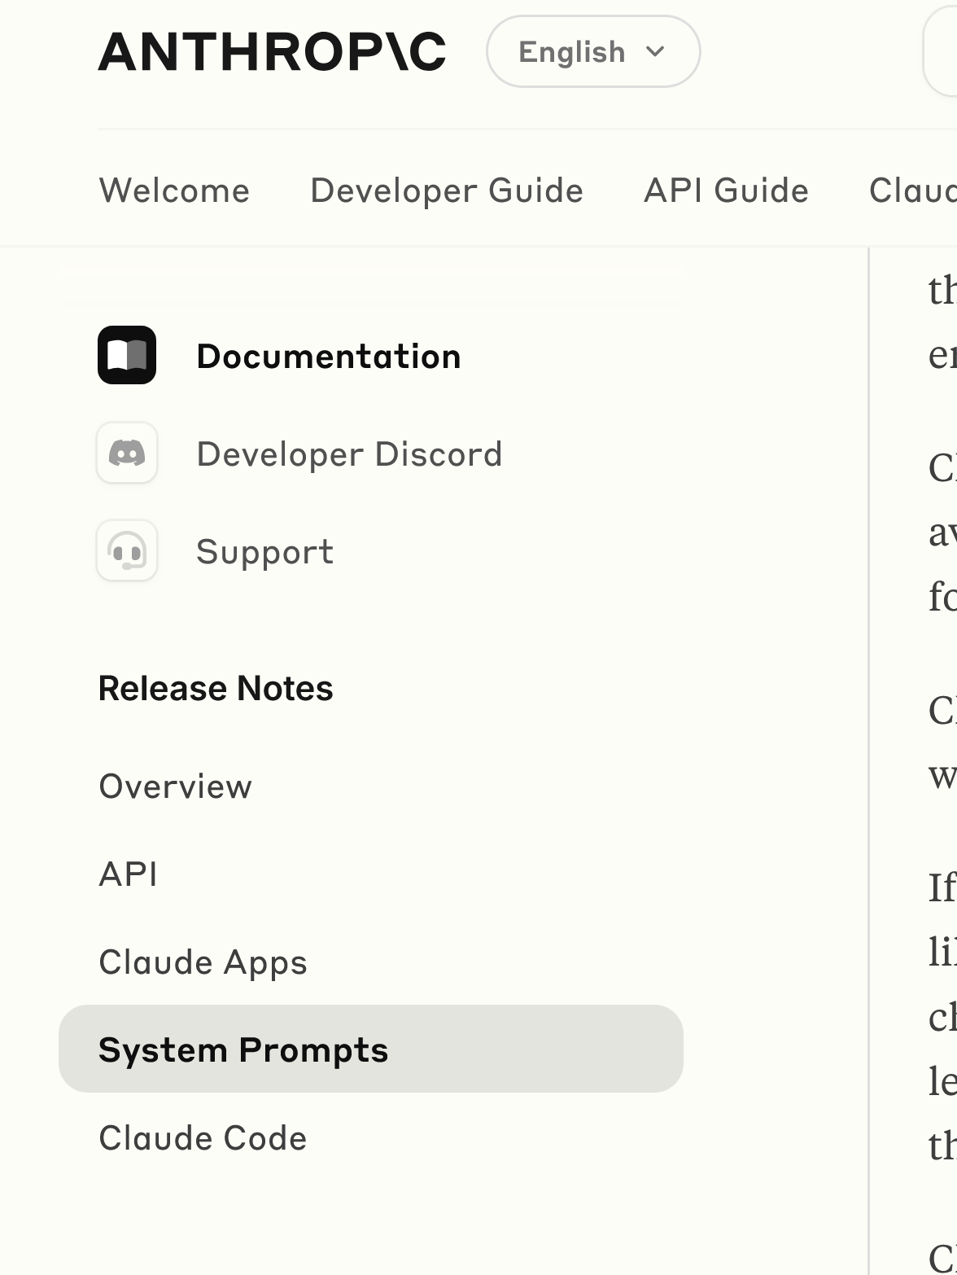
Advances in Artificial Intelligence
System Prompts
Eg. For Claude https://docs.anthropic.com/en/release-notes/system-prompts#may-22th-2025
Eg. For ChatGPT https://chatgpt.com/share/67870f6a-39c0-8006-920c-5b695fc0b01b
See Carl T. Bergstrom, Jevin D. West. 2025. Autocomplete in Overdrive. https://thebullshitmachines.com/lesson-1-autocomplete-in-overdrive/

Slide 6
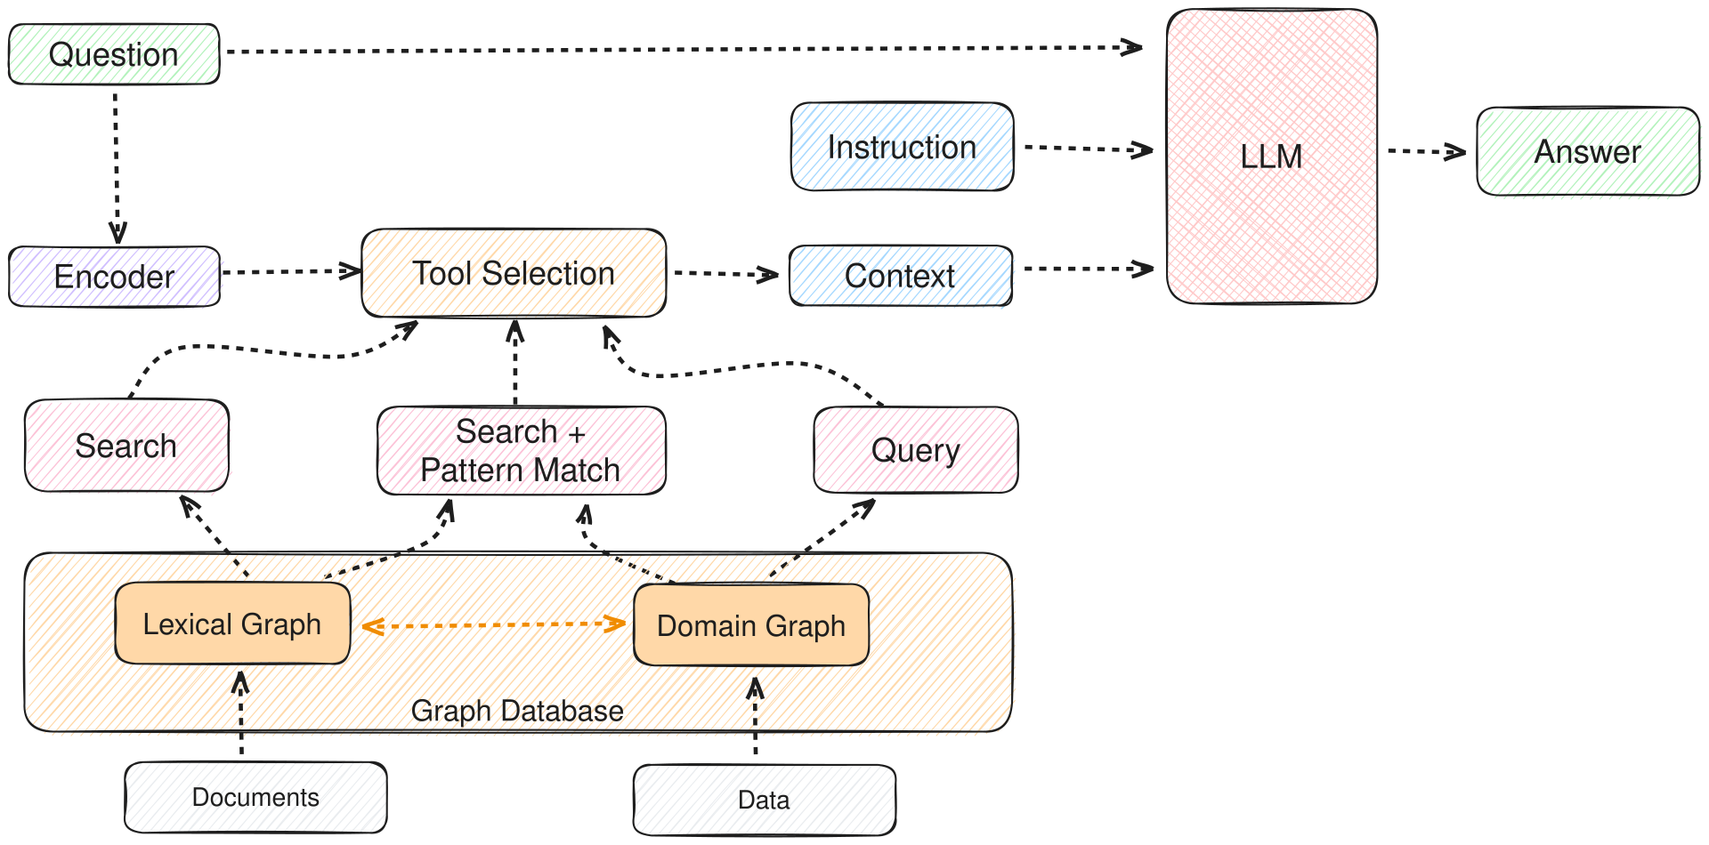
Advances in Artificial Intelligence
RAG, MCP, A2A
Resource Augmented Generation
https://en.wikipedia.org/wiki/Prompt_engineering

Slide 7
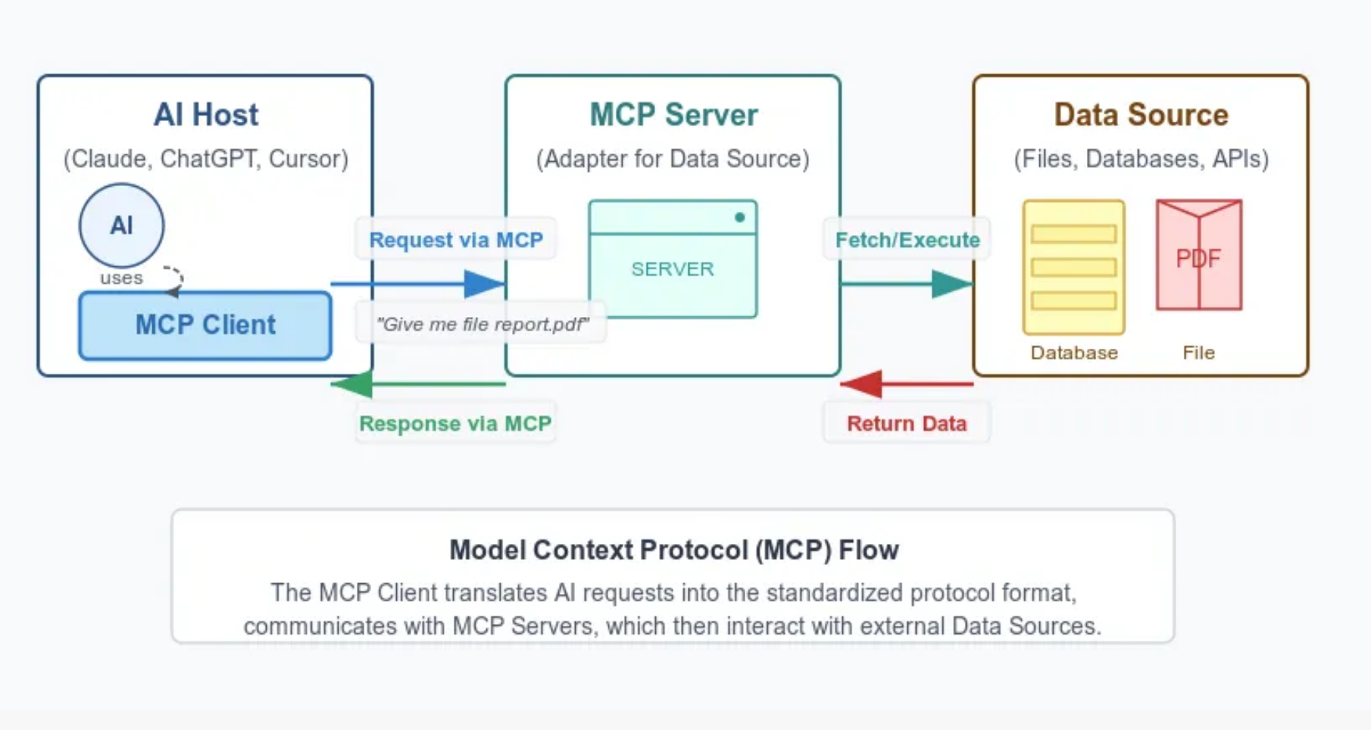
Advances in Artificial Intelligence
RAG, MCP, A2A
Model Context Protocol
Anthropic. 2024. Introducing the Model Context Protocol. https://www.anthropic.com/news/model-context-protocol

Slide 8

Advances in Artificial Intelligence
Veo
Google. 2025. Veo 3 in Gemini is now in the UK. https://www.youtube.com/watch?v=ecTqFLS-9mg

Slide 9
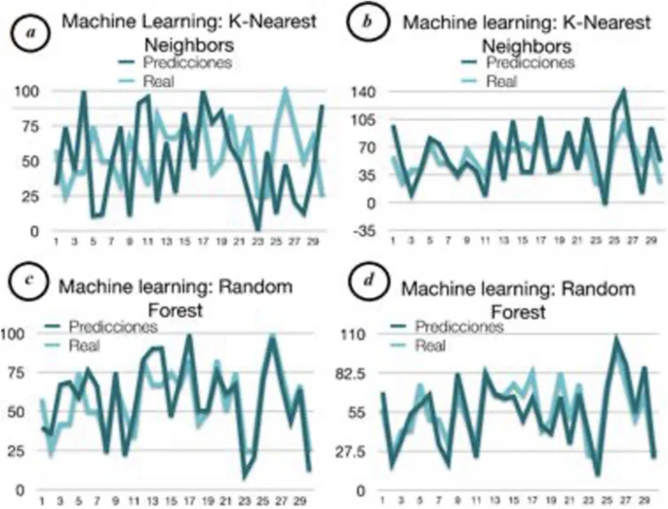
Advances in Artificial Intelligence
more than online instruction and adaptive learning
more than open content and automated assessment
Rincon-Flores, E.G., Castano, L., Guerrero Solis, S.L. et al. Improving the learning-teaching process through adaptive learning strategy. Smart Learn. Environ. 11, 27 (2024). https://doi.org/10.1186/s40561-024-00314-9

Slide 10
How We Understand Ourselves
We Are Interactive
Human-AI Interaction (HAX)
Collaborative decision-making, virtual assistants, personalized recommendation
Human-AI-teaming (HAT): Redefining collaboration in the digital era
Emergent states, trust, shared cognition
Interaction Design Foundation. 2025. Human-AI Interaction (HAX). https://www.interaction-design.org/literature/topics/human-ai-interaction
Jan B. Schmutz, Neal Outland, Sophie Kerstan, Eleni Georganta, Anna-Sophie Ulfert. 2024. AI-teaming: Redefining collaboration in the digital era. Current Opinion in Psychology, Volume 58, 2024. https://www.sciencedirect.com/science/article/pii/S2352250X24000502

Slide 11
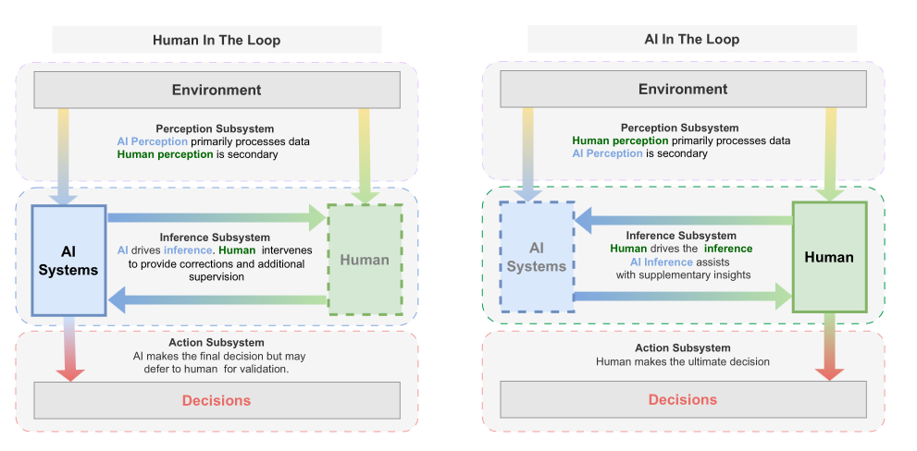
How We Understand Ourselves
Decision-Making Processes
Sriraam Natarajan, Saurabh Mathur, Sahil Sidheekh, Wolfgang Stammer, Kristian Kersting . 2025. Human-in-the-loop or AI-in-the-loop? Automate or Collaborate? arXiv, Jan 03, 2025. https://arxiv.org/abs/2412.14232v1

Slide 12
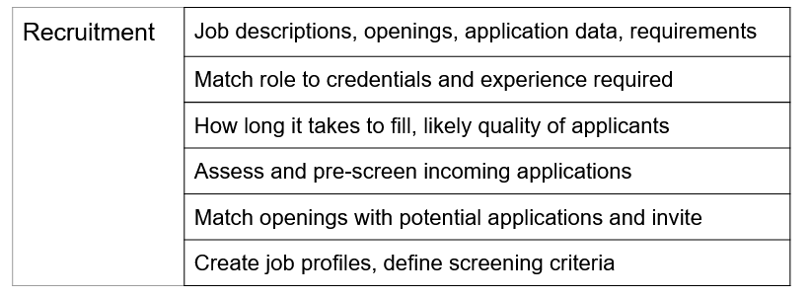
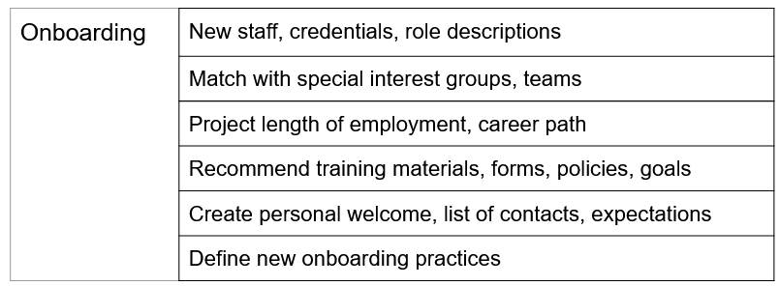
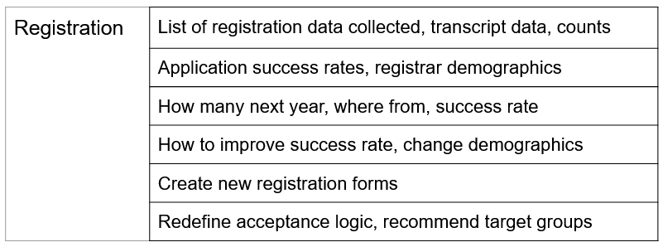
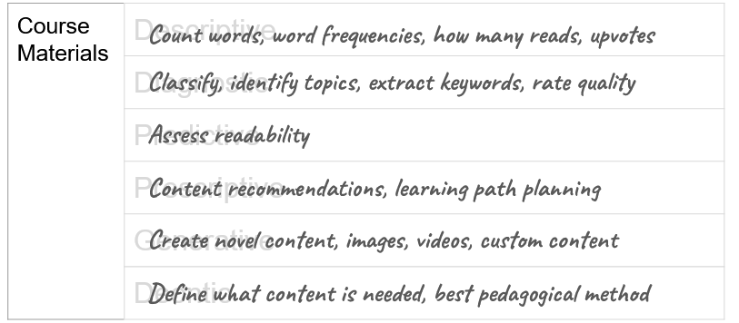
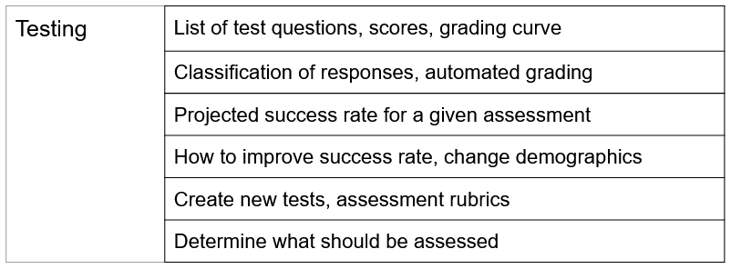
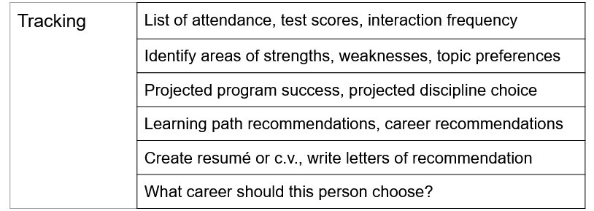
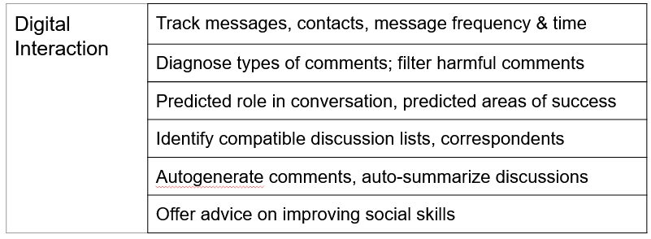
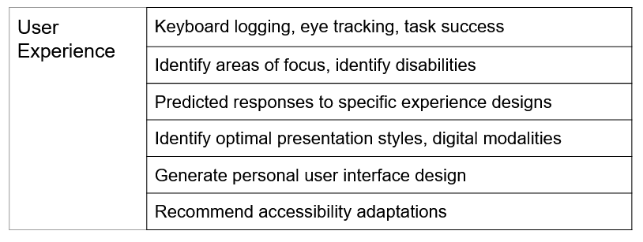
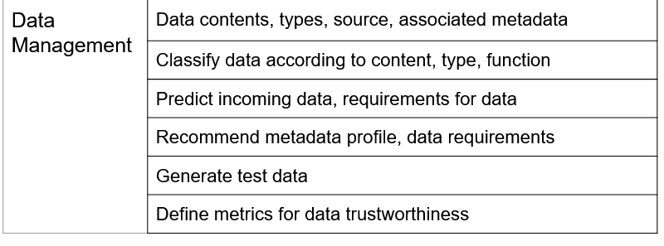
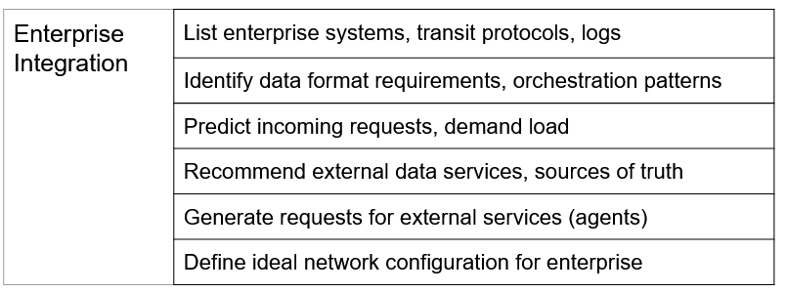
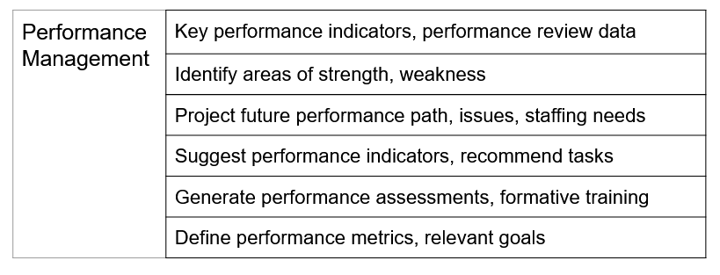
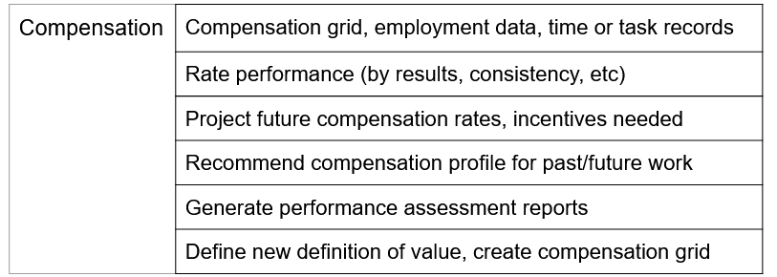
How We Understand Ourselves
Using AI to Support Staff Diversity at Institution P
Recruit
https://www.downes.ca/presentation/582
Connect
Enrol
Adapt
Assess
Strengths
Engage
Assist
Metrics
Recommend
Compensate Fairly
Support

Slide 13
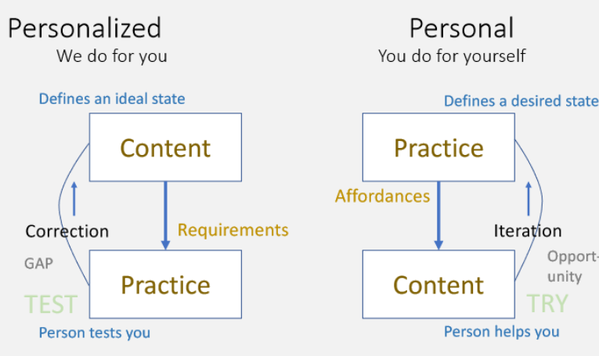
How We Understand Ourselves
Purpose-Based
Goal-directed learning vs content-based
https://www.downes.ca/presentation/497

Slide 14
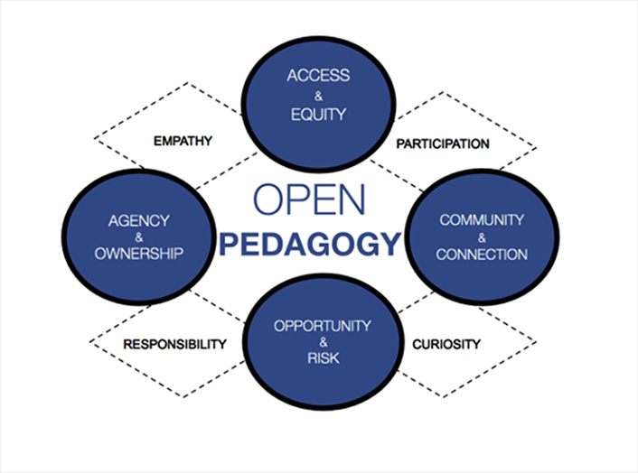
How We Understand Ourselves
Open Pedagogy
“Open pedagogy is a site of praxis, a place where theories about learning, teaching, technology, and social justice enter into a conversation with each other and inform the development of educational practices and structures."
Caroline Sinkinson. 2018. EDUCAUSE. https://er.educause.edu/blogs/2018/11/the-values-of-open-pedagogy

Slide 15
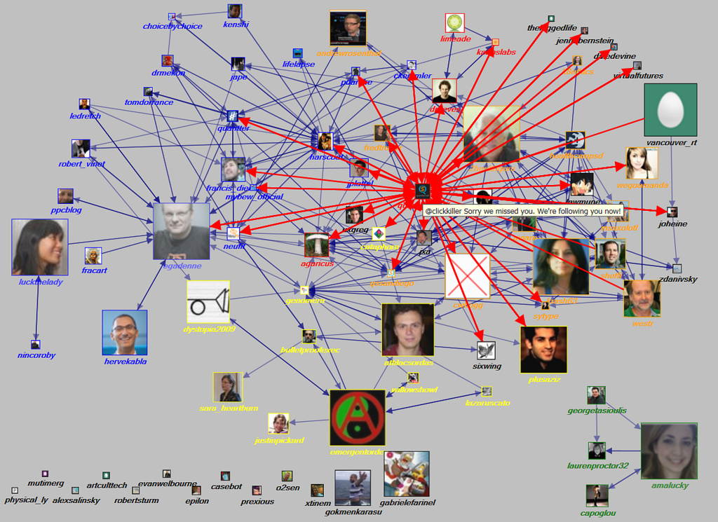
How We Understand Ourselves
Open learning communities
Image: Marc Smith https://www.flickr.com/photos/marc_smith/5373492204

Slide 16
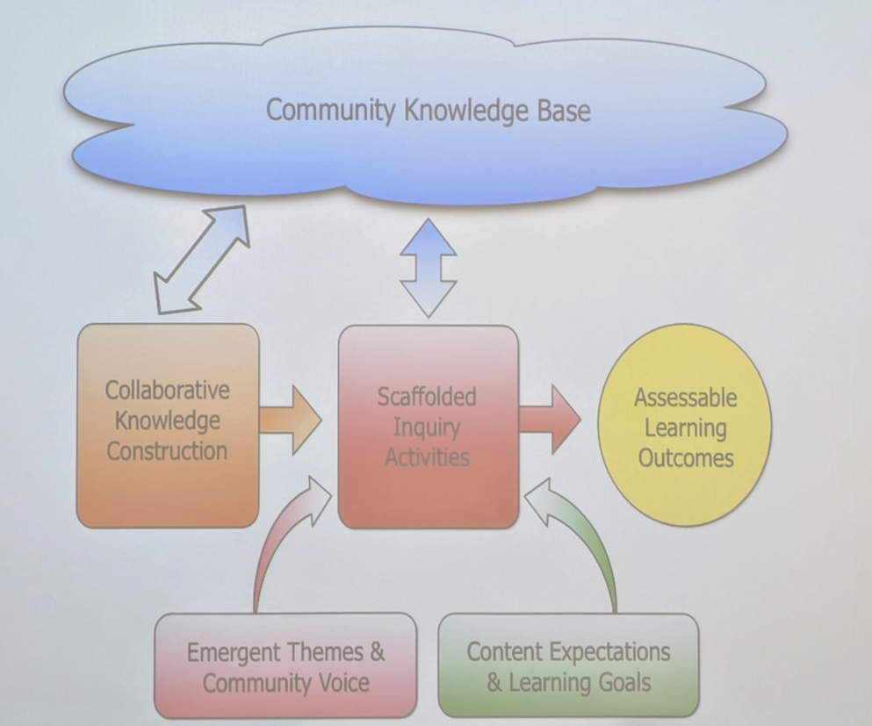
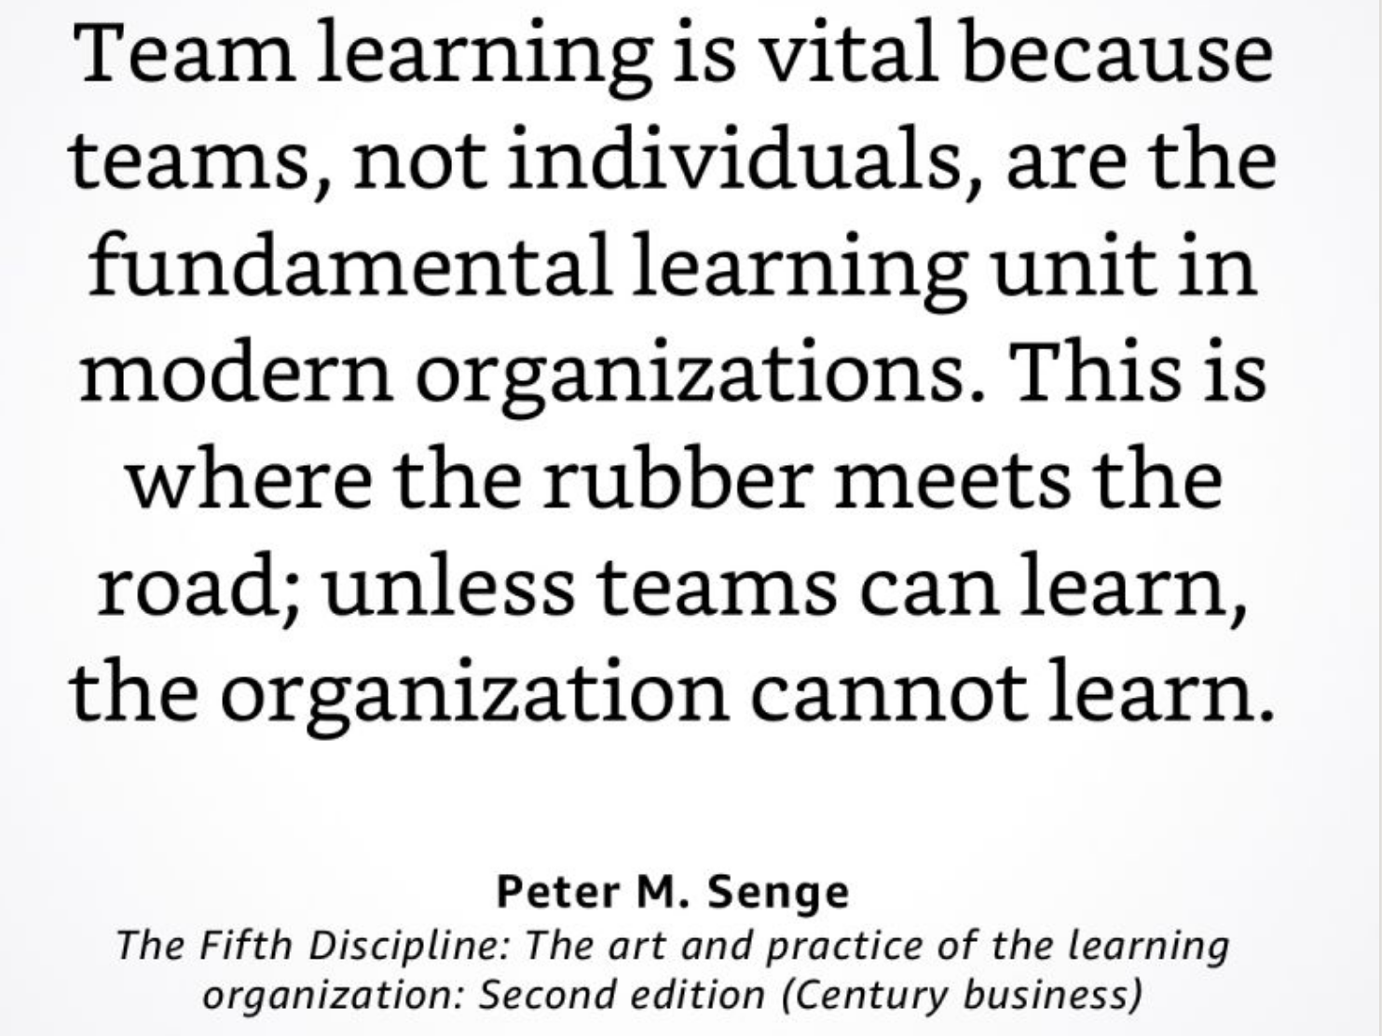
How We Understand Ourselves
Learning communities
Communities of learners / Communities that learn
Image: James Slotta, OTESSA 2025; photo by me

Slide 17
How We Understand Ourselves
Distributed Cognition
“We need more than discursive critique—we need an epistemology capable of accounting for distributed cognition, relational emergence, and the hybrid co-construction of meaning. We need a vision of learning that acknowledges the classroom as a cognitive assemblage, where agency and thought are shared across human and nonhuman nodes. We need to reframe the role of the educator—not as a content manager, but as a relational steward, holding curricular purpose while sustaining epistemic openness and unpredictability.”
J. Owen Matson . 2025. What We (Don't) Talk About When We Talk About AI in Education: A Posthumanist Response to Audrey Watters.
Intralation: Culture, Theory, Pedagogy, Jun 01, 2025. https://intralation-culture-theory-posthuman-pedagogy.ghost.io/what-we-dont-talk-about-when-we-talk-about-ai-in-education-a-posthumanist-response-to-audrey-watters/

Slide 18
Genuinely Emancipatory Open Learning
The Open Question
But what needs to be done to realize such a vision? The technology itself offers no guarantee, and critics have already pointed out the many ways AI-based learning technology can undermine, rather than extend, the needs and interests of many people and group

Slide 19
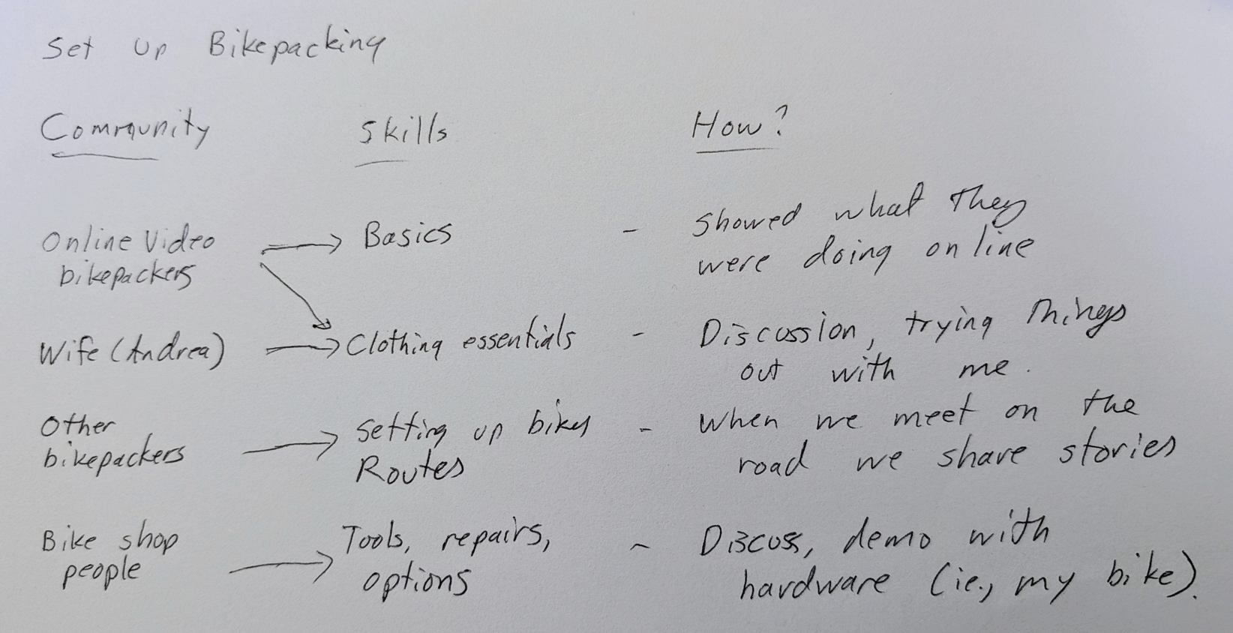
Genuinely Emancipatory Open Learning
Open Pedagogy
Bronwyn Hagerty
Nadia Abu-Zara workshop
Community Mobilization in Crisis - UOttawa

Slide 20
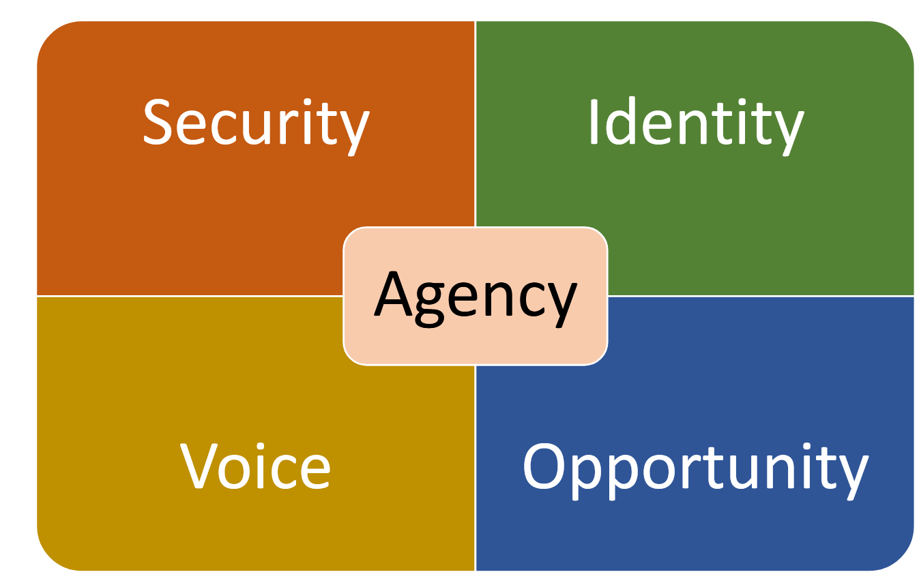
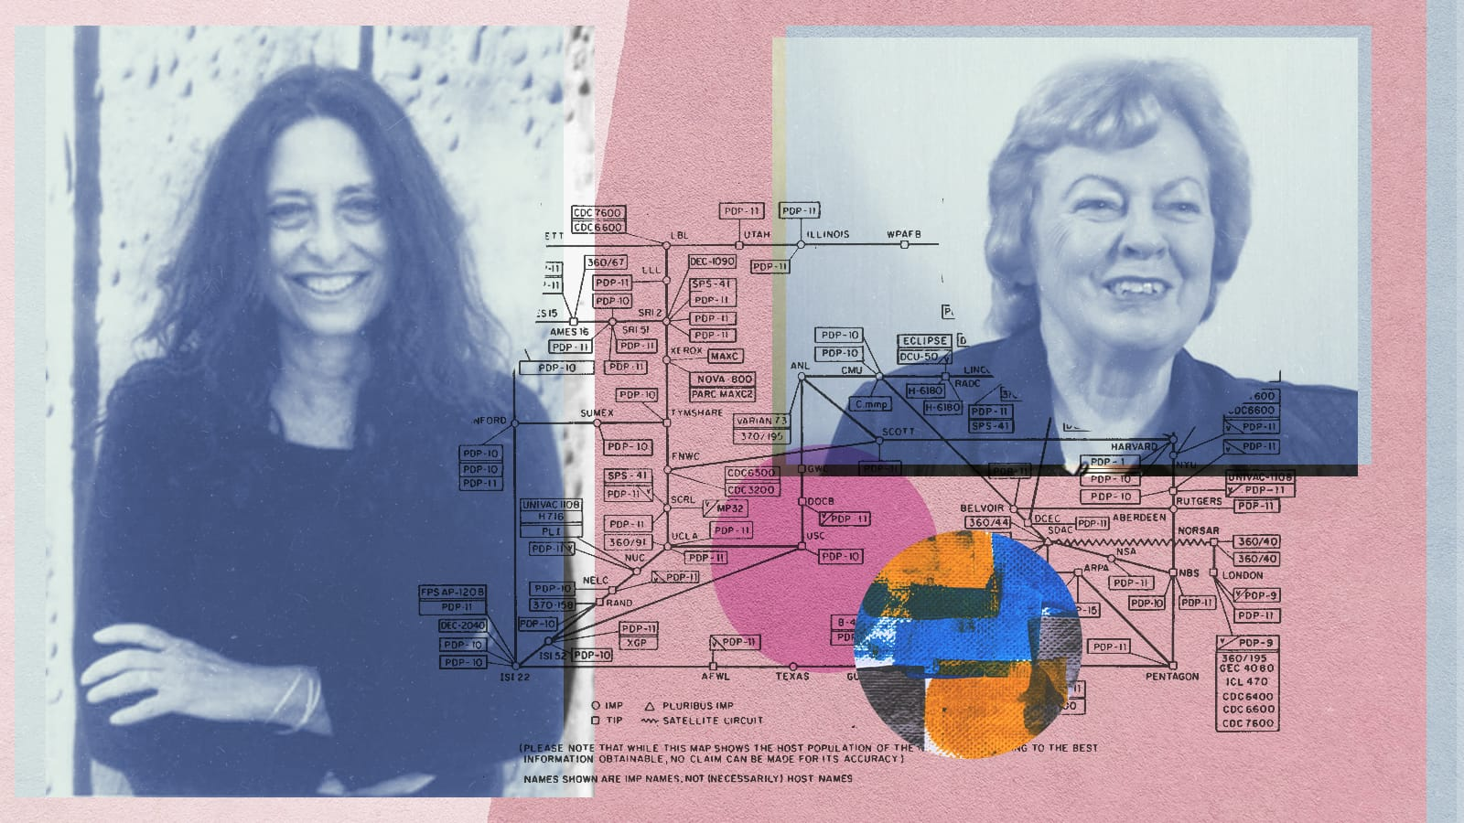
Genuinely Emancipatory Open Learning
Agency
Care
“Shared activity is distinguished from a mere aggregation of individual acts by a structure of appropriately related participatory intentions across different individuals.” - Abraham Sesshu Roth
Based on ‘What Peace Means to Me’ https://www.downes.ca/post/68088
https://ethics.mooc.ca/cgi-bin/page.cgi?presentation=85
Persons are understood to have varying degrees of dependence and interdependence on one another.
Other individuals affected by the consequences of one's choices deserve consideration in proportion to their vulnerability.
Situational details determine how to safeguard and promote the interests of those involved.
https://ethics.mooc.ca/cgi-bin/page.cgi?presentation=47

Slide 21
Genuinely Emancipatory Open Learning
A framework based on agency and care to work with the new technology to support open online learning community
 | Agency | Care
Aggregate | Choose own sources | Evaluate sources, don’t take for granted
Remix | Work in your own space | Ensure diversity of voices
Repurpose | Reframe to match your own experience | Create a point of view or perspective, check bias
Feed Forward | To your own communities | Positive contributions

Slide 22
Genuinely Emancipatory Open Learning
genuinely emancipatory open learning for everyone.
Setting our own direction
Owning our own data

Slide 23

Thank You
Stephen Downes
https://www.downes.ca

