Slide 1
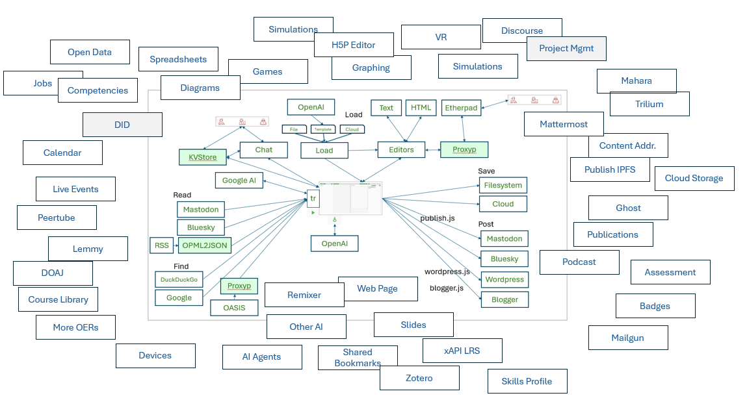
Convergent Discussions in the Fediverse
Stephen Downes
Presented to
Open/Technology in Education, Society, and Scholarship Association (OTESSA)
Toronto, Ontario, Canada
June 4, 2025

Slide 2
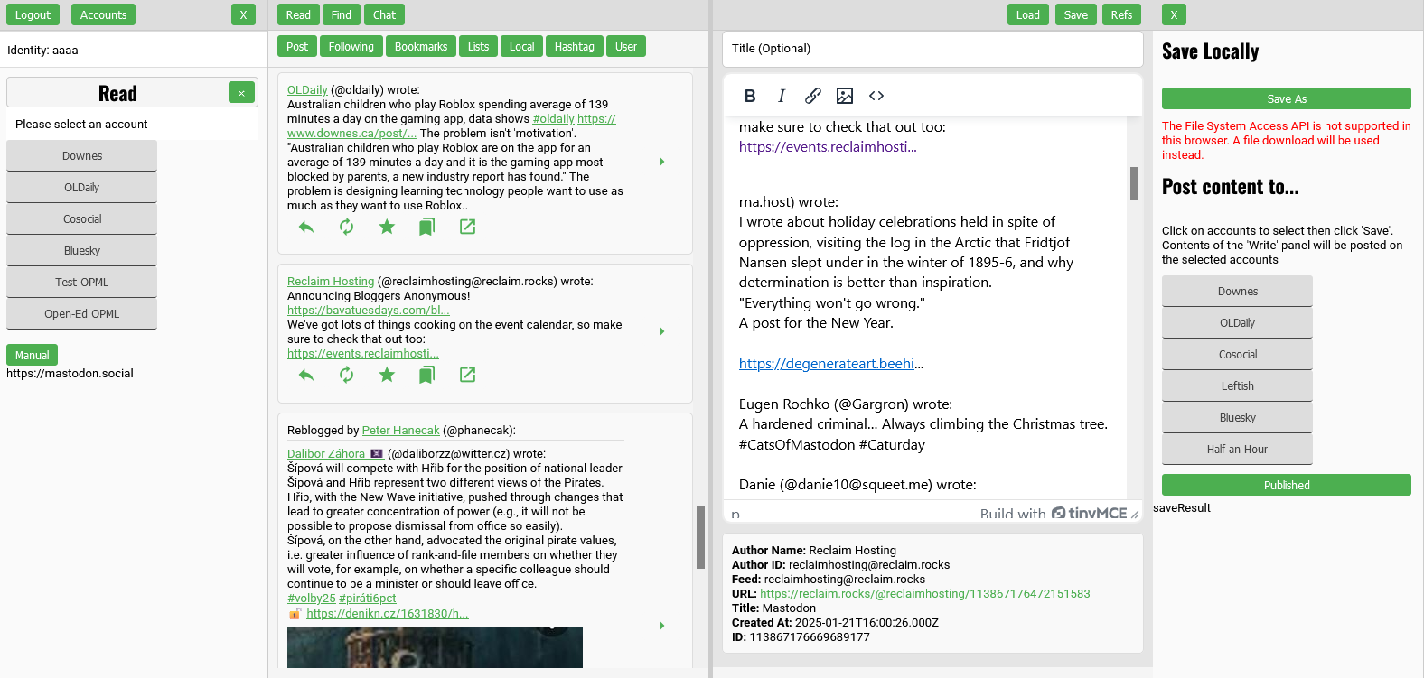
Start With The Demo
https://ple.mooc.ca/

Slide 3
Promises I Made in the Abstract
Description of the fediverse and introduction to major fediverse services such as Mastodon, Bluesky, Peertube, etc.
Discussion of the dynamics on online discussion including especially the characteristics of ‘divergent’, ‘linear’ and convergent discussions
Demonstration of convergent fediverse discussion software
Interactive practice using the software among participants to conduct an online convergent discussion
Consideration of learning potential for convergent discussions in the fediverse

Slide 4
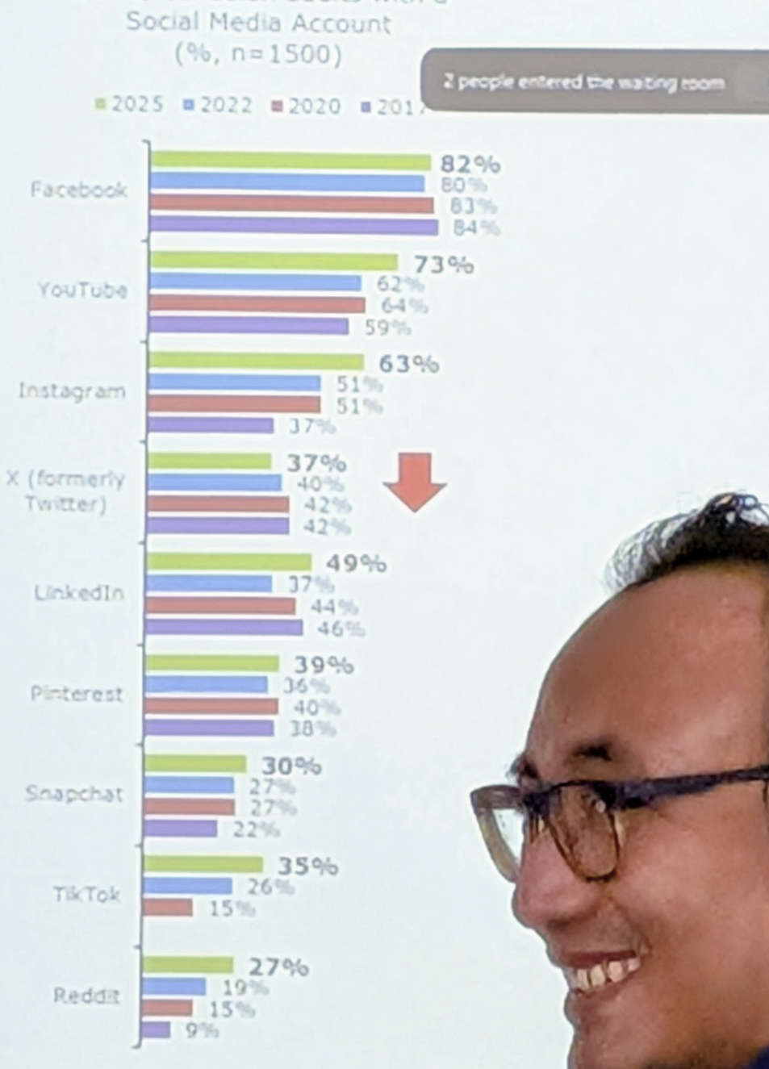



Platforms
Why platform social media is so awful
Wikipedia: “Criticisms include the outsize influence Facebook has on the lives and health of its users and employees, as well as Facebook's influence on the way media, specifically news, is reported and distributed.”
https://en.wikipedia.org/wiki/Criticism_of_Facebook
https://en.wikipedia.org/wiki/Criticism_of_Twitter
https://en.wikipedia.org/wiki/LinkedIn#Criticism_and_controversies
Trends image: Anatoliy Gruzd, OTESSA 2025, photo by author

Slide 5
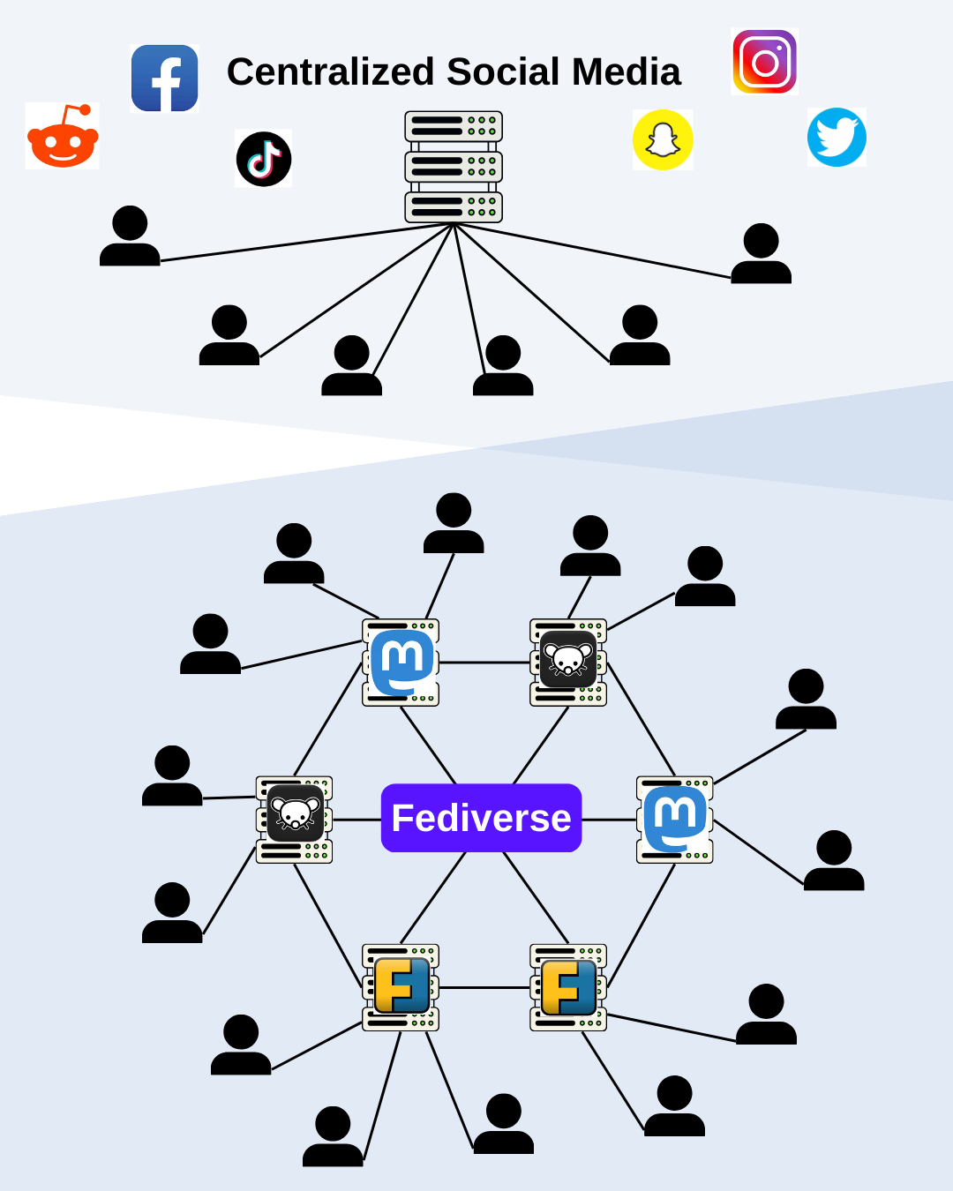
The Fediverse
A federation of social network services based on common protocols and distributed governance
Some applications include:
Mastodon
Bluesky
Lemmy
Peertube
Pixlfed
https://aimresearch.co/market-industry/10-must-try-apps-in-the-fediverse-for-the-decentralized-social-media-revolution

Slide 6
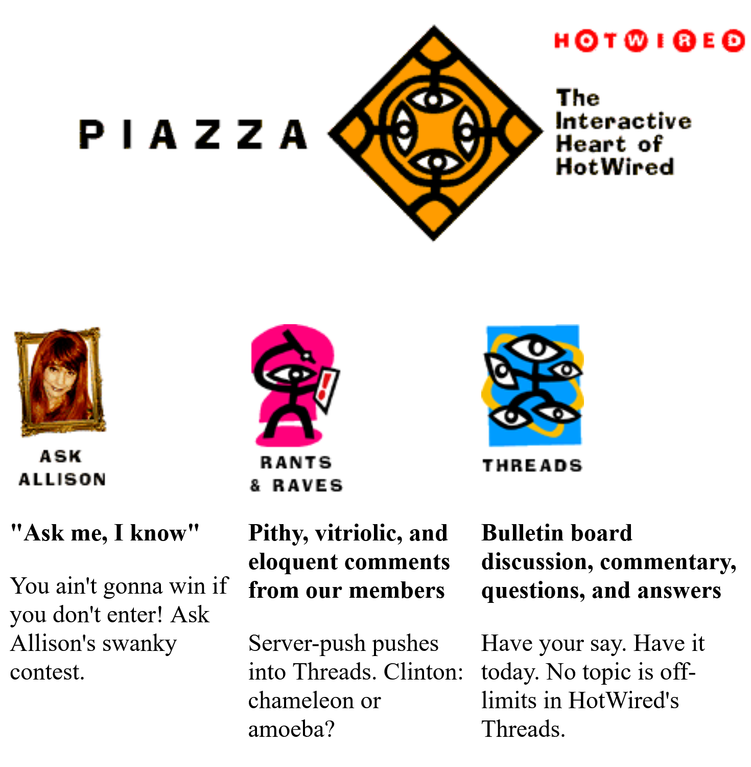
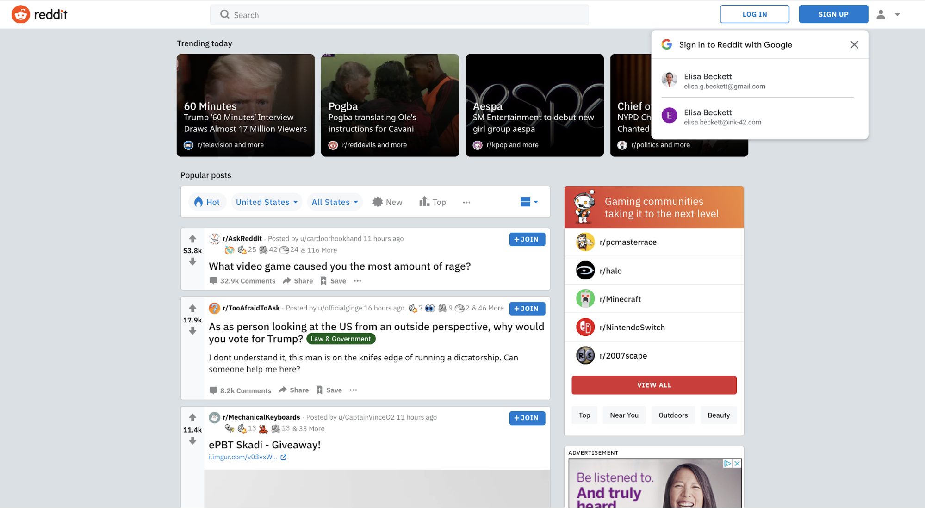
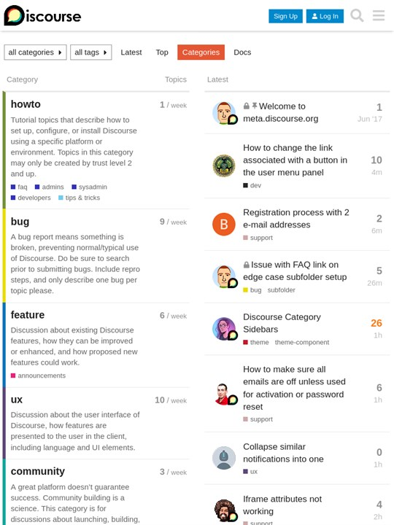
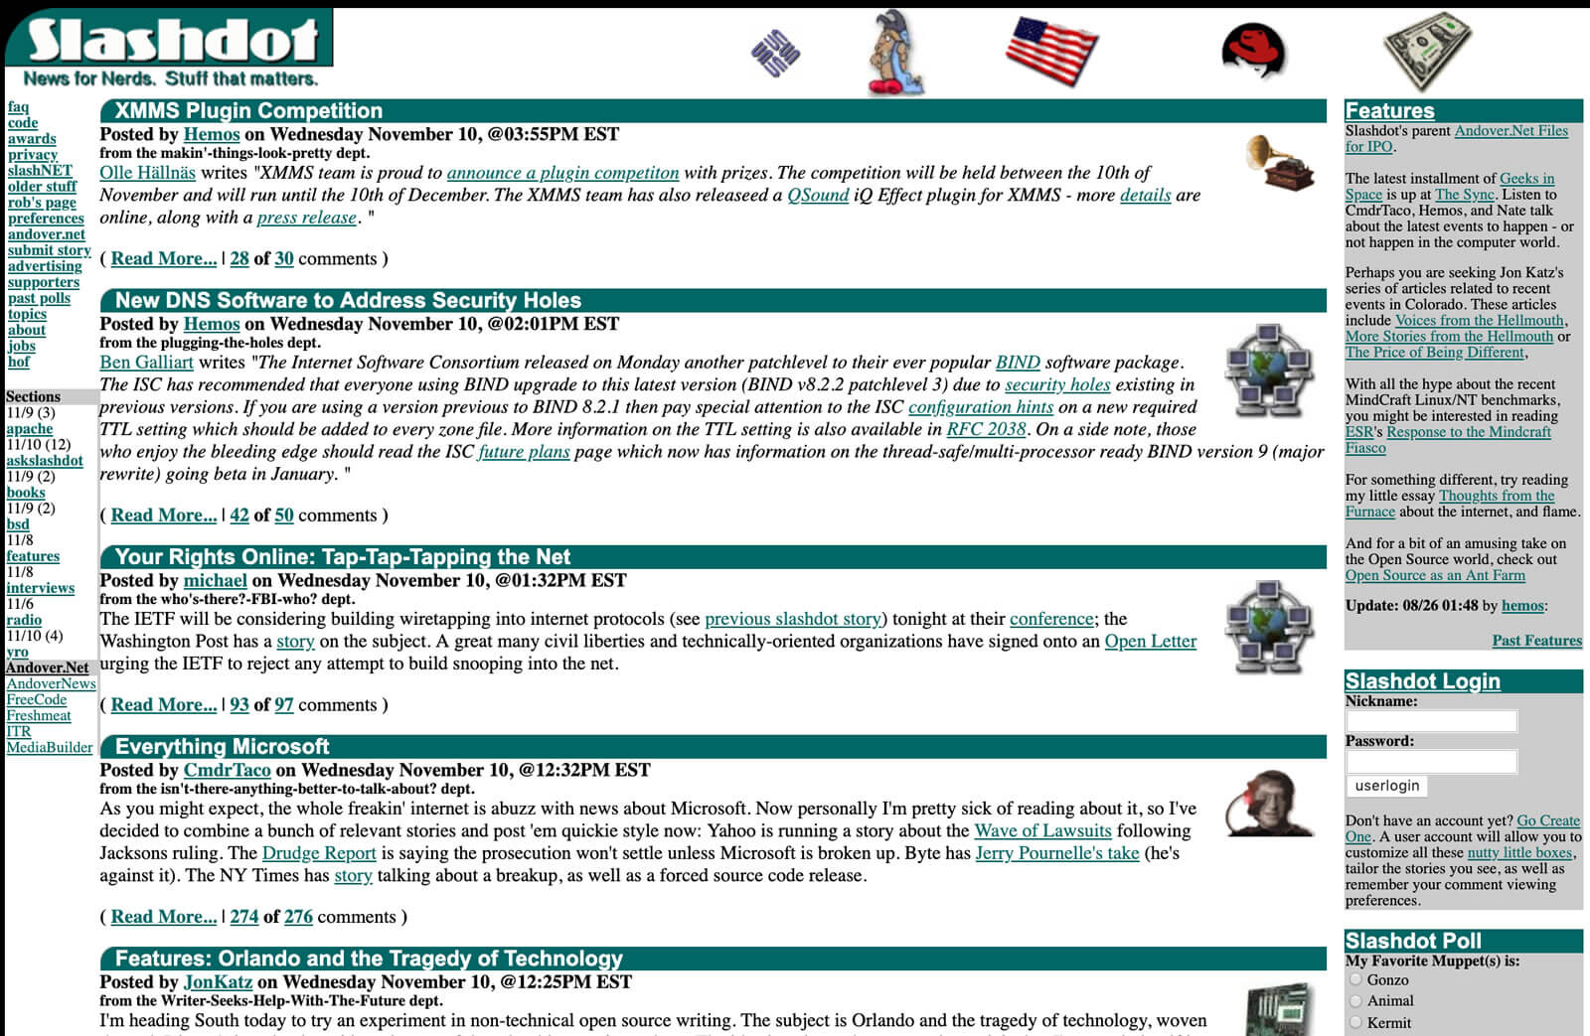
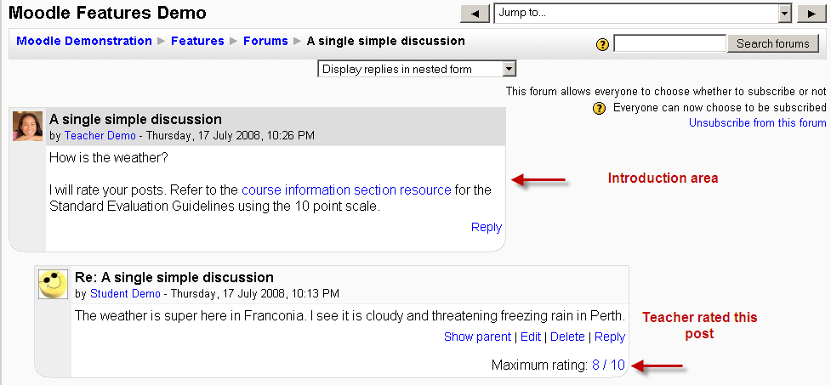
Online Discussion
I don’t think online discussion has ever really succeeded as a format
Hotwired Threads - https://archive.gyford.com/1995/11/13/HotWiredDemo/piazza/index.htm Moodle - https://docs.moodle.org/22/en/Using_Forum Slashdot - https://slashdot.org/ Reddit - https://www.reddit.com/ Discourse - https://www.discourse.org/

Slide 7
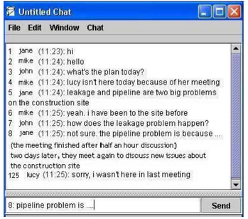
Linear Discussion Lists
https://www.researchgate.net/publication/220729380_Unraveling_the_ordering_in_persistent_chat_a_new_message_ordering_feature

Slide 8
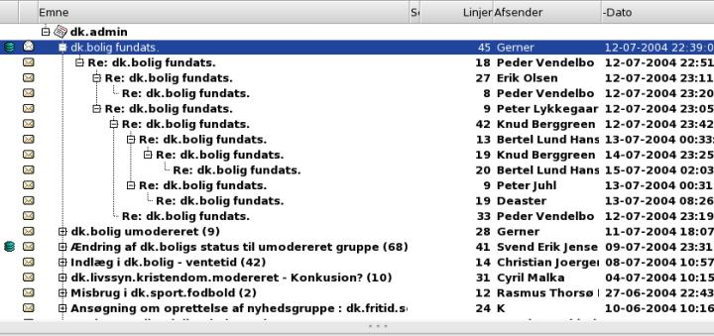
Threaded Discussion Lists
https://en.wikipedia.org/wiki/Thread_%28online_communication%29

Slide 9
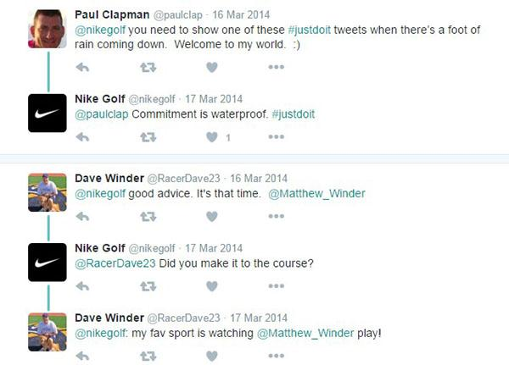
Linear-Threaded Discussion Lists
https://firstmonday.org/ojs/index.php/fm/article/view/6607/6190

Slide 10
Convergent
This is a pattern very common in scientific literature but mostly absent from social media

Slide 11
Convergence in Scientific Literature
Paper B
Cites A
Paper A
Paper C
Cites A,B

Slide 12
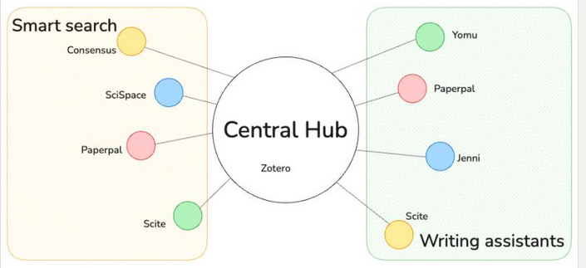
Some (AI) Tools for Convergence
https://www.linkedin.com/posts/nacke_phd-research-writingtips-activity-7261003352866533377-y6YV

Slide 13
My Approach
Social Network
Social Network
Writing Space
Blogs
Blog Post
Articles
List of references
Article

Slide 14
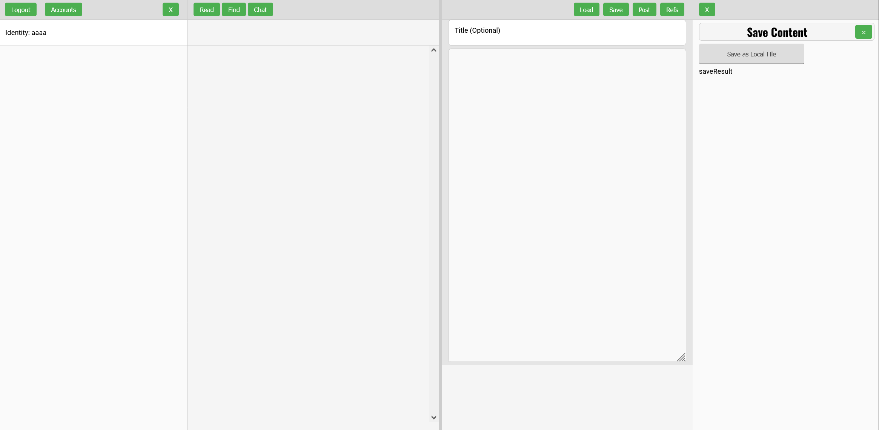
Flow
Left Read Write Right
Pane Pane Pane Pane
Aggregate Remix Repurpose Feed Forward

Slide 15
Caveats
This is a prototype, not a completed application
This is a live demo, so some things might not work
Yes, other people have done some of the same things
No, it’s not fully secure against all possible attacks
I know that other people could have coded it better

Slide 16
Design Considerations
This is a single user application, not a multi-user platform
It’s completely open source CC-by to be used by anyone
As a whole it is designed to be distributed and decentralized
It is as simple as possible, so anyone can use it
The ideal is that it can run anywhere (still working on that)
Mostly plain HTML-JS-CSS (no Node, no React, no crazy installs)

Slide 17
OK Let’s Get Started

Slide 18
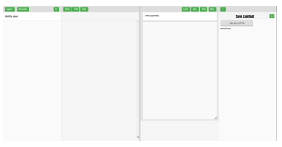
Identity Server and Accounts
KVStore
Each service is enabled by a standalone JS, in this case, kvstore.js
Scripts provide information to Clist in a standardized format, in this case an accounts array with values in a JSON object
Obviously, we would like a more robust identity server for the future.
kvstore.js
Flasker
Identity server and accounts
Simple Flask key-value store
let flaskSiteUrl = 'https://datastore.downes.ca’;
// Base URL of your identity server

Slide 19
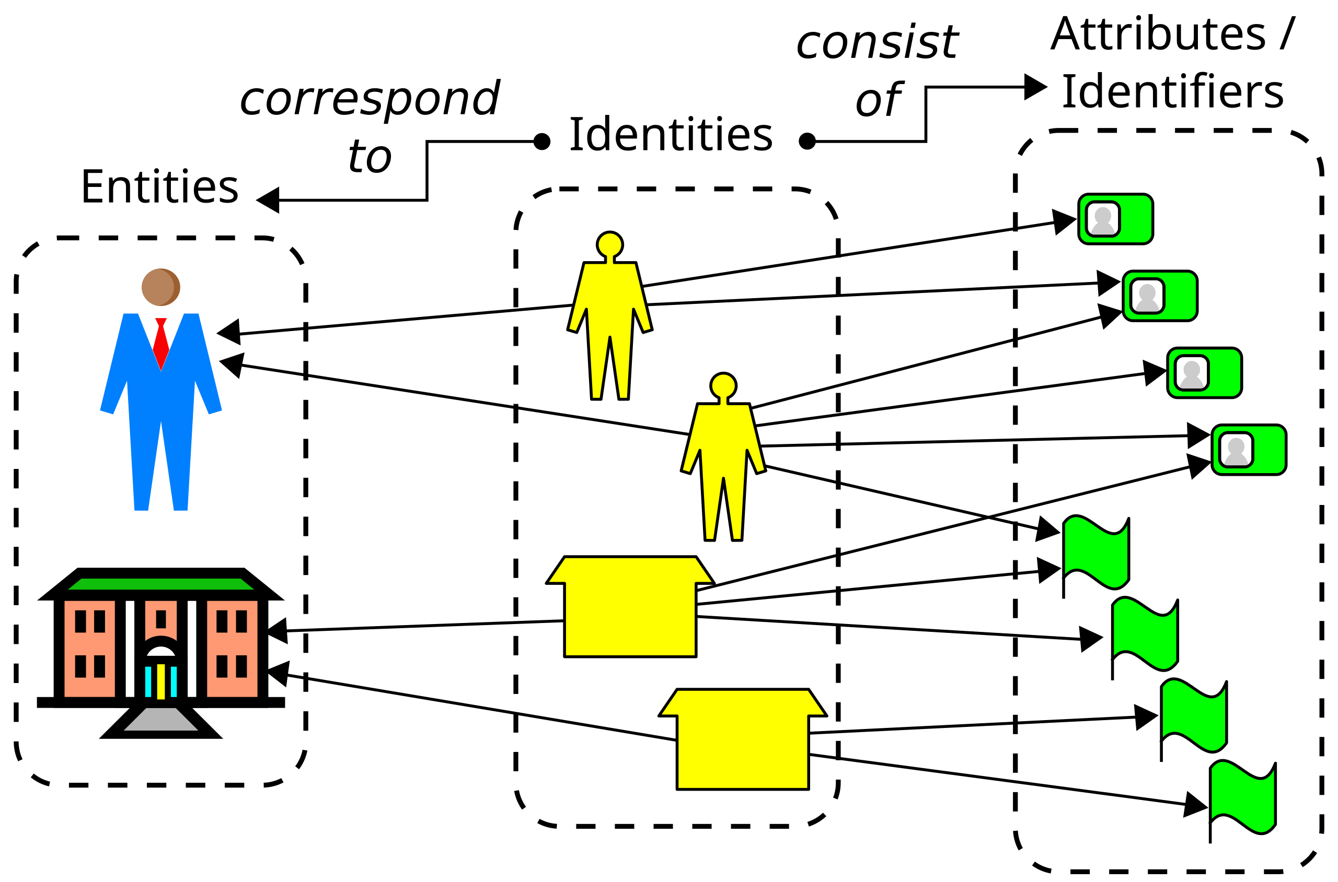
Design Considerations
Issues related to decentralized identity
OAuth2 https://auth0.com/intro-to-iam/what-is-oauth-2
OIDC https://openid.net/developers/how-connect-works/
Self-Sovereign Identity
https://en.wikipedia.org/wiki/Self-sovereign_identity
Key-Value Stores
Cloud, e.g. Vault
Host, e.g. 1Password
Dock. Decentralized Identity: The Ultimate Guide. https://www.dock.io/post/decentralized-identity

Slide 20
Mastodon
KVStore
Write
Read
mastodon.js
Mastodon
Mastodon
https://mastodon.social
https://softwaremill.com/the-architecture-of-mastodon/ - architecture
https://joinmastodon.org/servers - about Mastodon instances
https://instances.social/ - select an instance

Slide 21
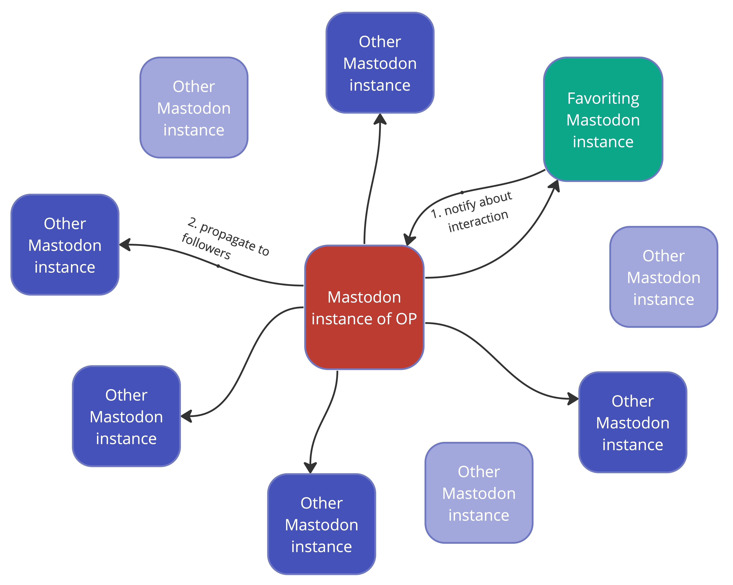
Mastodon
Image: https://softwaremill.com/the-architecture-of-mastodon/

Slide 22
Mastodon
API

Slide 23
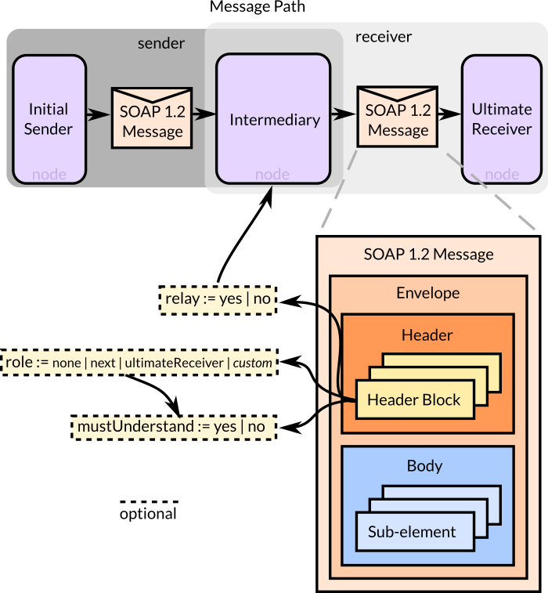
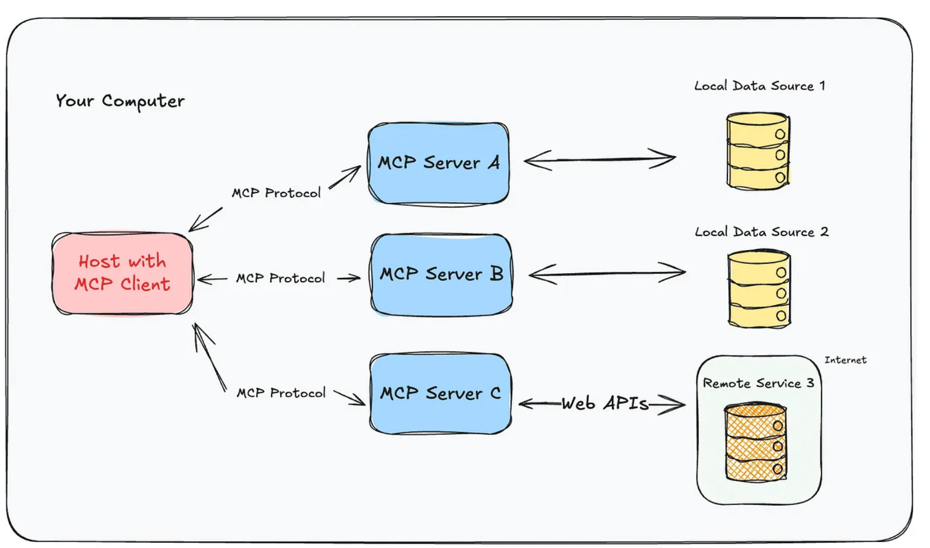
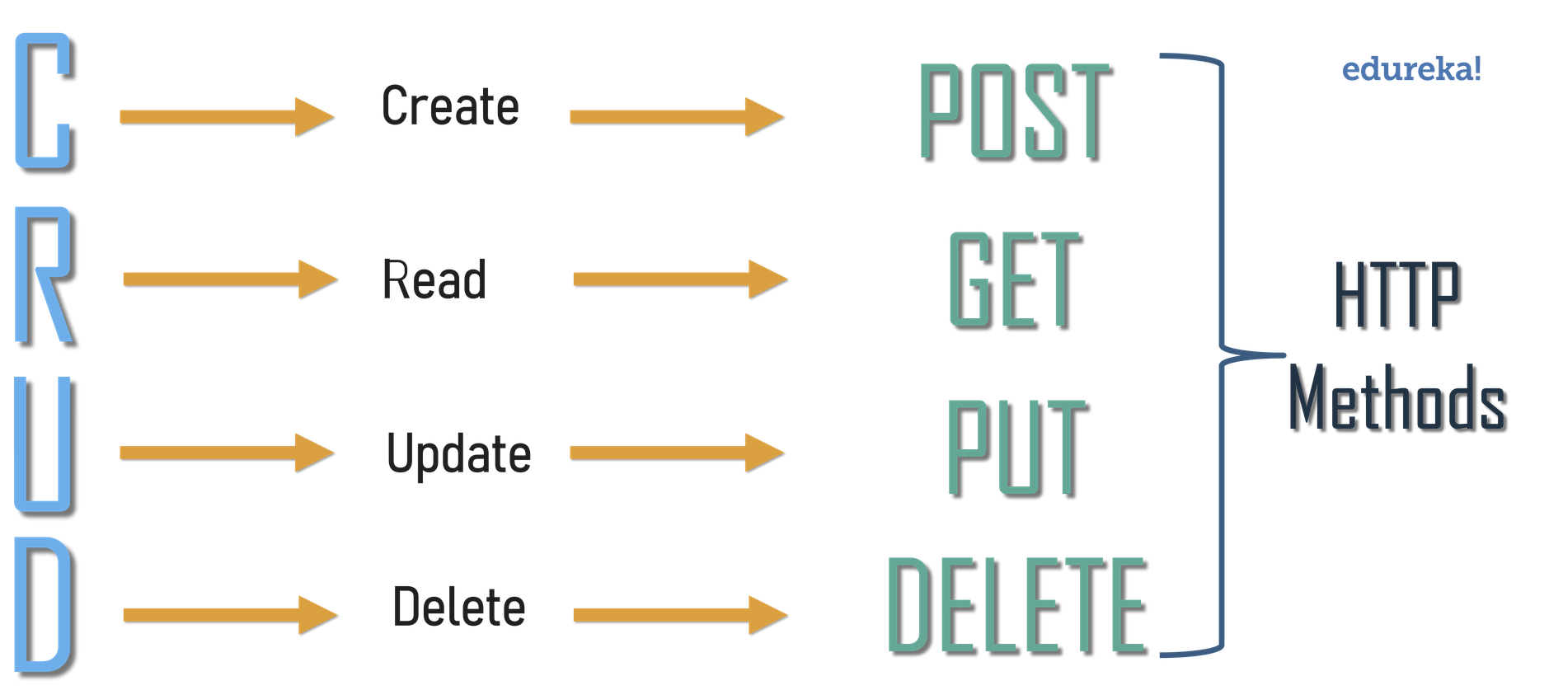
Three Generations of APIs
SOAP | REST | MCP
https://garba.org/article/general/soa/soap.html | https://www.edureka.co/blog/what-is-rest-api/ | https://medium.com/@elisowski/mcp-explained-the-new-standard-connecting-ai-to-everything-79c5a1c98288

Slide 24
Auto-Translation
And Auto-Accessibility…?
KVStore
Google AI
translate.js
Post
Read
tr
Mastodon
Mastodon
Translation
Account from AI translation service
Optional and need not be used
Raises AI costs
https://cloud.google.com/translate

Slide 25
Bluesky
KVStore
Google AI
Post
Read
tr
Mastodon
Mastodon
Bluesky
Bluesky
bluesky.js
Bluesky
Accounts from multiple servers (if we ever get multiple servers)
Multiple accounts from the same server
https://bsky.app/

Slide 26
Fediverse Protocols
Three major decentralized protocols have emerged:
Fediverse (#ActivityPub) – The most established and widely used, forming a “native” backbone of the #openweb.
Bluesky (#AtProto) – A Twitter-funded project that claims decentralization but is still highly centralized.
Nostr – A relay-based, censorship-resistant protocol with interesting tech but major cultural and usability challenges.
hamish campbell. 2025. Comparing Decentralized #openweb Protocol. Medium. https://hamishcampbell.com/comparing-decentralized-social-protocols-why-activitypub-fediverse-is-the-best-choice-over-bluesky-atproto-and-nostr/

Slide 27

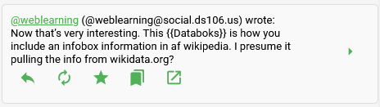






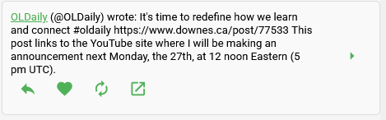
Feed and Status Actions
Mastodon
Reply
Boost
Thread
View Original
Favorite
Like
Bookmark
Repurpose
Bluesky

Slide 28

Thread Summary
KVStore
Google AI
Post
Read
tr
Mastodon
Mastodon
Bluesky
Bluesky
summarize.js
OpenAI
Thread Summarizer
Account from AI summarization service
Thread (or whatever) fed to summarizer service
Summary becomes new feed item

Slide 29
Content Feeds: OPML and RSS
KVStore
Google AI
Post
Read
tr
Mastodon
Mastodon
Bluesky
opml.js
Bluesky
RSS
OPML2JSON
OpenAI
Retrieving and Reading RSS
Standalone https://opml2json.downes.ca deployed
OPML URLs are entered as accounts

Slide 30

Audio Content: Podcast Player
KVStore
Google AI
Post
Read
tr
Mastodon
Mastodon
reader.js
Bluesky
Bluesky
RSS
OPML2JSON
OpenAI
Create and Play Podcast List
RSS reader detects audio enclosures in feed
Builds playlist in audio player

Slide 31
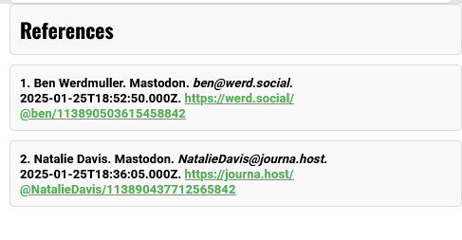
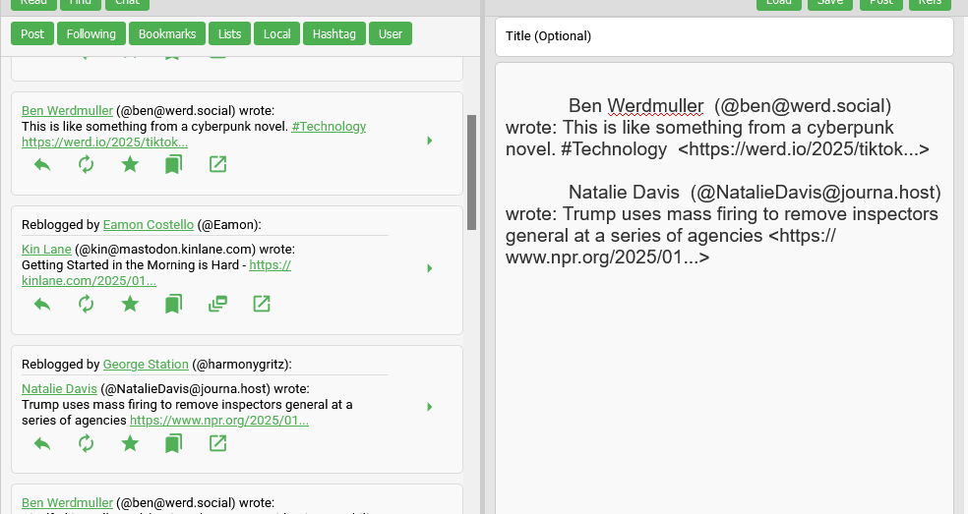
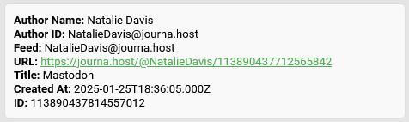
Convergence
Convergence = Reply to Multiple Posts at Once
Place content from any feed into the editor
Clist keeps track of each source for reply notifications
Click ‘Refs’ to toggle the full list of references

Slide 32
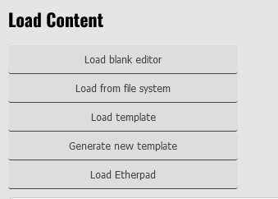
Preloading Content
Load
File
Template
Cloud
KVStore
Load
editors.js
Google AI
Post
Read
tr
Mastodon
Mastodon
Bluesky
Bluesky
RSS
OPML2JSON
OpenAI
Loading Content
Editing area can be preloaded with content
Context may be stored locally, generated, or cloud-based
Feed content then loaded in editing context

Slide 33
Templates
OpenAI
Text
HTML
chatgpt.js
Load
tinymce.js
File
Template
Cloud
KVStore
Load
Editors
Google AI
Post
Read
tr
Mastodon
Mastodon
Bluesky
Bluesky
RSS
OPML2JSON
OpenAI
Predefined or Generated Templates
Select template from template library (not yet available)
Generate template on demand from generative AI
Templates can be editor-specific

Slide 34
Editors
Text
HTML
Load
tinymce.js
File
Template
Cloud
KVStore
Load
Editors
editors.js
Google AI
Post
Read
tr
Mastodon
Mastodon
Bluesky
Bluesky
RSS
OPML2JSON
OpenAI
Selecting Editors
After content load is selected, editor is selected
Editor selection may be based on content type
Future: image editors, games, applications

Slide 35
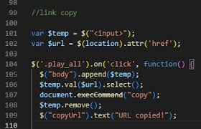
The Open Editor Apocalypse
W3C. execCommand() https://w3c.github.io/editing/docs/execCommand/
David Dal Busco. 2020. Reimplementing doc.execCommand. https://medium.com/swlh/reimplementing-document-execcommand-6ffc33a80f02

Slide 36

Collaboration
OpenAI
Text
HTML
Etherpad
Load
File
Template
Cloud
KVStore
Load
Editors
Proxyp
editors.js
Google AI
Post
Read
tr
Mastodon
Mastodon
Bluesky
Bluesky
RSS
OPML2JSON
OpenAI
Collaborative Editing
Editors can support multiple users
Current configuration supports EtherPad
In this case, Etherpad is access through proxy server

Slide 37
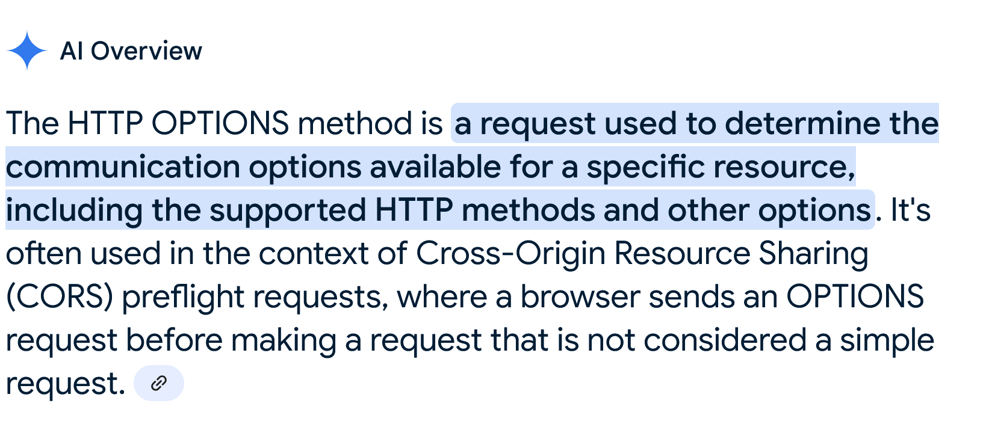
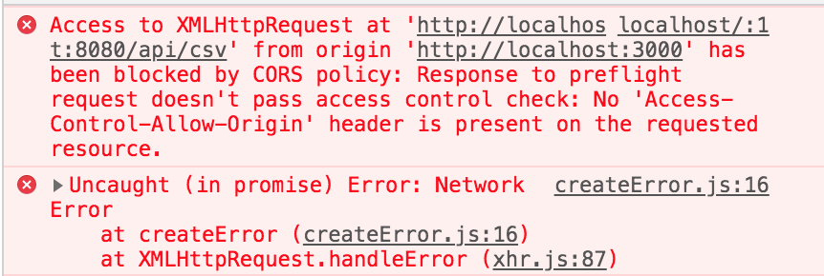
The OPTIONS Conundrum
If a non-standard response header is required (e.g. ‘X-Access-Code’) a ‘preflight check’ is performed using HTTP method ‘OPTIONS’ – which fails as a CORS error if the server does not allow OPTIONS
Mozilla Developer’s Network https://developer.mozilla.org/en-US/docs/Web/HTTP/Reference/Methods/OPTIONS

Slide 38
Chat and Share
OpenAI
Text
HTML
Etherpad
Load
dynamicp2p.js
peerjs.js
File
Template
Cloud
Chat
Load
Editors
Proxyp
KVStore
Google AI
Post
Read
tr
Mastodon
Mastodon
Bluesky
Bluesky
RSS
OPML2JSON
OpenAI
Peer to Peer Chat
Discussions are discovered via KVStore
No central chat server required
Chat insertion of, e.g., link to join etherpad

Slide 39
Discovery and Indexing
Decentralized discovery and indexing already exists:
Telephone directory services
DNS
Blockchain-style decentralized consensus
Byzantine Generals Problem

Slide 40
Search and Find
OpenAI
Text
HTML
Etherpad
Load
File
Template
Cloud
Chat
Load
Editors
Proxyp
KVStore
Google AI
Post
Read
tr
Mastodon
Mastodon
Bluesky
Bluesky
OPML2JSON
OpenAI
Find
reader.js
Resource Discovery
Search results via open APIs
Proxy also usable for search
Future: people, courses, open data, etc
DuckDuckGo
Proxyp
Google
OASIS

Slide 41
Save
OpenAI
Text
HTML
Etherpad
Load
File
Template
Cloud
Chat
Load
Editors
Proxyp
KVStore
Save
Google AI
files.js
Filesystem
Read
tr
Cloud
Mastodon
Bluesky
Post
OpenAI
Mastodon
RSS
OPML2JSON
Bluesky
Find
Save Editor Contents
Save to local file system (download for Firefox)
Planned: save as selected file type
Cloud save (e.g. AWS, Dropbox) not yet implemented
DuckDuckGo
Proxyp
Google
OASIS

Slide 42
Post Articles
OpenAI
Text
HTML
Etherpad
Load
File
Template
Cloud
Chat
Load
Editors
Proxyp
KVStore
Save
Google AI
Filesystem
Read
tr
Cloud
Mastodon
publish.js
Bluesky
Post
OpenAI
Mastodon
RSS
OPML2JSON
Bluesky
Find
Create Blog Posts
Wordpress, Blogger supported
Future: Ghost, web pages
Multi Post+Link Publishing
wordpress.js
DuckDuckGo
Wordpress
Proxyp
blogger.js
Google
Blogger
OASIS

Slide 43
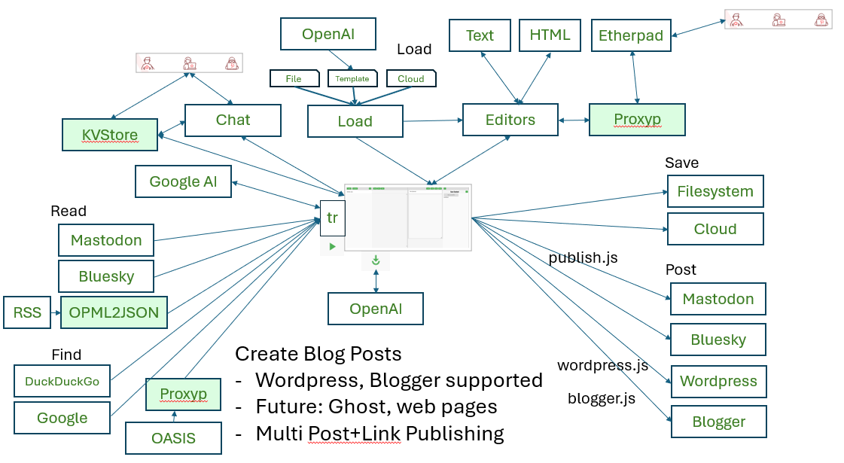
The Future…?
Simulations
VR
Discourse
Open Data
H5P Editor
Project Mgmt
Spreadsheets
Graphing
Simulations
Games
Jobs
Diagrams
Mahara
Competencies
Trilium
DID
Mattermost
Calendar
Content Addr.
Publish IPFS
Cloud Storage
Live Events
Ghost
Peertube
Publications
Lemmy
Podcast
DOAJ
Assessment
Remixer
Web Page
Course Library
Badges
More OERs
Other AI
Slides
Mailgun
Devices
AI Agents
Shared Bookmarks
xAPI LRS
Zotero
Skills Profile

