Slide 1
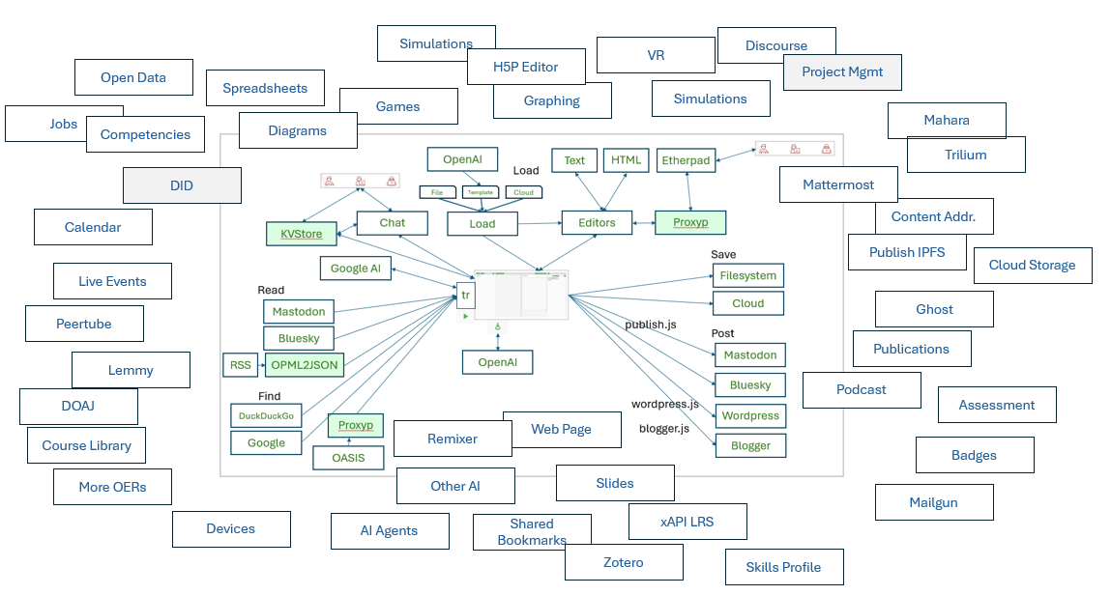
Design and Development of a Personal Learning Environment
Stephen Downes
Presented to
Canadian Network for Innovation in Education
Toronto, Ontario, Canada
June 2, 2025

Slide 2
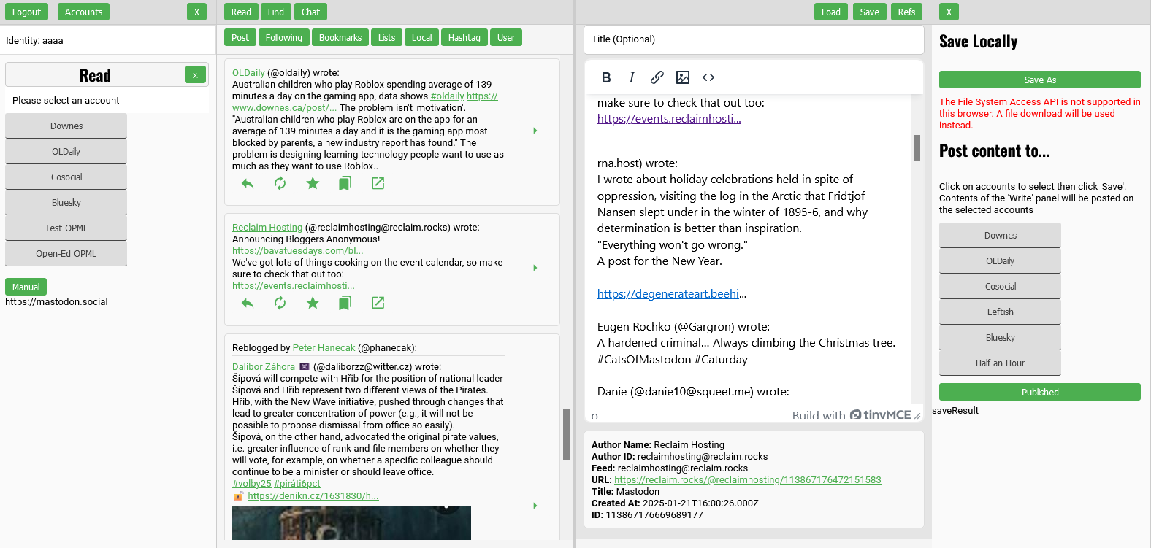
Start With The Demo
https://ple.mooc.ca/

Slide 3
Promises I Made in the Abstract
Technological and business model considerations addressing:
the challenges faced in the early years of PLEs
the elements of the system
and broader learning ecosystem requirements that will support PLEs in general.
The PLE will be contrasted with the existing LMS infrastructure in order to highlight the pedagogical and economic advantages of an open and decentralized learning infrastructure
Advice will be provided to enable institutional support for a PLE ecosystem.

Slide 4
What Even Is a PLE?
“A PLE is an environment equipped with digital and non-digital resources (Bolton et al., 2016) and it can also include peer groups gathered to study, courses, reading summaries, concept maps and institutional resources such as libraries and manuals (Henri, 2014) for learning purposes.
“Generally, a basic PLE should comprise a variety of tools selected by learners according to their individualized learning strategies to better manage and control their learning activities with the collaboration of his peer groups.”
Ben Rebah, H., Barthes, D. & Carnus, MF. (2023). Personal learning environment: instrument system for learning beyond the boundaries of the university. Learning Environ Res 26, 843–87. https://link.springer.com/article/10.1007/s10984-023-09457-x

Slide 5
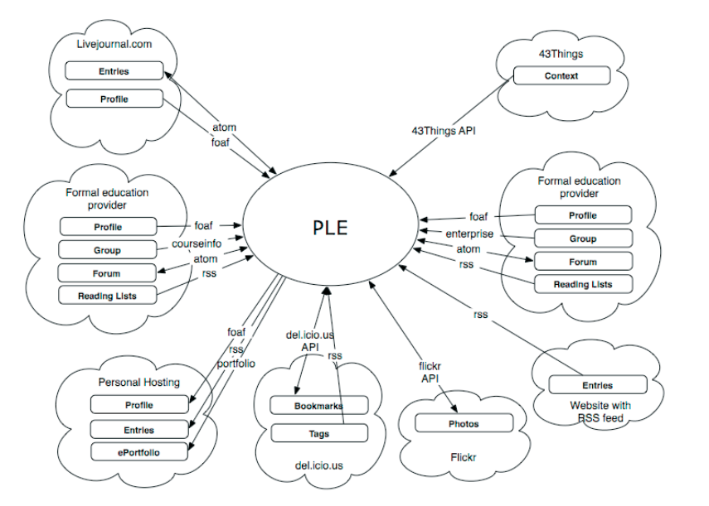
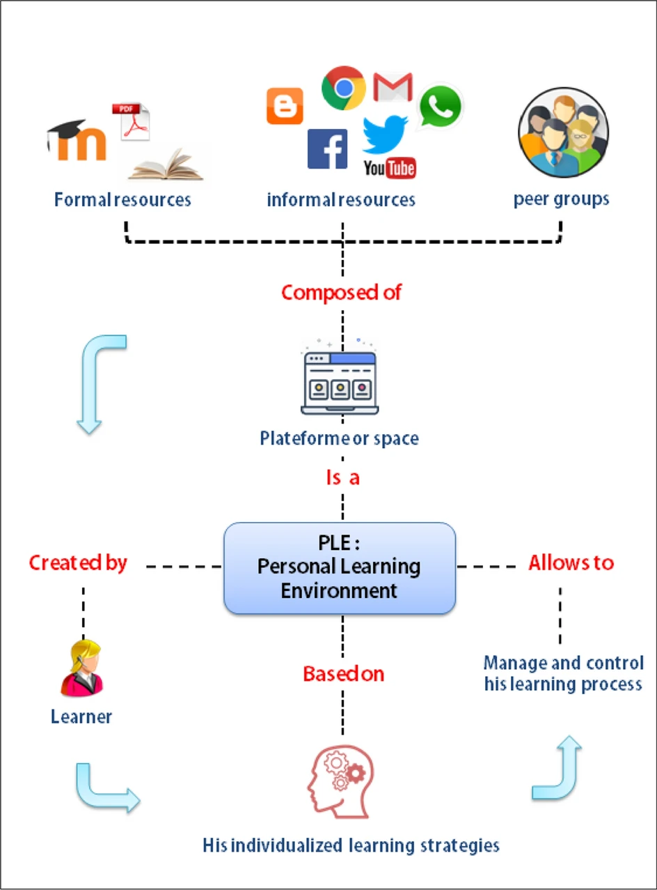
What Even Is a PLE?
Wilson, S., Liber, O., Johnson, M., Beauvoir, P., Sharples, P., & Milligan, C. (2009). Personal Learning Environments: Challenging the dominant design of educational systems. Journal of E-Learning and Knowledge Society, 3(2). https://www.je-lks.org/ojs/index.php/Je-LKS_EN/article/view/29
Ben Rebah, H., Barthes, D. & Carnus, MF. (2023). Personal learning environment: instrument system for learning beyond the boundaries of the university. Learning Environ Res 26, 843–87. https://link.springer.com/article/10.1007/s10984-023-09457-x

Slide 6
Why a PLE?
“The idea of PLEs appears to have been associated with the development of new models of learning, breaking with traditional educational structures and focusing on the learner (to the point of placing her at the centre of the learning process), and providing increased autonomy.
“At the same time, teachers are seen as adopting the role of facilitator and guide. It can be claimed that the idea of PLEs has challenged the traditional failure of educational technology to reconcile technological and pedagogical change.”
Castañeda, L., Tur, G., Torres-Kompen, R., & Attwell, G. (2022). The Influence of the Personal Learning Environment Concept in the Educational Research Field: A 2010-2020 Systematized Review. International Journal of Virtual and Personal Learning Environments (IJVPLE), 12(1), 1-16. https://doi.org/10.4018/IJVPLE.2022010102

Slide 7
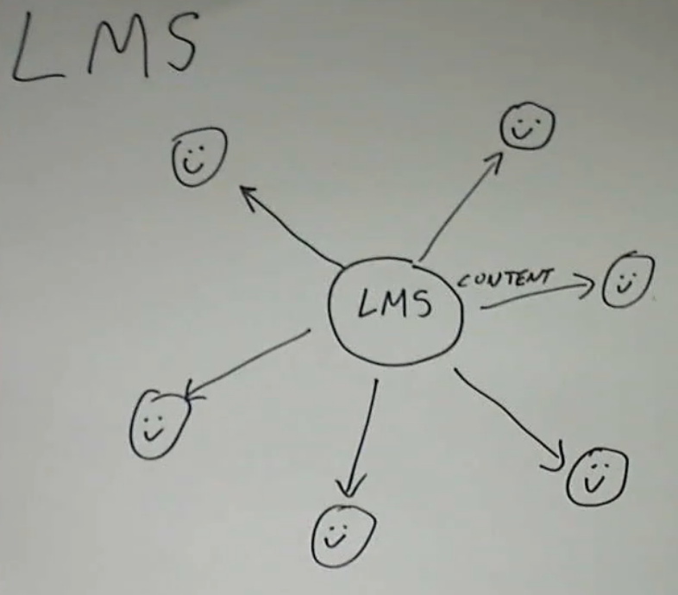
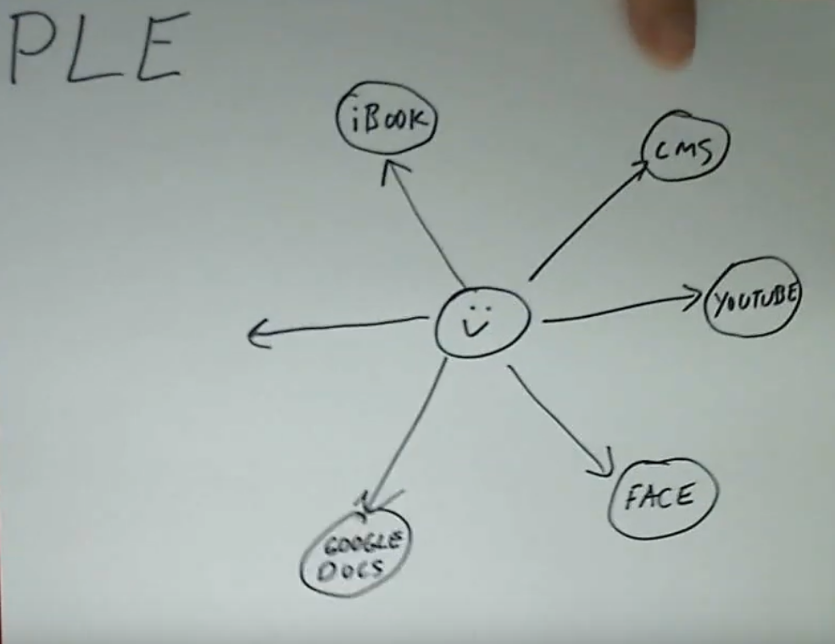
PLE vs LMS
In an LMS, the learning is ‘managed’ by the institution. All activities, all sociality, even, is mediated through the learning platform.
“When we disaggregate the power in education, we empower individual learners. It can encourage them to learn more than is presented in the curriculum. It can encourage lifelong learning. PLEs provide an excellent venue for this to happen.”
Cormier, D. (2010). PLE vs. LMS – disaggregate power, not people. Dave’s Educational Blog. https://davecormier.com/edblog/2010/09/19/ple-vs-lms-disaggregate-power-not-people/
My video PLE vs LMS: https://www.youtube.com/watch?v=zDwcCJncyiw

Slide 8

Business Model Challenges
Software licensed to institutions isn’t personal software
No incentive for institutions to allow others into the same learning environment
Access controls and restrictions enforced by commercial content providers
Institutional control of learning environment for record-keeping and assessment
Strong adherence to traditional pedagogical models
eduSource: Canadian Network of Learning Object Repositories. https://www.edusource.ca/
Downes, S. (2014). A Personal Learning Framework (PLEarn). https://www.downes.ca/presentation/335

Slide 9
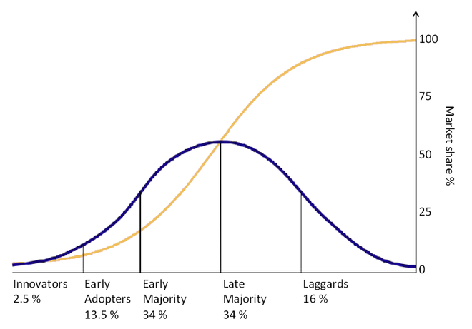
Business Model Challenges
Here’s Terry Anderson in 2006: “LMS systems have afforded teachers the capacity to create their own web courses with minimal programming expertise or even instructional design support…
“Similarly, PLEs are nowhere near as easy to use to facilitate and support many of the educational functions that are trivial in modern LMS systems.”
Anderson, T. (2006). PLE's versus LMS: Are PLEs ready for Prime time? Virtual Canuck. https://virtualcanuck.ca/2006/01/09/ples-versus-lms-are-ples-ready-for-prime-time/

Slide 10
Business Model Challenges
Similarly, Rita Kop: “People learning on an informal network will choose the subject they want to learn about or the activity they want to engage in, but in a connectivist environment they have to make other choices as well.
“For instance, they have to manage time, set their own learning goals, find resources, and try out new tools and make them work. These choices would in a formal classroom be the instructor’s responsibility, but are in an autonomous learning environment linked to tasks that the learner will carry out independently, which could be problematic.”
Kop, R. (2011). The challenges to connectivist learning on open online networks: Learning experiences during a massive open online course. The International Review of Research in Open and Distributed Learning, 12(3), 19–38. https://doi.org/10.19173/irrodl.v12i3.882
Kop, R. (2010). The Design and Development of a Personal Learning Environment: Researching the Learning Experience. European Distance and E-learning Network annual Conference 2010, June 2010, Valencia, Spain, Paper H4 32. https://www.researchgate.net/profile/Rita-Kop/publication/44390189_The_Design_and_Development_of_a_Personal_Learning_Environment_Researching_the_Learning_Experience/links/02e7e531e76782527b000000/

Slide 11
Technical Challenges
No real model for single user website
  Before web 2.0, people used discussion boards or Blogger
  After web 2.0 multi-user services like Twitter and Facebook took over
No cloud
  Hosting a personal website was difficult
  No place to store data online for use by multiple services
Platform lockdown
  Web 2.0 started with open APIs but eventually they were all locked down
  Open standards such as RSS were depreciated (cf. Google kills Reader)
Complexity
  Identity, permissions, copyright, etc. created major challenges
  Interoperability standards (eg. SOAP) were difficult and cumbersome

Slide 12
Design Considerations
This is a single user application, not a multi-user platform
It’s completely open source CC-by to be used by anyone
As a whole it is designed to be distributed and decentralized
It is as simple as possible, so anyone can use it
The ideal is that it can run anywhere (still working on that)
Mostly plain HTML-JS-CSS (no Node, no React, no crazy installs)

Slide 13
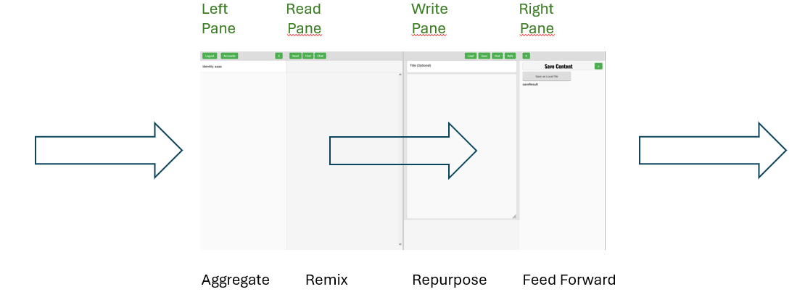
Flow

Slide 14
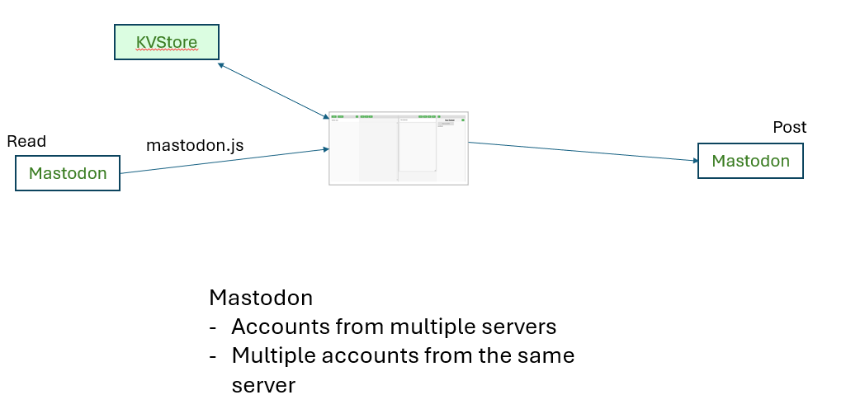
Read – Edit - Write

Slide 15
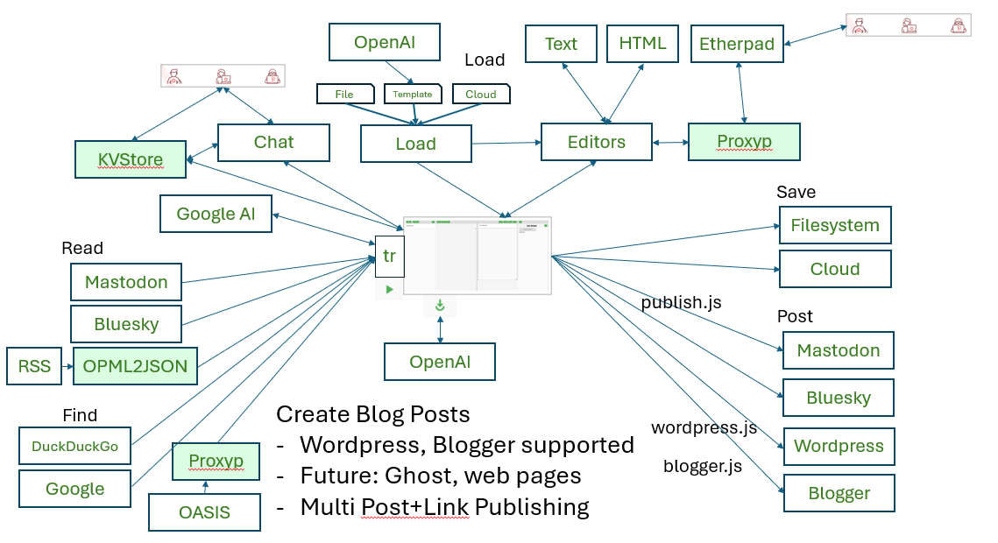
Multi-Functional

Slide 16
The Future…?

