Slide 1

Assessment of Barriers to Educational Technology Acceptance
Stephen Downes
CELDA, Zagreb, Croatia
October 27, 2024

Slide 2
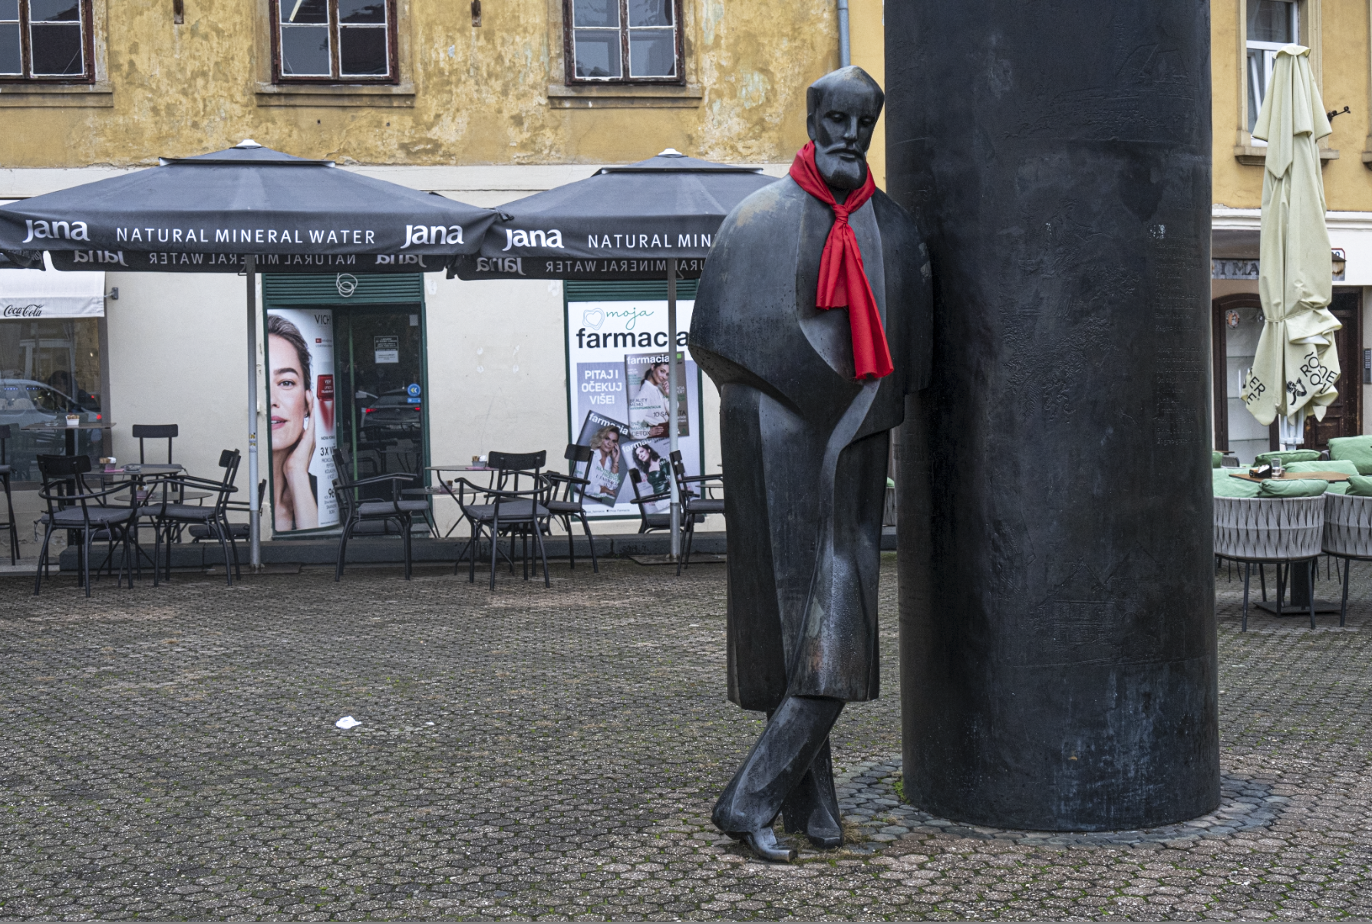


The Project
Assessment of Barriers to Educational Technology Acceptance
Stephen Downes, CELDA, Zagreb, Croatia, October 27, 2024

Slide 3
The Project
Part of an overall training modernization process
This report examines work by Defense Research and Development Canada (DRDC) to develop a model of factors that inhibit the use of learning technology
Assessment of Barriers to Educational Technology Acceptance
Stephen Downes, CELDA, Zagreb, Croatia, October 27, 2024

Slide 4

Full Publications
Defense Research and Development Canada (DRDC)
Training and Education Modernization: Analysis of Barriers to Technology Adoption . Mar 27, 2023. https://cradpdf.drdc-rddc.gc.ca/PDFS/unc466/p817939_A1b.pdf
Assessment of Barriers to Educational Technology Acceptance
Stephen Downes, CELDA, Zagreb, Croatia, October 27, 2024

Slide 5
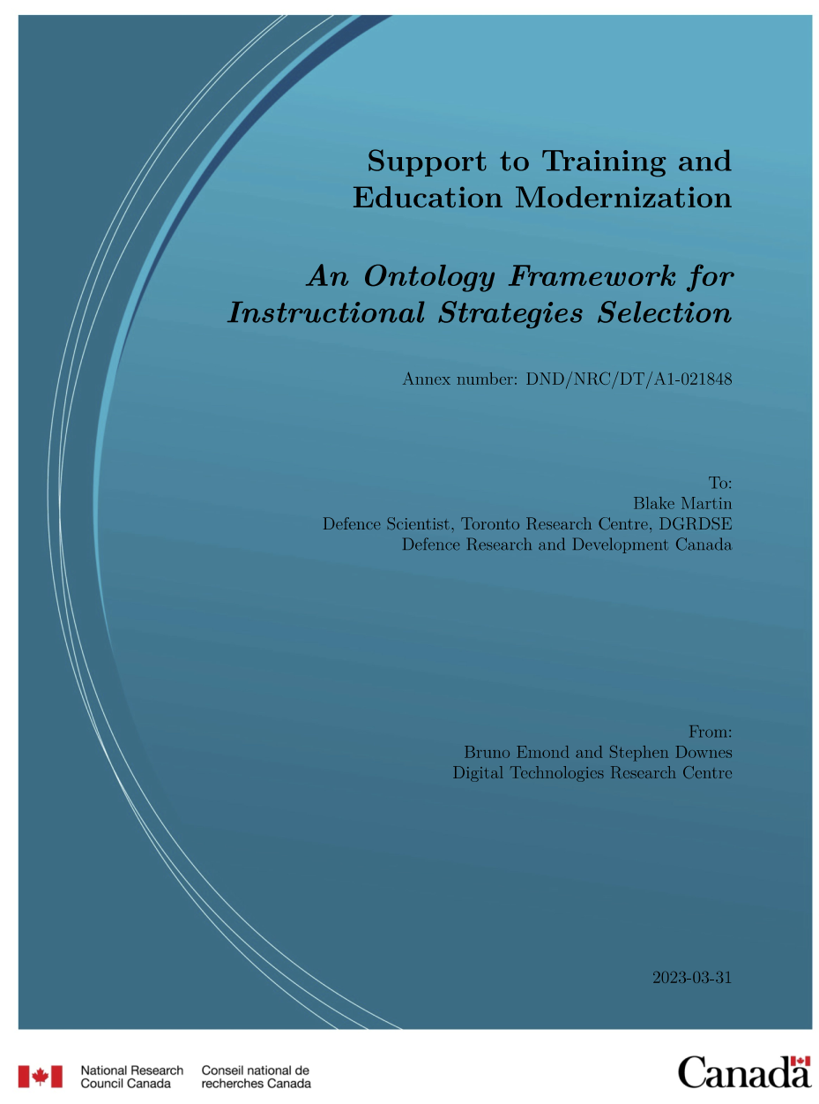
Full Publications
Defense Research and Development Canada (DRDC)
An Ontology Framework for Instructional Strategies Selection Report Report. Mar 31, 2023. https://cradpdf.drdc-rddc.gc.ca/PDFS/unc456/p817583_A1b.pdf
Assessment of Barriers to Educational Technology Acceptance
Stephen Downes, CELDA, Zagreb, Croatia, October 27, 2024

Slide 6
My Motivations
To share a structured description of the factors involved in a study of this sort – to inform people who may not have this background
To ask about the use of ‘x perception of y’ studies
To consider the limits of a cognitive (aka folk psychological) study of human motivations, actions and decision-making
Assessment of Barriers to Educational Technology Acceptance
Stephen Downes, CELDA, Zagreb, Croatia, October 27, 2024

Slide 7
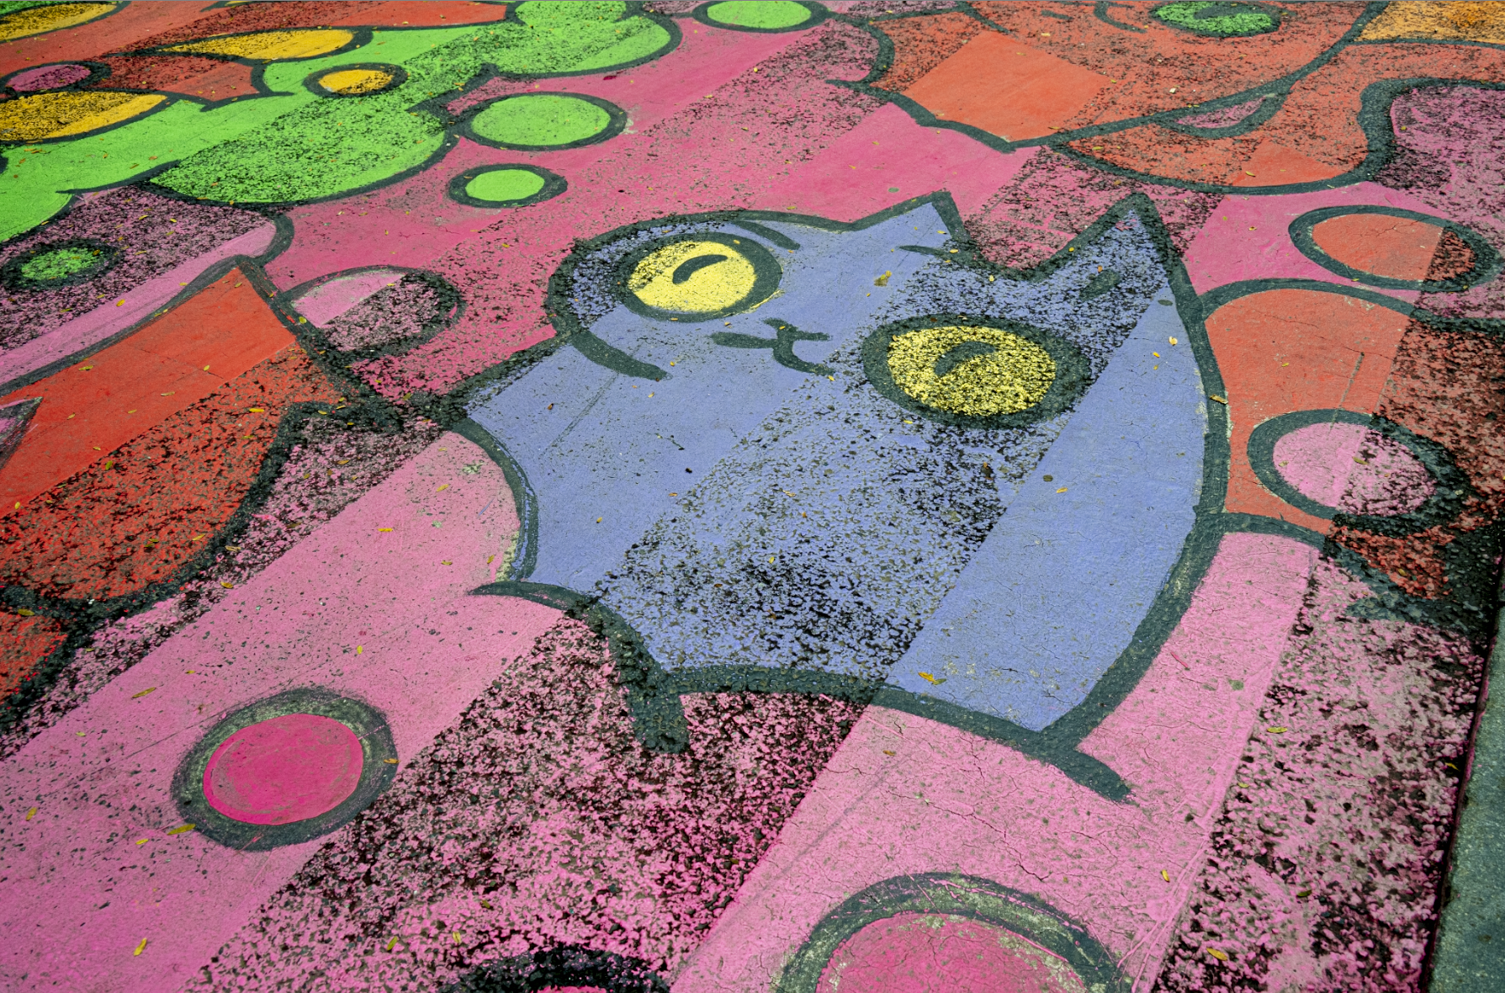
Acceptance Models
Assessment of Barriers to Educational Technology Acceptance
Stephen Downes, CELDA, Zagreb, Croatia, October 27, 2024

Slide 8
Acceptance Models
Adoption theory describes the choices individuals make and is understood in terms of behaviour change.
Diffusion theory considers the spread of a technology over time across an organization
Assessment of Barriers to Educational Technology Acceptance
Stephen Downes, CELDA, Zagreb, Croatia, October 27, 2024

Slide 9
Innovation Diffusion Theory (Rogers, 1962)
Five stages of diffusion :
awareness of the innovation,
persuasion of its benefits,
decision to adopt the innovation,
implementation of the decision, and
confirmation of the innovation process.
Assessment of Barriers to Educational Technology Acceptance
Stephen Downes, CELDA, Zagreb, Croatia, October 27, 2024

Slide 10
Theory of Planned Behavior (Azjen, 1985)
Changes in intention can be caused by:
changes in the salience of belief,
new information,
changes in confidence or commitment,
individual differences (skills, willpower, emotions)
external factors (time, opportunity, others).
Assessment of Barriers to Educational Technology Acceptance
Stephen Downes, CELDA, Zagreb, Croatia, October 27, 2024

Slide 11
Technology Acceptance Model (Davis, 1989)
Considers attitudes, rather than behavioural intentions, as the main predictors of behaviour:
usefulness
ease of use
Decomposed Theory of Planned Behavior (DTPB) combines TPB and TAM to depict specific beliefs as decomposed into belief constructs (Taylor & Todd, 1995).
Assessment of Barriers to Educational Technology Acceptance
Stephen Downes, CELDA, Zagreb, Croatia, October 27, 2024

Slide 12
Concerns-Based Adoption Model (Straub, 2009)
Includes three diagnostic, judgement-free components:
the Stages of Concern (SoC) survey;
Levels of Use (LoU) interviews; and
Innovation Configuration Maps (ICM)
“Technology adoption is a complex, inherently social, developmental process.”
Assessment of Barriers to Educational Technology Acceptance
Stephen Downes, CELDA, Zagreb, Croatia, October 27, 2024

Slide 13
Unified Theory of Acceptance and Use of Technology (Venkatesh, et al., 2003)
three direct determinants of intention to use (performance expectancy, effort expectancy, and social influence)
two direct determinants of usage behavior (intention and facilitating conditions).
Assessment of Barriers to Educational Technology Acceptance
Stephen Downes, CELDA, Zagreb, Croatia, October 27, 2024

Slide 14
UTAUT2 (Venkatesh, et al., 2012)
four constructs (performance expectancy, effort expectancy, social influence and facilitating conditions) from the UTAUT model
three new constructs (hedonic motivation, price value and habit) as antecedents of behavioral intention and use behavior
Assessment of Barriers to Educational Technology Acceptance
Stephen Downes, CELDA, Zagreb, Croatia, October 27, 2024

Slide 15
Barriers to Technology Adoption (Reid, 2014)
Unavailable technology is an obvious barrier.
Less obvious are the reliability and complexity of available instructional technologies.
Faculty with poor self-efficacy may be reluctant to try them.
Faculty turning away from it will influence others to do the same
Assessment of Barriers to Educational Technology Acceptance
Stephen Downes, CELDA, Zagreb, Croatia, October 27, 2024

Slide 16
Discussion
The DRDC Model
Technology
Process
Administration
Environment
Faculty
Technology acceptance is individual but influenced by beliefs, desires, fears, perceptions, social factors
Technology adoption is organizational and influenced by acceptance along with other factors
Difficulty of obtaining a structured description
Assessment of Barriers to Educational Technology Acceptance
Stephen Downes, CELDA, Zagreb, Croatia, October 27, 2024

Slide 17

Risk Management
Assessment of Barriers to Educational Technology Acceptance
Stephen Downes, CELDA, Zagreb, Croatia, October 27, 2024

Slide 18
Risk Assessment Models
measure exposure to negative consequences as a result of a policy or plan
may be qualitative, quantitative, or a combination of
usually subjective, measuring ‘perceived’ or ‘expected’ risk
Assessment of Barriers to Educational Technology Acceptance
Stephen Downes, CELDA, Zagreb, Croatia, October 27, 2024

Slide 19
Fine-Kinney method (1971, 1976)
calculates a risk score based on the product of scores for probability, exposure, and consequences.
Each is weighted equally; later modifications vary the weighting.
Assessment of Barriers to Educational Technology Acceptance
Stephen Downes, CELDA, Zagreb, Croatia, October 27, 2024

Slide 20
Analytical Hierarchy Process Model (Harker, 1989)
method for weighting and combining multiple goals or outcomes and multiple criteria in order to obtain weighted outcomes
classification scheme organizing risk factors according to categories, for example, ‘acts of god’, ‘financial’, ‘design’, etc., with subfactors being identified under each
Assessment of Barriers to Educational Technology Acceptance
Stephen Downes, CELDA, Zagreb, Croatia, October 27, 2024

Slide 21
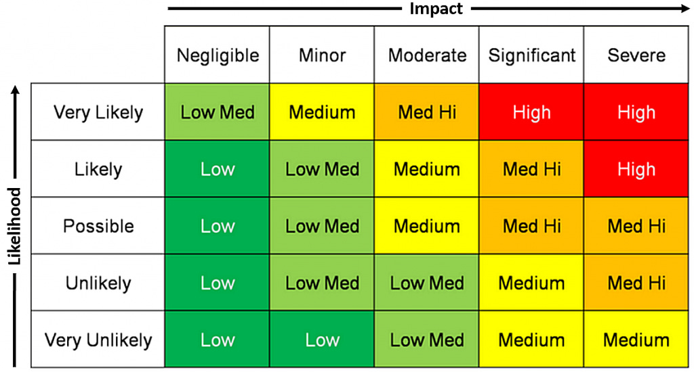
Risk Matrix
“Consistent predefined likelihood and consequence” (DOD, 2017, 23).
Assessment of Barriers to Educational Technology Acceptance
Stephen Downes, CELDA, Zagreb, Croatia, October 27, 2024

Slide 22
Discussion
Risk is self-referential – ie., a discussion of perceptions of rick will result in a revision of perceptions of risk
Risk perceptions vary depending on point of view
Risk as an individual construct is quite different from risk as an organizational construct
Assessment of Barriers to Educational Technology Acceptance
Stephen Downes, CELDA, Zagreb, Croatia, October 27, 2024

Slide 23

Validation
Assessment of Barriers to Educational Technology Acceptance
Stephen Downes, CELDA, Zagreb, Croatia, October 27, 2024

Slide 24
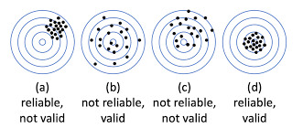
Validity and Reliability (AERA, 2014)
reliability refers to the consistency of a measure,
validity refers to the accuracy of a measure.
Assessment of Barriers to Educational Technology Acceptance
Stephen Downes, CELDA, Zagreb, Croatia, October 27, 2024

Slide 25
Content Validity
Content validity involves assessing whether the questions in the survey cover the entire range of issues or concepts being studied.
the degree of correlation of test scores with external criteria (Cureton (1951) in Sireci, 1998, 88)
includes elements of content representativeness and content relevance (Messick, 1975) or process (Tenopyr, 1977).
Assessment of Barriers to Educational Technology Acceptance
Stephen Downes, CELDA, Zagreb, Croatia, October 27, 2024

Slide 26
Construct Validity
The structure or construction of the concept intended to be measured
E.g. In a Likert survey, where respondents the option that best describes their attitudes, beliefs, and experiences, the Rasch model measures such factors as the unidimensionality and local independence of those options (Yamashita, 2022, 4).
Assessment of Barriers to Educational Technology Acceptance
Stephen Downes, CELDA, Zagreb, Croatia, October 27, 2024

Slide 27
Criterion Validity
“The extent to which an operationalization of a construct, such as a test, relates to, or predicts, a theoretical representation of the construct - the criterion“
evidence concerning its reliability, the extent to which it represents the intended construct (AERA, 2014)
‘Logic Model’
Assessment of Barriers to Educational Technology Acceptance
Stephen Downes, CELDA, Zagreb, Croatia, October 27, 2024

Slide 28
Test-Retest Reliability
Administering the survey twice to the same group of people and comparing the results to ensure that they are consistent
it may be sufficient to administer the same survey twice to the same type of people.
distinguishing random short-term score differences from true improvements or deteriorations over time” (Polit, 2014).
Assessment of Barriers to Educational Technology Acceptance
Stephen Downes, CELDA, Zagreb, Croatia, October 27, 2024

Slide 29
Internal Consistency
Extent to which the questions in the survey are measuring the same construct.
For example, if some questions are asking about the objective existence of an entity, and other questions are asking about a respondent’s perceptions of an entity, the questions are not measuring the same construct.
Assessment of Barriers to Educational Technology Acceptance
Stephen Downes, CELDA, Zagreb, Croatia, October 27, 2024

Slide 30
Discussion
Three major components of study validity:
Data – issues of fidelity, provenance, completeness, cleaning, etc
Instrument – surveys vs measurement; what we study; limitations on what can be measured or comprehended
Theory – defines what counts as data, the relation between a subject perspective and objective reality
Assessment of Barriers to Educational Technology Acceptance
Stephen Downes, CELDA, Zagreb, Croatia, October 27, 2024

Slide 31
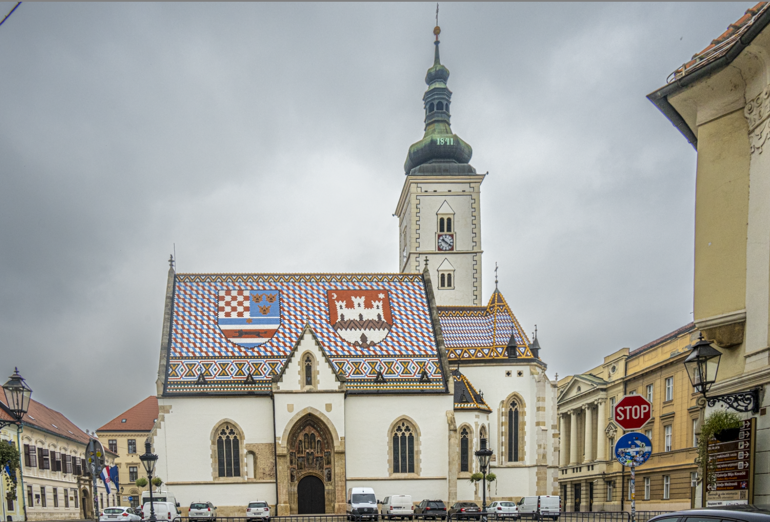
The Assessment
Assessment of Barriers to Educational Technology Acceptance
Stephen Downes, CELDA, Zagreb, Croatia, October 27, 2024

Slide 32
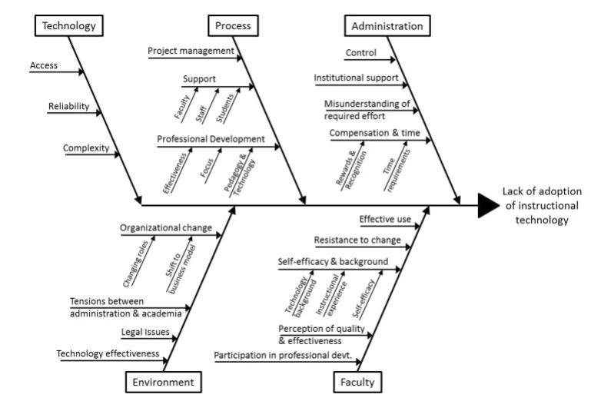
The DRDC Model
Technology
Process
Administration
Environment
Faculty
Assessment of Barriers to Educational Technology Acceptance
Stephen Downes, CELDA, Zagreb, Croatia, October 27, 2024

Slide 33
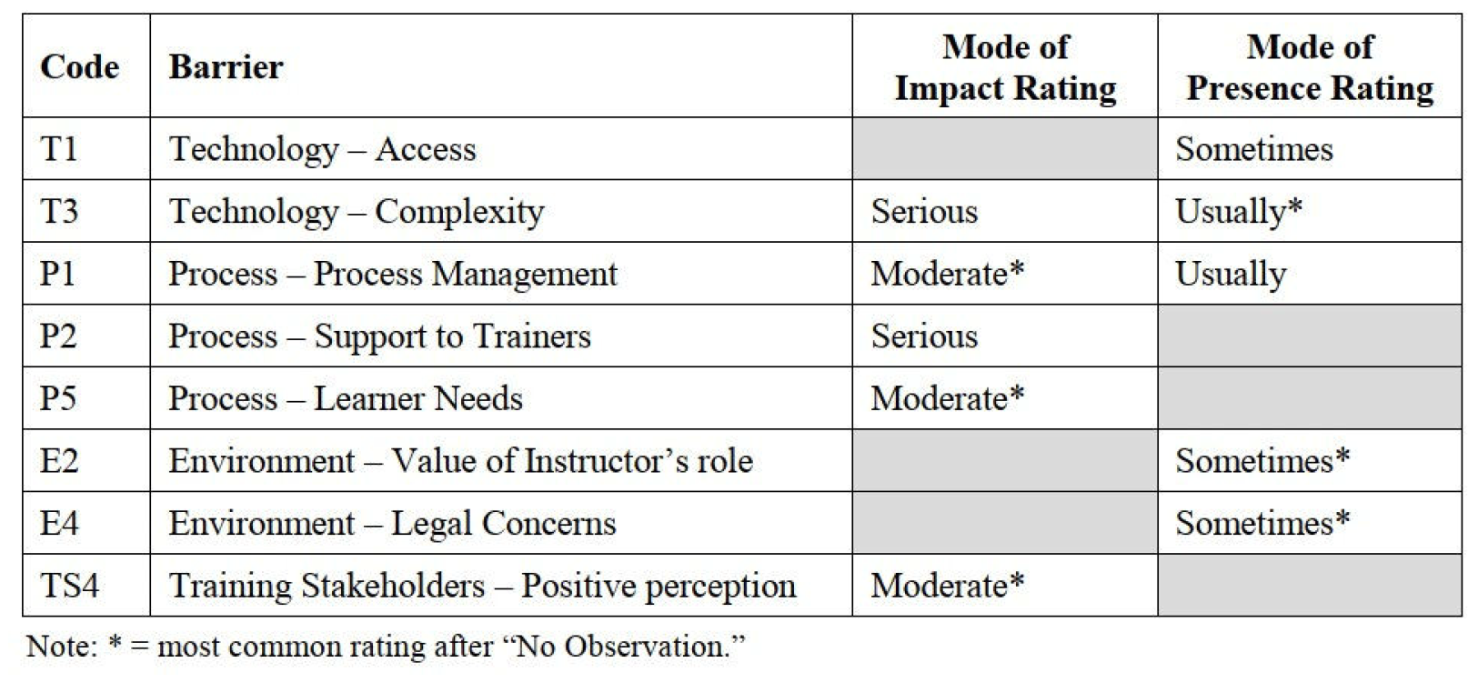
Results and Key Takeaways
Assessment of Barriers to Educational Technology Acceptance
Stephen Downes, CELDA, Zagreb, Croatia, October 27, 2024

Slide 34
Looking at Barriers as…
Pathways
less focused on acceptance models than it is an examination of an institution and specifically, what affordances are needed for an institution design or adapt new models and technologies
Risk
Questions addressing each of the categories and subcategories were designed following a risk assessment matrix model
Assessment of Barriers to Educational Technology Acceptance
Stephen Downes, CELDA, Zagreb, Croatia, October 27, 2024

Slide 35
Conceptual Issues
Are respondents talking about other people, or are they talking about themselves?
Individual perceptions are influenced not only by their own experience but also as experienced either by behaviour that is modelled by others
The emphasis on role may suggest to the respondent an intention to adopt an organizationally-based stance, a ‘view from nowhere’.
Assessment of Barriers to Educational Technology Acceptance
Stephen Downes, CELDA, Zagreb, Croatia, October 27, 2024

Slide 36
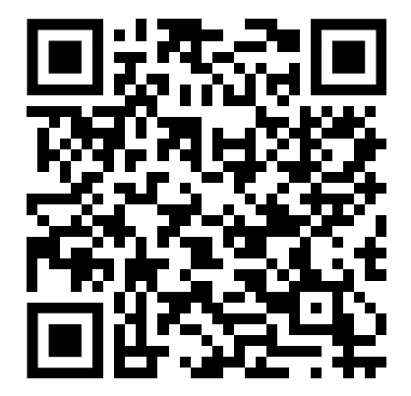
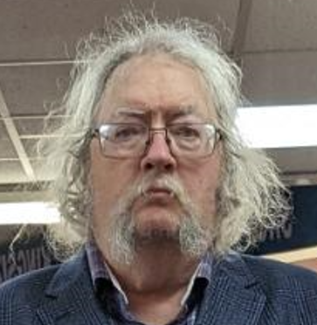
Thank You
Stephen Downes
https://www.downes.ca
Assessment of Barriers to Educational Technology Acceptance
Stephen Downes, CELDA, Zagreb, Croatia, October 27, 2024

