Slide 1
AI Ethics in a research context: current approaches and future challenges
Kathleen Fraser, AI Researcher, NRC Digital Technologies
Terrence Stewart, Senior Research Officer, NRC Digital Technologies
Stephen Downes, Senior Research Officer, NRC Digital Technologies
Margaret McKay, Program Leader Digital Privacy & Security, NRC
CAREB 2024

Slide 2

Part 1: (14:10 – 14:55 EST)
How should REB members expect to encounter AI ethics questions? (M. McKay)
Understanding the ethics-relevant qualities of AI (T. Stewart)
Overview of leading AI ethics approaches and perspectives (S. Downes)
Practical examples of AI ethics challenges (K. Fraser)
Part 2: (15:05 – 15:50 EST)
Breakout sessions: Applying AI ethics principles for REB reviews in specific disciplines (facilitated small group discussions)
Current and future AI ethics challenges for REBs, resources available (S. Downes)

Slide 3
REB Encounters with AI Ethics: an introduction
Part 1(a)
Margaret McKay
Digital Technologies Research Centre
National Research Council Canada

Slide 4
AI Ethics in REB Context
Sources of Risk
 | Research Data | AI Models/Tools
Research Participant Well-being | Privacy, consent, use of publicly-accessible data | Direct harm to participant, privacy risks
Proportionality (Value of Research) | Flawed data leads to flawed results | Inappropriate AI tool use leads to flawed results
Impact on Research

Slide 5
3 example approaches:
AI Ethics/ responsible AI Frameworks & Principles

Slide 6

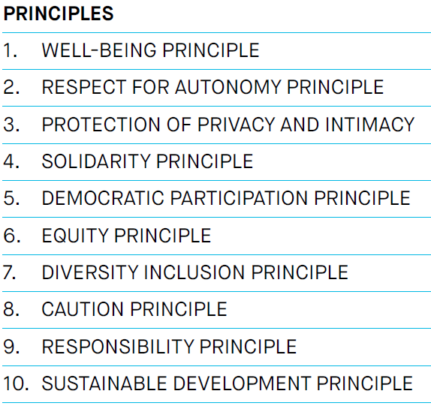
The Montreal Declaration For Responsible AI Development
The Montréal Declaration for responsible AI development has three main objectives:
Develop an ethical framework for the development and deployment of AI;
Guide the digital transition so everyone benefits from this technological revolution;
Open a national and international forum for discussion to collectively achieve equitable, inclusive, and ecologically sustainable AI development.
https://declarationmontreal-iaresponsable.com/wp-content/uploads/2023/04/UdeM_Decl-IA-Resp_LA-Declaration-ENG_WEB_09-07-19.pdf

Slide 7

OECD Principles for responsible stewardship of trustworthy AI
Principles:
Inclusive growth, sustainable development and well-being
Human-centred values and fairness
Transparency and explainability
Robustness, security and safety
Accountability.
Recommendations:
…a) Governments should consider long-term public investment, and encourage private investment, in research and development, including interdisciplinary efforts, to spur innovation in trustworthy AI that focus on challenging technical issues and on AI-related social, legal and ethical implications and policy issues.
b) Governments should also consider public investment and encourage private investment in open datasets that are representative and respect privacy and data protection to support an environment for AI research and development that is free of inappropriate bias and to improve interoperability and use of standards.
https://legalinstruments.oecd.org/en/instruments/OECD-LEGAL-0449

Slide 8

Hiroshima AI Process
Eleven Principles and Actions, including:
Take appropriate measures throughout the development of advanced AI systems, including prior to and throughout their deployment and placement on the market, to identify, evaluate, and mitigate risks across the AI lifecycle.
Work towards responsible information sharing and reporting of incidents among organizations developing advanced AI systems including with industry, governments, civil society, and academia.
Prioritize research to mitigate societal, safety and security risks and prioritize investment in effective mitigation measures.
Implement appropriate data input measures and protections for personal data and intellectual property
We, the Leaders of the Group of Seven (G7), stress the innovative opportunities and transformative
potential of advanced Artificial Intelligence (AI) systems, in particular, foundation models and
generative AI. We also recognize the need to manage risks and to protect individuals, society, and our shared principles including the rule of law and democratic values, keeping humankind at the center….
https://www.mofa.go.jp/ecm/ec/page5e_000076.html

Slide 9
So…how does all this fit with the tcps2?

Slide 10
Applying Guidance – Proportionality:
TCPS2 requires a proportional approach to ethics review. This includes balancing the foreseeable risks, as well as the potential benefits, of the proposed research.
Data issues: AI-enabled research which uses biased or otherwise flawed training or validation data can offer little to no evidence of potential benefits.
AI Issues: A research team using third-party AI tools without adequate AI-specific expertise can inadvertently obtain seemingly convincing but actually erroneous results which can delay advances in the field and potentially lead to wider harms.
Security issues (data and / or AI model): where data and models are not adequately protected form hostile interference, even a well-designed project can be manipulated to produce useless or even harmful results.

Slide 11
Applying Guidance – Research Participant Risks
Data Collection and Storage:
Consent, repository requirements, third-party sourced data
Security of data during collection, use, and storage
AI Model Privacy Risks:
Potential for model leakage of sensitive information
AI Model Risks:
Where the research relates to the interaction of the human with an AI-enabled system, system bias, accuracy, etc. may impact research subject well-being

Slide 12
Points to Consider:
Responsible AI / AI Ethics texts tend to focus primarily on broader societal impacts…yet they remain relevant to REBs as well.
The value of research involving or relying on the development or re-training of an AI model or system is impacted by risks that the model produced will produce inaccurate or biased results – REB and broader societal interests intersect here.
The selection of research participants and other data sources (human or non-human) can impact the quality of the resulting AI model and therefore the value of the research
Direct harms to research participants can come from conventional privacy issues, and also from weaknesses in the AI model developed (e.g. leakage).
Ethical priorities can differ between individuals, cultures, etc. Differences of opinion on questions of AI ethics are common (even within this panel).

Slide 13
examples:
Alignment between principles of Montreal Declaration on Responsible AI development and core REB principles

Slide 14
TCPS2 Concerns in Montreal Declaration Terms
(i) Risks Arising from Data Used in Research:
Risks to Proportionality - Value of the Research:
Equity: Bias - over/under representation, historical bias, labeling bias / off-shored ethics, etc.
Prudence: threats to AI model integrity - data poisoning, label flipping, etc.
Research Participant Risks:
Privacy: Consent, consent to secondary use, blanket vs. broad consent, limits on collection and use of publicly accessible data
Privacy: Security of data at rest and in movement (e.g. during AI training)
Margaret McKay, National Research Council, Digital Privacy and Security Program margaret.mckay@nrc-cnrc.gc.ca

Slide 15
(ii) Risks Arising from AI Models & Tools:
Research Participant Risks:
Prudence: Risks of AI models leaking sensitive training data
Risks to Proportionality of the Value of the Research:
Well-Being: Competence of research team in the use of the proposed AI tool
Well-Being: Risks of biased / inaccurate, or otherwise inappropriate model outputs which undercut the intended research value of the project
Margaret McKay, National Research Council, Digital Privacy and Security Program margaret.mckay@nrc-cnrc.gc.ca

Slide 16
Part 1(b)
Understanding the ethics-relevant qualities of AI
Terry Stewart
Digital Technologies Research Centre
National Research Council Canada

Slide 17
What is AI?

Slide 18
What is AI, practically?
A system that takes in input and produces corresponding output

Slide 19




What is AI, practically?
A system that takes in input and produces corresponding output
cat
cat
dog
dog

Slide 20
What is AI, practically?
A system that takes in input and produces corresponding output
cat
My favourite animal is a
I like to
I like to go
I like to go for
I like to go for a
dog
go
for
a
walk
cat
dog
dog

Slide 21
What is AI, practically?
A system that takes in input and produces corresponding output
cat
My favourite animal is a
I like to
I like to go
I like to go for
I like to go for a
dog
go
for
a
walk
cat
cat
cat
dog
dog
dog
dog

Slide 22





How does AI work?
Regression, scaled up
input
output
Use regression to find these weights

Slide 23


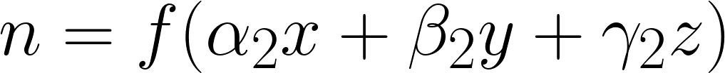

How does AI work?
Regression, scaled up
input
hidden features
output
Adjust first set of weights so that the second set does a good job
(“backprop”)

Slide 24
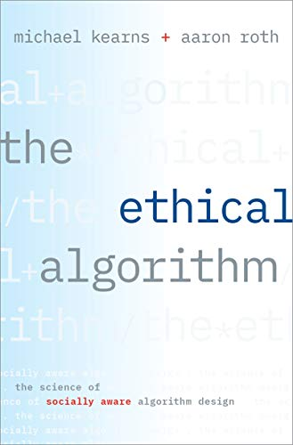
Relevance to ethics
When finding the weights, we are optimizing for something
Usually mean squared error (MSE) or categorization error (accuracy)
“loss function” or “objective”
“When learning is involved and you pick some objective function to optimize like error you should never expect to get for free anything that you didn't explicitly state in the objective and you shouldn't expect to avoid any behavior that you didn't specify should be explicitly avoided.”
“Because if you're searching some complicated model space looking for the lower error and there's some little corner of the model space where you can even incrementally infinitesimally improve your error at the expense of some social norm machine learning is going to go for that corner because that's what it does”

Slide 25
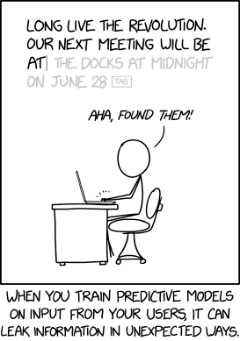
Relevance to ethics
Privacy
Where does this data come from?
Security
Can you recover the original training data?
https://xkcd.com/2169

Slide 26
Relevance to ethics
Bias
input
output
My favourite animal is a
My favourite animal is a
My favourite animal is a
My favourite animal is a
My favourite animal is a
dog
cat
dog
cat
dog

Slide 27
Relevance to ethics
Bias
Accuracy if output dog 60% of the time and cat 40% of the time
input
output
My favourite animal is a
My favourite animal is a
My favourite animal is a
My favourite animal is a
My favourite animal is a
dog
cat
dog
cat
dog

Slide 28
Relevance to ethics
Bias
Accuracy if output dog 60% of the time and cat 40% of the time
input
output
My favourite animal is a
My favourite animal is a
My favourite animal is a
My favourite animal is a
My favourite animal is a
dog
cat
dog
cat
dog
Accuracy if output dog 100% of the time

Slide 29
Relevance to ethics
Bias
Accuracy if output dog 60% of the time and cat 40% of the time
input
output
My favourite animal is a
My favourite animal is a
My favourite animal is a
My favourite animal is a
My favourite animal is a
dog
cat
dog
cat
dog
Accuracy if output dog 100% of the time
Optimizing for accuracy can make bias in the training data even worse!

Slide 30
Part 1(c)
Overview of leading AI ethics approaches and perspectives
Stephen Downes
Digital Technologies Research Centre
National Research Council Canada

Slide 31
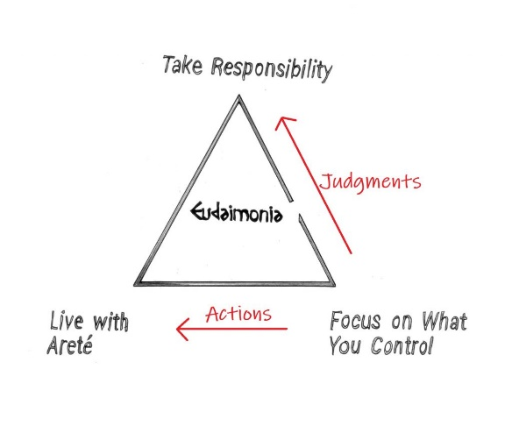
Leading AI ethics approaches and perspectives
Character and Virtue
Cultivation of inherent ethical qualities such as honesty
Arete “Be all you can be”
Between deficiency, excess
Character and Virtue in AI Ethics:
Issues around the impact on the individual, for example, loss of skills, loss of critical reflection, loss of sense of right and wrong
Virtue-based responses: standards of professional conduct (e.g. CFA Institute, ACM code, Nolan principles, AMA)
Values-based: “values are academic freedom, scholarly excellence, mutual respect, collaboration, integrity” (Folan, 2020)
Notes:
Image: https://www.reddit.com/r/Stoicism/comments/bq1njj/easy_way_to_explain_stoicism_the_stoic_happiness/

Slide 32
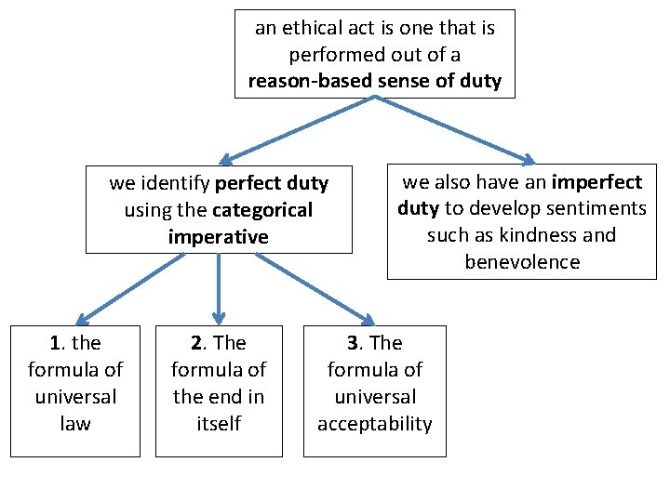
Leading AI ethics approaches and perspectives
Duty and Deontology
Inherent value of humans
Categorical Imperative – “What if everyone did that?”
Duty and Deontology in AI Ethics:
Issues based on rights and agency, including surveillance, tracking, anonymity, and privacy generally, human decisions
Response based on worth & dignity of each human (NEA, 1975)
Role and responsibility, e.g. duty to “the pursuit and dissemination of knowledge…” (SFU Code)
Informed consent (eauchamp and Childress, Helsinki, Belmont)
Notes:
Image: https://slidetodoc.com/ethics-theory-and-business-practice-3-2-kantian/

Slide 33
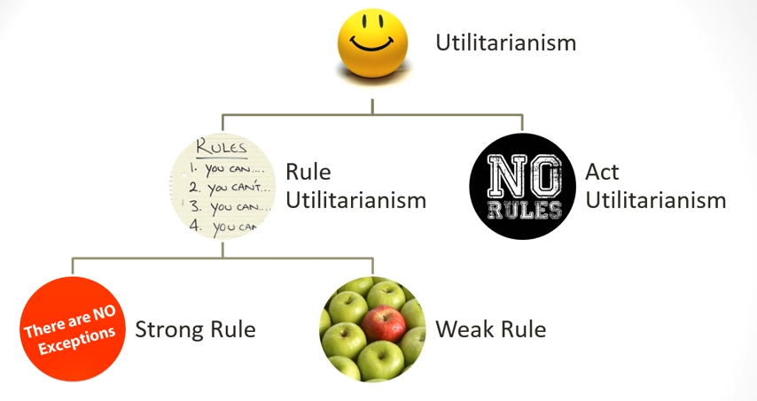
Leading AI ethics approaches and perspectives
Consequentialism
The greatest good for the greatest number of people
The happiness principle
Comparing acts versus rules
Consequentialism in AI Ethics:
Issues related to undesirable outcomes, including bias and prejudice, misinterpretation
Benefit-based response: “safety, health, and welfare of the public” (IEEE Code)
Reduction of Harm (HHS Common Rule)
Risk-based approaches
Notes:
Image: https://www.youtube.com/watch?v=GrZp12isYb4

Slide 34
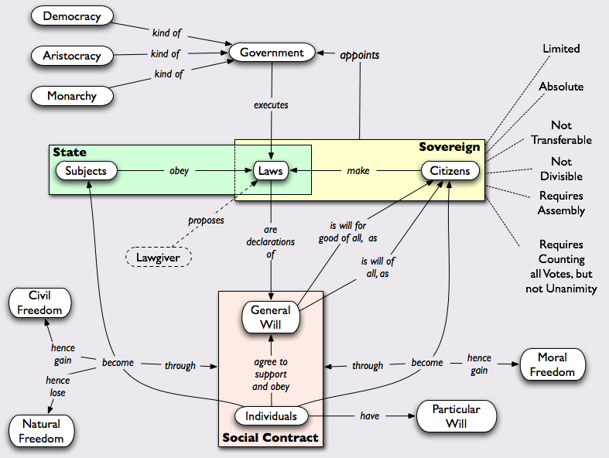
Leading AI ethics approaches and perspectives
Social Contract Theory
Ethics as agreement for the greater good
Rawls: ‘original position’
Justice as fairness
Social Contract Theory in AI Ethics
Issues that undermine decision-making and democracy, for example, content manipulation, micro-targeting, discrimination,
Society-based responses based in responsibility (Code Soleil)
Promotion of public trust (Ontario College of Teachers)
Constitutional and rights-based approaches
Notes:
Image: https://www.pinterest.it/pin/39688040449977807/

Slide 35
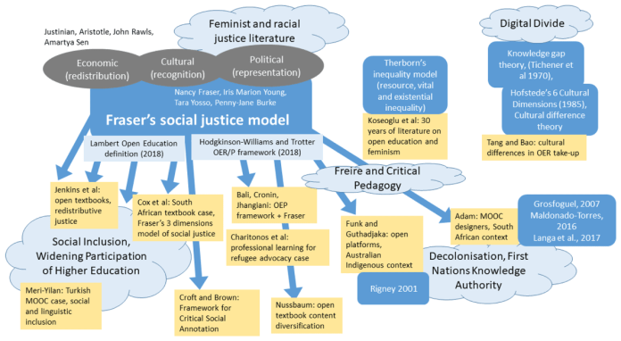
Leading AI ethics approaches and perspectives
Care and Community
Ethics as based in personal relationships, interaction
Based in a sense of ethics rather than rules & principles
Care and Community in AI Ethics:
Issues of alienation and dehumanization, including the creation of a climate of mistrust, fear and anxiety, loss of social cohesion
Relationship-based response: ““a privileged relationship exists between members and students” (BC Teachers Federation)
Benefit to subject as perceived by the subject (Cdn Nurses Assn)
Notes:
Image: https://jime.open.ac.uk/articles/10.5334/jime.584/

Slide 36
Leading AI ethics approaches and perspectives
Summary of Issues - https://ethics.mooc.ca/all_issues.htm
Approaches to ethics https://ethics.mooc.ca/cgi-bin/page.cgi?module=9
The Ethical Codes Reader https://docs.google.com/document/d/1mv9VxbIyGvBaFwHSvtyN1a3iwAKws6SZDGuDTlYMZ48/edit
MetaEthics https://ethics.mooc.ca/cgi-bin/page.cgi?presentation=41

Slide 37
Real-World Examples
Part 1(d)
Kathleen C. Fraser
Digital Technologies Research Centre
National Research Council Canada

Slide 38
AI Ethics in REB Context
Sources of Risk
 | Research Data | AI Models/Tools
Research Participant Well-being | Privacy, consent, use of public data | Direct harm to participant, privacy risks
Proportionality (Value of Research) | Flawed data leads to flawed results | Use of an inappropriate third-party AI tool leads to flawed results
Impact on Research

Slide 39
Research Data – Participant Risks
Questions: Have users consented for their data to be used for this purpose? Would they consider it a breach of privacy?

Slide 40
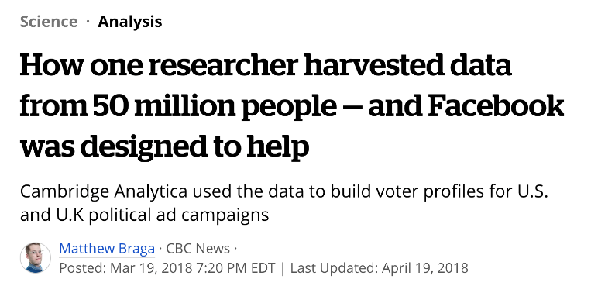

Example: Consent to participate
Cambridge Analytica scandal:
Data originally collected by Dr. Aleksandr Kogan, Cambridge University.
Online quiz for psychology research, common in his department
Collected from the quiz-taker (who had “consented”) and their friends
Data was collected according to Facebook’s Terms of Service
Does clicking a box online count as “informed consent”?
Can the user consent on behalf of their friends?

Slide 41
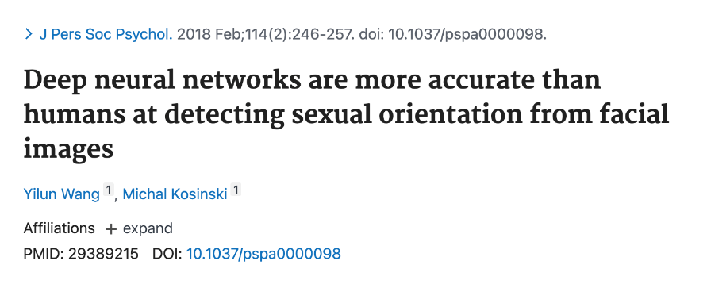
Example: Data from the public domain
“AI Gaydar” controversy:
Led by Dr. Michal Kosinski, Stanford University
Trained a machine learning classifier to distinguish between straight/gay men and women on the basis of a photo of their face
Scraped images and sexual orientation data from dating sites
Was the data in the public domain?
Was there a reasonable expectation of privacy?

Slide 42
Research Data: Proportionality Risks
Questions: Are there sources of bias in the data which will limit the value (potential benefits) of the research?

Slide 43
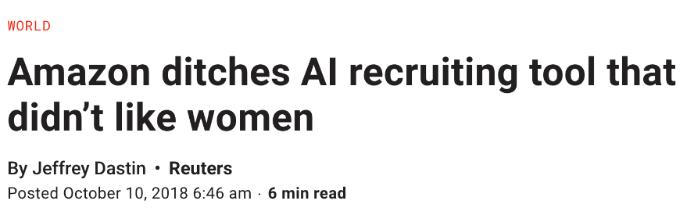
Example: Biased Data
Amazon algorithmic hiring tool
Replicated company’s historical bias for hiring men, rather than women
Note: “applicant gender” was not an input to the algorithm
Algorithm learned to down-vote resumes mentioning all-women colleges, women’s sports teams
Also learned to up-vote resumes with words like executed and captured, which were used more frequently by men
What is the likelihood of systemic bias in the training data?
Can that bias be removed or mitigated?

Slide 44
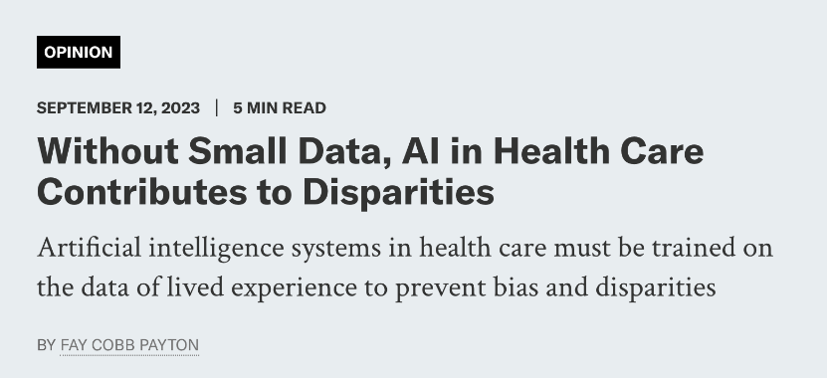
Example: Incomplete Data
AI tool for diabetes management
Designing treatment plans for lower socioeconomic status groups
Trained on medical records (lab tests, diagnosis codes, etc.)
Does not take into account social determinants of health, transportation options to medical centre, food insecurity, employment, etc.
Will an AI model trained on this data be capable of benefiting participants and society?

Slide 45
AI Models/Tools: Participant Risks
Questions: How does the AI tool use participant data? What is the risk that participant data will be leaked/exposed by the trained model?

Slide 46
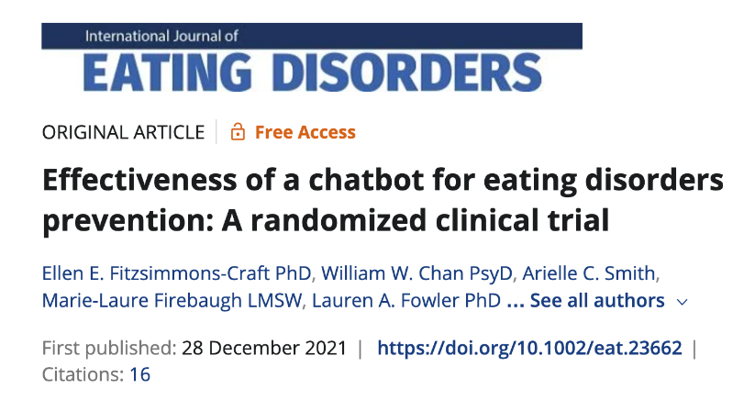
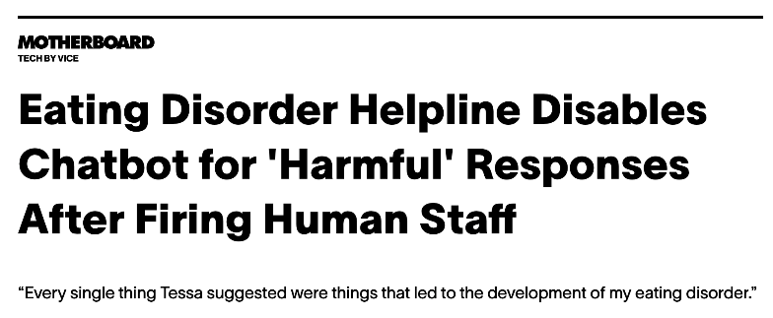
Example: Risk to Well-being
National Eating Disorders Association (US)
Nonprofit advocacy group shut down helpline after 20 years, replaced with chatbot
Used third-party mental health chatbot
Tested in clinical trial with university researchers, found to reduce short-term ED risk
At some point, chatbot company made “systems upgrade” to incorporate more AI in responses
Resulting chatbot gave diet
advice, promoted caloric
deficits, etc.
Do the potential benefits outweigh the risks?
Do the researchers ultimately control the technology?

Slide 47
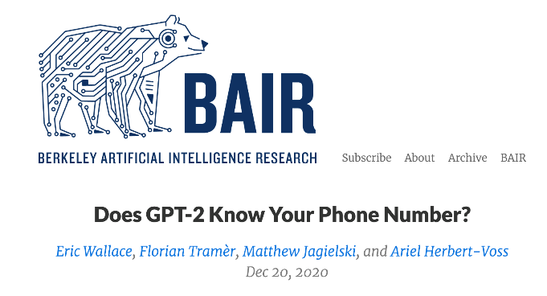
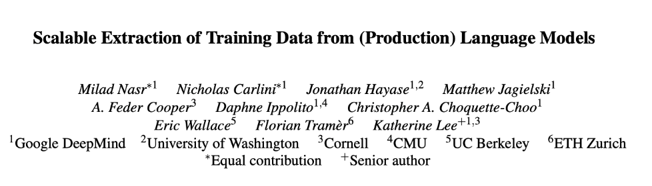
Example: Risk to Privacy
Berkley study extracting personal info from GPT-2
Developed a method to uncover outputs that had been “memorized” from the training data
Much of it was from news data, Wikipedia articles, and advertising
Some of it included personally-identifiable information, including addresses and
phone numbers
Note: training data,
not input data
When training a new AI model, can researchers ensure that none of their participants’ data will be memorized?
Including Llama, Falcon, GPT-3.5 turbo

Slide 48
AI Models/Tools: Proportionality Risks
Questions: How well has the AI tool been validated for the proposed purpose? What is the likelihood that the AI model will produce inaccurate output, and what will be the effect on the research? Does the research team have the expertise to use and understand the AI tool?

Slide 49
Example: Tool Not Validated for Population
My own research: webcam based eye-tracking in elderly population
Cognitive assessment tool that involves eye-tracking (REB approved)
Using a third-party AI model for the eye-tracking
Worked great .. until tested with older adults!
Turns out oldest person in the training data was 41 years old
Fortunately: our team has the AI expertise to implement personalized re-training
Has the AI model been validated on the population of interest?
If not, can the research team adapt/retrain?

Slide 50
Future Considerations
Most academic AI research is not reviewed by REB
Many societal concerns about AI are not under the mandate of REB
“[There is] a large gap between the relevant concerns that follow from AI research and those that fall under the purview of IRBs. Issues like dual use of data, worker displacement, unrepresentative training data and excluding stakeholders from project design and deployment remain unreviewed and often unmitigated.” [Waeiss, 2023]
https://www.adalovelaceinstitute.org/blog/ai-research-ethics-collective-problem/

Slide 51
Thank you
kathleen.fraser@nrc-cnrc.gc.ca

Slide 52
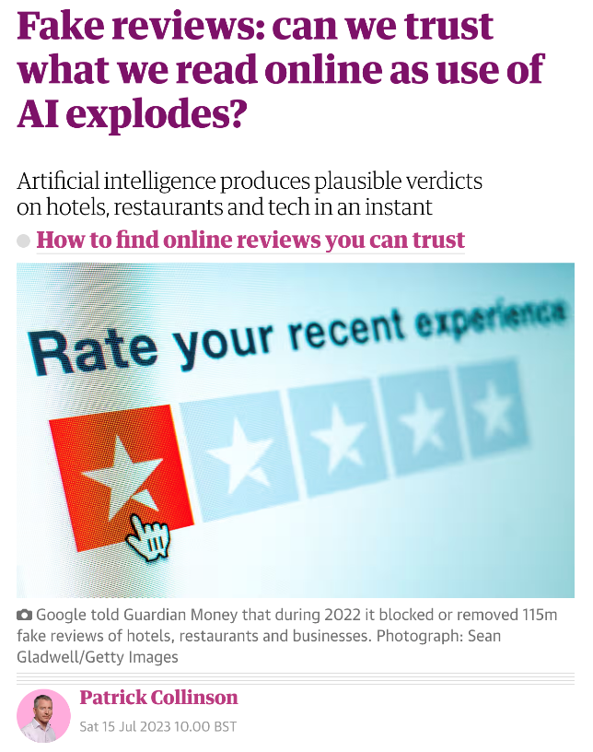
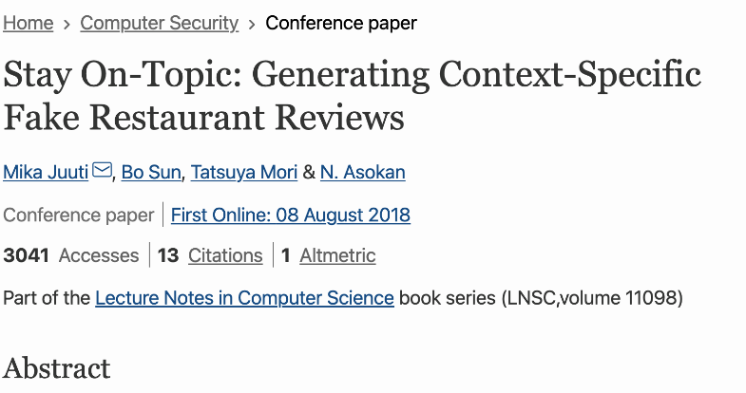
Example: long-term consequences of the research
2018
2023

Slide 53
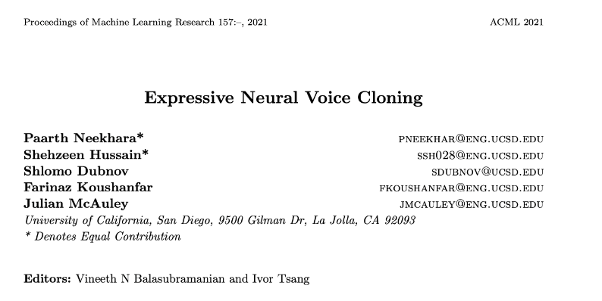
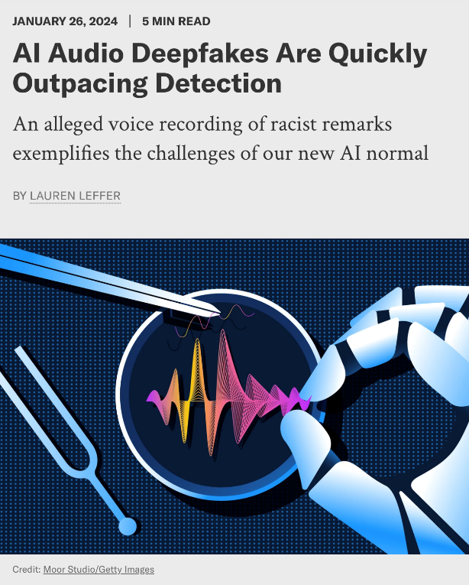
Example: long-term consequences of the research
2021
2024

Slide 54
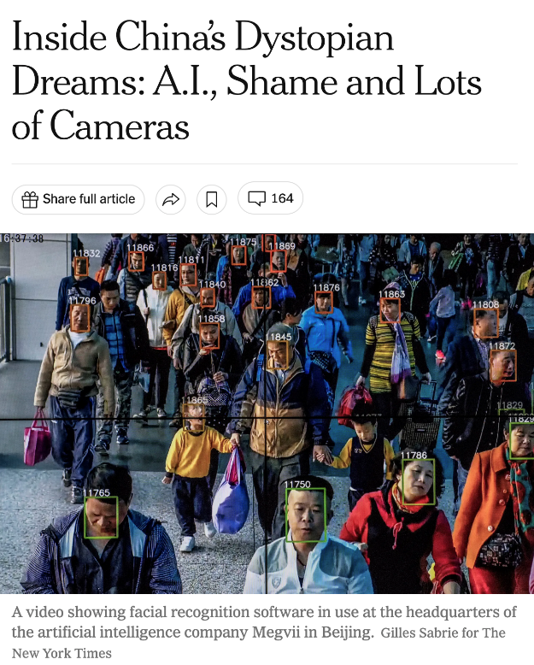
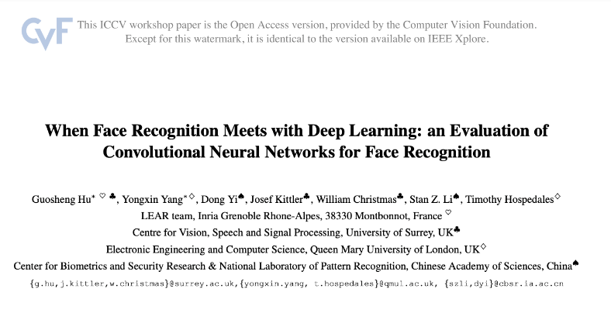
Example: long-term consequences of the research
2015
2018

Slide 55
Break
…please return by 15:05 EDT

Slide 56
Small Group discussions:
You will be assigned to a small group (virtual room) room, please click to enter
If you are comfortable, please turn on cameras for the small group discussions
Assign a note-keeper and spokes person (to present your group’s thoughts in the plenary)
Notes should be entered on the Google document for your group #
(see chat for links)

Slide 57
Discussion Questions (same for all groups):
A. What areas of AI Ethics do you feel:
Are likely to apply most often in your REB work?
Raise the trickiest questions for analysis in the context of the kind of proposals your REB sees?
B. Based on the structure and principles provided in the Montreal Declaration and the discussion today, what are the 3 to 5 key questions which you feel you will need to ask about many / most REB proposals you see which involve AI in some way?
C. (If time permits) What supports or processes do you feel would help REBs like yours address these challenges?
Montreal Declaration Links:
English: https://declarationmontreal-iaresponsable.com/wp-content/uploads/2023/04/UdeM_Decl-IA-Resp_LA-Declaration-ENG_WEB_09-07-19.pdf
Français: https://declarationmontreal-iaresponsable.com/wp-content/uploads/2023/01/UdeM_Decl_IA_Resp_LA_Declaration_FR_web_4juin2019.pdf

Slide 58
Links to Group Notes Pages:
Group 1: https://docs.google.com/document/d/17SmU2qFcvrIs7ix1skSYrM0NyD7uwiFVRwpJu9fKrVk/edit?usp=sharing
Group 2: https://docs.google.com/document/d/1vP2dnZTMpXurwNet3eBY4AUvdxckHAJ-odAdKJi90Rk/edit?usp=sharing
Group 3: https://docs.google.com/document/d/1T90gz96u833fqOjL5AKPeMKsE6fvWE3_u7HPMbccNkY/edit?usp=sharing
Group 4: https://docs.google.com/document/d/1WG8N5OWAns546DCqfJ40rDpPgBfanD_-6yjRlTGWO8c/edit?usp=sharing

Slide 59
Part 2(b)
Current and future AI ethics challenges for REBs

Slide 60
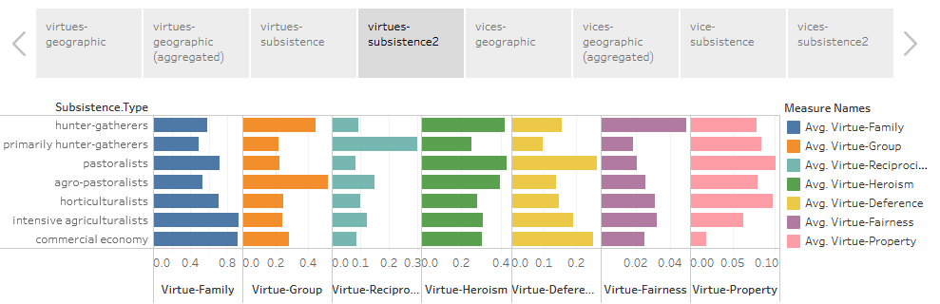
Current and future AI ethics challenges for REBs
Challenging some oft-held ideas about ethics
Universalism – the idea that there is (or should be) one set of ethics that applies to all
Normativity – the idea that ethics is prescriptive and describes attitudes we should have or how we should behave
Cognitivism – the idea that moral principles can be expressed as a series of knowable rules
Virtues and vices around the world
https://public.tableau.com/profile/mark.alfano#!/vizhome/Virtuesandvicesfromtheperspectivesof256cultures/Virtuesandvicesaroundtheworld

Slide 61
Current and future AI ethics challenges for REBs
MetaEthics
What is the basis for ethics?
Types of ethics: descriptive, normative, analytic
Relativism
  Cultural, agent, speaker
  Descriptive, metaethical, normative
Non-cognitivism – “views moral discourse as a way to express attitudes towards certain actions.”
Realism: naturalism and non-naturalism, objectivism
Rational choice vs intuition vs sentiment
  emotivism, prescriptivism, expressivism
Basis (motivation): deity, power, reason, agreement, sentiment

Slide 62
Current and future AI ethics challenges for REBs
Who Owns Ethics
Scientific Virtues
  “scientists invoke theoretical virtues explicitly, albeit rather infrequently, when they talk about models”
Business Ethics
  “real concerns and real-world problems of the vast majority of managers”
Silicon Valley Ethics
  Metcalf, Moss & Boyd: “broader and longer-standing industry commitments to meritocracy, technological solutionism, and market fundamentalism”
https://philpapers.org/archive/MIZTVI.pdf
https://hbr.org/1993/05/whats-the-matter-with-business-ethics
https://datasociety.net/library/owning-ethics-corporate-logics-silicon-valley-and-the-institutionalization-of-ethics/

Slide 63
Thankyou
Digital Privacy and Security program - National Research Council Canada
Programme de vie privée et sécurité numériques - Conseil national de recherches Canada
NRC.DPSec-VPSN.CNRC@nrc-cnrc.gc.ca

