Slide 1
Introduction to Open Pedagogy
Stephen Downes
Maskwacis Cultural College
Microlearning Series
March 8, 2024
https://www.downes.ca/presentation/579

Slide 2
What is Open Pedagogy
Historical context
Definition and key principles of open pedagogy
Why participate in Open Pedagogy
The role of Open Educational Resources (OER)

Slide 3
What is Open Pedagogy
Historical context
The open movement is an informal, worldwide phenomenon characterized by the tendency of individuals and groups to work, collaborate and publish in ways that favour accessibility, sharing, transparency and interoperability. Advocates of openness value the democratization of knowledge construction and dissemination, and are critical of knowledge controlling structures. (Couros) https://www.aupress.ca/app/uploads/120258_99Z_Veletsianos_2016-Emergence_and_Innovation_in_Digital_Learning.pdf
See also:
https://pressbooks.bccampus.ca/teachinginadigitalagev3m/chapter/11-4-open-pedagogy/

Slide 4
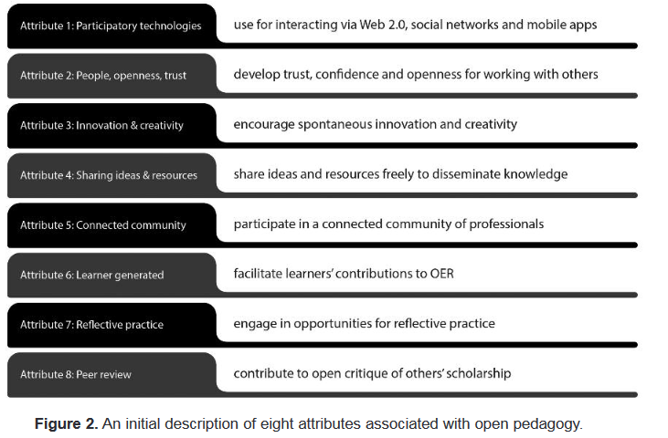
What is Open Pedagogy
Historical context
https://upload.wikimedia.org/wikipedia/commons/c/ca/Ed_Tech_Hegarty_2015_article_attributes_of_open_pedagogy.pdf

Slide 5
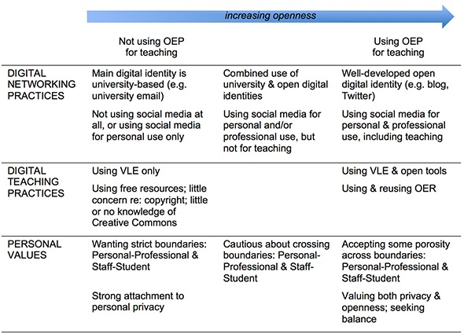
What is Open Pedagogy
Definition and key principles of open pedagogy
  Catherine Cronin – Open Educational Practices
https://www.irrodl.org/index.php/irrodl/article/view/3096/4301

Slide 6
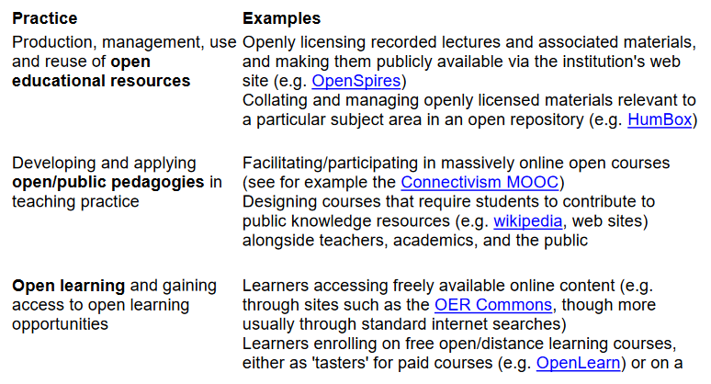
What is Open Pedagogy
Definition and key principles of open pedagogy
  Beetham et al. – Open Educational Practices
https://oersynth.pbworks.com/w/page/51668352/OpenPracticesBriefing

Slide 7
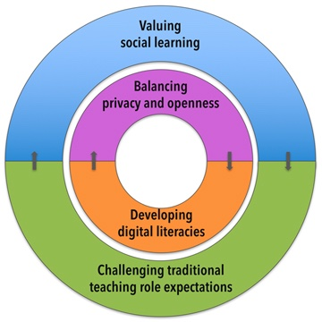
What is Open Pedagogy
Definition and key principles of open pedagogy
  Catherine Cronin – Open Educational Practices
https://www.irrodl.org/index.php/irrodl/article/view/3096/4301

Slide 8
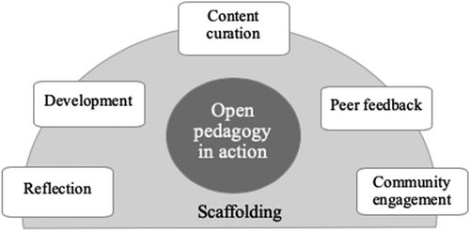
What is Open Pedagogy
Why participate in Open Pedagogy
Greater sense of community involvement
Students can draw upon the unique knowledge they bring
The result is a body of work diverse in language and approach
It allows students to be creative.
It helps students feel like they're being taken seriously.
Students can work with other professionals in the field.
https://libguides.humboldt.edu/c.php?g=1135659&p=8334460
Many more definitions: https://www.slideshare.net/BeckPitt/exploring-international-open-educational-practices?qid=d6132139-ecc1-45c2-a007-36d73b391680&v=&b=&from_search=1
https://www.tandfonline.com/doi/full/10.1080/01587919.2020.1757409

Slide 9
Core Values of Open Pedagogy
The 5 Rs: Respect, Reciprocate, Risk, Reach, and Resist, and how they inform open pedagogical practices
Student agency, creator rights, and community building
Activities to develop the core values

Slide 10
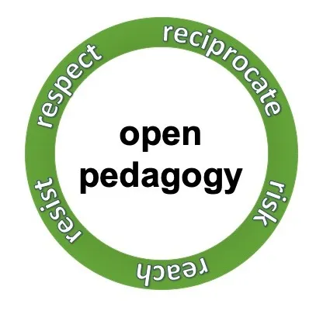
Core Values of Open Pedagogy
The 5 Rs: Respect, Reciprocate, Risk, Reach, and Resist, and how they inform open pedagogical practices
  Respect - agency of students and creators
  Reciprocate - Open pedagogy is about community
  Risk - should not be ignored or glossed over
  Reach - beyond the classroom
  Resist - the commodification of learning
https://rajivjhangiani.com/5rs-for-open-pedagogy/
Also by Rajiv Jhangiani: Beyond free: A social justice vision for open education https://osf.io/9hn56/

Slide 11
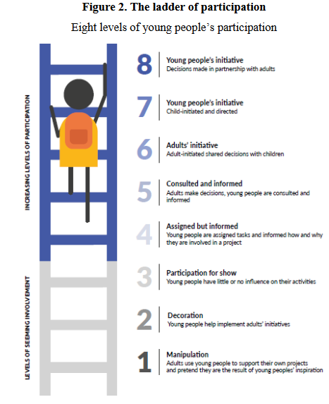
Core Values of Open Pedagogy
Student agency, creator rights, and community building
  Student agency – “students have the ability and the will to positively influence their own lives” https://www.oecd.org/education/2030-project/teaching-and-learning/learning/student-agency/Student_Agency_for_2030_concept_note.pdf
  Student creator rights – includes the choice on whether to be open, and who to be open to https://pressbooks.pub/openpedstudenttoolkit/chapter/student-creator-rights/
  Community – participation and service - https://www.intechopen.com/chapters/83541

Slide 12
Core Values of Open Pedagogy
Student agency, creator rights, and community building = a commitment to:
  Access and equity: reducing barriers that prevent equitable access to education, including economic, technical, social, cultural, and political factors.
  Community and connection: facilitating connections across the boundaries of learning experiences, viewpoints, classrooms, campuses, communities, and countries.
  Agency and ownership: protecting agency and ownership of one’s own learning experiences, choices of expression, and degrees of participation.
  Risk and responsibility: interrogating tools and practices that mediate learning, knowledge building, and sharing that resist the treatment of open as neutral.
Caroline Sinkinson and Amanda McAndrew https://milnepublishing.geneseo.edu/openpedagogyapproaches/chapter/approaching-open-pedagogy-in-community-collaboration/

Slide 13
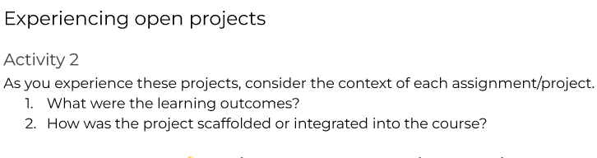
Core Values of Open Pedagogy
Activities to develop the core values – Evolve Guide - https://docs.google.com/document/d/14Ll6R4aj73FZmX8CIS5Hbstt-kWal-Qf140ooTqEMEw/edit#heading=h.b1qv5749hz99
Also: https://guides.lib.uw.edu/oer/openpedagogy
https://pressbooks.lib.jmu.edu/openpedagogy/chapter/evolve-guide/

Slide 14
Open Pedagogy in Practice
Renewable assignments and moving beyond disposable assignments
Student-created OER, including open textbooks and ancillary materials
Collaborative projects such as Wikipedia editing, creating instructional videos, and developing open syllabi

Slide 15
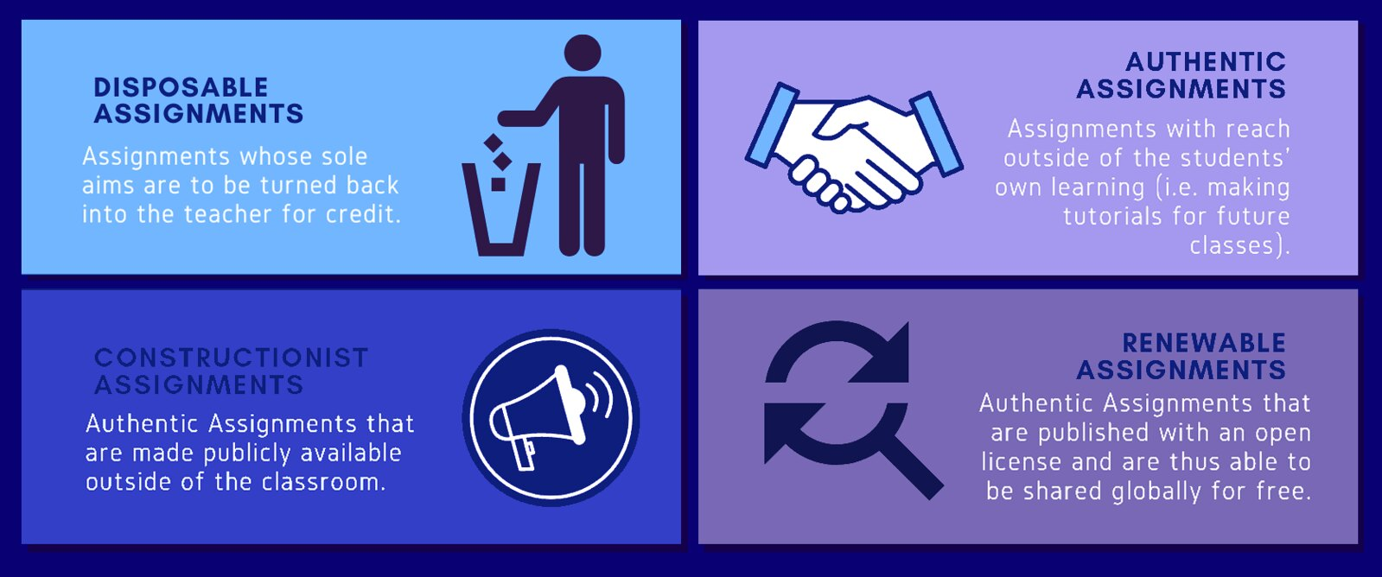
Open Pedagogy in Practice
Renewable assignments and moving beyond disposable assignments
These are assignments that students complain about doing and faculty complain about grading. They’re assignments that add no value to the world – after a student spends three hours creating it, a teacher spends 30 minutes grading it, and then the student throws it away.
https://opencontent.org/blog/archives/2975
https://www.flickr.com/photos/192827808@N02/
Non-Disposable Assignments by Christina Hendricks https://blogs.ubc.ca/chendricks/2015/08/18/non-disposable-assignments-intro-philosophy/

Slide 16
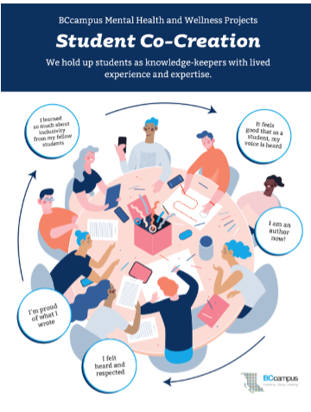
Open Pedagogy in Practice
Student-created OER, including open textbooks and ancillary materials
  A Guide to Making Open Textbooks with Students, Elizabeth Mays (ed) https://press.rebus.community/makingopentextbookswithstudents/
  Co-creating OER: Students Supporting Students https://bccampus.ca/2022/01/12/co-creating-oer-students-supporting-students/

Slide 17

Open Pedagogy in Practice
Collaborative projects such as Wikipedia editing, creating instructional videos, and developing open syllabi
  Hendricks – start with students creating Wikipedia-style articles on a local Wiki first
    Moodle Wiki activity https://docs.moodle.org/403/en/Wiki_activity
    Your first Wiki article https://en.wikipedia.org/wiki/Help:Your_first_article
    Creating content as a learning activity
https://americancultures.berkeley.edu/teaching-with-wikipedia

Slide 18
Challenges and Opportunities
The digital divide and ensuring equitable access to resources
Copyright and open licenses
Openness and respecting Protocol
Encouraging student participation
Privacy and security

Slide 19
Challenges and Opportunities
The digital divide and ensuring equitable access to resources
  “Students in disadvantaged communities still face the challenge of inadequate Internet and technology access (Cullinan et al., 2021). To help alleviate this problem, educators can consider providing physical copies and off-line access to the OER they are using.”
    https://source.sheridancollege.ca/cgi/viewcontent.cgi?article=1025&context=lls_publ
    https://educationaltechnologyjournal.springeropen.com/articles/10.1186/s41239-021-00262-1

Slide 20
Challenges and Opportunities
Copyright and open licenses
  Key questions to consider, eg. Can students in your class project choose whether to openly license their work or not? https://press.rebus.community/makingopentextbookswithstudents/chapter/licensing/
  Guide to Creative Commons licenses https://creativecommons.org/share-your-work/cclicenses/
  Additional considerations – cultural and community resources and knowledge https://www.graygroupintl.com/blog/cultural-rights

Slide 21
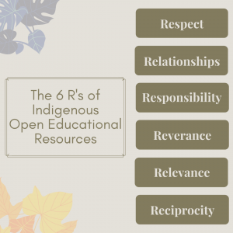
Challenges and Opportunities
Openness and respecting Protocol - Kayla Lar-Son:
  Respect – honour the knowledge sovereignty of Indigenous communities
  Relationships – build with the community to honour their traditions and protocols
  Responsibility – put community practices first and only share when and what we are allowed, and to publish in an ethical way
  Reverence – uphold what is sacred and respect sacred traditions
  Relevance – ensure the project serves the needs of the community
  Reciprocity – give back to the community through projects; don’t just take what you need
https://digitaltattoo.ubc.ca/2021/11/05/sovereignty-and-tradition-indigenous-knowledge-open-educational-resources/

Slide 22
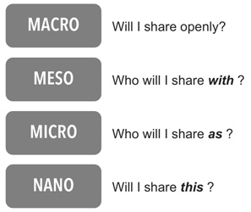
Challenges and Opportunities
Privacy and security
  Considering openness at four levels (Cronin)
https://www.irrodl.org/index.php/irrodl/article/view/3096/4301

Slide 23
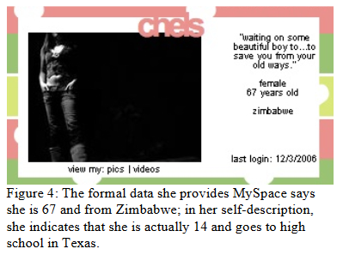
Challenges and Opportunities
Privacy and security
  Context collapse
My mom always uses the excuse about the internet being ‘public’ when she defends herself. It’s not like I do anything to be ashamed of, but a girl needs her privacy. I do online journals so I can communicate with my friends. Not so my mother could catch up on the latest gossip of my life.” – Bly Lauritano-Werner, 17, via danah boyd
https://www.danah.org/papers/WhyYouthHeart.pdf

Slide 24
Implementing Open Pedagogy
Strategies for integrating open pedagogy into existing courses
Building partnerships with librarians and leveraging library resources
Ensuring sustainability and scalability of open pedagogy initiatives
Open Educational Practice Rubric

Slide 25
Implementing Open Pedagogy
Strategies for integrating open pedagogy into existing courses
  10 such strategies https://mlpp.pressbooks.pub/mavlearn/chapter/10-strategies-for-engaging-learners-with-open-pedagogy/
  Tools for Promoting Open Pedagogy https://digscholarship.unco.edu/cgi/viewcontent.cgi?article=1000&context=oer_resources
  Open Pedagogy Notebooks https://openpedagogy.org/textbooks/an-open-companion-to-early-british-literature/

Slide 26

Implementing Open Pedagogy
Building partnerships with librarians and leveraging library resources
  OER Librarian Toolkit - https://acrl.libguides.com/cjcls/oer
To help with things like accessibility, policy development, advocacy, research, etc

Slide 27
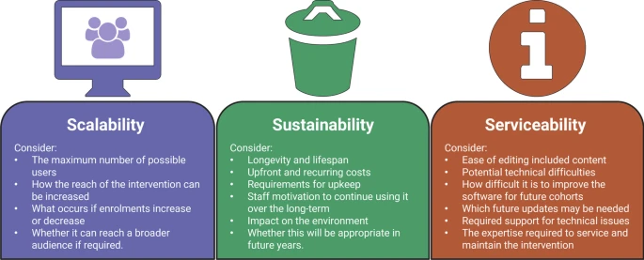
Implementing Open Pedagogy
Ensuring sustainability and scalability of open pedagogy initiatives
  The Triple-S framework
https://educationaltechnologyjournal.springeropen.com/articles/10.1186/s41239-022-00378-y

Slide 28
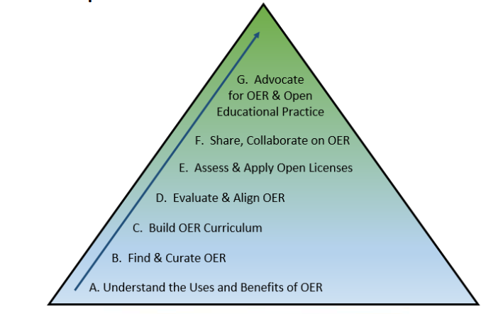
Implementing Open Pedagogy
Open Educational Practice Rubric
  ISKME’s rubric - https://oercommons.org/authoring/20997-iskme-s-open-educational-practice-rubric/view
https://qspace.library.queensu.ca/server/api/core/bitstreams/67c6e1b5-f7e9-43a4-8a1f-6632cc2e216b/content

Slide 29
Reflection and Discussion
The impact of open pedagogy on student learning and engagement
The importance of empathy in open pedagogy
Potential for open pedagogy to transform higher education and foster a culture of sharing and collaboration
Useful resources and platforms for exploring open pedagogy further
https://guides.lib.uw.edu/oer/openpedagogy

Slide 30
Reflection and Discussion
The impact of open pedagogy on student learning and engagement
  Gráinne Conole and Mark Brown - https://files.eric.ed.gov/fulltext/EJ1197527.pdf
    Discovery – This is the creation of new knowledge in a specific area or discipline.
    Integration – making connections across the disciplines
    Application –engagement with the wider world outside academia
    Teaching – becomes consequential only as it is understood by others

Slide 31

Reflection and Discussion
The importance of empathy in open pedagogy
  Jesse Stommel - https://www.jessestommel.com/dear-student/
  Pedagogy of Care – Maha Bali - https://hybridpedagogy.org/pedagogy-of-care-gone-massive/
  Nel Noddings –“Caring teachers listen to [learners] and help them to acquire the knowledge and attitudes needed to achieve their goals, not those of a pre-established curriculum.” https://infed.org/caring-in-education/

Slide 32
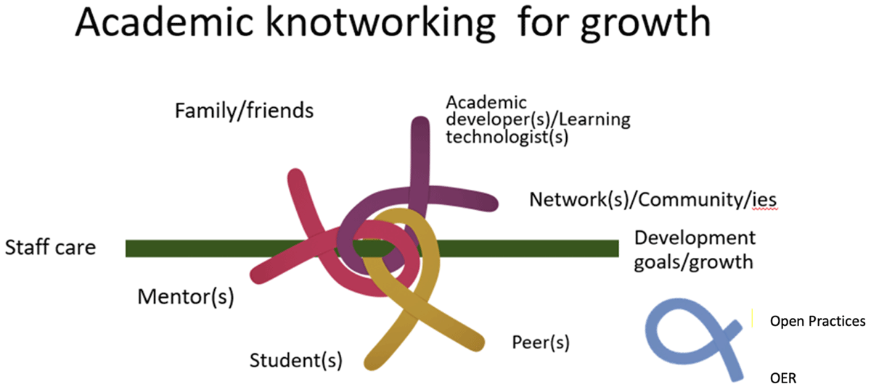
Reflection and Discussion
Potential for open pedagogy to transform higher education and foster a culture of sharing and collaboration
  E.g. in mentoring - https://openpraxis.org/articles/10.55982/openpraxis.15.4.595

Slide 33
Reflection and Discussion
Potential for open pedagogy to transform higher education and foster a culture of sharing and collaboration
  E.g. in Equity, Diversity and Inclusion in the classroom - https://source.sheridancollege.ca/cgi/viewcontent.cgi?article=1025&context=lls_publ

Slide 34
Thanks!
  Stephen Downes
  https://www.downes.ca

