Slide 1


Three Frameworks for Data Literacy
Stephen Downes
CELDA 20203
Madeira, October 21, 2023

Slide 2
Data Literacy
Data literacy is:
the ability to collect, manage, evaluate, and apply data, in a critical manner;
It includes the skills necessary to discover and access data, manipulate data, evaluate data quality, conduct analysis using data, interpret results of analyses, and understand the ethics of using data
a relatively new field of study, dating only from the 2010s

Slide 3
Three Frameworks
Data literacy education across three frameworks:
the competency model defining data literacy,
the assessment of data literacy competencies, and
methods for the development of data literacy in an organization.

Slide 4
Literacy
‘learning’ a ‘literacy’ involves more than learning about the components of that literacy,
and that there is an element of ‘being literate’, which is intended as an outcome of that learning.
To be literate is to:
embody a set of skills and competencies typically thought to define that literacy,
as reflected in an assessment of that literacy, and
which in turn informs the teaching of that literacy.
The study of data literacy limited
This paper seeks to fill that gap

Slide 5
Methodology
A formal review from Canada’s National Science Library for publications related to the definition, application and development of data literacy; a wider search using the same parameters was undertaken using Google Scholar.
Approximately 150 results were obtained:
from which 20 items were found to contain an identifiable data literacy model
and three major assessment frameworks were identified
A small number of highly specific data literacy development models were also identified.
The design framework employed draw from previous work by the author on connectivist massive open online courses (cMOOC)

Slide 6
Themes
Themes emerge from the discussion of data literacy over the last decade:
data literacy as a set of skills or competencies;
the idea of deriving meaningful information from data;
the data lifecycle or data workflow;
complexity of skills for differing roles;
data literacy as individual and corporate capacities.

Slide 7

1. The competency model defining data literacy

Slide 8
Data Literacy as Competency Model
Competencies:
“a set of basic knowledge, skills, abilities, and other characteristics that enable people at work to efficiently and successfully accomplish their job tasks.”
Following Oberländer, et al. (2020) we use the term ‘competencies’ here to draw on a well-established concept that includes knowledge, skills, abilities, and other characteristics (KSAO).
The concept of competencies also includes the requirement of evidence for competencies.

Slide 9
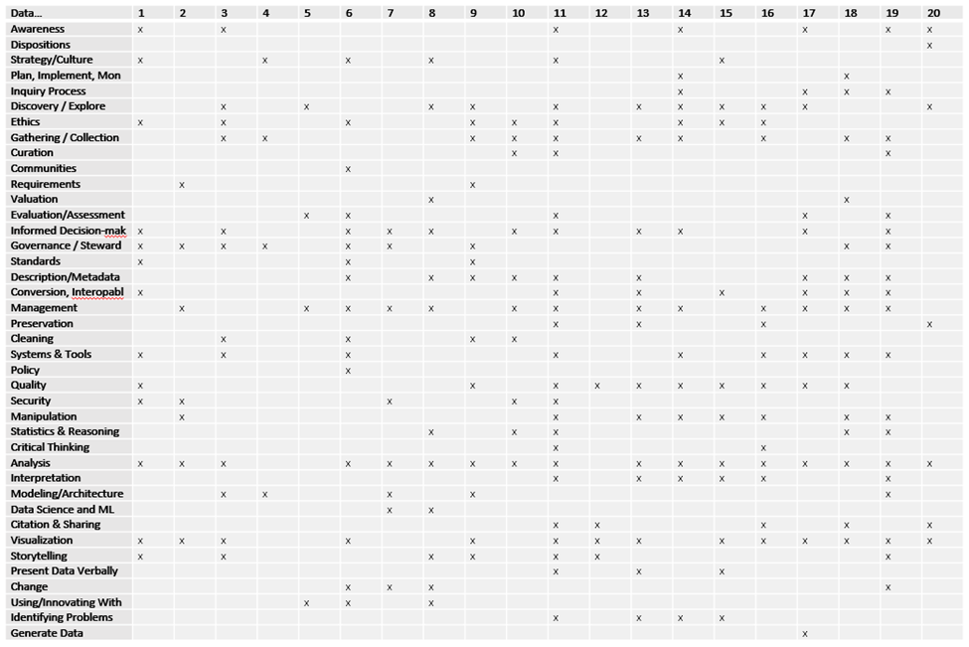
Analysis

Slide 10
Data Literacy Models
The list of competencies identified also makes it clear that data literacy does not fall into any single category described above.
Most work in data literacy falls into one of several models or interpretations.
“They each have a different focus which tends to reflect the context in which it was derived. They also have a different level of granularity, not just between the definitions, but also within them” (Wolff, et al., 2016).
Schield (2004) describes these as ‘perspectives’, for example, the ‘critical thinking’ perspective and the ‘social science data’ perspective:

Slide 11
Data Literacy Models
Data Stewardship Model: This model describes approaches to data literacy that emphasize data acquisition, curation, quality and deployment. A prototypical example of this approach is the Statistics Canada descriptions of data quality and the data journey (Statistics Canada, 2020).

Slide 12
Analysis and Decision-Making Model
This model is focused mostly on the use of data to support analytics and decision-making, for example, the collection of approaches taken by members of the Data Literacy Project, including Qlik (a data analytics company), Accenture, Cognizant, Experian, Pluralsight, the Chartered Institute of Marketing, and Data to the People.

Slide 13
Information Literacy Model
“According to Hunt (2004), data literacy education should borrow heavily from information literacy education, even if the domain of data literacy is more fragmented than the field of information literacy.“ (Koltay, 2016). Similarly, Maybee & Zilinski (2016) write, “The emerging construct of data literacy has typically been closely related to information literacy.”

Slide 14
Science and Research Data Literacy Model
This model of data literacy emphasizes aspects of data related to computer science, mathematics and statistics. It defines a set of data skills including data awareness, forms of statistical representation, the ability to analyze, interpret and evaluate statistical information, and communication of statistical information (Australian Bureau of Statistics, 2010).

Slide 15
Social Engagement Model
This model distinguishes between the need for everyday uses of data from the deeper requirements of data science. It is only really articulated in a single source (Rahul Bhargava, et. al., 2015), though it has its origins in a broader definition of literacy, as exemplified by Robinson (2005), who talks of literacy as enabling individuals to achieve their goals, to develop their knowledge and potential, and to participate fully in their community and wider society” (p. 13).

Slide 16
Data Workflow
makes it clear that data literacy involves much more than ‘reading’ and ‘writing’ with data and includes but not limited to:
the framing of the problem or context of use;
the data set itself
application, and
testing.
For example, machine learning engineering describes the construction and use of these three elements: data engineering; model engineering; and deployment,

Slide 17
Individual and Group Competencies
Data literacy is a concept that can be applied equally to both individuals and organizations
both the description of data literacy as well as the assessment of data literacy will vary in the given context

Slide 18

2. The assessment of data literacy competencies

Slide 19
Proposal
Single-factor measure of data literacy ‘levels’ insufficient to account for
the variability in both the set of data literacy competencies
the varying degree to which each competency is required in different job functions or roles.
Accordingly, a role-defined data literacy model is proposed. This model illustrates the calculation of a role-defined data literacy profile, as well as the process used to create actual competency profiles.

Slide 20
Assessment Programs
We analyzed major skills and data literacy assessment programs, including the following:
OECD Programme for the International Assessment of Adult Competencies (PIAAC) literacy (Kirsch & Thorn, 2016, 2.2.1.3)
Endorsed by the American Statistical Association, the Guidelines for Assessment and Instruction in Statistics Education (GAISE) (GAISE, 2016, 8).
Eckerson Group data literacy assessment including assessment not only of individual data literacy but also of the organization (Wells, 2021).

Slide 21
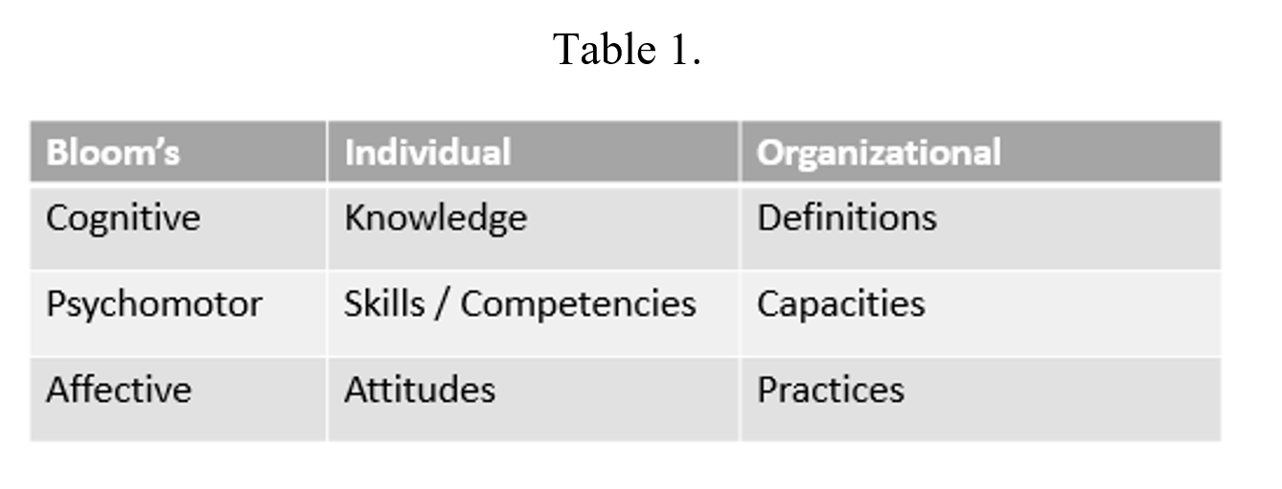
An Assessment Model
We obtained an unstructured list of competencies
No consistency whatsoever in the categorization scheme from study to study.
What is offered here is a model based on a slightly modified full list of competencies
For the sake of consistency with much of the work done previously a slightly modified version of Bloom’s taxonomy is used (Bloom, 1956).

Slide 22
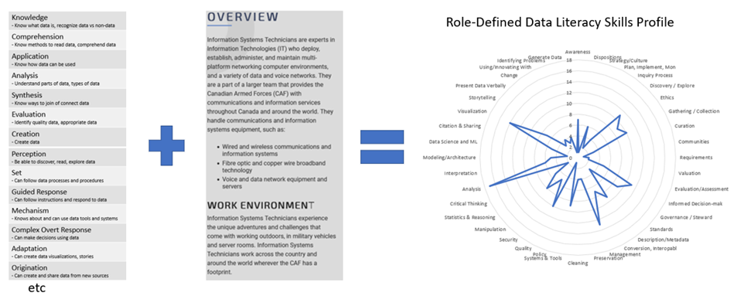
Role-Defined Dta Literacy

Slide 23
Competency Profiles
The same process may be used to create actual competency profiles for each individual evaluated, by employing test results or actual communications generated by the person in question (such a process would be subject to ethical and privacy considerations).
A similar process may be used to generate organizational level competency profiles.

Slide 24

3. Methods for the development of data literacy in an organization

Slide 25
Where Data Literacy Fits
Data literacy seems to fall within two extremes:
among other types of information and communication competencies, such as digital literacy or information management programs
as a first step in the development of higher-level competencies such as data architect or information management
Either approach envisions a large-scale and complex learning initiative.
But it need be neither, provided we think of data literacy not such as knowledge or content to be used, but rather, as a part of other processes and strategies employed to achieve real objectives or outcomes.

Slide 26
Data Literacy Roadmaps
Numerous data literacy program development roadmaps provided by commercial consultants:
The Data Information Literacy project - four-step methodology of planning, development, implementation, and assessment’ (Carlson & Johnston, 2015).
QuantHub - a series of ‘foundational steps’ to develop a data literacy vision and roadmap; and an iterative process of assessment, planning, learning and practice (Cowell, 2020).
Dave Wells of Eckerson Group - organizational data literacy is not merely a sum of individual data literacies but requires in addition factors such as tools and systems, incentives and motivators.
Gartner - a three-phase methodology for the development of an institutional program (Panetta, 2021) consisting of assessment, data literacy training, and then evaluation of the outcome.

Slide 27
More Initiatives
Data Literacy Project - “a transdisciplinary examination of existing strategies and best practices for teaching data literacy, synthesizing documented explicit knowledge using a narrative-synthesis methodology and identifying areas where additional research is needed.” (DataLiteracy.ca, Internet Archive, 2021).
Conducted online between January and March 2022, the EDUCAUSE Data Literacy Institute consisted of a series of eight synchronous online meeting to discuss resources, activities, and projects in support of seven key data literacy competency areas (Kleitz & Shelly, 2022).

Slide 28
Teaching and Learning Methods
Datastorming - craft abstract data into hands-on design materials in the form of cards.” (Lim, et al., 2021)
Simulations and Interactive Technologies - a data visualization and modeling tool developed (Biehler, et al.,2016)
Case-Based Teaching Method - discuss complex, real‐life scenarios (Riddle, et al., 2017).
Utilising affordances in real-world data - use real-world data from the perspective of the affordances in the data presentation (Chick & Pierce, 2012).
Data-Driven Decision-Making - team-based approach combines a number of competency requirements in a single activity (Abbott, et al., 2015)

Slide 29
Data Literacy MOOC
Connectivist MOOC was employed because
structured as a graph of connected people, resources, and concepts, in other words, much more like a collection of data.
a data-based MOOC (dMOOC) organizes content and resources in a structure suggested by the literature being studied in the course
The next slide is a sample of the structure used in a similar dMOOC on ethics and analytics (ethics.mooc.ca)

Slide 30
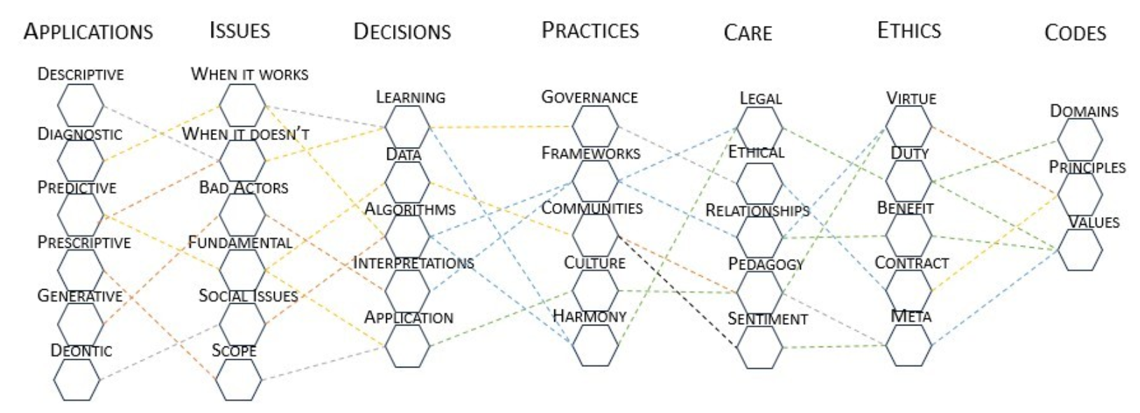
Sample dMOOC

Slide 31
Student Activities in a dMOOC
Less of learning and remembering content and more of working with relevant data, and specifically:
Classifying and labeling major sets and subsets of data
Identifying and labeling specific instances of data subjects (for example: an article describing ‘care’ as a legal concept)
Identifying and labeling relations between sets and subsets of data, either view argument threds in extant literature, or through data analytics of relevant bodies of literature
Assessing the resulting data model, identifying significant threads, and interpreting the resulting model

Slide 32
Participation in a dMOOC
Does not involve individual study and retention of a pre-defined body of knowledge
It requires working with others in order to develop not only individual capacities and skills, but also social or community capacities and skills.
These typically resist definition prior to the course
the consequence of such social interaction and application of a skill or practice is often the development of knew knowledge, approaches, and competencies.

Slide 33
What We Have Learned
There is no single or simple definition of data literacy.
But it is not yet taught that way.
We recommend developing and piloting non-hierarchal cooperative learning environments, such as the cMOOC, for the development of organizational and social competencies required for data literacy.
That said, these are assertions that need to be empirically tested before being widely adopted and applied.
This paper offers the conceptual framework within which such assertions may be tested, but does not itself constitute a test of them

Slide 34


Epilogue
This is a Picasso in the Funchal City Hall and that will later hang in my home
Data doesn’t have to be rows and columns of text
Learning how to work with anything, really, is learning how to work with data

