Slide 1

Introduction to Social Constructivism
Stephen Downes
November 16, 2023
Maskwacis Cultural College Online Microlearning Series
https://www.downes.ca/presentation/576

Slide 2


Constructivism
Individuals or learners do not acquire knowledge and understanding by passively perceiving it within a direct process of knowledge transmission
encode
decode
“cat”
transmission

Slide 3
Constructivism
Instead, they construct new understanding and knowledge through experience and social discourse
model
experience
construct

Slide 4


Constructivism
New knowledge is integrated into what is already known and thereby extended
model
experience
construct

Slide 5
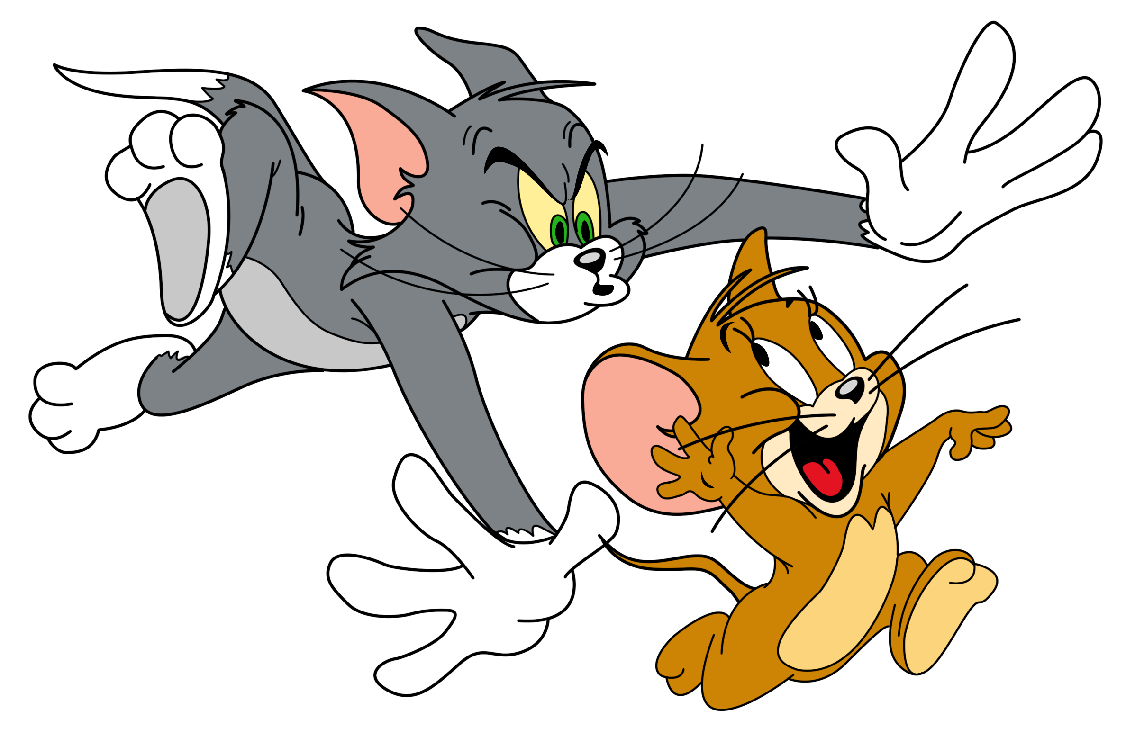

Constructivism
How new knowledge is integrated is a matter of interpretation
interpretation
Or?

Slide 6

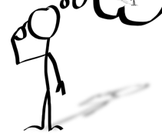
Social Constructivism
Human development is socially situated, and knowledge is constructed through interaction with others.
social construction
interaction

Slide 7

Social Constructivism
People work together to actively construct artifacts that represent or stand for the socially constructed models
model
artifacts
interaction
‘cat’
‘mouse’
representation

Slide 8
Social Constructivism
Social constructivism focuses on the artifacts (constructs) that are created through social interactions
model
artifacts
interaction
‘cat’
‘mouse’
representation

Slide 9
Social Constructionism
Social constructionism focuses on the artifacts (constructs) that are created through social interactions
model
artifacts
interaction
‘cat’
‘mouse’
representation

Slide 10
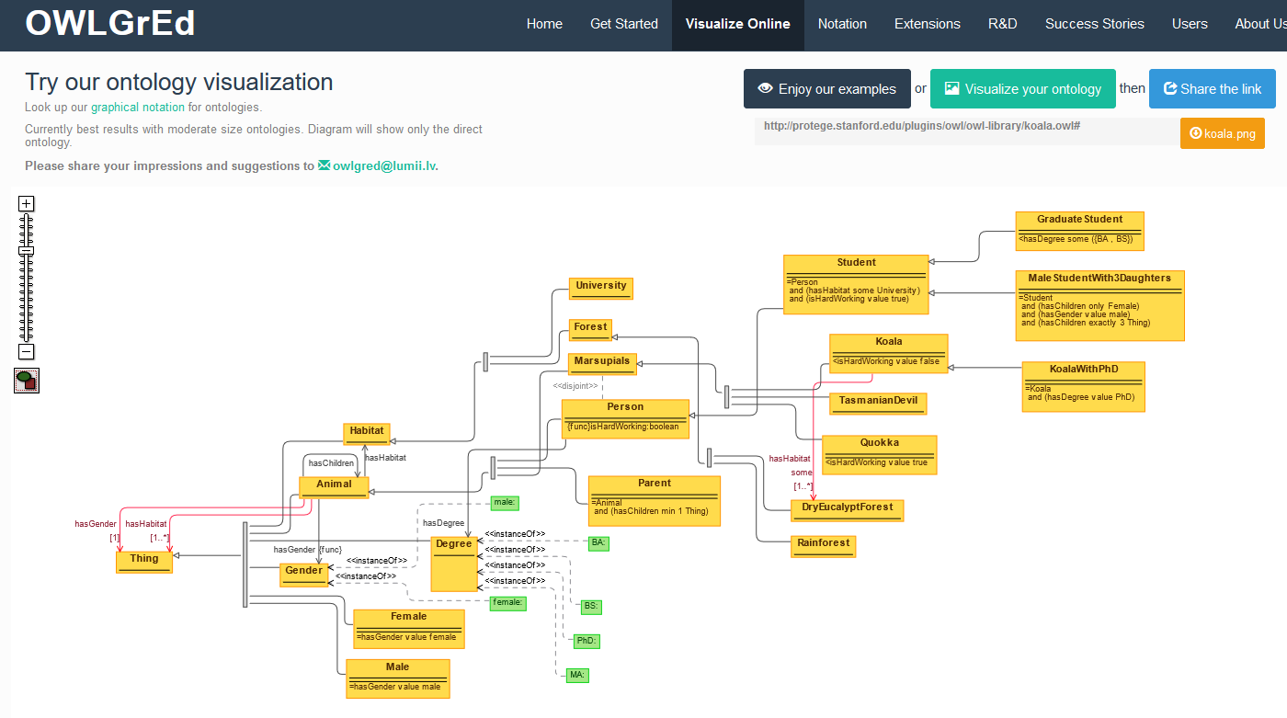
Building an Ontology
http://owlgred.lumii.lv/online_visualization

Slide 11
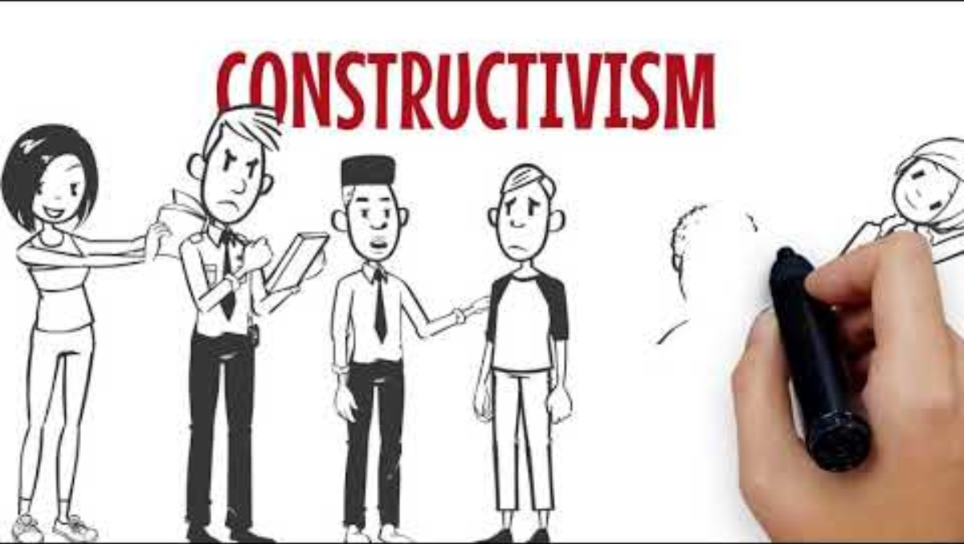
Constructivism and Reality

Slide 12

Constructivism and Reality
There is no inherent contradiction between constructivism and realism

Slide 13
Constructivism and Reality
The Logicist Perspective
There are objective principles of fact and reason, for example, mathematics and logic
Kant: necessary a priori and the philosophy of rationality
Chomsky: syntactic structures and the philosophy of language
Stages of development and transformations: Piaget

Slide 14
Constructivism and Reality
The Scientific Perspective
Science is a social process that subjects models (composed of theory and observation) to testing and confirmation
Popper and the logic of falsification
Van Fraassen and constructive empiricism

Slide 15
Radical Constructivism
Even if there is an objective reality, it is beyond our reach.

Slide 16
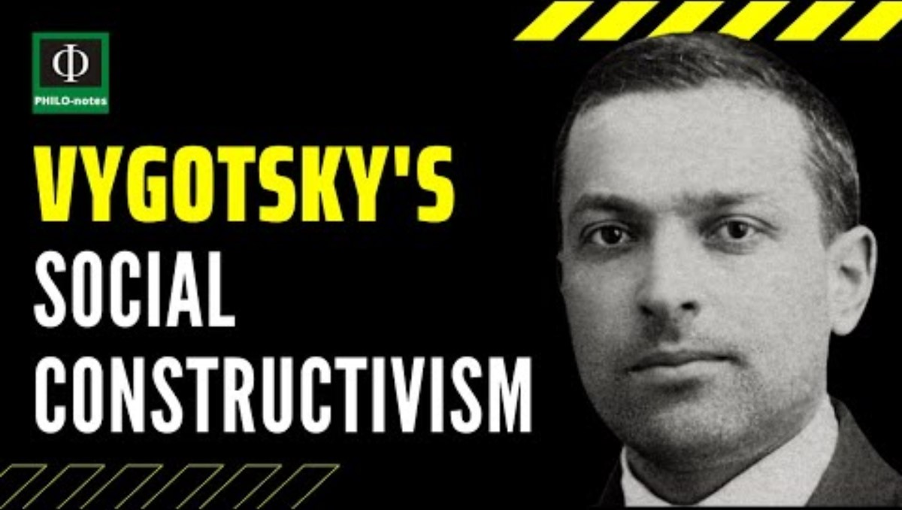
Social Cultural Learning

Slide 17
Two Views of Theory
Critique of Traditional Theory
The natural sciences attempt to descriptively mirror a given set of facts or establish law-like generalizations
However, traditional theories fail to analyze the broader social context in which they are embedded
Quoted from https://plato.stanford.edu/entries/critical-theory/#CritTheoVersTradTheo

Slide 18
Two Views of Theory
Critical Theory
Reflects on the context of its own origins and aims to be a transformative force within that context.
Aims to find insights into the forces of domination operating within society in a way that can inform practical action and stimulate change
Quoted from https://plato.stanford.edu/entries/critical-theory/#CritTheoVersTradTheo

Slide 19
Constructivism and the Classroom
Teachers are not instructors so much as facilitators
Need to learn about students in order to facilitate experiences
Shared authority and responsibility for learning
Focus on interaction, especially in small groups

Slide 20
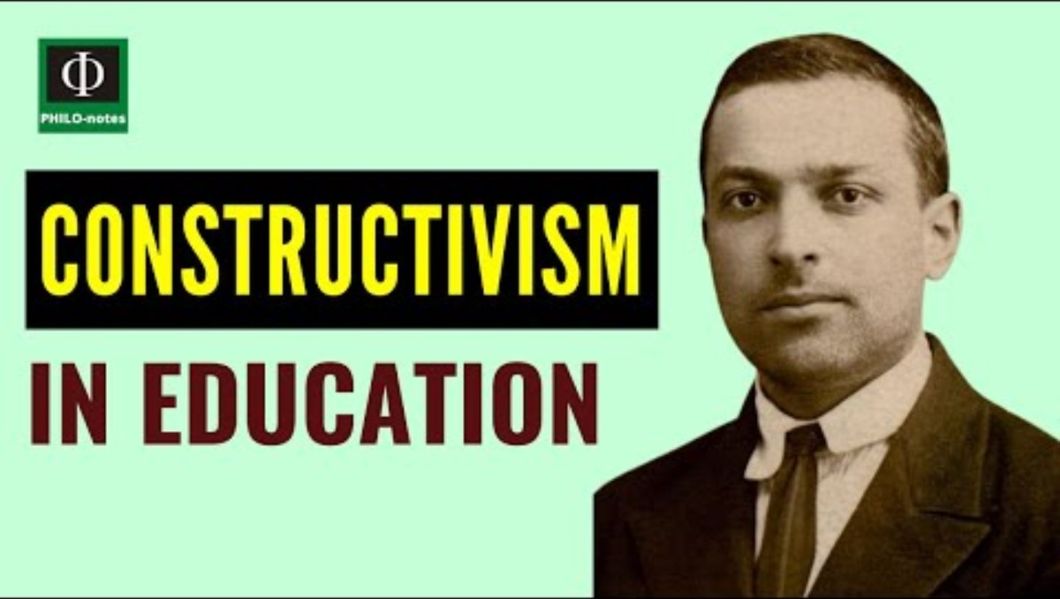
Constructivism and the Classroom

Slide 21
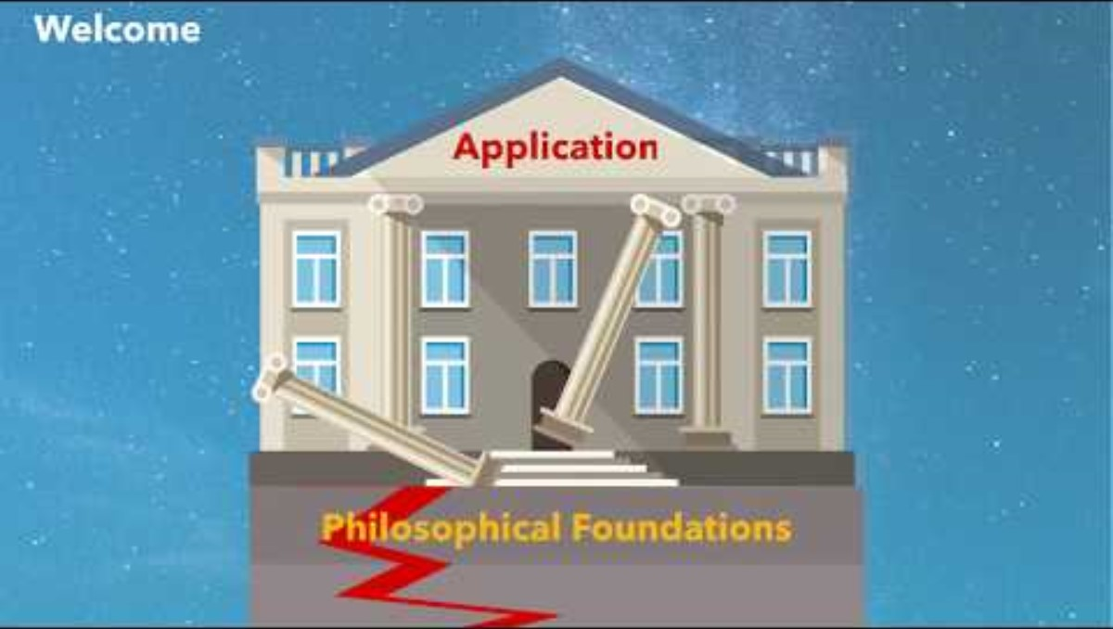
Criticisms of Constructivism

Slide 22
Constructivism Redux
Do our experiences tell us how or why something works?
Knowledge can’t be transmitted through language?
The potential for novices to uncritically digest false knowledge?
The assumption that truth will prevail is especially dubious in constructivist classrooms?

Slide 23
Constructivism and Learning Redux
Is all knowledge is subjective we can’t differentiate between science and pseudoscience?
The problem of peer pressure
The phenomenon of cognitive load

Slide 24

Stephen Downes
https://www.downes.ca

