Slide 1


Introduction to AI Policies, Guidelines, and Frameworks
Stephen Downes
November 16, 2023
Maskwacis Cultural College Online Microlearning Series
https://www.downes.ca/presentation/575

Slide 2
Introduction
This workshop will look at recent policies, guidelines and frameworks developed by governments and institutions for the ethical and responsible use of artificial intelligence.
How are they created, and what things do they address?
You will have the opportunity to identify important values and principles in order to develop a starting point for discussion relevant to your own context.

Slide 3

The Question
Artificial Intelligence (AI) is a new type of technology that offers many potential benefits but comes with unknown risks.
How do we as a society govern ourselves with regard to the creation and use of this technology?
Governments, industry and societies have been grappling with this question.

Slide 4
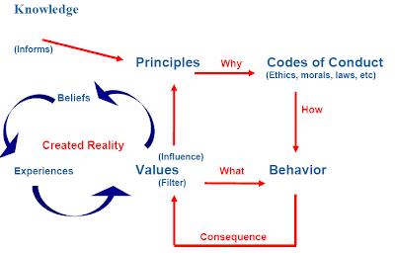
https://www.mvf-knowledge-base.com/2011/12/whats-difference-between-values-ethics.html

Slide 5
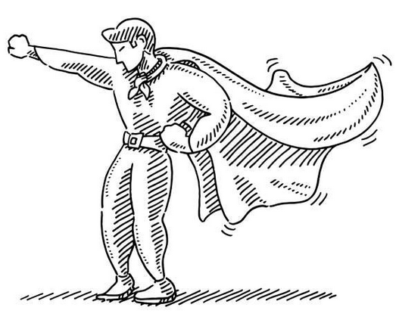
Approaches to Ethics
Virtue and character – “Be all that you can be”
Duty – “with great power comes great responsibility”
Consequentialism - ranging from “do no harm” to “the ends justify the means”.
Social contract – “We the people, in order to form a more perfect union…”
https://ethics.mooc.ca/cgi-bin/page.cgi?module=9

Slide 6
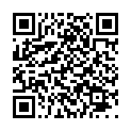
What Are Your Values?
Scan the QR code to the left or go to the following URL (probably works much better on a wider screen)
Enter your votes for the first ‘election’ (we’ll do the next two later in the session).
http://www.downes.ca/post/75794/rd

Slide 7

An Ethical Codes Reader
Survey of 70 ethical codes of conduct in professions dealing with knowledge and technology
Brief summary of each code
Link to the code web page
Text of relevant sections of the code
https://docs.google.com/document/d/1mv9VxbIyGvBaFwHSvtyN1a3iwAKws6SZDGuDTlYMZ48/edit#heading=h.roink2k5jm7f
Image: https://www.aje.com/services/research-promotion/

Slide 8
Some Major Statements
House of Lords Select Committee on AI
It would be better to focus on “the consequences of AI, rather than on the way it works”, in a way that empowered individuals to exercise their rights (para 51).
Four of the five principles in fact represent a consequentialist approach, however one principle states that AI “should operate on principles of intelligibility and fairness” (para 417).
https://publications.parliament.uk/pa/ld201719/ldselect/ldai/100/100.pdf

Slide 9
Some Major Statements
US Whitehouse - Blueprint for an AI Bill of Rights
Safe and Effective Systems
Algorithmic Discrimination Protections
Data Privacy
Notice and Explanation
Human Alternatives, Consideration, and Fallback
https://www.whitehouse.gov/ostp/ai-bill-of-rights/

Slide 10
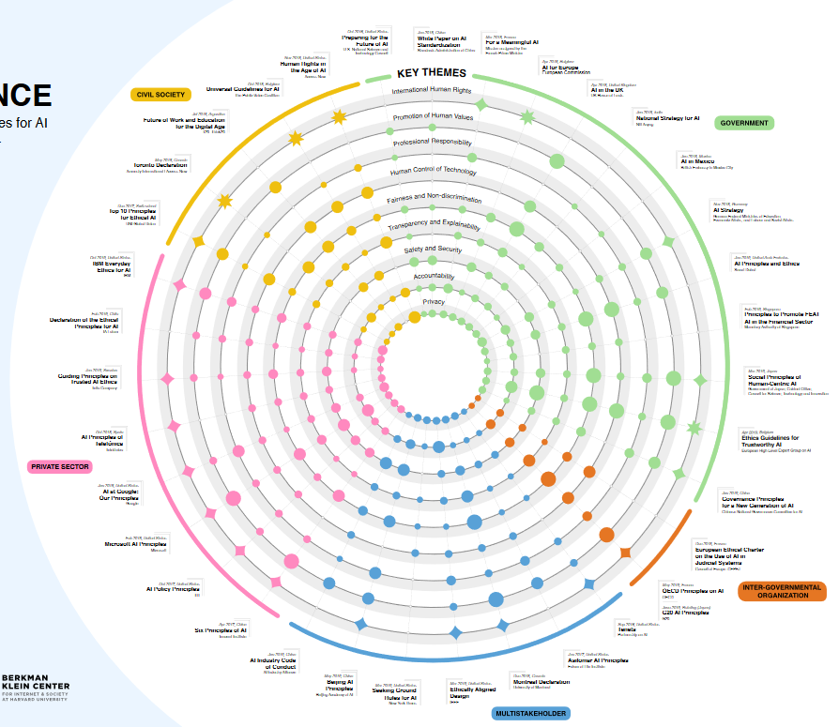
Some Major Statements
Harvard – Fjeld, et al. – Principled Artificial Intelligence
Mapping Consensus in Ethical and Rights-Based Approaches to Principles for AI
  Privacy
  Accountability
  Safety and Security
  Transparency and Explainability
  Fairness and Nondiscrimination
  Human Control of Technology
  Professional Responsibility
  Promotion of Human Values
https://papers.ssrn.com/sol3/papers.cfm?abstract_id=3518482

Slide 11
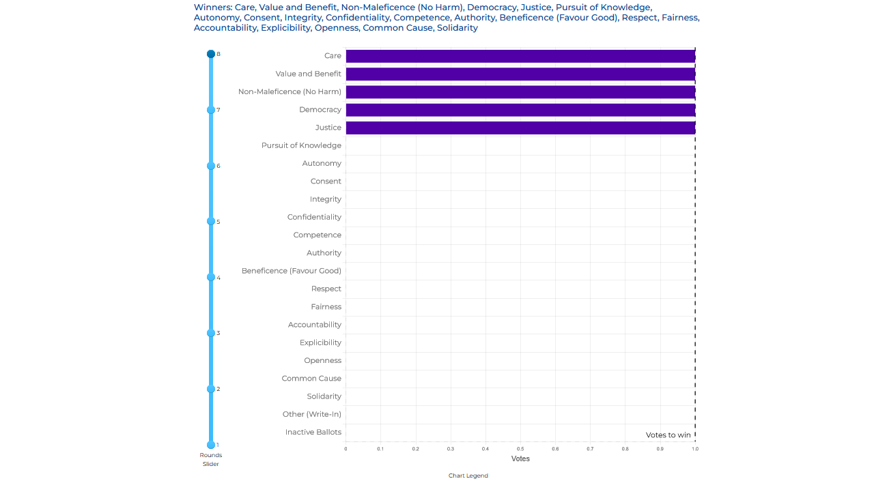
Is There a Consensus?

Slide 12
Who Are We Responsible To?
Scan the QR code to the left or go to the following URL (probably works much better on a wider screen)
Enter your votes for the second ‘election’ (we’ll do the third later in the session).
http://www.downes.ca/post/75794/rd

Slide 13
Some Major Statements
TBC Canada - Directive on Automated Decision-Making
Algorithmic Impact Assessment
Transparency
Quality Assurance
Recourse
Reporting
Testing and monitoring outcomes
Data quality
Data governance
Peer review
Gender-based analysis Plus
Employee Training
IT and business continuity management
Security
Legal
Ensuring human intervention
https://www.tbs-sct.canada.ca/pol/doc-eng.aspx?id=32592

Slide 14
Some Major Statements
Amnesty - Equality and Non-discrimination
Using the framework of international human rights law
The right to equality and non-discrimination
Preventing discrimination
Protecting the rights of all individuals and groups: promoting diversity and inclusion
Duties of states: human rights obligations
Identify risks
Ensure transparency and accountability
Enforce oversight
https://www.accessnow.org/wp-content/uploads/2018/08/The-Toronto-Declaration_ENG_08-2018.pdf

Slide 15
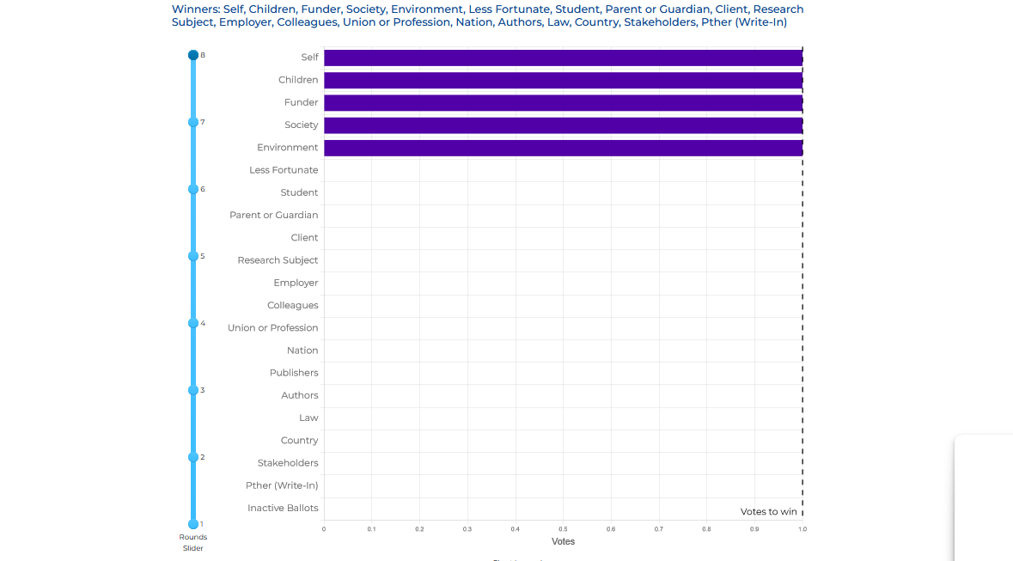
Who Matters?

Slide 16
Foundational Principles
Scan the QR code to the left or go to the following URL (probably works much better on a wider screen)
Enter your votes for the third ‘election’
http://www.downes.ca/post/75794/rd

Slide 17
Some Major Statements
Canada - Guide on the use of Generative AI
FASTER Principles:
Fair: do not include or amplify biases, comply with human rights, accessibility, and procedural and substantive fairness obligations
Accountable: making sure it is factual, legal, ethical, and compliant with the terms of use
Secure: security classification of the information, that privacy and personal information are protected
Transparent: identify content that has been produced using generative AI and notify users
Educated: learn about the strengths, limitations and responsible use of the tools
Relevant: identify appropriate tools for the task; AI tools aren’t the best choice in every situation
https://www.canada.ca/en/government/system/digital-government/digital-government-innovations/responsible-use-ai/guide-use-generative-ai.html

Slide 18
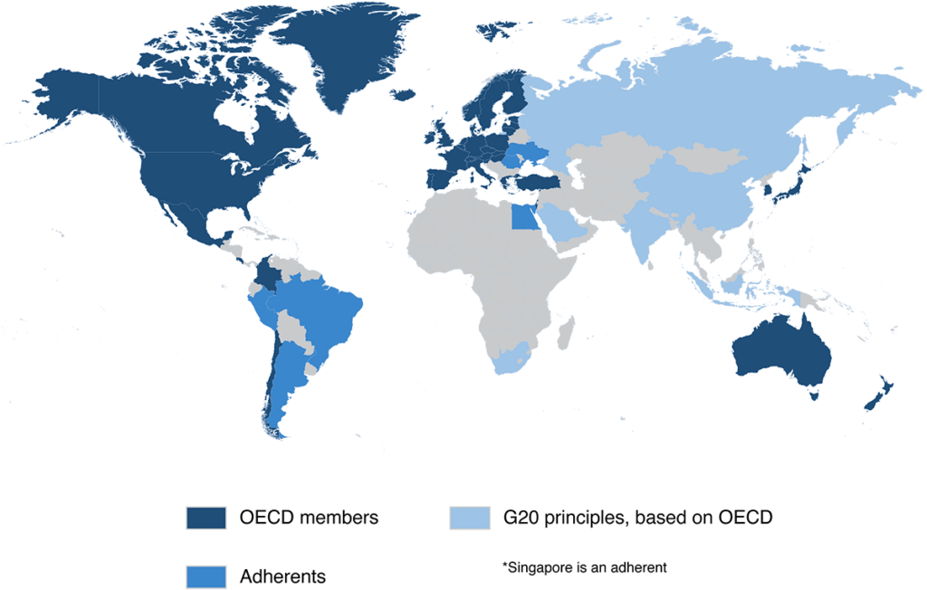
Some Major Statements
OECD AI Principles overview
Inclusive growth, sustainable development and well-being
Human-centred values and fairness
Transparency and explainability
Robustness, security and safety
Accountability
https://oecd.ai/en/ai-principles

Slide 19
Some Major Statements
University of Helsinki – AI Ethics MOOC
The five principles of AI ethics answer different questions and focus on different values:
Should we use AI for good and not for causing harm? (the principle of beneficence/ non-maleficence)
Who should be blamed when AI causes harm? (the principle of accountability)
Should we understand what, and why AI does whatever it does? (the principle of transparency)
Should AI be fair or non-discriminative? (the principle of fairness)
Should AI respect and promote human rights? (the principle of respecting basic human rights)
https://ethics-of-ai.mooc.fi/

Slide 20
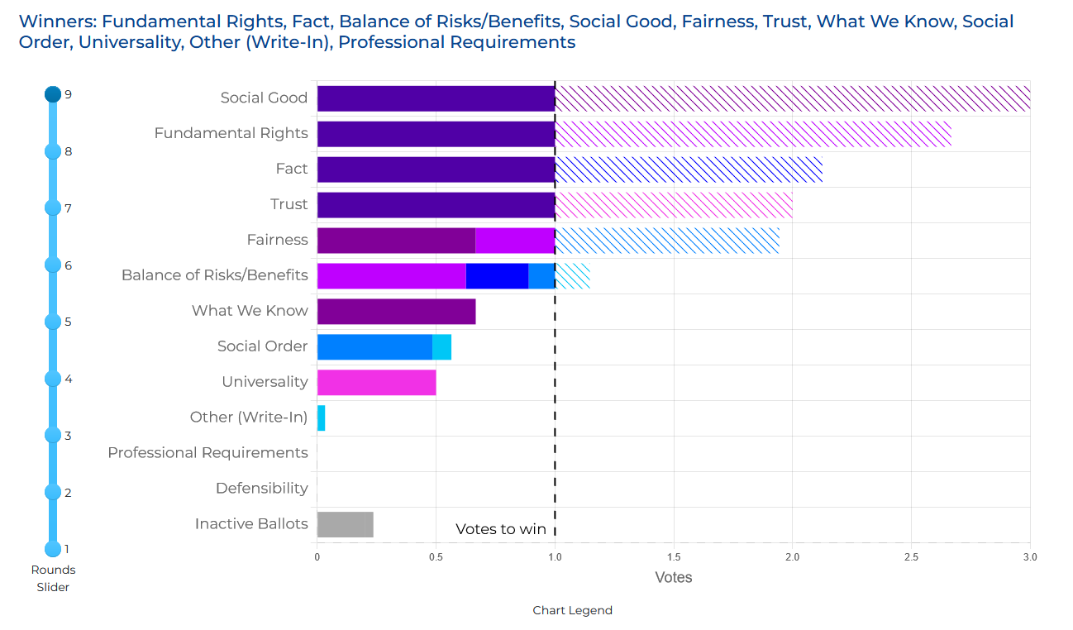
What Matters?

Slide 21
Your Questions
Some more resources:
https://bryanalexander.org/classes-and-teaching/what-should-my-grad-students-read-about-emerging-ai/

Slide 22

Stephen Downes
https://www.downes.ca

