Slide 1
Digital Transformations
Why Do
Fail?

Slide 2


Not authored by any AI
Designed using the Microsoft ‘Baby Shower Slide Show’ theme
https://www.downes.ca/presentation/571
Written and Presented by
Stephen Downes
for
CNIE 2023, May 25, 2023

Slide 3
New Technology
Help us welcome
to the world

Slide 4
What could go wrong?
Help us welcome
to the world

Slide 5
The Question
Why do digital transformations fail?
Accenture: “Digital transformation is the process by which companies embed technologies across their businesses to drive fundamental change.”
IBM: “Digital transformation means adopting digital-first customer, business partner and employee experiences.”
Wikipedia: “Digital transformation is the adoption of digital technology by an organization to digitize non-digital products, services or operations.”
Gartner: “Digital transformation can refer to anything from IT modernization (for example, cloud computing), to digital optimization, to the invention of new digital business models.”
Notes:
https://www.accenture.com/ca-en/insights/digital-transformation-index
https://www.ibm.com/topics/digital-transformation
https://en.wikipedia.org/wiki/Digital_transformation

Slide 6


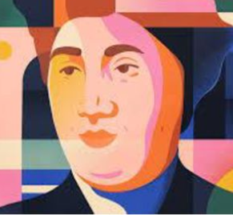

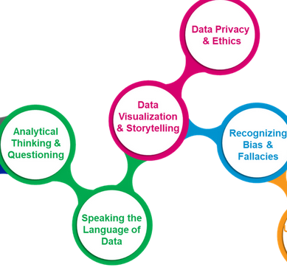

How We Got Here
Web3
AI Ethics
Data Literacy
el30.mooc.ca
ethics.mooc.ca
data.mooc.ca
Lurking in the Background…

Slide 7



How We Got Here
Tech Guide
Fediverse
Barriers
bit.ly/quicktechguide
downes.ca/presentation/566
drdc-rddc.gc.ca
This Past Year or So…

Slide 8
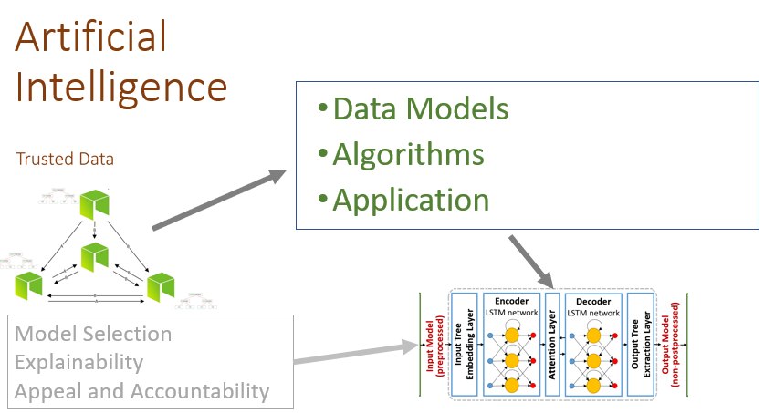
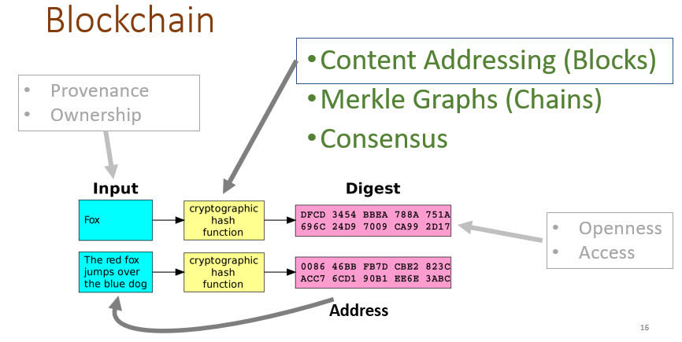
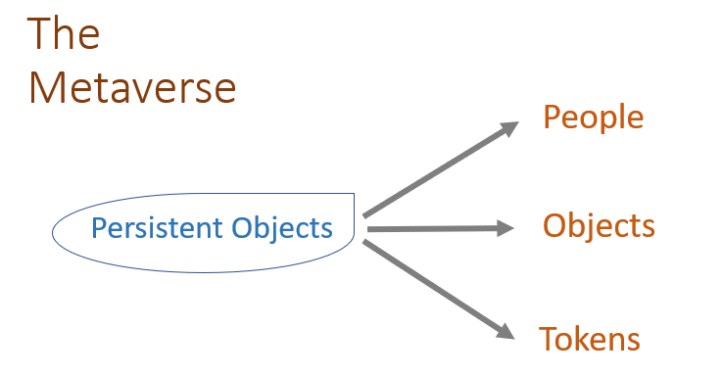
what the new tech does
Notes:
https://singularityhub.com/2016/07/17/the-world-will-soon-depend-on-technology-no-one-understands/

Slide 9
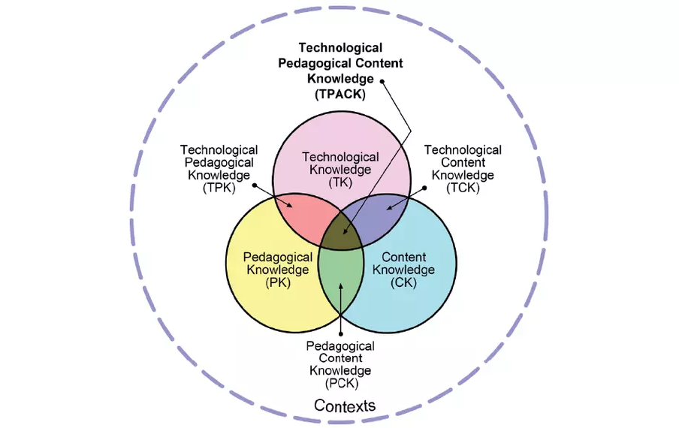
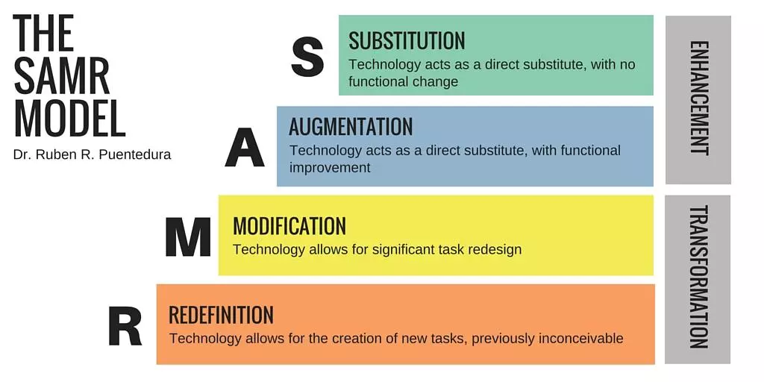
Some Models
https://taylorinstitute.ucalgary.ca/resources/SAMR-TPACK

Slide 10
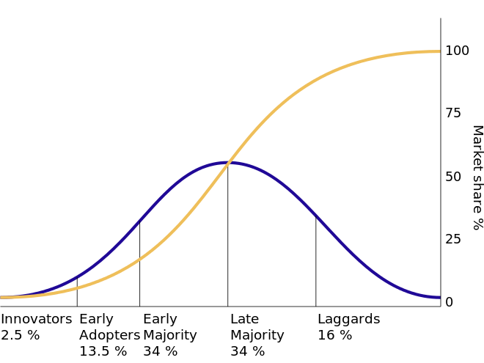
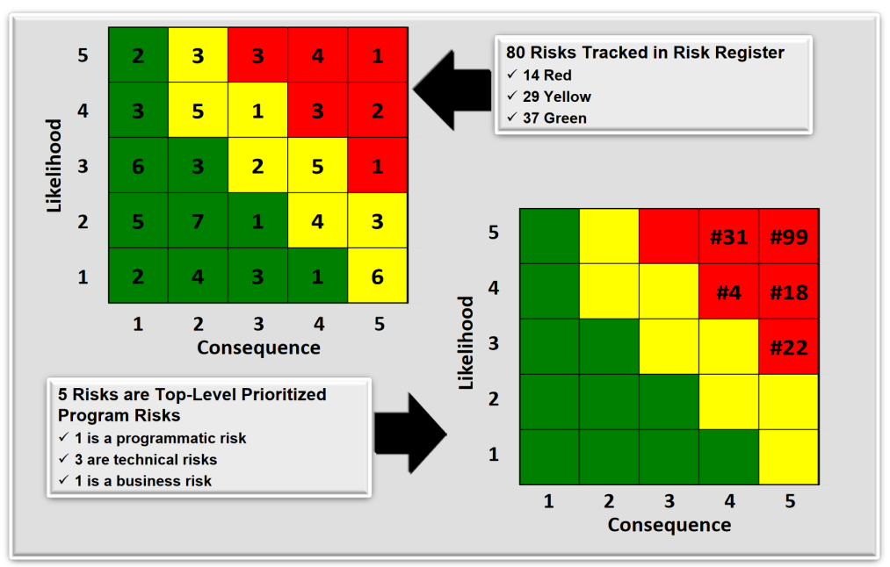
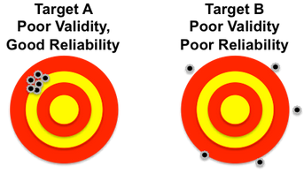
Three Approaches
Technology Acceptance
Risk Management
Validation Protocols
Roger’s Innovation Diffusion Theory
Theory of Planned Behaviour
Technology Acceptance Model (Attitudes)
Concerns-Based Adoption Model (Complex social factors)
Fine-Kinney Method (exposure, likelihood, consequence)
Risk Matrix
Analytical Hierarchy Process Model
Content validity (coverage)
Construct validity (independence)
Criterion validity (indicators)
Test-Retest Validity
Internal Consistency

Slide 11
Risk Registry
Org. Change
Technology
Access
Reliability
Complexity
Process
Management
Support
Prof. Development
Control
Environment
Administration
Faculty
Effective Use
Support
Compensation
Tensions
Legal Issues
Effectiveness
Resistance to Change
Self-efficacy
Perceptions
Prof. Development
Reid, 2014

Slide 12
Wait…
What do we mean by “fail”?
Hersheys, 1996: leadership reduced the timeline for the rollout Implementation team cut down on testing. $100 million worth of orders were unfulfilled.
Hewlett-Packard, 2003: new ERP wasn’t configured to sync with their old systems, as much as 20% of customer orders for servers were left unfulfilled. Cost: $160 million.
MillerCoors, 2013: $100 million project dragged on for three years without an end in sight. The company terminated its implementation partner and filed a lawsuit against them.
Revlon, 2018: Revlon lost over $64 million in unshipped orders, suffered a 6.9% drop in its stock price, and got sued by its investors.
All quoted or paraphrased from Rohn, 2022
Notes:
https://whatfix.com/blog/digital-transformation-failures/

Slide 13
Wait…
But there are more kinds of failure
Microsoft Zune: the personal MP3 player never caught on
Sony Betamax: JVC’s product was lighter (29 pounds vs. 36 pounds), had a longer recording capacity, and was cheaper
Blackberry Storm: its interface was nearly impossible to use, it had connectivity issues, and it was too expensive
Theranos: was apparently manipulating its lab and pushing its products to market before they actually worked
Merck’s Vioxx: increased risk of cardiovascular events such as strokes and heart attacks; they settled for $4.85 billion in damages
Ford Pinto: impact would rupture the fuel tank and risk making the car explode
McDonald’s McDLT: extraordinarily wasteful packaging to “keep the hot side hot, and the cool side cool”
Google Glass: expensive, and never got past the dorkiness factor
All quoted or paraphrased from Livescault, 2014
Notes:
https://www.braineet.com/blog/innovation-failures

Slide 14
The Lesson
Failure doesn’t just mean “people are not using the technology”
When people don’t use a new technology, there’s often a very good reason
Sometimes, people use the technology when they really shouldn’t have
Notes:
https://www.accenture.com/ca-en/insights/digital-transformation-index
https://www.ibm.com/topics/digital-transformation
https://en.wikipedia.org/wiki/Digital_transformation

Slide 15
New Technology
Here’s how
will fail (my version)

Slide 16

nobody knows what the new tech does
“We are in a new era, one in which we are building systems that can’t be grasped in their totality or held in the mind of a single person.”
“We’ll need interpreters of what’s going on in these systems, a bit like TV meteorologists”– Samuel Arbesman
Notes:
https://singularityhub.com/2016/07/17/the-world-will-soon-depend-on-technology-no-one-understands/

Slide 17
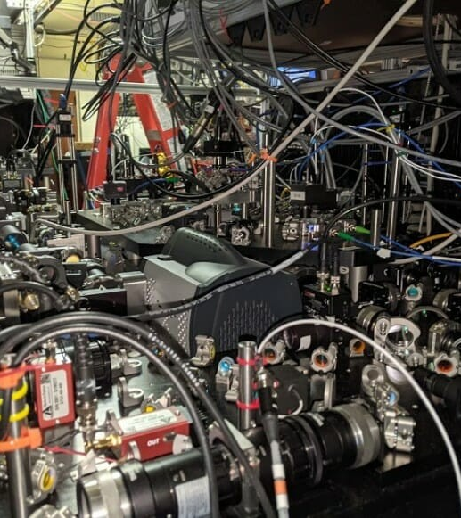

the new tech is harder to use than the old tech
(and/or is badly designed, or can’t be learned just by using it, etc.)
Notes:
https://chicagoquantum.org/news/uw-madison-industry-partners-run-quantum-algorithm-neutral-atom-quantum-computer-first-time

Slide 18
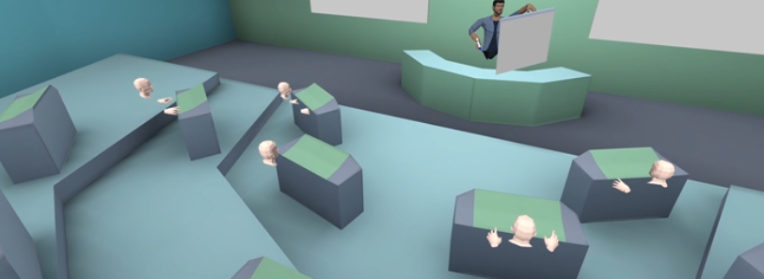
the new tech is used to do the exact same thing as the old tech
which the old tech did fine, but takes longer and adds extra steps
Notes:
https://www.accenture.com/ca-en/insights/digital-transformation-index
https://www.ibm.com/topics/digital-transformation
https://en.wikipedia.org/wiki/Digital_transformation

Slide 19
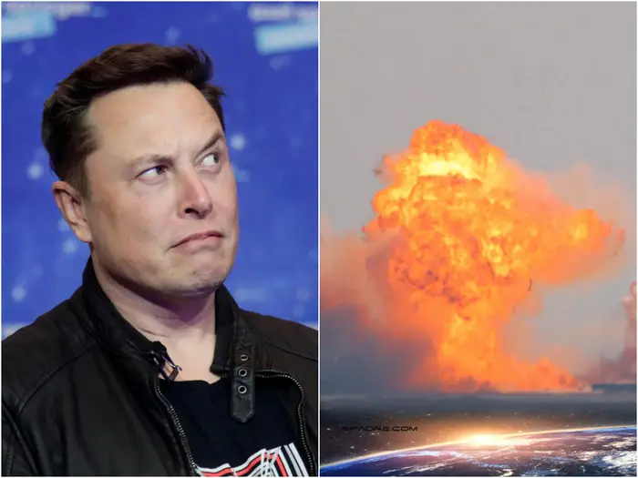
other unexpected side-effects

Slide 20
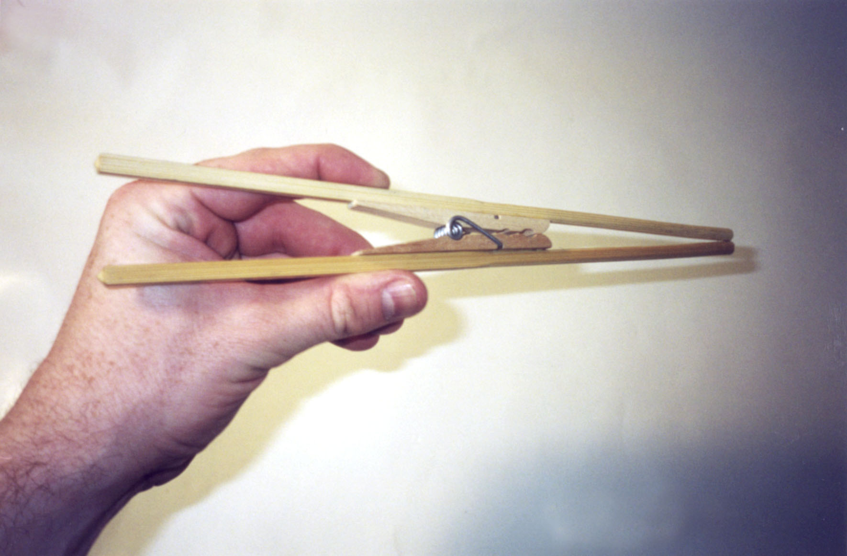
the new tech doesn’t address actual needs
chindogu.com

Slide 21

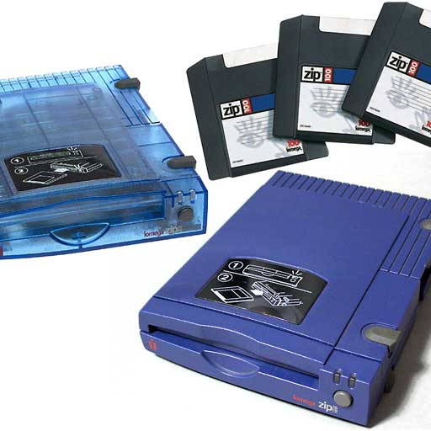
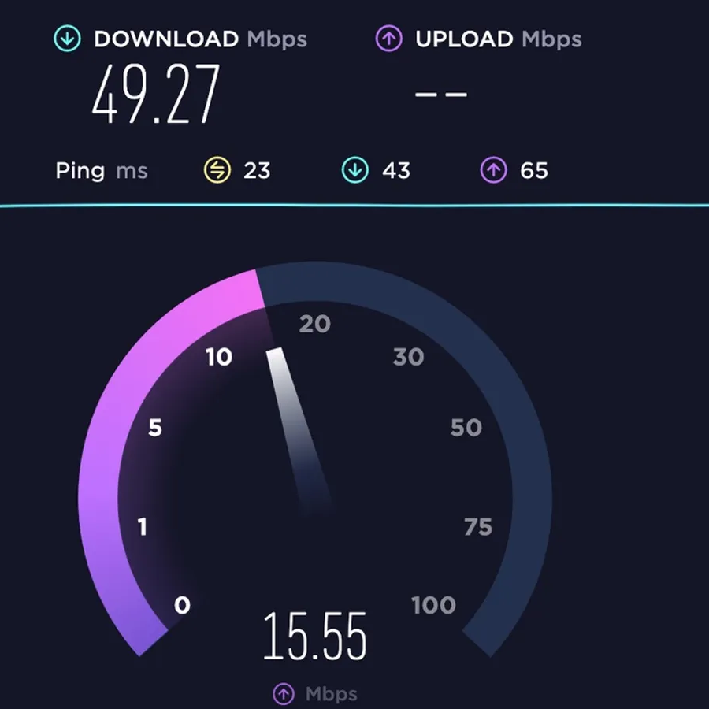
the new tech is unreliable and glitchy
Blue Screen of Death
Zip Disc Click of Death
Bandwidth and slow internet
https://www.youtube.com/playlist?list=PLeBQHgzQN9x3Ef-JuV-HQw2on-_RkjTBM

Slide 22
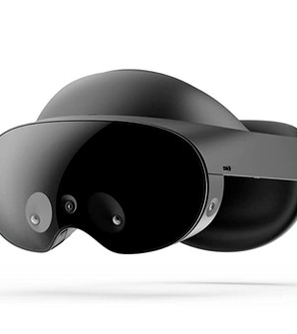
the new tech was a lot more expensive and had to be rationed or partially deployed
(which means it went to executives and managers and not the people who needed it)
Notes:
https://chicagoquantum.org/news/uw-madison-industry-partners-run-quantum-algorithm-neutral-atom-quantum-computer-first-time

Slide 23
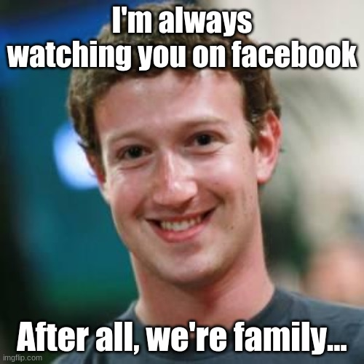
the new tech was creepy and tracked everyone’s every move

Slide 24
Causes?

Slide 25
- no consultation done with the people who would use the new tech
- the new tech wasn’t piloted long enough before being put into production
- no marketing or introduction to help people use the new tech in new ways
- a risk assessment was not conducted
- proper budgeting and ongoing investment was not done
- business processes never adapted to match the capabilities of the new tech
- a culture of trust was never established
Notes:
https://www.accenture.com/ca-en/insights/digital-transformation-index
https://www.ibm.com/topics/digital-transformation
https://en.wikipedia.org/wiki/Digital_transformation

Slide 26
Not Why Transformation Fails
Staff and Students
Human Resources
Psychology
resistance to change
fear of losing our jobs
speed of change or rapid change
lack of training and/or inability to learn
not having the right talent
insufficient leadership and/or buy-in from the corner suite
not having the right mindset
failure to innovate

Slide 27
One Final Note
Let me give you an example of how I view this. Probably the most transformative technology in the workplace over the last decade or so has been the Android/iPhone. It’s like we looked up one day and everybody in the workplace had one. How did this happen? Think about it:
    we paid for them ourselves
    we trained ourselves (if we needed training on them at all, which we mostly didn’t)
    they just worked
    they made things a lot easier to do
We know what happened: everybody went out and bought one, because having a combination computer-phone-camera-walkman-whatever system in our pockets was too good an opportunity to ignore.

Slide 28
Thank you
xo
Stephen

