Slide 1
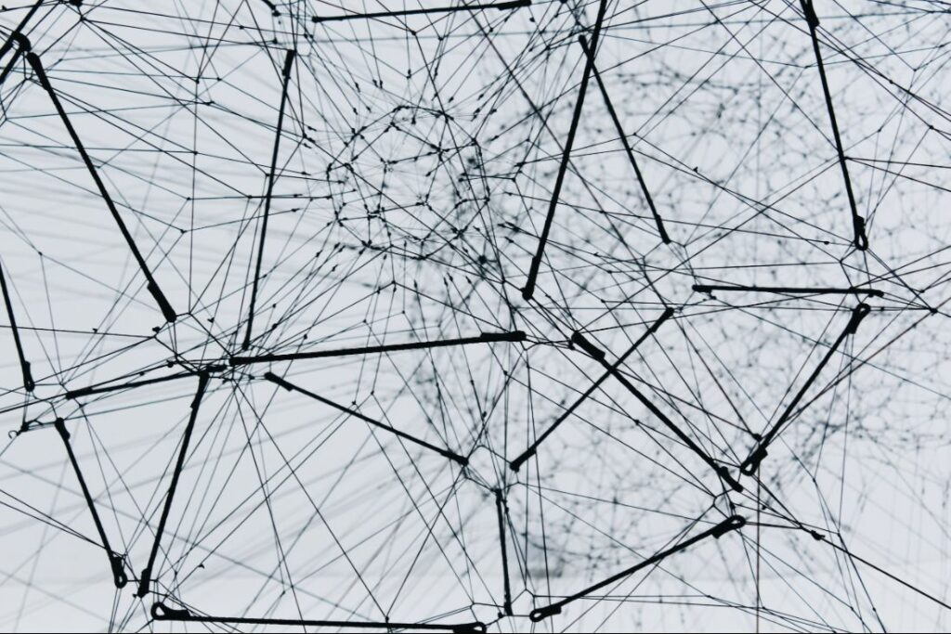

Navigating the AI Revolution
Education at the Crossroads: Technologies, Values, and the Role of the Institution
Stephen Downes
February 10, 2023
https://www.downes.ca/presentation/569

Slide 2
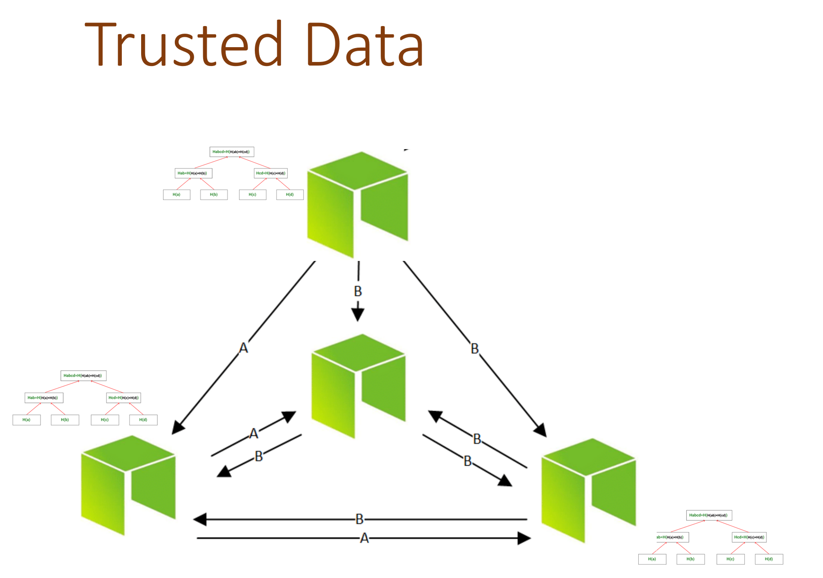
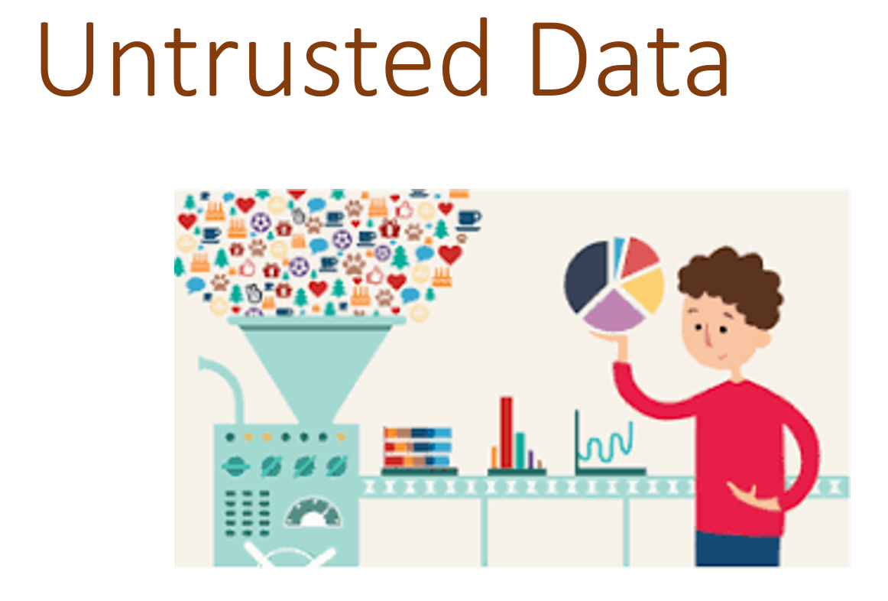
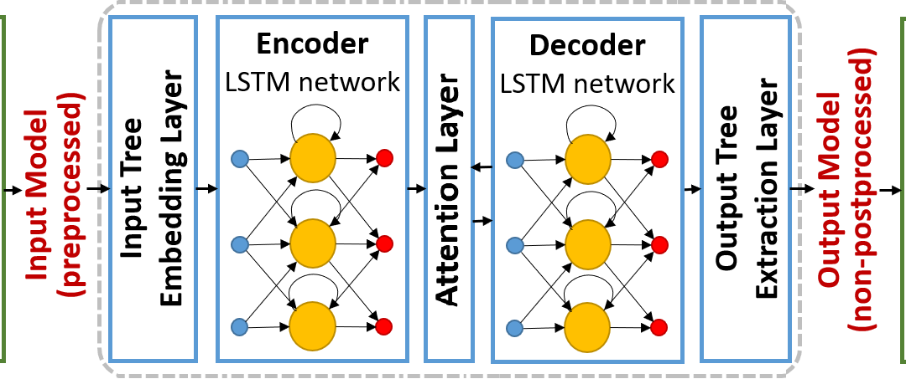
The Challenge…
Before this year: descriptive, diagnostic, predictive, prescriptive
After this year: generative
Future: deontic analytics
The domain of education?

Slide 3
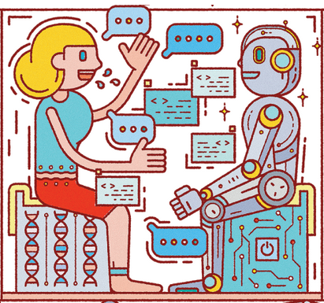
The Challenge…
What do we do when everything we do, and everything we teach people to do, can be done by artificial intelligence?
Image: https://hbr.org/2018/07/collaborative-intelligence-humans-and-ai-are-joining-forces

Slide 4
The Response (tl:dr)
It is not what we do for our students. It is What we help students to do for themselves.
Image: https://hbr.org/2018/07/collaborative-intelligence-humans-and-ai-are-joining-forces

Slide 5
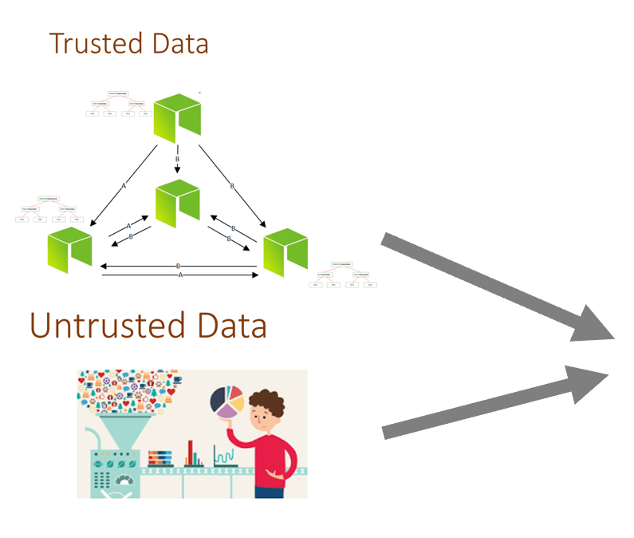
Artificial Intelligence…
Generative Analytics
  Generative Pre-trained Transformer 3 (GPT-3 and chatGPT)
  Generative Adversarial Network (GAN)
  Contrastive Language-Image Pre-training (CLIP) e.g. DALL-E 2
AI
Research and Education
Images Music Software Text

Slide 6

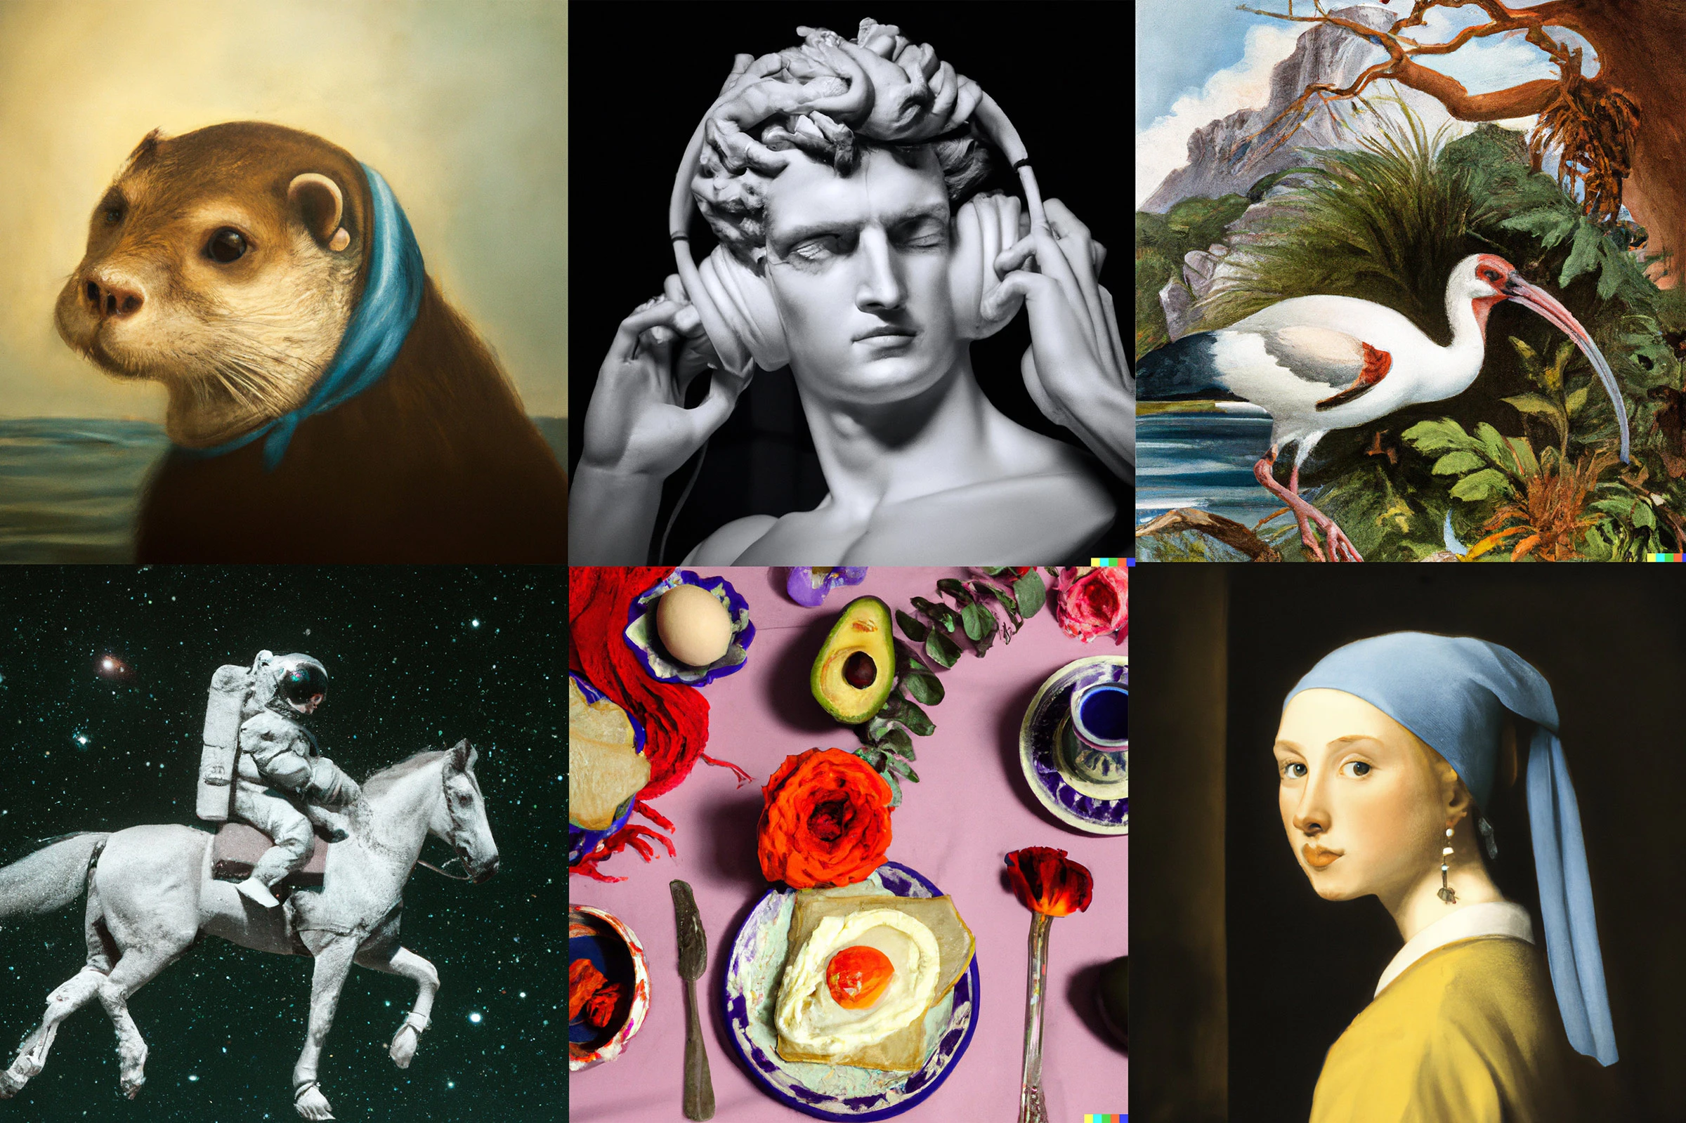
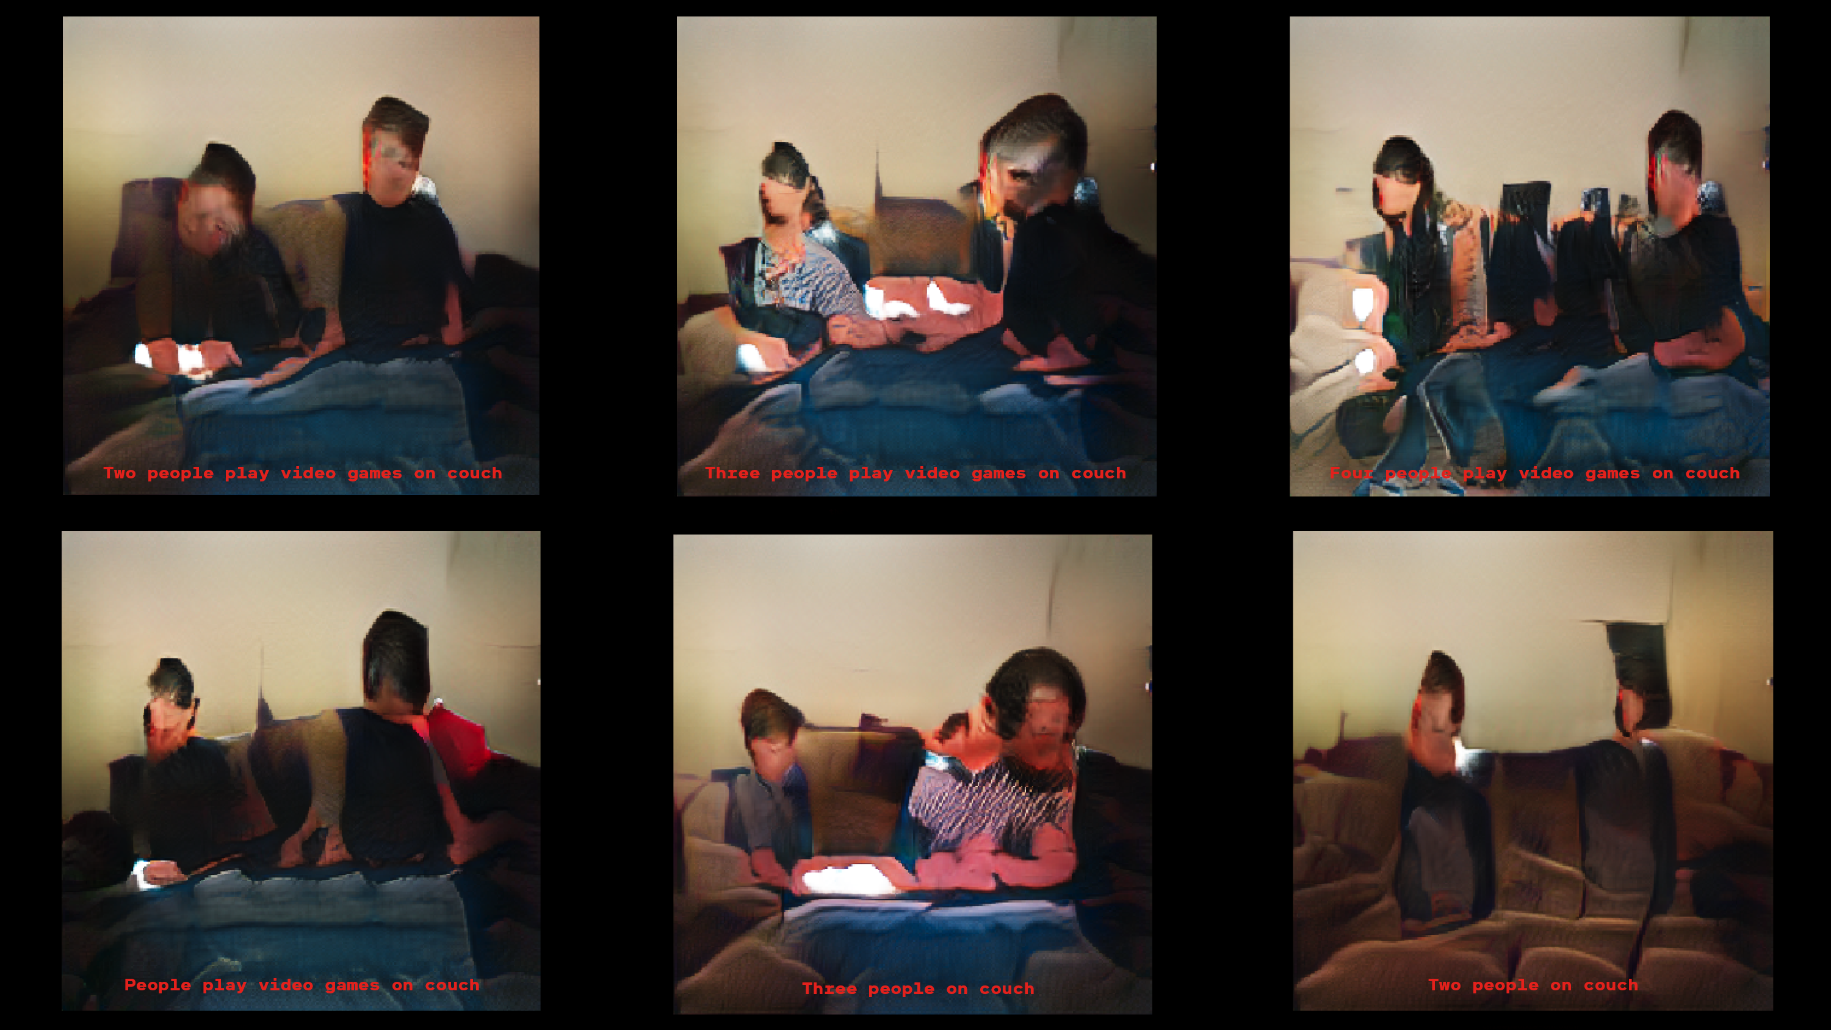
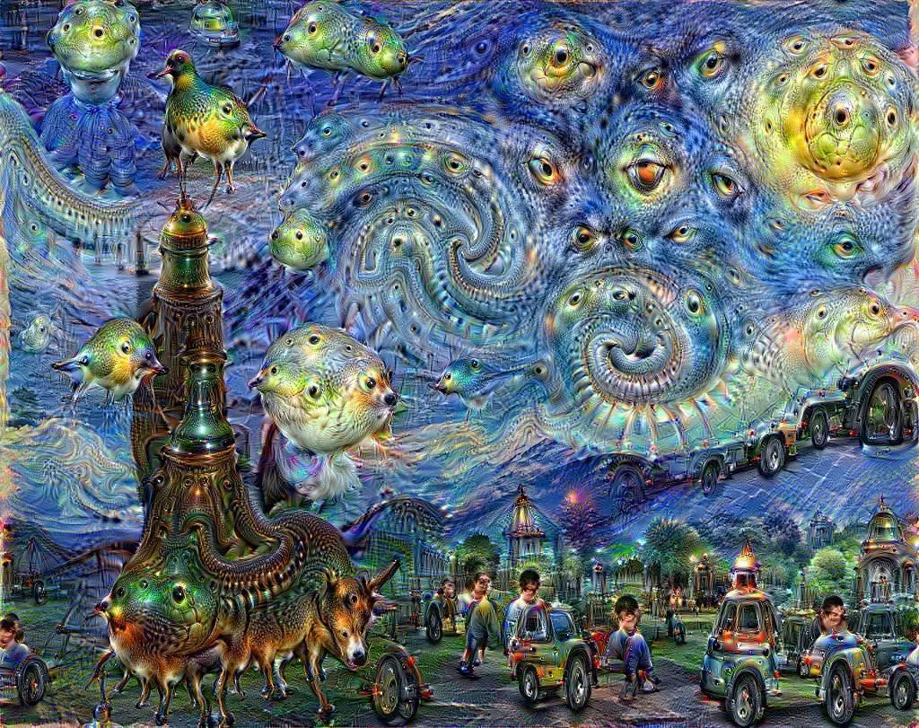
Artificial Intelligence… Images
2019 – This Person Doesn’t Exist – GAN - https://thispersondoesnotexist.com/
2022 – Dall-e https://openai.com/dall-e-2/
2020 – GPT-3 https://www.technologyreview.com/2020/09/25/1008921/ai-allen-institute-generates-images-from-captions/
2015 - Google Deep Dream - https://deepdreamgenerator.com/

Slide 7
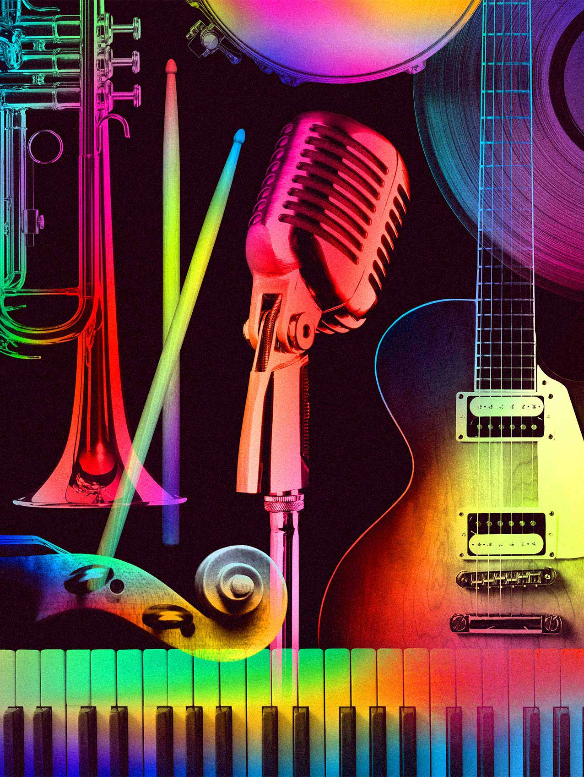


Artificial Intelligence… Music
2022 – Soundraw - https://soundraw.io/
2018 - Brian Eno – Reflection - https://www.youtube.com/watch?v=fSofXKGpenQ&t=5s
2020 – OpenAI Jukebox https://openai.com/blog/jukebox/
https://www.youtube.com/watch?v=JSlGuYQMTyQ
https://soundcloud.com/openai_audio/jukebox-86115728

Slide 8
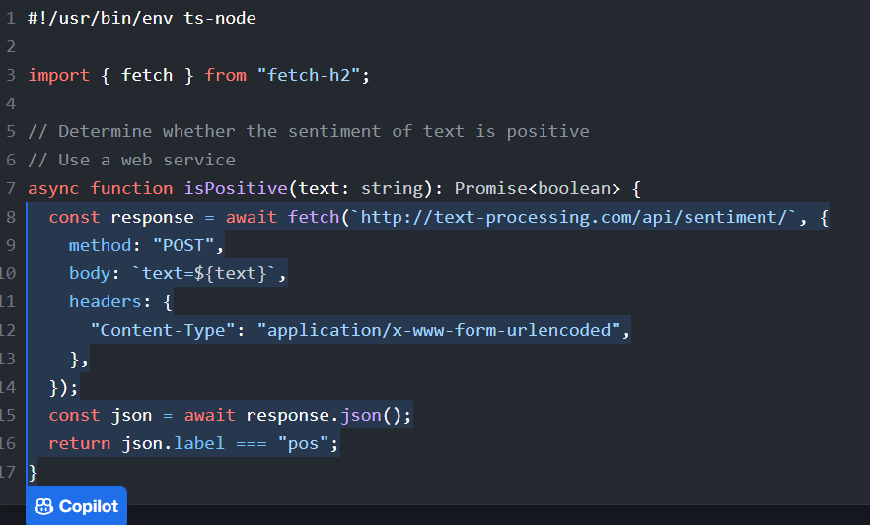

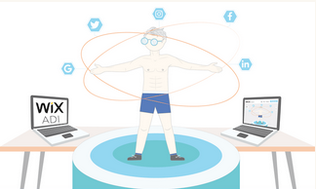
Artificial Intelligence… Software
2021 – GitHub Co-pilot - https://github.com/features/copilot
2016 – Wix ADI - https://www.tooltester.com/en/wix-adi-review/
2023 – Durable - https://durable.co/ai-website-builder

Slide 9

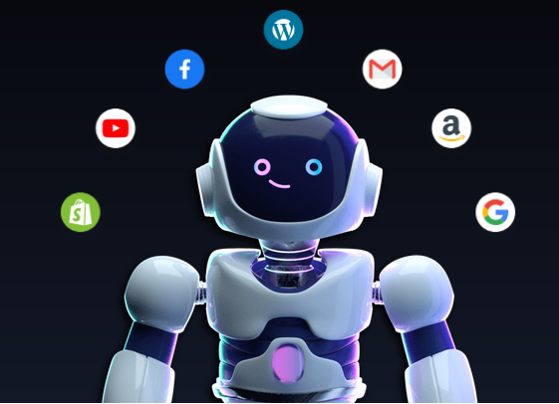
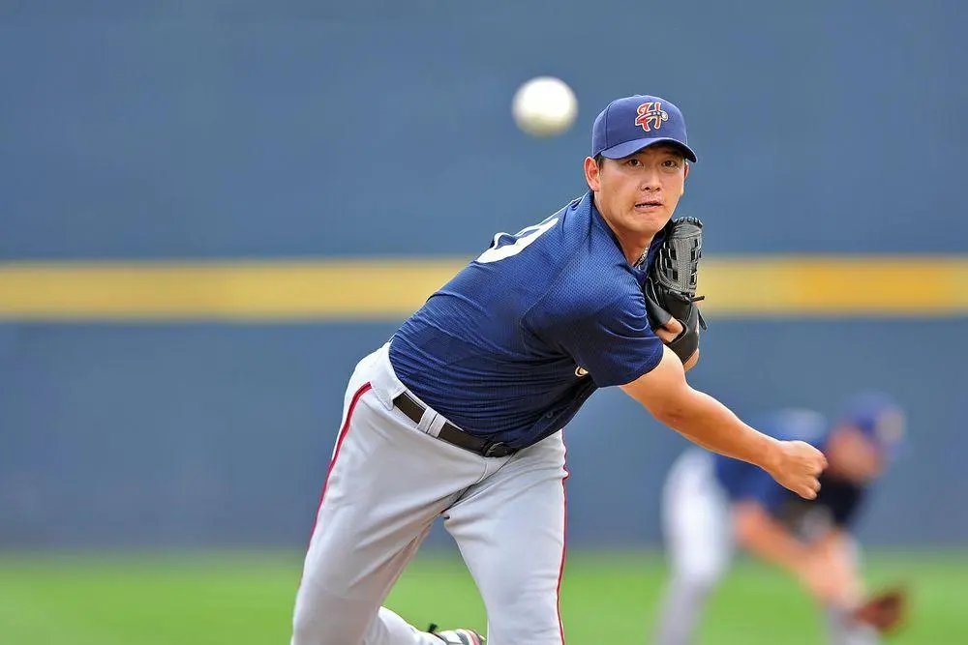

Artificial Intelligence… Text
2022 – chatGPT - https://openai.com/blog/chatgpt/
2022 – Jasper - https://www.jasper.ai
2016 – Associated Press - https://www.digitaltrends.com/cool-tech/ap-uses-ai-for-sports-writing/
2019 – Grammarly - https://www.grammarly.com/blog/how-grammarly-uses-ai/

Slide 10
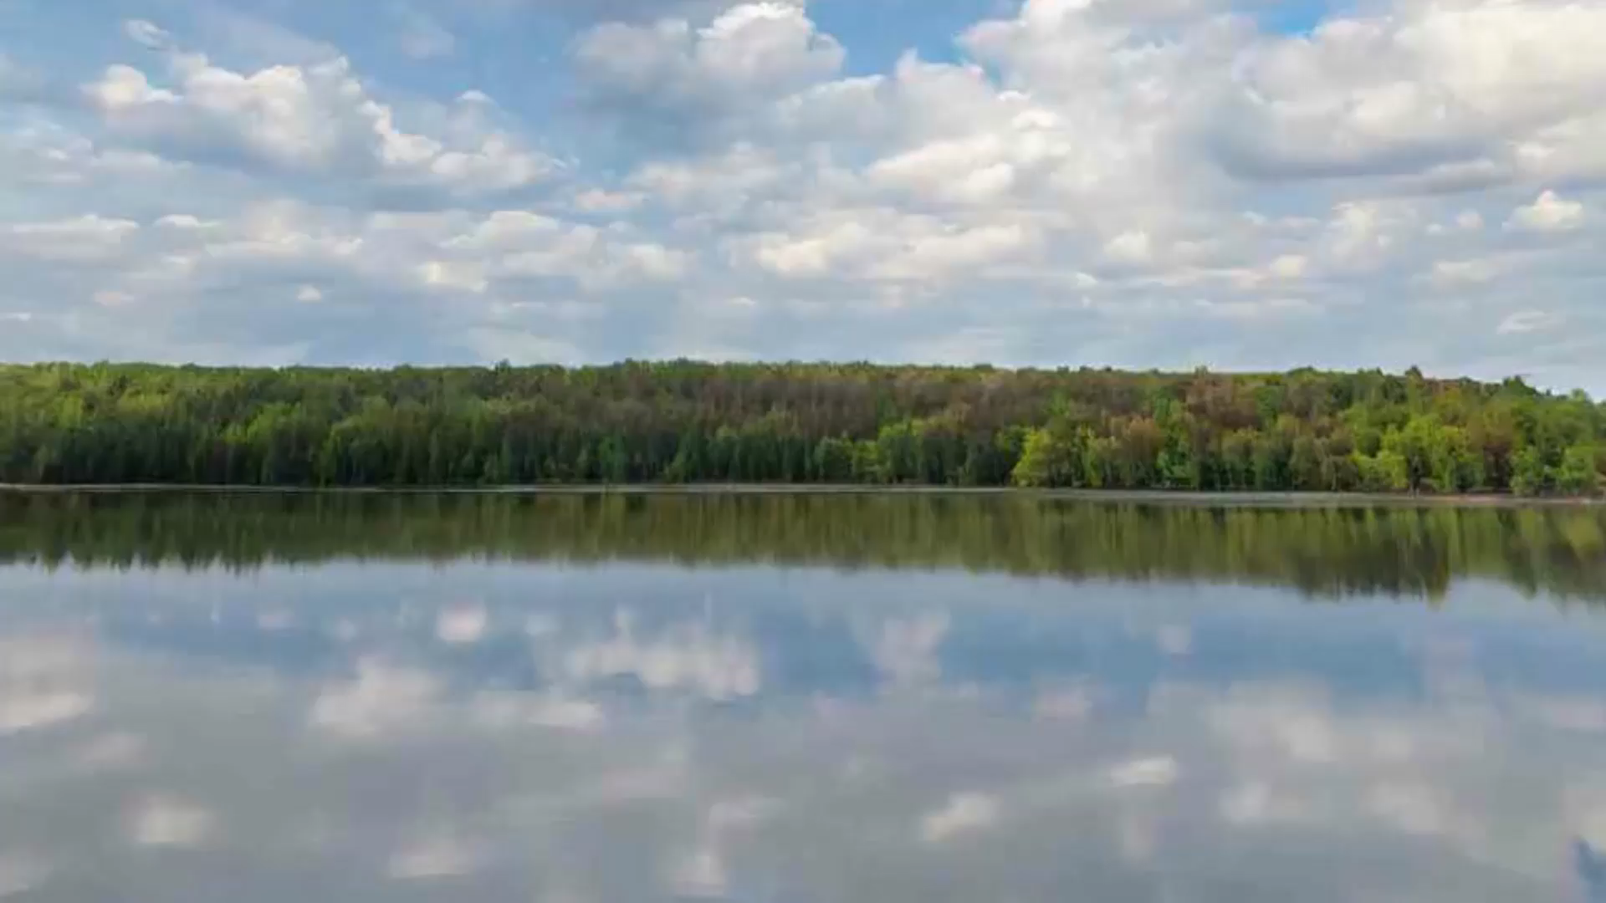

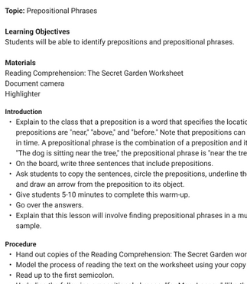

Artificial Intelligence… Research and Education
2023 – LessonPlans.ai https://www.lessonplans.ai/
2023 – 3D Audio and Video – Nvidia gauGAN - https://www.nvidia.com/en-us/research/ai-playground/
2022 – OpenAI Playground - https://www.vice.com/en/article/m7g5yq/students-are-using-ai-to-write-their-papers-because-of-course-they-are
2022 – Genei - https://www.genei.io/

Slide 11
Artificial Intelligence…
Data Models
Algorithms
Application
How AI Works https://ethics.mooc.ca/cgi-bin/page.cgi?presentation=59

Slide 12
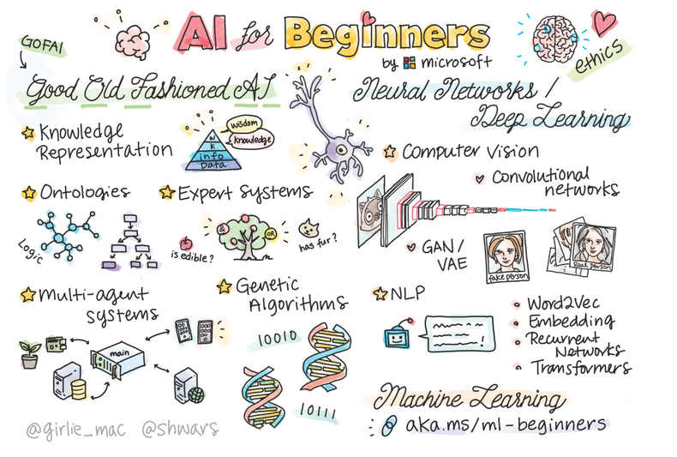

GOFAI and Neural Networks
Image: https://changelog.com/news/microsofts-new-ai-for-beginners-course-qM9j

Slide 13

Pattern Recognition

Slide 14
The Prediction Game
Mary had a little _________ .
There’s no place like _________ .
Oh say can you _______ .
Luke, I am your ________ .
Trust ________ .
https://www.downes.ca/presentation/233

Slide 15
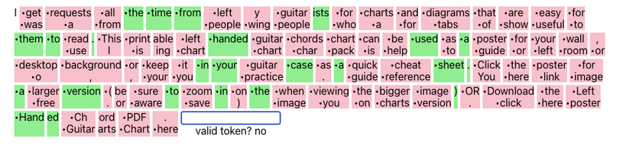
The Prediction Game
http://rr-lm-game.herokuapp.com/

Slide 16
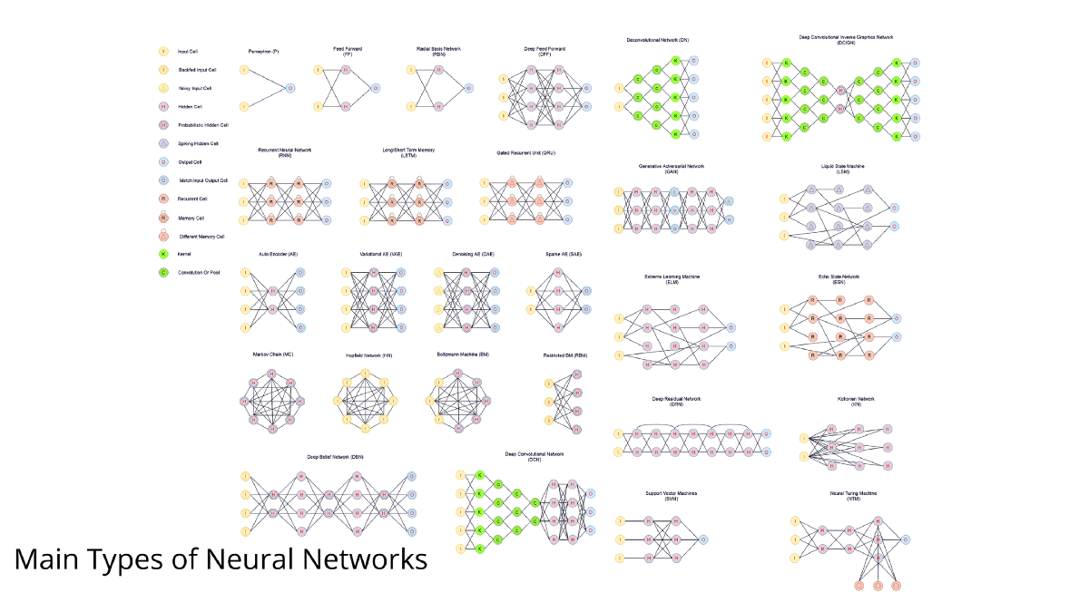
Questions…
What is the model that we’re going to select?
https://towardsai.net/p/machine-learning/main-types-of-neural-networks-and-its-applications-tutorial-734480d7ec8e

Slide 17
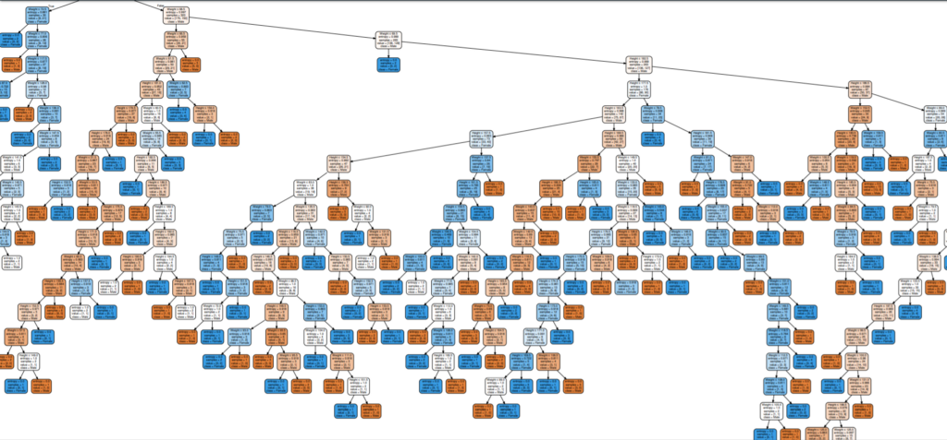
Questions…
How do we explain how a model produced the result that it did?
Image: https://towardsai.net/p/programming/decision-trees-explained-with-a-practical-example-fe47872d3b53
Exploring AI Interpretability Methods - https://www.infoq.com/articles/deep-learning-models-ai-interpretability-methods/

Slide 18
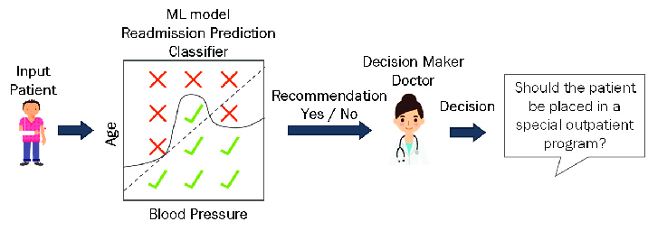
Questions…
Can you appeal an AI decision? Who is accountable?
Image: https://www.microsoft.com/en-us/research/publication/beyond-accuracy-the-role-of-mental-models-in-human-ai-team-performance/
2019 – AI and Agency - https://escholarship.org/uc/item/8q15786s
2023 – Nature – chatGPT listed as author on research papers - https://www.nature.com/articles/d41586-023-00107-z
2022 - US Court of Appeals Affirms That AI Cannot Be An Inventor Under US Patent Law - https://www.dww.com/articles/us-court-of-appeals-affirms-ai-cannot-be-an-inventor-under-us-patent-law

Slide 19
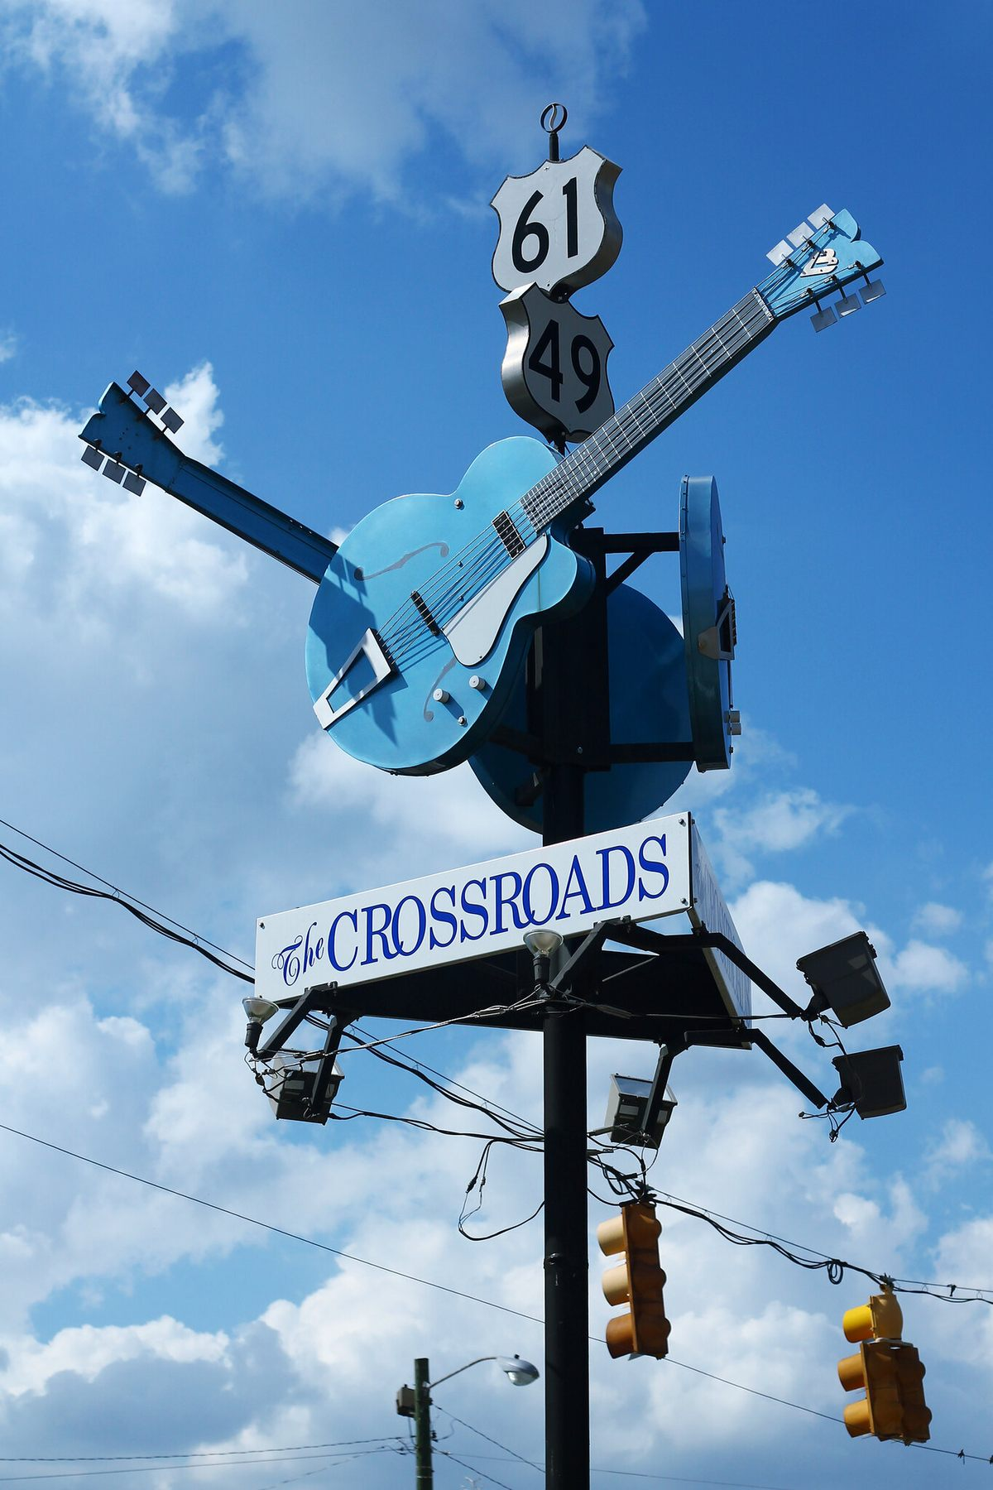
The Crossroads
Technology
Institutions
Values
  Inclusion
  Sustainability
  Ethics
Image: https://www.atlasobscura.com/places/clarksdale-crossroads

Slide 20
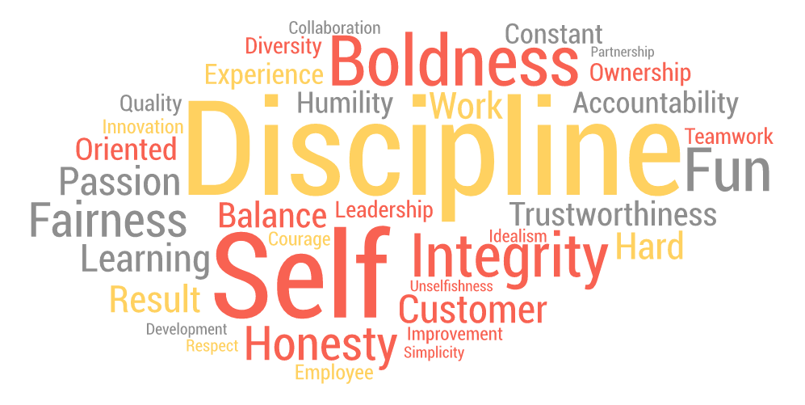
Values
  Inclusion
  Sustainability
  Ethics
Other Themes?
  Autonomy and Agency
  Integrity and Honesty
  Openness
  Care and Respect
  Value and Benefit
    etc
Image: https://haiilo.com/blog/the-importance-of-company-values/
See also: https://ethics.mooc.ca/cgi-bin/page.cgi?module=8

Slide 21
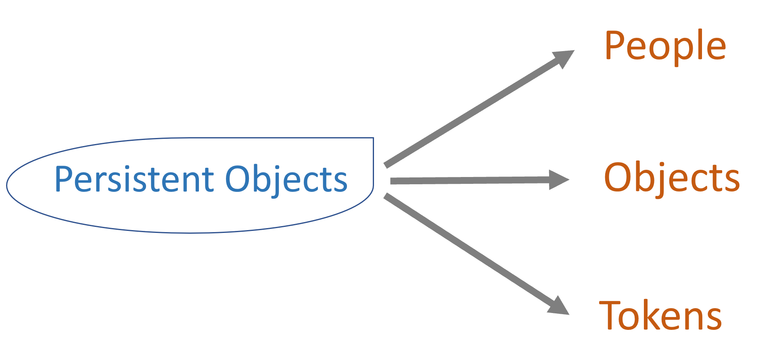
The AI Values Chain
Data
Objects
Application
Metaverse
AI
Blockchain

Slide 22
The Metaverse
Virtual Reality
Augmented Reality
Mixed Reality
eXtended Reality
Persistent Objects

Slide 23
The Metaverse
People
Persistent Objects
Objects
Tokens

Slide 24
The Metaverse
People
Persistent Objects
Objects
Tokens
Validity
Integrity

Slide 25
The Metaverse
People
Persistent Objects
Objects
Consent
Universality
Autonomy
Ownership
Tokens

Slide 26
The Metaverse
Content Addressing (Blocks)
Merkle Graphs (Chains)
Consensus
How?
Blockchain

Slide 27
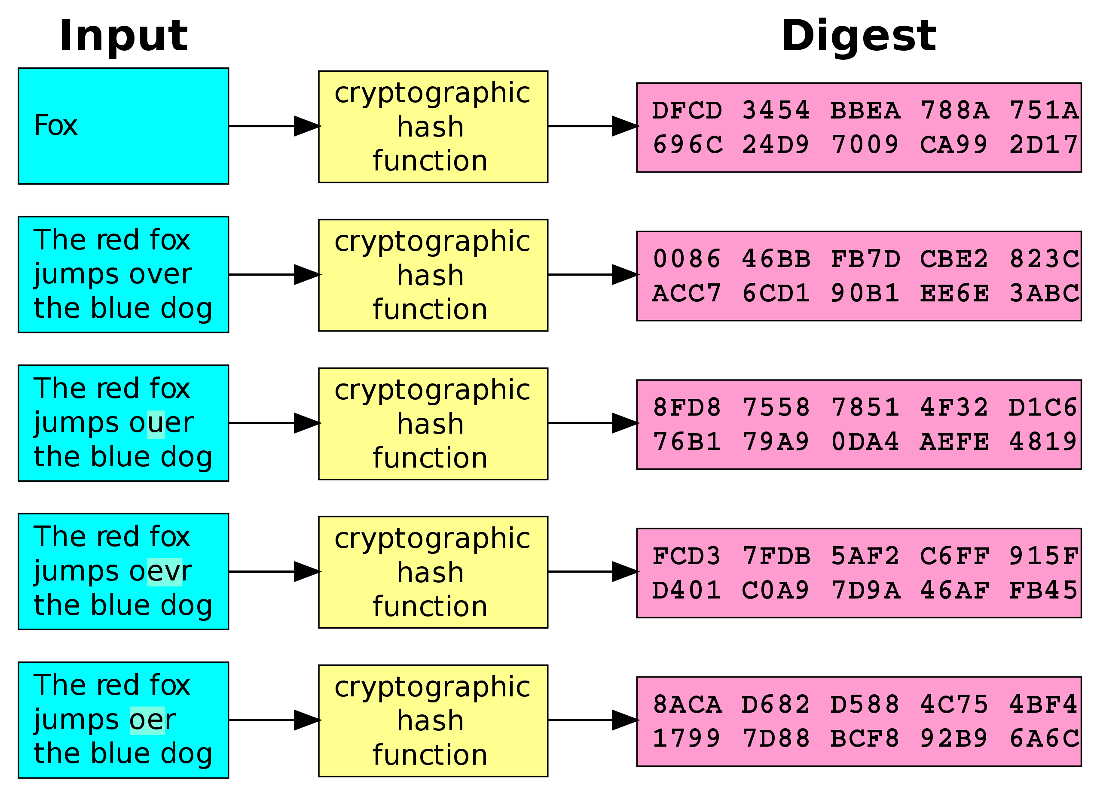
Blockchain
Content Addressing (Blocks)
Merkle Graphs (Chains)
Consensus
Provenance
Ownership
Openness
Access
Address

Slide 28
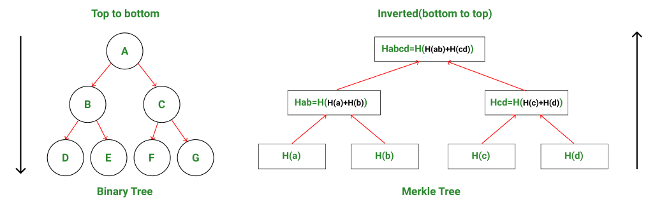
Blockchain
Content Addressing (Blocks)
Merkle Graphs (Chains)
Consensus
Findable
Accessible
Interoperable
Reusable

Slide 29
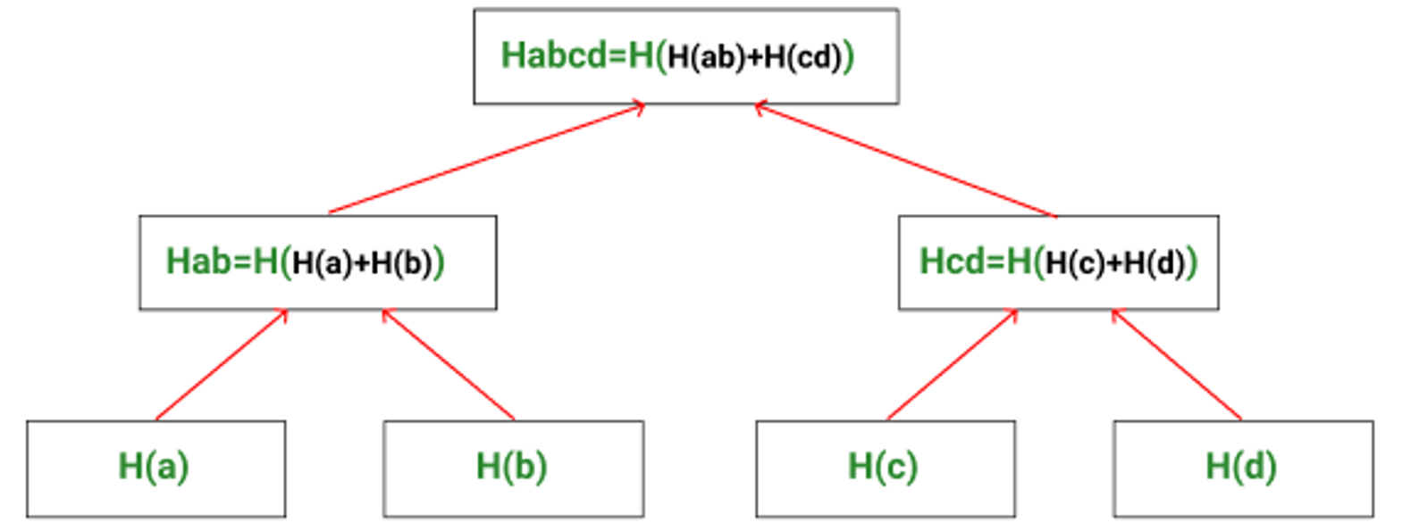

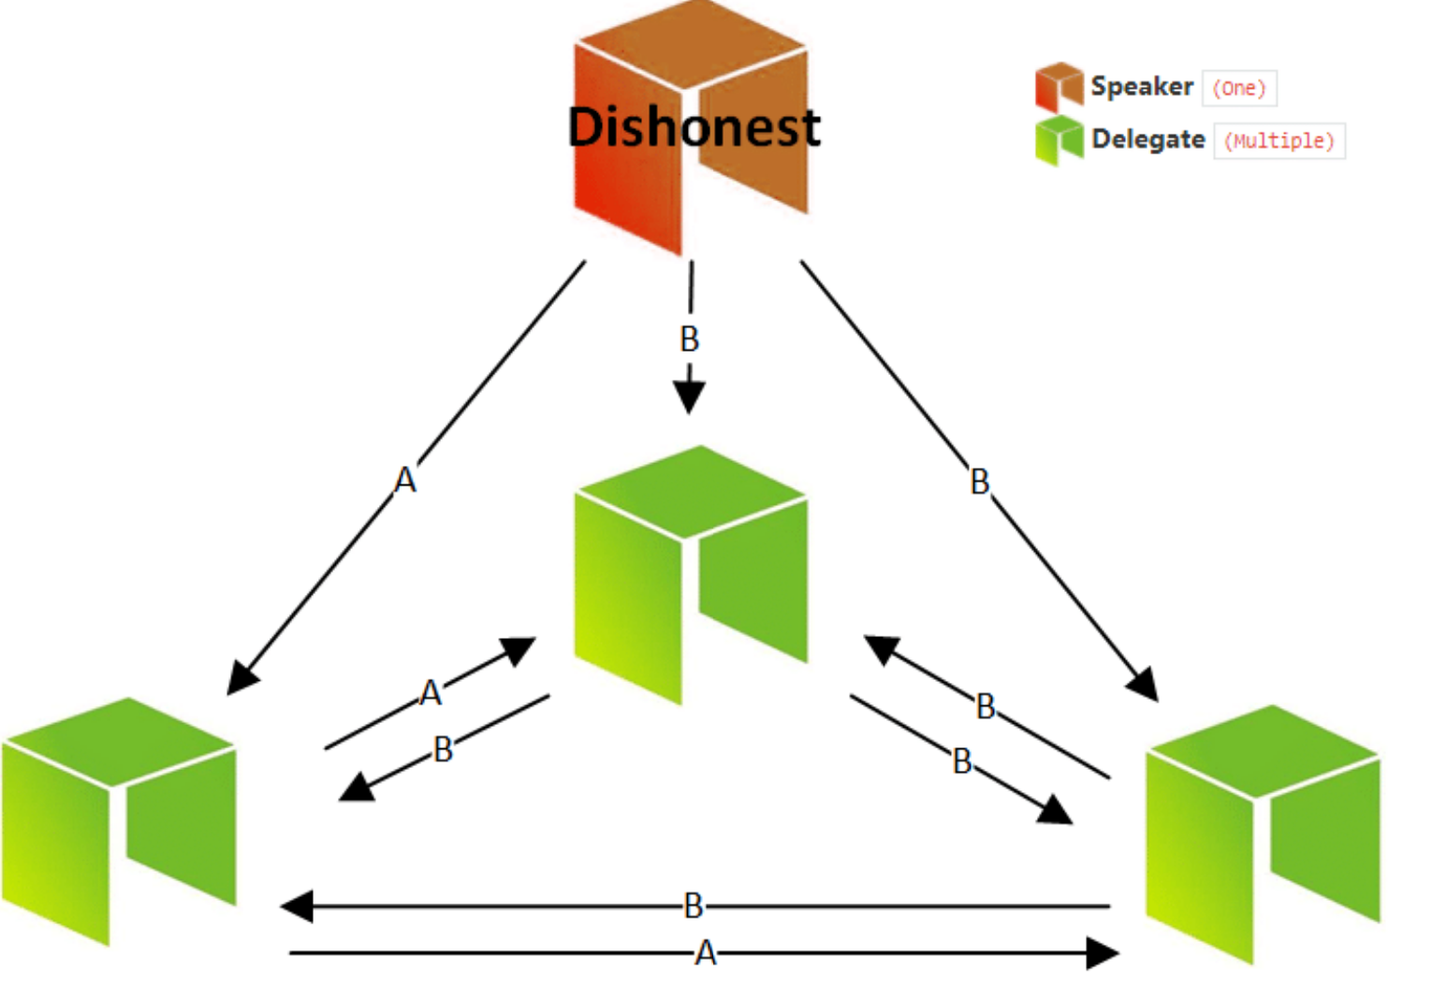
Blockchain
Content Addressing (Blocks)
Merkle Graphs (Chains)
Consensus
Environment
  Proof of Work
  Proof of Stake
  Proof of Authority
Inclusion

Slide 30
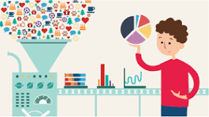
Trusted versus Untrusted Data
Data bias, representation, consent and inclusivity

Slide 31


Values
Fear
Focused on the good
More personal
Less formal
Regulation
Practices
More formal
More institutional
Focused on wrongs
Culture
Joy

Slide 32
Institutions…
  Teaching and Learning
  Research and Development
  Innovation and Growth

Slide 33
Institutions…
  Teaching and Learning
  Research and Development
  Innovation and Growth
Our roles are changing

Slide 34
Institutions…
  Persistent Objects
    Distributed ID (DID)
    Open Educational Resources
    Badges and Credentials
Ensuring individual agency and autonomy
Ensuing diversity, equity and inclusion

Slide 35
Institutions…
  Persistent Objects
    Distributed ID (DID)
    Open Educational Resources
    Badges and Credentials
Accessible and usable learning resources
Support for informal and lifelong learning

Slide 36
Institutions…
  Persistent Objects
    Distributed ID (DID)
    Open Educational Resources
    Badges and Credentials
Bridging the link to employability
Facilitating knowledge recognition networks

Slide 37
Institutions…
  Consensus
    Peer Networks
    Fediverse (Mastodon)
    Open Community
Building and facilitating mechanisms for people to support their own learning
For example, Personal Learning Environments

Slide 38
Innovation and Growth
  Artificial Intelligence
    Resource Creation
    Coaching and Tutoring
    Automated Assessment
Build quality trusted data networks
Assess and validate AI models
Automated resource development
Support public access to the technology

Slide 39
Institutions…
  Consensus
    Innovation Networks
    Needs Assessment
Redefinition from how to innovate to what we want from innovation
Key role for access and inclusion

Slide 40

Concluding Remarks
  This is us
Image: https://www.radiotimes.com/tv/drama/this-is-us-season-5-how-to-watch/

Slide 41

Concluding Remarks
  Everything this does depends on what we do
Image: https://www.pinterest.ca/pin/everything-depends-on-how-we-see-things--137641332331769408/

Slide 42
Concluding Remarks
  If we want a more inclusive, sustainable and ethical society, we must make inclusive, sustainable and ethical decisions

Slide 43
Concluding Remarks
  All of us
  It is not what we do for our students. It is What we help students to do for themselves.

Slide 44

Stephen Downes
https://www.downes.ca
stephen@downes.ca

