Slide 1
Universities at the Crossroads: Technologies, values and the role of the institution
Stephen Downes
December 2, 2022
Catalan Pedagogical Society
Lleida, Catalonia (Spain) December 2, 2022

Slide 2
The Crossroads
Technology
Institutions
Values
My objectives are to:
offer clear and understandable descriptions of three current technologies (metaverse, blockchain, artificial intelligence)
discuss how they will impact the traditional role and function of universities
describe the application of the conference themes to these technologies with respect to these roles

Slide 3
The Crossroads
Technology
The Metaverse
Blockchain and Crypto
Artificial Intelligence
Institutions
Values

Slide 4
The Crossroads
Technology
Institutions
Teaching and Learning
Research and Development
Innovation and Growth
Values

Slide 5
The Crossroads
Technology
Institutions
Values
Inclusion
Sustainability
Ethics

Slide 6
Values
Inclusion
Sustainability
Ethics
Other Themes?
Autonomy and Agency
Integrity and Honesty
Openness
Care and Respect
Value and Benefit
etc

Slide 7
Values and Practices
Fear
Focused on the good
More personal
Less formal
Regulation
Practices
More formal
More institutional
Focused on wrongs
Culture
Joy

Slide 8
Technology
The Metaverse
Blockchain and Crypto
Artificial Intelligence
These technologies are here now. In the future we will face the same decisions with future technologies.

Slide 9
The Metaverse
Virtual Reality
Augmented Reality
Mixed Reality
Values
Accessibility
Environmental Sustainability
Benefits and Outcomes

Slide 10
The Metaverse
Virtual Reality
Augmented Reality
Mixed Reality
eXtended Reality
Persistent Objects

Slide 11
The Metaverse
People
Persistent Objects
Objects
Tokens

Slide 12
The Metaverse
People
Persistent Objects
Objects
Consent
Universality
Autonomy
Ownership
Tokens

Slide 13
The Metaverse
People
Persistent Objects
Objects
Tokens
Validity
Integrity

Slide 14
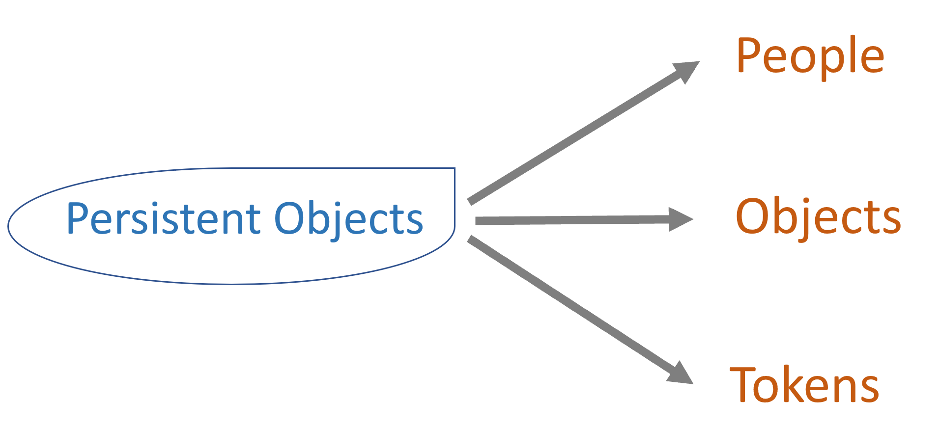
Blockchain
Content Addressing (Blocks)
Merkle Graphs (Chains)
Consensus
How?

Slide 15
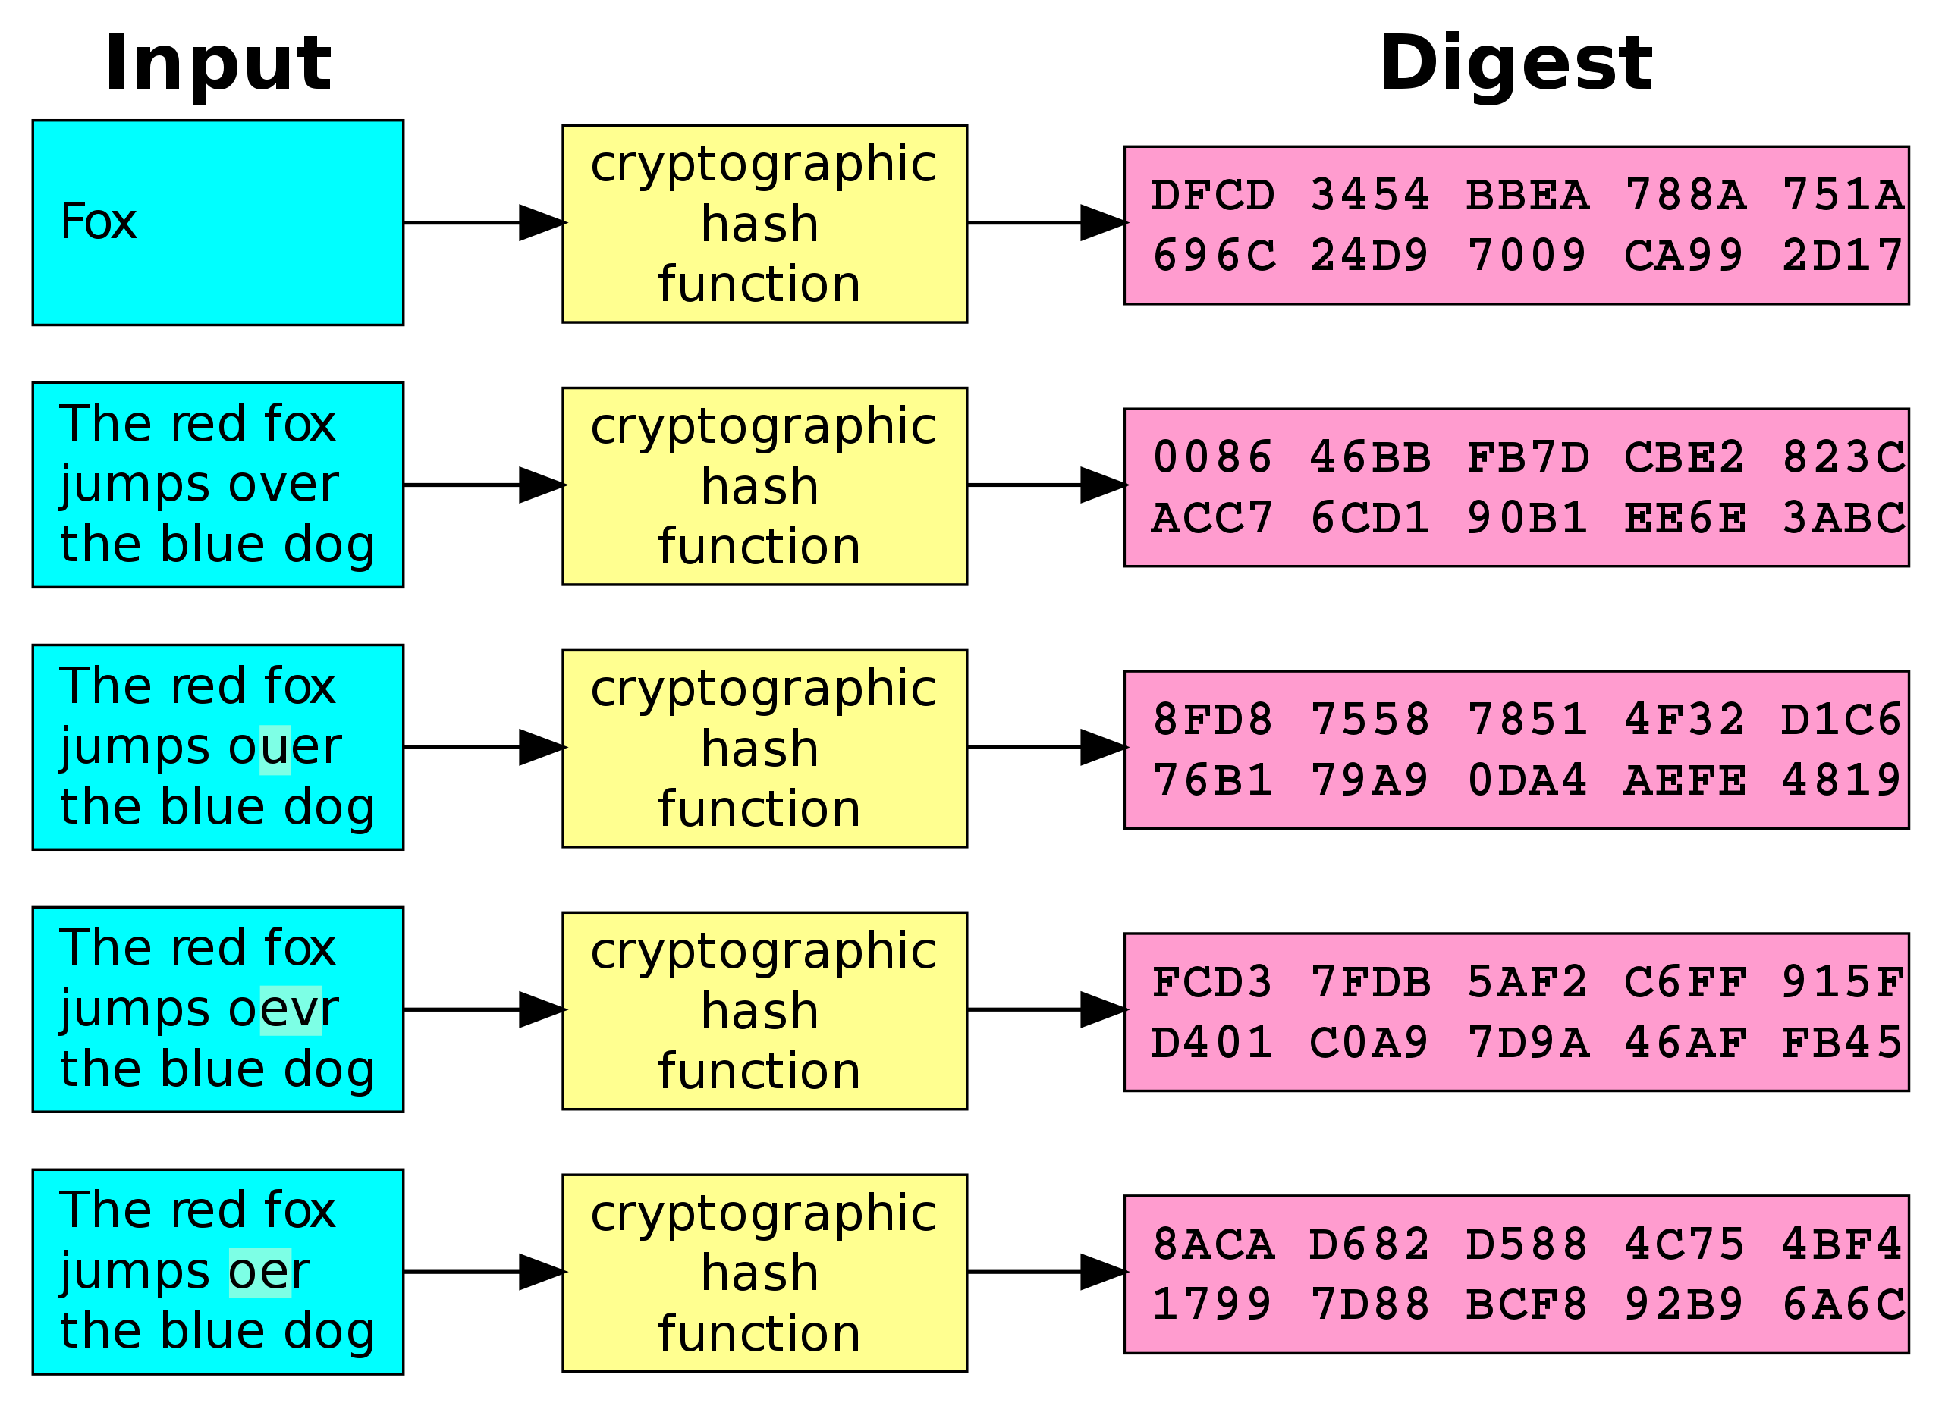
Blockchain
Content Addressing (Blocks)
Merkle Graphs (Chains)
Consensus
Address

Slide 16
Blockchain
Content Addressing (Blocks)
Merkle Graphs (Chains)
Consensus
Provenance
Ownership
Openness
Access
Address

Slide 17
Blockchain
Content Addressing (Blocks)
Merkle Graphs (Chains)
Consensus
Findable
Accessible
Interoperable
Reusable

Slide 18
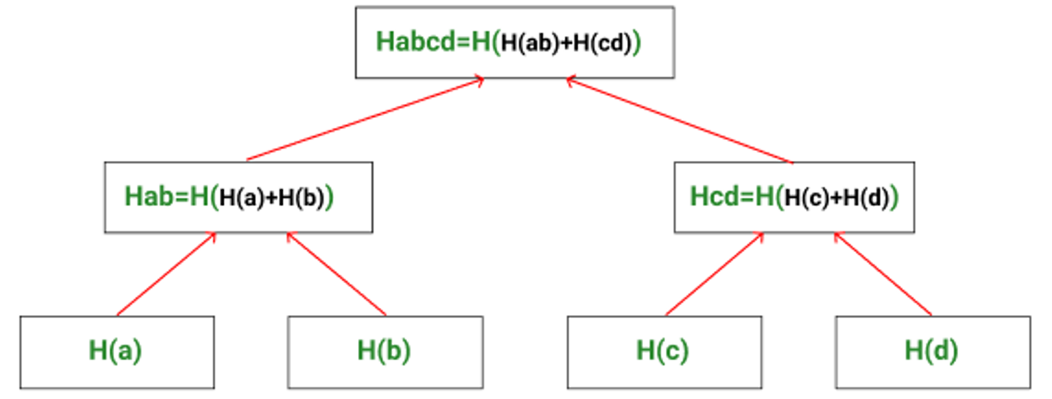
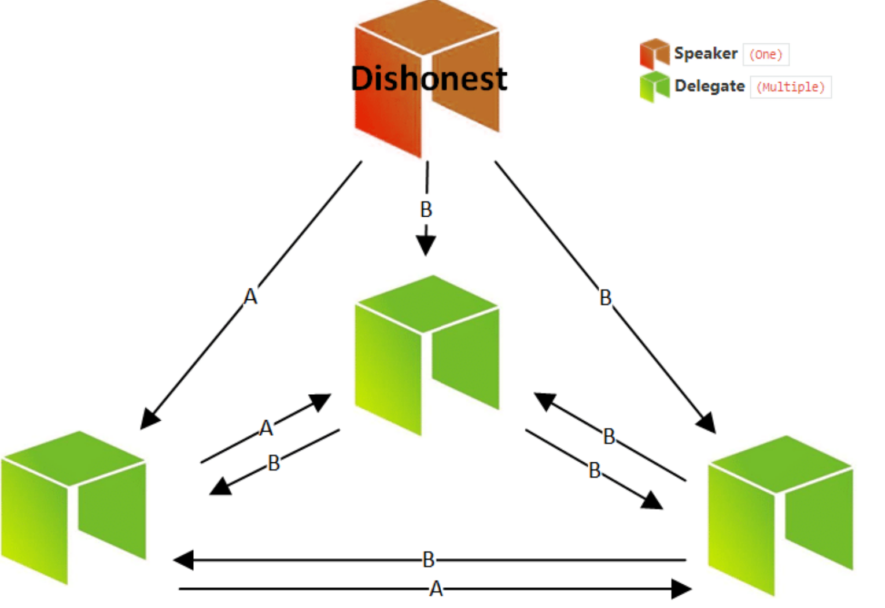
Blockchain
Content Addressing (Blocks)
Merkle Graphs (Chains)
Consensus

Slide 19
Blockchain
Content Addressing (Blocks)
Merkle Graphs (Chains)
Consensus
Data Federation Issues & Principles

Slide 20
Blockchain
Content Addressing (Blocks)
Merkle Graphs (Chains)
Consensus
Proof of Work
Proof of Stake
Proof of Authority

Slide 21
Blockchain
Content Addressing (Blocks)
Merkle Graphs (Chains)
Consensus
Environment
Proof of Work
Proof of Stake
Proof of Authority
Inclusion

Slide 22
Trusted Data
vs
Untrusted Data

Slide 23
Trusted Data
vs
Untrusted Data
Data bias, representation, consent and inclusivity

Slide 24
Artificial Intelligence

Slide 25
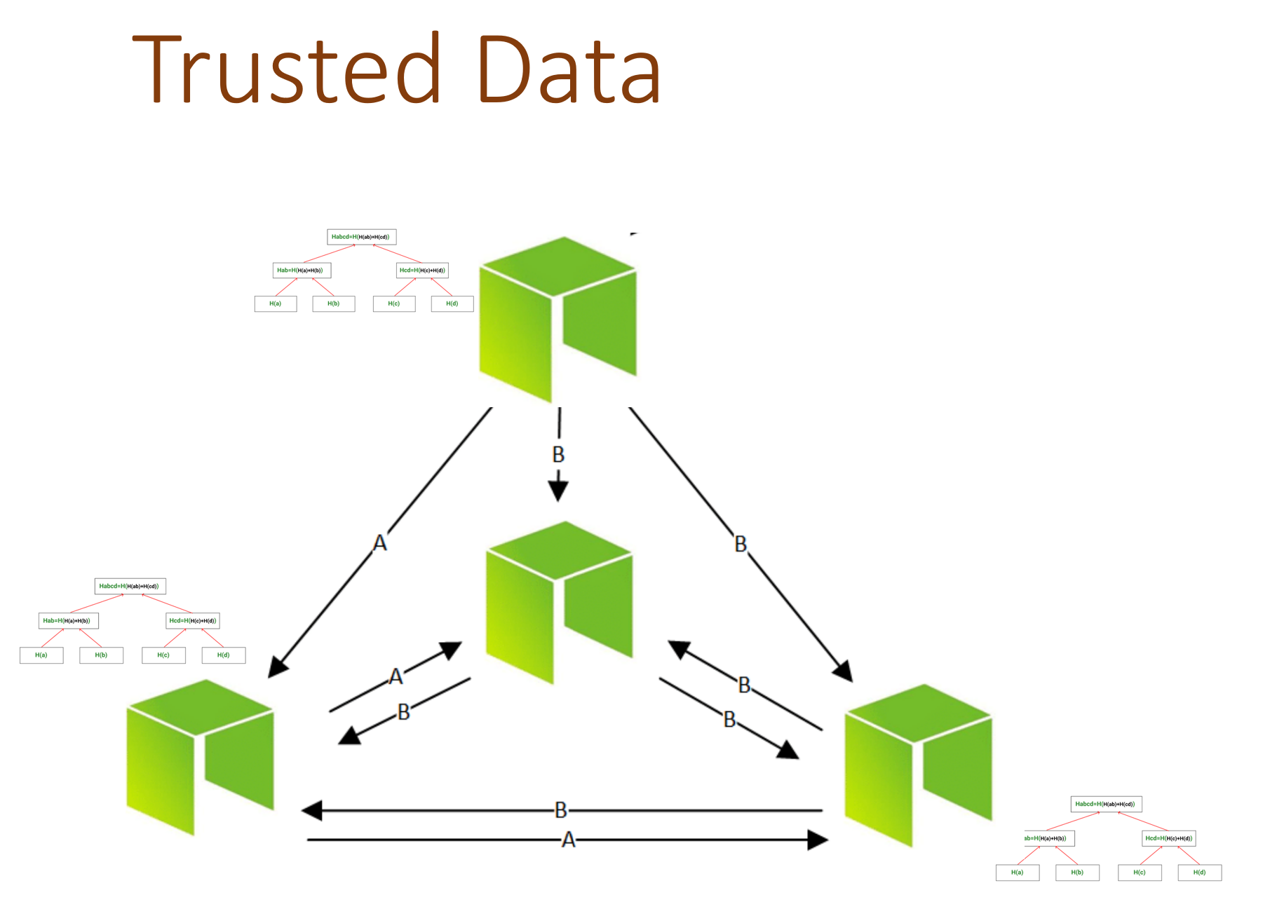
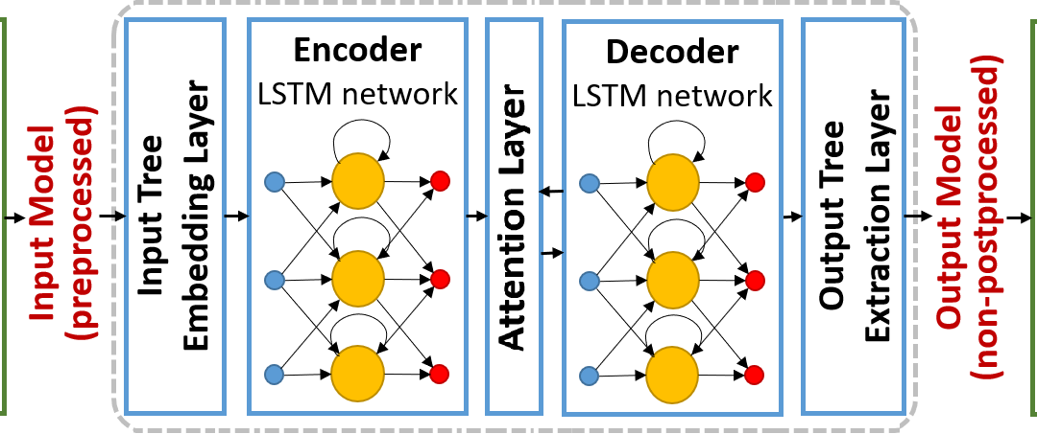
Artificial Intelligence
Data Models
Algorithms
Application
Model Selection
Explainability
Appeal and Accountability

Slide 26
Artificial Intelligence
Before this year: descriptive, diagnostic, predictive, prescriptive
After this year: generative
Future: deontic analytics
The domain of universities?

Slide 27
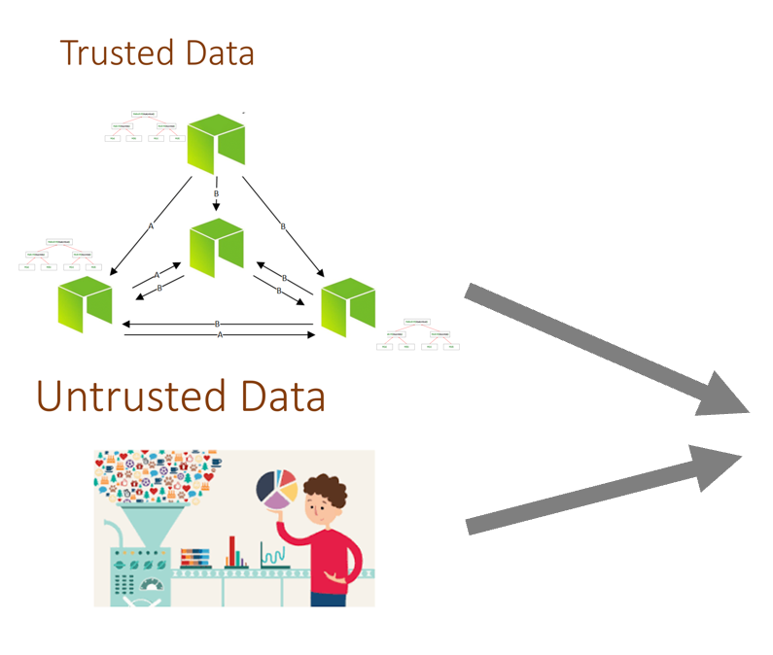
Artificial Intelligence
Generative Analytics
Generative Pre-trained Transformer 3 (GPT-3)
Generative Adversarial Network (GAN)
Contrastive Language-Image Pre-training (CLIP) e.g. DALL-E 2
AI
Research
Images Music Software Text

Slide 28
Artificial Intelligence
What do we do when everything we do, and everything we teach people to do, can be done using artificial intelligence?
AI
Research
Images Music Software Text
Notes:
George Siemens feels very similar to what I want to say this week in Lleida. It requires truly coming to grips with Artificial Intelligence. "AI presents humanity with a unique challenge that we have not faced before: an agent with intelligence that rivals our own in a growing range of domains," he says. "The accrual of inefficiencies – doing the things afforded by previous philosophies and technologies – is confronting education. How should we teach when AI is better at many cognitive tasks than we are? What should we teach when we can find and access the world's information from our phone?"

Slide 29
Institutions
Teaching and Learning
Research and Development
Innovation and Growth

Slide 30
Institutions
Teaching and Learning
Research and Development
Innovation and Growth
Our roles are changing

Slide 31
Teaching and Learning
Persistent Objects
Distributed ID (DID)
Open Educational Resources
Badges and Credentials

Slide 32
Teaching and Learning
Persistent Objects
Distributed ID (DID)
Open Educational Resources
Badges and Credentials
Ensuring individual agency and autonomy
Ensuing diversity, equity and inclusion

Slide 33
Teaching and Learning
Persistent Objects
Distributed ID (DID)
Open Educational Resources
Badges and Credentials
Accessible and usable learning resources
Support for informal and lifelong learning

Slide 34
Teaching and Learning
Persistent Objects
Distributed ID (DID)
Open Educational Resources
Badges and Credentials
Bridging the link to employability
Facilitating knowledge recognition networks

Slide 35
Teaching and Learning
Consensus
Peer Networks
Fediverse (Mastodon)
Open Community

Slide 36
Teaching and Learning
Consensus
Peer Networks
Fediverse (Mastodon)
Open Community
Building and facilitating mechanisms for people to support their own learning
For example, Personal Learning Environments

Slide 37
Teaching and Learning
Artificial Intelligence
Resource Creation
Coaching and Tutoring
Automated Assessment

Slide 38
Teaching and Learning
Artificial Intelligence
Resource Creation
Coaching and Tutoring
Automated Assessment
Build quality trusted data networks
Assess and validate AI models
Automated resource development
Support public access to the technology
Notes:
AI authored lesson plans - https://www.aare.edu.au/blog/?p=15151

Slide 39
Research and Development
Persistent Objects
Open Access Publications
Open Data

Slide 40
Research and Development
Persistent Objects
Open Access Publications
Open Data
The university’s new role: as stewards rather than creators and owners
Findable
Accessible
Interoperable
Reusable

Slide 41
Research and Development
Consensus
Research Networks

Slide 42
Research and Development
Consensus
Research Networks
We face an immediate and pressing need to redefine how consensus about facts and truth are determined in society

Slide 43
Research and Development
Consensus
Research Networks
Transparency and open research networks
Include the public in the research process
Ensure the benefits of research are shared by all, not only corporations

Slide 44
Research and Development
Artificial Intelligence
Software Development
Concept Formation
Prediction

Slide 45
Research and Development
Artificial Intelligence
Software Development
Concept Formation
Prediction
Software validation techniques
Optimization and efficiency

Slide 46
Research and Development
Artificial Intelligence
Software Development
Concept Formation
Prediction
Research ethics review
What we need vs what we want vs what we can do

Slide 47
Innovation and Growth
Market and Assets
Performance Indicators
Tokens and Recognition

Slide 48
Innovation and Growth
Market and Assets
Performance Indicators
Tokens and Recognition
Based on consent and inclusion
Definition of non-monetary assets, e.g., happiness, sustainability
Reflection of these in data

Slide 49
Innovation and Growth
Market and Assets
Performance Indicators
Tokens and Recognition
How can we include non-quantitative?
Diverse perspectives, contexts
Monitoring and feeding into data

Slide 50
Innovation and Growth
Market and Assets
Performance Indicators
Tokens and Recognition
Redefining wealth as a negative indicator
Social good (vs. ‘social credit’)

Slide 51
Innovation and Growth
Consensus
Innovation Networks
Needs Assessment

Slide 52
Innovation and Growth
Consensus
Innovation Networks
Needs Assessment
Redefinition from how to innovate to what we want from innovation
Key role for access and inclusion

Slide 53
Innovation and Growth
Artificial Intelligence
Product Development
Logistics and Distribution
Management and Admin

Slide 54
Innovation and Growth
Artificial Intelligence
Product Development
Logistics and Distribution
Management and Admin
Redefining ‘productivity’ and share of benefits
Require definition of entire product cycle
Consider impact on communities

Slide 55
Innovation and Growth
Artificial Intelligence
Product Development
Logistics and Distribution
Management and Admin
Management for sustainability
Redefine wages as benefit, not cost
Consider impact on communities

Slide 56
Concluding Remarks
This is us

Slide 57
Concluding Remarks
Everything this does depends on what we do

Slide 58
Concluding Remarks
If we want a more inclusive, sustainable and ethical society, we must make inclusive, sustainable and ethical decisions

Slide 59
Stephen Downes
https://www.downes.ca
stephen@downes.ca

