Slide 1

Open Learning in the Metaverse
Stephen Downes
https://www.downes.ca
October 18, 2022

Slide 2
As a new generation of digital technologies evolves we are awash in new terms and concepts: the metaverse, the fediverse, blockchain, web3, acitivitypub, and more.

Slide 3
Participants will see clearly the relation between such diverse concepts as digital badges and credentials, cloud-based services, open data management, activity records and tools interoperability, and persistent digital objects such as digital IDs and non-fungible tokens.

Slide 4
This is a technical presentation that is structured and designed for a non-technical audience.

Slide 5
This presentation will also consider these technologies from a critical perspective, addressing affordances alongside potential risks and impacts, pedagogical considerations, access and equity, issues of privacy and security, and the role of policy and legislation. Participants will learn specific steps they can take to limit the adverse impacts of new forms of corporate control, surveillance and oversight, disinformation, and related harms.

Slide 6
Identify and describe a range of emerging technological concepts associated with web3 and the fediverse
Suggest ways and refer to examples that demonstrate the application of these technologies in open online learning
Take specific steps to mitigate adverse impacts of these technologies on open learning

Slide 7
What is Open Learning?
“An educational approach which combines the principles of:
  learner-centredness,
  lifelong learning,
  flexibility of learning provision,
  the removal of barriers to access learning,
  the recognition for credit of prior learning experience,
  the provision of learner support,
  the construction of learning programmes in the expectation that learners can succeed,
  and the maintenance of rigorous quality assurance over the design of learning materials and support systems.”
Government of South Africa. (2017). Open Learning Policy Framework for Post-school Education and Training. Staatskoerant No. 40772, p. 363. https://static.pmg.org.za/170407openlearningframework-postschooleduc.pdf

Slide 8
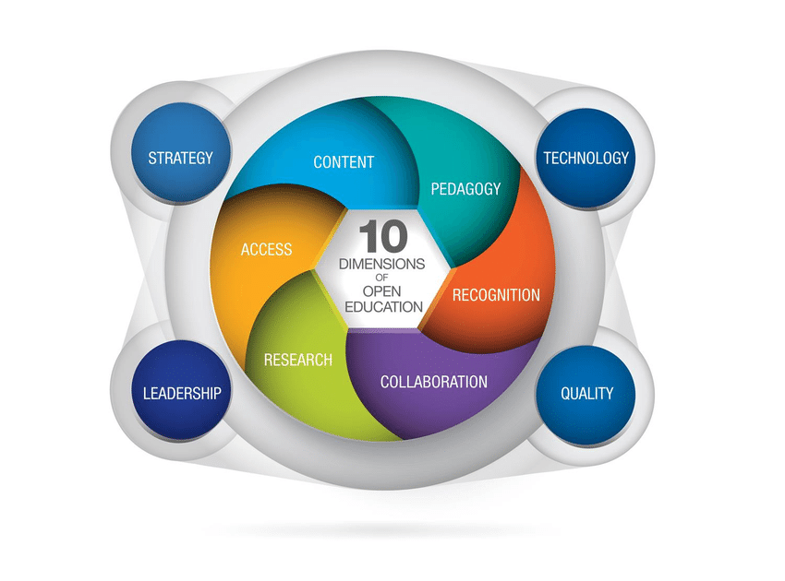
What is Open Learning?
Dimensions of open learning:
Santos, Andreia & Punie, Yves & Castaño-Muñoz, Jonatan. (2016). Opening up Education: A Support Framework for Higher Education Institutions. Publications Office of the European Union, JRC101436
https://publications.jrc.ec.europa.eu/repository/handle/JRC101436

Slide 9
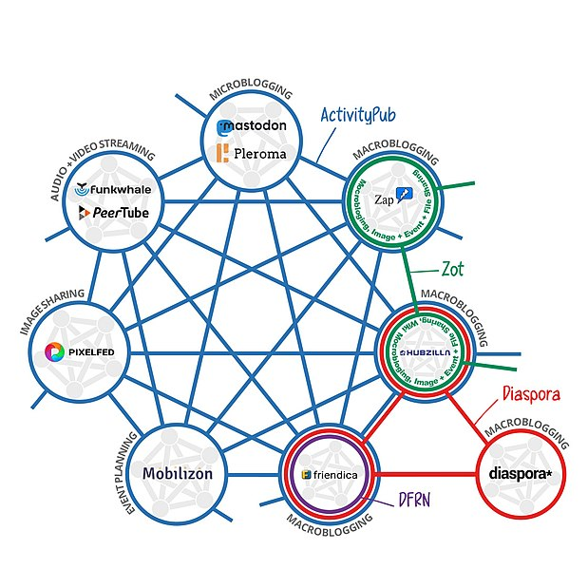
What is the Fediverse?
A network of networks:
Mike Kuketz. (2021). Das Fediverse: Social Media losgelöst von den Fesseln kommerzieller Interessen. Kuketz IT-Security Blog. https://www.kuketz-blog.de/das-fediverse-social-media-losgeloest-von-den-fesseln-kommerzieller-interessen/

Slide 10
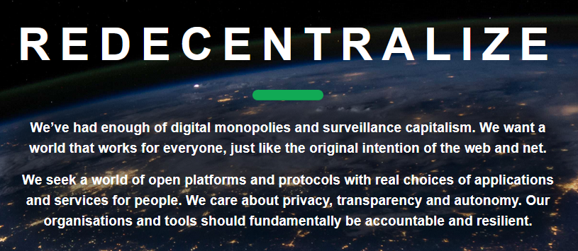
The Redecentralization of the Web
Fediverse advocates
Something in common:
Open Learning advocates
https://redecentralize.org/

Slide 11
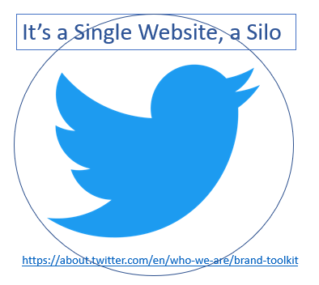
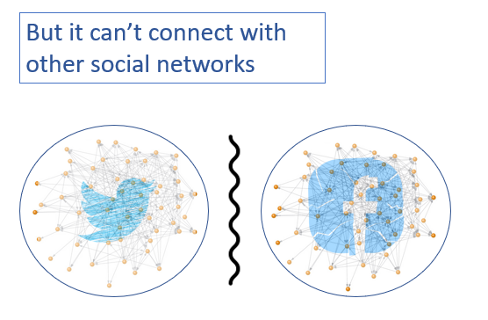
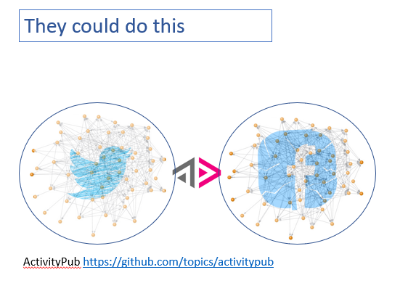
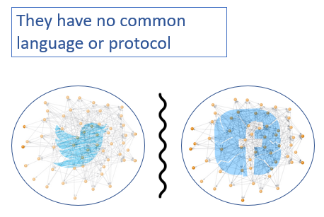
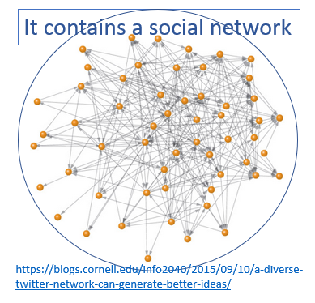
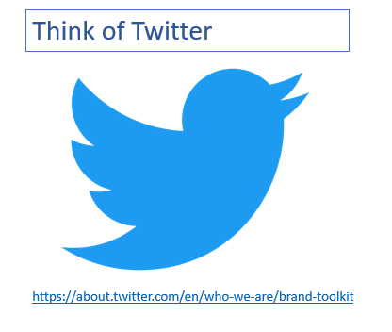
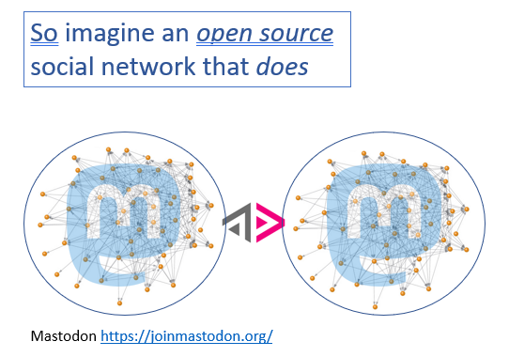
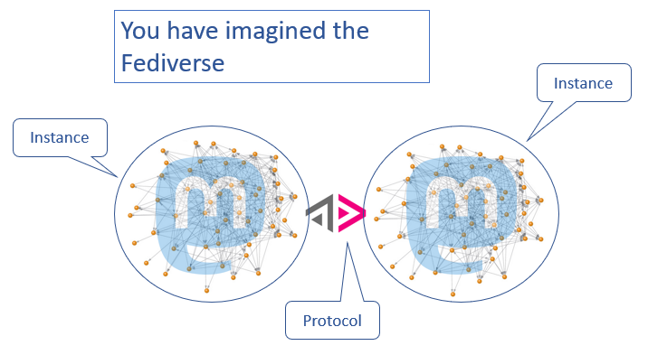
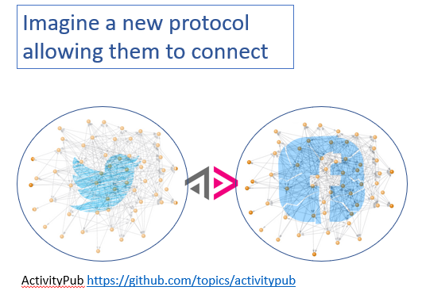
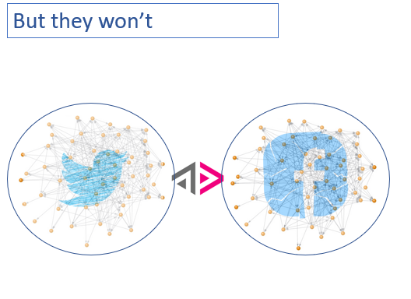
Imagining Redecentralization
A thought experiment:

Slide 12
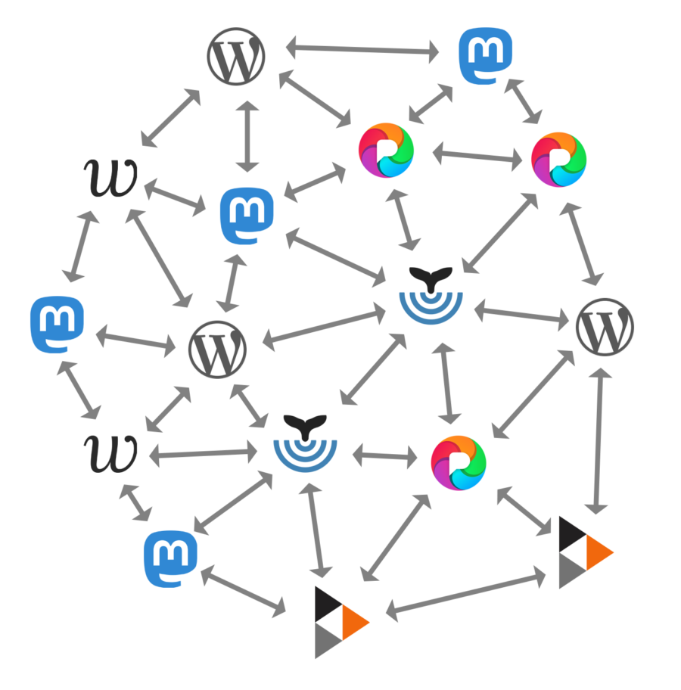
Why the Fediverse?
My site, my rules…
“That’s one of the many reasons I prefer Mastodon to Twitter: I pay with money, not my data. And there are actually enforced rules against abuse (and a specific no-Nazi policy, as the instance I’m on is based in Germany). No emphasis on ‘freedom of speech is always good and we just need more of it to drown out the Nazis’ kind of rhetoric on the instance I’ve joined.” https://blogs.ubc.ca/chendricks/tag/mastodon/
Notes:
Understanding the growth of the Fediverse through the lens of Mastodon
https://appliednetsci.springeropen.com/articles/10.1007/s41109-021-00392-5

Slide 13

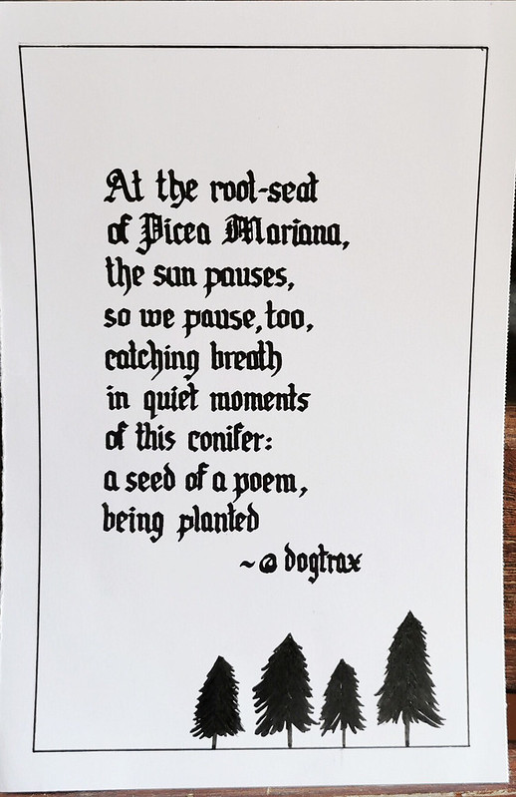
The Pedagogy of Small
Some Open Learning Applications
Exploring narratives…
Through this exploration, a series of potential benefits connected to a pedagogy of small have emerged including: making space for consent, accepting incomplete collectivities, celebrating resistance, embracing impermanence, seeking alternate possibilities, having time to have time and welcoming endings.
https://heretothere.trubox.ca/towards-a-pedagogy-of-small-a-continuing-journey/
Notes:
Chapter 16 A Pedagogy of ‘Small’: Principles and Values in Small, Open, Online Communities
In: Open(ing) Education. Authors: Tanya Elias, Laura Ritchie, Geoffrey Gevalt, and Kate Bowles
#smallstories - a modest exploration of these questions using narrative and conversational enquiry within the online context of the #smallstories hashtag on the open-source social platform Mastodon and the community-led Young Writers Project (YWP). https://prism.ucalgary.ca/bitstream/handle/1880/111613/Pedagogy%20of%20Small_EOO_Final.docx?sequence=1&isAllowed=y
https://youngwritersproject.org/ - https://heretothere.trubox.ca/towards-a-pedagogy-of-small-a-continuing-journey/ -- https://brill.com/view/book/edcoll/9789004422988/BP000027.xml
OERu social network - https://course.oeru.org/lida103/learning-pathways/orientation/oeru-social-network/ - scavenger hunt - https://pacificopencourses.col.org/as4odfl/learning-challenges/establish-a-ple/scavenger-hunt-challenge/

Slide 14

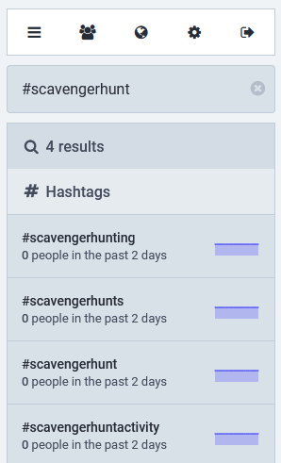
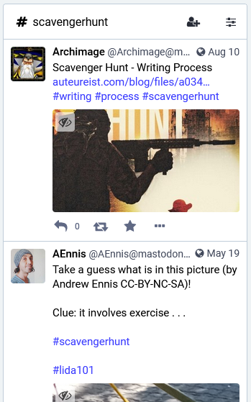
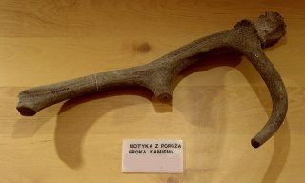
OERu Social Network
Some Open Learning Applications
Connecting with hashtags
Scavenger hunt challenge
https://pacificopencourses.col.org/as4odfl/learning-challenges/establish-a-ple/scavenger-hunt-challenge/
#scavengerhunt
Notes:
Chapter 16 A Pedagogy of ‘Small’: Principles and Values in Small, Open, Online Communities
In: Open(ing) Education. Authors: Tanya Elias, Laura Ritchie, Geoffrey Gevalt, and Kate Bowles
#smallstories - a modest exploration of these questions using narrative and conversational enquiry within the online context of the #smallstories hashtag on the open-source social platform Mastodon and the community-led Young Writers Project (YWP). https://prism.ucalgary.ca/bitstream/handle/1880/111613/Pedagogy%20of%20Small_EOO_Final.docx?sequence=1&isAllowed=y
https://youngwritersproject.org/ - https://heretothere.trubox.ca/towards-a-pedagogy-of-small-a-continuing-journey/ -- https://brill.com/view/book/edcoll/9789004422988/BP000027.xml
OERu social network - https://course.oeru.org/lida103/learning-pathways/orientation/oeru-social-network/ - scavenger hunt - https://pacificopencourses.col.org/as4odfl/learning-challenges/establish-a-ple/scavenger-hunt-challenge/
Commenting - https://fluid.quest/testing-comments-on-fediverse.html

Slide 15
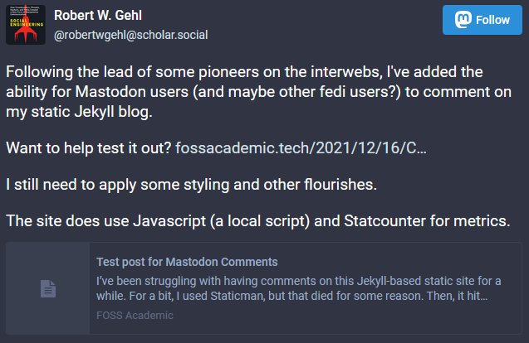
Federated Commenting
Some Open Learning Applications
Social networking and static content
https://fluid.quest/testing-comments-on-fediverse.html
https://scholar.social/@robertwgehl/107457359549037273
Notes:
Commenting - https://fluid.quest/testing-comments-on-fediverse.html

Slide 16
Not Just Microcontent
Different Types, Different Platforms
Pleroma (site): Microblogging platform
Friendica (site): Personal network
Lemmy: Link aggregator
PeerTube (Fedi account, site): Video-hosting
PixelFed (site, Fedi account): Photo Sharing
Pubcast (site): Podcasting platform
A curated list of Fediverse applications based on the ActivityPub protocol
https://codeberg.org/fediverse/delightful-fediverse-apps
Notes:
Friendica https://medium.com/welands-smithy/teaching-and-learning-with-decentralized-social-networks-friendica-and-the-fediverse-d2a7afa831bd
https://blogs.ubc.ca/etec523/2020/06/03/teaching-and-learning-with-decentralized-social-networks-friendica-and-the-free-network/
Plemora - https://pleroma.social/
Large list of apps - https://codeberg.org/fediverse/delightful-fediverse-apps
Belshaw’s fediverse field trip - https://dougbelshaw.com/blog/2019/04/03/fediverse-field-trip/

Slide 17
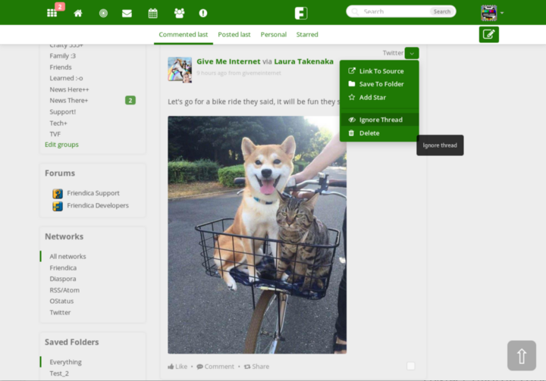
Teaching and Learning With Frendica
Some Open Learning Applications
Social networking without surveillance
“You have absolute control over your data to do with as you will: you can make it, change it, move it (in case you want to change nodes) or delete it forever. It is not subject to surveillance, data mining, or profiling for the purposes of targeted advertising or demographic data.
“This makes Friendica a space where students can make mistakes on social media that can be taken back; where our younger selves can post things that our embarrassed older selves can delete; where we aren’t 100% accountable forever.”
Matthew Turner, Teaching and learning with decentralized social networks: Friendica and the Free Network
https://medium.com/welands-smithy/teaching-and-learning-with-decentralized-social-networks-friendica-and-the-fediverse-d2a7afa831bd

Slide 18
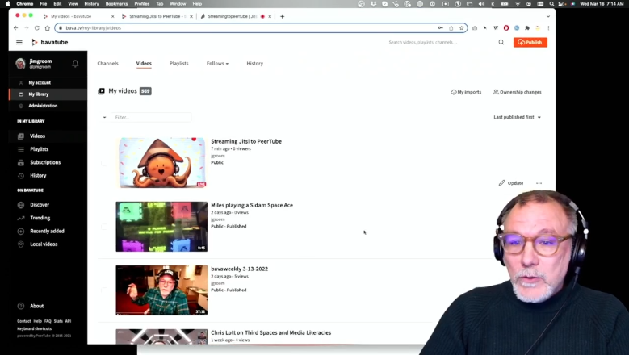
Streaming Jitsi through PeerTube Live
Some Open Learning Applications
Live conferencing in the Fediverse
“One of the cool things Taylor Jadin discovered recently is how easy it is to stream a Jitsi web video call through PeerTube. After creating a live stream in PeerTube, you would grab the stream URL and the stream key from the Live Settings tab.”
Jim Groom, https://bavatuesdays.com/streaming-jitsi-through-peertube-live/

Slide 19
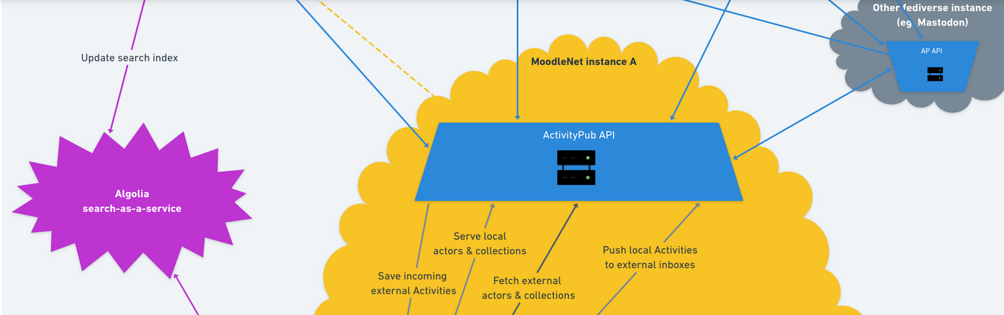
The Original MoodleNet
Some Open Learning Applications
Federated content sharing in an LMS
“There are many benefits to this type of decentralisation, including:
Participation – encourages diverse contributions
Efficiency – quicker, more locally-informed decisions
Privacy – allows organisations to keep some data private”
Doug Belshaw, https://moodle.com/news/moodlenet-what-is-a-federated-social-network/
Notes:
The original MoodleNet - https://alexcastano.com/moodlenet-more-than-a-technical-project/
https://moodle.com/news/moodlenet-what-is-a-federated-social-network/
https://new.next.moodle.net/docs/server/MoodleNetWeb.Test.Orderings.html#content
https://docs.moodle.org/dev/MoodleNet/1.0/DPIA

Slide 20
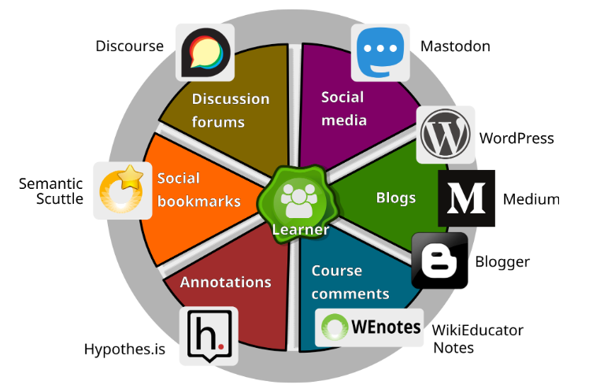
Next Generation Digital Learning Ecosystem
A Federated Infrastructure…
“An inherently dynamic
living
environment
in which the place and its inhabitants are interdependent,
and their many
interconnections enable the living
parts to grow in diverse ways.”
David C. Lane and Claire Goode, Open For All: The OERu’s Next Generation Digital Learning Ecosystem. IRRODL 24-4. https://www.irrodl.org/index.php/irrodl/article/view/5763/5630

Slide 21
Decentralization Generally
Common elements of decentralized networks
Instances (aka Hubs, Servers, Pods…)
Individual web servers that can be hosted in the network or in the cloud.
There are different types of instance: Mastodon, Frendica, etc.
Instance2
Instance2
Notes:
https://docs.joinmastodon.org/user/run-your-own/
https://justinribeiro.com/chronicle/2019/09/27/setting-up-mastodon-on-google-cloud-platform/

Slide 22
Decentralization Generally
Common elements of decentralized networks
Protocols
Languages used by instances to communicate. For example:
ActivityPub
Diaspora
Zot
Atom
SMTP
Instance2
Instance2
Notes:
https://www.w3.org/TR/activitypub/
https://en.wikipedia.org/wiki/Comparison_of_software_and_protocols_for_distributed_social_networking

Slide 23
Decentralization Generally
Common elements of decentralized networks
U1
U2
Users (aka subscribers, members, accounts)
Individuals subscribe or create accounts on individual servers
U1
U2
U3
Instance2
Instance2
Notes:
https://www.w3.org/TR/activitypub/
https://en.wikipedia.org/wiki/Comparison_of_software_and_protocols_for_distributed_social_networking

Slide 24
Decentralization Generally
@U1
Common elements of decentralized networks
U1
@U2
@U1
U2
User Addresses
Combine user name and instance address:
@U1@Instance2
@U2@Instance1
@U2
@U3
U1
U2
U3
Instance1.com
Instance2.com
Instance2
Instance2
Notes:
https://www.w3.org/TR/activitypub/
https://en.wikipedia.org/wiki/Comparison_of_software_and_protocols_for_distributed_social_networking

Slide 25



Decentralization Generally
Common elements of decentralized networks
U1
U2
Clients
Applications that connect you to instances. Mastodon clients:
Tusky
Tooter
Pinafore
etc.
Clients exist for iOS, Android, Desktop, Web, Sailfish… (or just use the default web site)
U1
U2
U3
Instance2
Instance2
https://joinmastodon.org/apps
Notes:
https://joinmastodon.org/apps

Slide 26


Decentralization Generally
Common elements of decentralized networks
U1
U2
Plugins
Extensions for other software applications that connect with the Fediverse. For Mastodon, plugins exist for:
WordPress
Drupal
Or plugins can write to ActivityPub directly, turning your blog into a Fediverse instance
U1
U2
U3
Instance2
Instance2
Notes:
https://www.commoninja.com/discover/wordpress/plugin/autopost-to-mastodon – for WordPress
Drupal - https://www.drupal.org/project/mastodon - Drupal
https://realize.be/blog/activitypub-drupal
Your federated username https://www.inmotionhosting.com/support/fediverse/pleroma/pleroma-fediverse-features/
Clients - https://github.com/tleb/awesome-mastodon

Slide 27
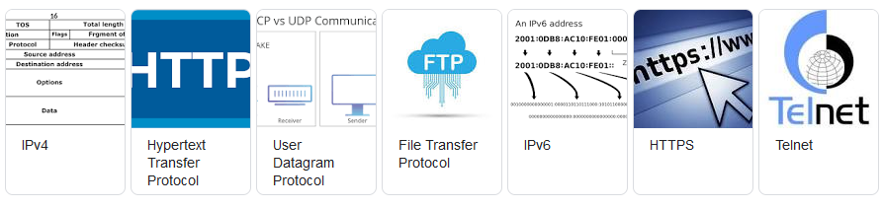
Types of Protocols
Different languages for different purposes
Content Protocol – HTML, XML, PDF
Data protocol - JSON
Linking Protocol – HREF, Dat
Transit protocol – HTTP, ActivityPub
Syndication protocol – FOAF, RSS, OPML, h-card
Notes:
https://microformats.org/wiki/h-card
Doug on protocols - https://dougbelshaw.com/blog/2018/01/31/social-network/

Slide 28
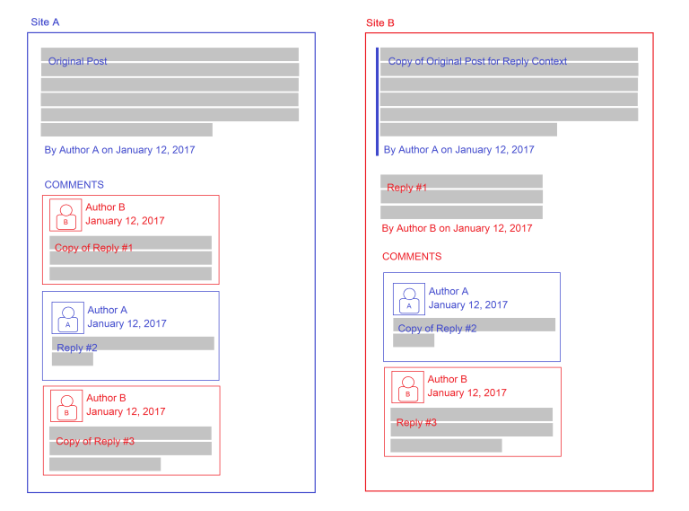
Decentralized Blog Networks
WebMention Protocol and the Indieweb
https://indieweb.org/
https://micro.blog/
WebMention allows notifications between web addresses, if both sites are set up to send and receive them
https://www.w3.org/TR/webmention/
https://webmention.io/
Webmention.io is a hosted service created to easily receive webmentions on any web page.
Notes:
https://indieweb.org/
and
Webmention - https://boffosocko.com/2018/07/19/webmentions-enabling-better-communication-on-the-internet-2/
Turn your blog into a fediverse server - https://mastodon.oeru.org/@lightweight
https://mstdn.social/@feditips/109100055551093635
https://www.wired.com/2013/12/indieweb-principles/

Slide 29
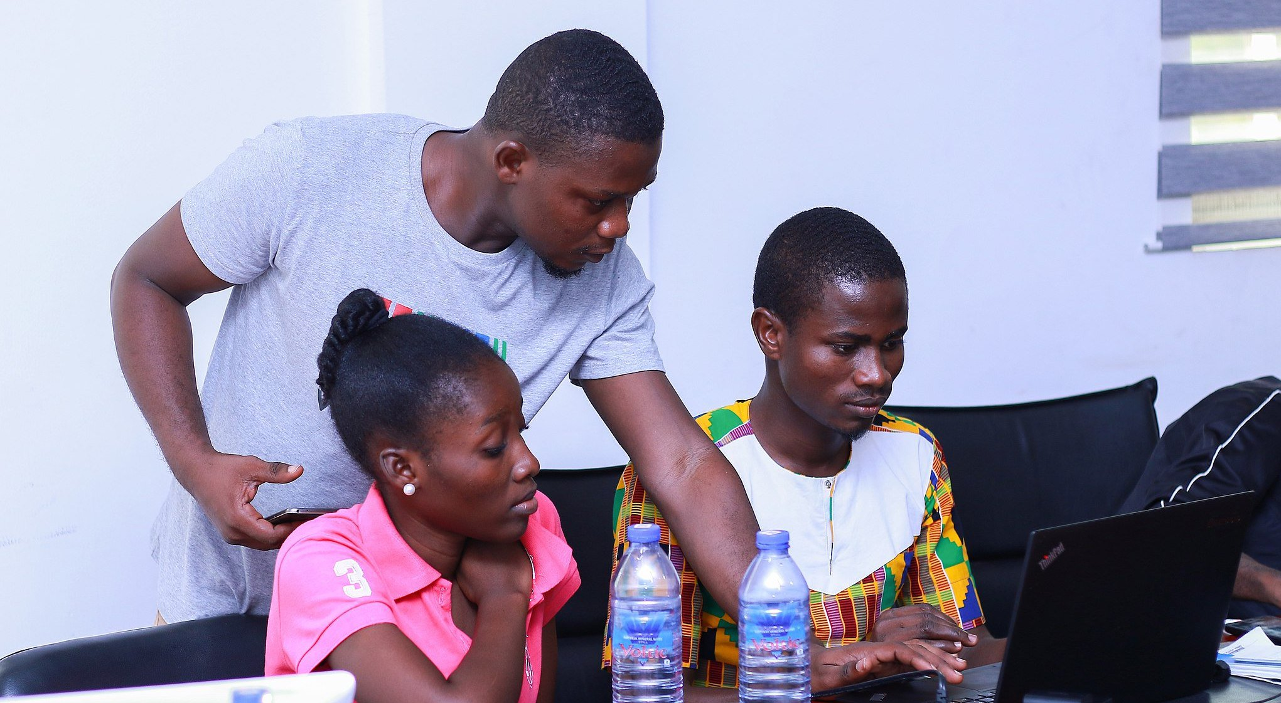
Indieweb for Ghana
Some Open Learning Applications
Creating a personal web presence
We will be using indieweb building blocks to help students and educators create their own OER. Our program will provide free personal websites to students and educators. As members begin to curate and create OER on their own sites, the community will write or remix these resources to develop collections of community-approved OER.
Abigail Cabunoc Mayes, IndieWeb and OER Ghana | an Open Leaders X program, Mozilla https://foundation.mozilla.org/en/blog/indieweb-and-oer-ghana-open-leaders-x-program/
Notes:
https://indieweb.org/
and
Webmention - https://boffosocko.com/2018/07/19/webmentions-enabling-better-communication-on-the-internet-2/
Turn your blog into a fediverse server - https://mastodon.oeru.org/@lightweight
https://mstdn.social/@feditips/109100055551093635
https://www.wired.com/2013/12/indieweb-principles/

Slide 30
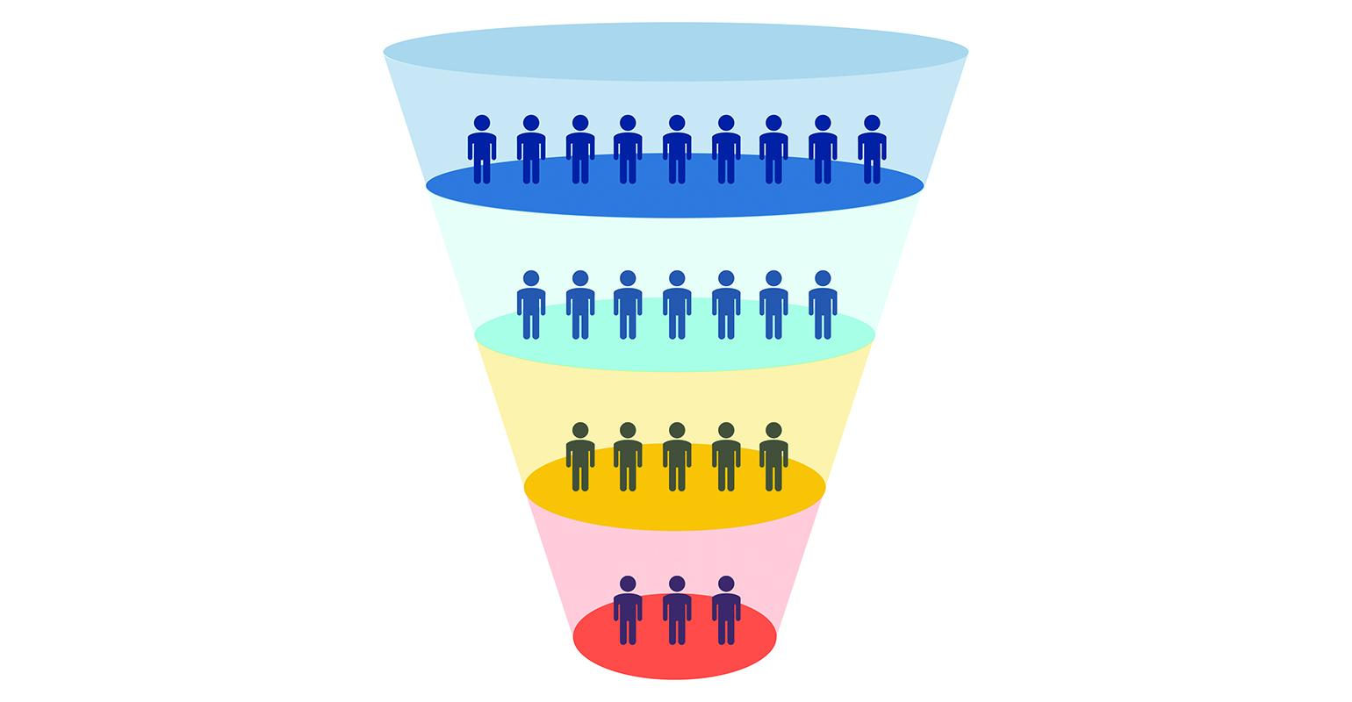
Persistence
How do you know it’s the same thing?
ARK http://www.cdlib.org/services/uc3/arkspec.pdf
CrossRef http://www.crossref.org
DataCite http://www.datacite.org
DOI http://www.doi.org/
Handle http://www.handle.net/
Perma.CC https://perma.cc/about
PURL http://archive.org/services/purl/
URN http://tools.ietf.org/html/rfc3986
Notes:
https://www.dpconline.org/handbook/technical-solutions-and-tools/persistent-identifiers

Slide 31


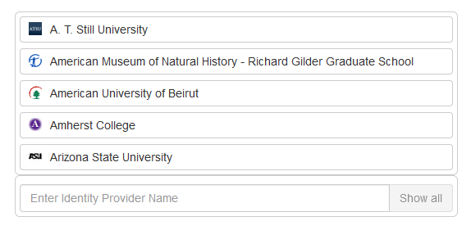
Identity Federations
Some Open Learning Applications
Single Sign-On and the silo identity providers
InCommon uses an identity federation system called Shibboleth to provide a single sign-on.
Shibboleth is an implementation of the Security Assertion Markup Language (SAML) protocol which is similar in spirit to systems used by many webapps that allow you to log in via Google, Facebook, or Twitter.
https://apps.cirrusidentity.com/console/ds/index?entityID=https%3A%2F%2Fsso.educause.edu%2Fsp
Notes:
https://incommon.org/
https://iam.harvard.edu/resources/saml-shibboleth-integration
https://guides.dataverse.org/en/latest/installation/shibboleth.html
Federated identity authentication mechanisms such as OpenID and SAML?
Identity federations – e.g. InCommon https://incommon.org/ Shibboleth - https://www.shibboleth.net/about-us/
https://incommon.org/software/shibboleth/ “Shibboleth is the linchpin that securely authenticates identities within the InCommon Federation. It is a single sign-on (SSO) solution that allows management to make informed authorization decisions in a privacy-preserving manner. “
An educause login - https://apps.cirrusidentity.com/console/ds/index?entityID=https%3A%2F%2Fsso.educause.edu%2Fsp

Slide 32
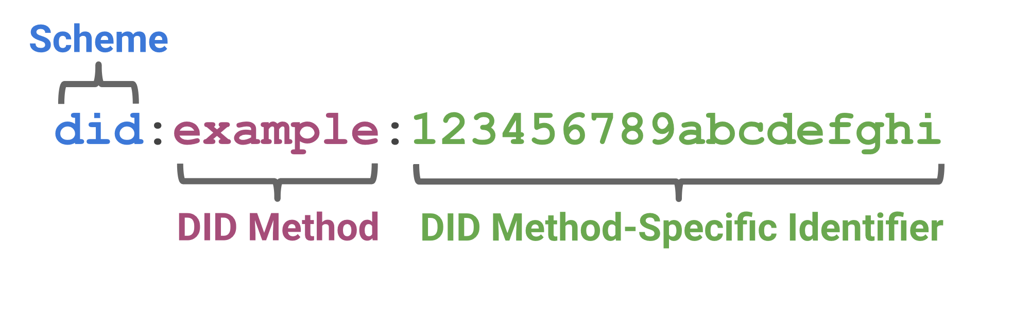
Decentralized Identity
Self-Sovereign Identity and Other Remedies
decentralized identifier (DID) - A globally unique persistent identifier that does not require a centralized registration authority and is often generated and/or registered cryptographically. The generic format of a DID is defined in 3.1 DID Syntax. A specific DID scheme is defined in a DID method specification. Many—but not all—DID methods make use of distributed ledger technology (DLT) or some other form of decentralized network. https://w3c.github.io/did-core/
Notes:
https://www.dpconline.org/handbook/technical-solutions-and-tools/persistent-identifiers
DID – W3C DID Core - https://w3c.github.io/did-core/
Advantages of Decentralized ID (DID) over federated identity - https://stackoverflow.com/questions/56113106/advantages-of-decentralized-id-did-over-federated-identity
“Open source and standards organizations (e.g. Decentralized Identity Foundation - https://identity.foundation) are also working on another key component of decentralized identity: encrypted personal datastores. “
Webfinger
Webfinger in Moodle - https://tracker.moodle.org/browse/MDLNET-233

Slide 33
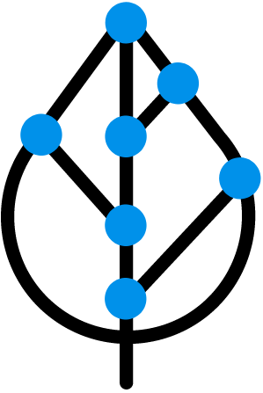
DID and the Fediverse
Same identity, different instances
Our goal is to bring self sovereign identity concepts to the current ActivityPub fediverse as soon and as securely as possible.
The hypothesis behind that goal is that long term stability of a federated service crucially depends on persistent trust relations across all participants (developers, admins, users) that are not distorted by the implicit hierarchical structure of a centralized reference system, such as DNS.
Sidetree
https://identity.foundation/sidetree/spec/
https://blog.identity.foundation/tag/fediverse/
Paul Fuxjaeger, Michael Pimmer and Markus Sabadello , Gently introducing DIDs to the Mastodon/ActivityPub Fediverse https://github.com/WebOfTrustInfo/rwot9-prague/blob/master/topics-and-advance-readings/fediverse-did-integration.md
Notes:
Our goal is to bring self sovereign identity concepts to the current ActivityPub fediverse as soon and as securely as possible.
The hypothesis behind that goal is that long term stability of a federated service crucially depends on persistent trust relations across all participants (developers, admins, users) that are not distorted by the implicit hierarchical structure of a centralized reference system, such as DNS.
https://decentralized-id.com/companies/danube-tech/
https://github.com/WebOfTrustInfo/rwot9-prague/blob/master/topics-and-advance-readings/fediverse-did-integration.md
https://blog.identity.foundation/tag/fediverse/

Slide 34
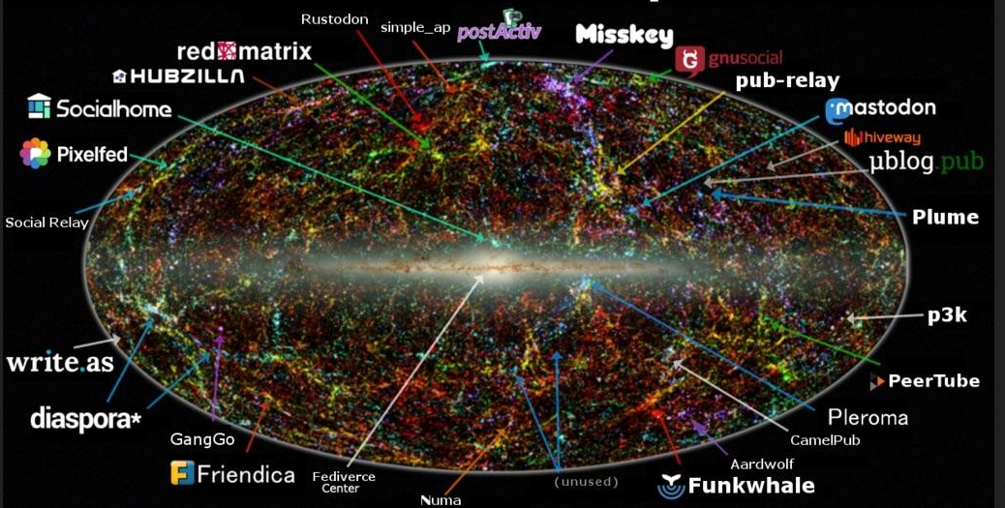
Following
Some Open Learning Applications
Connecting people in the Fediverse
OPML - https://github.com/Downes/OPML
Trunk - https://communitywiki.org/trunk
https://communitywiki.org/trunk/grab/Open%20Education
Open Educators on Mastodon
https://edtechfactotum.com/open-educators-on-mastodon/
But note: you can’t just click - https://meshedinsights.com/2017/11/15/open-education-consortium/
https://www.linkedin.com/pulse/distributed-future-already-here-its-just-evenly-part-shanan-holm-1d/
Notes:
https://post.lurk.org/@320x200/103590378544522784

Slide 35
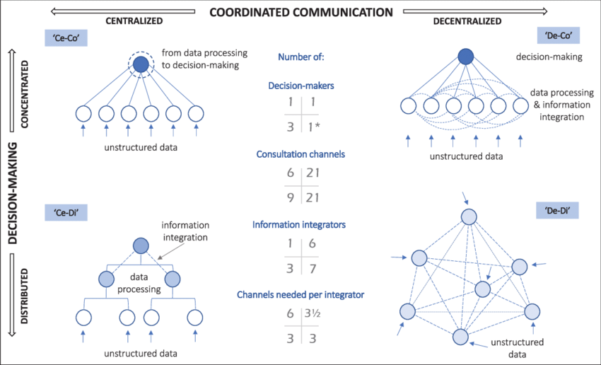
More different types of decentralization
These core concepts apply more generally
HTML pages
Software repositories
Messaging
Content and data
Ledgers and finance
Virtual worlds
Jean-Philippe Vergne. Decentralized vs. Distributed Organization: Blockchain, Machine Learning, and the Future of the Digital Platform. https://www.researchgate.net/figure/The-Decentralization-and-Distribution-of-Organization_fig3_344955210

Slide 36
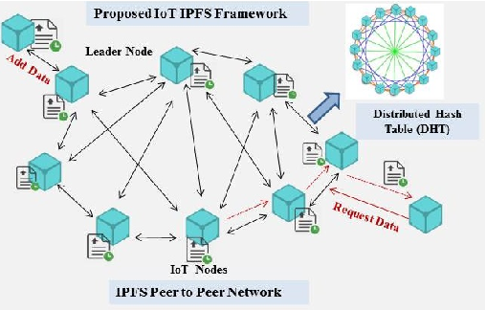
Decentralized Content and Data
Dat: and IPFS
Solid - https://solidproject.org/

Slide 37
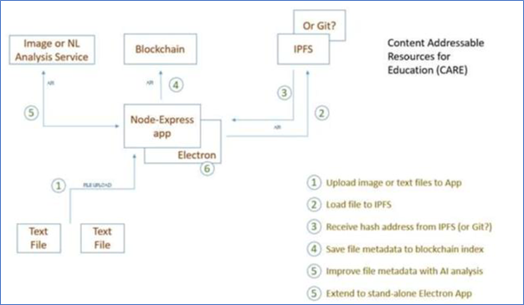
Decentralized Content and Data
Content Addressable Resources for Education
“Content Addressable Resources for Education (CARE) as a method for addressing issues of scale, access, management and distribution that currently exist for open educational resources (OER) as they are currently developed in higher education. CARE is based on the concept of the distributed web (dweb) and, using (for example) the Interplanetary File System (IPFS) provides a means to distributed OER.”
https://eric.ed.gov/?id=ED608573

Slide 38
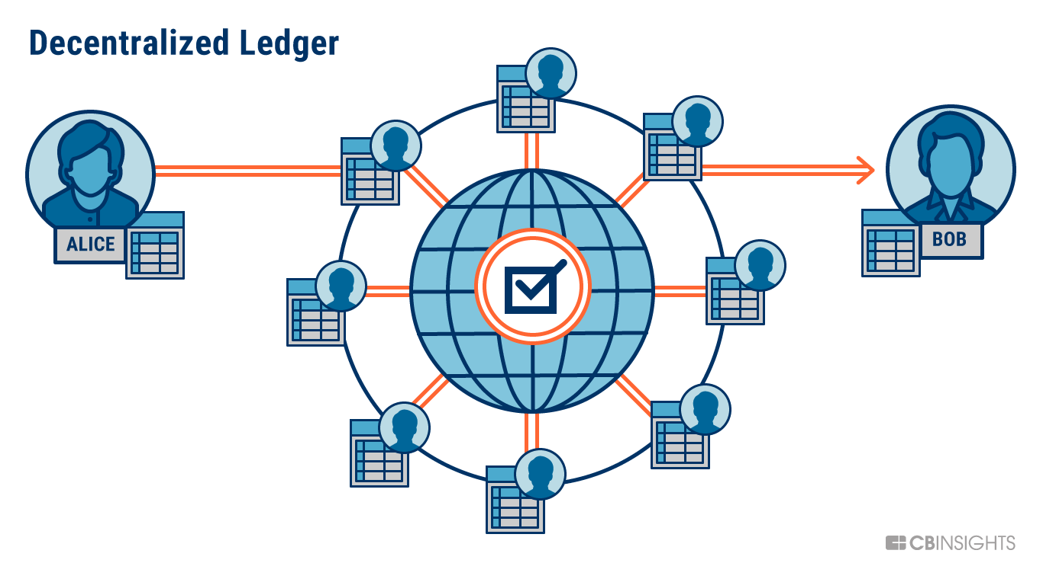
Decentralized Ledgers
Blockchain: Bitcoin, Ethereum, and the rest
Notes:
https://www.cbinsights.com/research/what-is-blockchain-technology/

Slide 39

Decentralized Ledgers
Some Open Learning Applications
Decentralized credentials
Learning application: credentials e.g. Qualichain. A key output of this pilot is the Badged Open Course (BOC): “Decentralising Education Using Blockchain Technology”, which introduces Blockchain technology and its potential for decentralising and transforming education
https://qualichain-project.eu/the-role-of-web-3-0-and-blockchain-in-the-future-of-education/
https://www.open.edu/openlearncreate/course/view.php?id=7981
Notes:
https://www.open.edu/openlearncreate/course/view.php?id=7981
Landscape analysis - https://alfresco.epu.ntua.gr/share/proxy/alfresco-noauth/api/internal/shared/node/RMbJFtv5SdK6uAuHXg3mmw/content/QualiChain_Landscape%20Analysis%2C%20QualiChain%20Concept%20and%20Potential%20Investigation%20Report_v1.00.pdf?c=force&noCache=1595721600040&a=true

Slide 40
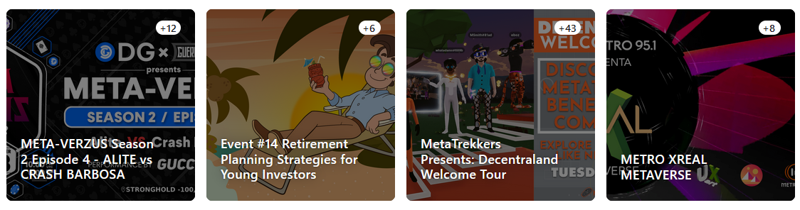
Decentralized worlds
One world, many servers…
Metaverse
Minecraft? https://blog.tcea.org/tag/gaming/
Decentraland: https://decentraland.org/

Slide 41
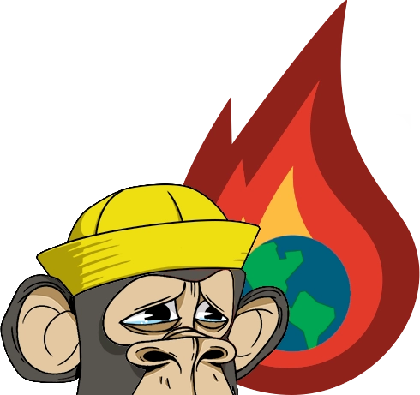
Web3
Web3 is all of the above
"On web3, your access credentials are not based on a username or password, but is based on cryptographic proof of you are who you are, and that proof is the same for any and all websites or platforms users access.“ https://web.archive.org/web/*/https://digiday.com/media/wtf-is-web3/
History of web3 Through the Pages of OLDaily
https://www.downes.ca/history_web3.htm
https://web3isgoinggreat.com/
Notes:
https://web3isgoinggreat.com/

Slide 42
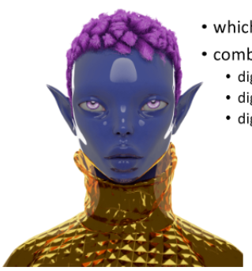
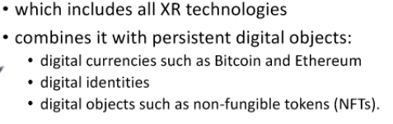
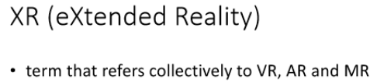
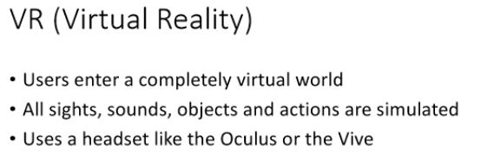
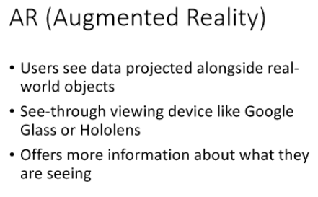
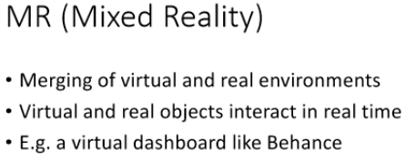
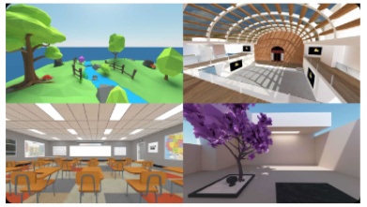

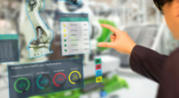
The Metaverse
S.Downes
2022 CC-by

Slide 43
Issues
Sustainability
Preventing abuse - https://redecentralize.org/events/2019-conference/notes/preventing-abuse-in-decentralized-systems
Social media choices in open education - https://connect.oeglobal.org/t/social-media-choices-for-open-educators/3892/3
When inclusion excludes – do interaction patterns really change on Mastodon? https://jennymackness.files.wordpress.com/2018/02/when-inclusion-excludes-mfjm-280218.pdf
https://www.robinwils.com/technology/why-the-fediverse-sucks/

Slide 44
Stephen Downes
https://www.downes.ca

Slide 45
Design Considerations
Diversity, openness, interactivity(centralization),autonomy
5Rs - https://madland.ca/writing/2eyed-open-education - respect, reciprocity, relevance, responsibility, relationships
Notes:
with the five R's of Indigenous education: respect, reciprocity, relevance, responsibility, and relationships.
Respect.
It is critical for Indigenous learning environments to be respectful of Indigenous values, specifically the lack of hierarchy in Indigenous cultures where every person is equal to every other person. This can clearly be a problem as modern Canadian universities are very hierarchical and bureaucratic, leading Indigenous learners to feel alienated.
Reciprocity.
For decades, Indigenous communities have been the objects of Western greed, research, and experimentation with researchers seeking only to answer an academic question. This extractive exploitation of Indigenous knowledge is deeply problematic. It is essential for both research and reconciliatory educational programs to be mutually beneficial with the community receiving tangible and durable benefits.
Relevance.
Indigenous learning environments must be relevant to the learners, meaning that the learning experiences must go beyond studying texts. There must be allowance for learners to engage with their own community needs and also to experience a sense of a learning community within the course.
Responsibility.
With the deeply interrelated nature of Indigenous communities, it is important for there to be a clear sense of responsibility for each individual to uphold the cultural norms of the community. This includes responsibilities within the course, but also responsibilities to the community and family.
Relationships.
Relationships are the foundation of Indigenous education. The other 4 R's depend on the existence and maintenance of healthy relationships within the course and also external to the course.

Slide 46
Misc
Social search https://search.noc.social/?search=%23school e.g. for #school
Distributed knowledge graph - https://anagora.org/index - or distributed wiki
POSSE - post here first and syndicate/cross-post duplicates out to them (POSSE). - https://boffosocko.com/
Edurne 6 and I have been working on HAHA Academy 7 which seeks to enable p2p knowledge sharing and self-directed learning. (The software component is part of the #software:commonspub ecosystem). https://socialhub.activitypub.rocks/t/the-fediverse-as-an-educational-platform/983/4

Slide 47
Misc (2)
+1 for THIS topic. We’re working on LearnAwesome.org 2 which is creating a learning map - and already supports ActivityPub. Both users and topics have inboxes and outboxes and it seems to be working well with about 3,000 active users. https://socialhub.activitypub.rocks/t/the-fediverse-as-an-educational-platform/983/5
Personal hubs - https://myhub.ai/@mathewlowry/?tags=decentralised
Activity streams - https://gh.fakev.cn/topics/activitystreams
Nonlinear blog - https://feeldothink.org/index.php/Feel_Do_Think_-_a_nonlinear_blog
Learning System based on Decentralized Learning Model using
Blockchain and SNS https://pdfs.semanticscholar.org/b118/34fb98bd3abd195e0efd9610630ee8a0b2ed.pdf

Slide 48
The iron law
https://www.bmc.com/blogs/cap-theorem/

