Slide 1
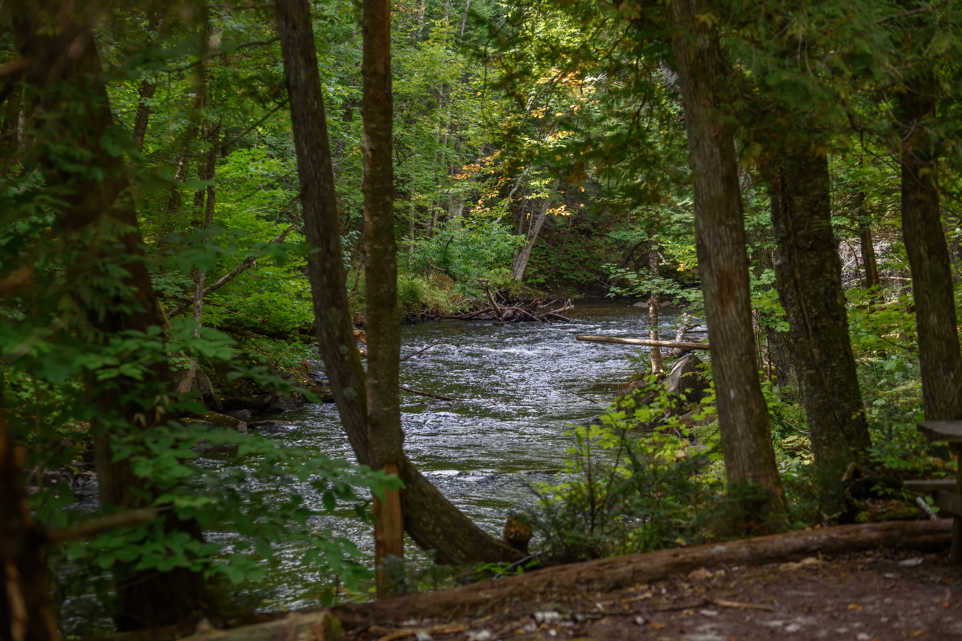

The Future of Learning Technology: 10 Key Tools and Methods
Stephen Downes

Slide 2
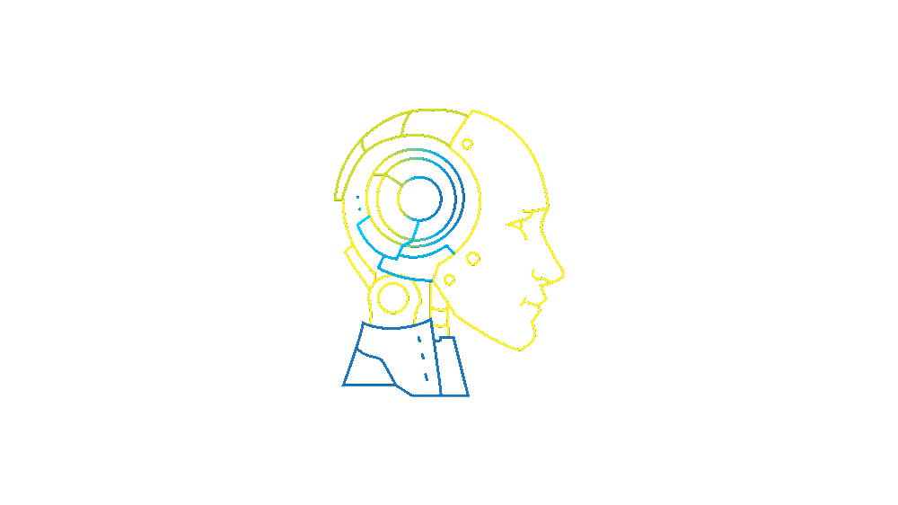
The Future of Learning is Here…
Artificial Intelligence
Notes:
Image: https://www.dignari.com/projects/artificial-intelligence

Slide 3

The Future of Learning is Here…
Metaverse
Notes:
Image: https://www.behance.net/gallery/131425971/Lets-explore-the-metaverse-together/report

Slide 4
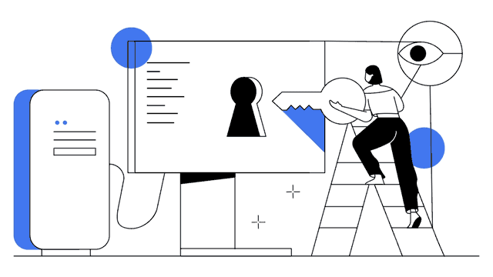
The Future of Learning is Here…
Blockchain
Notes:
Image: https://www.behance.net/gallery/131425971/Lets-explore-the-metaverse-together/report

Slide 5


But…
The pivot to remote learning was in many ways flawed.
Arrraughhhh!
Notes:
Images:
https://www.300feetout.com/stories/5-tips-for-social-media-marketing-post-pandemic/300feetout_zoom-grid/
https://tenor.com/view/cv19-virus-lol-laugh-gif-16748847

Slide 6
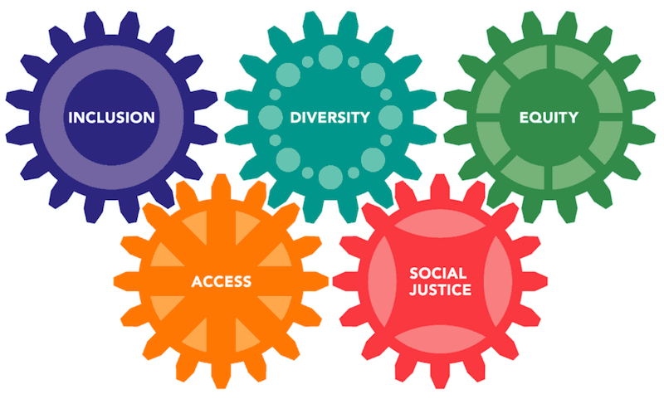
But…
The pivot to remote learning also exposed issues of equity and access.

Slide 7

These Issues Are In The Balance
Future Tools and Methods
Blockchain
AI
Metaverse
Pedagogy
Access
Here’s what we can do to get ready….

Slide 8
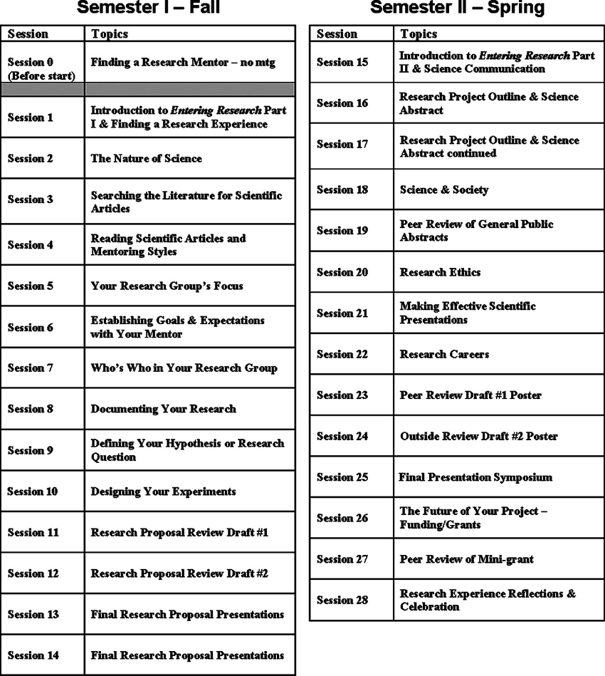
1. The Web of Data
The most significant long-term transformation in knowledge and learning is the pedagogical transition from narrative to data.
This is not a course
Notes:
Image: https://www.researchgate.net/publication/44643376_Entering_Research_A_Course_That_Creates_Community_and_Structure_for_Beginning_Undergraduate_Researchers_in_the_STEM_Disciplines

Slide 9
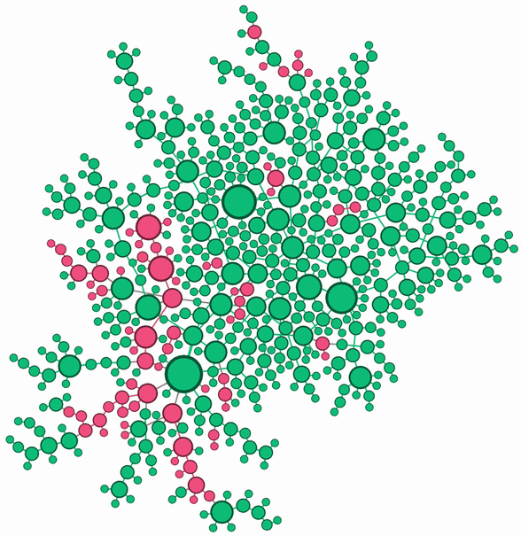
1. The Web of Data
We are transformed from storytellers and narrators to explorers and guides.
This is
Notes:
Courses need to be designed as changing and dynamic environments. The course curriculum becomes the web of data informing this environment, ideally connected to real-world data
Image: https://math.utsa.edu/directory/zhuolin-qu/large_network-zhuolin-qu/

Slide 10

1. The Web of Data
Points to Consider:
Open Data
Data Literacy
Data Ethics
Designing for Data
https://open.canada.ca/en/open-data
https://www.crossref.org/
Notes:
Image: https://cnu.libguides.com/jgstats

Slide 11
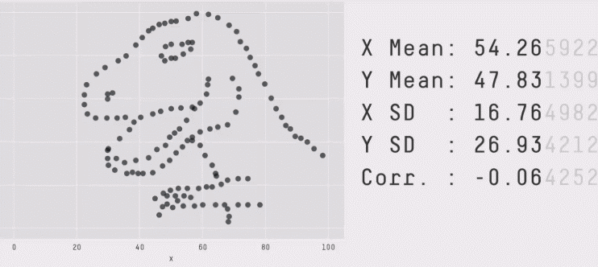
1. The Web of Data
Points to Consider:
Open Data
Data Literacy
Data Ethics
Designing for Data
https://www.downes.ca/files/docs/FINAL_May_2022_Data_Literacy_Report.pdf
Notes:
Image: https://cnu.libguides.com/jgstats

Slide 12
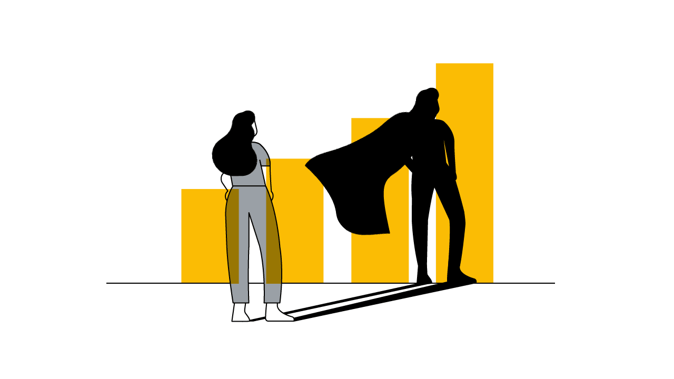
1. The Web of Data
Points to Consider:
Open Data
Data Literacy
Data Ethics
Designing for Data
https://royalsocietypublishing.org/toc/rsta/2016/374/2083

Slide 13
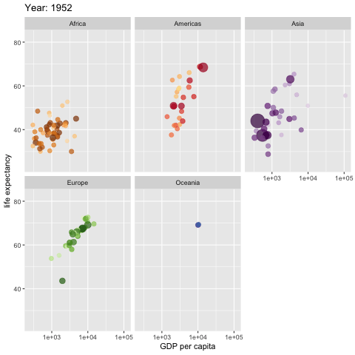
1. The Web of Data
Points to Consider:
Open Data
Data Literacy
Data Ethics
Designing for Data
https://towardsdatascience.com/
Notes:
Courses need to be designed as changing and dynamic
environments. The course curriculum becomes the web of data
informing this environment, ideally connected to real-world data and
authentic problems.
Image: https://towardsdatascience.com/animating-your-data-visualizations-like-a-boss-using-r-f94ae20843e3
See also: https://animatedtraffic.tumblr.com/

Slide 14
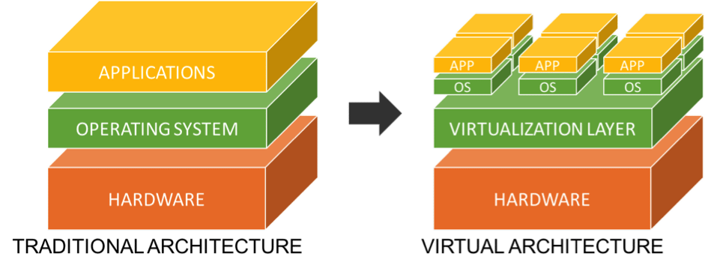
2. Virtualization
Virtualization takes a traditional computer environment…
Notes:
Image: https://resources.infosecinstitute.com/topic/11-points-consider-virtualizing-security/

Slide 15
2. Virtualization
… and simulates it with software using a ‘virtualization layer’
This allows one computer to run different virtual environments called ‘images’
Notes:
Image: https://resources.infosecinstitute.com/topic/11-points-consider-virtualizing-security/

Slide 16
2. Virtualization
The same image can run on many different computers

Slide 17
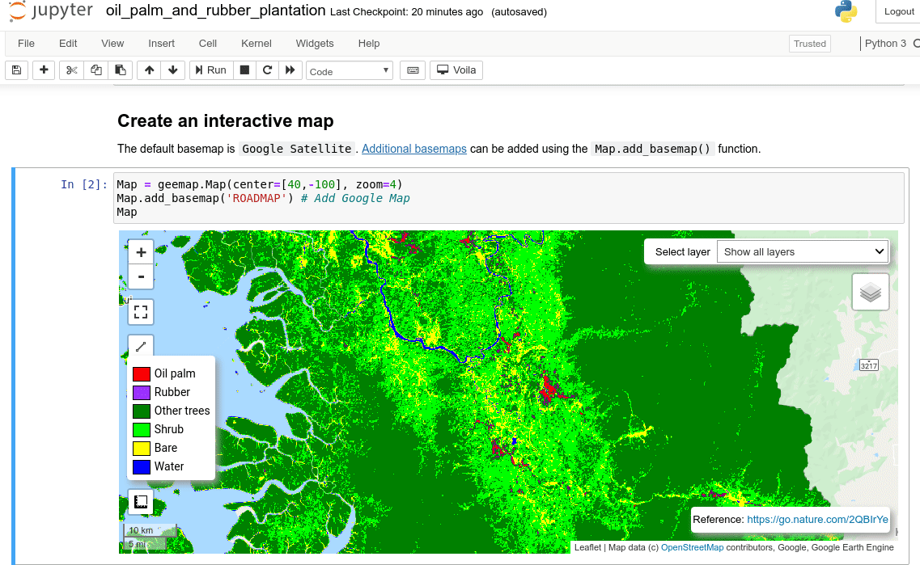
2. Virtualization
These new resources allow us to redefine what we mean by “textbooks” and even “learning objects.”
Students can easily access a complex computing environment preconfigured to support learning or research
Notes:
Image: https://giswqs.medium.com/a-jupyter-notebook-example-for-interactive-mapping-with-earth-engine-ipyleaflet-and-ipywidgets-f1790a9fae0d

Slide 18
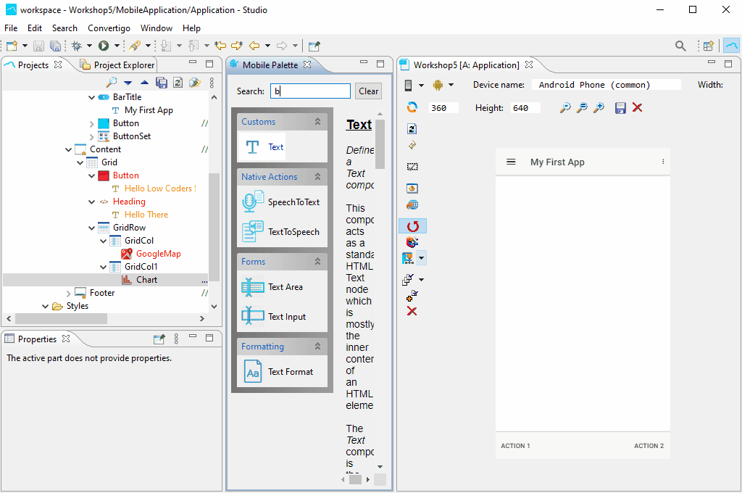
2. Virtualization
Or they can build their own resources…
Notes:
Image: https://www.convertigo.com/
No-code platforms

Slide 19
2. Virtualization
Or they can build their own resources…

Slide 20
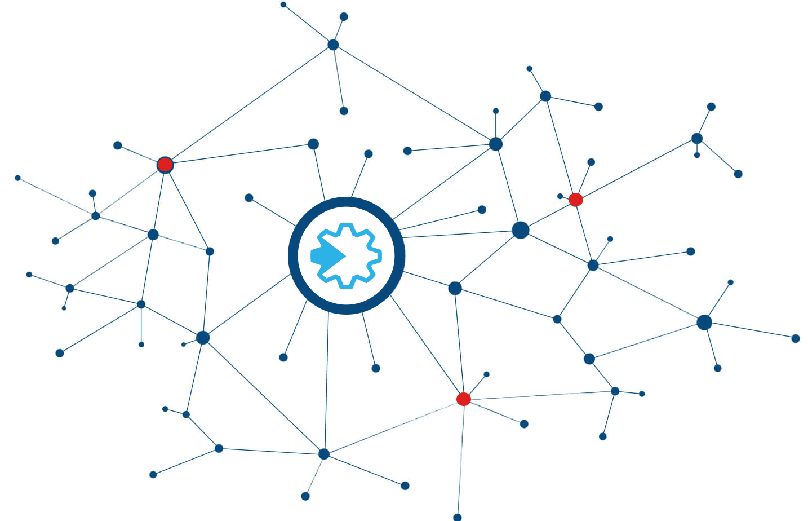
3. Graph
A graph is a network of things that are connected together.

Slide 21
3. Graph
A graph is a network of things that are connected together.
A social graph connects people

Slide 22
3. Graph
A graph is a network of things that are connected together.
A hash graph connects hashes

Slide 23
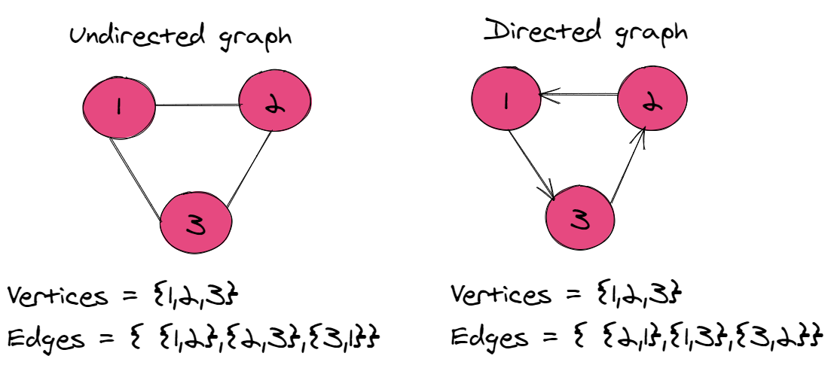
3. Graph
A graph can be directed or undirected
Notes:
Image: https://algodaily.com/lessons/implementing-graphs-edge-list-adjacency-list-adjacency-matrix

Slide 24
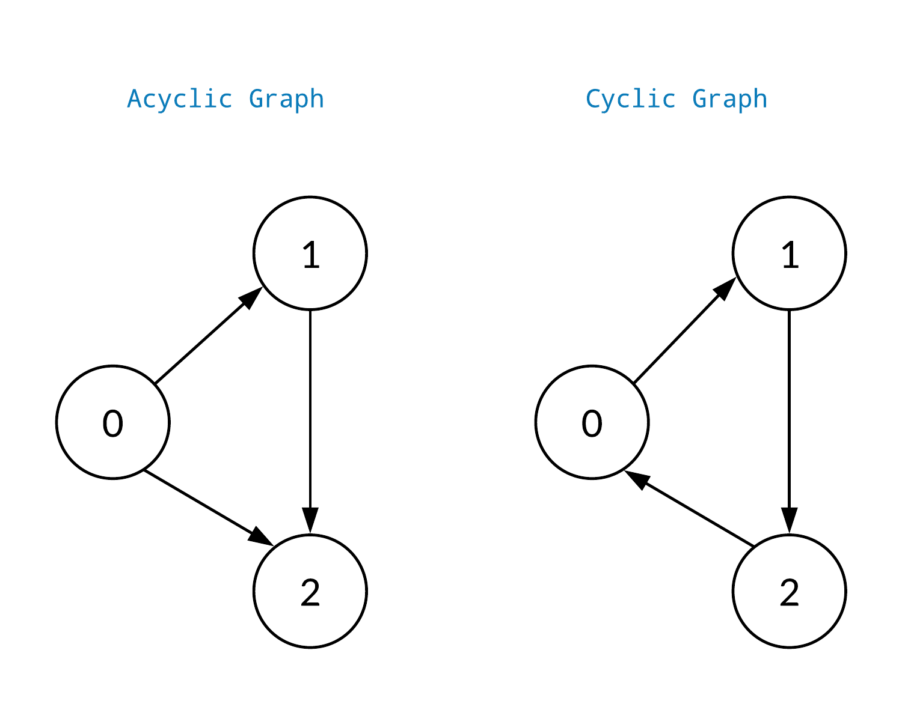
3. Graph
A graph can be cyclic or acyclic

Slide 25
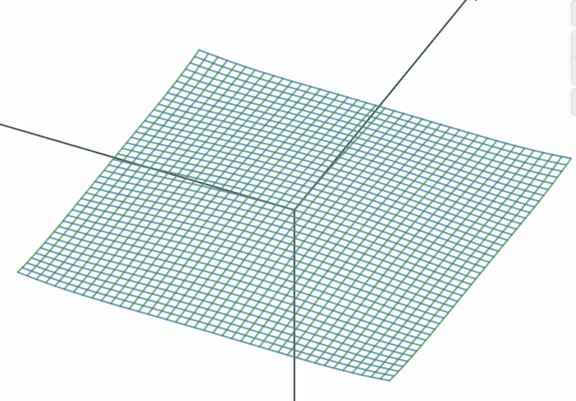
3. Graph
Graphs are important because they represent knowledge, not only as collections of facts and statements, but also as patterns of connectivity.

Slide 26
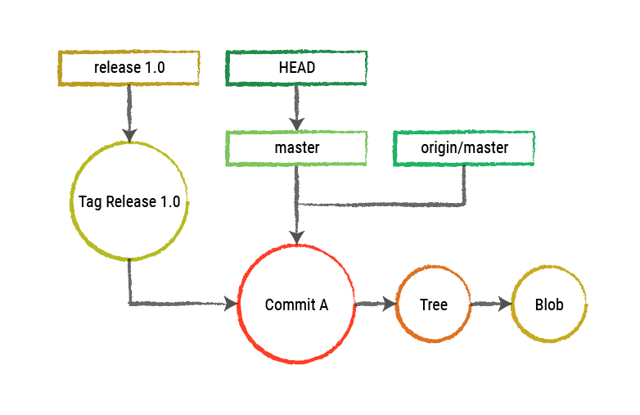
3. Graph
Graphs are everywhere in modern technology
GitHub
https://blog.10pines.com/2018/05/21/the-model-behind-git/

Slide 27
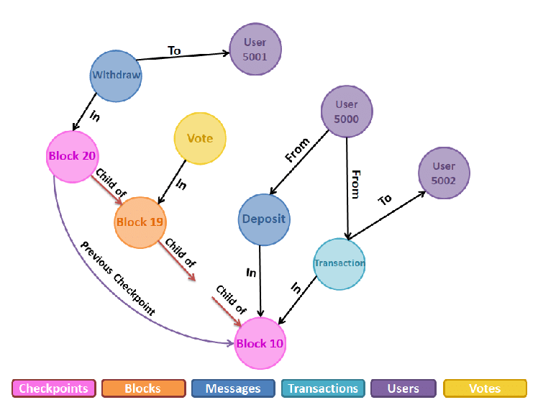
3. Graph
Graphs are everywhere in modern technology
Blockchain
https://www.researchgate.net/publication/342616825_A_Graph_Model_Based_Blockchain_Implementation_for_Increasing_Performance_and_Security_in_Decentralized_Ledger_Systems

Slide 28
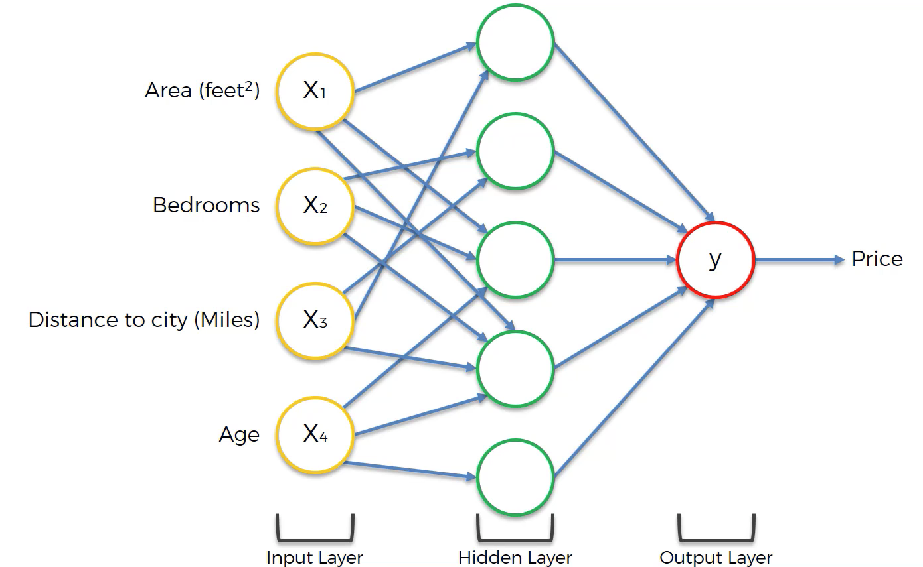
3. Graph
Graphs are everywhere in modern technology
Neural Networks
https://www.freecodecamp.org/news/deep-learning-neural-networks-explained-in-plain-english/

Slide 29
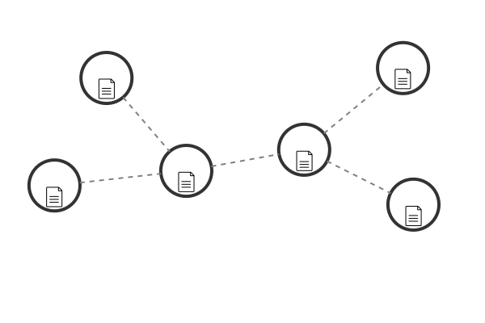
4. Distributed Resources
The same piece of content can be in multiple locations at the same time
No single location needs to contain all the resources
Think:
Content delivery networks (CDN)
Content sharing networks like BitTorrent or Napster
Notes:
https://neo4j.com/blog/import-bitcoin-blockchain-neo4j/

Slide 30
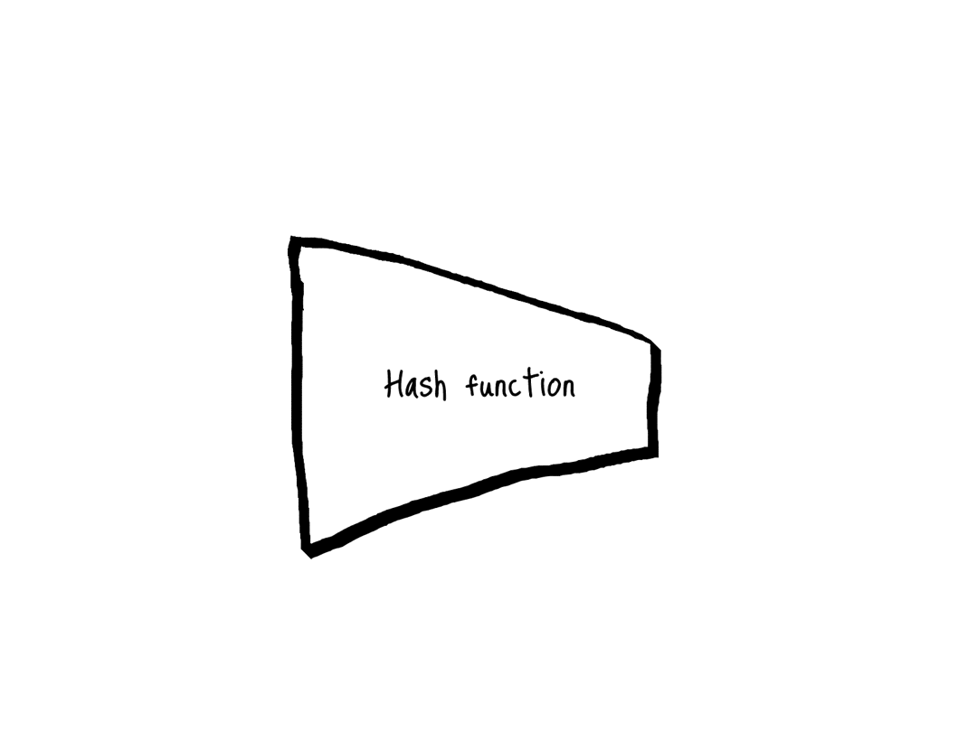
4. Distributed Resources
Distributed networks use hash addressing to identify data
(Compare with the existing internet, which uses location)
Notes:
https://neo4j.com/blog/import-bitcoin-blockchain-neo4j/

Slide 31
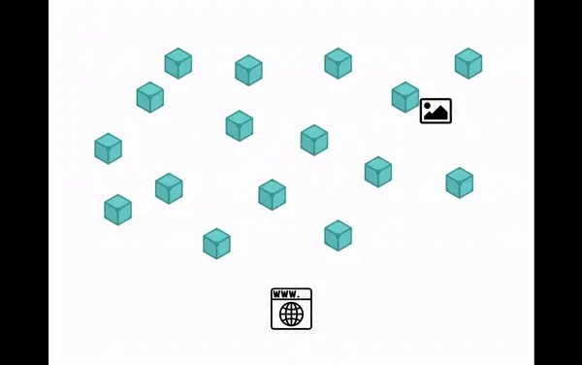
4. Distributed Resources
Distributed web content protocols such as Dat and the interplanetary file system (IPFS) are running as prototypes using content addressing to create a distributed network of resources
Notes:
Image: https://blog.like.co/en/can-ipfs-the-distributed-web-fight-against-content-censorship-300e55cbf88c/

Slide 32
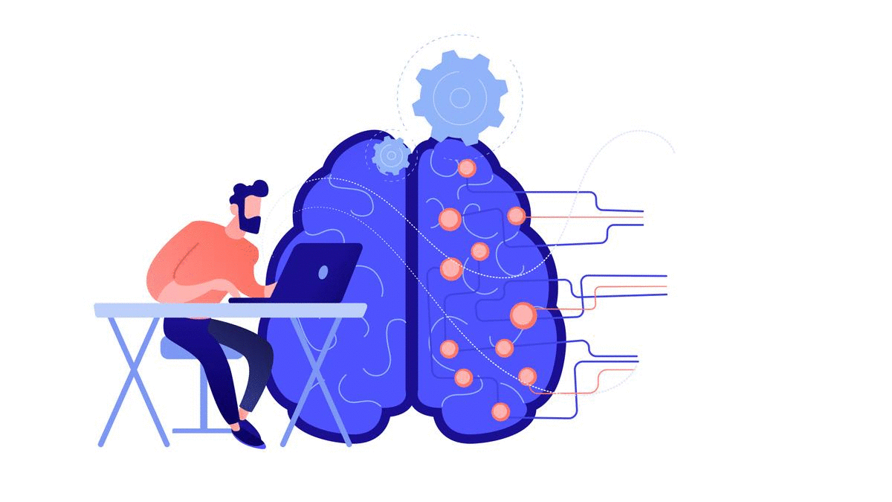
4. Distributed Resources
Distributed resources in education include:
Content Addressable Resources for Education (CARE)
Digital badge and microcredential networks
https://www.downes.ca/post/70094

Slide 33
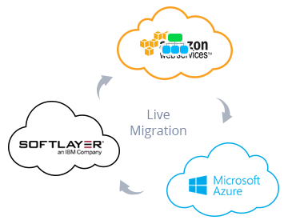
4. Distributed Resources
Cloud
Notes:
https://jelastic.com/blog/live-migration-of-docker-containers-within-cloud-regions/

Slide 34
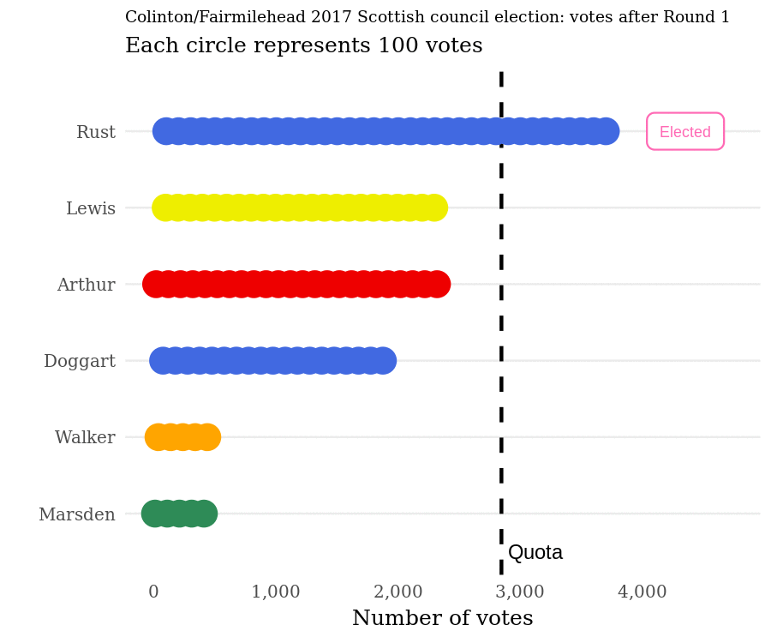
5. Consensus
The fundamental challenge to community is to make decisions.
In a democracy, many of these decisions are made through some form of majority rule

Slide 35
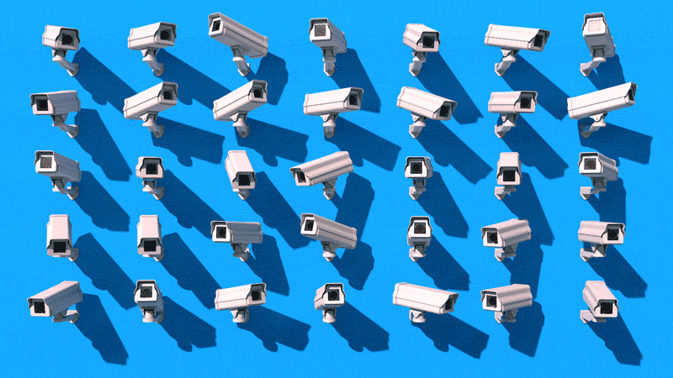
5. Consensus
But many are not.
Some of the alternative systems we use include:
Authoritarianism
Hierarchy and delegation
Markets
Rumour and Innuendo
Anarchy
Notes:
Image: https://dashnews.org/cryptocurrencies-modern-check-authoritarianism/

Slide 36
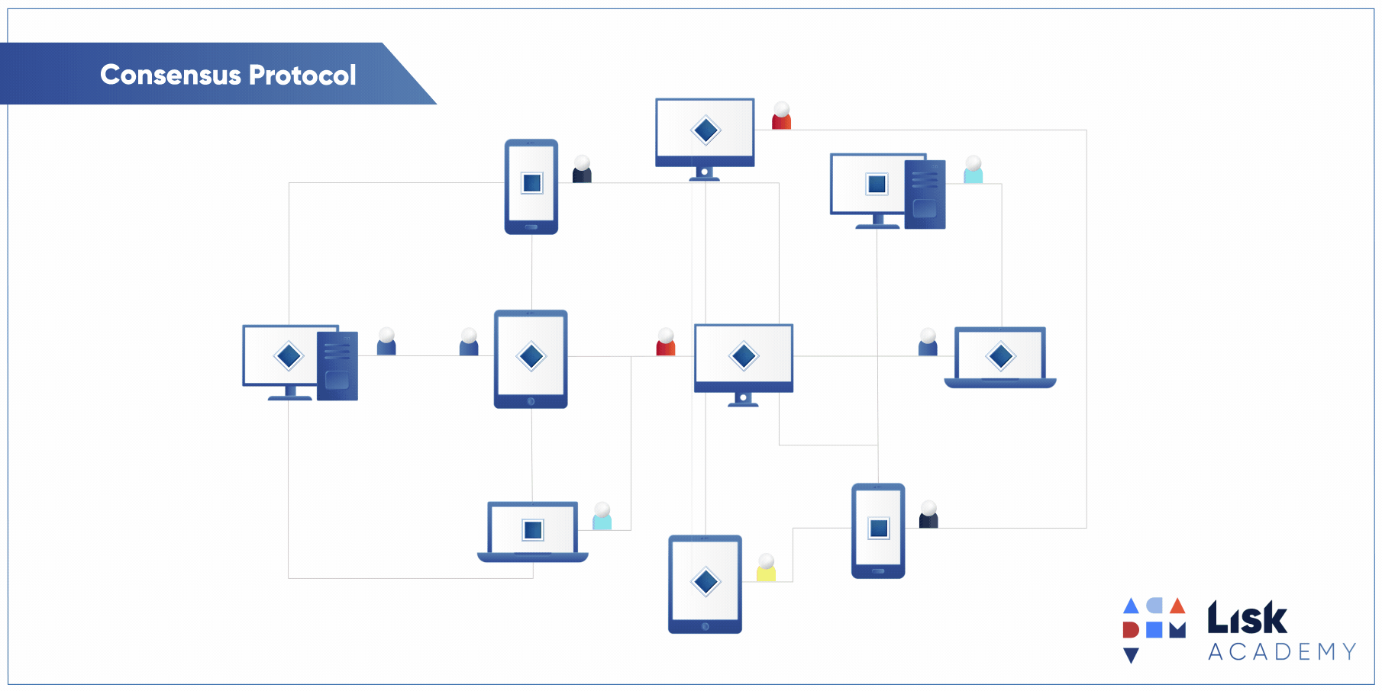
5. Consensus
Enter consensus algorithms…
Notes:
Image: https://www.pinterest.ca/pin/blockchain-consensus-protocols--382031980889350490/

Slide 37

5. Consensus
Community is defined by membership in the network
Membership in the network is based on agreement with the consensus protocol
Data networks depend on single sources of truth
The consensus protocol defines what members agree is a source of truth
Notes:
Images: https://www.valispace.com/cases/single-source-of-truth/

Slide 38
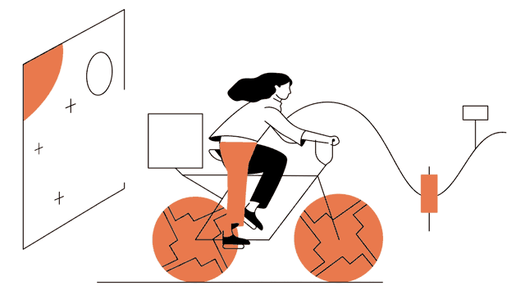
5. Consensus
The adoption of new learning technologies can and should include room for new forms of community and promote new literacies enabling students to thrive in them:
Teams, collaborations, unions
Cooperatives and networks
Distributed Autonomy (DAO)
Notes:
Image: https://www.gemini.com/cryptopedia/the-dao-hack-makerdao

Slide 39
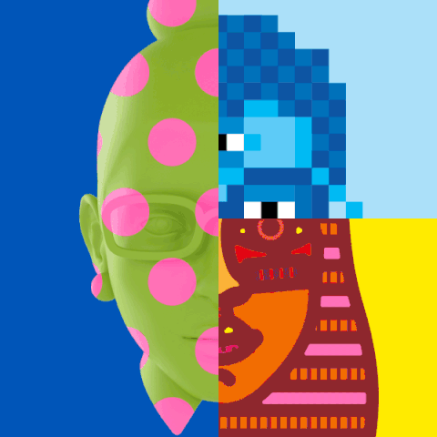
6. Digital Identity
Soon, simple passwords will be replaced, and identity theft will be a thing of the past.
Our attention will shift from how we prove we are who we are to how we define ourselves online.
Notes:
Image: https://ayeshaazeem.ca/social-media-identity-theft/

Slide 40
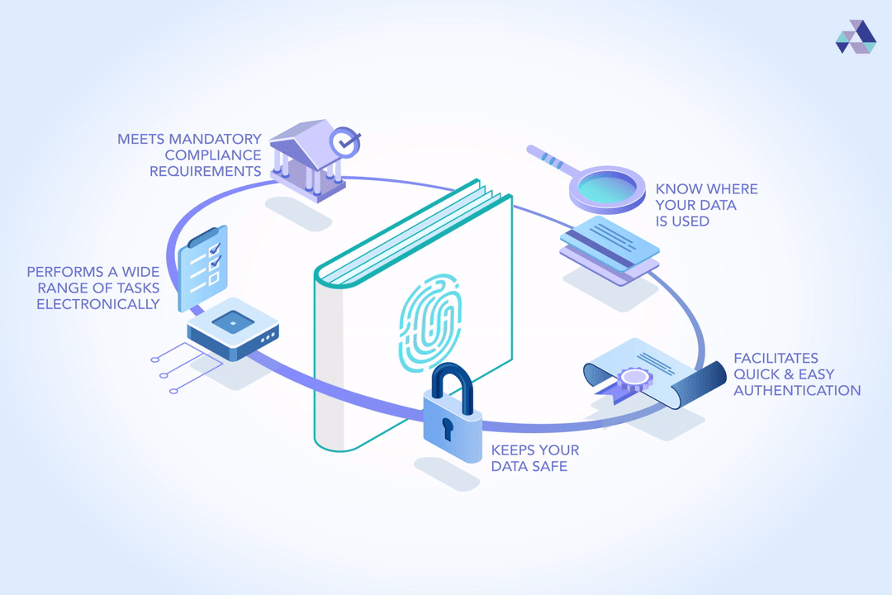
6. Digital Identity
New secure identities backed by decentralized identifiers (DID) and verifiable credentials will become commonplace.
You already carry them in your chip card or Google Pay.
https://www.w3.org/TR/did-core/
Notes:
Decentralized identifiers Image: https://academy.affinidi.com/5-reasons-to-use-an-identity-wallet-c289ba2980cf

Slide 41
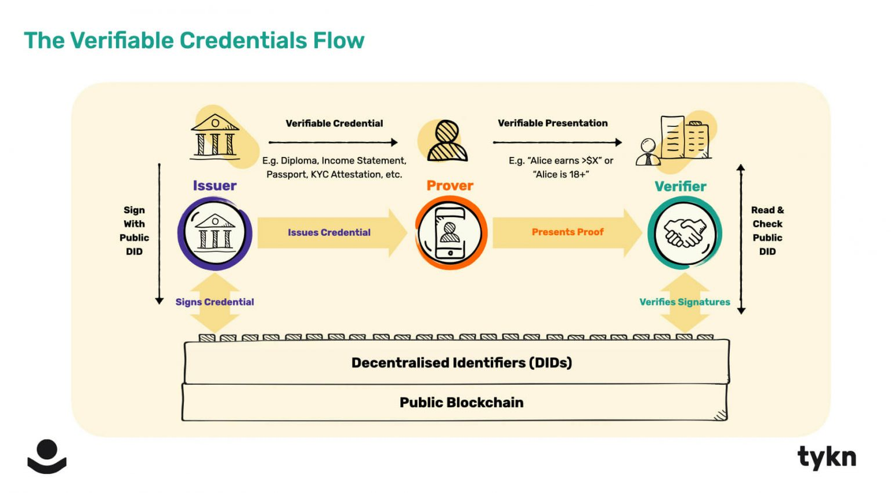

6. Digital Identity
New secure identities backed by decentralized identifiers (DID) and verifiable credentials will become commonplace.
They will be issued and verified in a distributed network
https://tykn.tech/decentralized-identifiers-dids/
Notes:
Decentralized identifiers Image: https://academy.affinidi.com/5-reasons-to-use-an-identity-wallet-c289ba2980cf

Slide 42
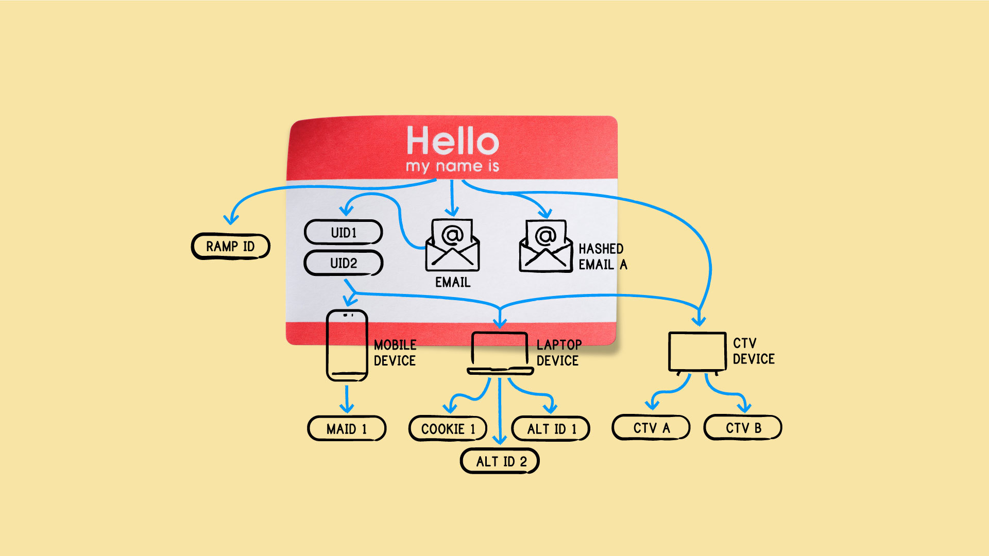
6. Digital Identity
But new, robust online identity raises a host of new questions. Who are we? What does our digital identity look like?
Notes:
Image: https://www.thetradedesk.com/us/resource-desk/how-identity-graphs-are-built-the-present-and-the-future

Slide 43
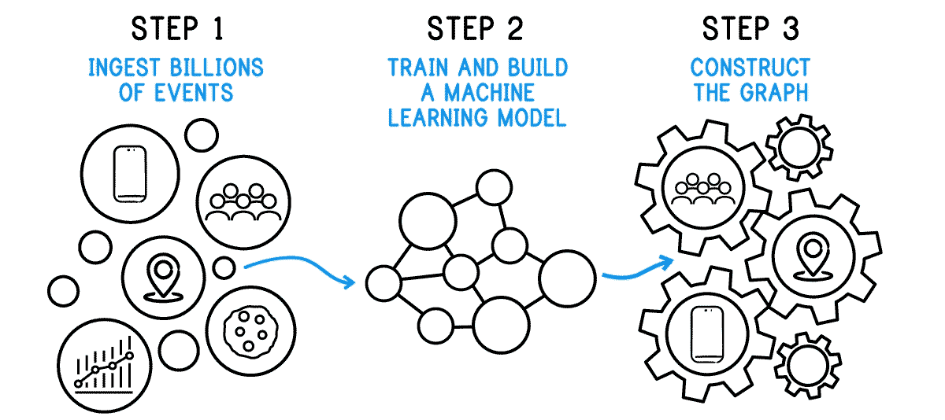
6. Digital Identity
But new, robust online identity raises a host of new questions. Who are we? What does our digital identity look like?
How Identity Graphs are Built

Slide 44
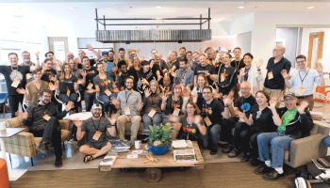
6. Digital Identity
In this new data-rich world, we are the content.
https://indieweb.org/
Notes:
Image: https://kylewm.medium.com/indieweb-summit-2016-b9e438fc0087

Slide 45
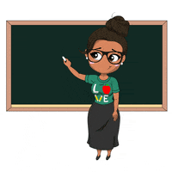
7. Creative Experiences
So much of education continues to rely on indirect methods that depend on knowledge transfer — reading, lectures, videos — rather than hands-on practice and knowledge creation.
This is about to change.
Notes:
Image: https://giphy.com/explore/hello-teacher

Slide 46
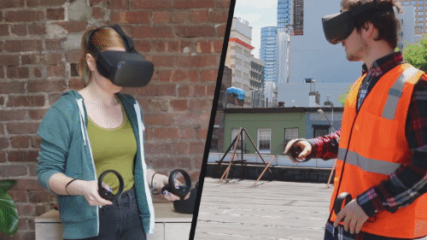
7. Creative Experiences
Instead of delivering content, a teacher will model and demonstrate successful practice, and learners will seek to emulate and build on what they see and experience.

Slide 47

7. Creative Experiences
Open Working
Job Shadowing
Apprenticeships
https://www.youtube.com/playlist?list=PLeBQHgzQN9x3Ef-JuV-HQw2on-_RkjTBM
https://nbold.co/working-in-the-open/
Notes:
Image: https://makeagif.com/gif/business-people-working-together-in-a-light-and-modern-open-plan-office-space-stock-footage-4-n88d

Slide 48
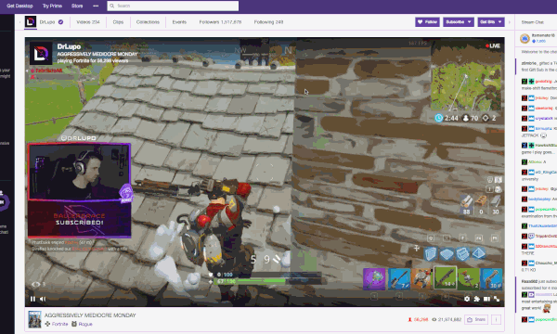
7. Creative Experiences
Tools
Twitch
OBS
Teams / Slack
Discord

Slide 49

7. Creative Experiences
The dialogue and interactivity that takes place sets the work into context and enables learners to see it as a process rather than an artifact.
Notes:
Image: https://www.type-c.media/digital-learning

Slide 50

8. Recognition
Today we rely on artificial forms of assessment like tests and exams…
Notes:
Image: https://giphy.com/explore/cheating-on-test

Slide 51
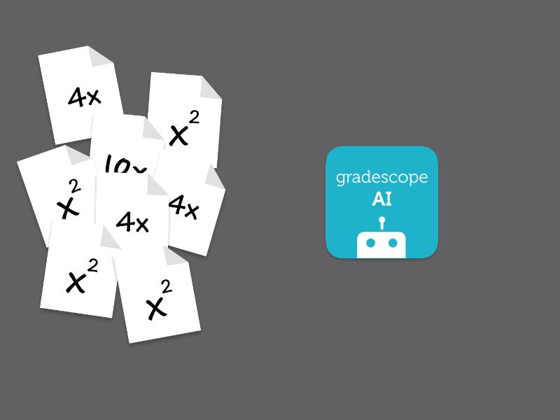
8. Recognition
We used to assess these by hand but the future belongs to automated assessment tools already used to grade natural language content.
Notes:
Image: https://developer.nvidia.com/blog/artificial-intelligence-helps-grade-exams-90-faster/

Slide 52
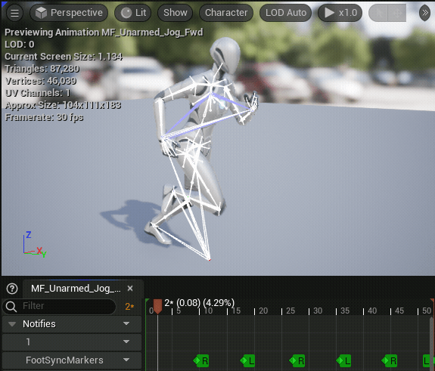
8. Recognition
We will need to refine these tools.
Actual authentic tasks designed or contributed by humans may be needed to balance the possibility of biased algorithms.
Notes:
Image: https://docs.unrealengine.com/5.0/en-US/animation-sequences-in-unreal-engine/

Slide 53

8. Recognition
But this means that anyone can perform assessments
And they will base these assessments on actual public performance or personal portfolios
Notes:
Image: https://weheartit.com/entry/307411779

Slide 54
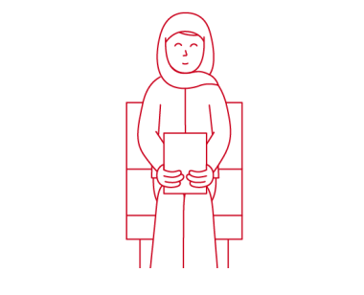
8. Recognition
The credential of the future will be a job offer
Learning institutions may need to consider how to contribute to a desirable profile that satisfies a wide range of currently undefined performance criteria.
Notes:
Image: https://nursing.jnj.com/get-hired-as-a-nurse/

Slide 55
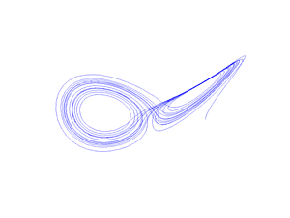
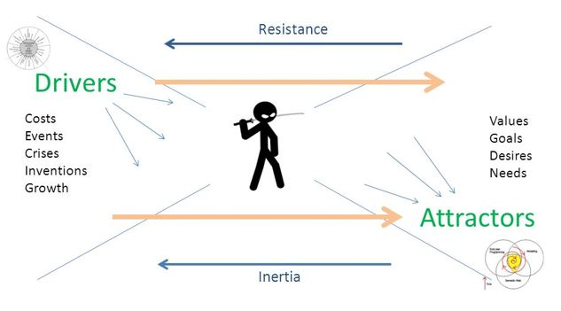
9. Agency
What we learn depends on why we learn, and the idea of agency is to enable this to be shaped by the learner.
We can think of this as the attractor as opposed to a driver.

Slide 56
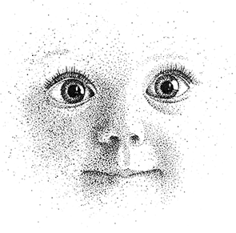
9. Agency
Agency - a shift in the relative standing of the individual with respect to community, institutions and governments, for better or worse - is impacted by technology.
Notes:
Image: https://www.illustrationx.com/styles/animation/children

Slide 57
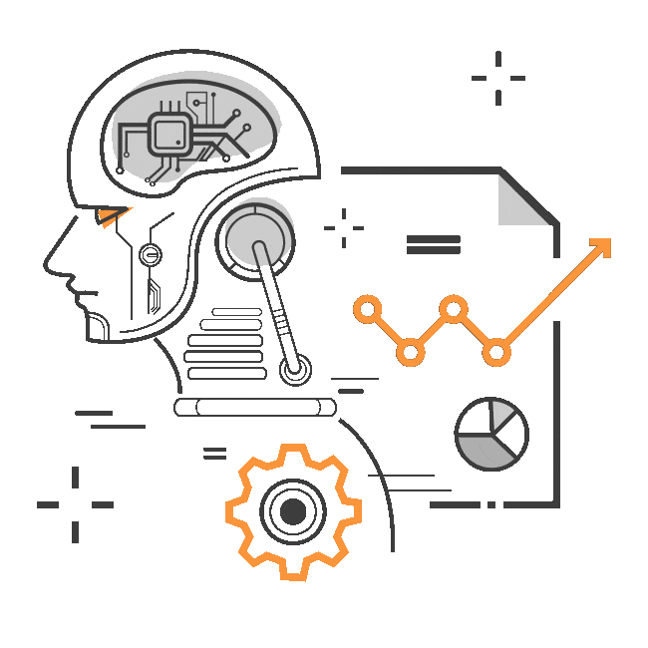
9. Agency
There is a growing development and acceptance of digital agents working on our behalf:
Automated publishing
Algorithmic stock trading
Content alerts

Slide 58

9. Agency
Individual agency is what consensus-based decentralized communities are designed to augment.
How much agency is enough? Too much?
What types of agency do we want? Do we lack?
Notes:
Image: https://www.newagencyca.com/

Slide 59

9. Agency
What counts as success?
Priorities are established by individual conditions and character, and may include elements such as security, identity, voice and opportunity. Success therefore needs to be evaluated according to these wider metrics

Slide 60
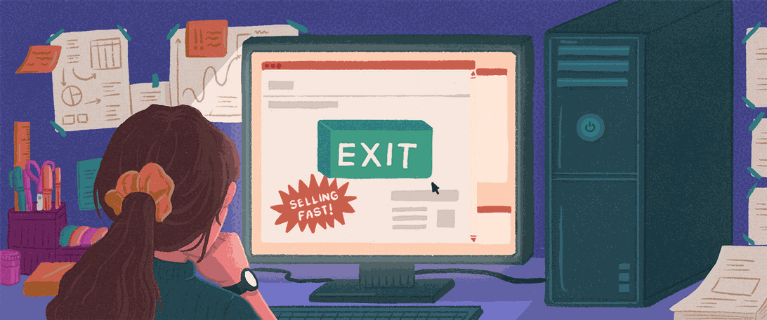
10. Infrastructure
People are rethinking what they value in their lives and how their work and learning should be structured.
The outcome of this process is a reorganization of social infrastructure to fit these new priorities.
Notes:
Image: https://www.chanceupon.co/blog/30/why-the-great-resignation-may-outlast-the-pandemic

Slide 61
10. Infrastructure
People are rethinking what they value in their lives and how their work and learning should be structured.
The outcome of this process is a reorganization of social infrastructure to fit these new priorities.

Slide 62
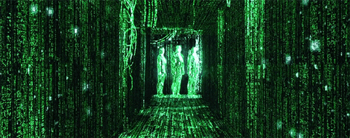
10. Infrastructure
Anonymity, encryption and zero-knowledge data networks
Accountability, resilience, security, robustness
Notes:
Image: https://steemit.com/science/@ertwro/trust-and-perception-zero-knowledge-proofs

Slide 63
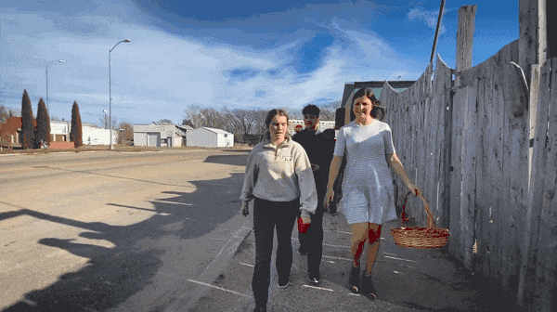
10. Infrastructure
The gaps in our social fabric…

Slide 64
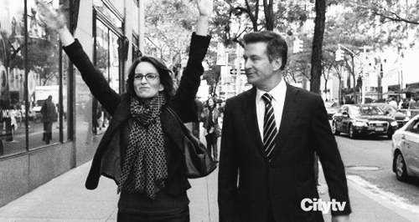
10. Infrastructure
The greater need for individual and collective capacity
Notes:
Image: https://gifer.com/en/3WTE

Slide 65
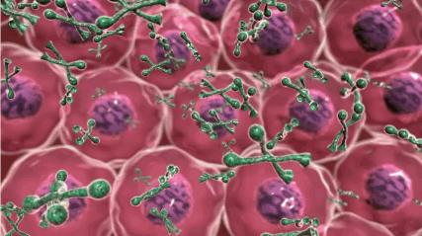
10. Infrastructure
Resilience of our scientific and industrial infrastructure

Slide 66
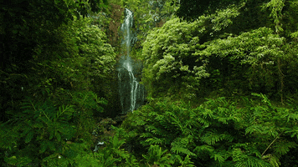
10. Infrastructure
Climate and environmental sustainability

Slide 68

Stephen Downes
https://www.downes.ca

