Slide 1
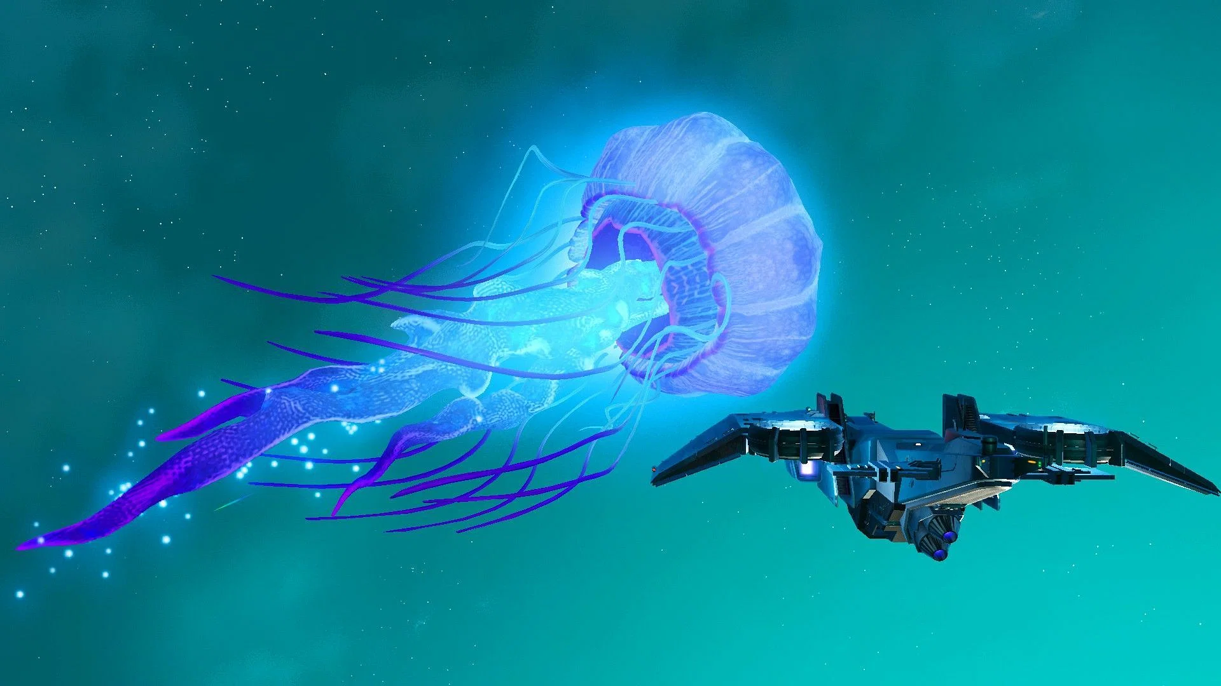
Opportunities for Education in the Metaverse
Stephen Downes
March 13, 2022

Slide 2
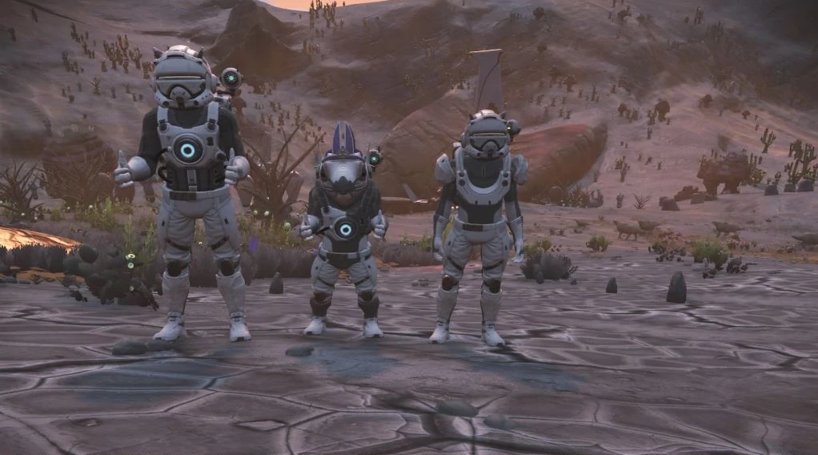
What is the Metaverse?

Slide 3
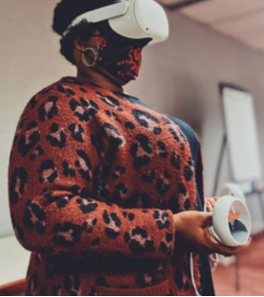
XR / VR in Learning and Development
Virtual reality (VR) and related technologies support active learning in an immersive and hands-on environment.
At the same time, it can be expensive and difficult to apply.
Still, there are pilot projects being run around the world.
VR pilot exposes high school students to manufacturing, USA https://www.cbia.com/news/workforce-development/virtual-reality-pilot-program-students-manufacturing/

Slide 4
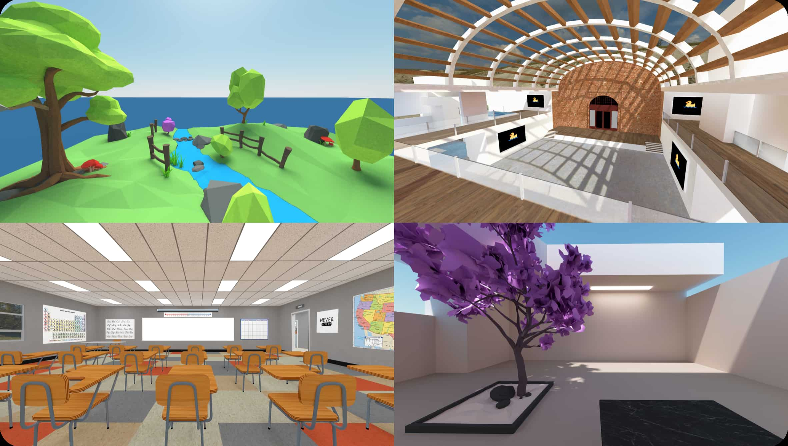
VR (Virtual Reality)
Users enter a completely virtual world
All sights, sounds, objects and actions are simulated
Uses a headset like the Oculus or the Vive
Mozilla Hubs https://hubs.mozilla.com/

Slide 5

AR (Augmented Reality)
Users see data projected alongside real-world objects
See-through viewing device like Google Glass or Hololens
Offers more information about what they are seeing
Augmented reality (AR) snapshop, NRC Canada https://publications.gc.ca/collections/collection_2020/cnrc-nrc/NR16-294-2019-eng.pdf

Slide 6
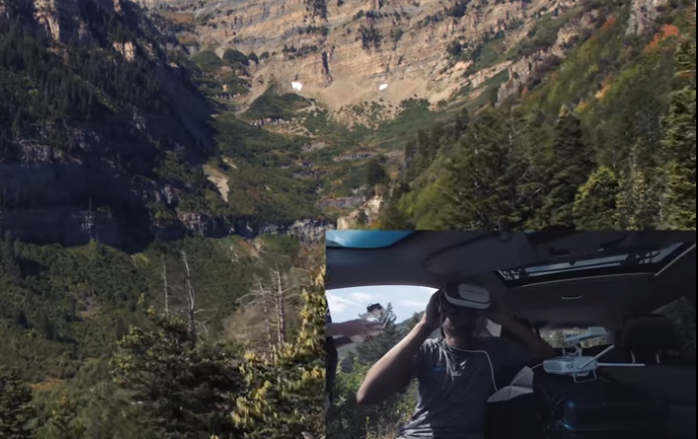
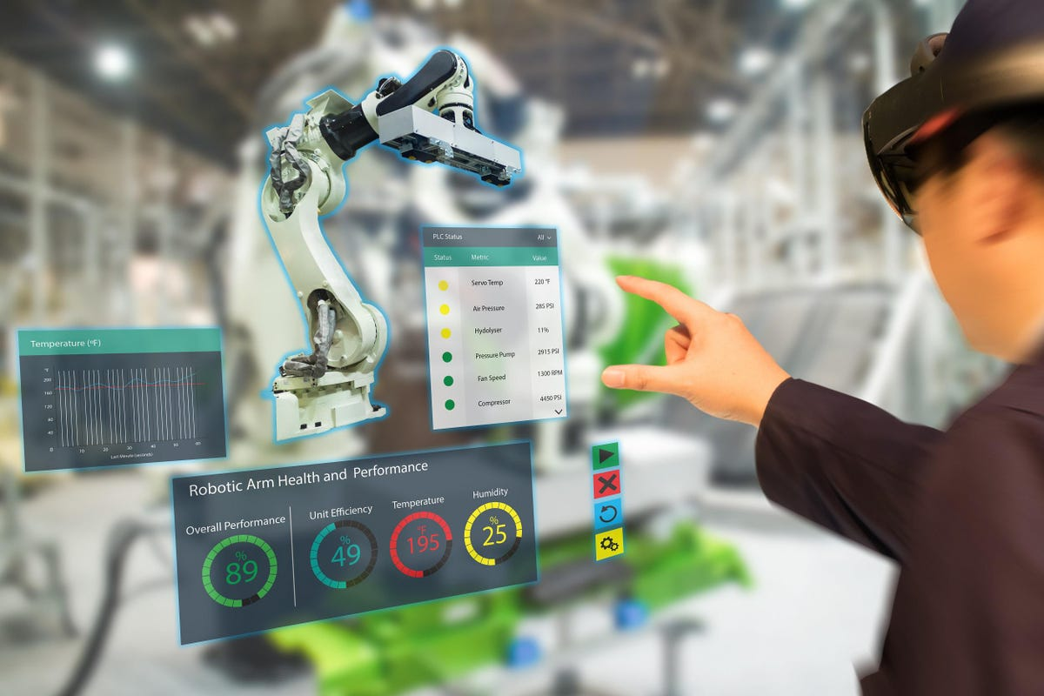
MR (Mixed Reality)
Merging of virtual and real environments
Virtual and real objects interact in real time
E.g. a virtual dashboard like Behance
https://www.forbes.com/sites/bernardmarr/2022/01/07/the-5-biggest-virtual-augmented-and-mixed-reality-trends-in-2022/?sh=2c68909d4542
https://www.youtube.com/watch?v=z3zwAeBMbKU

Slide 7
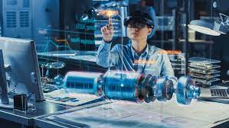
XR (eXtended Reality)
term that refers collectively to VR, AR and MR
Remote diagnosis & repair, Switz. & Ukraine https://skywell.software/blog/mixed-reality-benefits-uses-in-manufacturing/

Slide 8

The Metaverse,
which includes all XR technologies
combines it with persistent digital objects:
  digital currencies such as Bitcoin and Ethereum
  digital identities
  digital objects such as non-fungible tokens (NFTs).
How to enter the metaverse, Sensorium https://sensoriumxr.com/articles/how-to-enter-the-metaverse

Slide 9
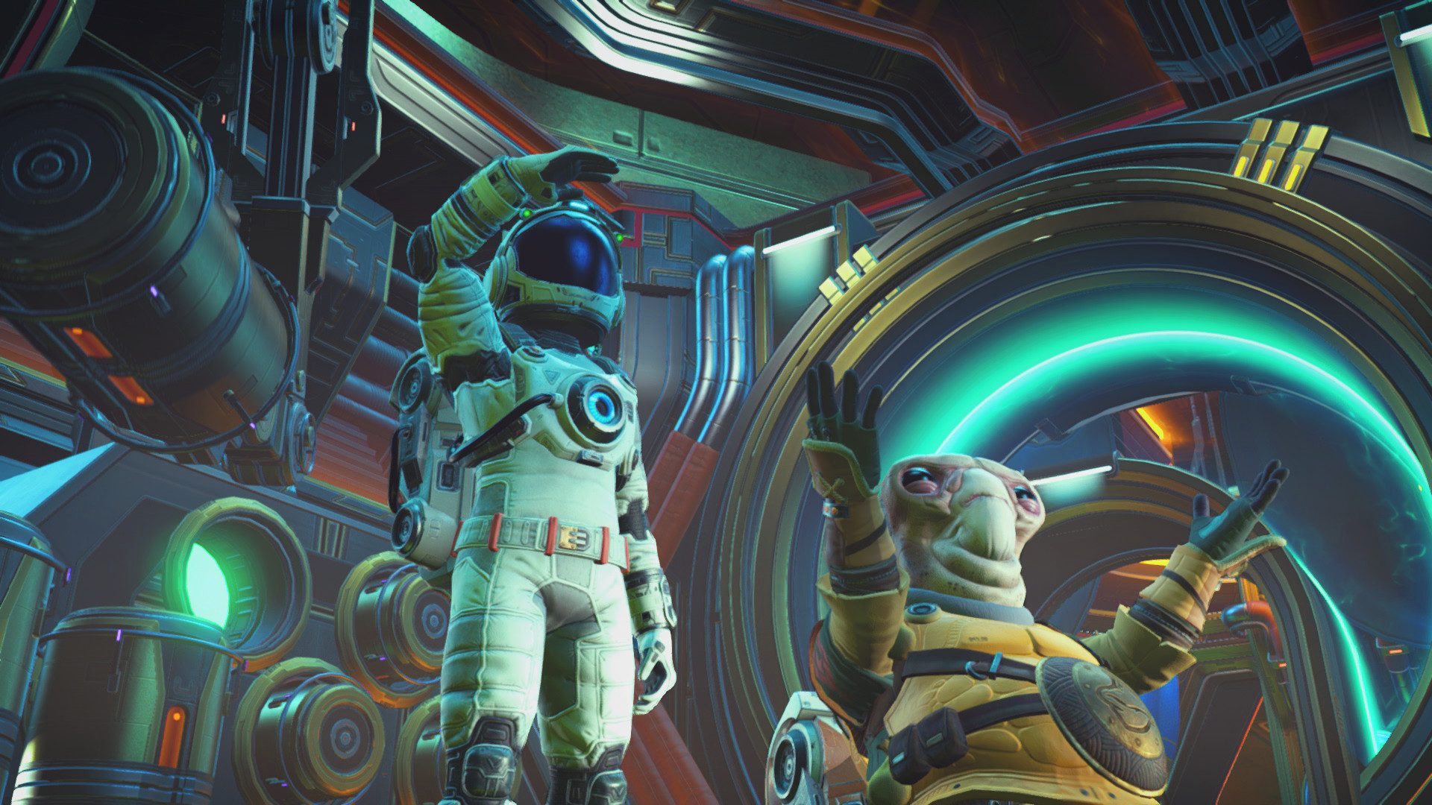
Applications of the Metaverse

Slide 10
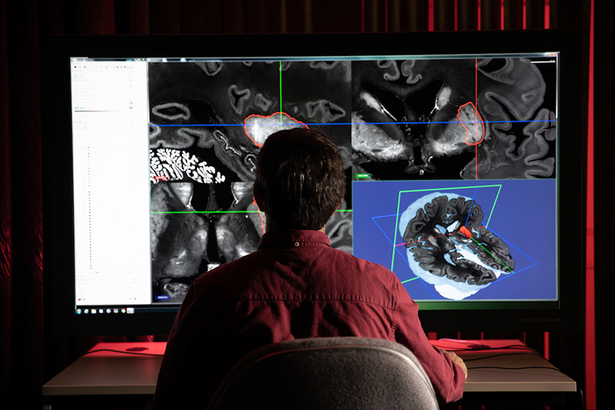
Visualization
Small things can be magnified
We can look inside things
Time can be sped up or slowed down
Computer vision and graphics, NRC Canada https://nrc.canada.ca/en/research-development/products-services/technical-advisory-services/computer-vision-graphics

Slide 11
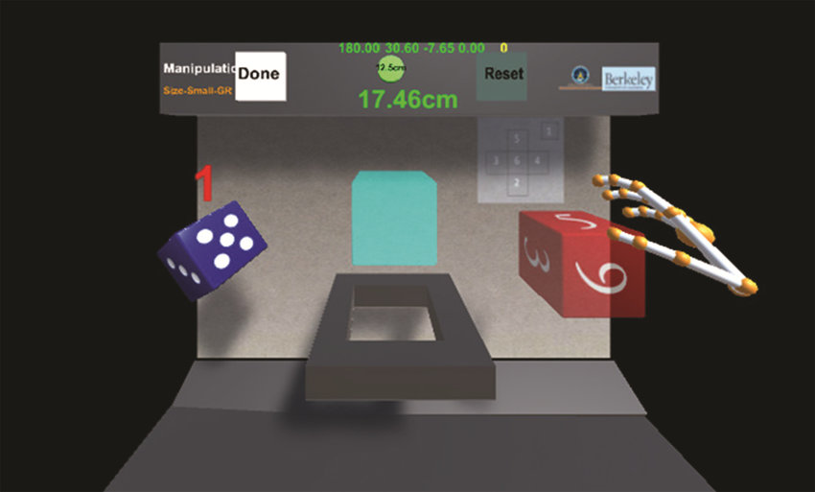
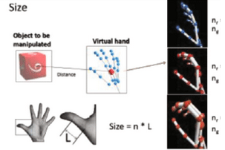
Interactivity
Hands-on manipulation of objects
  Illustrate mechanical or physical principles
  Control devices or machines
Hand Gestures for Manipulating Objects in Virtual Reality, USA https://www.researchgate.net/publication/317173375_Design_of_Hand_Gestures_for_Manipulating_Objects_in_Virtual_Reality

Slide 12
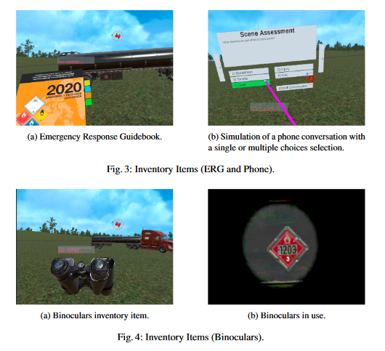
Safe Environments
Observe and practice hazardous operations
  flying a plane
  fighting a fire
  working with high-voltage equipment.
Design and Development for a First
Responders VR Training System on Dangerous Goods
Transportation Incidents, NRC Canada (forthcoming at https://2022.hci.international/ )

Slide 13
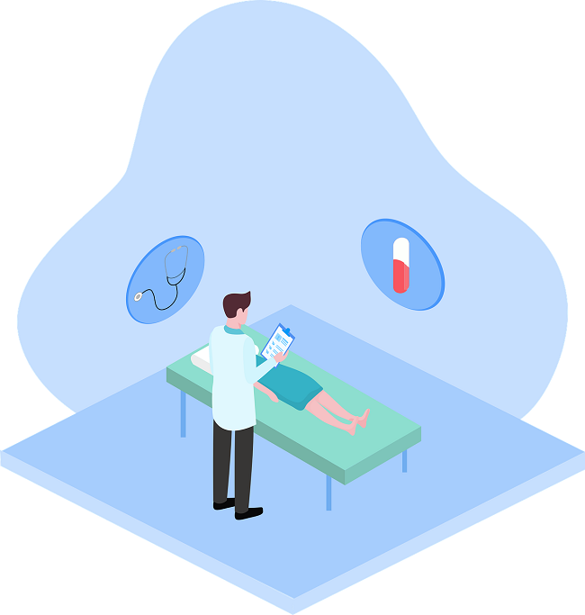
Accessibility
Helps people…
  with limited mobility
  who live in remote regions
  with time constraints
  where hands-on equipment is not available
Helps people learn how to support diverse needs
Improving cognitive ability using virtual reality (VR) and games, NRC Canada https://nrc.canada.ca/en/stories/virtual-reality-game-changer-neurodevelopmental-treatments
VR for empathy-building and experiential education in hospitals, Canada https://cjni.net/journal/?p=8571

Slide 14
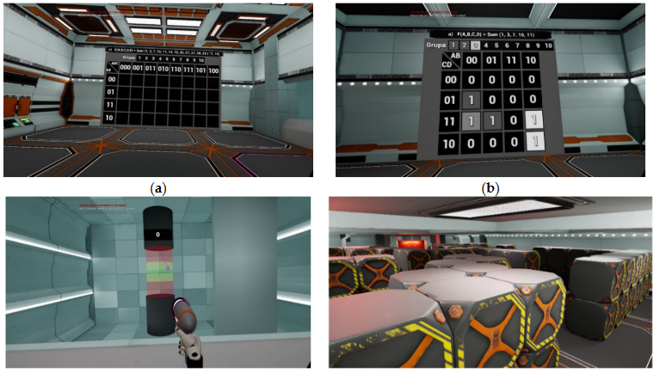
Remote Collaboration
Create or manipulate common digital objects
Design buildings or equipment
Co-create any other digital content.
Digital circuit design, Poland https://mdpi-res.com/d_attachment/energies/energies-15-00277/article_deploy/energies-15-00277-v2.pdf

Slide 15
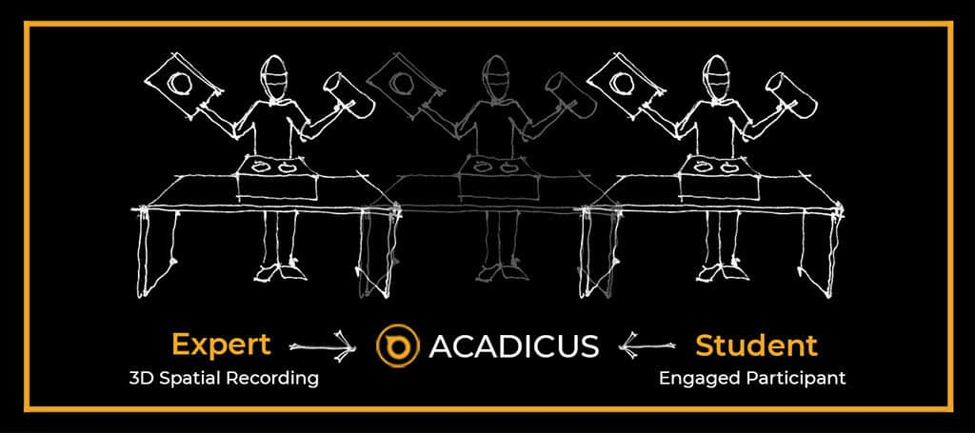
Recordings
Viewed later as objects for discussion
Debrief or to be used as learning resources.
Adacus, USA https://acadicus.com/3d-spatial-recordings-for-enhanced-teaching-and-learning-in-vr/

Slide 16
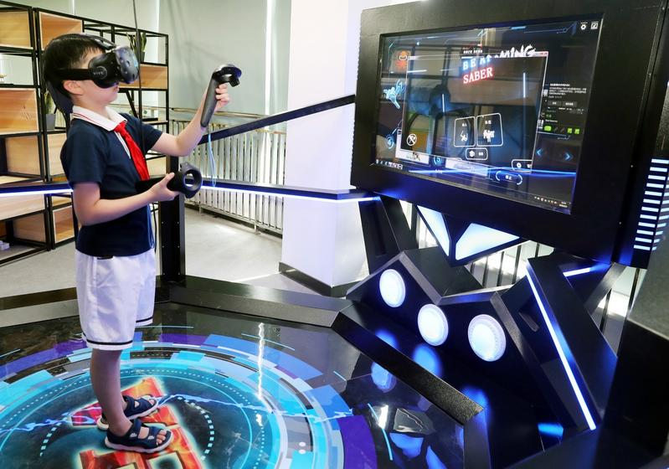
Combined with AI
Lifelike immersive environments
Smart agents that can:
  interact with users
  generate tasks, resources
  Make recommendations based on user activities.
Evaluate learning in the XR environment.
AI enabled VR tuition, China https://www.chinadailyhk.com/articles/80/86/192/1559976439971.html

Slide 17
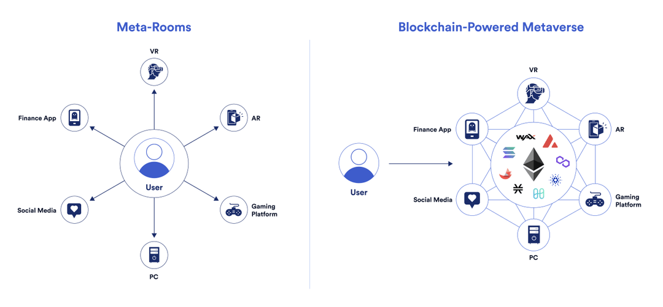
Combined with Cryptography
E.g. digital signatures and blockchain networks
E.g. distributed and multi-user virtual environments
These support massive simulations such as:
  sporting events
  financial markets
  military exercises
  climate change
https://chain.link/education/metaverse

Slide 18
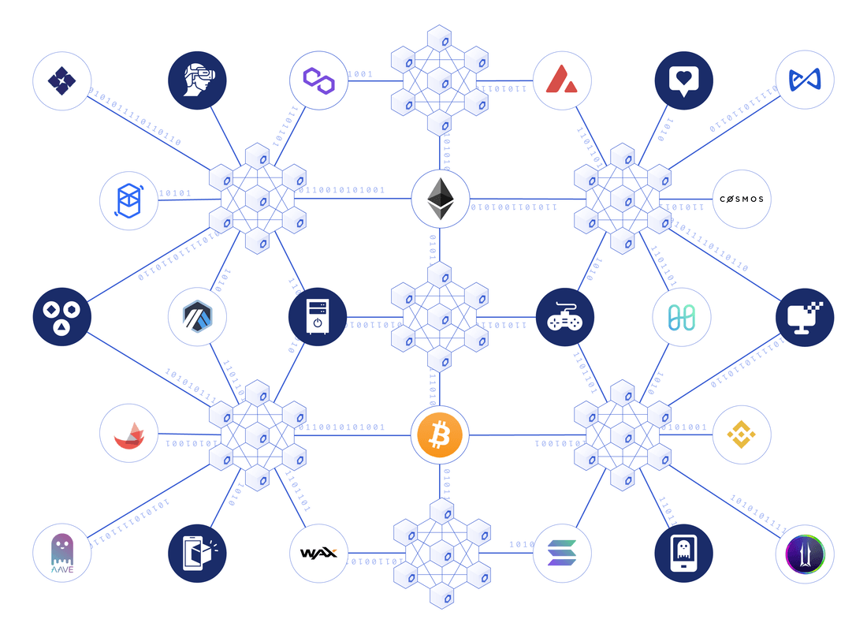
Combined with Cryptography
E.g. digital signatures and blockchain networks
E.g. distributed and multi-user virtual environments
These support massive simulations such as:
  sporting events
  financial markets
  military exercises
  climate change
https://chain.link/education/metaverse

Slide 19
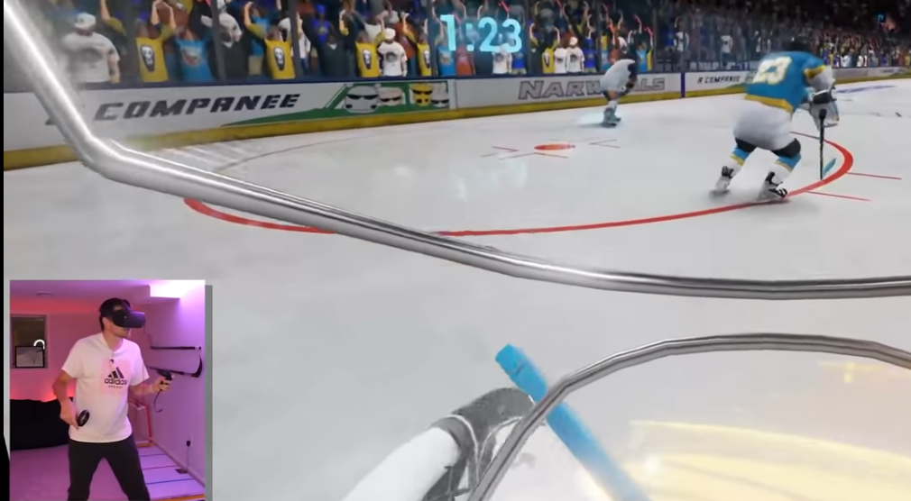
Combined with Real-Time Data
Based on real-world models and statistics
Enjoy an on-ice view or player’s perspective of a hockey game
Watch heart surgery from the perspective of the surgeon, or the heart
https://www.youtube.com/watch?v=nAzOBgpttZc

Slide 20
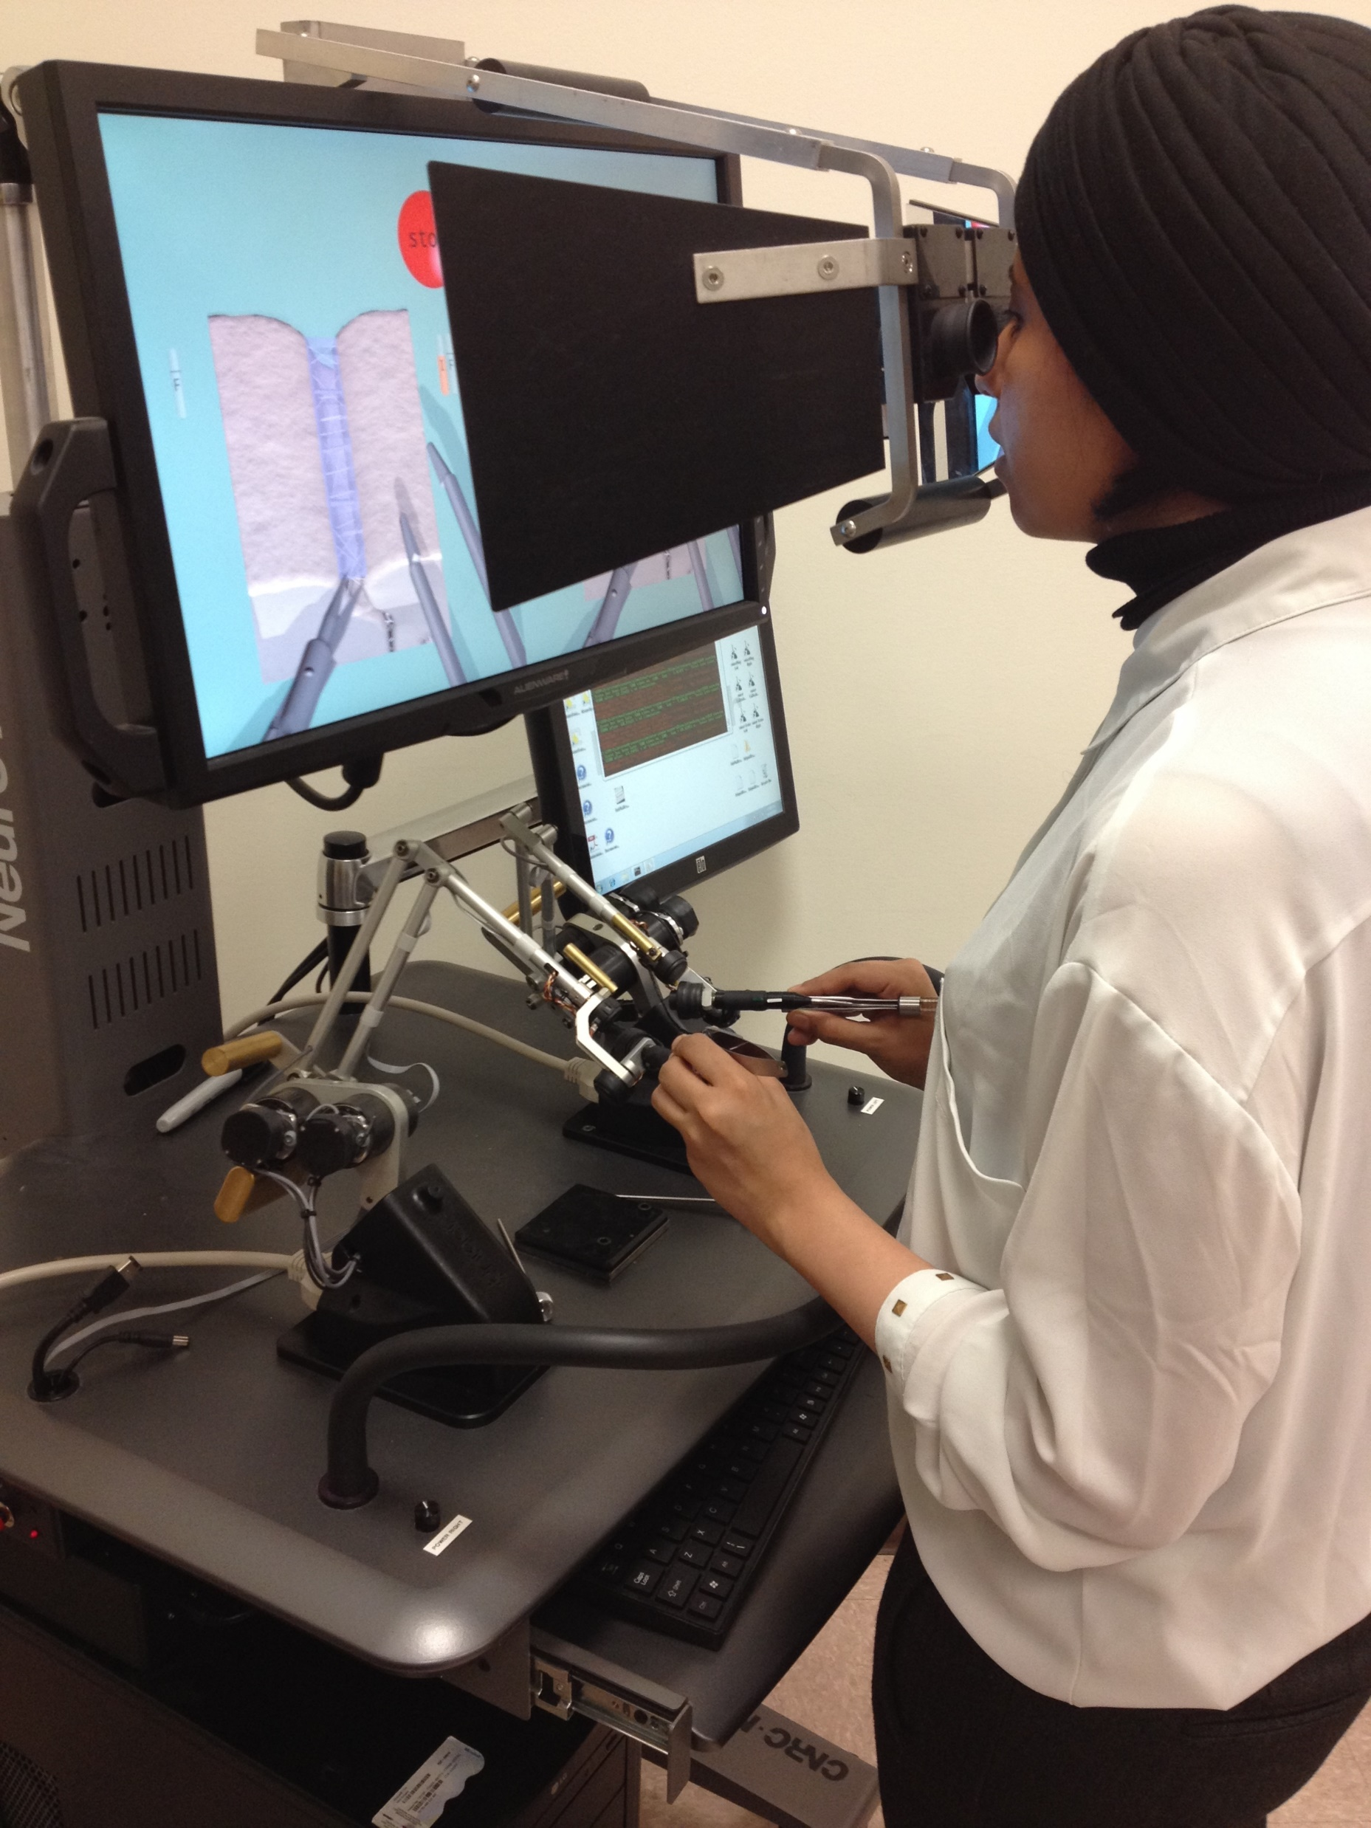
Combined with Haptics
Other forms of sensory feedback
Extends beyond the purely audio-visual
E.g. ‘Hands-On’ medical examination simulation
NeuroVR (previously NeuroTouch) combines haptics with a virtual reality (VR) neurosurgical simulator, NRC Canada https://neurosim.mcgill.ca/neurotouch

Slide 21
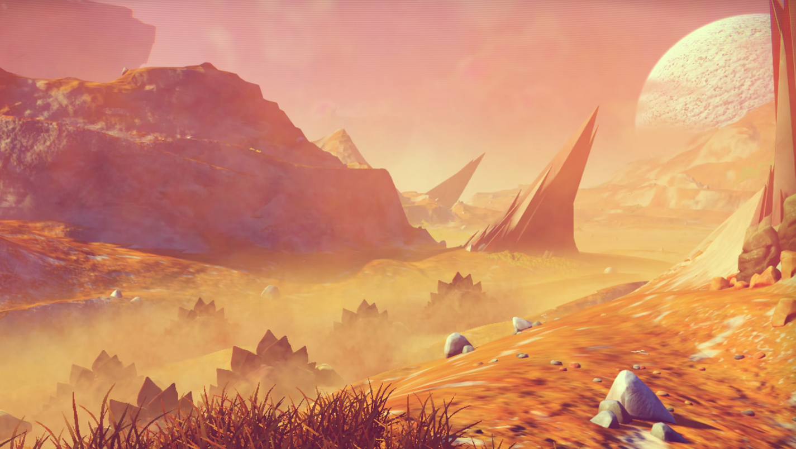
Risks and Potential Issues

Slide 22
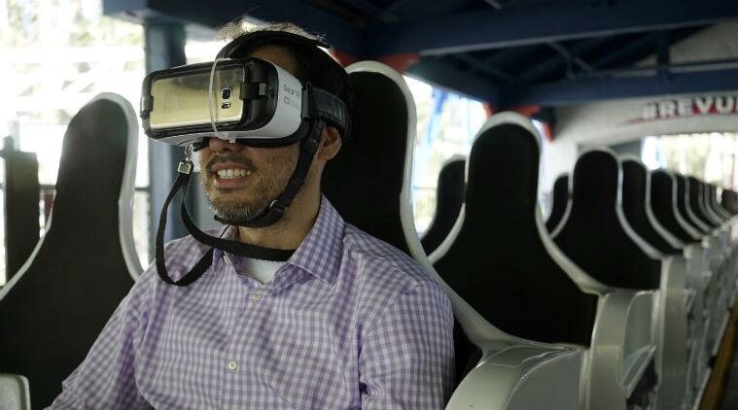
Technology
Cost is a major factor
It takes time to learn how to use
https://indianexpress.com/article/technology/tech-news-technology/six-virtual-reality-experiences-that-dont-cost-too-much-4387265/

Slide 23
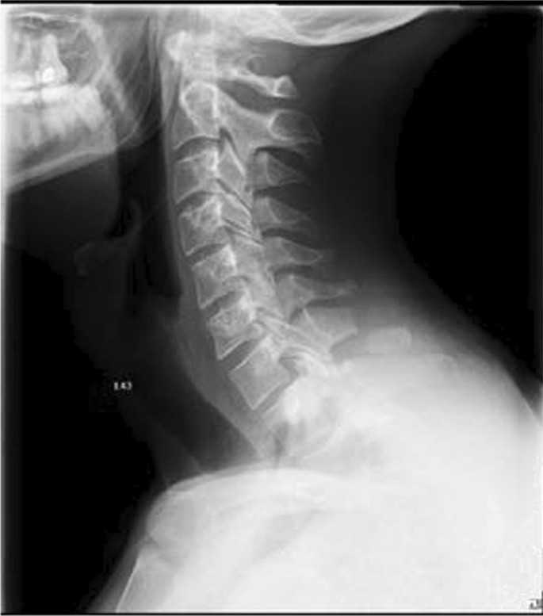
Health
Stress and anxiety over virtual experiences
Ergonomic issues
Physical injury caused by falling or stumbling
Nausea and other forms of cybersickness caused by latency issues
Cervical spine injury after virtual reality gaming: a case report https://jmedicalcasereports.biomedcentral.com/articles/10.1186/s13256-021-02880-9

Slide 24
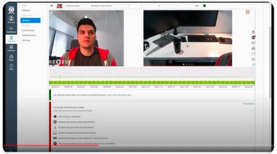
Bad Actors and Malpractice
Misrepresentation of physical phenomena in a way that leads to incorrect beliefs
Inappropriate use of XR surveillance technologies
Harassment and Bullying by groups or individuals
Proctorio used DMCA to take down a student’s critical tweets https://techcrunch.com/2020/11/05/proctorio-dmca-copyright-critical-tweets/

Slide 25
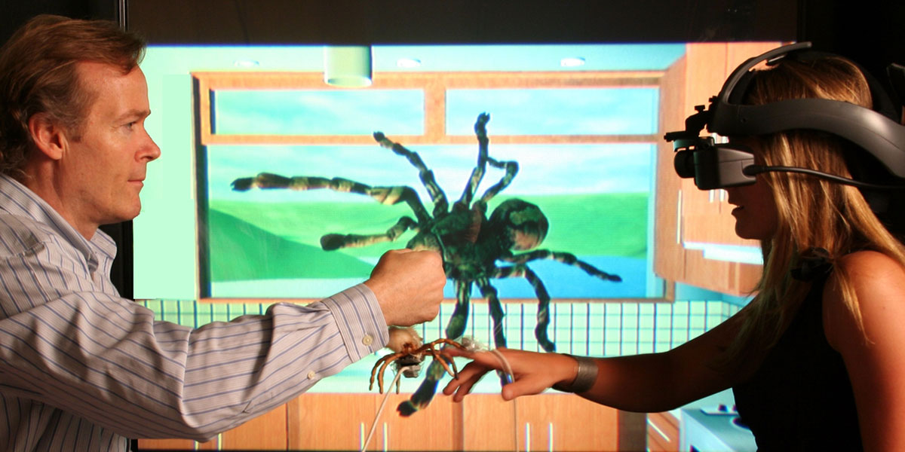
Social and Cultural Issues
Desensitization to disturbing behaviours and events
Cultural and ethical values may change through virtual world interactions
https://realnewworld.com/vr-fear-relief/

Slide 26
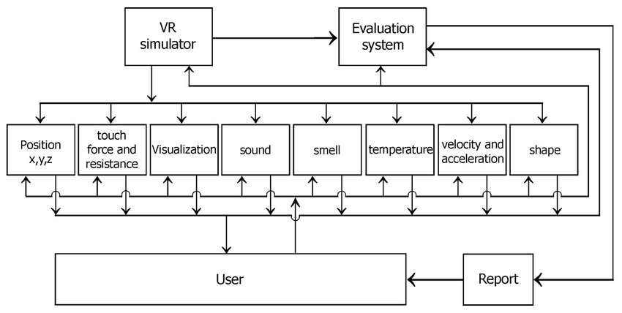
Issues Specific to Learning and Development
Coaching and Mentoring is typically required to guide participants through a virtual reality experience
Few metrics exist for evaluation of performance in XR environments and best practices have yet to be developed.
https://www.researchgate.net/figure/Evaluation-systems-collect-data-from-VR-based-simulations-to-evaluate-user-performance_fig5_267660585

