Slide 1
Data Literacy
Models, Assessment, and Development
Stephen Downes
March 28, 2022

Slide 2
Three Frameworks
Competency Model or Framework
Evaluation or Assessment Framework
Teaching Framework

Slide 3
Competency Model or Framework
Evaluation or Assessment Framework
Teaching Framework

Slide 4
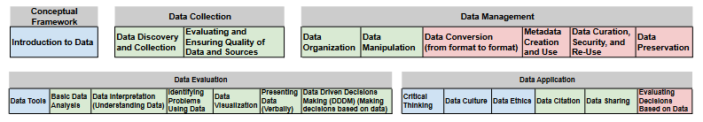
Defining Data Literacy
“Data literacy is the ability to collect, manage, evaluate, and apply data, in a critical manner” (p. 2).
“We define the core skills and competencies that comprise data literacy, using a thematic analysis of the elements of data literacy described in peer-reviewed literature. These competencies (23 in total) and their skills, knowledge, and expected tasks (64 in total) are organized under the top-level elements of the definition (data, collect, manage, evaluate, apply) and are categorized as conceptual competencies, core competencies, and advanced competencies.”
Chantel Ridsdale, et.al.. 2015. Strategies and Best Practices for Data Literacy Education. Dalhousie University. https://dalspace.library.dal.ca/bitstream/handle/10222/64578/Strategies%20and%20Best%20Practices%20for%20Data%20Literacy%20Education.pdf?sequence=1&isAllowed=y (Open University)

Slide 5
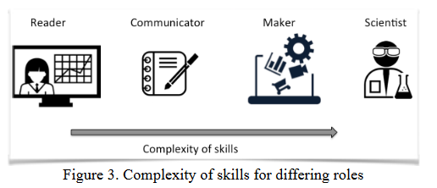
Defining Data Literacy
Wolff, et.al. 2016. “Data literacy is the ability to ask and answer real-world questions from large and small data sets through an inquiry process, with consideration of ethical use of data.”
“It is based on core practical and creative skills, with the ability to extend knowledge of specialist data handling skills according to goals. These include the abilities to select, clean, analyse, visualise, critique and interpret data, as well as to communicate stories from data and to use data as part of a design process.”
Annika Wolff, Daniel Gooch, Jose J. Cavero Montaner, Umar Rashid, Gerd Kortuem. 2016. Creating an understanding of data literacy for a data-driven society. https://openjournals.uwaterloo.ca/index.php/JoCI/article/view/3275

Slide 6

Defining Data Literacy
Data literacy is the “ability to derive meaningful information from data” (Sperry 2018). “To summarize, a data literate individual would, at minimum, be able to understand information extracted from data and summarized into simple statistics, make further calculations using those statistics, and use the statistics to inform decisions. However, this definition is context-dependent...” (Bonikowska, Sanmartin and Frenette, Statistics Canada, 2019)
https://www150.statcan.gc.ca/n1/pub/11-633-x/11-633-x2019003-eng.htm

Slide 7
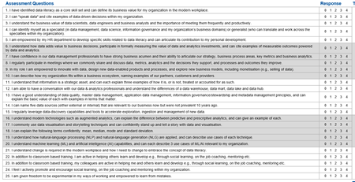
Defining Data Literacy
"Data literacy" is formally called out as a new core competency as part of a clear commitment to the organization and leadership valuing "information as a strategic asset." Training programs (online and/or in-person; internal and/or external) are available and supported across all required levels of proficiency. (Gartner, 2019, Toolkit)
Gartner. 2019. Toolkit: Data Literacy Individual Assessment. Gartner. https://www.gartner.com/en/documents/3983897/toolkit-data-literacy-individual-assessment
Alan D. Duncan, Donna Medeiros, Aron Clarke, Sally Parker. 2021. How to Measure the Value of Data Literacy. Gartner. https://www.gartner.com/en/documents/4003941-how-to-measure-the-value-of-data-literacy

Slide 8
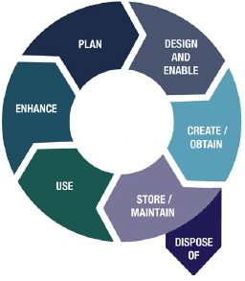
Defining Data Literacy
Literacy broadly means having competency in a particular area. Data literacy includes the skills necessary to discover and access data, manipulate data, evaluate data quality, conduct analysis using data, interpret results of analyses, and understand the ethics of using data. (Department of National Defence, 2019)
Department of National Defence . 2019. Annex A – Definitions. The Department of National Defence and Canadian Armed Forces Data Strategy. https://www.canada.ca/en/department-national-defence/corporate/reports-publications/data-strategy.html
John Walsh. 2021. Implementing DND/CAF Data Strategy. Canada.ca, Department of National Defence. https://publicsectornetwork.co/wp-content/uploads/2021/09/John-Walsh-PDF.pdf

Slide 9
Major Themes
Data literacy as a set of skills or competencies
The idea of deriving meaningful information from data
The data lifecycle or data workflow
Complexity of skills for differing roles
Data literacy as individual and corporate capacities

Slide 10
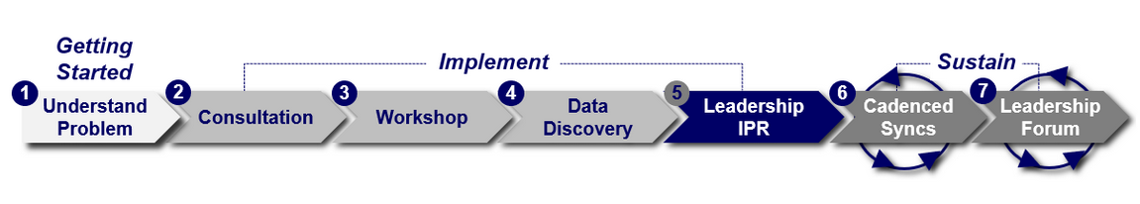
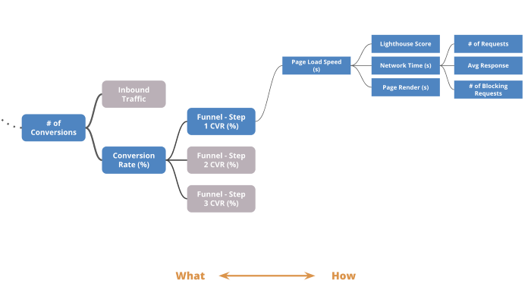
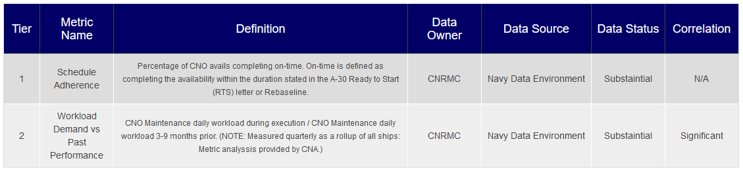
Exmples…
Drive Navy performance improvement through mission-driven metric reporting advanced data analytics techniques
U.S. Navy – Performance to Plan (P2P)
Driver Tree
Data Dictionary
https://p2p.navy.mil/
https://medium.com/swlh/driver-trees-a-tool-to-make-your-teams-more-successful-88f751e86482

Slide 11
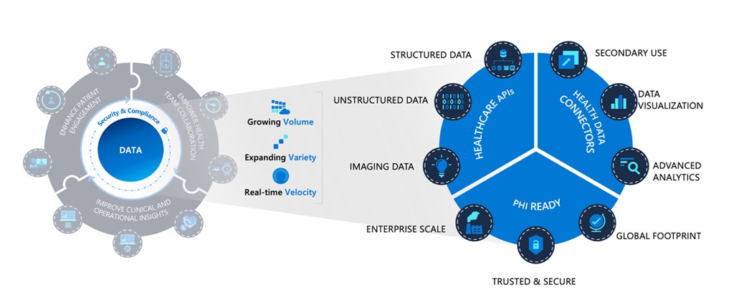
Examples
Azure Health Data Services
Example of data management and use (in health care). "Azure Health Data Services, a platform as a service (PaaS) designed to support Protected Health Information (PHI) in the cloud."
Heather Jordan Cartwright. 2022. Microsoft launches Azure Health Data Services to unify health data and power AI in the cloud. Microsoft. https://azure.microsoft.com/en-us/blog/microsoft-launches-azure-health-data-services-to-unify-health-data-and-power-ai-in-the-cloud/

Slide 12
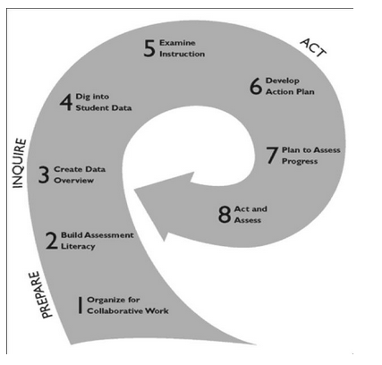
Examples
Datawise
Program to teach instructors to use data to support learning and assessment
Addresses “a need to bridge the resources of an institution of higher education with the instructional capacity of professional development providers and the authentic experiences of school-based practitioners.”
Candice Bocala, Kathryn Parker Boudett, Teaching Educators Habits of Mind for Using Data Wisely, Teachers College Record. https://www.tcrecord.org/Content.asp?ContentID=17853
Boudett, K. P., City, E. A., & Murnane, R. J. (2013). Data Wise: A step-by-step guide to using assessment results to improve learning and teaching (revised and expanded ed.). Cambridge, MA: Harvard Education Press.

Slide 13
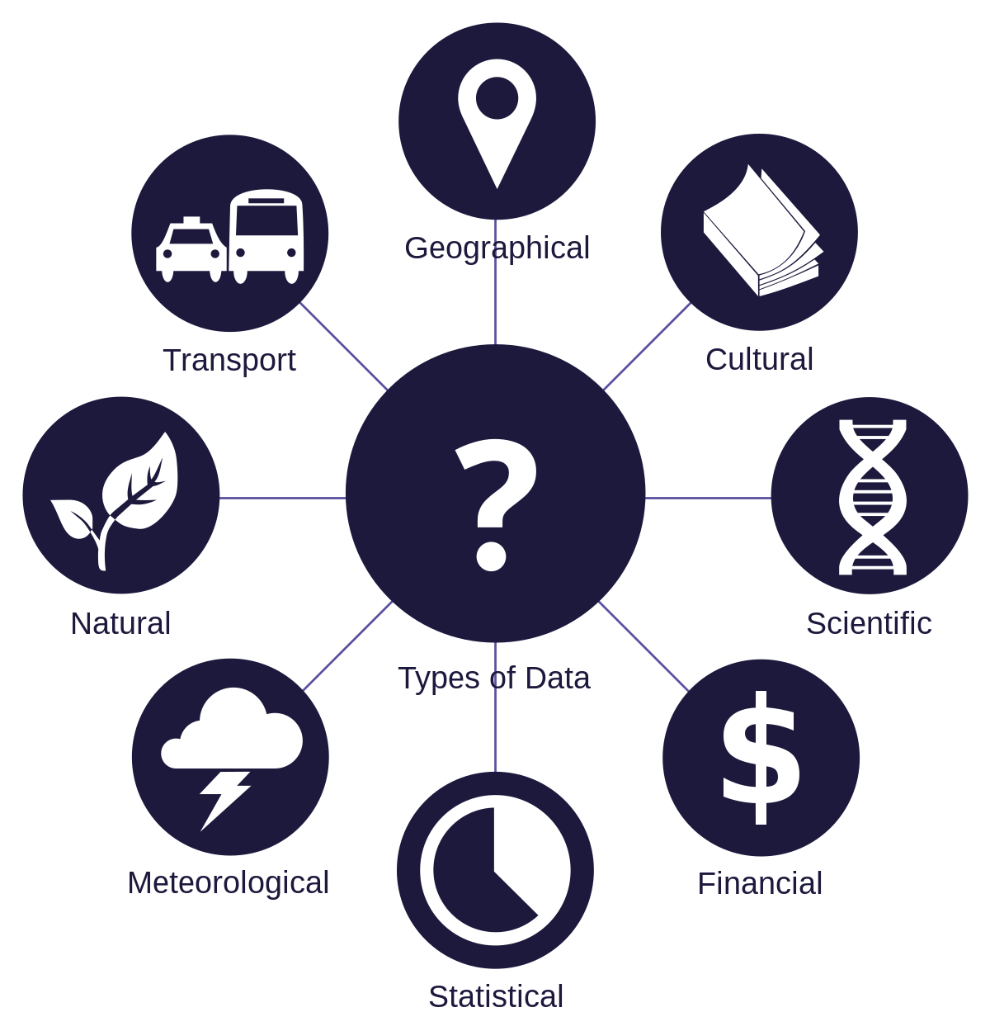
Data
“The representation of facts as text, numbers, graphics, images, sound, or video” (The Department of National Defence and Canadian Armed Forces Data Strategy, 2019)
“An object, variable, or piece of information that has the perceived capacity to be collected, stored, and identifiable.” (Bhargava, et.al., 2015)
https://www.canada.ca/en/department-national-defence/corporate/reports-publications/data-strategy.html
https://datapopalliance.org/item/beyond-data-literacy-reinventing-community-engagement-and-empowerment-in-the-age-of-data/

Slide 14
Data
Data types
Structure
Structured
Sensor data
Geospatial
Quantities
Unstructured
Verbal reports
Photographs
Blog posts
Semi-structured
Entry Form
News article
API response
Mixed
Combination of the other types
Types of data

Slide 15
Data
Data types
Velocity
Batch
At time intervals
Near-time
At small time intervals
Real-time
Continuous input, process output
Stream
Data flows
Types of data

Slide 16
Data
Data types
Formats
Numeric
Counts
Values
Measures
Text
Articles
Transcripts
Form input
Media
Images
Graphs
Charts
Mixed
Combination of the three
Types of data
https://datatracker.ietf.org/doc/html/rfc6838
https://guides.library.oregonstate.edu/research-data-services/data-management-types-formats

Slide 17
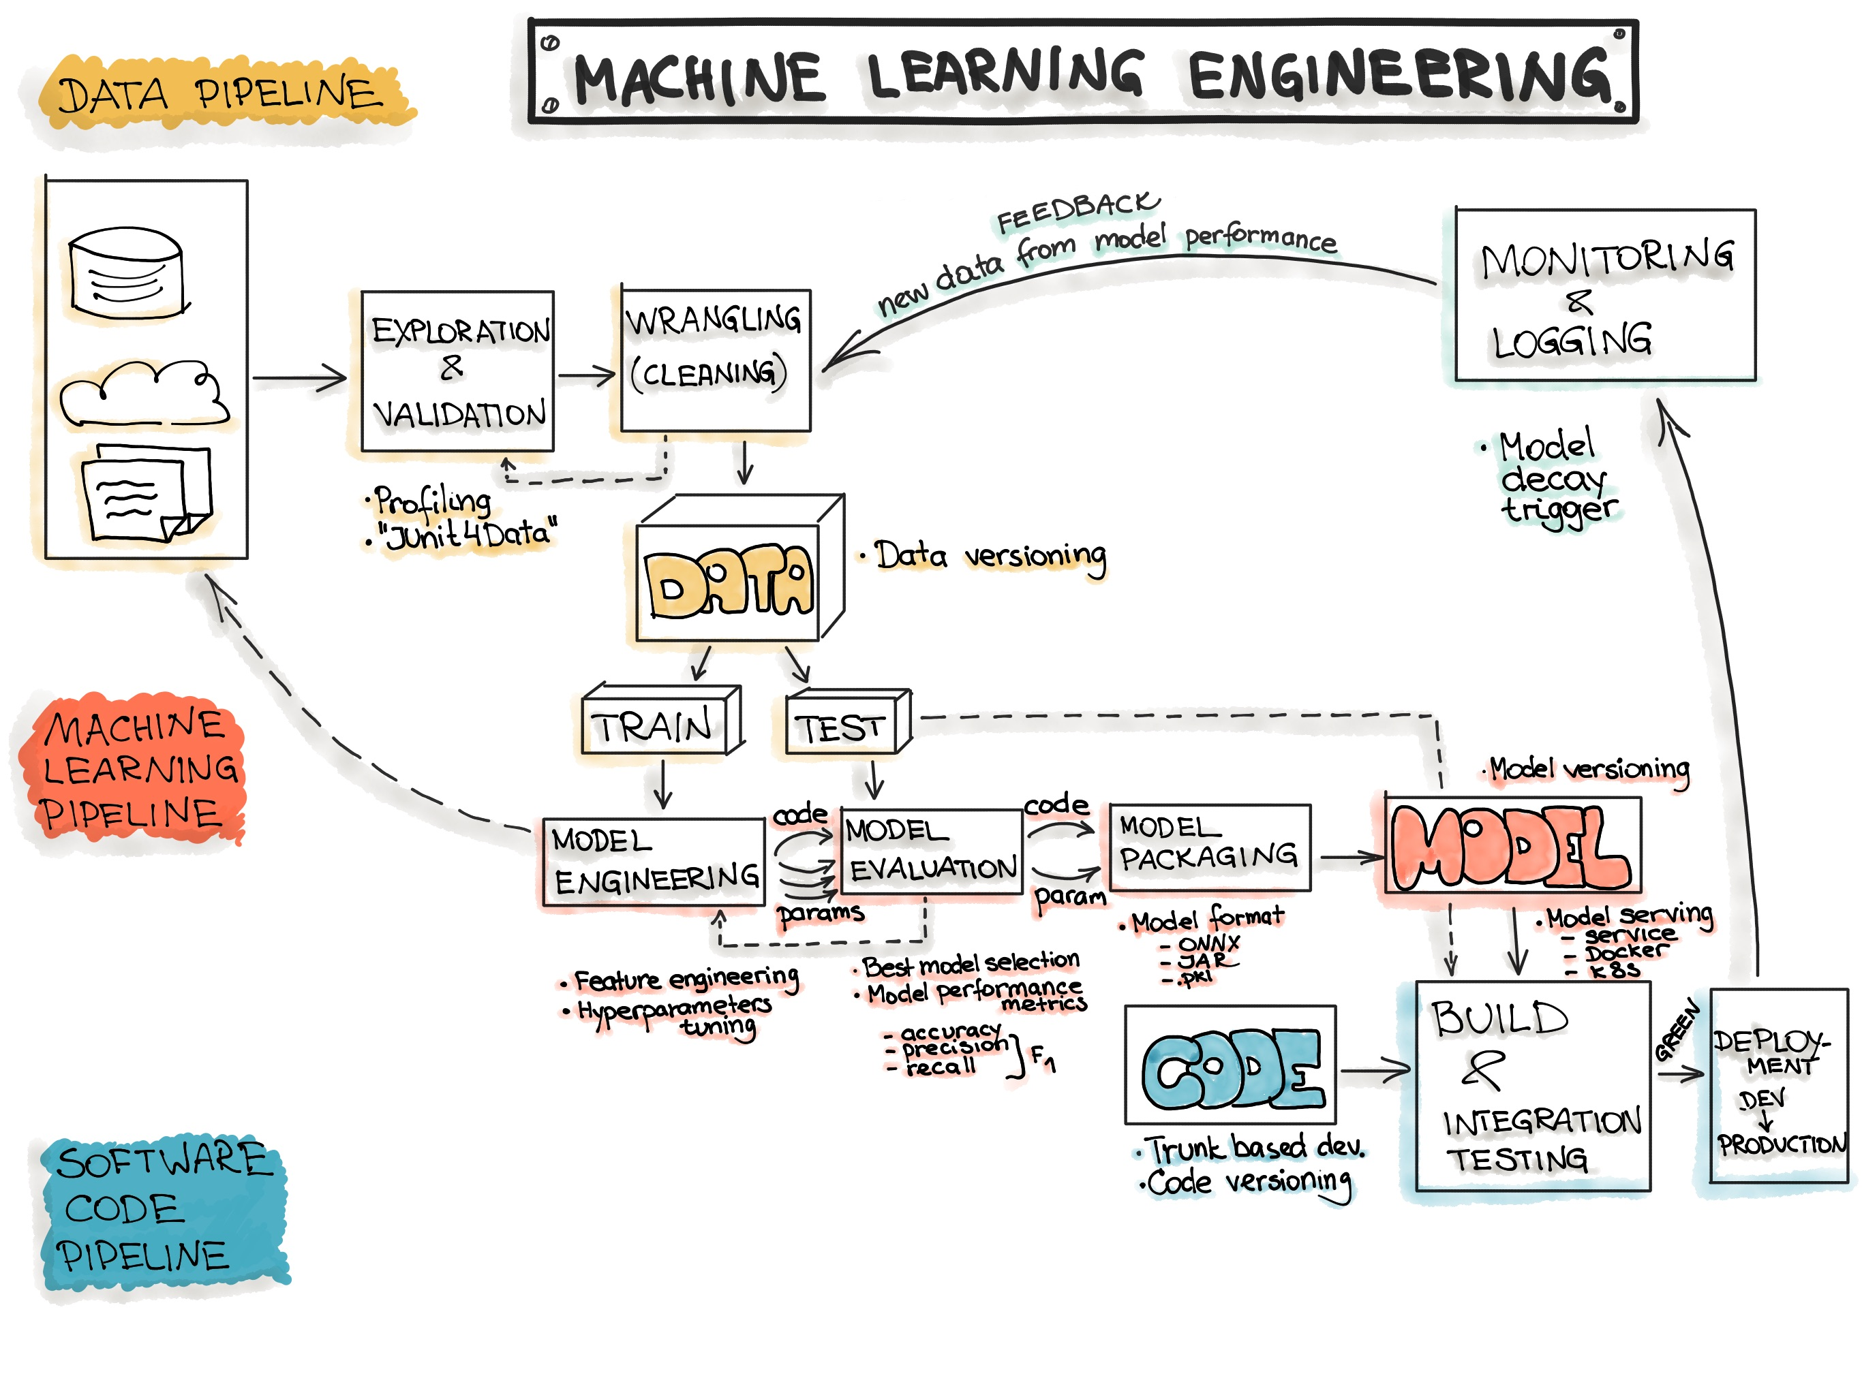
Data Workflows
Machine Learning Engineering
MLops https://ml-ops.org/content/end-to-end-ml-workflow

Slide 18
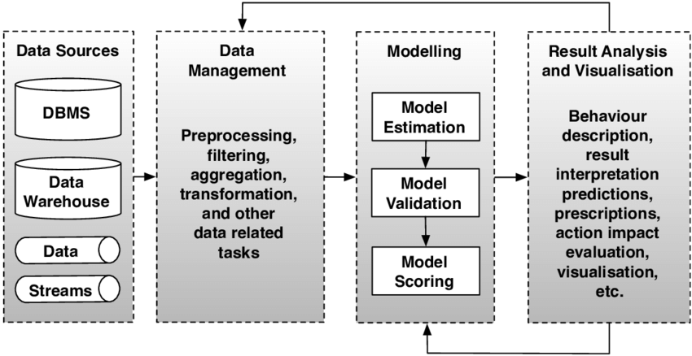
Data Workflows
Big Data Analytics
Marcos D. Assuncao, Rodrigo N. Calheiros, Silvia Bianchi, Marco A. S. Netto, Rajkumar Buyya. (2014). Big Data Computing and Clouds: Trends and Future Directions. Journal of Parallel and Distributed Computing. https://www.researchgate.net/publication/259335041_Big_Data_Computing_and_Clouds_Challenges_Solutions_and_Future_Directions

Slide 19
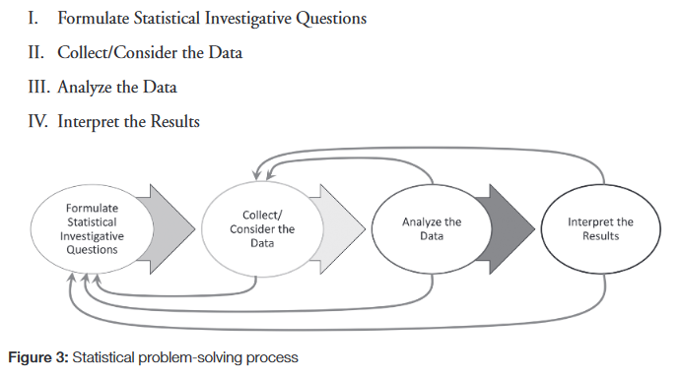
Data Workflows
GAISE
Anna Bargagliotti, et.al. (2020). Pre-K–12 Guidelines for Assessment and Instruction in Statistics Education II (GAISE II). American Statistical Association. https://www.amstat.org/docs/default-source/amstat-documents/gaiseiiprek-12_full.pdf

Slide 20
Subdivisions
Information Literacy
Probability and Statistics
Critical Thinking
Data Management

Slide 21
Data… | 1 | 2 | 3 | 4 | 5 | 6 | 7 | 8 | 9 | 10 | 11 | 12 | 13 | 14 | 15 | 16 | 17 | 18 | 19 | 20
Awareness | x |  | x |  |  |  |  |  |  |  | x |  |  | x |  |  | x |  | x | x
Dispositions |  |  |  |  |  |  |  |  |  |  |  |  |  |  |  |  |  |  |  | x
Strategy/Culture | x |  |  | x |  | x |  | x |  |  | x |  |  |  | x
Plan, Implement, Mon |  |  |  |  |  |  |  |  |  |  |  |  |  | x |  |  |  | x
Inquiry Process |  |  |  |  |  |  |  |  |  |  |  |  |  | x |  |  | x | x | x
Discovery / Explore |  |  | x |  | x |  |  | x | x |  | x |  | x | x | x | x | x |  |  | x
Ethics | x |  | x |  |  | x |  |  | x | x | x |  |  | x | x | x
Gathering / Collection |  |  | x | x |  |  |  |  | x | x | x |  | x | x |  | x |  | x | x
Curation |  |  |  |  |  |  |  |  |  | x | x |  |  |  |  |  |  |  | x
Communities |  |  |  |  |  | x
Requirements |  | x |  |  |  |  |  |  | x
Valuation |  |  |  |  |  |  |  | x |  |  |  |  |  |  |  |  |  | x
Evaluation/Assessment |  |  |  |  | x | x |  |  |  |  | x |  |  |  |  |  | x |  | x
Informed Decision-mak | x |  | x |  |  | x | x | x |  | x | x |  | x | x |  |  | x |  | x
Governance / Steward | x | x | x | x |  | x | x |  | x |  |  |  |  |  |  |  |  | x | x
Standards | x |  |  |  |  | x |  |  | x
Description/Metadata |  |  |  |  |  | x |  | x | x | x | x |  | x |  |  |  | x | x | x
Conversion, Interopabl | x |  |  |  |  |  |  |  |  |  | x |  | x |  | x |  | x | x | x
Management |  | x |  |  | x | x | x | x |  | x | x |  | x | x |  | x | x | x | x
Preservation |  |  |  |  |  |  |  |  |  |  | x |  | x |  |  | x |  |  |  | x
Cleaning |  |  | x |  |  | x |  |  | x | x
Systems & Tools | x |  | x |  |  | x |  |  |  |  | x |  |  | x |  | x | x | x | x
Policy |  |  |  |  |  | x
Quality | x |  |  |  |  |  |  |  | x |  | x | x | x | x | x | x | x | x
Security | x | x |  |  |  |  | x |  |  | x | x
Manipulation |  | x |  |  |  |  |  |  |  |  | x |  | x | x | x | x |  | x | x
Statistics & Reasoning |  |  |  |  |  |  |  | x |  | x | x |  |  |  |  |  |  | x | x
Critical Thinking |  |  |  |  |  |  |  |  |  |  | x |  |  |  |  | x
Analysis | x | x | x |  |  | x | x | x | x | x | x |  | x | x | x | x | x | x | x | x
Interpretation |  |  |  |  |  |  |  |  |  |  | x |  | x | x | x | x |  |  | x
Modeling/Architecture |  |  | x | x |  |  | x |  | x |  |  |  |  |  |  |  |  |  | x
Data Science and ML |  |  |  |  |  |  | x | x
Citation & Sharing |  |  |  |  |  |  |  |  |  |  | x | x |  |  |  | x |  | x |  | x
Visualization | x | x | x |  |  | x |  |  | x |  | x | x | x |  | x | x | x | x | x | x
Storytelling | x |  | x |  |  |  |  | x | x |  | x | x |  |  |  |  |  |  | x
Present Data Verbally |  |  |  |  |  |  |  |  |  |  | x |  | x |  | x
Change |  |  |  |  |  | x | x | x |  |  |  |  |  |  |  |  |  |  | x
Using/Innovating With |  |  |  |  | x | x |  | x
Identifying Problems |  |  |  |  |  |  |  |  |  |  | x |  | x | x | x
Generate Data |  |  |  |  |  |  |  |  |  |  |  |  |  |  |  |  | x

Slide 22
Data…
Awareness
Dispositions
Strategy/Culture
Plan, Implement, Mon
Inquiry Process
Discovery / Explore
Ethics
Gathering / Collection
Curation
Communities
Requirements
Valuation
Evaluation/Assessment
Informed Decision-mak
Governance / Steward
Standards
Description/Metadata
Conversion, Interopabl
Management
Preservation
Cleaning
Systems & Tools
Policy
Quality
Security
Manipulation
Statistics & Reasoning
Critical Thinking
Analysis
Interpretation
Modeling/Architecture
Data Science and ML
Citation & Sharing
Visualization
Storytelling
Present Data Verbally
Change
Using/Innovating With
Identifying Problems
Generate Data

Slide 23
Data… | 1 | 2 | 3 | 4 | 5 | 6 | 7 | 8 | 9 | 10 | 11 | 12 | 13 | 14 | 15 | 16 | 17 | 18 | 19 | 20
Awareness | x |  | x |  |  |  |  |  |  |  | x |  |  | x |  |  | x |  | x | x
Dispositions |  |  |  |  |  |  |  |  |  |  |  |  |  |  |  |  |  |  |  | x
Strategy/Culture | x |  |  | x |  | x |  | x |  |  | x |  |  |  | x
Plan, Implement, Mon |  |  |  |  |  |  |  |  |  |  |  |  |  | x |  |  |  | x
Inquiry Process |  |  |  |  |  |  |  |  |  |  |  |  |  | x |  |  | x | x | x
Discovery / Explore |  |  | x |  | x |  |  | x | x |  | x |  | x | x | x | x | x |  |  | x
Ethics | x |  | x |  |  | x |  |  | x | x | x |  |  | x | x | x
Gathering / Collection |  |  | x | x |  |  |  |  | x | x | x |  | x | x |  | x |  | x | x
Curation |  |  |  |  |  |  |  |  |  | x | x |  |  |  |  |  |  |  | x
Communities |  |  |  |  |  | x
Requirements |  | x |  |  |  |  |  |  | x
Valuation |  |  |  |  |  |  |  | x |  |  |  |  |  |  |  |  |  | x
Evaluation/Assessment |  |  |  |  | x | x |  |  |  |  | x |  |  |  |  |  | x |  | x
Informed Decision-mak | x |  | x |  |  | x | x | x |  | x | x |  | x | x |  |  | x |  | x
Governance / Steward | x | x | x | x |  | x | x |  | x |  |  |  |  |  |  |  |  | x | x
Standards | x |  |  |  |  | x |  |  | x
Description/Metadata |  |  |  |  |  | x |  | x | x | x | x |  | x |  |  |  | x | x | x
Conversion, Interopabl | x |  |  |  |  |  |  |  |  |  | x |  | x |  | x |  | x | x | x
Management |  | x |  |  | x | x | x | x |  | x | x |  | x | x |  | x | x | x | x
Preservation |  |  |  |  |  |  |  |  |  |  | x |  | x |  |  | x |  |  |  | x
Cleaning |  |  | x |  |  | x |  |  | x | x
Systems & Tools | x |  | x |  |  | x |  |  |  |  | x |  |  | x |  | x | x | x | x
Policy |  |  |  |  |  | x
Quality | x |  |  |  |  |  |  |  | x |  | x | x | x | x | x | x | x | x
Security | x | x |  |  |  |  | x |  |  | x | x
Manipulation |  | x |  |  |  |  |  |  |  |  | x |  | x | x | x | x |  | x | x
Statistics & Reasoning |  |  |  |  |  |  |  | x |  | x | x |  |  |  |  |  |  | x | x
Critical Thinking |  |  |  |  |  |  |  |  |  |  | x |  |  |  |  | x
Analysis | x | x | x |  |  | x | x | x | x | x | x |  | x | x | x | x | x | x | x | x
Interpretation |  |  |  |  |  |  |  |  |  |  | x |  | x | x | x | x |  |  | x
Modeling/Architecture |  |  | x | x |  |  | x |  | x |  |  |  |  |  |  |  |  |  | x
Data Science and ML |  |  |  |  |  |  | x | x
Citation & Sharing |  |  |  |  |  |  |  |  |  |  | x | x |  |  |  | x |  | x |  | x
Visualization | x | x | x |  |  | x |  |  | x |  | x | x | x |  | x | x | x | x | x | x
Storytelling | x |  | x |  |  |  |  | x | x |  | x | x |  |  |  |  |  |  | x
Present Data Verbally |  |  |  |  |  |  |  |  |  |  | x |  | x |  | x
Change |  |  |  |  |  | x | x | x |  |  |  |  |  |  |  |  |  |  | x
Using/Innovating With |  |  |  |  | x | x |  | x
Identifying Problems |  |  |  |  |  |  |  |  |  |  | x |  | x | x | x
Generate Data |  |  |  |  |  |  |  |  |  |  |  |  |  |  |  |  | x
Row 13
Databilities

Slide 24
Defining Data Literacy
Individual | Organizational
 | Team | Division | Branch
 | Tools and systems | Employee skills and capabilities | Procedures and mechanisms

Slide 25
Defining Data Literacy
Individual | Organizational
Knowledge | Definitions
Skills / Competencies | Capacities
Attitudes | Practices

Slide 26
Example: Data Visualization
Individual | Organizational
Knowledge - knows visualization formats - understands data representation | Definitions - standard visualizations for key data - visualizations referenced to original data
Skills / Competencies - can create visualizations from data - can generate meaning from visualizations | Capacities - staff have access to data visualizations - staff includes data visualization expertise
Attitudes - is comfortable working with visualizations - recognizes importance of visualizations | Practices - maintains data visualization software tools - data visualization part of reports workflow

Slide 27
Competency Model or Framework
Evaluation or Assessment Framework
Teaching Framework

Slide 28
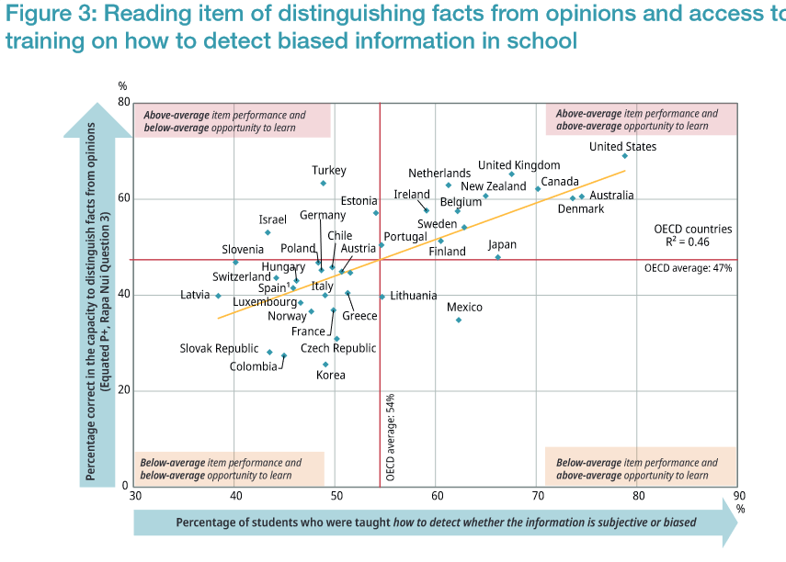
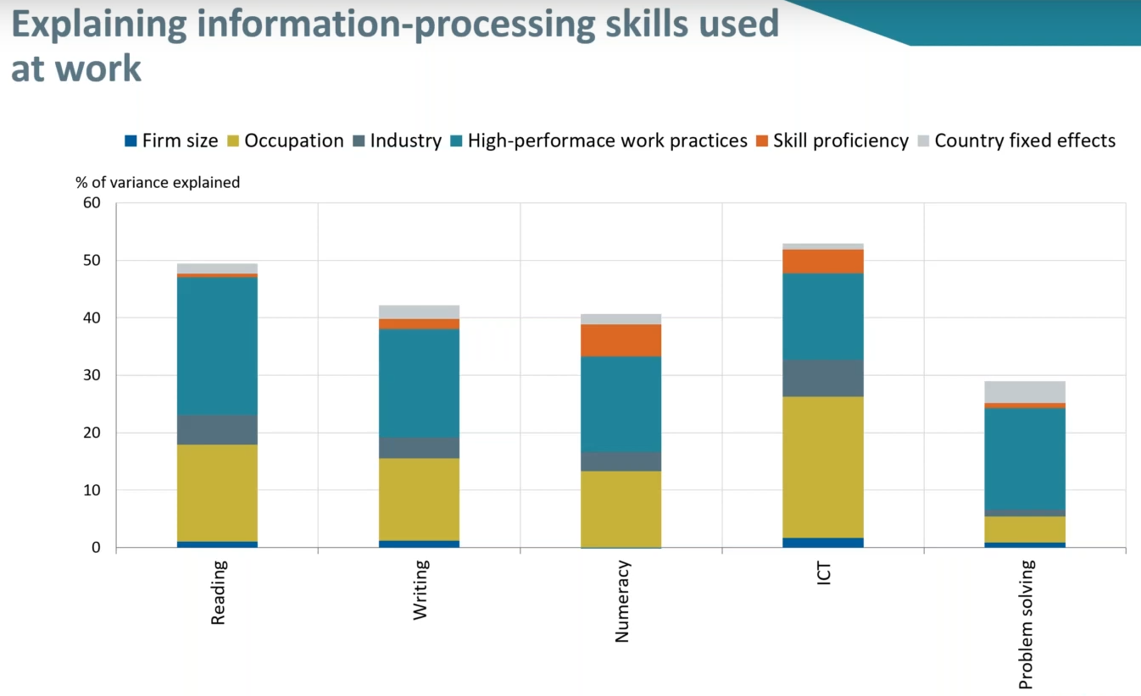
Assessment Programs
OECD
The Programme for the International Assessment of Adult Competencies (PIAAC)
Programme for International Student Assessment (PISA)
OECD (PISA). 2021. Are 15-year-olds prepared to deal with fake news and misinformation? https://www.oecd-ilibrary.org/education/are-15-year-olds-prepared-to-deal-with-fake-news-and-misinformation_6ad5395e-en
OECD (PIAAC). 2021. PIAAC Round 3 International Launch Webinar. https://www.oecd.org/skills/piaac/

Slide 29
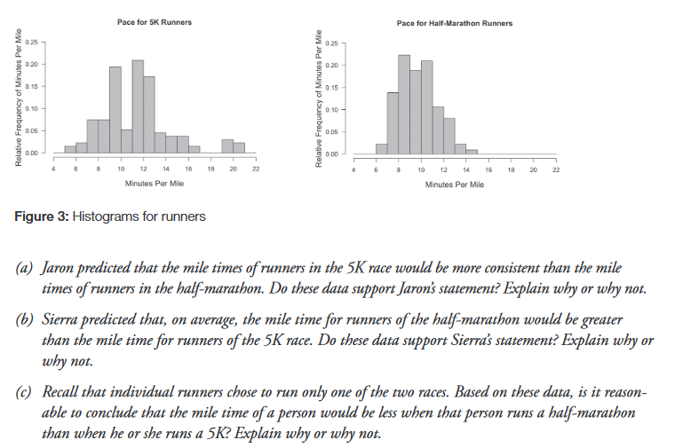
Assessment Programs
Guidelines for Assessment and Instruction in Statistics Education (GAISE)
Robert Carver, et.al.. (2016). Guidelines for Assessment and Instruction in Statistics Education (GAISE) College Report. American Statistical Association. https://www.amstat.org/docs/default-source/amstat-documents/gaisecollege_full.pdf
Anna Bargagliotti, et.al. (2020). Pre-K–12 Guidelines for Assessment and Instruction in Statistics Education II (GAISE II). American Statistical Association. https://www.amstat.org/docs/default-source/amstat-documents/gaiseiiprek-12_full.pdf

Slide 30
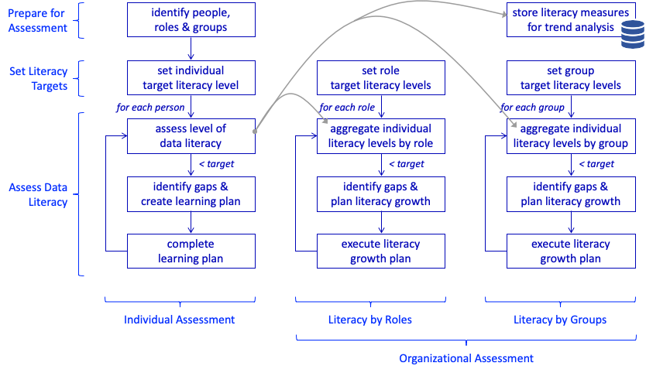
Assessment Programs
Eckerson Group Data Literacy Imperative
Dave Wells. 2022. The Data Literacy Imperative - Part III: Data Literacy Assessment. Eckerson Group. https://www.eckerson.com/articles/the-data-literacy-imperative-part-iii-data-literacy-assessment

Slide 31
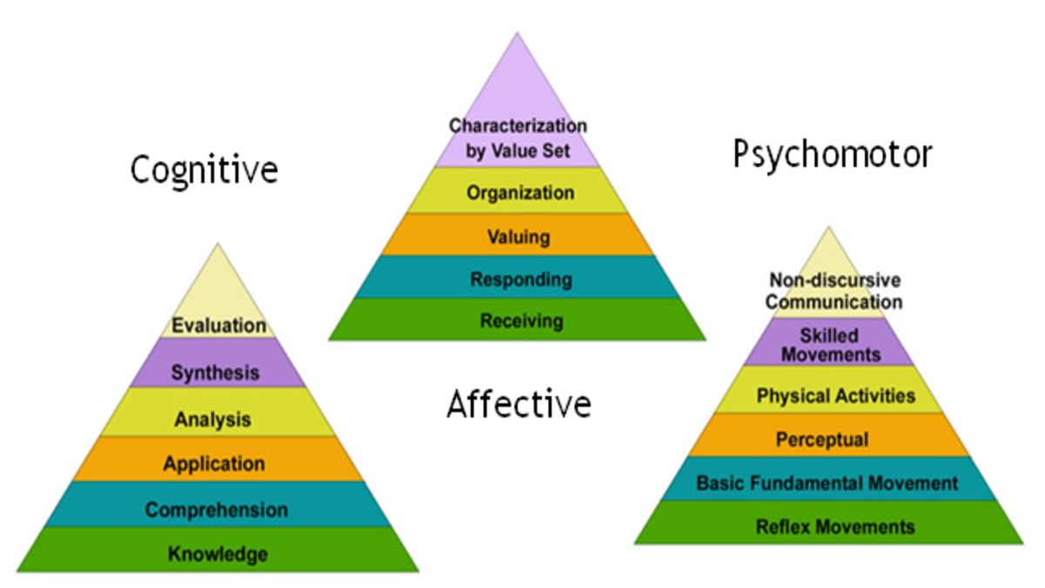
Data Literacy Model-Based Assessment
Extant list of skills based on empirical analysis of data workflows
This list can be cross-referenced with a comprehensive skills taxonomy
  (For simplicity I used a modified Bloom’s Taxonomy)
  Treated as taxonomies not hierarchies
  Represented as types of skills or competences

Slide 32
Assessing Data Literacy
Individual | Organizational
Knowledge | Definitions
Skills / Competencies | Capacities
Attitudes | Practices

Slide 33
Knowledge
Individual | Organizational
Knowledge - Know what data is, recognize data vs non-data | - Has or uses data in some way
Comprehension - Know methods to read data, comprehend data | - Provides mechanisms for data access
Application - Know how data can be used | - Data can be used as input in tools and systems
Analysis - Understand parts of data, types of data | - Data can be accessed in different views, formats
Synthesis - Know ways to join of connect data | - Data can be pooled or connected
Evaluation - Identify quality data, appropriate data | - The are organizational data quality standards
Creation - Create data | - Data is recorded and produced in the organization

Slide 34
Skills / Competencies
Individual | Organizational
Perception - Be able to discover, read, explore data | - The organization actively collects data
Set - Can follow data processes and procedures | - There are data management processes
Guided Response - Can follow instructions and respond to data | - There is a capacity to respond to data
Mechanism - Knows about and can use data tools and systems | - Data management tools and systems are supported
Complex Overt Response - Can make decisions using data | - Decisions are driven by data
Adaptation - Can create data visualizations, stories | - Visualizations and data stories are used
Origination - Can create and share data from new sources | - The organization regularly collects and shares data

Slide 35
Attitudes
Individual | Organizational
Receiving - Is open to learning from data | - Data is welcomed and sought after
Recognizing - Can detect patterns and regularities in data | - Data is considered and analyzed; there are data-based alerts
Responding - Is willing to act on new data | - Data drives actions and responses to challenges
Framing - Is willing to work in a data-centered way | - Knowledge management is data centered
Valuing - Values and can assign value to different types of data | - Data is valued in the organization and quality controls apply
Organizing - Actively orients data to address challenges | - Key strategies are oriented by data
Characterizing - Develops abstractions, generalizations and principles | - Organizational frameworks, structures, procedures driven by data

Slide 36
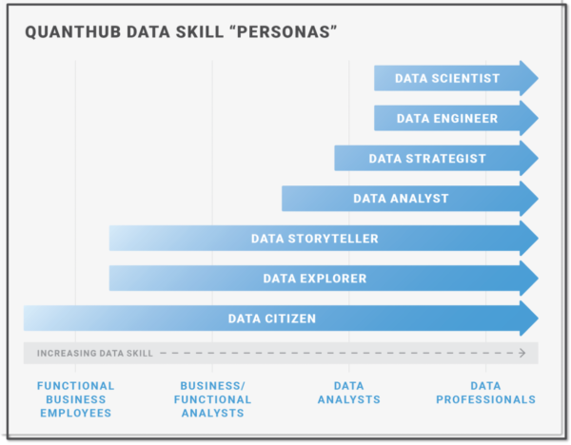
Levels
GAISE: Levels A, B, C program contents
Quanthub Personas
Jen DuBois. 2022. Thriving Data Culture Starts with Data Literacy Assessments. QuantHub. https://quanthub.com/data-literacy-assessment/

Slide 37
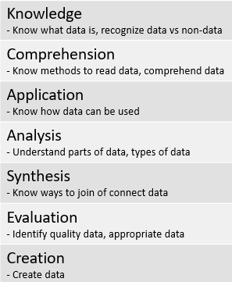
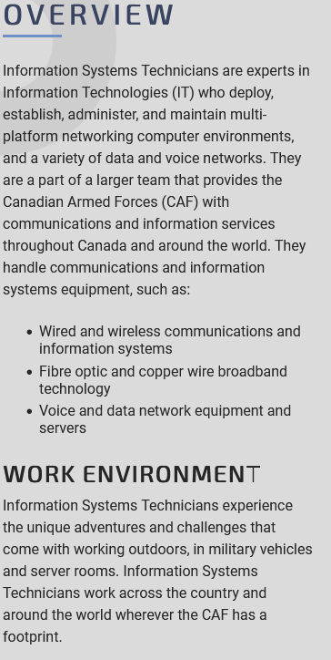
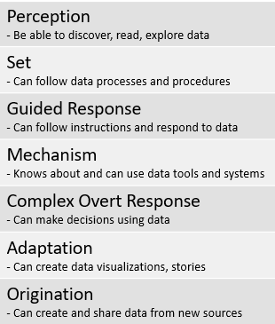
Role-Defined Data Literacy
Etc…
https://forces.ca/en/careers

Slide 38
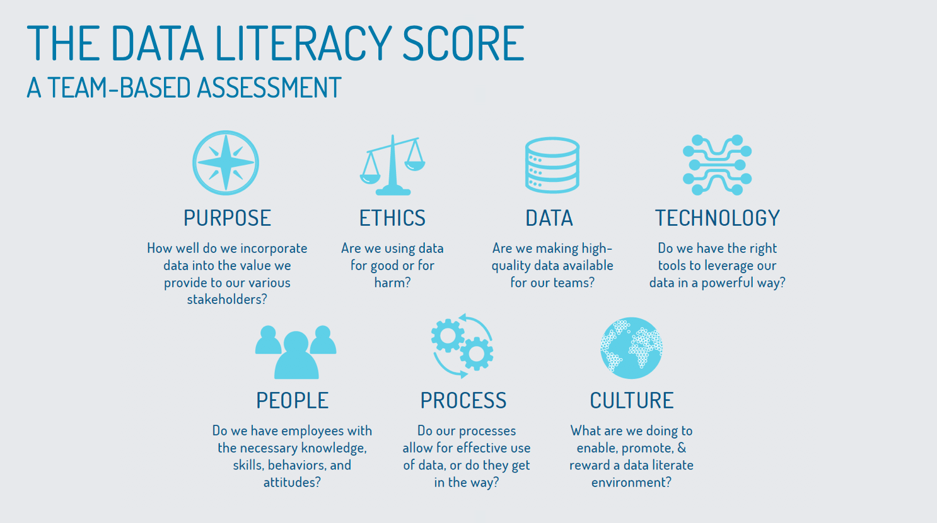
Assessment Methods
Self-Report
Skills Test (Multiple Choice)
Skills Test (Open Response)
Analysis
https://dataliteracy.com/data-literacy-score/

Slide 39
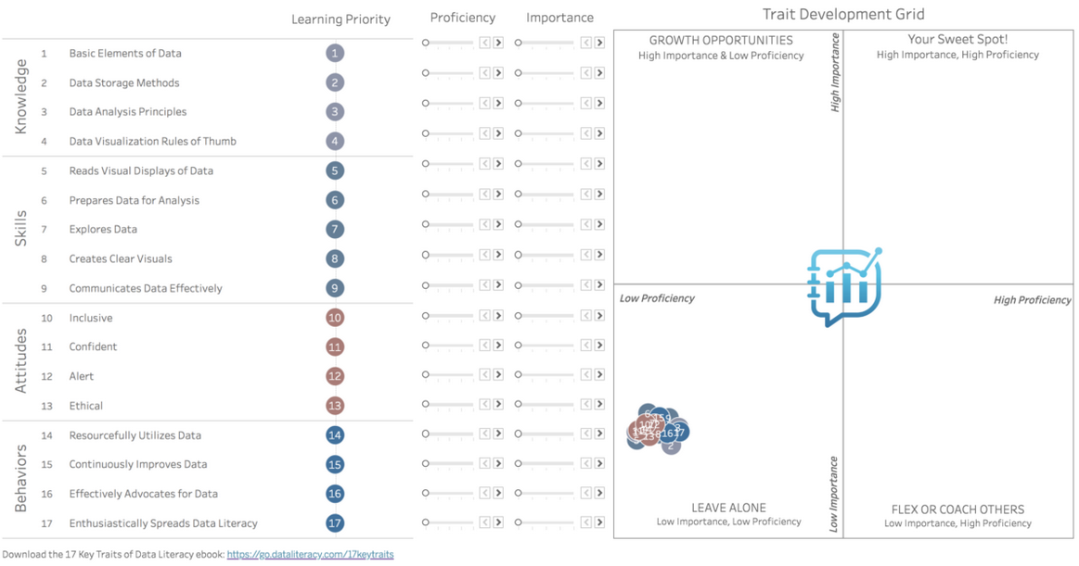
Methods
Self-Report
2019. Take the 17 Key Traits of Data Literacy Self-Assessment. Data Literacy. https://dataliteracy.com/take-the-17-key-traits-self-assessment/
Ben Jones. 2022. A Data Literacy Assessment for Every Employee. Udemy. https://business.udemy.com/resources/data-skills-assessment-template/

Slide 40
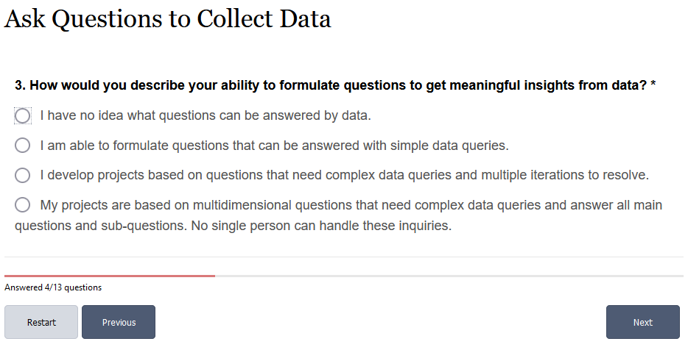
Methods
Self-Report
Canada School of Public Service. . How Data Literate Are You?. Government of Canada. https://catalogue.csps-efpc.gc.ca/product?catalog=DDN302&cm_locale=en

Slide 41
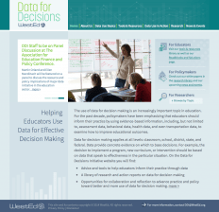
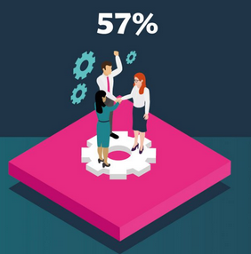
Method
Skills Test (Open Response)
Questionmark Data Literacy by Cambridge Assessment. QuestionMark. https://www.questionmark.com/platform-services/questionmark-data-literacy-by-cambridge-assessments/
WestEd. Developing Assessments of Data Literacy. https://www.wested.org/project/data-literacy-assessment-development/

Slide 42
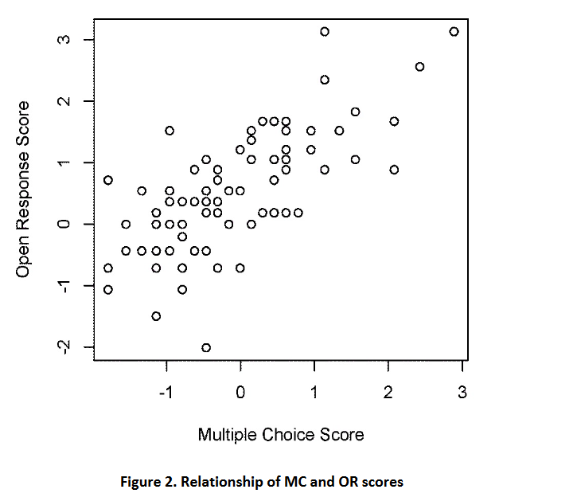
Method
Skills Test (Multiple Choice)
The objective here is to develop a multiple-choice (“MC”) assessment of students’ ability that compares favorably with more time-consuming, open response instruments.
Design and development effort using Rasch modeling. “The Rasch model assumes that the underlying construct that is being measured varies along a single dimension (Bond & Fox, 2012).”
Bill Zoellick, Molly Schauffler, Marcella Flubacher. Ryan Weatherbee, Hannah Webber. (2016). Data Literacy: Assessing Student Understanding of Variability in Data. Annual Meeting of the National Association for Research in Science Teaching. https://www.researchgate.net/publication/301802243_Data_Literacy_Assessing_Student_Understanding_of_Variability_in_Data

Slide 43
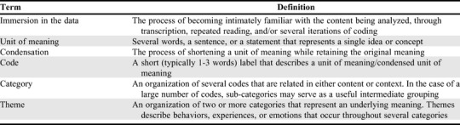
Method
Analysis
E.g. Data literacy was measured on the 60 students using a written essay test of 6 items, according to the aspects contained in data literacy
Suryadi, I K Mahardika, Supeno, Sudarti. (2021). Data literacy of high school students on physics learning. Journal of Physics: Conference Series. https://www.researchgate.net/publication/350169382_Data_literacy_of_high_school_students_on_physics_learning
A. J. Kleinheksel, Nicole Rockich-Winston, Huda Tawfik, Tasha R. Wyatt. (2020). Demystifying Content Analysis. American Journal of Pharmaceutical Education. https://www.ncbi.nlm.nih.gov/pmc/articles/PMC7055418/

Slide 44
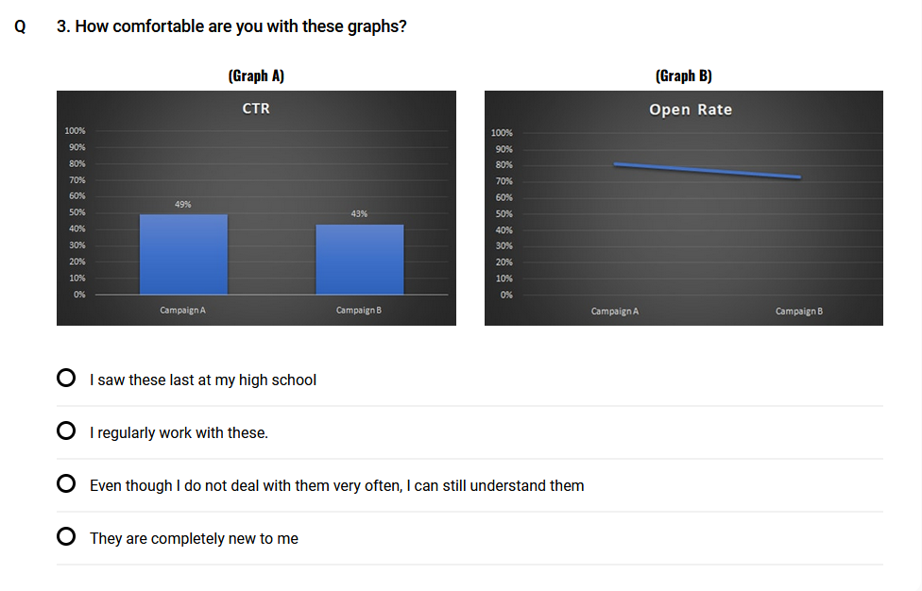
Method
Mixed
Example:
Short 10-question quiz with a mix of attitude questions and objective questions to classify people into one of six 'data literacy' categories.
2022. Data literacy assessment. Aryng. https://aryng.com/data-literacy-test

Slide 45
Competency Model or Framework
Evaluation or Assessment Framework
Teaching Framework

Slide 46
Developing Data Literacy
Individual | Organizational
Knowledge | Definitions
Skills / Competencies | Capacities
Attitudes | Practices

Slide 47
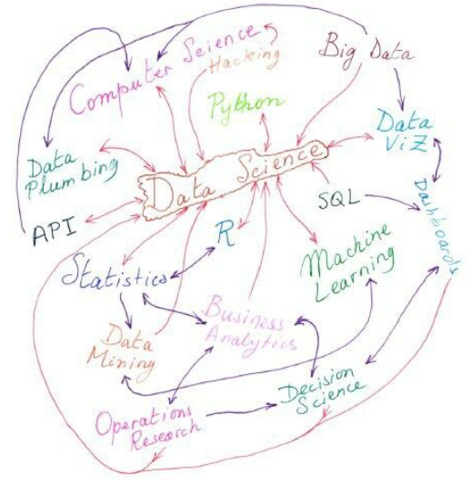
Developing Data Literacy
Data Literacy Programs
Teaching and learning methods
Individual learning resources
https://www.pinterest.ca/pin/731905376935604058/?mt=login

Slide 48
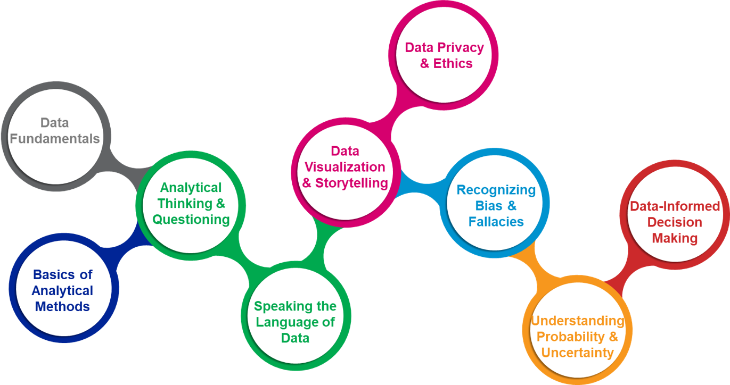
Data Literacy Programs
Methods and Examples
Models and designs for data literacy program development
Extant Data literacy training programs and curricula
https://community.alteryx.com/t5/Women-of-Analytics/To-require-Data-Literacy-for-every-university-student-what-does/td-p/542076

Slide 49
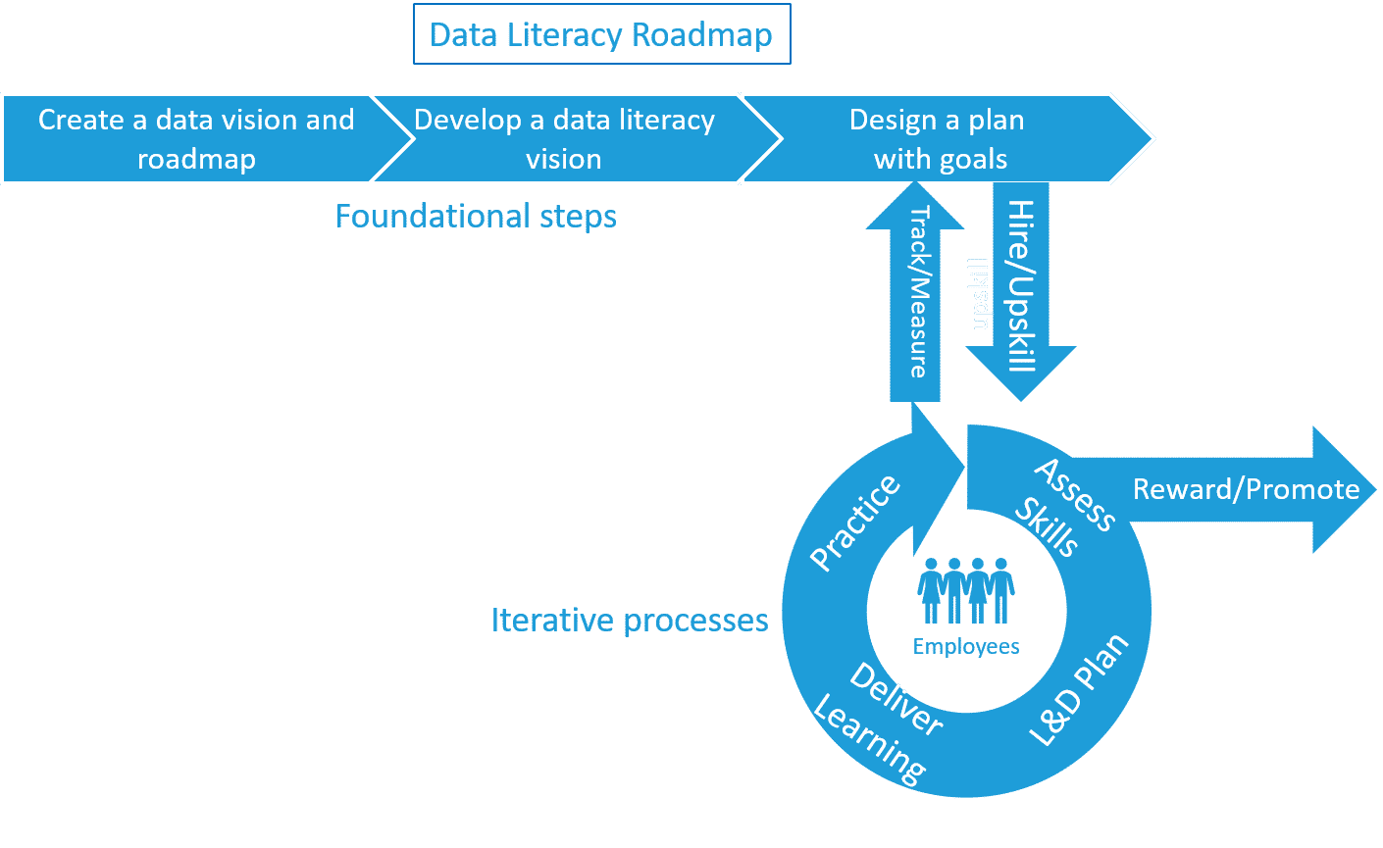
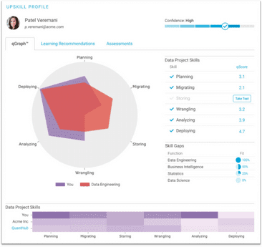
Method
A Roadmap for Creating a Data Literacy Program
Individual and team data literacy learning and development plans
Matt Cowell, QuantHub https://quanthub.com/data-literacy-program/

Slide 50
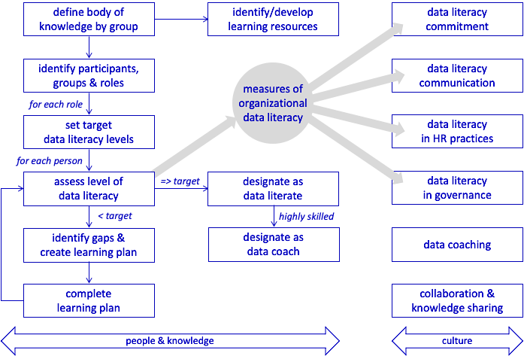
Method
The Data Literacy Imperative
Part I: Building a Data Literacy
Program
Dave Wells, Eckerson Group https://www.eckerson.com/articles/the-data-literacy-imperative-part-i-building-a-data-literacy-program

Slide 51
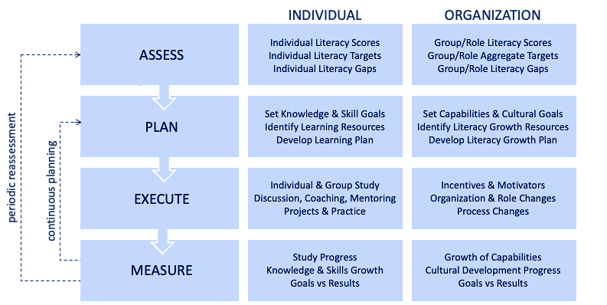
Method
The Data Literacy Imperative - Part IV: Developing Data Literacy
Dave Wells, Eckerson Group https://www.eckerson.com/articles/the-data-literacy-imperative-part-iv-developing-data-literacy

Slide 52
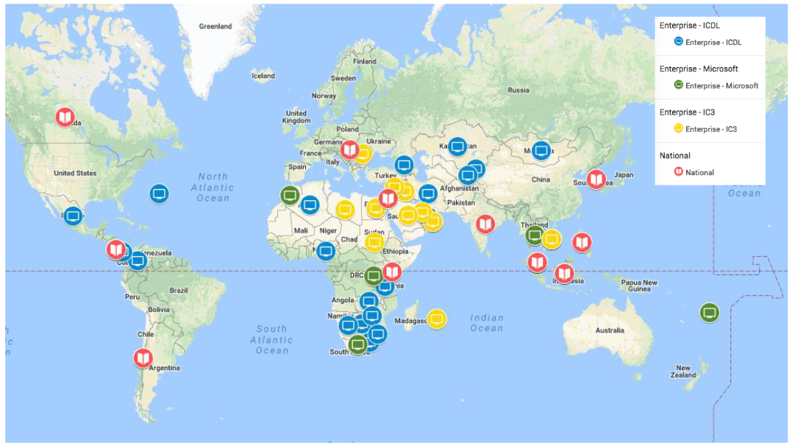
Example
UNESCO Digital Literacy Global Framework
Six of the national frameworks (Costa Rica, India, Kenya, Philippines, Chile and British
Columbia (Canada)) that are most clearly written with regard to the competency areas, as well as the three enterprise frameworks to map against the DigComp 2.0 framework
Published by the UNESCO Institute for Statistics, is part of the Global Alliance to Monitor Learning (GAML), a Digital Literacy Global Framework was developed, http://uis.unesco.org/en/blog/digital-literacy-skills-framework-measure
A Global Framework of Reference on Digital Literacy Skills for Indicator 4.4.2 http://uis.unesco.org/sites/default/files/documents/ip51-global-framework-reference-digital-literacy-skills-2018-en.pdf
Recommendations on Assessment Tools for Monitoring Digital Literacy within UNESCO DLGF http://gaml.uis.unesco.org/wp-content/uploads/sites/2/2018/12/4.4.2_02-Assessment-tools-for-monitoring-digital-literacy.pdf

Slide 53
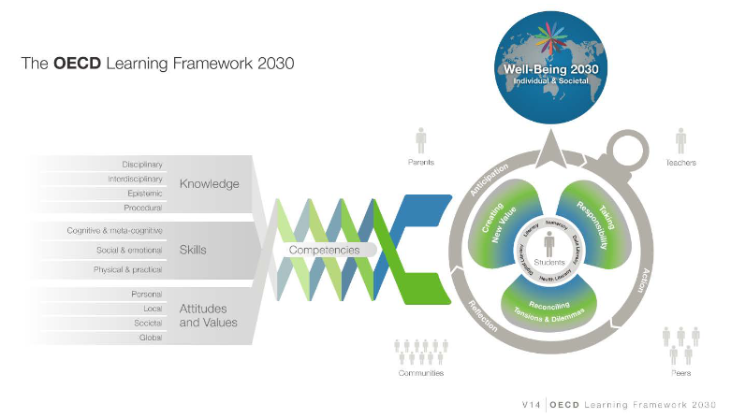
Example
OECD on Skills Development
It will be important to:
Involve stakeholders in the design of integrated information systems
Use information management systems to inform rather than automate decisions that should be taken by stakeholders themselves.
Make use of different kinds of data
OCED has a website on skills development at https://www.oecd.org/skills/
Although not focused on Data Literacy, this report has some policy on dealing with stakeholders: Strengthening the Governance of Skills System: a self-assessment tool. https://www.oecd.org/skills/centre-for-skills/Strengthening_the_Governance_of_Skills_Systems_Self_Assessment_Tool.pdf
Survey of Adult Skills (PIAAC): Full selection of indicators
Image: https://www.oecd.org/education/2030/E2030%20Position%20Paper%20(05.04.2018).pdf

Slide 54
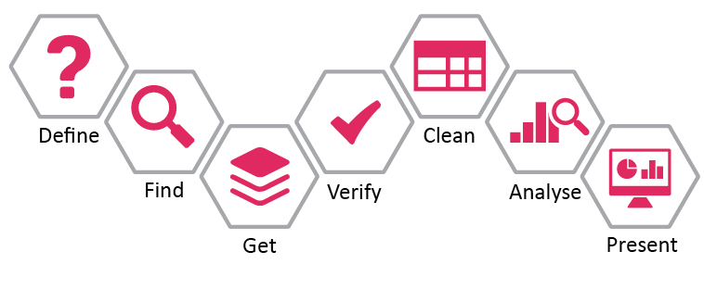
Teaching and Learning Methods
Pedagogical methods to teach or support data literacy training
Specific trials of different methods in various learning contexts
https://www.stateofopendata.od4d.net/chapters/issues/data-literacy.html

Slide 55
Methods
Overall recommendations
Recommendations for statistical literacy instruction may apply more broadly to data literacy in general
Teach statistical thinking.
  Teach statistics as an investigative process of problem-solving and decision-making.
  Give students experience with multivariable thinking.
Focus on conceptual understanding.
Integrate real data with a context and purpose.
Foster active learning.
Use technology to explore concepts and analyze data.
Use assessments to improve and evaluate student learning.
Guidelines for Assessment and Instruction in Statistics Education (GAISE)
Robert Carver, et.al.. (2016). Guidelines for Assessment and Instruction in Statistics Education (GAISE) College Report. American Statistical Association. https://www.amstat.org/docs/default-source/amstat-documents/gaisecollege_full.pdf
Anna Bargagliotti, et.al. (2020). Pre-K–12 Guidelines for Assessment and Instruction in Statistics Education II (GAISE II). American Statistical Association. https://www.amstat.org/docs/default-source/amstat-documents/gaiseiiprek-12_full.pdf

Slide 56
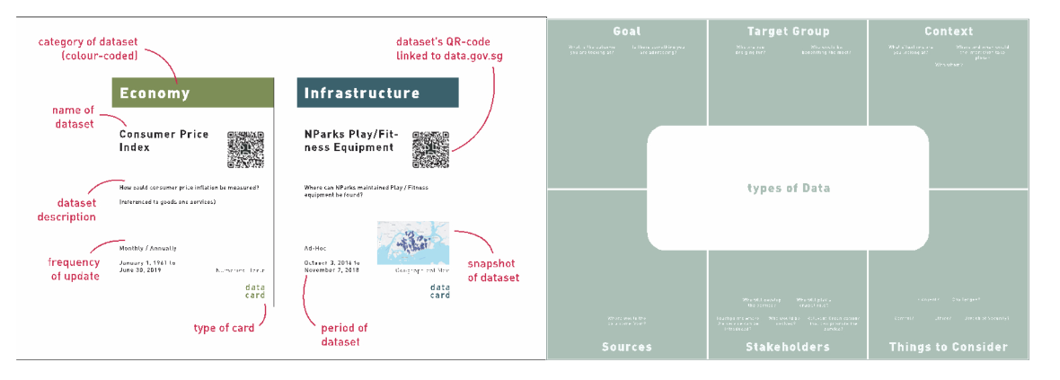
Methods
Datastorming
Description of 'datastorming', a way to think about using how to create designs using data. "To overcome their unfamiliarity to data, we aimed to craft abstract data into hands-on design materials in the form of cards”
Datastorming: Crafting Data into Design Materials for Design Students’ Creative Data Literacy
Delia Yi Min Lim, Christine Ee Ling Yap, Jung-Joo Lee, C&C '21: Creativity and Cognition https://dl.acm.org/doi/pdf/10.1145/3450741.3465246

Slide 57
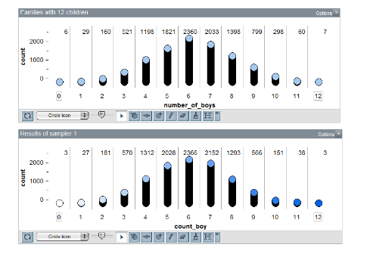
Methods
Simulations and Interactive Technologies
Rolf Biehler, Daniel Frischemeier, Susanne Podworny. Elementary preservice teachers' reasoning about modeling a family factory with TinkerPlots - A pilot study
Statistics Education Research Journal,
TinkerPlots https://www.tinkerplots.com/
http://iase-web.org/documents/SERJ/SERJ16%282%29_Biehler.pdf

Slide 58
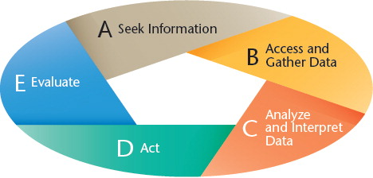
Methods
Case-Based Teaching Method
Case­‐based teaching as “an active learning strategy in which students read
and discuss complex, real‐life scenarios that call on their analytical thinking skills and decision-­‐making”
Derek R. Riddle, Jori S. Beck, Joseph John Morgan, Nancy Brown, Heather Whitesides. (2017). Making a case for case-based teaching in data literacy. Kappa Delta Pi Record. https://www.tandfonline.com/doi/full/10.1080/00228958.2017.1334479 https://digitalcommons.odu.edu/cgi/viewcontent.cgi?article=1104&context=teachinglearning_fac_pubs

Slide 59
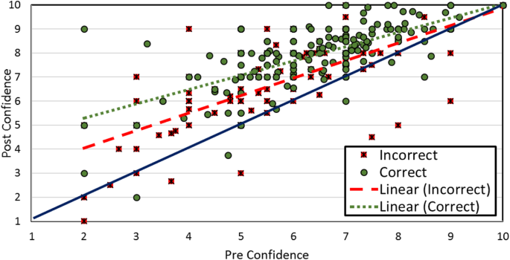
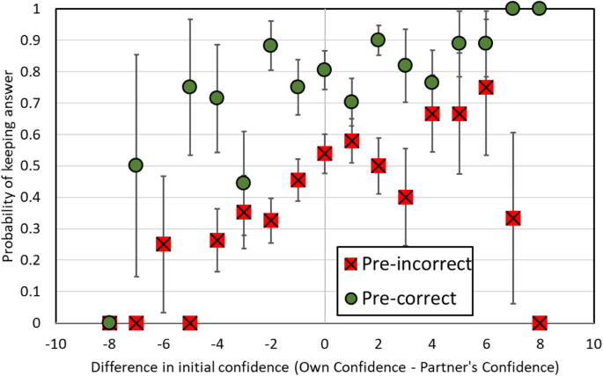
Methods
Utilising affordances in real-world data.
Based on the Teaching for Statistical Literacy Hierarchy, analyzes statistical literacy lessons that use real-world data from the perspective of the affordances in the data presentation.
Helen L. Chick, Robyn Pierce, International Journal of Science and Mathematics Education. 2022. Teaching for statistical literacy: Utilising affordances in real-world data. International Journal of Science and Mathematics Education. https://link.springer.com/article/10.1007/s10763-011-9303-2

Slide 60
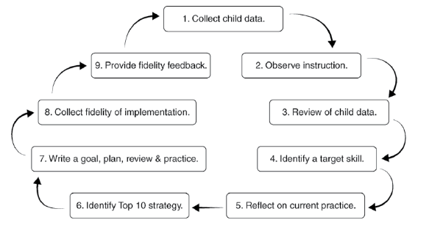
Methods
Literacy Data-Driven Decisions
Requirements:
Expertise in data collection
Management of variable environment
Need space & time for the process
Need to ensure process fidelity
Mary Abbott, et.al. (2017). A Team Approach to Data-Driven Decision-Making Literacy Instruction in Preschool Classrooms: Child Assessment and Intervention Through Classroom Team Self-Reflection. Young Exceptional Children. https://files.eric.ed.gov/fulltext/EJ1151410.pdf

Slide 61
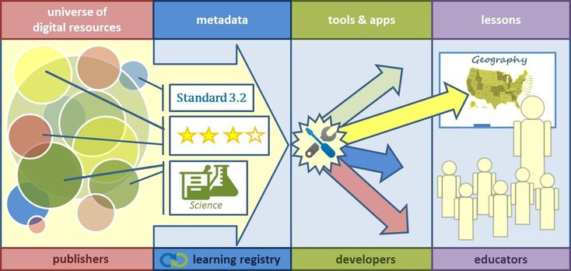
Resources
Types of Resources:
Lessons and Lesson Plans
Help Sheets and Templates
Course and Video Libraries
Performance Support Tools
Image: https://www.pinterest.ca/pin/332984966170591583/

Slide 62
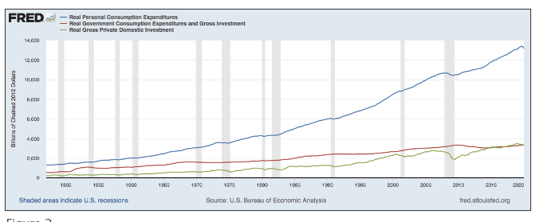
Resources
Lessons for Teaching Data Literacy
Federal Reserve Bank of St. Louis. Each lesson reviews data interpretation, analysis, and/or presentation concepts in detail, and is written in an accessible manner Sample lesson here.
https://www.stlouisfed.org/education/lessons-for-teaching-data-literacy

Slide 63
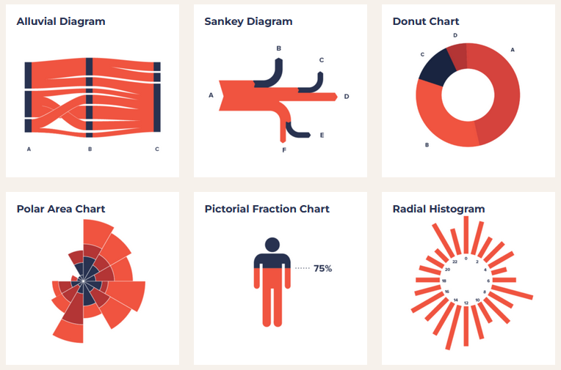
Resources
Data Visualization Project
Set of common data visualization formats or templates, with an accompanying instruction page for each one. https://datavizproject.com/

Slide 64
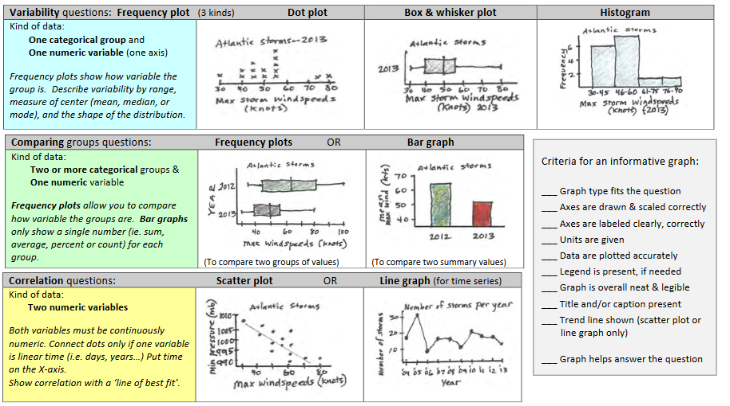
Resources
Data Analysis Worksheet
Van Andel Education Institute, Mar 23, 2022
https://vaei.vai.org/wp-content/uploads/sites/6/2018/10/Data-Analysis-Strategies.pdf

Slide 65
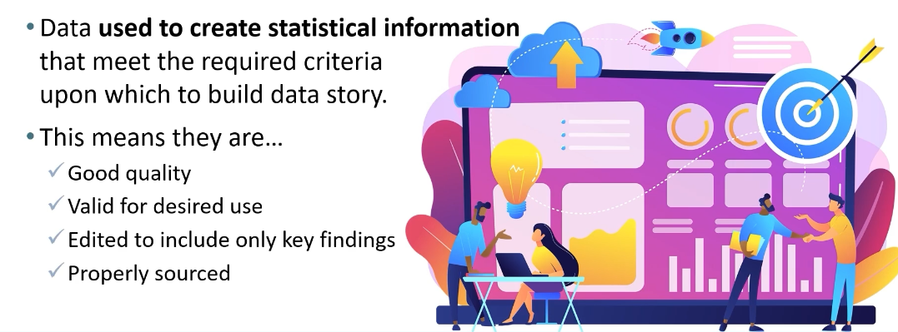
Resources…
Statistics Canada Data Literacy Training Products
20 Short-form Videos https://www150.statcan.gc.ca/n1/en/catalogue/89200006#wb-auto-2=

Slide 66

Resources
Kubicle Data Literacy courses
Subscription-based data literacy and data management course library (courses are series of videos) https://kubicle.com/library

Slide 67


Resources
eLearning Curve
Course libraries.
https://ecm.elearningcurve.com/Online_Data_Stewardship_Education_s/119.htm

Slide 68
THANK YOU
Stephen Downes • Senior Research Officer • Stephen.Downes@nrc-cnrc.gc.ca

