Slide 1
A Critical Stance
Stephen Downes
January 8, 2022

Slide 2
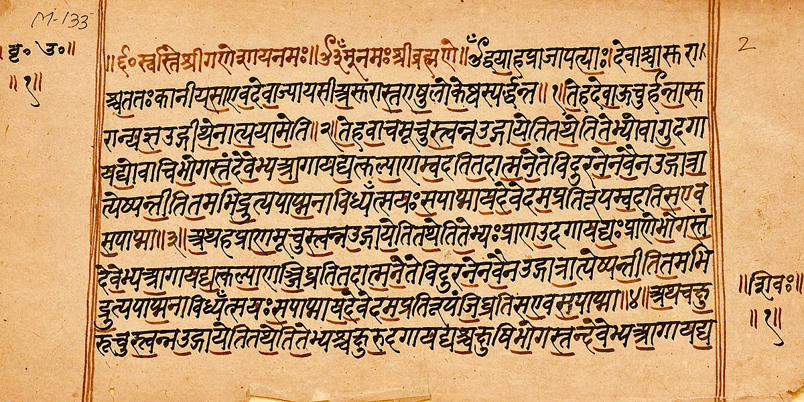

Ourselves
What counts as a ‘self’?
  Self as pure subject of experiences
  Self as continuing physical existence
  Self as self-contained network
  Self as function or role
  Self as set of intersectional identities
  Self as a set of memories
“The Self is the seer, Gargi, though unseen; the hearer, though unheard; the thinker, though unthought; the knower, though unknown. Nothing other than the Self can see, hear, think, or know (BU 3.7.23).”
(Bṛhadāraṇyaka Upaniṣad 3.7.23)
https://gita-society.com/wp-content/uploads/PDF/108upanishads.pdf p. 308 See also https://plato.stanford.edu/entries/personhood-india/
Image https://en.wikipedia.org/wiki/Brihadaranyaka_Upanishad

Slide 3
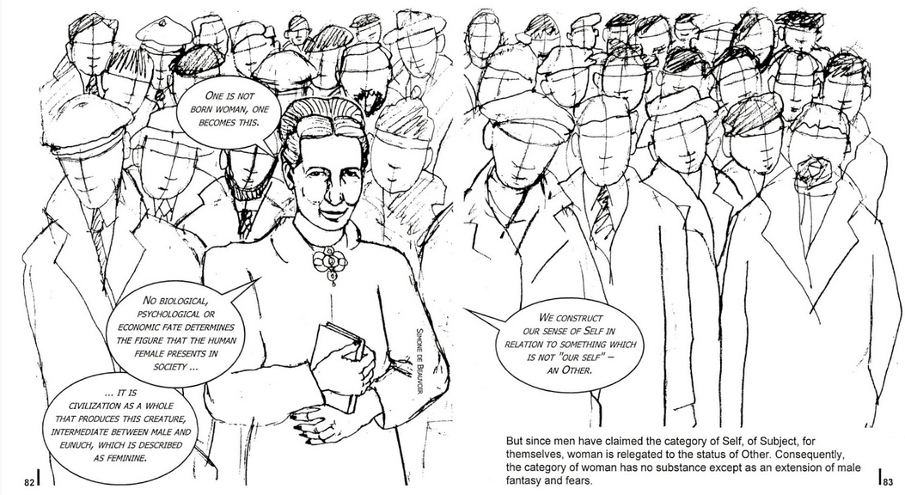
The Social Construction of Self
Our everyday under­standings are culturally and historically situated
  “one’s conception of self, and indeed one’s moral integrity, emerges from one’s narrative of self.” (MacIntyre, 1984, p. 205)
  “When a fundamental distinction between self and other is established, the social world is constituted in terms of differences.” (Gergen, 2011)
Kenneth J. Gergen, 2011 https://core.ac.uk/download/pdf/80560097.pdf
Alasdair MacIntyre, A. C. (1984). After virtue. A study in moral theory. Notre Dame, IN: University of Notre Dame Press. https://epistemh.pbworks.com/f/4.+Macintyre.pdf
Image citing Simone de Beauvoir’s The Second Sex https://circularsoftware.com/MasterPlan/Client3333/Job4060/?

Slide 4
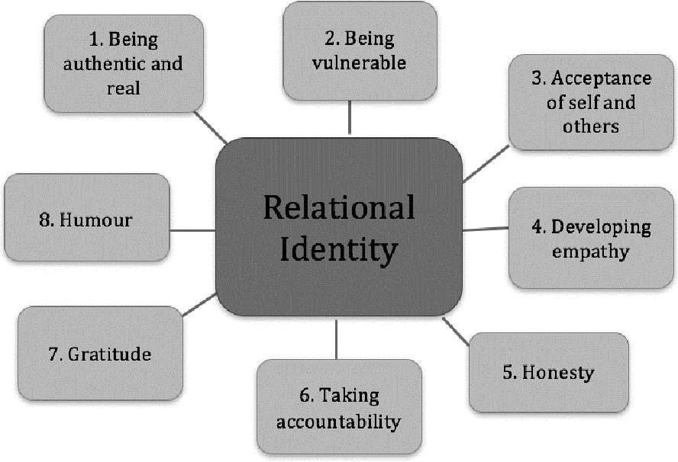
The Relational Self
Aspects of youths’ identity development.
  Lev Vygotsky (1978) “also offered a bold alternative to the dominant conception of mind independent from social process. For Vygotsky, individuals are inextricably related, both to each other and to their physical surrounds”
  “the question emerges as to whether it is possible to eliminate entirely the ‘thinker behind the words’. Wittgenstein’s Philosophical Investigations (1953) provides the groundwork for such a venture.”
J. Riddell, D. Pepler, Victoria Creighton. 2019. Youths’ Perspectives on Their Relational Identity Development through Residential Treatment. Journal of Therapeutic Schools and Programs. https://static1.squarespace.com/static/555e3952e4b025563eb1c538/t/5c6f2098e5e5f073ef84a85d/1550786719468/Youths%E2%80%99+Perspectives+on+Their+Relational+Identity+Development+through+Residential+Treatment.pdf
Quotes from Gergen, 2011

Slide 5
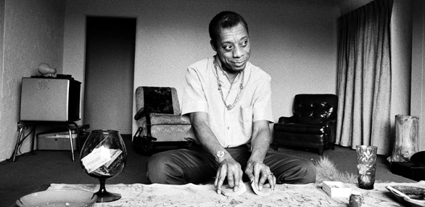
The Purpose of Education
James Baldwin writes “The purpose of education, finally, is to create in a person the ability to look at the world for himself, to make his own decisions…”
He also notes that “no society is really anxious to have that kind of person around.”
James Baldwin (1963) A Talk to Teachers https://richgibson.com/talktoteachers.htm
Image: https://www.thenation.com/article/archive/james-baldwin-guide-dark-times/

Slide 6
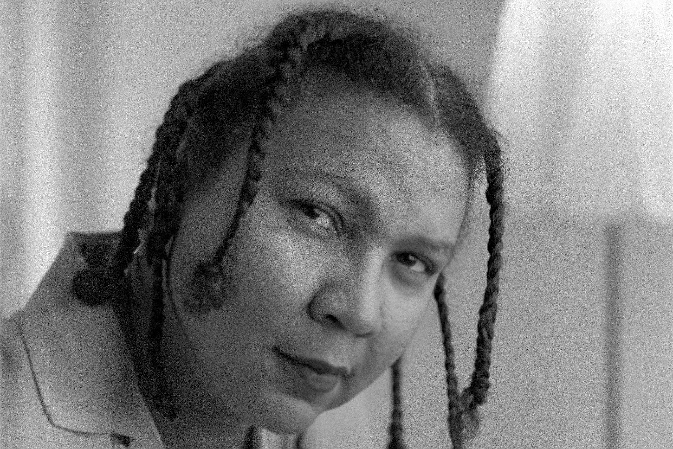
Teaching to Transgress
“in Teaching to Transgress, bell hooks urges teachers to contemplate ‘Education as the practice of freedom’ as their point of departure for praxis. A phrase originating from the work of Paulo Freire.”
Julie Fellmayer. (2018). Disruptive Pedagogy and the Practice of Freedom. Hybrid Pedagogy (weblog). Oct 11, 2018. https://hybridpedagogy.org/disruptive-pedagogy-and-the-practice-of-freedom/
Image: https://www.npr.org/2021/12/15/1064509418/bell-hooks-feminist-author-critic-activist-died

Slide 7

Respect and Care
“To teach in a manner that respects and cares for the souls of our students is essential if we are to provide the necessary conditions where learning can most deeply and intimately begin.” - hooks
which works out to be something like "self-actualization", which means to "sacrifice privilege" and " to immerse yourself in the work of as many POC, feminist, activist, and academic writers, bloggers, podcasters and tweeters as possible."
Julie Fellmayer. (2018). Disruptive Pedagogy and the Practice of Freedom. Hybrid Pedagogy (weblog). Oct 11, 2018. https://hybridpedagogy.org/disruptive-pedagogy-and-the-practice-of-freedom/
Image: https://medium.com/human-restoration-project/hrps-books-of-the-month-august-teaching-to-transgress-by-bell-hooks-f2b548ad4b97

Slide 8
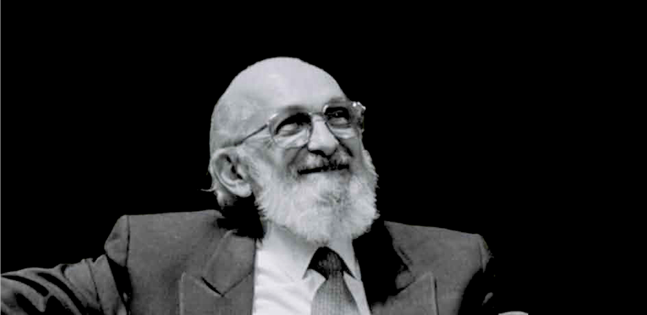
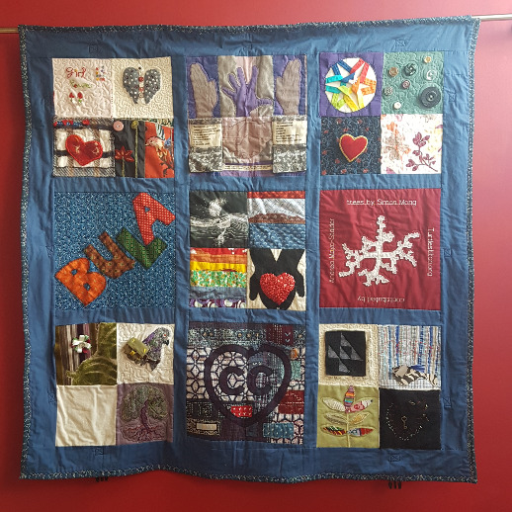
Activism and Identity
Fem ed quilt
Black Likes Matter
Idle No More
“A phrase originating from the work of Paulo Freire, hooks writes that ‘education as the practice of freedom’ will come easiest ‘to those of us…who believe that our work is not merely to share information, but to share in the intellectual and spiritual growth of our students.’” Fellmayer. (2018).
https://quilt.femedtech.net/quilt/
https://ageofrevolutions.com/2017/07/17/paulo-freire-pedagogy-of-the-oppressed-and-a-revolutionary-praxis-for-education-part-i/

Slide 9
The Construction Of…

Slide 10
Ethics as a Way of Life
In speaking here of a “way of life [Lebensform]” Mollenhauer does not mean one’s personal, ethical values and commitments as much as he does a way or form of life sensu Wittgenstein, who famously asserted that “to imagine a language means to imagine a form of life.”6 In these terms—in terms of the implicit patterns and values we embody, articulate and act out every day—engaging in education in the broadest sense is all but unavoidable. As parents and educators, even simply as adults in public life, we embody and exemplify a way of living to children and young people, we perform a tacit affirmation of certain values, arrangements and relationships. “Even the most radical” critic of education and society, Mollenhauer argues, “cannot avoid embodying an adult way of life in front of children; like any adult, he or she powerfully exemplifies one way of life or another for a child.”7 We cannot not affirm for others a way of life much as we “cannot not communicate.”8
-- From Norm Friesen - https://www.researchgate.net/publication/320290102_Towards_a_Pedagogical_Hermeneutics_A_Response_to_the_Manifesto_for_a_Post-Critical_Pedagogy p. 2

Slide 11
Social Activism
Critical Pedagogy
Personal Reflection

