Slide 1
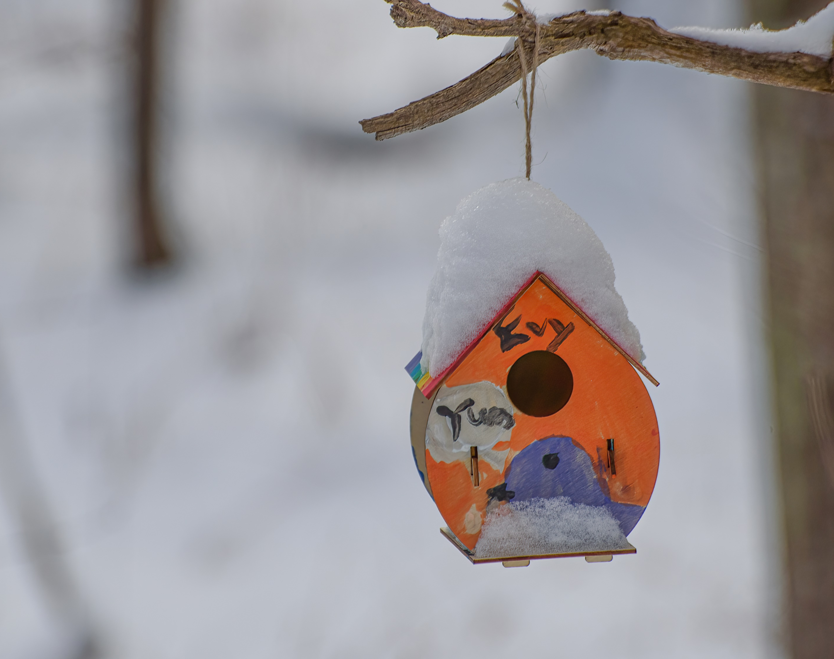
Supporting Open Educational Resources
Stephen Downes
LISACON-2021, Gulbarga University, Kalaburagi, Karnataka State, India
January 7, 2022

Slide 2
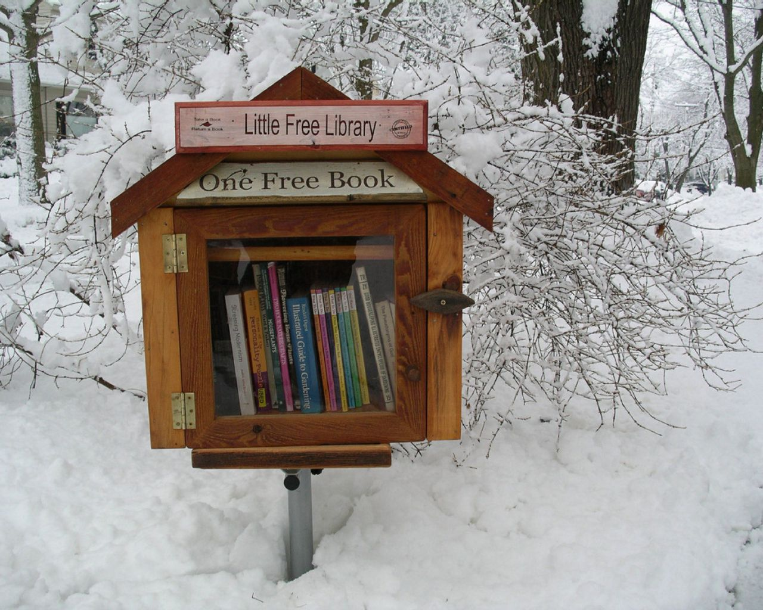
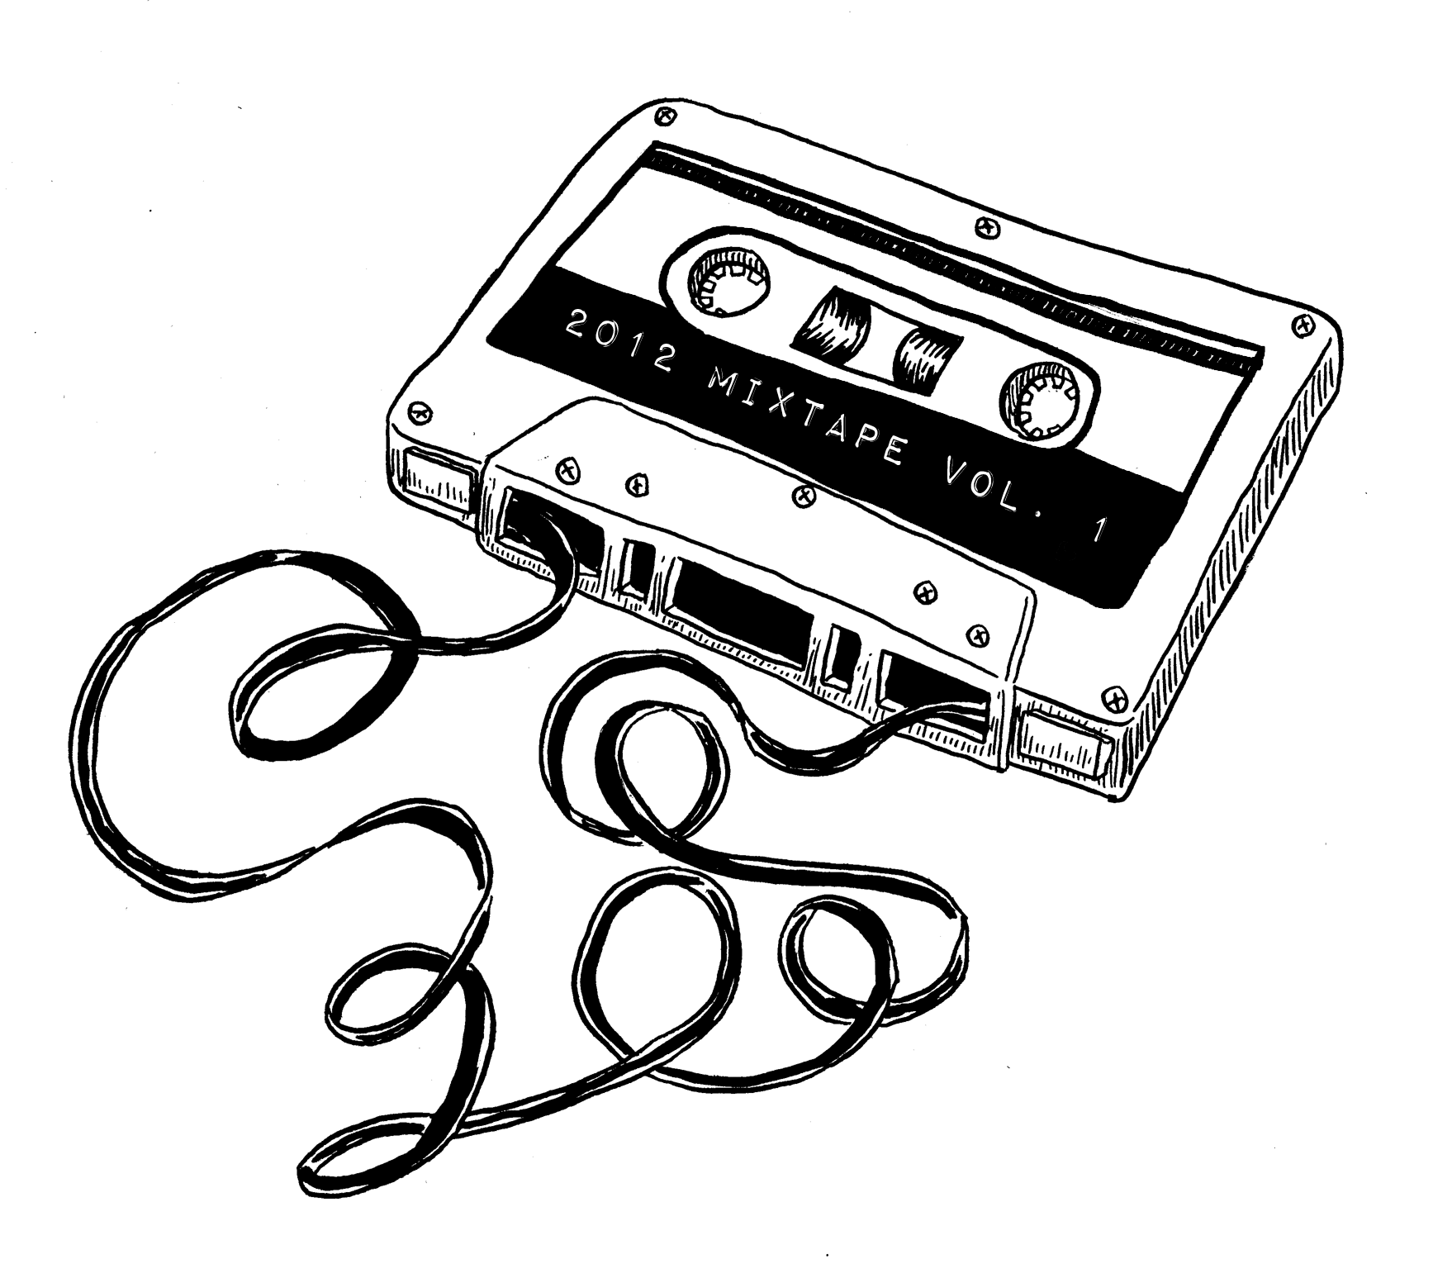
Sharing Before OER
Sharing paper-based lesson plans
Teaching with the newspaper
Worksheets, templates, maps, etc…
Handouts and photocopies
Library books, videos, music
Advantages: low-tech, could be used by everyone, portable
Disadvantages: cost, weight, can be out of date
Notes:
https://www.educationworld.com/a_lesson/Ten-Great-Activities-Teaching-With-the-Newspaper.shtml
https://teflpedia.com/Handout
https://www.thestar.com/news/insight/2011/09/17/the_little_library_that_could.html

Slide 3
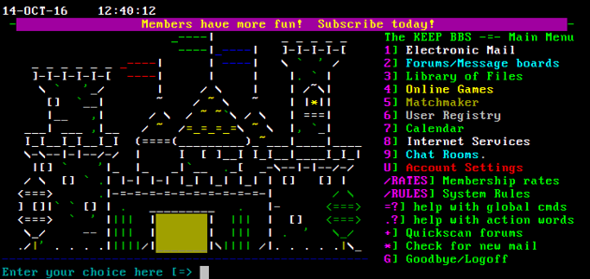

A Digital Sharing Culture
Bulletin Board Systems (1978)
Usenet (1979) and FTP servers (1970s).
Shareware (1982) & GPL (1989)
Archie (1990), Yahoo (1995), Google (1997)
Gopher, World Wide Web (1991)
Napster peer-to-peer (1999) Also Gnuzilla, Kazaa
BitTorrent services (2002) Suprnova.org, isoHunt, TorrentSpy, Pirate Bay.
Notes:
https://en.wikipedia.org/wiki/Bulletin_board_system
https://en.wikipedia.org/wiki/File_sharing
https://en.wikipedia.org/wiki/GNU_General_Public_License
https://en.wikipedia.org/wiki/Shareware
https://telegra.ph/The-Lost-Civilization-of-Dial-Up-Bulletin-Board-Systems-04-22

Slide 4



Learning Resources (1)
Project Gutenberg (1971, 2000)
arXiv preprints (1991)
GeoCities (1995)
Stanford Encyclopedia of Philosophy (1995)
MERLOT (1997)
Slashdot (1997)
Web Syndication: ICE, RSS (1998)
Open Content (1998)
Notes:
https://en.wikipedia.org/wiki/Project_Gutenberg
https://en.wikipedia.org/wiki/ArXiv
https://www.howtogeek.com/692445/remembering-geocities-the-1990s-precursor-to-social-media/
https://info.merlot.org/merlothelp/How_We_Got_Started.htm
https://en.wikipedia.org/wiki/LiveJournal
https://en.wikipedia.org/wiki/Blogger_(service)
https://unesdoc.unesco.org/ark:/48223/pf0000128515
https://en.wikipedia.org/wiki/Open_Archives_Initiative
https://www.ubiquitypress.com/site/chapters/10.5334/bbc.b/download/590/
https://en.wikipedia.org/wiki/Slashdot
https://slashdot.org/
https://en.wikipedia.org/wiki/Stanford_Encyclopedia_of_Philosophy
https://plato.stanford.edu/

Slide 5


Learning Resources (2)
Nupedia (1999), Wikipedia (2001)
LiveJournal, Blogger (1999)
Open Archives Initiative (2000)
Creative Commons (2001)
MIT’s OpenCourseWare (2001)
OER (UNESCO definition), 2002
Stack Overflow (2008)
MOOC (2008)
Open Educational Practices (2009)
Notes:
https://en.wikipedia.org/wiki/Project_Gutenberg
https://www.howtogeek.com/692445/remembering-geocities-the-1990s-precursor-to-social-media/
https://info.merlot.org/merlothelp/How_We_Got_Started.htm
https://en.wikipedia.org/wiki/LiveJournal
https://en.wikipedia.org/wiki/Blogger_(service)
https://creativecommons.org/
https://en.wikipedia.org/wiki/Creative_Commons
https://unesdoc.unesco.org/ark:/48223/pf0000128515
https://en.wikipedia.org/wiki/Open_Archives_Initiative
https://www.ubiquitypress.com/site/chapters/10.5334/bbc.b/download/590/
https://en.wikipedia.org/wiki/Stack_Overflow
https://search.informit.org/doi/epdf/10.3316/informit.559671315718016

Slide 6

Major Elements of OER (from the history)
Content library of some sort
Creation, editing, storage
Search and retrieval service
Content description and metadata
Licensing and permissions
Review and moderation
Community and networks
Support and training
Access from other services
Management & Sustainability

Slide 7
Programmers
Designers
Experts
Description & Metadata
Librarians
Archivists
Community Development
Social Services
Companies & Trades
Creation, Editing, Storage
Content Library
Search & Retrieval
Management. Infrastructure & Sustainability
Licensing & Permissions
Review & Moderation
Community & Networks
Learners
Adults
Children
Community
Access from Other Services
Government
Industry
Universities
Foundations
Community
Support & Training
Practices & Pedagogy
Instructors Practitioners
Tutors
Supporting Open Educational Resources
Stephen Downes (2021)
Notes:
Content library of some sort
Editing, storage, update
Search and retrieval service
Content description and metadata
Licensing and permissions
Review and moderation
Community and networks
Support and training
Access from other services

Slide 8
The Plan…
Continuing barriers to access and use of OER
As found in the literature and surveys
Examples from other fields and content types
Using the wider internet to draw inspiration
Supporting OER Services and Platforms
Examples and ideas to support OER in learning today

Slide 9
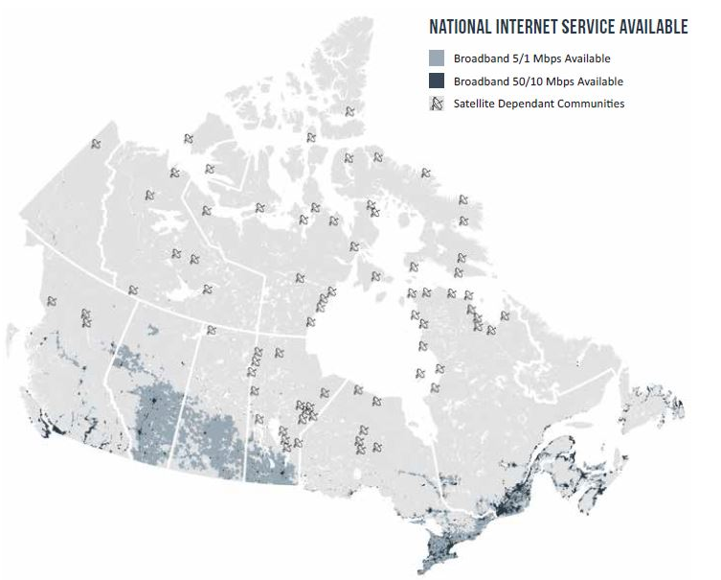
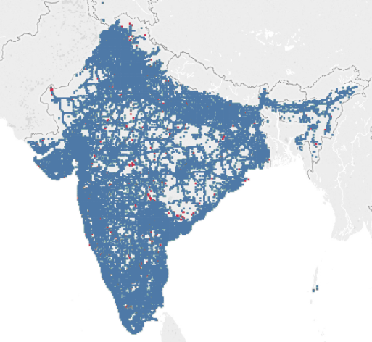
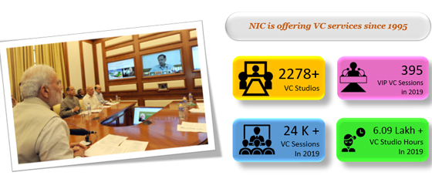
Physical Barriers
Computer equipment and electricity
File storage or bandwidth
Management. Infrastructure & Sustainability
Mobile learning network support
Community access centres
BCcampus, eCampusOntario, Contact North, IGNOU
Canada: national broadband initiative; India: Bharat Net
Energy: hydro, solar, wind, nuclear
Platforms: Raspberry Pi, Framework
Media: USB, local area network
Notes:
https://www.ic.gc.ca/eic/site/139.nsf/eng/h_00002.html
https://news.abplive.com/technology/what-is-bharatnet-programme-world-s-largest-broadband-network-to-connect-rural-india-1466824
https://frame.work/ca/en
https://www.speedtest.net/insights/blog/india-4g-availability-2019/
https://bccampus.ca/
https://www.ecampusontario.ca/
https://contactnorth.ca/
http://ignou.ac.in/
https://www.internetsociety.org/resources/doc/2017/community-networks-regulatory-issues-gaps-experiences-india/
National Informatics Centre https://nagaland.nic.in/infrastructure/

Slide 10
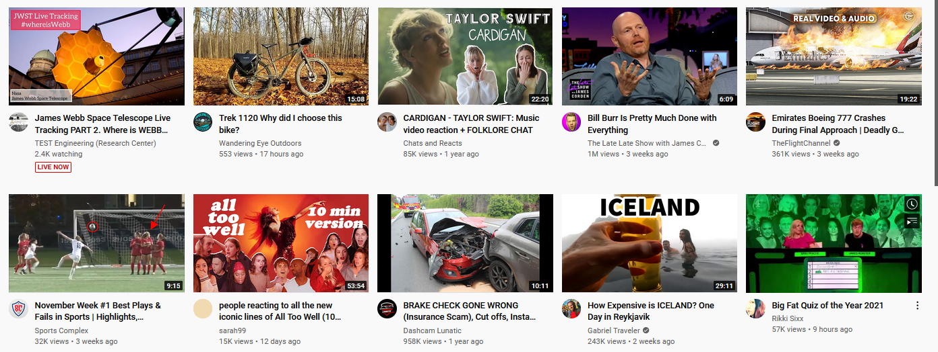

Lack of OER
E.g. no OER in a given field of study, language, locale
Also, no OER in the proper format
E.g. hard copy resources for field trip in climate science
Creation, Editing, Storage
Government or Institutional MOOCs
OCW reourposed content
Community generated content (OERu)
Government Content, CBC, BBC
Community generated content (YouTube, Flickr, Twitter, Facebook, Wikipedia, Stack Overflow)
Notes:
https://files.eric.ed.gov/fulltext/EJ1030130.pdf
https://www.oecd.org/education/ceri/38654317.pdf
https://oeru.org/
OER providers: https://www.oercommons.org/oer/providers

Slide 11
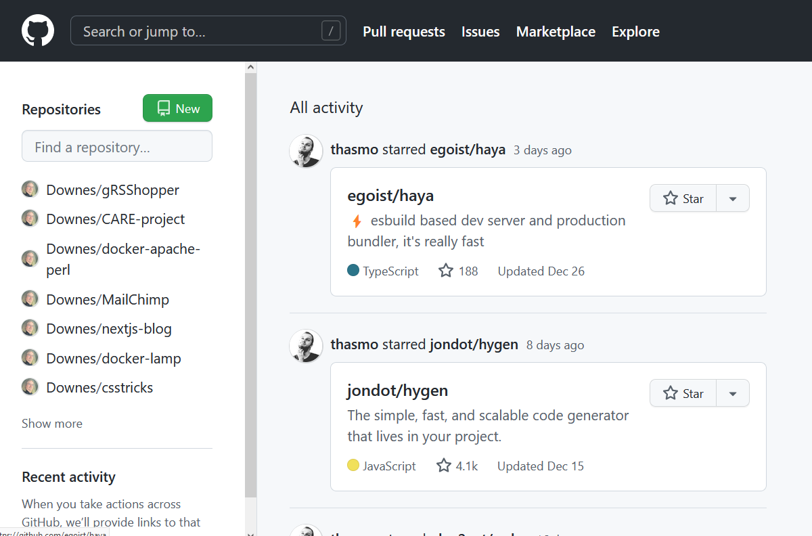
Lack of OER
E.g. no OER in a given field of study, language, locale
Also, no OER in the proper format
E.g. hard copy resources for field trip in climate science
Creation, Editing, Storage
Content authoring and version control tools
Desktop & Mobile: Word, Docs, Slides, etc
Web Authoring: Blogger, WordPress
Versioning and community: GitHub, Gitlab
Audio & Video: Audacity, OBS, OpenShot
Resources need to be portable & reusable
Notes:
https://obsproject.com/
https://en-ca.wordpress.org/download/
https://github.com/
https://iastate.pressbooks.pub/oerstarterkit/chapter/tools-creating-oer/

Slide 12


Awareness
Community & Networks
“material that is free and available needs to be marketed and collated in a database properly since many of the well-intentioned professors don’t know about some of these materials.”
NASA
Mailing Lists
Newsletters
Social Media
Conferences
Programmes
CC Open Learning Platform
Open Education Conference
OER Commons & OER Hubs
Commonwealth of Learning (COL)
Notes:
https://www.openpraxis.org/articles/10.5944/openpraxis.8.3.308/galley/437/download/
NASA – Space Flight Awareness - https://www.nasa.gov/directorates/heo/sfa/space-flight-awareness
https://network.creativecommons.org/cc-open-education-platform/
https://openeducationconference.org/
https://www.oercommons.org/hubs/
https://www.col.org/

Slide 13
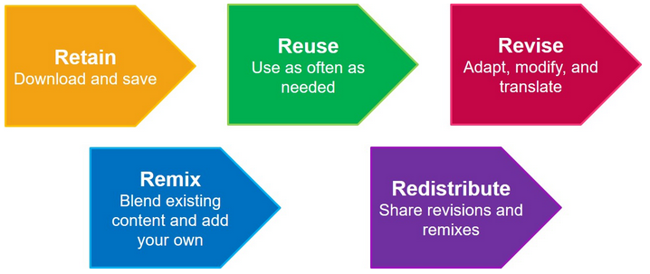
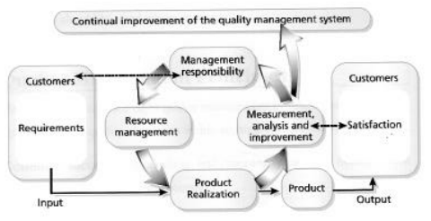
Perceptions of Quality
Most surveyed feel OER overall is of sufficient quality
However, lack of time to evaluate OER
ISO Standards and Certification
Product testing and reporting
Review and moderation
TIPS Framework
Teaching and learning processes
Information & material content
Presentation product & format
System technical & technology
Notes:
https://files.eric.ed.gov/fulltext/EJ1030130.pdf
https://www.cemca.org/ckfinder/userfiles/files/CEMCA_NLU_OER_CapacityBuilding_ShironicaPKarunanayaka.pdf
https://www.oecd.org/education/ceri/38654317.pdf
https://oeru.org/
TIPS http://dspace.col.org/bitstream/handle/11599/562/TIPSFramework_Version%202%5B1%5D%20Copy.pdf?sequence=1&isAllowed=y
Ontario Colleges quality assurance: https://www.ontariocolleges.ca/en/programs/business-finance-and-administration/quality-assurance-control
https://www.consumerreports.org/cro/index.htm
Via TRU:
JISC. (n.d.). Open Educational Resources infoKit https://www.jisc.ac.uk/guides/open-educational-resources/quality-considerations MERLOT. (n.d.). MERLOT Faculty Development Portal: EVALUATION CRITERIA. http://facultydevelopment.merlot.org/ReviewCriteria.html Shank, J. D. (2014). Interactive open educational resources: A guide to finding, choosing, and using what's out there to transform college teaching. San Francisco: Jossey-Bass.
Victoria University: https://libraryguides.vu.edu.au/OpenEducationResources/quality
Image: https://biblio.uottawa.ca/en/services/faculty/oer/resources

Slide 14

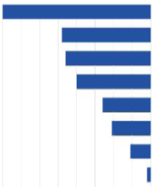
Curation
Curation is “an integral part of the normal workflow of data creation and managing of open educational resources… good data and digital asset management at local levels is also good practice”
Content Library
Library Services
Scholarly Communication
Subject Liaisons
Administration
Teaching & learning
Public Service & Reference
Collections & Tech Service
Other
University Press
Media and Journalism
Stock video – Kaltura
Image library – Flickr, DigiKam
Docs and Notes
Teams, Slack, Mattermost, Rocket Chat, Wire
Notes:
https://www.researchgate.net/profile/Domingo-Docampo/publication/316240463_OER_Curation_through_using_an_application-linked_repository/links/58f72ded0f7e9b67a34be290/OER-Curation-through-using-an-application-linked-repository.pdf
http://downloads.alcts.ala.org/ce/20191211_Supporting_OER_at_Your_Institution_Slides.pdf
https://tlp-lpa.ca/oer-toolkit/collaborating
https://www.kaltura.org/
https://www.digikam.org/
https://rigorousthemes.com/blog/best-kaltura-alternatives/
https://itsfoss.com/open-source-slack-alternative/

Slide 15
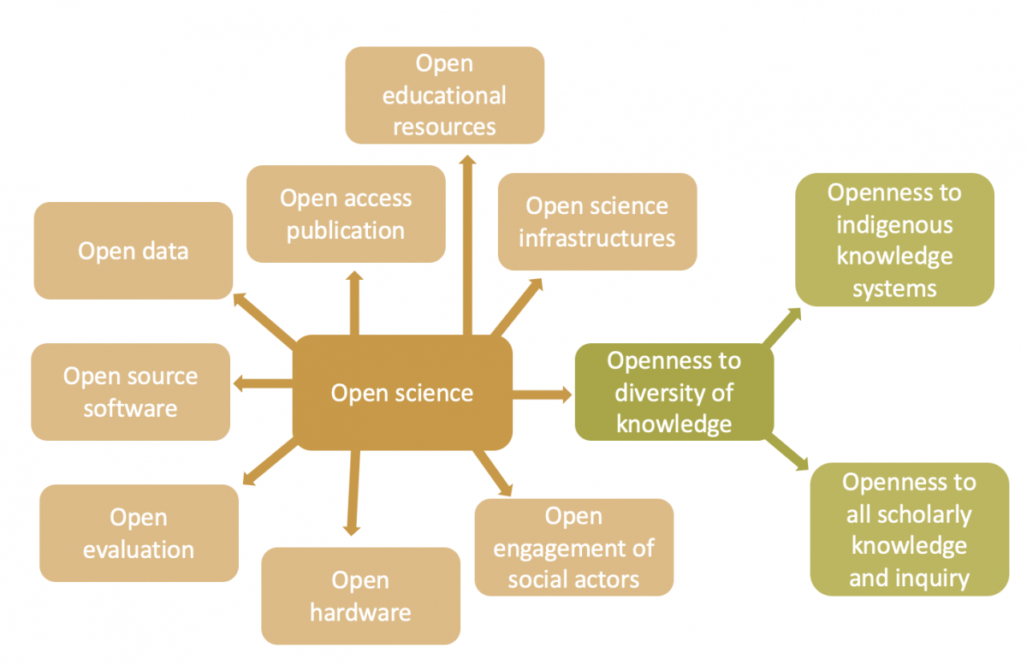

Open Data
“From accelerating economic growth to ensuring government accountability, Open Data can benefit citizens, organizations – and the governments themselves.”
Access from Other Services
“The COVID-19 response requires an integrative, collaborative and managing real-time deidentified data and information to produce the best decision-making.”
OER Commons: Open Data Sets
APIs and End Points
Working with Data: Jupyter Notebooks, Kaggle
Notes:
https://sparcopen.org/open-data/
https://informatics.bmj.com/content/27/1/e100159
https://www.zdnet.com/article/white-house-leads-effort-to-publish-covid-19-open-research-data-set/
https://www.kaggle.com/
https://www.oercommons.org/curated-collections/376
https://libguides.rockhurst.edu/OER/data
https://www.splitgraph.com/opendata-maryland-gov/school-assessment-outcomes-and-higher-education-xnv4-iwf6/latest/-/api-schema
https://www.oerafrica.org/content/what-open-science-and-how-does-it-relate-open-knowledge
http://opendatatoolkit.worldbank.org/en/starting.html

Slide 16


Discoverability
“We need to know where to go for high-quality resources that will fit with our course goals and that can be easily adopted by us and our students”
Search & Retrieval
Search Services
Google, Bing, DuckDuckGo
Hashtags
Flickr, Twitter
Subscription
Mailing Lists, Podcasts
AI and Algorithms
Feedly LEO
FAIR
Findable – can be indexed, searched
Interoperable – common formats, not plugins
Accessible – alternative formats, readers
Reusable – licensed, generic, adaptable
Notes:
https://www.openpraxis.org/articles/10.5944/openpraxis.8.3.308/galley/437/download/
https://www.go-fair.org/fair-principles/
https://en.wikipedia.org/wiki/FAIR_data
https://www.frdr-dfdr.ca/docs/en/fair_principles/
UBC OER Accessibility Toolkit - https://open.ubc.ca/oer-accessibility-toolkit/

Slide 17
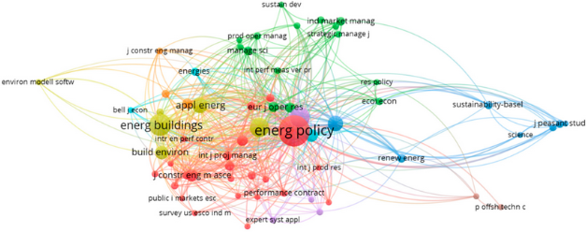

Supporting OER
“Institutional support is critical for any innovation or staff engagement, and the institution's policies are the primary guide to how staff will approach OER adoption and creation.”
Support & Training
Documenting impact
Financial
Outcomes & student learning
Incentives – promotion, tenure
Training and development
Government Impact Calculation
Logic model / Theory of Change
Outputs and Outcomes
Key Performance Indicators
Benefits
Notes:
https://ieeexplore.ieee.org/abstract/document/8252355?casa_token=2Yva41OermYAAAAA:df78FuLdD7GymH8nOqWgxStojCISaJ_pslqGnxo7qmB5pJZWubPTP29sVsAyFqMUL9HkTHMn9A
https://files.eric.ed.gov/fulltext/EJ1030130.pdf
https://www.oecd.org/education/ceri/38654317.pdf
https://oeru.org/
https://www.openpraxis.org/articles/10.5944/openpraxis.11.2.935/
https://edshare.gcu.ac.uk/4856/1/OER19%20poster%20-S.Thompson%20-%20GCU.pdf
https://libguides.sait.ca/OER

Slide 18
Funding models
Endowment Model, e.g. the Stanford Encyclopedia of Philosophy
Membership Model, e.g. Sakai Educational Partners Program
Donations Model, e.g. Wikipedia and Apache Foundation.
Conversion Model, e.g. Redhat, Ubuntu, SuSe. They convert free to paying customers
Contributor Pay Model, e.g. Public Library of Science (PLoS)
Sponsorship Model, Stanford on iTunes, sponsored by Stanford & Apple
Institutional Model, e.g. MIT OpenCourseWare
Government Model (including UN) e.g. BCcampus
Community model, e.g. Slashdot, Stackoverflow
Notes:
https://en.wikipedia.org/wiki/Open_educational_practices
https://www.oecd.org/education/ceri/36781698.pdf

Slide 19

Stephen Downes
https://www.downes.ca

