Slide 1

Agency – Part Two
Stephen Downes
January 5, 2022

Slide 2
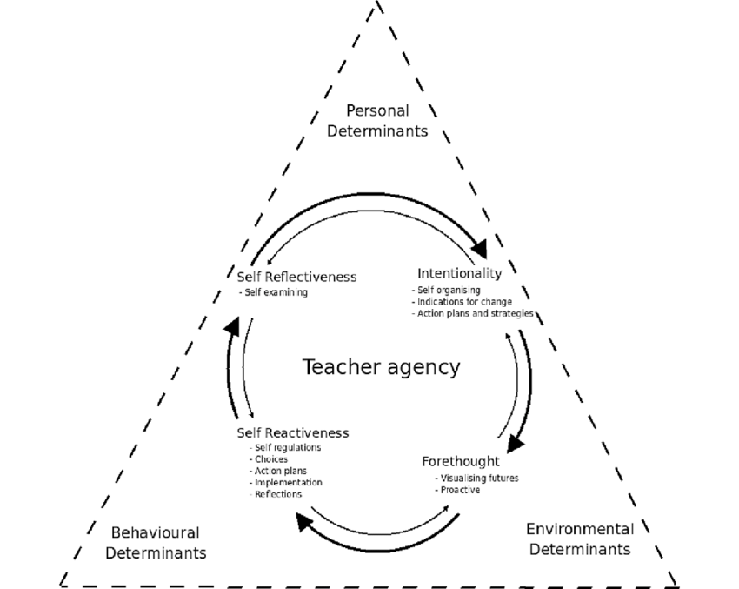
Conceptions of Agency
Power / Outcomes
Competences
Feeling
Ownership
Image: Gayle Jenkins, 2019, Teacher agency: the effects of active and passive responses to curriculum change. Australian Educational Researcher 47(1):1-15 https://www.researchgate.net/publication/333663018_Teacher_agency_the_effects_of_active_and_passive_responses_to_curriculum_change

Slide 3
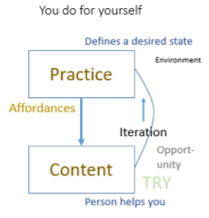
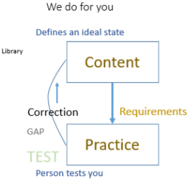
Free Learning and Control Learning
Ben Werdmüller, 2022, The perfomative demonstration of education https://werd.io/2022/the-perfomative-demonstration-of-education

Slide 4
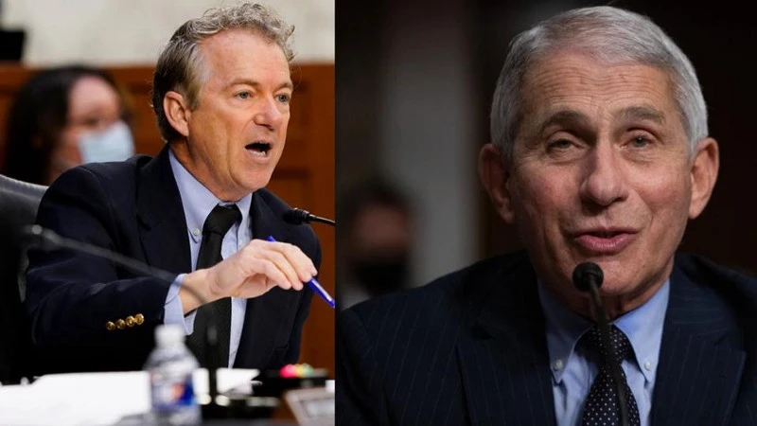
About Science Literacy
“For decades, we've been mistakenly measuring science literacy by measuring which specific facts people have memorized.
“Instead, developing an awareness of and an appreciation for science and what it does for society is a far more impactful approach.
“Science is our best tool for separating what is true from what is not, and we abandon it at our own peril as a society.”
Ethan Siegel, 2021, America’s big mistake about science literacy came back to haunt us in 2021, Big Think https://bigthink.com/starts-with-a-bang/americas-big-mistake-science-literacy/

Slide 5
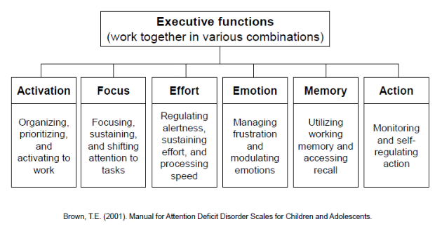
Agency and Biology
Allen Newell – the notion of a ‘control system’ (these days thought of as ‘executive function’)
“There is no actual selection carried out by natural ‘selection’. Nature – in this case the different rates of survival – is simply a passive filter.
Possible role of agency in evolution – Denis Noble
Noble, 2021 https://link.springer.com/article/10.1007/s12304-021-09405-3
Image: https://ldaamerica.org/info/the-reading-brain-executive-function-hard-at-work/

Slide 6
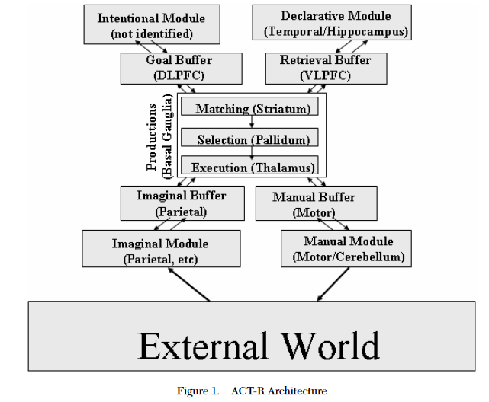
The Newell Test
Any Universal Theory of Control (UTC) must:
Behave flexibly as a function of the environment
Exhibit adaptive (rational, goal-oriented) behavior
Operate in real-time;
Operate in rich, complex, detailed environments
Use symbols and abstractions
Use language
Learn from the environment and from experience
Acquire capabilities through development
Operate autonomously, but within a social community
Be self-aware and have a sense of self
Be realizable as a neural system
Be constructible by an embryological growth process
Arise through evolution
Allan Newell, 1994, Unified theories of cognition, Harvard University Press, p. 19
Image: John R. Anderson & Christian Lebiere, 2003. The Newell Test for a theory of cognition. Behavioral and Brain Sciences, 26(05).p. 594 doi:10.1017/s0140525x0300013x

Slide 7
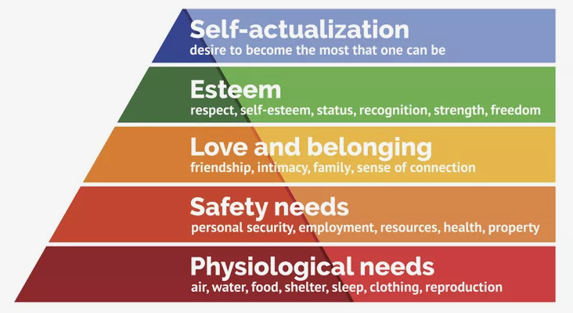
Maslow’s Hierarchy
“The role and importance of safety—physical, emotional, and psychological—cannot be overstated in understanding how human needs are, and sometimes are not, met.”
Bob Bowen (2021) The Matrix of Needs: Reframing Maslow’s Hierarchy. Health, 13, 538-563. https://www.scirp.org/journal/paperinformation.aspx?paperid=109226
Image: https://www.thoughtco.com/maslows-hierarchy-of-needs-4582571

Slide 8
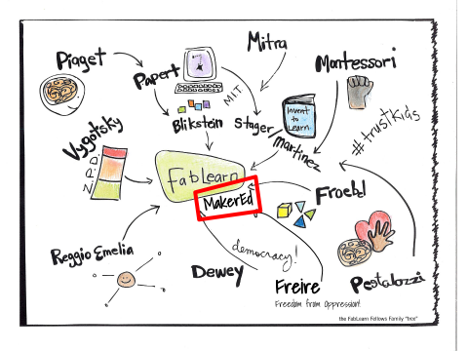
A Constructivist Model of Agency
Coherence
  “living organisms have a substantially harmonious anatomic and functional structure”
Autonomy
  “living organisms create and maintain an internal environment which follows dynamics of its own”
Brizio & Tirassa, 2016 https://www.ncbi.nlm.nih.gov/pmc/articles/PMC4745100/
Image: https://fablearn.stanford.edu/fellows/blog/constructionism-learning-theory-and-model-maker-education

Slide 9
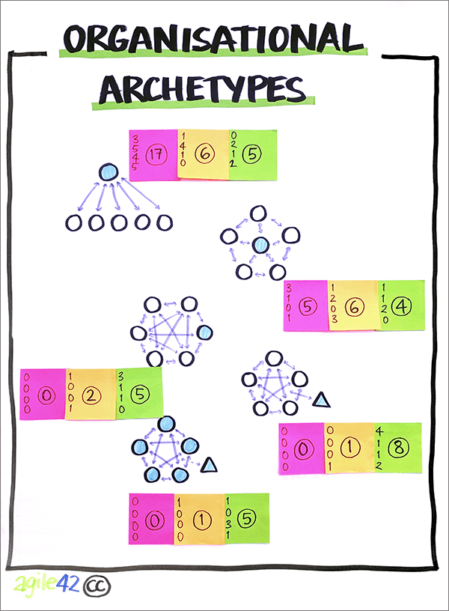
Maintaining Coherence and Autonomy
by creating and maintaining a permeable separation between their internal environment and the external milieu.
by exploiting the features of the environment that are relevant to the organism.
by exploiting the biological, behavioral, etc. features of other individuals
Brizio & Tirassa, 2016 https://www.ncbi.nlm.nih.gov/pmc/articles/PMC4745100/
Image: https://www.agile42.com/en/agile-teams/archetype-assessment/

Slide 10
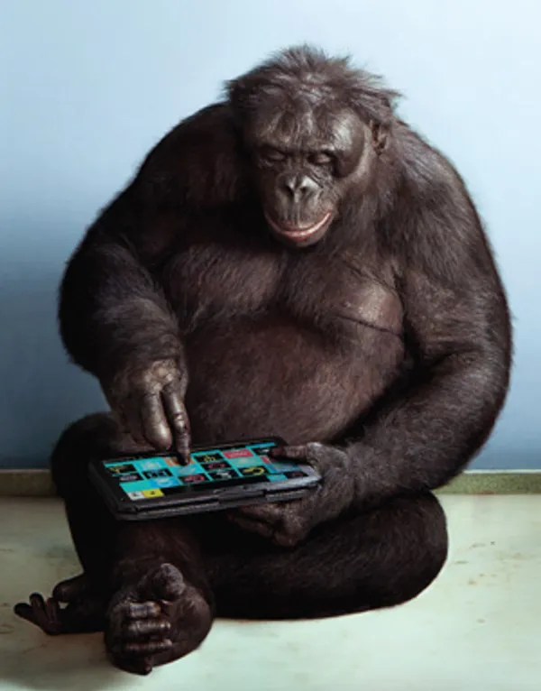
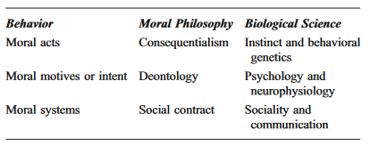
Morality as Social Evolution
Robin Dunbar
  The Social Brain Hypothesis and Its Implications for Social Evolution
  “Social living puts strong evolutionary selection pressures on acquiring social intelligence”
Ernst Fehr
  “Altruism can be accounted for when kin selection and inclusive fitness are taken into account”
https://en.wikipedia.org/wiki/Evolution_of_morality
Image: https://spectrum.ieee.org/apes-with-apps

Slide 11
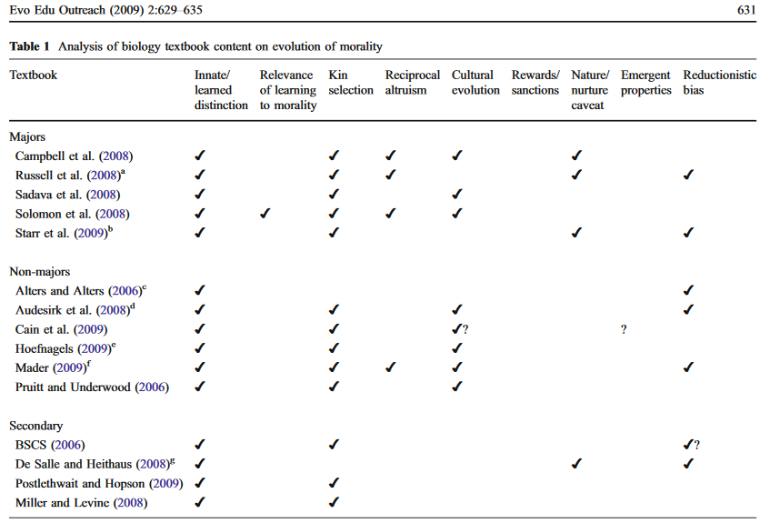
https://evolution-outreach.biomedcentral.com/track/pdf/10.1007/s12052-009-0173-9.pdf p. 631

Slide 12

Biologized Knowledge
Ben Williamson: two new research projects
  "a data-intensive, bioinformatics-driven approach to education remains in development" - basically, using a person's genome to identify their learning needs and potential.
  “a set of 'affect-aware’ technologies to gauge and respond to student emotional states that aims to make ‘emotional life machine-readable, and to control, engineer, reshape and modulate human behaviour”
Ben Williamson . 2021. New biological data and knowledge in education. https://codeactsineducation.wordpress.com/2021/09/08/new-biological-data-knowledge-education/

Slide 13
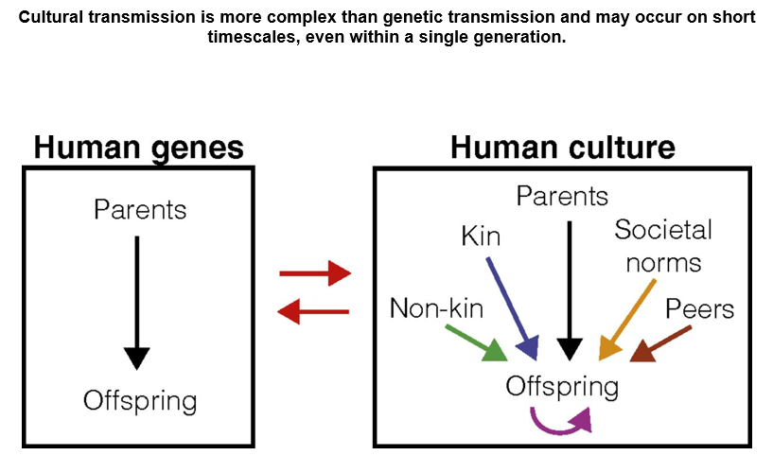
Agency as Evolution of Culture
Kim Sterenly: “human lifeways depend on cognitive capital that has typically been built over many generations. This process of gradual accumulation produces an adaptive fit between human agents and their environments; an adaptive fit that is the result of hidden-hand, evolutionary mechanisms.” p. 137
Kim Sterelny, 2006. The Evolution and Evolvability of Culture. Mind Language, 21(2), 137–165. doi:10.1111/j.0268-1064.2006.00309.x https://www.semanticscholar.org/paper/The-Evolution-and-Evolvability-of-Culture-Sterelny/4130942a5732b58a6872163fda7f42725ce96c5a
Nicole Creanza, Oren Kolodny, and Marcus W. Feldman, 2017. Cultural evolutionary theory: How culture evolves and why it matters . PNAS July 25, 2017. 114 (30) 7782-7789 https://doi.org/10.1073/pnas.1620732114

Slide 14
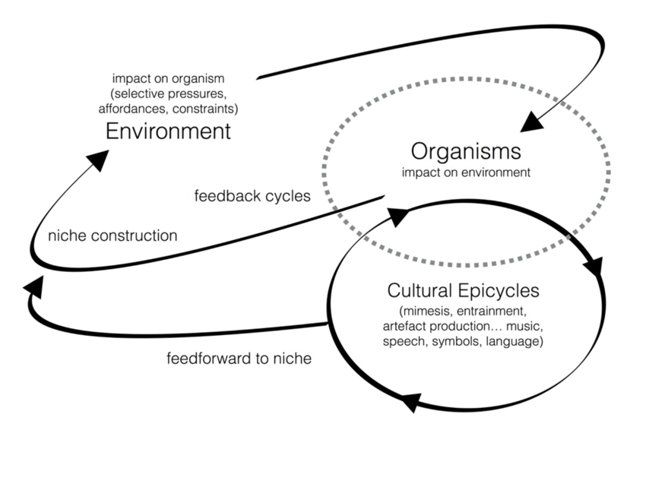
Dual Inheritance Theory
“Dual inheritance theory models cultural evolution closely on genetic evolution, and cultural inheritance closely on biological inheritance. The central idea is that there are features of human psychology—most obviously imitation learning and language—and features of human social environments—most obviously long periods of juvenile dependence—that result in a high fidelity flow of ideas from parents to their offspring.” - Sterelny
Dylan van der Schyff & Andrea Schiavio, 2017, Evolutionary Musicology Meets Embodied Cognition: Biocultural Coevolution and the Enactive Origins of Human Musicality. Frontiers in Neuroscience 11 https://www.researchgate.net/publication/319472389_Evolutionary_Musicology_Meets_Embodied_Cognition_Biocultural_Coevolution_and_the_Enactive_Origins_of_Human_Musicality

Slide 15
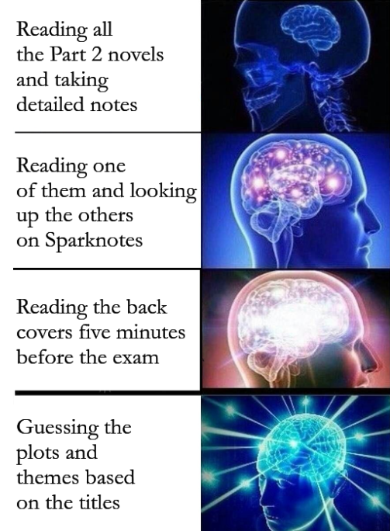
Meme-based Theory
Both dual inheritance and meme-based theories share the idea that cultural transmission is both important and accurate.
Dawkins calls the information that is copied the ‘replicator’ and contrasts this with ‘vehicles’ that carry the replicators
But on the dual inheritance picture it is the biological fitness of the vehicles (human agents) that explains the spread of cultural variants
“What is fitness for a short melody? It is the ability to survive and reproduce?”
Dawkins,R. (1976) The Selfish Gene Oxford, Oxford University Press (new edition with additional material, 1989)
Susan Blackmore, 2010, Memetics Does Provide a Useful Way of Understanding Cultural Evolution https://www.researchgate.net/publication/274706611_Memetics_Does_Provide_a_Useful_Way_of_Understanding_Cultural_Evolution

Slide 16
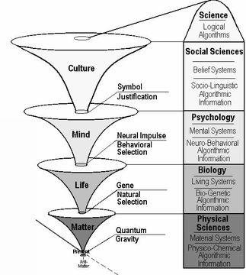
The Evolution of Morality
“The ultra-reductionism and implicit promotion of competition… once dominated the field… yielded to more balanced perspectives and more nuanced interpretations.”
“Reductionistic bias varies, but the texts basically omit the concept of emergent properties or new levels of organization at the psychological and social levels
“They do not describe how social rewards or sanctions can regulate “selfish” behavior or individual “cheating”—for example, as observed in food sharing among vampire bats”
Douglas Allchin, 2009 Teaching the Evolution of Morality: Status and Resources. BioMed Central
https://evolution-outreach.biomedcentral.com/track/pdf/10.1007/s12052-009-0173-9.pdf

Slide 17
Supporting Agency
Agency
Security
Identity
Voice
Opportunity
Based on ‘What Peace Means to Me’ https://www.downes.ca/post/68088

Slide 18
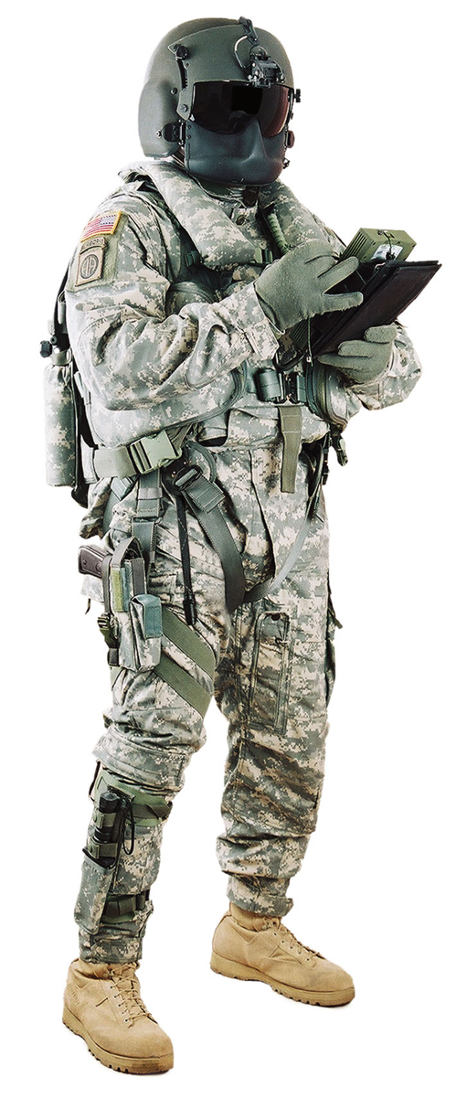
Security
The first thing they take away from you is your sense of security.
  The direct threat of violence is the most brutal and the least effective.
  A threat against your property, your business, or your love, is more common.
  The threat that some other will inflict this violence is the most subtle.
You do not feel secure, and hence feel compelled to comply.
The only response, I think, is to remove the effectiveness of violence. The solidarity of, and trust in, a community is the only effective response.

Slide 19
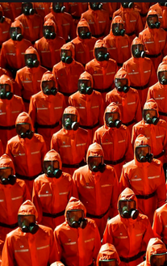
Identity
Identity is the right to define, and to be, who you are. War reduces each and every one of us to one thing: a tool of one side or another fighting the war.
  E.g. Read A Long Way Gone, or watch Blood Diamond,
Conformity becomes mandatory
  People are expected to dress in certain ways, to speak in certain ways, or in certain languages, to believe the same things, support the same religions.
  Obedience is demanded, and expected.
People who seek to deny us our individual identities are people who are endangering the peace
Sally Haslanger: Autonomy, Identity, and Social Justice (pdf, 3718 words) https://sallyhaslanger.weebly.com/uploads/1/8/2/7/18272031/haslanger_autonomy_identity_and_social_justice_-_review_of_appiah.pdf

Slide 20

Voice
Voice is in part the expression of identity but voice is also the way we create community, develop ideas, and create future visions and possibilities.
Voice is the right to a say, the expectation that this expression will have an impact that can be - and is - measured and weighed.
To have voice, people must learn to self-organize, to make decisions and resolve disputes in an open and peaceful manner, to create forums and newspapers and assemblies, to have community groups and societies and special interest groups.
Image: https://www.winemag.com/2020/02/26/activism-wine/

Slide 21
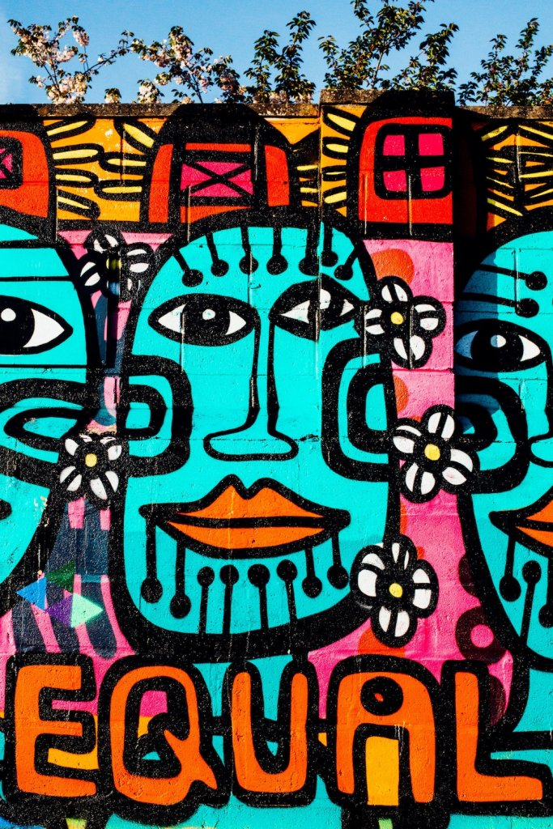
Opportunity
By opportunity what we mean is that there is a path - or the potential of a path - to get from where you are to what you aspire to achieve.
Those who do not have opportunity are not at peace; those who deny opportunity are waging war against them.
Opportunity - especially for those in marginalized or vulnerable groups - requires support.
But it also requires a commercial infrastructure that is robust and trustworthy.
Image: https://werd.io/2018/equality-of-opportunity-vs-equality-of-outcome

Slide 22
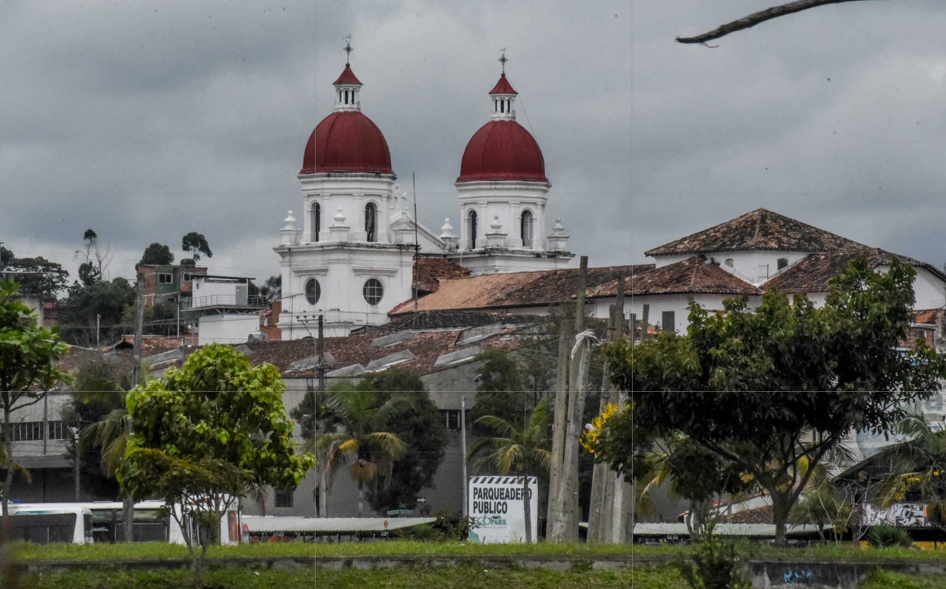
Four Steps to Peace - José Restrepo
See also: https://www.mcgill.ca/msr/volume3/article5
https://www.jstor.org/stable/20707165
https://web.archive.org/web/20171024143227/http://www.bath.ac.uk/management/news_events/news/2017/23-10-jose-restrepo-explains-how-he-is-spreading-peace-in-colombia.html

Slide 23
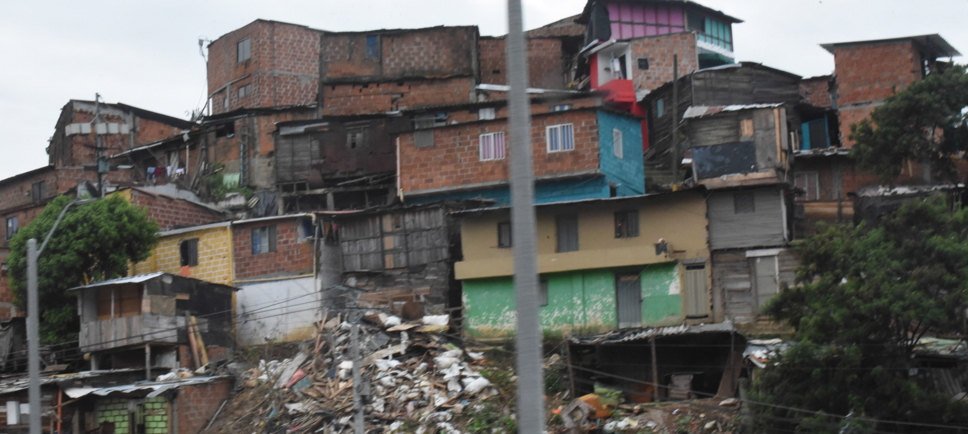
Redistribution
Scholarships for students from low income families and areas of conflict. Increase capacities in communications, information technologies, learning
http://aprende.colombiaaprende.edu.co/pilopaga
SEP: Ethics of Redistribution: “couching discussions of distributive justice in terms implied by redistribution smuggles in associations of forceful takings and rights infringements” https://www.uio.no/studier/emner/sv/sai/SOSANT2210/v15/pensumliste/taylor_the_politics_of_recognition.pdf

Slide 24
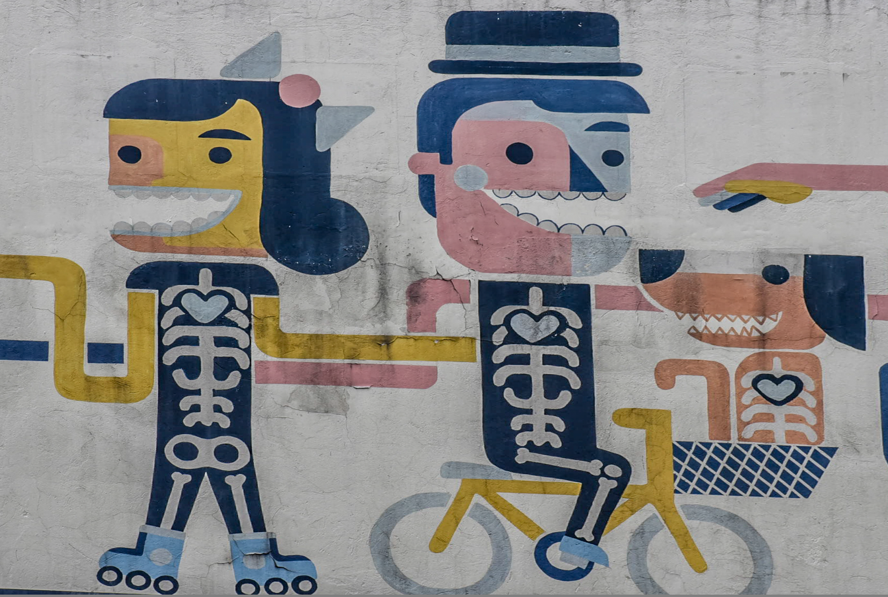
Recognition
Gender equality and diversity while also promoting remembrance, truth and reconciliation. A focus on training of indigenous communities and ex-combatants.
Charles Taylor: recognition of dignity and of difference. ‘The Politics of Recognition’ https://www.uio.no/studier/emner/sv/sai/SOSANT2210/v15/pensumliste/taylor_the_politics_of_recognition.pdf

Slide 25

Representation
Working together to promote interdisciplinary research to develop capacity to rebuild society, sharing curricula on human rights and writing textbooks to teach new generations.
“Who speaks for us?” Issues include media representation, stereotypes, democratic representation, etc. https://ethicsunwrapped.utexas.edu/video/representation
https://www.jstor.org/stable/3561597 http://annettemarkham.com/writing/denzingalleyproofs.pdf

Slide 26
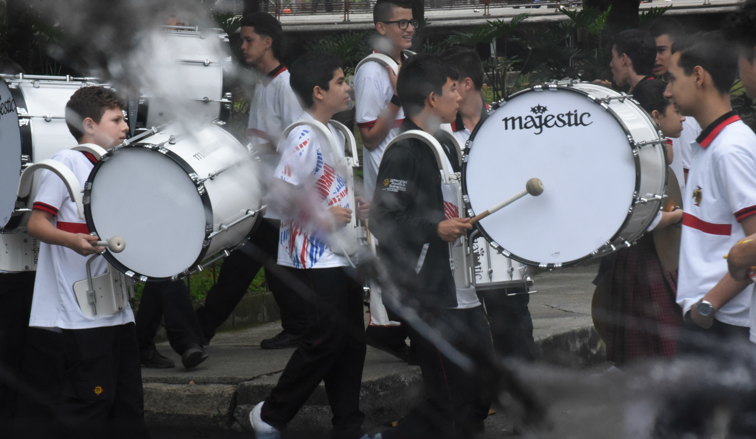
Reconciliation
Processes of reconciliation:
Apologies
Memorials
Truth Telling
Amnesties
Trials and Punishment
Lustration
Reparations
Forgiveness
Participation in Deliberative Processes
https://plato.stanford.edu/entries/reconciliation/
Promoting peaceful conflict resolution and offering alternative paths to success, self-expression, and community support

Slide 27

Shared Agency
"Shared activity is distinguished from a mere aggregation of individual acts by a structure of appropriately related participatory intentions across different individuals. It is a structure that has a distinctive normative significance for those individuals, with an impact most immediately on each individual’s intention-based practical reasoning."
Image: https://www.thestar.com/news/canada/2013/01/28/idle_no_more_activists_resume_protests_against_conservatives.html
Abraham Sesshu Roth, Stanford Encyclopedia of Philosophy, May 03, 2017 https://plato.stanford.edu/entries/shared-agency/
See also: collective intentionality. https://iep.utm.edu/coll-int/

