Slide 1

Agency – Part One
Stephen Downes
December 25, 2021

Slide 2
Where We Are
Ethical Practice
Regulation
Frameworks
Culture
Ourselves
Ethical practice as culture
Ethical practice as citizenship
Ethical practice as democracy
Ethical practice as agency

Slide 3
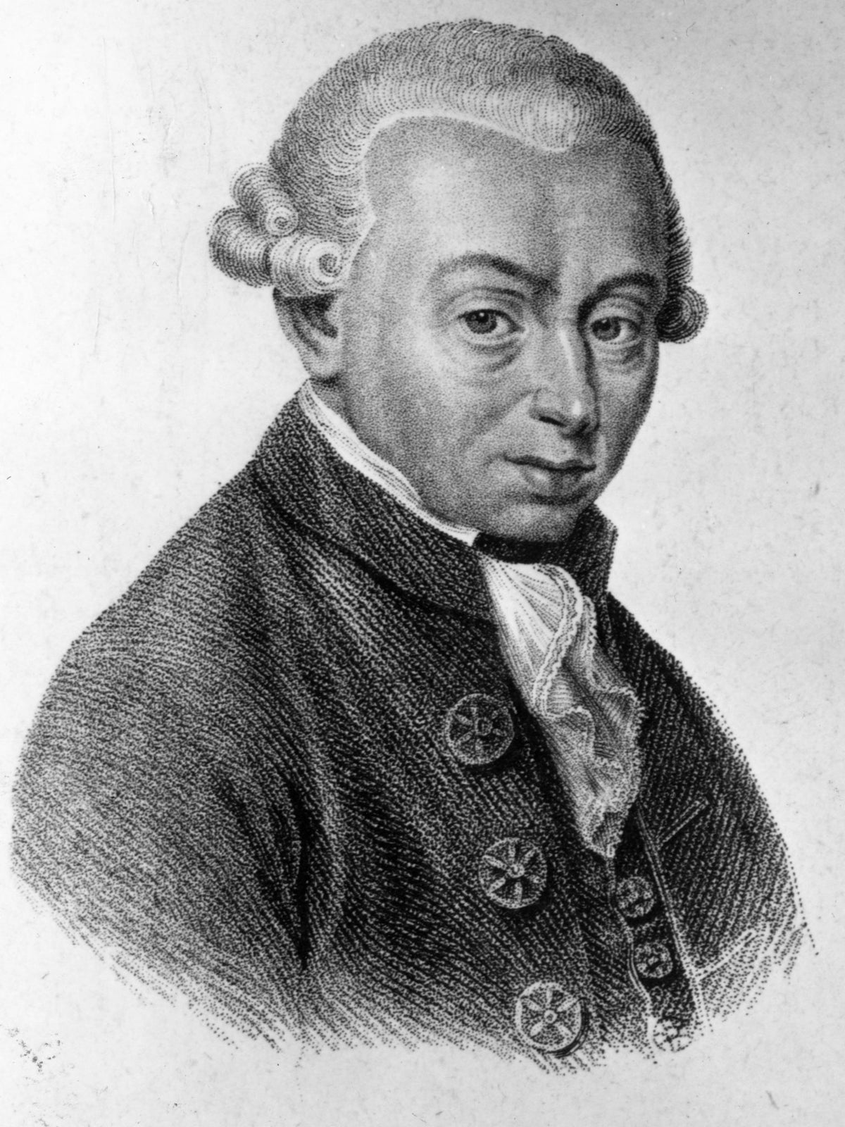
Two Roles of Agency
Ethics requires agency
  This is the idea that ‘ought’ entails ‘can’ – that if there is an ethical obligation, then it must be possible for a person to be able to meet that obligation
Agency requires ethics
  This is the idea that ‘can’ entails ‘ought’ – that is, our capacities to think, to reason, to act generate in us obligations to think, reason and act correctly
    For example: “Kant believed that the shared ability of humans to reason should be the basis of morality, and that it is the ability to reason that makes humans morally significant.” https://en.wikipedia.org/wiki/Kantian_ethics

Slide 4
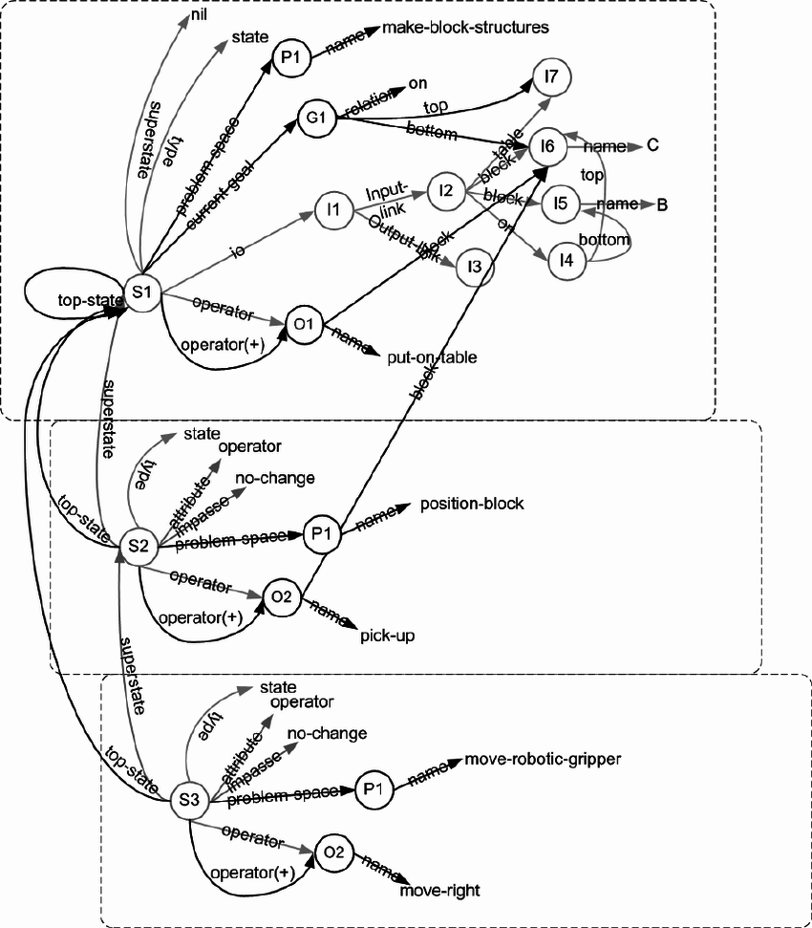
The Idea of Agency
widespread commitment to a desire-belief-intention version of agency, with a close connection between action and reasons
This view carries over into software design, e.g. the belief–desire–intention software model (BDI)
https://plato.stanford.edu/entries/agency/
https://en.wikipedia.org/wiki/Belief%E2%80%93desire%E2%80%93intention_software_model
See also https://link.springer.com/chapter/10.1007/3-540-49057-4_1
And (1970) https://www.researchgate.net/publication/2596320_The_Belief-Desire-Intention_Model_of_Agency
Image: SOAR https://www.researchgate.net/publication/228398068_An_introduction_to_Soar_as_an_agent_architecture

Slide 5
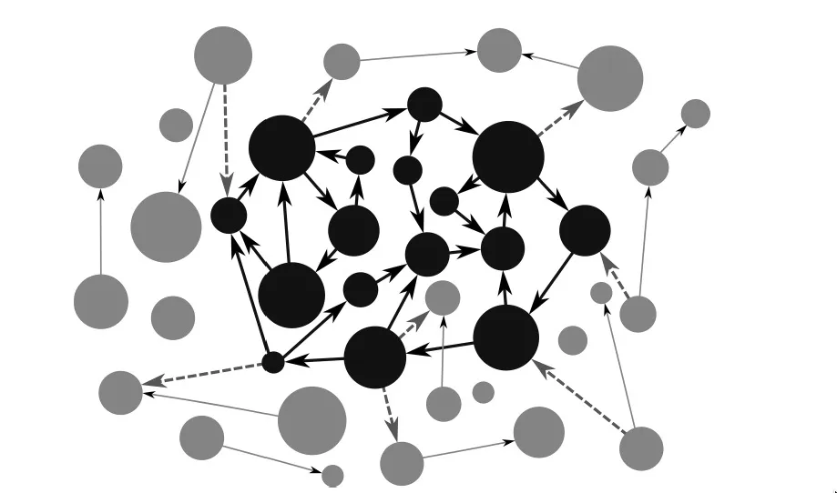
Agency Without Mental Representations
BDI theories usually explain agency in terms of representations
  that is, “in terms of intentional mental states and events that have representational contents (typically, propositional contents)”.
But there are beings capable of genuine agency without representational states (e.g. an embodied enactive approach to mind)
Varela, in his 1979 book, Principles of Biological Autonomy, presented autonomy as a generalization of the concept of autopoiesis (cellular self-production).
https://plato.stanford.edu/entries/agency/
https://philosophyofbrains.com/2017/01/27/the-enactive-approach.aspx

Slide 6
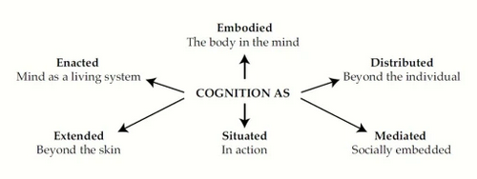
Extended Mind Thesis
The claim that minds or cognitive systems can extend into the environment. Two ways of expressing this:
  EMT1: Mental states extend beyond an organism’s physical boundary
  EMT2: The right unit of analysis in cognitive science is the entire cognitive system, or at least large parts thereof
Overextension: The Extended Mind and Arguments from Evolutionary Biology
Armin Schulz https://people.ku.edu/~a382s825/Overextension%20PSD%20RDER%20AI.pdf
Also: https://en.wikipedia.org/wiki/Extended_mind_thesis
Image: https://ronbc.wordpress.com/2012/03/30/proposing-an-extremely-embedded-mind/

Slide 7
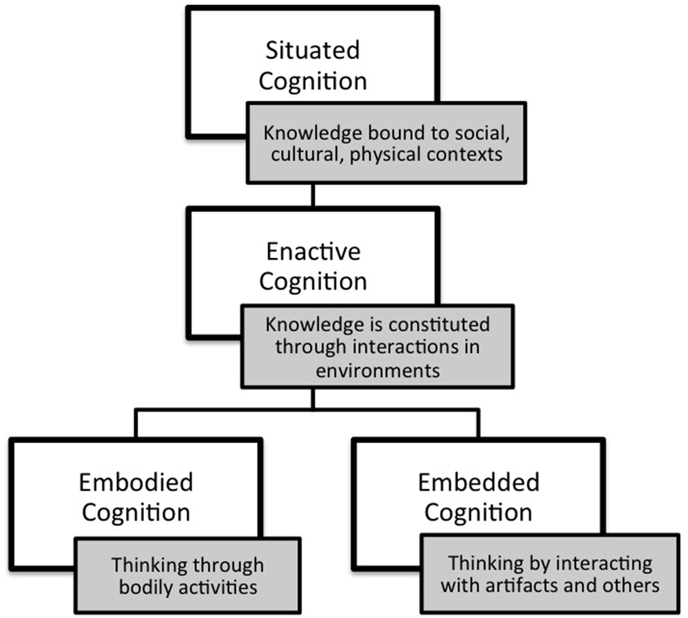
Embodied and Enacted Cognition
As described by Mark Rowlands, mental processes are:
  Embodied involving more than the brain, including a more general involvement of bodily structures and processes.
  Embedded functioning only in a related external environment.
  Enacted involving not only neural processes, but also things an organism does.
  Extended into the organism's environment.
Mark J. Rowlands, 2010 The New Science of the Mind: From Extended Mind to Embodied Phenomenology https://books.google.ca/books?id=AiwjpL-0hDgC&pg=PA51&redir_esc=y#v=onepage&q&f=false
Above quoted from https://en.wikipedia.org/wiki/Extended_mind_thesis
Image: https://www.frontiersin.org/articles/10.3389/fpsyg.2015.01978/full

Slide 8
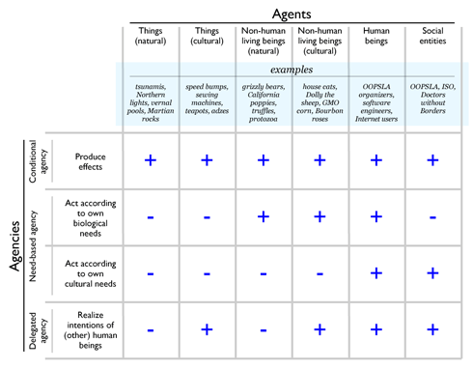
Agency in Non-Human Entities
‘the Stock market wants / reacts / etc’
Eduardo Kohn in How forests think
Anna Tsing: global trade in matsutake mushrooms displays “patterns of unintentional coordination” between multiple actors
Hamilton and Mitchell: sheep, humans, and dogs embedded in a complex web of relations, markets, and terrains
Examples from: https://journals.sagepub.com/doi/10.1177/0731121420921897
See https://anthrosource.onlinelibrary.wiley.com/doi/full/10.1111/aman.13628 for a criticism
Image: http://www.oopsla.org/2005/ShowEvent.do?id=76

Slide 9
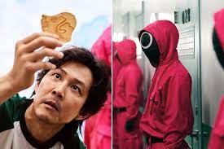
Some Conceptions of Agency
Not an exhaustive survey, but an exploration of some examples of discussions around more traditional conceptions of agency

Slide 10

Agency and Power
“There is a need to revise and redefine existing power structures while advocating for ethics and empathy in digital and hybrid spaces. Members of the community need to problematize the complexities of these interactions, and prepare all children to participate in complex democratic discourses using diverse digital tools.
Ian O’Byrne https://wiobyrne.com/building-ethical-communities/

Slide 11

Ethics of Power
This is a theme that will sound familiar to educators. "Data ethics is not only about power—it also is power
  “Power for governments, companies, self-proclaimed experts and advisors and even academic disciplines to point out the problems and their solutions, to set the priorities for what role data technologies should play in our human lives and in society.”
Don’t ask if artificial intelligence is good or fair, ask how it shifts power
  “Those who could be exploited by AI should be shaping its projects.”
Gry Hasselbalch, Data Ethics of Power https://dataethics.eu/data-ethics-of-power-a-human-approach-to-big-data-and-ai/ Pratyusha Kalluri, 2020 https://www.nature.com/articles/d41586-020-02003-2

Slide 12

Power as Limitation
Jaron Lanier: "The problem is not the Internet or social media in a broad sense but rather specifically the use of the algorithms... people being directed rather than exploring and that makes the world small."
Small. That's a really good word for it. Like, when I'm looking for something to watch on YouTube, I feel the walls of the algorithm closing in on me.
Jaron Lanier (2021). Was the Internet a Horrible Mistake? Honestly with Bari Weiss. Podcast. https://www.honestlypod.com/podcast/episode/2a738715/was-the-internet-a-horrible-mistake Stefanie Panke, 2021 Social Media: Time for a Break?, AACE Review, https://www.aace.org/review/social-media-time-for-a-break/

Slide 13

Resilience
UNICEF: resilient children—those equipped with skills in areas such as communication, conflict resolution and self-efficacy—are more likely to make appropriate choices when using social media
Fostering resilience: "protective factors" in three major categories:
  caring and supportive relationships
  positive and high expectations
  opportunities for meaningful participation
BUT: “correlates of resilient outcomes are generally so modest that it is not possible accurately identify who will be resilient to potential trauma and who not”
UNICEF: https://www.unicef.org/eap/press-releases/build-resilience-children-help-them-stay-safe-social-media
Bonnie Benard, 1995, Fostering Resilience in Children. ERIC Digest. https://eric.ed.gov/?id=ED386327
George A. Bonanno, 2021: https://www.tandfonline.com/doi/full/10.1080/20008198.2021.1942642

Slide 14
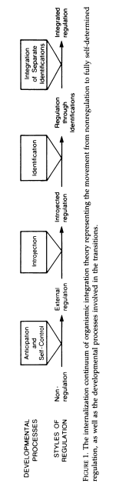
Self-Determination
Self-Determination Theory (SDT) and “basic psychological needs”
  competence (feeling one is effective in meeting environmental demands)
  autonomy (feeling authentic, acting with volition, having input)
  relatedness (feeling connected with and cared for by significant others)
    Duda & Appleton
Deci, E. L., & Ryan, R. M. (1985). Intrinsic Motivation and Self-Determination in Human Behavior. Berlin: Springer Science & Business Media. https://doi.org/10.1007/978-1-4899-2271-7 esp. pp 154-160, image p. 139
Joan L. Duda, Paul R. Appleton, in Sport and Exercise Psychology Research, 2016 https://www.sciencedirect.com/topics/social-sciences/self-determination-theory

Slide 15
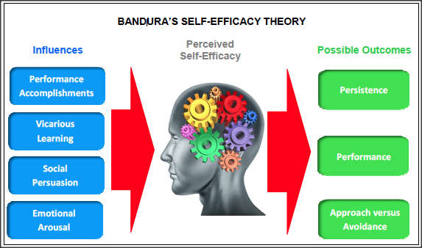
Self-Efficacy
“Self-efficacy refers to an individual's belief in his or her capacity to execute behaviors necessary to produce specific performance attainments (Bandura, 1977, 1986, 1997).”
  Mastery experiences
  Vicarious experiences
  Verbal persuasion and feedback
  Physical signals
APA https://www.apa.org/pi/aids/resources/education/self-efficacy
Image: https://www.ovpconsulting.com/weekly/2018/11/16/086p3teoj8d0dbvuwbt51sh7qkc63c
Laura Ritchie, 2016, Fostering Self-Efficacy in Higher Education Students, pp. 25-30

Slide 16
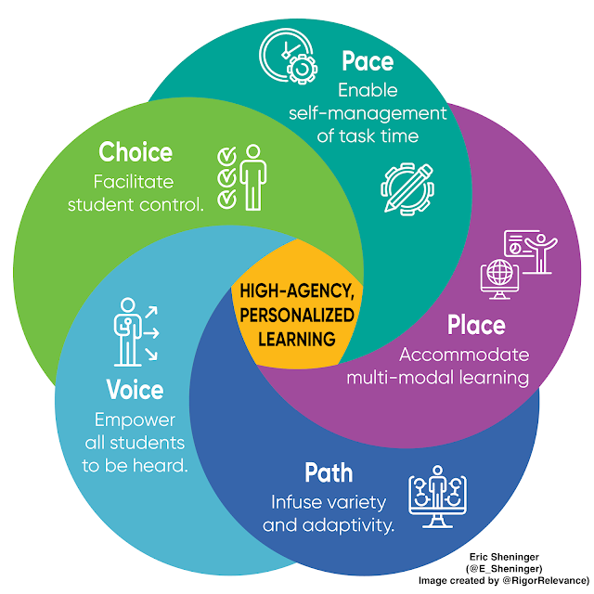
Dimensions of Learner Agency
Eric Sheninger's approach: "There are many strategies that educators were implementing well before the pandemic that hold more value now. Regardless of the terminology used, these represent more personalized pathways that focus on student agency leading to empowerment and more ownership of the learning experience."
http://esheninger.blogspot.com/2020/09/high-agency-in-remote-and-hybrid.html

Slide 17
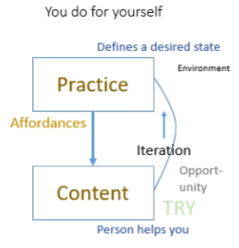
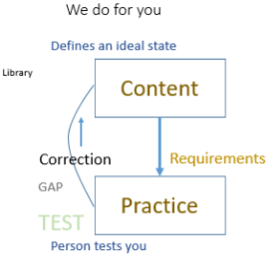
Free Learning and Control Learning
https://www.downes.ca/presentation/172
https://www.downes.ca/presentation/380

