Slide 1
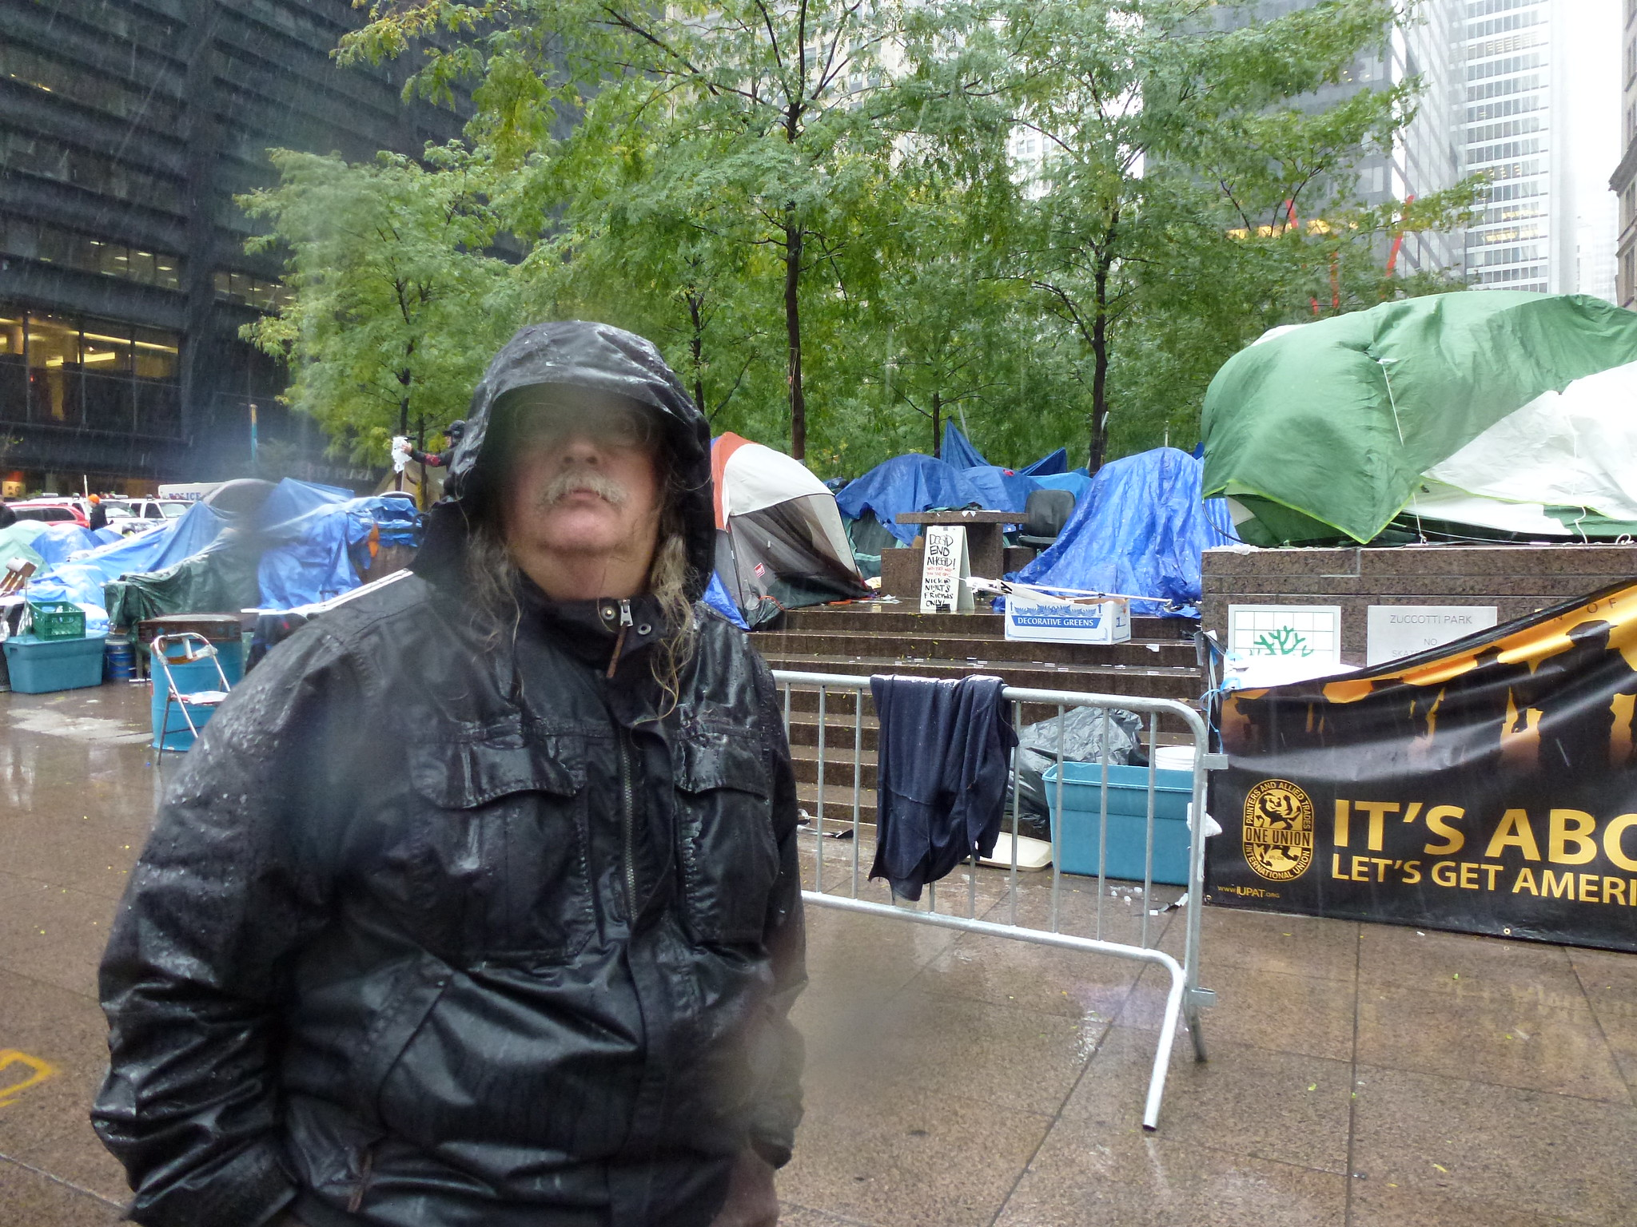

The Search for the Social Algorithm
Stephen Downes
October 12, 2021

Slide 2
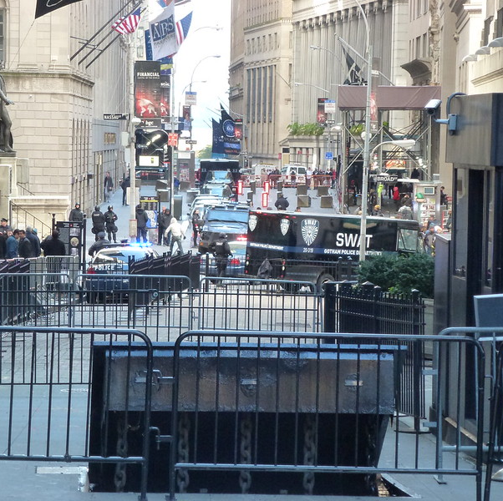
Governance and Anarchy
We have reached a point in history where we don’t know how to govern ourselves
As individuals we struggle with what to believe and how to survive in an increasingly unfair world
As a society we struggle with issues of power and information in the face of multiple global crises

Slide 3
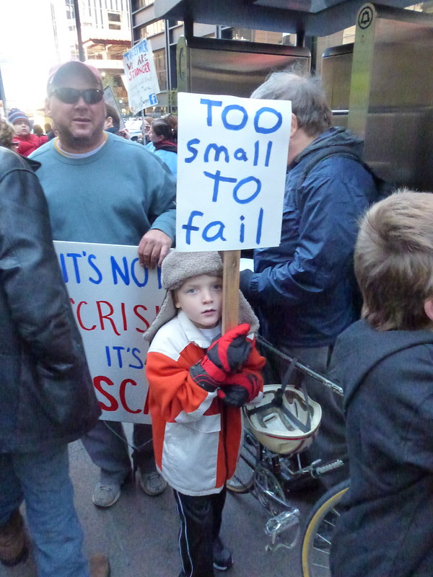
Complexity and Chaos
Rapid change
Information moving at the speed of light
Globalization (and global problems)
Division and polarization
Breakdown of communities and institutions
Mismanagement of complex events

Slide 4
The Paucity of Our Response
We need to view ‘analytics’ much more widely, as (say) “using data about students and their activities ‘to help institutions understand and improve educational processes, and provide better support to learners’” (Sclater)
We need a deeper understanding of ‘ethics’ as more than just a set of rules and principles. “Colleges should teach ethical reasoning rather than just ethical principles.” (Sternberg)
All of this is happening in a climate of change we have yet to fully grasp…
Sternberg: https://www.ideaedu.org/idea-notes-on-learning/developing-ethical-reasoning-and-or-ethical-decision-making/
Sclater: https://www.researchgate.net/publication/282150533_Developing_a_Code_of_Practice_for_Learning_Analytics

Slide 5
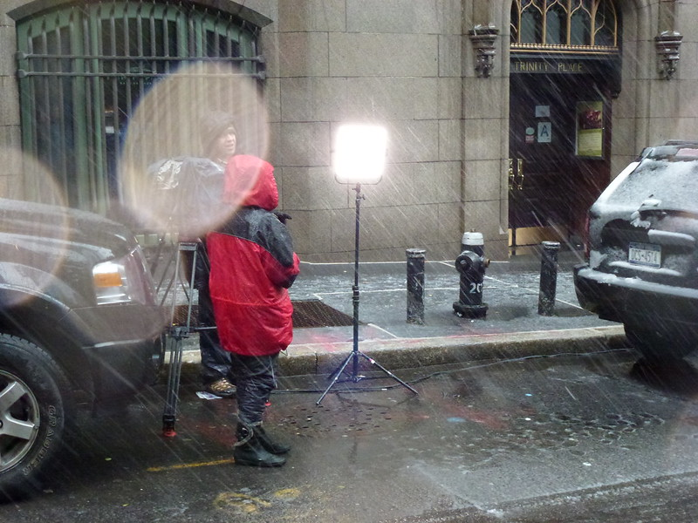
Society is transforming from a tree to a mesh

Slide 6
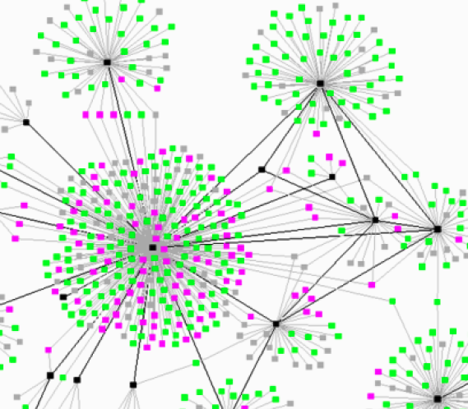
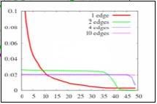
Network Structures - Tree
Traditional social network
Central
Influence
Power Law
Viral
Hierarchy
http://middleburydemocrats.wordpress.com/2008/09/28/college-democrats-getting-obama-to-go-viral-no-really/

Slide 7
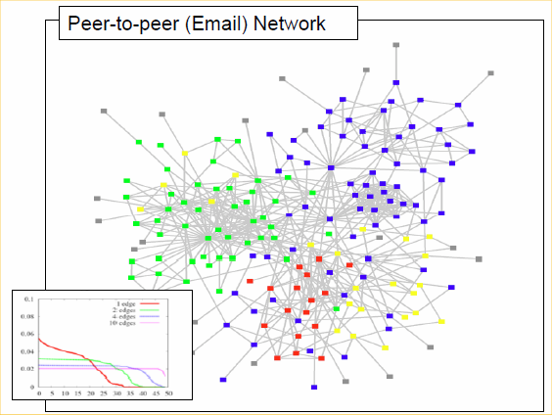
Network Structures - Mesh
Distributed
Discussion
Balanced
Reflective
Democracy
http://www.daniel-lemire.com/fr/abstracts/DIVERSITY2008.html
http://www.mailchimp.com/blog/using-email-to-uncover-hidden-social-networks/

Slide 8
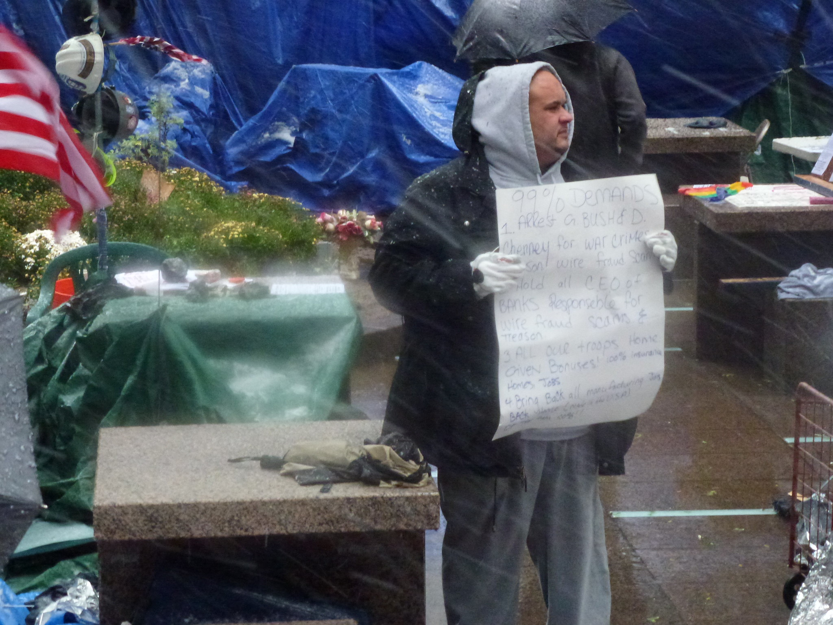
What is it Like to Live in a Mesh?
What matters?
How do we know?
What can we do?
Etc.
We are only beginning to learn

Slide 9
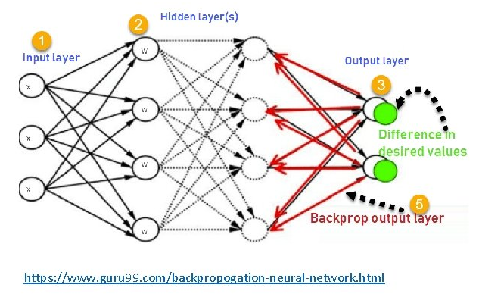
AI / Neural Networks
Inputs and outputs
The study of algorithms that add or strengthen/weaken connections
Also: activation functions, topographies, etc
The intent is to produce the set of algorithms that will produce the best result
E.g. Hinton, Rumelhart & McClelland, etc.
Learn more: https://machinelearningmastery.com/

Slide 10
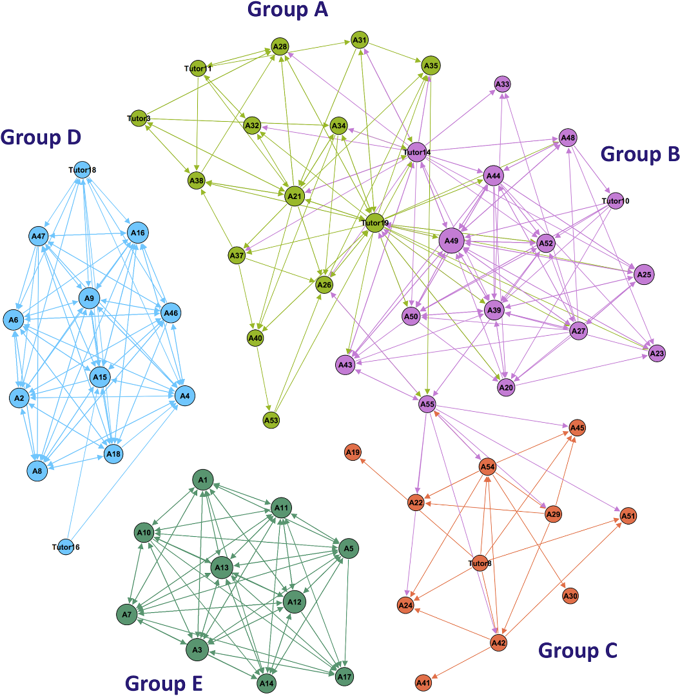
Neural & Social Network Analysis
The study of networks in the world
Identification of entities and the connections between then
Studies network topology and also the growth and development of networks
Objective is to explain why things are the way they are
E.g. Watts, Barabasi, Krebs, etc.
Learn more: https://towardsdatascience.com/how-to-get-started-with-social-network-analysis-6d527685d374

Slide 11
Networks
Ethics
Analysis
Literacy

Slide 12
Ethics, Analytics & the Duty of Care
MOOC – October to November 2021 https://ethics.mooc.ca
AIP-CoP AI in Learning Subcommittee Report (Government of Canada internal)
NRC Research Ethics Board https://nrc.canada.ca/en/corporate/values-ethics/research-involving-human-participants/research-ethics-board
Data Equity Working Group (NRC internal but see https://drive.google.com/drive/folders/1tjLyb6R18GTh4mR5Q56TX2ZVFz2rDgk8 )
Creative Commons Ethics of Sharing Report https://docs.google.com/document/d/1GRx7V2utoVV-bd2ALzYv5fSxlIMNmMHAftEHHPbYMJQ/edit
Ethical Codes and Learning Analytics https://www.downes.ca/post/71041

Slide 13
Data Literacy
MOOC February to March, 2022
DRDC Data Literacy Project (DRDC internal but see https://cradpdf.drdc-rddc.gc.ca/PDFS/unc362/p813314_A1b.pdf )
FAIRsFAIR book project https://docs.google.com/document/d/1_xs3mMDKGybSbOxHBslbH8qpTaf4gjuW6z_GSZYMk_c/edit
What Does It mean to Enrol in a Course? https://docs.google.com/document/d/1kbhkWzl99-7v0G6AokTHWZr98IrPzLwqYBezb_mW0wg/edit
CovidEA Reports https://www.foggs.org/covidea/
Blockchain and Consensus https://docs.google.com/document/d/1P3UbO7MaOX8N51QvQB06uMifCWiykIeU0JQ2ID8fySM/edit#heading=h.34e9fogs01b4

Slide 14
Critical Literacies
Applications (Self-Organization, Consensus, Learning Theory)
  Syntax – patterns, regularizes, classes, etc (where AI is now)
  Semantics – sense, reference, value, meaning, goals (where AI is moving)
Values (Diversity, Openness, Interaction, Autonomy)
  Use – actions, persuasion, interrogations, scientific method, propaganda
  Context – alternatives, vocabulary and labels, frames, community, culture
Practices (Aggregate, Remix, Repurpose, Feed Forward)
  Cognition – argument, explanation, definition, description
  Change – connections, flow, sequence, progression, cycles

Slide 15
Ethics
Involves a comprehensive study of what the ethics actually are and how they are established
  How We Apply AI
    Applications of AI in Learning
    The Decisions We Make
  The Ethical Dimension
    Ethical Issues Identified
    Approaches to Ethics
    The Duty of Care
  Practices
    Ethical Codes Across Domains
    Ethical Practices in Learning Analytics
Applications
Practices
Values

Slide 16
Literacy
Applications
  Data Literacy Models
  Elements of Data Literacy
Values
  Benefits of data Literacy
  Operational Requirements
Practices
  Measuring and Assessing
  Enhancing Data Literacy
Applications
Practices
Values

