Slide 1
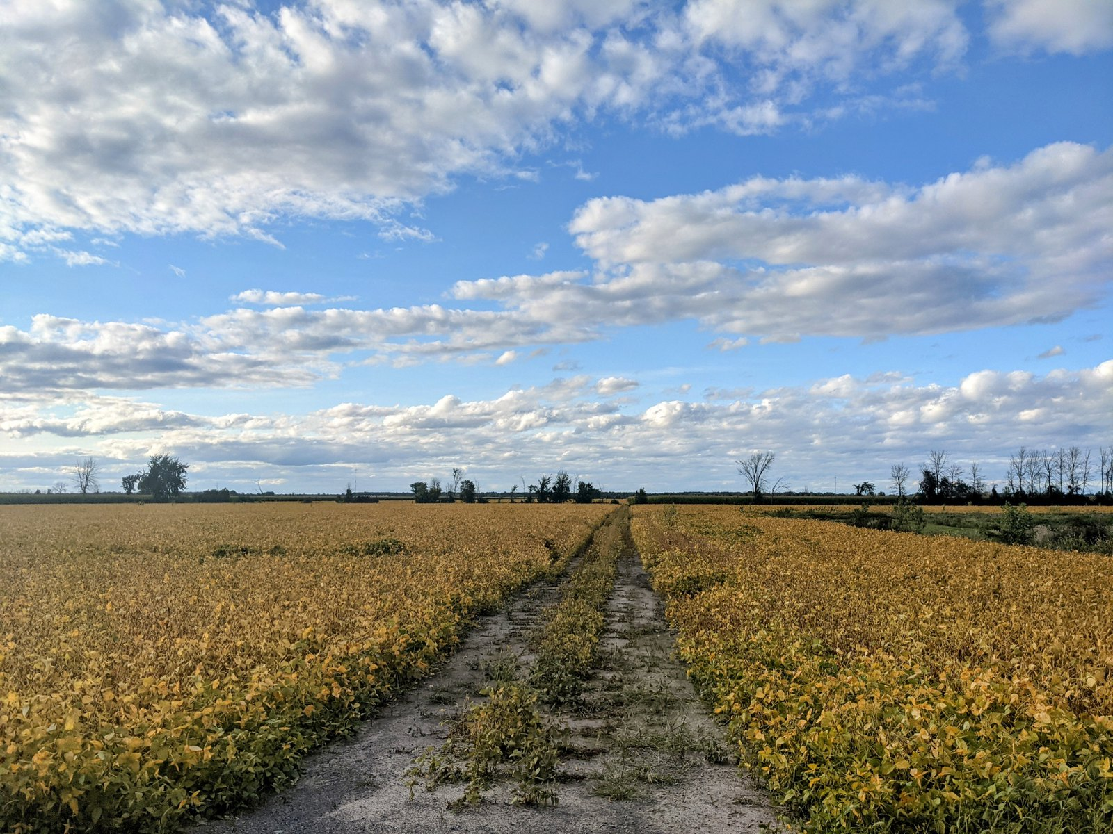
Learning and Teaching in a Pandemic: Opportunities, Challenges and Lessons Learned
Stephen Downes
TILT Annual Learning and
Teaching Conference
(ALTC) 2021
September 14, 2021

Slide 2
The Three Conference Themes
Active, Collaborative Learning (ACL)–a continuum of practice(s): Stories from Lockdown / Socially Distanced Classrooms;
Teaching, Technology and the Pandemic: Everyday Scholarship Stories of Digital Tools and Technologies; and,
Being Together, While Apart: Sustaining Learning Communities through and beyond Covid.

Slide 3
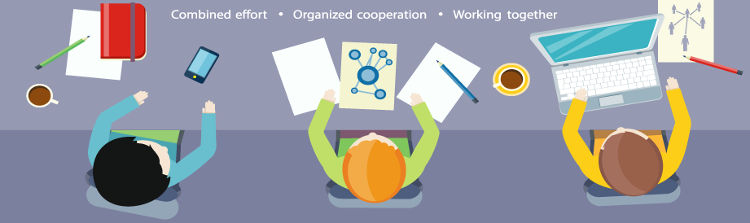
Collaborative
Active, Collaborative Learning (ACL)–a continuum of practice(s): Stories from Lockdown / Socially Distanced Classrooms
Are we really ‘working together’ toward common outcomes?
Image: https://www.itweapons.com/tips-for-improving-office-communication-collaboration/

Slide 4
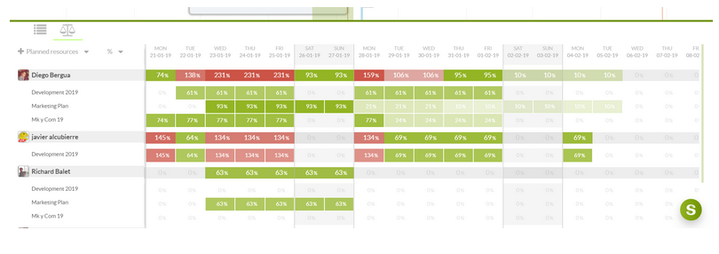

Collaborative
Active, Collaborative Learning (ACL)–a continuum of practice(s): Stories from Lockdown / Socially Distanced Classrooms
By ‘collaboration’ do we not just mean ‘better communication’?
Images: https://www.sinnaps.com/en/project-management-blog/collaborative-communication

Slide 5
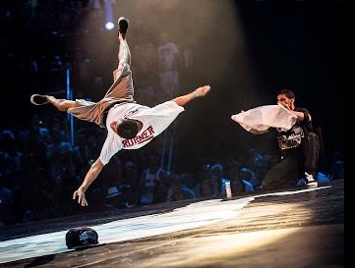




Collaborative
Active, Collaborative Learning (ACL)–a continuum of practice(s): Stories from Lockdown / Socially Distanced Classrooms
What do we mean by ‘active’?
Breaking?
Choosing?
Playing?
Creating?
Liking?
Pushing buttons?
Finding?
Competing?
Notes:
Images:
Buttoms: Lightfield, https://lightfieldstudios.net/229703214/stock-photo-cropped-view-woman-pushing-button.html
Choosing: Niche, https://www.niche.com/blog/3-things-you-might-not-consider-before-choosing-a-college-but-should/ swi
Playing: Time, https://time.com/5824415/video-games-quarantine/d
Creating: Inc. https://www.inc.com/chris-dessi/why-you-need-to-create-something-every-day.html
Breakingf: https://www.youtube.com/watch?v=kleBuzNDdTQ

Slide 6
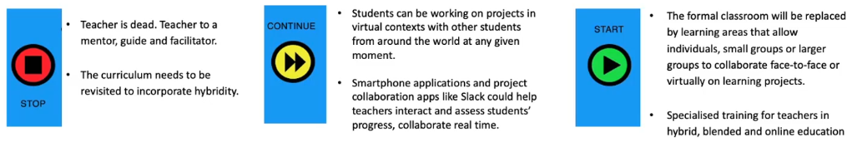
Scholarship
Teaching, Technology and the Pandemic: Everyday Scholarship Stories of Digital Tools and Technologies
What is ‘teaching’ anyway?
From: Meha Jayaswal and Mahima Hasija (ALTC Frings)

Slide 7
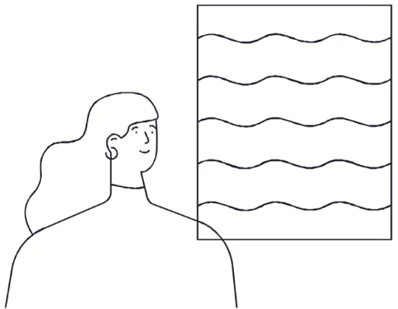
Scholarship
Teaching, Technology and the Pandemic: Everyday Scholarship Stories of Digital Tools and Technologies
Is this really true?
“Technology is not the learning outcome. It is the medium. It’s a tool. And learning has to be platform agnostic. It is just a tool in our hands.”
From: Meha Jayaswal and Mahima Hasija, quoting George Couros (ALTC Fringe)

Slide 8
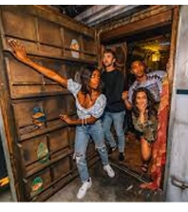
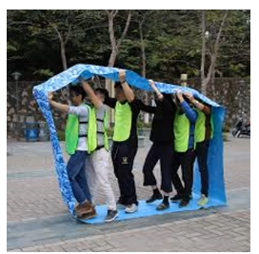
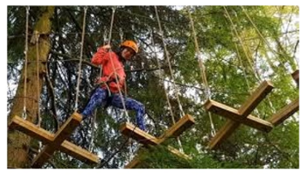
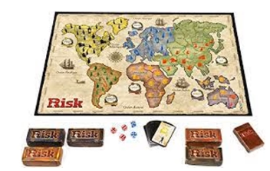
Scholarship
Teaching, Technology and the Pandemic: Everyday Scholarship Stories of Digital Tools and Technologies
Does there have to be a learning objective?
From: Shish Malde (ALTC Fringe)
Notes:
Games versus ‘serious games’
Jane McGonigal – students spend 10,000 hours ‘learning’, but also 10,000 hours playing games (esp. online games)
What do they learn? McGonigal: Optimism, trust, happiness, meaningfulness, perception, reaction time
Daphine Bavelier: concentration, multi-tasking, sustained improvement

Slide 9
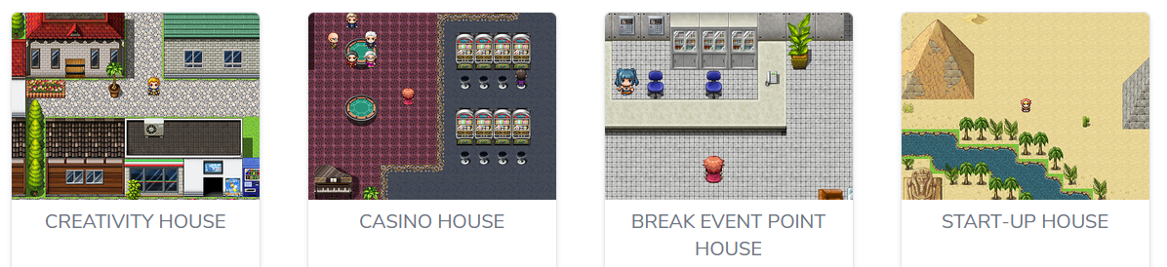
Scholarship
Teaching, Technology and the Pandemic: Everyday Scholarship Stories of Digital Tools and Technologies
Is this learning, or propaganda?
From: Entrepoly discussed in https://isgee.eu/ Shish Malde (ALTC Fringe)

Slide 10
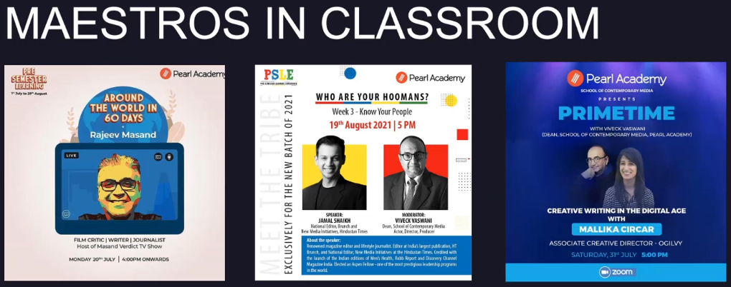
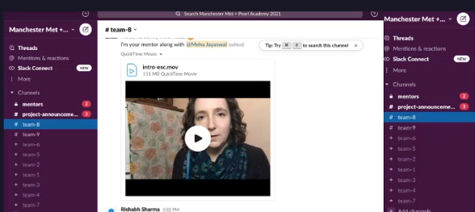
Communities
Being Together, While Apart: Sustaining Learning Communities through and beyond Covid
Who is in our community? Who isn’t?
From: Meha Jayaswal and Mahima Hasija (ALTC Fringe)

Slide 11
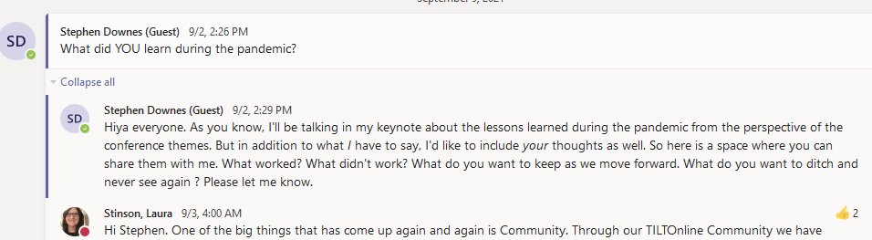
Communities
Being Together, While Apart: Sustaining Learning Communities through and beyond Covid
Can we actually create community?
https://teams.microsoft.com/_?tenantId=8acbc2c5-c8ed-42c7-8169-ba438a0dbe2f#/conversations/Live%20Fringe%20Sessions?threadId=19:96ca032d06d7413fa57ecbe3d4dcca60@thread.tacv2&messageId=1631176852970&replyChainId=1630607217581&ctx=channel

Slide 12
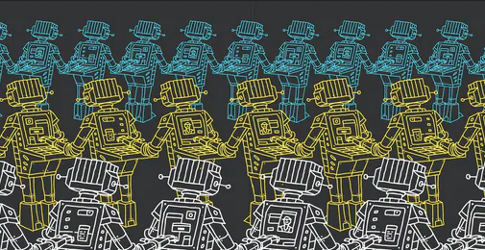
As faculty and instructors…
What are we learning?
What can we build on?
What changes can we make?
Image: https://www.edsurge.com/news/2018-07-02-why-are-we-still-personalizing-learning-if-it-s-not-personal
Notes:
What are we learning from this experience about teaching and learning?
What can we build on as we get back to class in 2021?
What changes can we make to how we teach, assess and work with students to make learning more effective?

Slide 13

10 Lessons

Slide 14

Any change will be hard at first.
We can’t directly compare the new thing with the old thing.
We need to give ourselves some time
Image: https://medium.com/mind-munchies/why-is-change-so-hard-807eae0b2dcb
Notes:
It was hard to jump right into remote learning, and it was hard to jump back into the new classroom environment. So we can’t directly compare the new thing with the old thing. We have to give ourselves some time to get used to it and for people to get good at it.

Slide 15
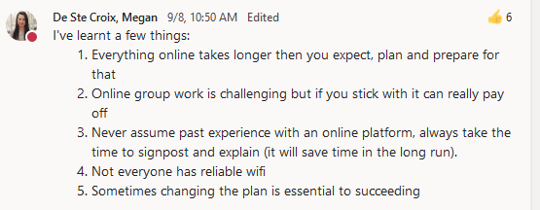
Any change will be hard at first.
We can’t directly compare the new thing with the old thing.
We need to give ourselves some time

Slide 16

Any change will be hard at first.
We can’t directly compare the new thing with the old thing.
We need to give ourselves some time

Slide 17

Learning is social.
We knew that already
Some outcomes are social
We learn as a community
We exchange ideas, conduct trade, and develop networks
Image: https://www.td.org/insights/how-to-be-a-catalyst-for-social-learning
Notes:
Of course, we knew that already,
but being apart underlined the idea that some of the important outcomes of learning are social.
We don’t just learn as individuals, we learn as a community, and
learning is about how we exchange ideas, conduct trade, and develop community networks with each other.

Slide 18
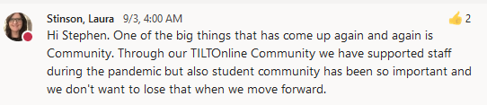
Learning is social.
We knew that already
Some outcomes are social
We learn as a community
We exchange ideas, conduct trade, and develop networks

Slide 19

Learning is social.
We knew that already
Some outcomes are social
We learn as a community
We exchange ideas, conduct trade, and develop networks

Slide 20

Learning is social.
We knew that already
Some outcomes are social
We learn as a community
We exchange ideas, conduct trade, and develop networks
From: Elyse Wakelin (ALTC Fringe)

Slide 21
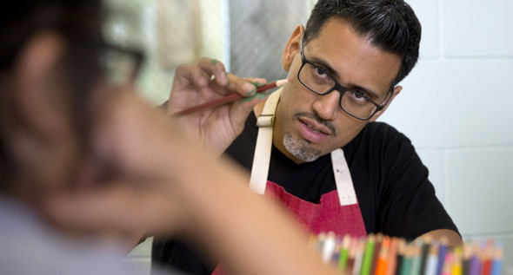
Teaching is not a solitary profession.
Teachers need buildings, etc.
Now they need a support team.
Like when we watch the news
Image: https://www.kqed.org/news/11040591/young-inmates-help-turn-solitary-confinement-cells-into-art-spaces
Notes:
We already know teachers need buildings and facilities and support staff and computer networks and the rest.
But now that they are working with advanced technology in both digital and in-person environments, they need to be constantly developing their skills, and they need a team supporting them.
It’s like when we watch Newsfeed on CB-Stream: we may see only the presenters in our hololens, but we know there’s a team of people supporting them.

Slide 22
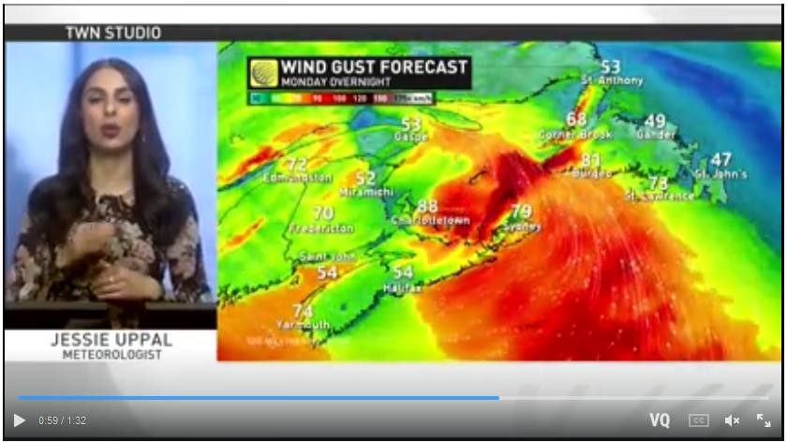
Teaching is not a solitary profession.
Teachers need buildings, etc.
Now they need a support team.
Like when we watch the news
Image: https://ca.news.yahoo.com/ge-2020-psp-prizes-character-not-just-academics-when-selecting-candidates-tan-cheng-bock-043855531.html

Slide 23
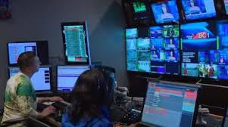
Teaching is not a solitary profession.
Teachers need buildings, etc.
Now they need a support team.
Like when we watch the news
Image: https://ca.news.yahoo.com/ge-2020-psp-prizes-character-not-just-academics-when-selecting-candidates-tan-cheng-bock-043855531.html

Slide 24
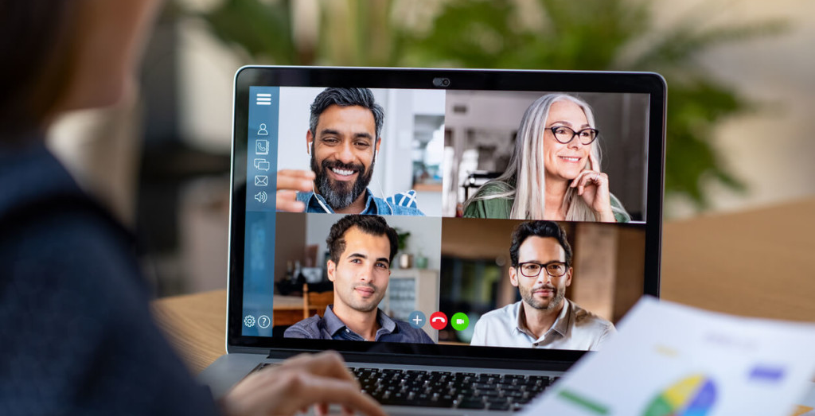
We need live events.
Not for everything, but live events draw us in
They stimulate planning and anticipation
They provide interaction, presence
Image: https://www.dacast.com/blog/virtual-events/
Notes:
Sure, not everything needs to be live – there’s a lot we can get from vids and sims and the rest.
But live events draw us in and challenge us. When we don’t know what’s going to happen, we are engaged in planning and anticipation. And live events have us interacting, even if indirectly with the people in the scene. It’s what we used to call ‘presence’, back in the day.

Slide 25
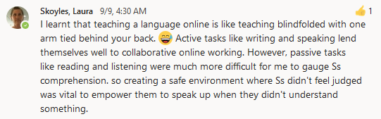
We need live events.
Not for everything, but live events draw us in
They stimulate planning and anticipation
They provide interaction, presence

Slide 26
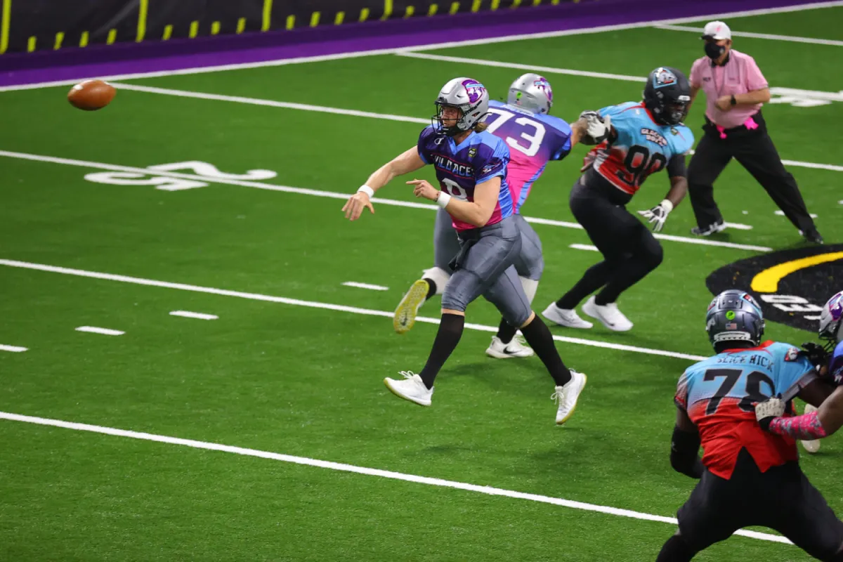
We need live events.
Not for everything, but live events draw us in
They stimulate planning and anticipation
They provide interaction, presence
In the independent league known as Fan Controlled Football, they take play calls from strangers on the internet, who are watching the contest on the gaming platform Twitch, voting in real time via the league’s app.
https://expmag.com/2021/09/in-this-football-league-the-fans-call-the-plays/

Slide 27
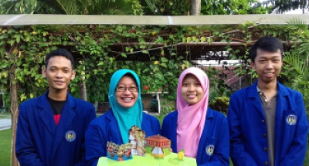
Open media plays a key role.
We can’t learn without it
We need an alphabet
We need words, we need data
Image: http://english.uny.ac.id/article/archipelago-pop-encyclopedia-learning-media
Notes:
It’s not simply about saving money.
We can’t learn – we can’t even communicate – without open media.
We need an alphabet, we need words, we need data –
and these need to be available for any of us to use without worrying about who owns it or how much it costs.
We use open media to write the first draft of our experiences, the first draft of the lessons learned and the practices we should follow.
That’s why we needed Zoom, and that’s why open textbooks became so essential.

Slide 28
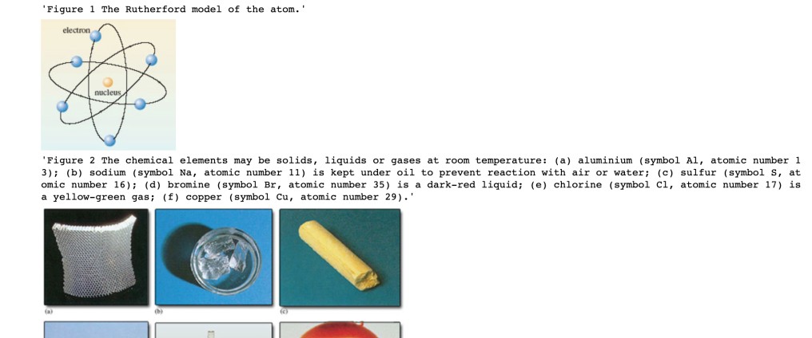
Open media plays a key role.
We can’t learn without it
We need an alphabet
We need words, we need data
What assets are actually reusable?
“What are the granular things that take time to produce, that can be hard to get right, and that someone may have already done? And what other spin-offs or benefits might there be from being able to reuse the asset?”
Tony Hirst: https://blog.ouseful.info/2021/09/03/reusing-educational-assets/

Slide 29
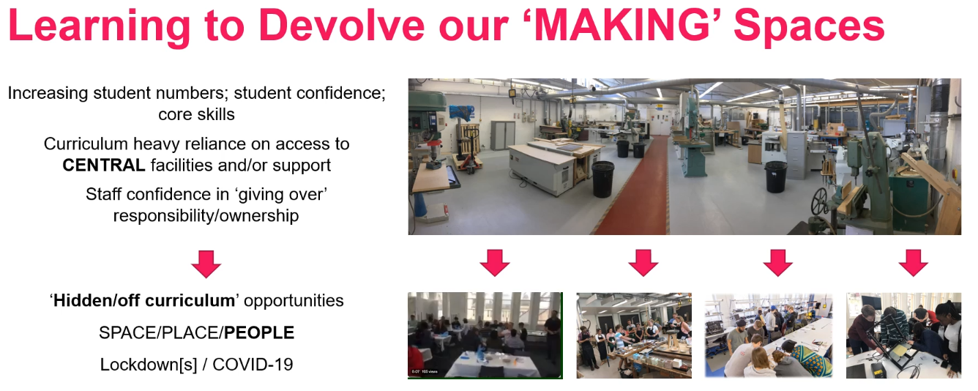
Open media plays a key role.
We need responsibility
We need ownership
From:Luke Siena, Kerry Truman, Chris Forbes (ALTC Fringe)

Slide 30

Quality matters,
It’s not guaranteed
We have to make our own judgements
We have to be critically-minded
“There was a lot of misinformation in the 20s; some of it came from Russia, some of it came from advocacy groups, some of it was advertising, and some of it came from our own governments. The development of trust networks, zero-knowledge proofs and crypto-addressing helped a lot, but we still have to be critically-minded.”
Image: https://thriveglobal.com/stories/8-ways-self-reflection-improves-your-life-and-helps-you-become-happier/
Notes:
but is not guaranteed.
It doesn’t matter how much we paid, or where it came from.
We have to make our own judgements about quality, because of our different needs and circumstances.
There was a lot of misinformation in the 20s; some of it came from Russia, some of it came from advocacy groups, some of it was advertising, and some of it came from our own governments. The development of trust networks, zero-knowledge proofs and crypto-addressing helped a lot, but we still have to be critically-minded.
There was a lot of misinformation in the 20s; some of it came from Russia, some of it came from advocacy groups, some of it was advertising, and some of it came from our own governments.

Slide 31
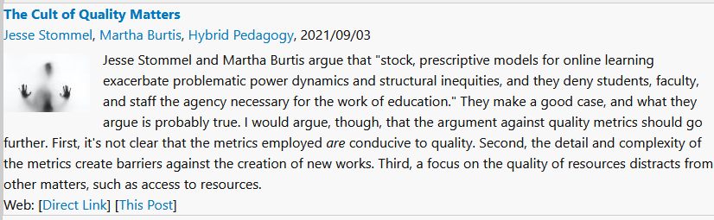
Quality matters,
It’s not guaranteed
We have to make our own judgements
We have to be critically-minded
https://www.downes.ca/post/72700
Notes:
but is not guaranteed.
It doesn’t matter how much we paid, or where it came from.
We have to make our own judgements about quality, because of our different needs and circumstances.
There was a lot of misinformation in the 20s; some of it came from Russia, some of it came from advocacy groups, some of it was advertising, and some of it came from our own governments. The development of trust networks, zero-knowledge proofs and crypto-addressing helped a lot, but we still have to be critically-minded.
There was a lot of misinformation in the 20s; some of it came from Russia, some of it came from advocacy groups, some of it was advertising, and some of it came from our own governments.

Slide 32
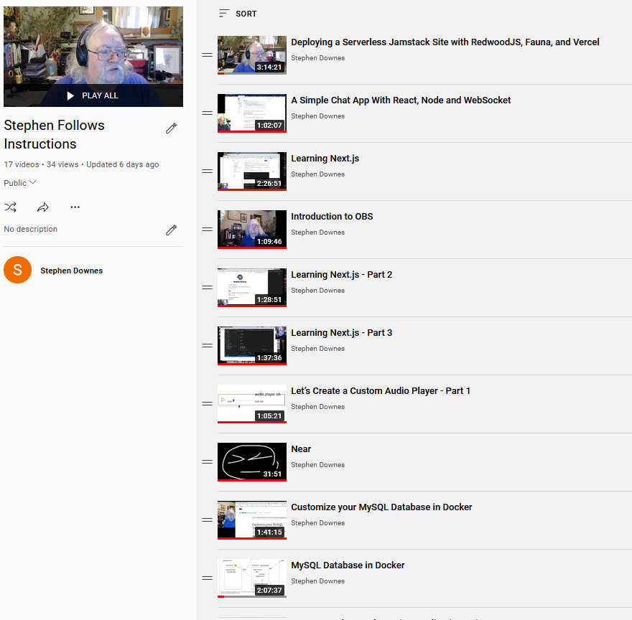
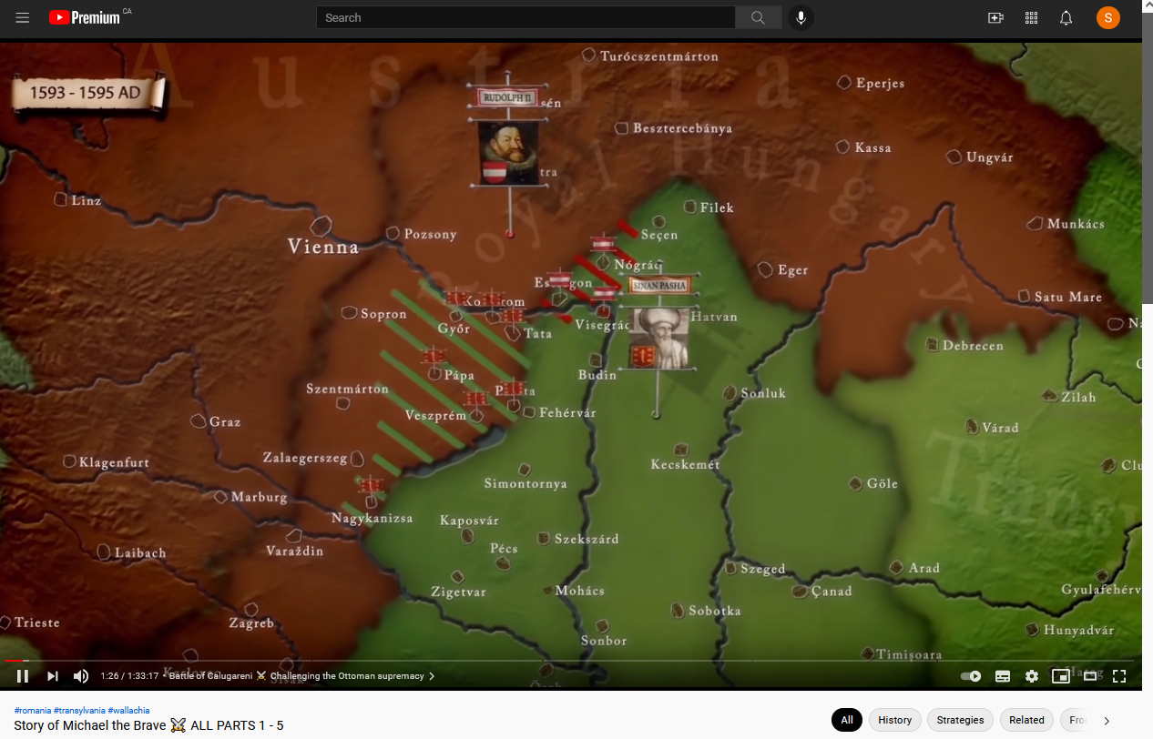
Teaching is more than broadcasting.
8-hour videos (sometimes) bad
Get us away from the keyboard
Still true when we return to the classroom
https://www.youtube.com/playlist?list=PLeBQHgzQN9x3Ef-JuV-HQw2on-_RkjTBM
https://www.youtube.com/watch?v=AVZNTJ7RL80 - Story of Michael the Brave
Notes:
Again, this is something we already knew, but had to learn again when we went online in the 20s.
We can still remember how bad those 8-hour days of video lectures were.
The best learning used the computer where needed, but then got us away from the keyboard and doing something practical.
And this was still true when we returned to the classroom. Suddenly we realized that we didn’t need to be stuck in a room in order to learn.

Slide 33

Reading the room is harder.
We can scan a classroom and observe how students are reacting
Online, it’s a lot more difficult
This needs to become a deliberate practice
Image: https://www.istockphoto.com/photos/broadcasting
Notes:
An experienced teacher can scan a classroom, observe how students are reacting, and change strategies on the fly to stimulate interest or attention.
Online, it’s a lot more difficult to gauge reactions.
So this needs to become a deliberate practice of asking directly for feedback and engaging in interactive exercises.
And it turns out that reading the room is not enough. We need to make understanding our learners a major part of what we do.
Comment about Tony Bates and Data

Slide 34

We need structure, order and routines.
A respite from uncertainty
Balance our work with our play, rest and self-care.
That’s what school often provides
https://www.constructionexec.com/assets/site_18/images/article/092320024449.jpg?width=1280
Notes:
Here were not talking about military discipline, but rather, a respite from uncertainty and precarious circumstances.
When we were at home, we needed to learn how to balance our work with our play, rest and self-care.
We needed to know when we would eat, where we would sleep, and to be able to plan our days and our futures.
That’s what school often provides

Slide 35
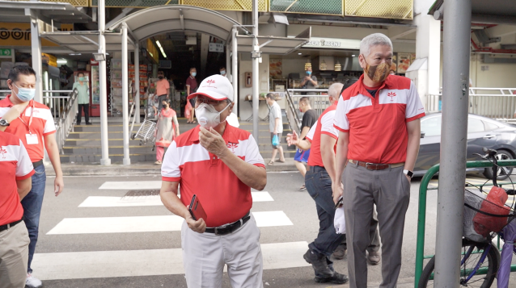
It’s not just school subjects
Not just schools and universities
Beyond traditional academics
Support in-home workers, self-employed, new careers
Image: https://ca.news.yahoo.com/ge-2020-psp-prizes-character-not-just-academics-when-selecting-candidates-tan-cheng-bock-043855531.html
Notes:
. When we began looking at our learning needs on a society-wide basis, we realized that we couldn’t just focus on educational institutions like schools, colleges and universities.
We needed to think beyond traditional ‘academic’ subjects.
We needed to find ways to support in-home workers, people who were self-employed, and people trying to find a new career.

Slide 36
3 Challenges

Slide 37
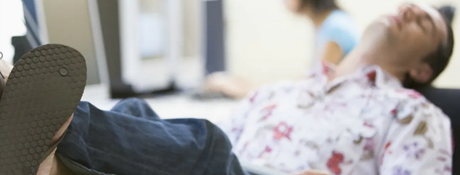
Motivation matters.
Educators have always known this
Online we haven’t the same tools
  We can’t force them; we need people interested and engaged
Image: https://www.edsurge.com/news/2016-05-31-unpacking-the-problem-of-unmotivated-online-students
Notes:
Educators have always known this, and have taken steps to keep students engaged in class.
But when people are out of school and learning online, we don’t have the same tools.
It’s harder to take attendance.
We can’t force them to stare at the computer screen.
People have to be interested and engaged in what they’re studying, which means they have to have a lot more say in what they’re doing and why it matters.

Slide 38
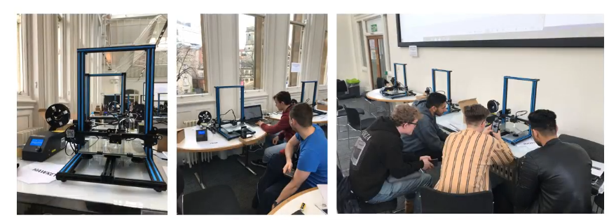
Motivation matters.
Educators have always known this
Online we haven’t the same tools
  We can’t force them; we need people interested and engaged
Democratic manufacturing
- Giving students independence and confidence in their skills
- Adapted by creating video induction series
From:Luke Siena, Kerry Truman, Chris Forbes (ALTC Fringe)

Slide 39
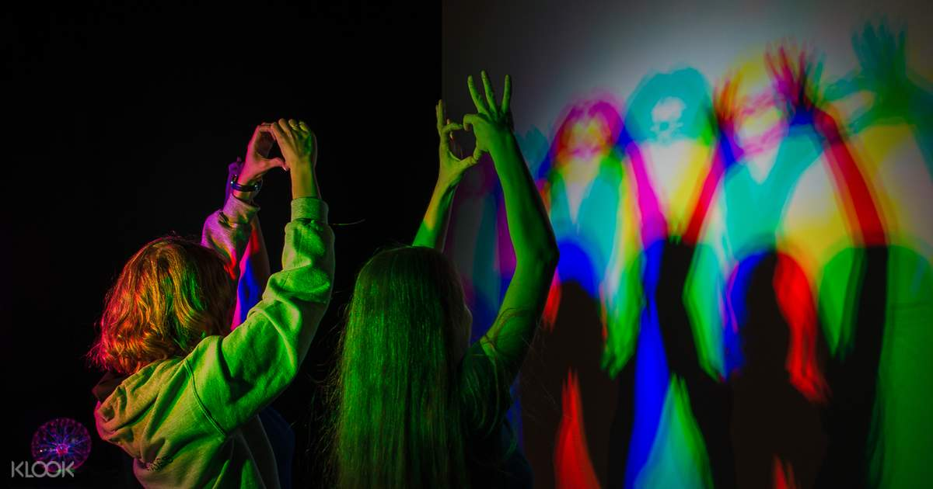
People have diverse needs.
Designed for the mainstream
Built-in, systemic discrimination
Everyone has special needs
Image: https://www.klook.com/en-IN/activity/24658-museum-senses-ticket-bucharest/
Notes:
They come from different cultures, speak different languages, and have different abilities.
Before the 2020s we designed for the mainstream and hoped that the rest could adapt.
But a lot of difficult issues surfaced in those years, and we had to address built-in or systemic discrimination.
We had to get past the idea that some people are ‘special needs’ and to adopt the attitude that everyone has special needs.

Slide 40

People have diverse needs.
Designed for the mainstream
Built-in, systemic discrimination
Everyone has special needs

Slide 41
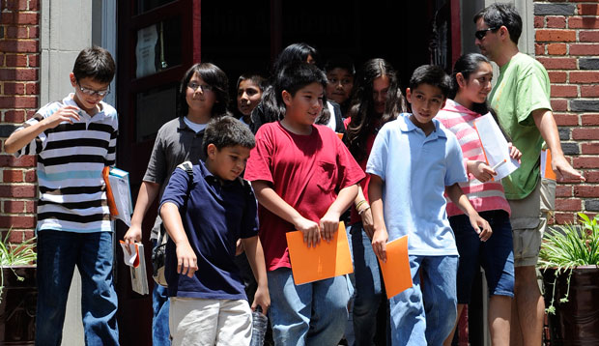
Inequities harm learning.
School mitigated some of the worst inequities
This disappeared online; people in need just vanished.
We need the will to solve it
Image: https://cdn.americanprogress.org/wp-content/uploads/2012/09/19031533/stealth_onpage1.jpg
Notes:
In many ways, coming together to learn at school mitigated some of the worst impacts of poverty and disability
, because we could all access books, teachers and time to study at school. A lot of us depended on school for internet access and a good meal.
A lot of this support disappeared when we went online.
People in need just vanished.
We knew that this was a problem, but it took a long time to solve it.

Slide 42
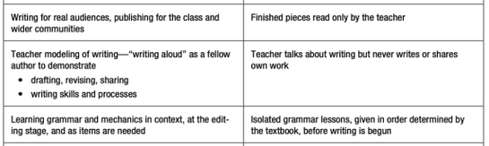
Inequities harm learning.
School mitigated some of the worst inequities
This disappeared online; people in need just vanished.
We need the will to solve it
Radical Eyes for Equity: Moving from “All Students Must” to “Each Student Deserves”
P.L. Thomas, https://nepc.colorado.edu/blog/moving-all-students
Notes:
In many ways, coming together to learn at school mitigated some of the worst impacts of poverty and disability
, because we could all access books, teachers and time to study at school. A lot of us depended on school for internet access and a good meal.
A lot of this support disappeared when we went online.
People in need just vanished.
We knew that this was a problem, but it took a long time to solve it.

Slide 43
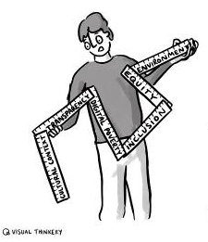
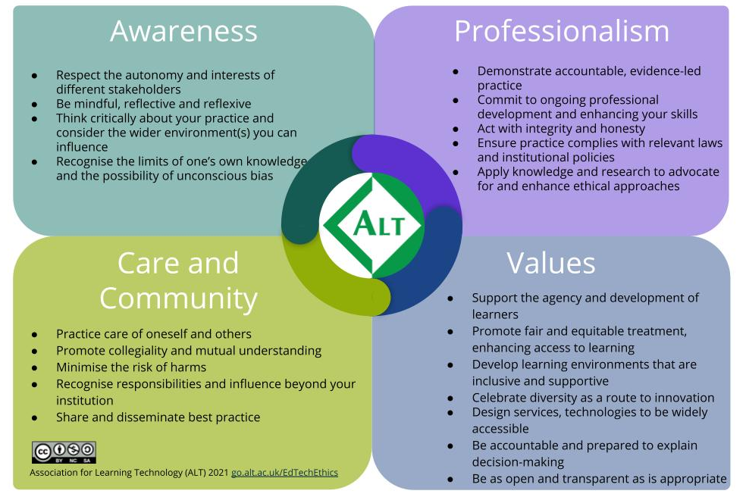
Inequities harm learning.
School mitigated some of the worst inequities
This disappeared online; people in need just vanished.
We need the will to solve it
https://www.alt.ac.uk/sites/alt.ac.uk/files/public/ALT%E2%80%99%20Framework%20for%20Ethical%20%20Learning%20Technology%20%28FELT%29%202021%20%284%29.pdf

Slide 44
3 Ways to Improve

Slide 45
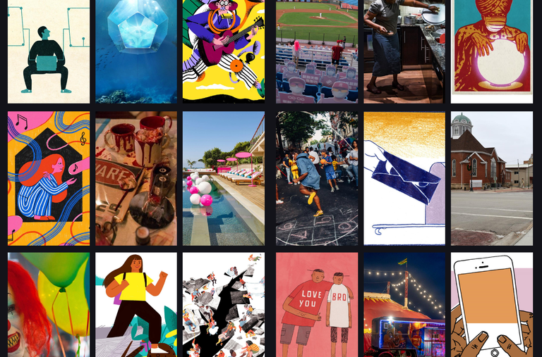
We need to learn how to learn.
It’s really hard for people to learn on their own.
If nobody there to teach them, they wouldn’t try to learn
This applies to both teachers and students
Image: https://www.nytimes.com/spotlight/learning-english-language-arts
Notes:
This applies to both teachers and students.
What we found was that many students who had been in school for ten years had no idea how to learn on their own.
They didn’t know where to start, they didn’t know how to structure their work, and often, they weren’t motivated to try.
If there was nobody there to teach them, then they simply wouldn’t try to learn.

Slide 46
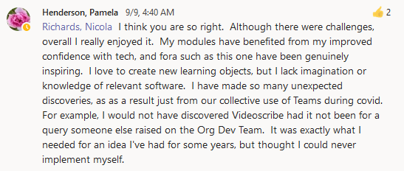
We need to learn how to learn.
It’s really hard for people to learn on their own.
If nobody there to teach them, they wouldn’t try to learn
This applies to both teachers and students

Slide 47
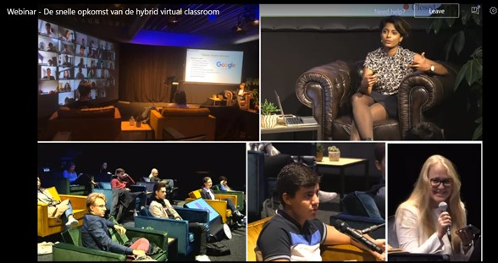
Employ a range of strategies.
Develop ‘hybrid learning’ but not doing both at once
Meet the different needs of people at different times and in different ways
Image: http://zacwoolfitt.blogspot.com/2020/11/the-rapid-rise-of-hybrid-virtual.html
Notes:
We learned to develop ‘hybrid learning’, that is, learning that was at times based on digital tools and resources, and at other times interactive and in-person. We also learned not to have a teacher doing both of these at once, because the two methods are so different. But there was no need – by varying strategies, it’s possible to meet the different needs of people at different times and in different ways.

Slide 48
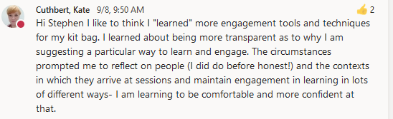
Employ a range of strategies.
Develop ‘hybrid learning’ but not doing both at once
Meet the different needs of people at different times and in different ways

Slide 49
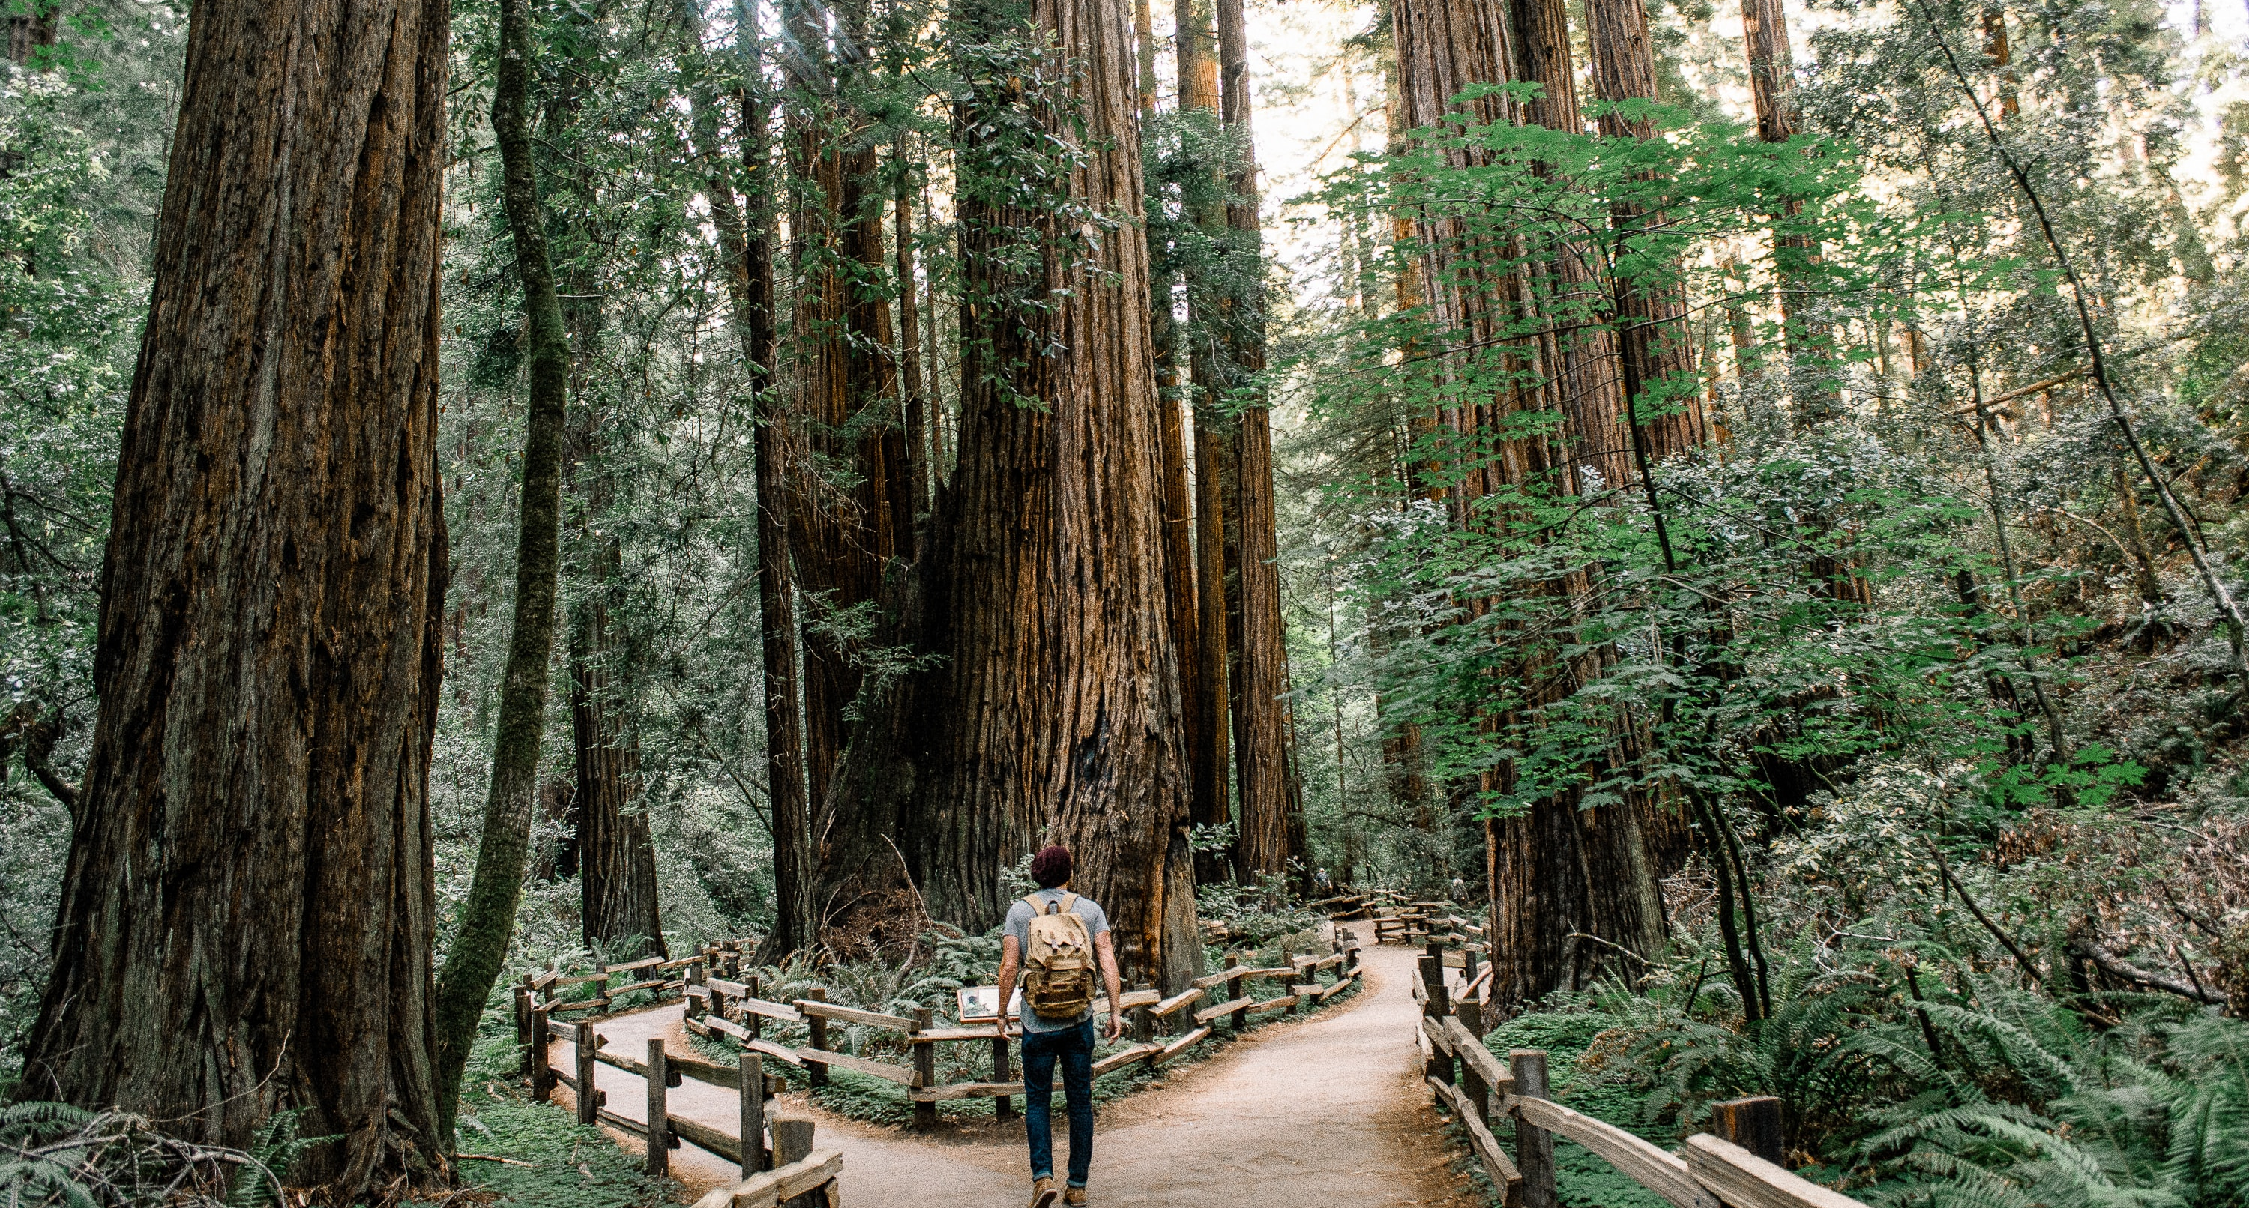
Assessment needs to be flexible.
Traditional testing has become dysfunctional
Depending on surveillance
Instead, show work directly to employers
Image: https://teachingblog.mcgill.ca/2019/10/08/flexible-assessment-one-instructors-implementation-in-a-large-class/
Notes:
Moving online showed us just how dysfunctional traditional testing has become, and
we realized we were depending more and more on surveillance, when
we should have instead been offering counselling and feedback.
Once students were able to create portfolios and show their work directly to employers, the push for stringent testing eased.

Slide 50
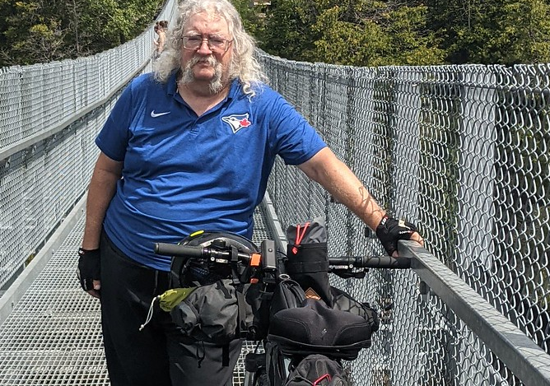
Stephen Downes https://www.downes.ca

