Slide 1
Agency
Stephen Downes
December 25, 2021

Slide 2
Where We Are
Ethical Practice
Regulation
Frameworks
Culture
Ourselves
Ethical practice as culture
Ethical practice as citizenship
Ethical practice as democracy
Ethical practice as agency

Slide 3
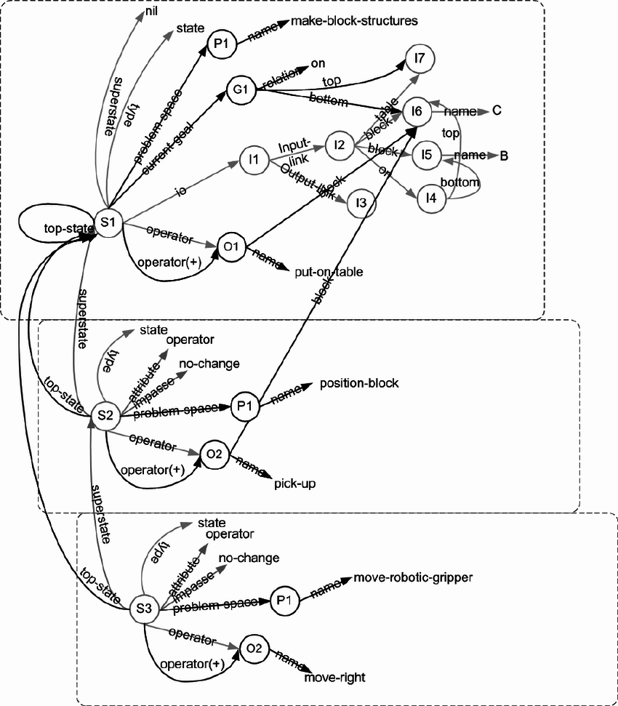
The Idea of Agency
widespread commitment to a desire-belief-intention version of agency, with a close connection between action and reasons
This view carries over into software design, e.g. the belief–desire–intention software model (BDI)
https://plato.stanford.edu/entries/agency/
https://en.wikipedia.org/wiki/Belief%E2%80%93desire%E2%80%93intention_software_model
See also https://link.springer.com/chapter/10.1007/3-540-49057-4_1
And (1970) https://www.researchgate.net/publication/2596320_The_Belief-Desire-Intention_Model_of_Agency
Image: SOAR https://www.researchgate.net/publication/228398068_An_introduction_to_Soar_as_an_agent_architecture

Slide 4
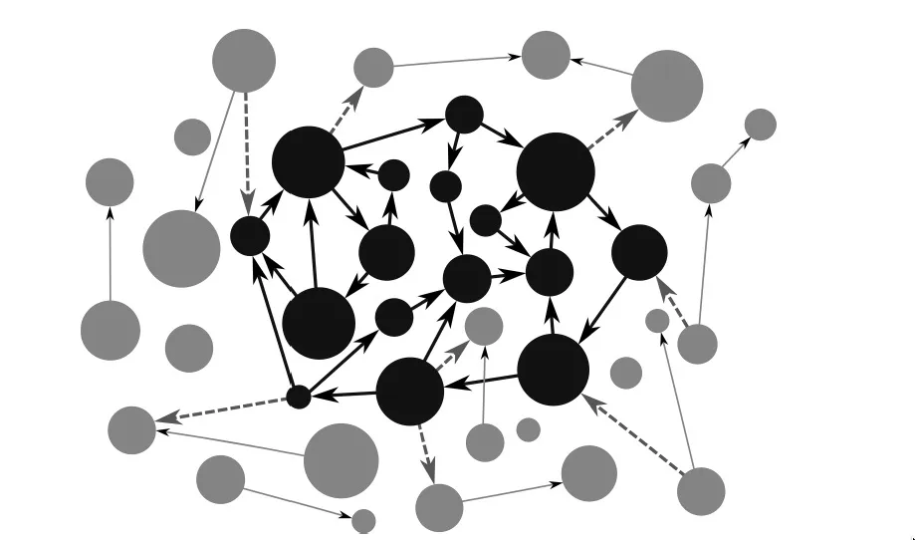
Agency Without Mental Representations
BDI theories usually explain agency in terms of representations
  that is, “in terms of intentional mental states and events that have representational contents (typically, propositional contents)”.
But there are beings capable of genuine agency without representational states (e.g. an embodied enactive approach to mind)
Varela, in his 1979 book, Principles of Biological Autonomy, presented autonomy as a generalization of the concept of autopoiesis (cellular self-production).
https://plato.stanford.edu/entries/agency/
https://philosophyofbrains.com/2017/01/27/the-enactive-approach.aspx

Slide 5
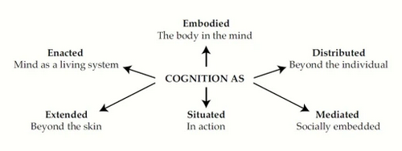
Extended Mind Thesis
The claim that minds or cognitive systems can extend into the environment. Two ways of expressing this:
  EMT1: Mental states extend beyond an organism’s physical boundary
  EMT2: The right unit of analysis in cognitive science is the entire cognitive system, or at least large parts thereof
Overextension: The Extended Mind and Arguments from Evolutionary Biology
Armin Schulz https://people.ku.edu/~a382s825/Overextension%20PSD%20RDER%20AI.pdf
Also: https://en.wikipedia.org/wiki/Extended_mind_thesis
Image: https://ronbc.wordpress.com/2012/03/30/proposing-an-extremely-embedded-mind/

Slide 6
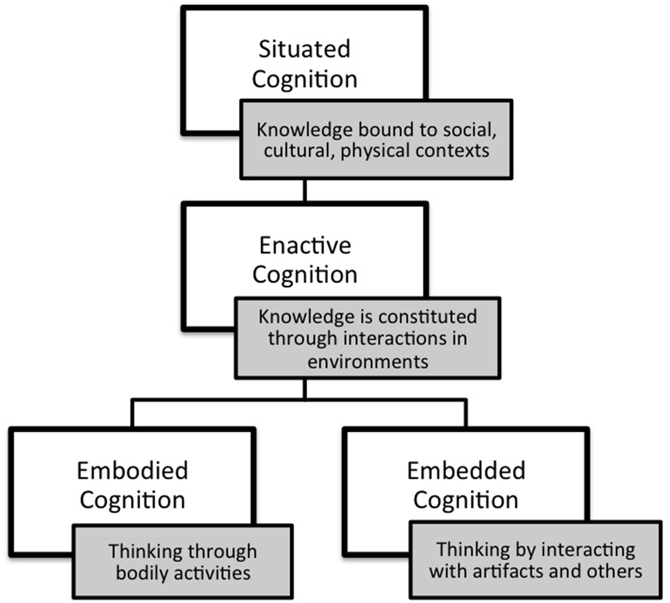
Embodied and Enacted Cognition
As described by Mark Rowlands, mental processes are:
  Embodied involving more than the brain, including a more general involvement of bodily structures and processes.
  Embedded functioning only in a related external environment.
  Enacted involving not only neural processes, but also things an organism does.
  Extended into the organism's environment.
Mark J. Rowlands, 2010 The New Science of the Mind: From Extended Mind to Embodied Phenomenology https://books.google.ca/books?id=AiwjpL-0hDgC&pg=PA51&redir_esc=y#v=onepage&q&f=false
Above quoted from https://en.wikipedia.org/wiki/Extended_mind_thesis
Image: https://www.frontiersin.org/articles/10.3389/fpsyg.2015.01978/full

Slide 7
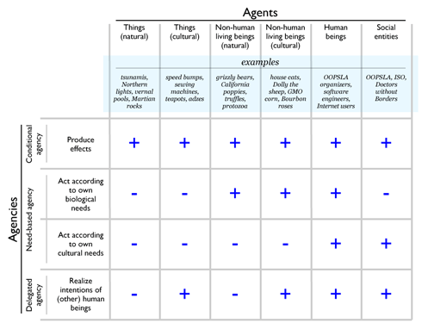
Agency in Non-Human Entities
‘the Stock market wants / reacts / etc’
Eduardo Kohn in How forests think
Anna Tsing: global trade in matsutake mushrooms displays “patterns of unintentional coordination” between multiple actors
Hamilton and Mitchell: sheep, humans, and dogs embedded in a complex web of relations, markets, and terrains
Examples from: https://journals.sagepub.com/doi/10.1177/0731121420921897
See https://anthrosource.onlinelibrary.wiley.com/doi/full/10.1111/aman.13628 for a criticism
Image: http://www.oopsla.org/2005/ShowEvent.do?id=76

Slide 8
Traditional Conceptions of Agency
Not an exhaustive survey, but an exploration of some examples of discussions around more traditional conceptions of agency

Slide 9
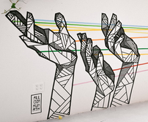
Agency and Power
“There is a need to revise and redefine existing power structures while advocating for ethics and empathy in digital and hybrid spaces. Members of the community need to problematize the complexities of these interactions, and prepare all children to participate in complex democratic discourses using diverse digital tools.
Ian O’Byrne https://wiobyrne.com/building-ethical-communities/

Slide 10

Ethics of Power
This is a theme that will sound familiar to educators. "Data ethics is not only about power—it also is power
  “Power for governments, companies, self-proclaimed experts and advisors and even academic disciplines to point out the problems and their solutions, to set the priorities for what role data technologies should play in our human lives and in society.”
Don’t ask if artificial intelligence is good or fair, ask how it shifts power
  “Those who could be exploited by AI should be shaping its projects.”
Gry Hasselbalch, Data Ethics of Power https://dataethics.eu/data-ethics-of-power-a-human-approach-to-big-data-and-ai/ Pratyusha Kalluri, 2020 https://www.nature.com/articles/d41586-020-02003-2

Slide 11
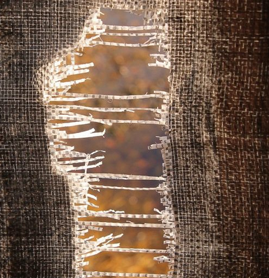
Power as Limitation
Jaron Lanier: "The problem is not the Internet or social media in a broad sense but rather specifically the use of the algorithms... people being directed rather than exploring and that makes the world small."
Small. That's a really good word for it. Like, when I'm looking for something to watch on YouTube, I feel the walls of the algorithm closing in on me.
Jaron Lanier (2021). Was the Internet a Horrible Mistake? Honestly with Bari Weiss. Podcast. https://www.honestlypod.com/podcast/episode/2a738715/was-the-internet-a-horrible-mistake Stefanie Panke, 2021 Social Media: Time for a Break?, AACE Review, https://www.aace.org/review/social-media-time-for-a-break/

Slide 12
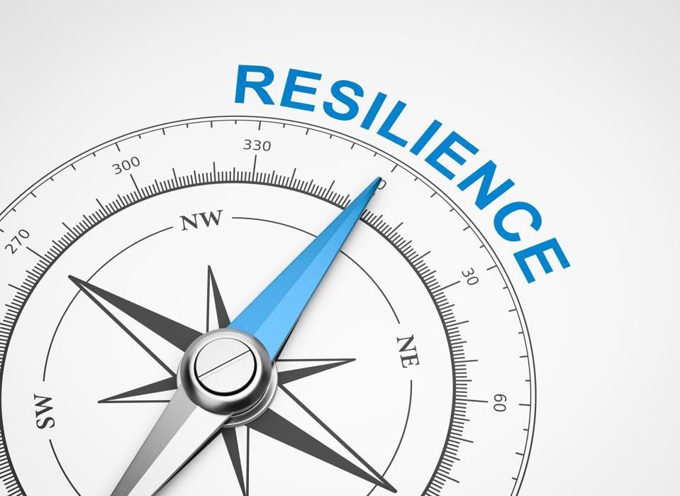
Resilience
UNICEF: resilient children—those equipped with skills in areas such as communication, conflict resolution and self-efficacy—are more likely to make appropriate choices when using social media
Fostering resilience: "protective factors" in three major categories:
  caring and supportive relationships
  positive and high expectations
  opportunities for meaningful participation
BUT: “correlates of resilient outcomes are generally so modest that it is not possible accurately identify who will be resilient to potential trauma and who not”
UNICEF: https://www.unicef.org/eap/press-releases/build-resilience-children-help-them-stay-safe-social-media
Bonnie Benard, 1995, Fostering Resilience in Children. ERIC Digest. https://eric.ed.gov/?id=ED386327
George A. Bonanno, 2021: https://www.tandfonline.com/doi/full/10.1080/20008198.2021.1942642

Slide 13
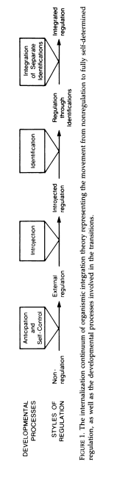
Self-Determination
Self-Determination Theory (SDT) and “basic psychological needs”
  competence (feeling one is effective in meeting environmental demands)
  autonomy (feeling authentic, acting with volition, having input)
  relatedness (feeling connected with and cared for by significant others)
    Duda & Appleton
Deci, E. L., & Ryan, R. M. (1985). Intrinsic Motivation and Self-Determination in Human Behavior. Berlin: Springer Science & Business Media. https://doi.org/10.1007/978-1-4899-2271-7 esp. pp 154-160, image p. 139
Joan L. Duda, Paul R. Appleton, in Sport and Exercise Psychology Research, 2016 https://www.sciencedirect.com/topics/social-sciences/self-determination-theory

Slide 14
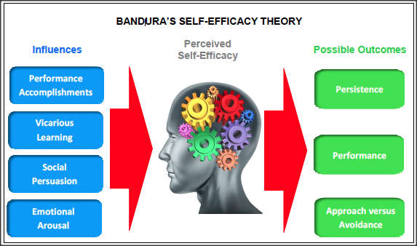
Self-Efficacy
“Self-efficacy refers to an individual's belief in his or her capacity to execute behaviors necessary to produce specific performance attainments (Bandura, 1977, 1986, 1997).”
  Mastery experiences
  Vicarious experiences
  Verbal persuasion and feedback
  Physical signals
APA https://www.apa.org/pi/aids/resources/education/self-efficacy
Image: https://www.ovpconsulting.com/weekly/2018/11/16/086p3teoj8d0dbvuwbt51sh7qkc63c
Laura Ritchie, 2016, Fostering Self-Efficacy in Higher Education Students, pp. 25-30

Slide 15
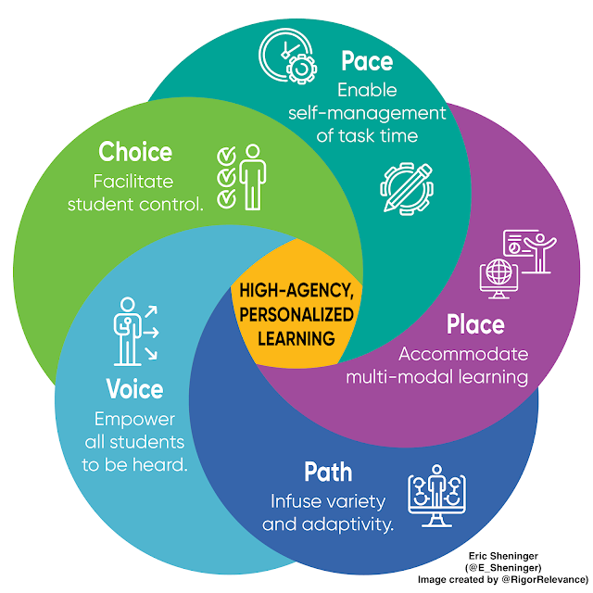
Dimensions of Learner Agency
Eric Sheninger's approach: "There are many strategies that educators were implementing well before the pandemic that hold more value now. Regardless of the terminology used, these represent more personalized pathways that focus on student agency leading to empowerment and more ownership of the learning experience."
http://esheninger.blogspot.com/2020/09/high-agency-in-remote-and-hybrid.html

Slide 16
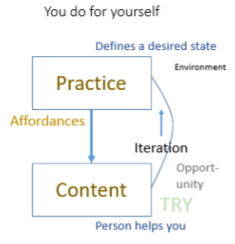
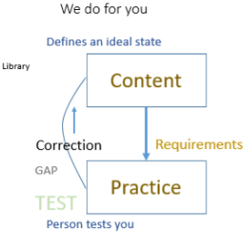
Free Learning and Control Learning
https://www.downes.ca/presentation/172
https://www.downes.ca/presentation/380

Slide 17
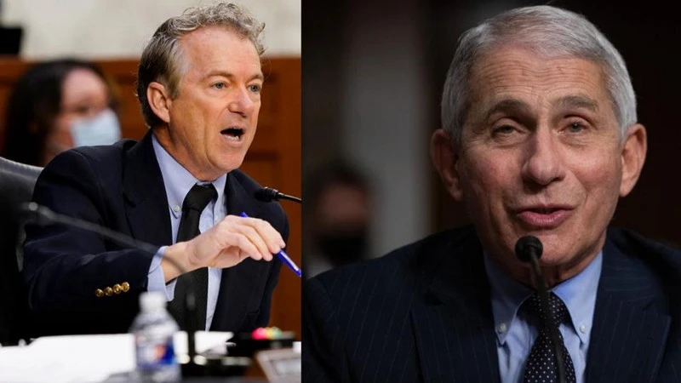
About Science Literacy
“For decades, we've been mistakenly measuring science literacy by measuring which specific facts people have memorized.
“Instead, developing an awareness of and an appreciation for science and what it does for society is a far more impactful approach.
“Science is our best tool for separating what is true from what is not, and we abandon it at our own peril as a society.”
Ethan Siegel, 2021, America’s big mistake about science literacy came back to haunt us in 2021, Big Think https://bigthink.com/starts-with-a-bang/americas-big-mistake-science-literacy/

Slide 18
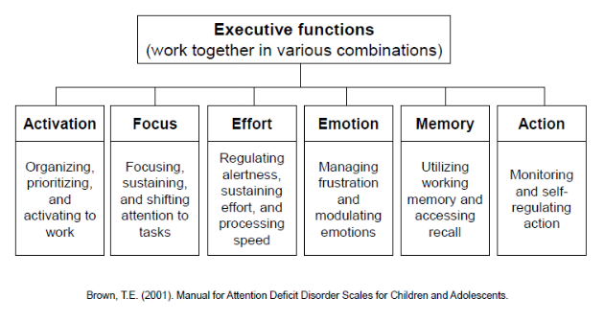
Agency and Biology
Allen Newell – the notion of a ‘control system’ (these days thought of as ‘executive function’)
“There is no actual selection carried out by natural ‘selection’. Nature – in this case the different rates of survival – is simply a passive filter.
Possible role of agency in evolution – Denis Noble
Noble, 2021 https://link.springer.com/article/10.1007/s12304-021-09405-3
Image: https://ldaamerica.org/info/the-reading-brain-executive-function-hard-at-work/

Slide 19
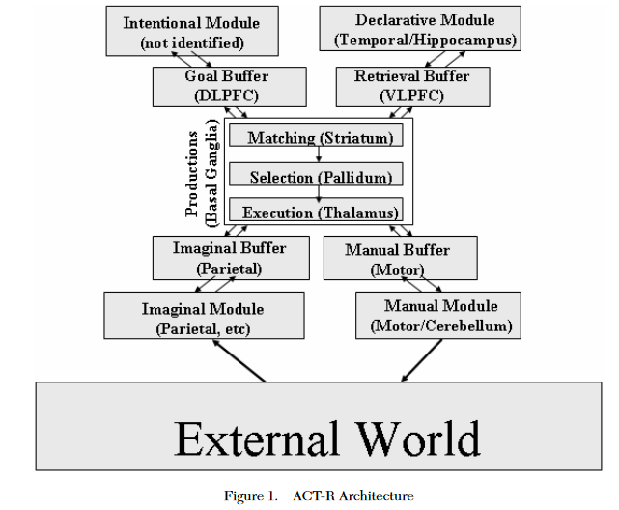
The Newell Test
Any Universal Theory of Control (UTC) must:
Behave flexibly as a function of the environment
Exhibit adaptive (rational, goal-oriented) behavior
Operate in real-time;
Operate in rich, complex, detailed environments
Use symbols and abstractions
Use language
Learn from the environment and from experience
Acquire capabilities through development
Operate autonomously, but within a social community
Be self-aware and have a sense of self
Be realizable as a neural system
Be constructible by an embryological growth process
Arise through evolution
Allan Newell, 1994, Unified theories of cognition, Harvard University Press, p. 19
Image: John R. Anderson & Christian Lebiere, 2003. The Newell Test for a theory of cognition. Behavioral and Brain Sciences, 26(05).p. 594 doi:10.1017/s0140525x0300013x

Slide 20
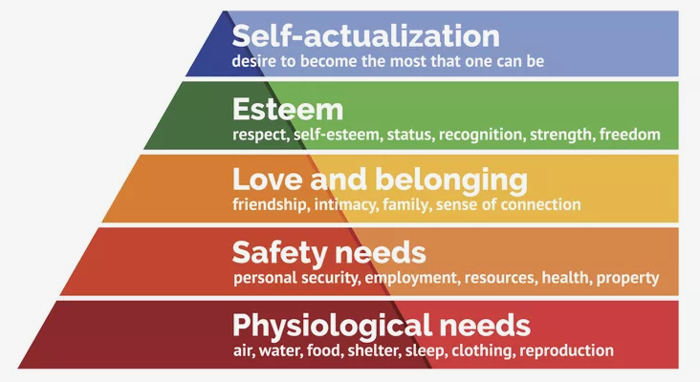
Maslow’s Hierarchy
“The role and importance of safety—physical, emotional, and psychological—cannot be overstated in understanding how human needs are, and sometimes are not, met.”
Bob Bowen (2021) The Matrix of Needs: Reframing Maslow’s Hierarchy. Health, 13, 538-563. https://www.scirp.org/journal/paperinformation.aspx?paperid=109226
Image: https://www.thoughtco.com/maslows-hierarchy-of-needs-4582571

Slide 21
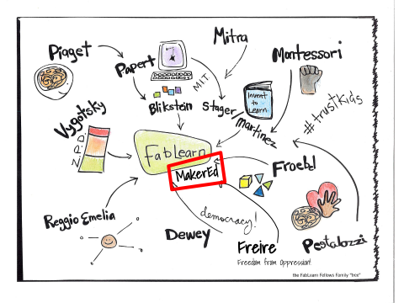
A Constructivist Model of Agency
Coherence
  “living organisms have a substantially harmonious anatomic and functional structure”
Autonomy
  “living organisms create and maintain an internal environment which follows dynamics of its own”
Brizio & Tirassa, 2016 https://www.ncbi.nlm.nih.gov/pmc/articles/PMC4745100/
Image: https://fablearn.stanford.edu/fellows/blog/constructionism-learning-theory-and-model-maker-education

Slide 22
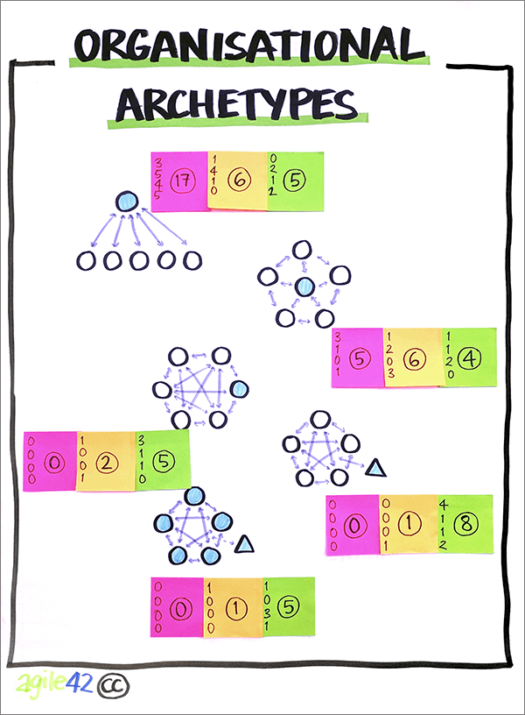
Maintaining Coherence and Autonomy
by creating and maintaining a permeable separation between their internal environment and the external milieu.
by exploiting the features of the environment that are relevant to the organism.
by exploiting the biological, behavioral, etc. features of other individuals
Brizio & Tirassa, 2016 https://www.ncbi.nlm.nih.gov/pmc/articles/PMC4745100/
Image: https://www.agile42.com/en/agile-teams/archetype-assessment/

Slide 23
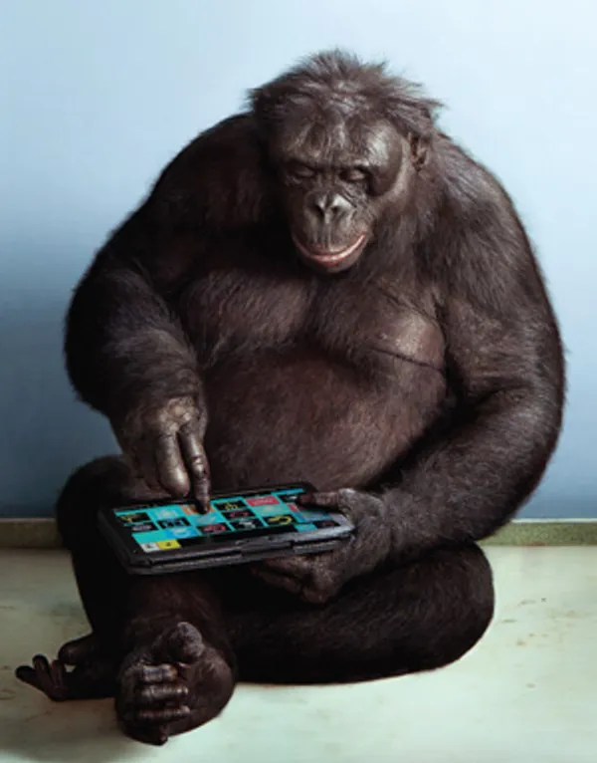
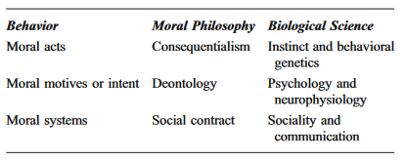
Morality as Social Evolution
Robin Dunbar
  The Social Brain Hypothesis and Its Implications for Social Evolution
  “Social living puts strong evolutionary selection pressures on acquiring social intelligence”
Ernst Fehr
  “Altruism can be accounted for when kin selection and inclusive fitness are taken into account”
https://en.wikipedia.org/wiki/Evolution_of_morality
Image: https://spectrum.ieee.org/apes-with-apps

Slide 24
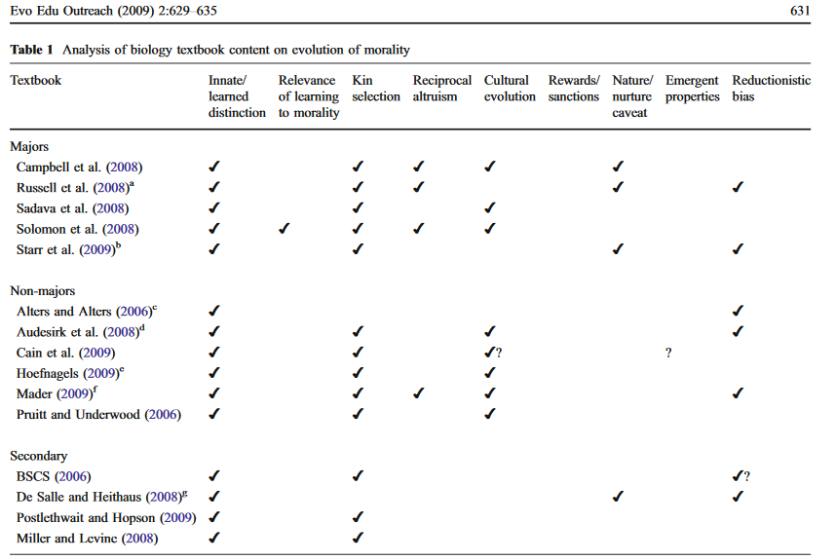
https://evolution-outreach.biomedcentral.com/track/pdf/10.1007/s12052-009-0173-9.pdf p. 631

Slide 25

Biologized Knowledge
Ben Williamson: two new research projects
  "a data-intensive, bioinformatics-driven approach to education remains in development" - basically, using a person's genome to identify their learning needs and potential.
  “a set of 'affect-aware’ technologies to gauge and respond to student emotional states that aims to make ‘emotional life machine-readable, and to control, engineer, reshape and modulate human behaviour”
Ben Williamson . 2021. New biological data and knowledge in education. https://codeactsineducation.wordpress.com/2021/09/08/new-biological-data-knowledge-education/

Slide 26
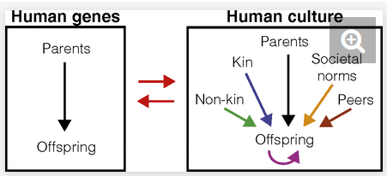
Agency as Evolution of Culture
Kim Sterenly: “human lifeways depend on cognitive capital that has typically been built over many generations. This process of gradual accumulation produces an adaptive fit between human agents and their environments; an adaptive fit that is the result of hidden-hand, evolutionary mechanisms.” p. 137
Kim Sterelny, 2006. The Evolution and Evolvability of Culture. Mind Language, 21(2), 137–165. doi:10.1111/j.0268-1064.2006.00309.x https://www.semanticscholar.org/paper/The-Evolution-and-Evolvability-of-Culture-Sterelny/4130942a5732b58a6872163fda7f42725ce96c5a
Nicole Creanza, Oren Kolodny, and Marcus W. Feldman, 2017. Cultural evolutionary theory: How culture evolves and why it matters . PNAS July 25, 2017. 114 (30) 7782-7789 https://doi.org/10.1073/pnas.1620732114

Slide 27
Selection-Like Processes
“Under what conditions are selection-like processes powerful, and how widely have those conditions characterised human cultural environments? To what extent is the flow of information between generations constrained, and by what? These issues have been canvassed in an increasingly impressive way by Peter Richerson, Robert Boyd and their co-workers.” Sterenly

Slide 28
Dual Inheritance Theory
“Dual inheritance theory models cultural evolution closely on genetic evolution, and cultural inheritance closely on biological inheritance. The central idea is that there are features of human psychology—most obviously imitation learning and language—and features of human social environments—most obviously long periods of juvenile dependence—that result in a high fidelity flow of ideas from parents to their offspring.”

Slide 29
Meme-based Theory
Dual inheritance theory shares with meme-based theories of cultural inheritance the idea that cultural transmission is both important and accurate. But on the dual inheritance picture it is the biological fitness of human agents that explains the spread or contraction of cultural variants: the fitness of those variants themselves plays no causal role in this picture.” Sterenly

Slide 30
The Evolution of Morality
“The ultra-reductionism and implicit promotion of competition that once dominated the field (for example, E.O. Wilson’s Sociobiology and On Human Nature, and Richard Dawkins’ The Selfish Gene) have, along with the rhetoric of the Cold War, yielded to more balanced perspectives and more nuanced interpretations.”
“Reductionistic bias varies, but the texts basically omit
the concept of emergent properties or new levels of
organization at the psychological and social levels
(Holland 1998; Camazine et al. 2001; Richerson and
Boyd 2005; Murphy and Brown 2007). They do not
describe how social rewards or sanctions can regulate
“selfish” behavior or individual “cheating”—for exam-
ple, as observed in food sharing among vampire bats
(Wilkinson 1984, 1990).”
Douglas Allchin, 2009 Teaching the Evolution of Morality: Status and Resources. BioMed Central
https://evolution-outreach.biomedcentral.com/track/pdf/10.1007/s12052-009-0173-9.pdf

Slide 31
Supporting Agency
Based on ‘What Peace Means to Me’
https://www.downes.ca/post/68088

Slide 32
Security
The first think they take away from you is your sense of security. This doesn't mean they are attacking you directly - more often they don't - but they want you to feel like you're in danger of being attacked at any moment.
We've seen this through history in many guises and under many names. The direct threat of violence is the most brutal and the least effective. The threat of violence against your property, your business, or those you love, is more common. The threat that some other will inflict this violence is the most subtle. But the outcome is always the same: you do not feel secure, and hence feel compelled to comply.
We are told that the only response is to arm ourselves, to be prepared to be violent ourselves, and to participate in the common defense. I don't think these are especially effective, especially if the defense force becomes as dangerous as the threat. They are not effective because they don't address the feeling of danger. If we carry weapons, our own weapons become a constant reminder that we are in danger.
The only response, I think, is to remove the effectiveness of violence. Each time we comply with the demands of an aggressor, we make violence more effective. So we have to make it easier to refuse to comply. We have to make it possible, and safe, to report the threat. The solidarity of, and trust in, a community is the only effective response. The community must exist to protect the people. If one person is threatened, they should be able to stand behind the other members of the community.
In Canada, we have campaigns that encourage people - especially children - to seek help, and if necessary, speak out. They need to be able to report abuse or bullying and be protected. The same protections need to apply to women and to people who are vulnerable. We all need to be able to communicate our need to various social agencies - police, fire, health services, legal aid, education, housing authorities, workplace rights and safety, welfare agencies - with the expectation of support, and with no fear of penalty.
And this means we need to ensure every person is aware of these services, and is able to communicate with them, and understands that they are trustworthy. The first thing the authoritarians and the violent seek to do us undermine trust in these basic community services. People who are undermining any of these - police, health care, education, etc. - are undermining peace.

Slide 33
Identity
Identity is the right to define, and to be, who you are. War reduces each and every one of us to one thing: a tool of one side or another fighting the war. We are no longer seen as individuals, we are seen as instruments, as weapons.
The depravity of this becomes evident as we look at it more closely. If you read A Long Way Gone, or watch Blood Diamond, you see how war creates child soldiers. No army is innocent. In war, entire societies are mobilized. People become kamikazes, or suicide bombers, or make heroic sacrifices. You're either supporting the war effort, or you're a traitor. You are asked to do the unthinkable, and then to do it again.
More generally, conformity becomes the order of the day. People are expected to dress in certain ways, to speak in certain ways, or in certain languages, to believe the same things, support the same religions. Obedience is demanded, and expected.
If a people is at peace, there is no need for order and conformity, and no sense that diversity and distinctness of identity poses a threat or a danger to society as a whole. And from the perspective of the individual, there is no peace unless there is freedom to establish and live one's own identity. Importantly, though, identity isn't just the right to say yes to some things, it's the right to say no to others.
In Canada, we have a good though not perfect right to express our own identity. We can for the most part dress as we please, speak in what language we prefer, follow any religion, or none, to work for or against the stated policies of the state, to support the government or opposition. We have a professional civil service, which means that any member of society, whatever their identity, may be a teacher, police officer, or legislator, and that any member of society, no matter what their identity, will be treated fairly by the civil service.
But we've also learned though our failures that we need to attend to the needs of the most vulnerable. We have historically discriminated against indigenous peoples, and must engage in a process of reconciliation. We need to do more to assist those who are vulnerable through lack of ability, or wealth, or of education. And we need to extend the ways we recognize the right to a different identity, to fully protect those of various sexual orientation, and of various religions.
The people who seek to deny us our individual identities - who tell us what to wear, what to believe, what language to speak - are people who are endangering the peace. War requires conformity, and war requires an enemy. It requires uniforms and scapegoats. We have to teach people to respect, honour and value the individuality of each person as a good in itself and as a good that ensures that each of us has the right to our own identity.

Slide 34
Identity
Identity
Sally Haslanger: Autonomy, Identity, and Social Justice (pdf, 3718 words)
The Lies that Bind is a moving and humbling book.

Slide 35
Voice
Voice is in part the expression of identity but voice is also the way we create community, develop ideas, and create future visions and possibilities. It is the possibility to create, and also to speculate, and also to celebrate.
In a war there is no voice; indeed, "loose lips sink ships." In war, the right to community and association is subservient, as is everything else, to the needs of the struggle and the power of the generals. In war, the only voice is the official voice.
Voice is the right to a say. Voice means not only the capacity of expression, but the expectation that this expression will have an impact that can be - and is - measured and weighed. It is not merely the right to be consulted, but also the right to constitute a part of the governance (and especially self-governance).
We think of democracy as an instance of voice. Each person gets a vote, and so each person is a part of the constitution of a government. But democracy can be a sham if only some parties are allowed to run, or if only some platforms are acceptable. There needs to be an open debate of ideas, and the possibility that people, through communication or association, can organize themselves. It's not simply about whether they have a vote (in fact, that's the least important part). It's about whether they have a voice.
The violence and the authoritarian create a climate not only of violence and fear, but also of silence. The possibility of a voice is an affront. 'Outsider' organizations are not permitted - in some cases they suppress labour unions, in other cases they suppress religions. Secret cabals, however, and conspiracies proliferate, and battle against each other. Militias and paramilitaries form, ostensibly to support the state, but in actuality to perpetuate the war.
To have voice, people must learn to have voice. They must learn to self-organize, to make decisions and resolve disputes in an open and peaceful manner, to create forums and newspapers and assemblies, to have community groups and societies and special interest groups. In Canada we see a thick network of different types of groups, but underlying that is a system of education that teaches us how to operate in this way.
The people who undermine voice - who say that some people shouldn't have a say, who seek to permit only some but not other organizations, who argue against due process, the right to be heard or have a hearing - these people are undermining peace.

Slide 36
Opportunity
We each of us what to achieve something in life. This desire may be very simple - Homer Simpson is happy if he can watch bowling on TV while eating pork rinds - while for others it may be very aspirational - help the poor, cure the sick, settle on Mars. Some of us want to earn money, some of us want to travel, some of us want to achieve inner peace. It all matters.
By opportunity what we mean is that there is a path - or the potential of a path - to get from where you are to what you aspire to achieve. It means that opportunity is not something possessed only by the rich or powerful (or the properly coloured, or the right religion, or caste, etc.) but for everyone in society. Those who do noty have opportunity are not ay peace; those who deny opportunity are waging war against them.
Opportunity is not a guarantee (and nobody pretends it is a guarantee). What we want to achieve may require an effort we cannot spend, an ability we do not have, time we cannot commit, strength we do not possess. What opportunity means is that we as a society do not impose any barriers between ourselves and our ambitions.
War takes away opportunity. Personal ambition becomes secondary to the needs of the conflict. What one will do or achieve in life is to a large degree decided. Often, in war, there are privileges awarded to some segment of society and denied to another, as a means of creating order through the creation of a ruling class. War, often, takes away opportunity through the destruction of any means to an opportunity - schools, houses, businesses, and roads are closed or destroyed.
In a society at war, in an authoritarian society, your ambitions are meaningless. It wasn't simply his business struggles that promoted Mohamed Bouazizi to set himself on fire in Tunisia to launch the Arab Spring; it was the indifference to the authoritarian state to his life and his aspirations.
Opportunity - especially for those in marginalized or vulnerable groups - requires support. It requires the protections of the state, as described above, and it requires the possibility to govern oneself and to be seen and heard by others. But it requires more, as well: it requires a commercial infrastructure that is robust and trustworthy, it requires the right to freely transport and exchange goods, and it requires the training and support to help a person plan, implement and achieve their objectives.
In a society at war, currency is scarce or valueless, bribery and corruption are common, and the means to conduct trade and commerce are allocated on a preferential basis to friends and family. A person denied opportunity is by that fact denied peace, and those who undermine opportunity undermine peace.

Slide 37
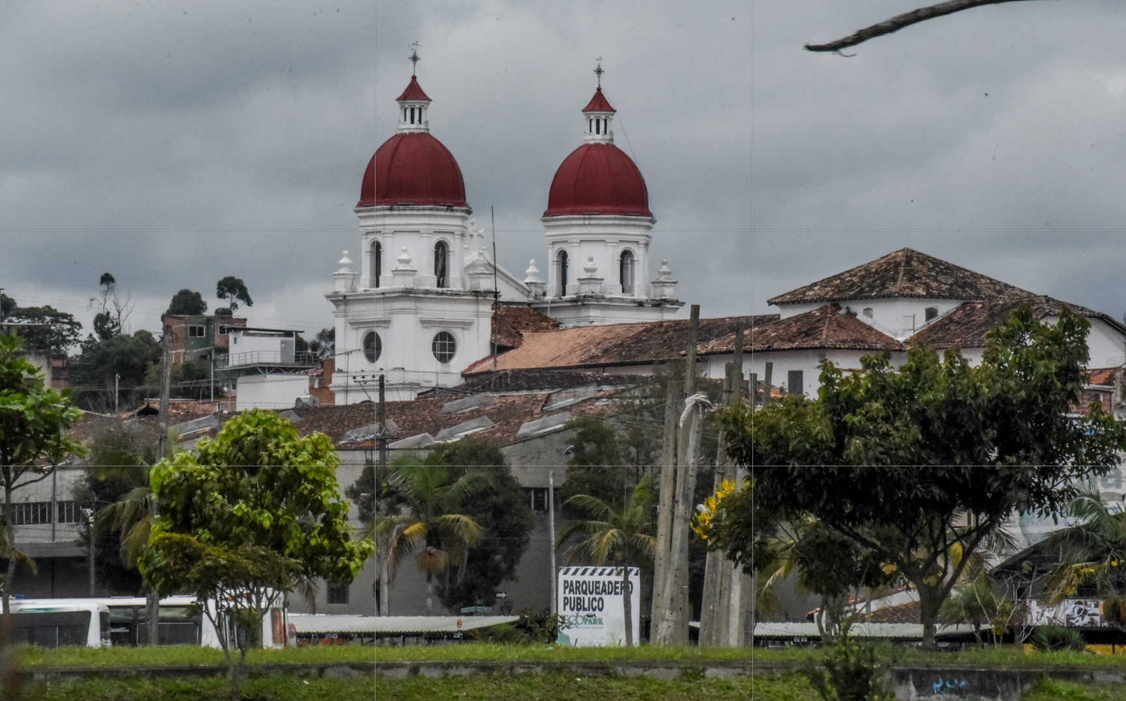
5. Four Steps to Peace - José Restrepo
http://www.bath.ac.uk/management/news_events/news/2017/23-10-jose-restrepo-explains-how-he-is-spreading-peace-in-colombia.html

Slide 38
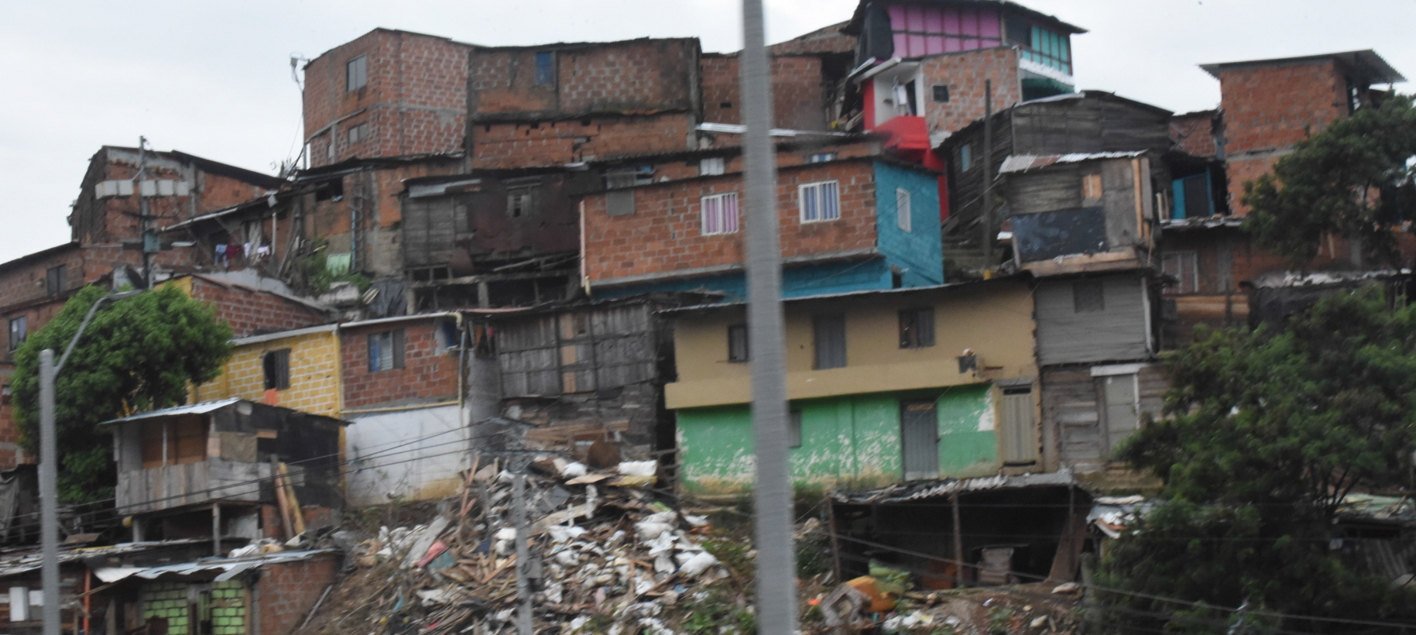
Redistribution - Scholarships for students from low income families and areas of conflict. Increase capacities in communications, information technologies, learning
http://aprende.colombiaaprende.edu.co/pilopaga

Slide 39
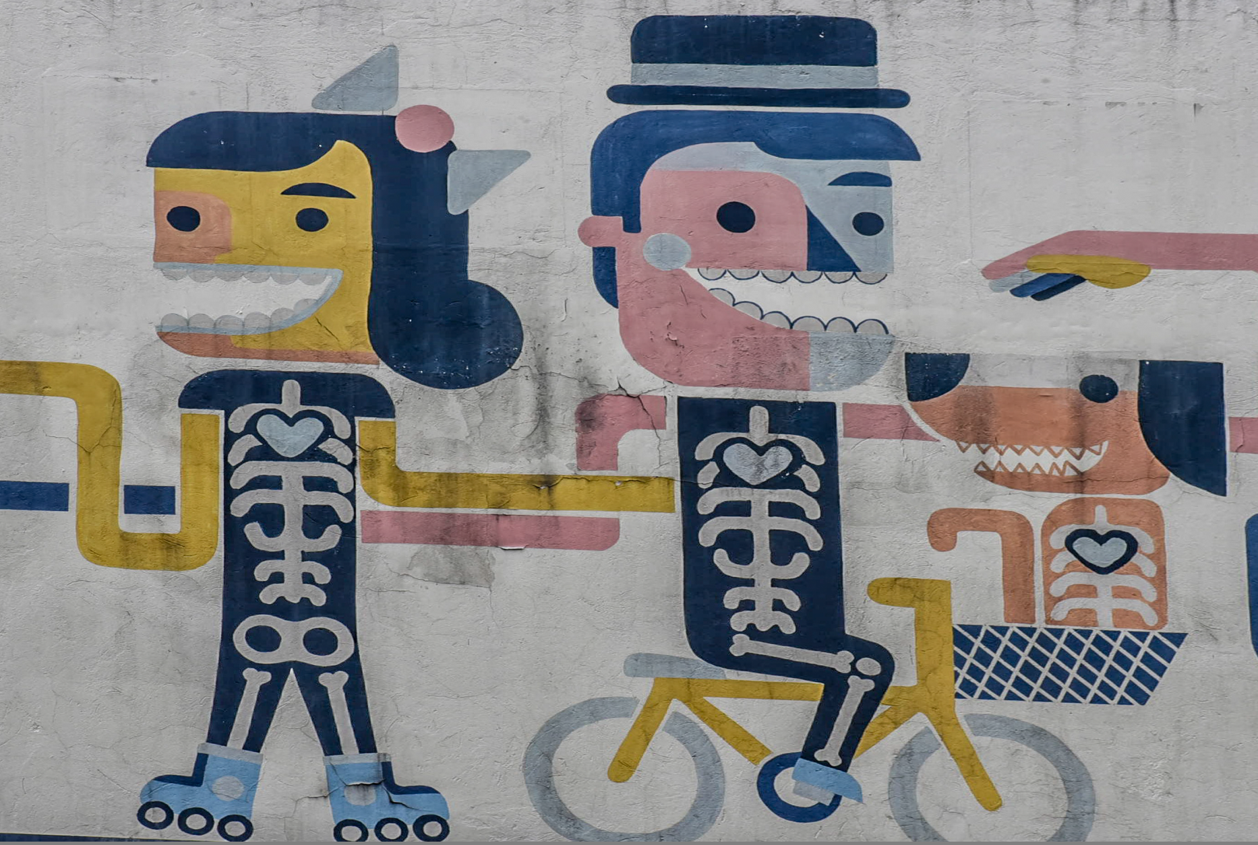
Recognition - gender equality and diversity while also promoting remembrance, truth and reconciliation. A focus on training of indigenous communities and ex-combatants.

Slide 40

Representation - working together to promote interdisciplinary research to develop capacity to rebuild society, sharing curricula on human rights and writing textbooks to teach new generations.

Slide 41
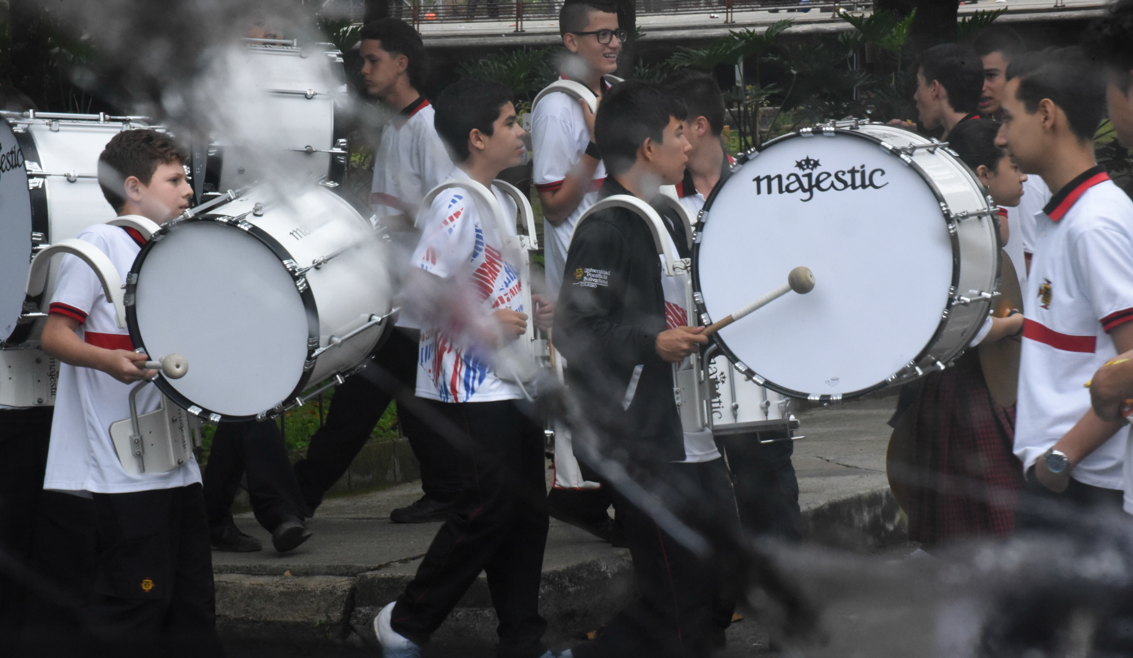
Reconciliation - promoting peaceful conflict resolution and offering alternative paths to success, self-expression, and community support

Slide 42
Shared Agency
Shared Agency
Abraham Sesshu Roth, Stanford Encyclopedia of Philosophy, May 03, 2017
Commentary by Stephen Downes
This excellent revision of the Stanford Encyclopedia of Philosophy's (SEP) article on shared agency is a must-read for anyone working on theories of applications of collaboration in learning. "Shared activity is distinguished from a mere aggregation of individual acts by a structure of appropriately related participatory intentions across different individuals. It is a structure that has a distinctive normative significance for those individuals, with an impact most immediately on each individual’s intention-based practical reasoning." The article discusses different accounts of shared action, mechanisms for structuring interrelated intentions, mutual obligations, and the group-mind hypothesis. See also: collective intentionality. Image: Idle no More, APTN News.
[Direct link]

Slide 43
Ethics as a Way of Life
In speaking here of a “way of life [Lebensform]” Mollenhauer does not mean one’s personal, ethical values and commitments as much as he does a way or form of life sensu Wittgenstein, who famously asserted that “to imagine a language means to imagine a form of life.”6 In these terms—in terms of the implicit patterns and values we embody, articulate and act out every day—engaging in education in the broadest sense is all but unavoidable. As parents and educators, even simply as adults in public life, we embody and exemplify a way of living to children and young people, we perform a tacit affirmation of certain values, arrangements and relationships. “Even the most radical” critic of education and society, Mollenhauer argues, “cannot avoid embodying an adult way of life in front of children; like any adult, he or she powerfully exemplifies one way of life or another for a child.”7 We cannot not affirm for others a way of life much as we “cannot not communicate.”8
-- From Norm Friesen - https://www.researchgate.net/publication/320290102_Towards_a_Pedagogical_Hermeneutics_A_Response_to_the_Manifesto_for_a_Post-Critical_Pedagogy p. 2

