Slide 1

Culture
Stephen Downes
December 24, 2021

Slide 2
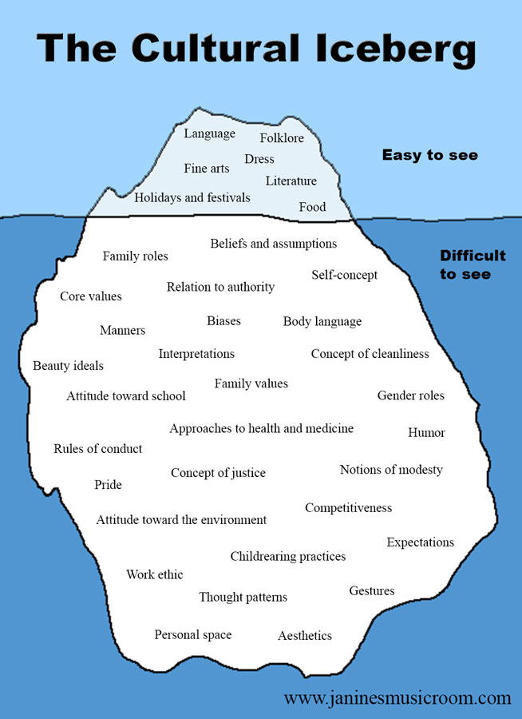
Culture
“the characteristics and knowledge of a particular group of people, encompassing language, religion, cuisine, social habits, music and arts”
“shared patterns of behaviors and interactions, cognitive constructs and understanding that are learned by socialization”
“a way of life of a group of people--the behaviors, beliefs, values, and symbols that they accept, generally without thinking about them”
https://www.livescience.com/21478-what-is-culture-definition-of-culture.html
https://carla.umn.edu/culture/definitions.html
http://people.tamu.edu/~i-choudhury/culture.html
https://www.janinesmusicroom.com/the-rest-of-the-iceberg.html

Slide 3
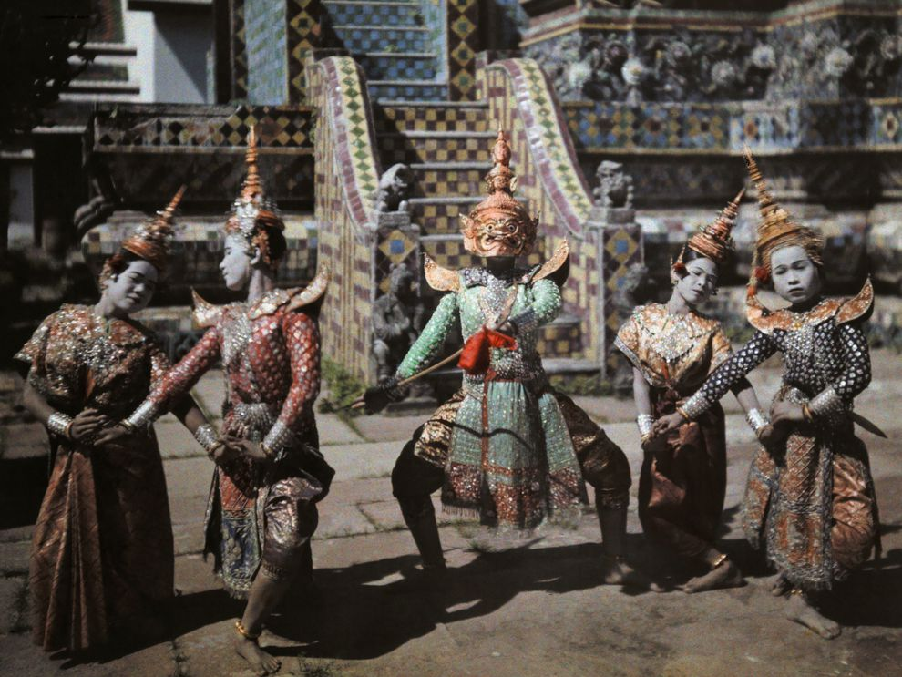
Aspects of Culture
Distinctions may be drawn between:
  the material, social and subjective aspects of culture, that is, between the material artefacts that are commonly used by the members of a cultural group (e.g. the tools, foods, clothing, etc.)
  the social institutions of the group (e.g. the language, the communicative conventions, folklore, religion, etc.)
  the beliefs, values, discourses and practices that group members commonly use as a frame of reference for thinking about and relating to the world
https://www.oecd.org/education/Global-competency-for-an-inclusive-world.pdf (Barrett et al., 2014; Council of Europe, 2016a). Image: https://www.nationalgeographic.org/media/cultural-richness/ Title Image: https://www.3blmedia.com/news/campaign/nortonlifelock-talent-culture-diversity-equity-and-inclusion

Slide 4

Culture of This, Culture of That
Culture of innovation’
  Eg. “More concrete signs that your organisation isn’t nurturing a culture of innovation. [...] include teams working in siloes, and decisions not being driven by data” blah blah blah
Culture of hospitality
  Pierre Levy - An Ethics of Collective Intelligence (a society of the just)
https://www.jisc.ac.uk/news/moving-past-the-tyranny-of-innovation-26-feb-2020
https://pierrelevyblog.com/2020/04/11/an-ethics-of-collective-intelligence/

Slide 5
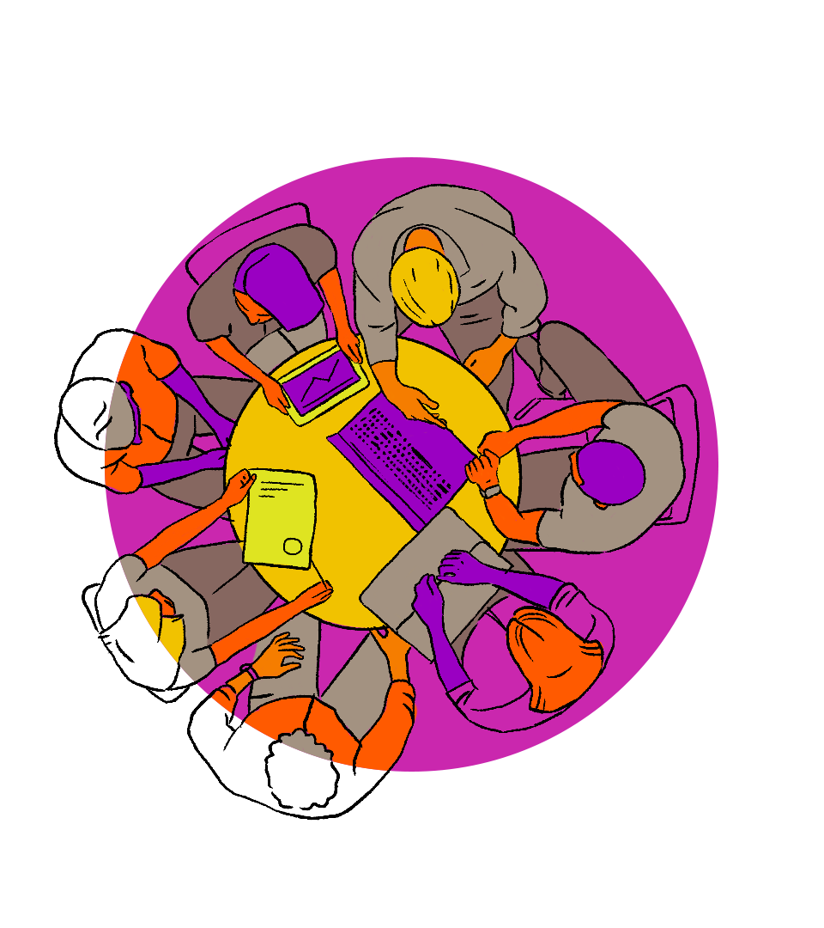
UNESCO: Culture of Global Citizenship
Cognitive:
  To acquire knowledge, understanding and critical thinking about global, regional, national and local issues and the interconnectedness an interdependency of different countries and populations.
Socio-emotional:
  To have a sense of belonging to a common humanity, sharing values and responsibilities, empathy, solidarity and respect for differences and diversity.
Behavioural:
  To act effectively and responsibly at local, national and global levels for a more peaceful and sustainable world.
UNESCO, 2015b, p. 15. Also: https://aspnet.unesco.org/en-us/Pages/Global-Citizenship-Education.aspx and http://gaml.uis.unesco.org/indicator-4-7-4/
Image: https://www.creativityculturecapital.org/blog/2021/09/13/global-citizenship-education-powered-by-art/

Slide 6
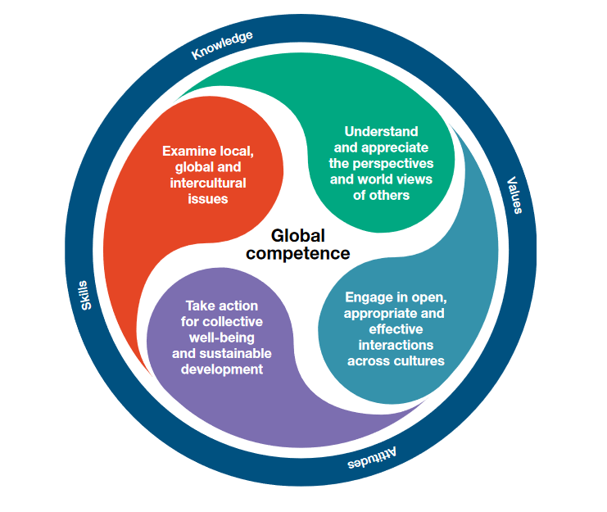
OECD: Dimensions of Global Competence
Global competence is the capacity to examine local, global and intercultural issues, to understand and appreciate the perspectives and world views of others, to engage in open, appropriate and effective interactions with people from different cultures, and to act for collective well-being and sustainable development. (PISA, 2018)
https://www.oecd.org/education/Global-competency-for-an-inclusive-world.pdf

Slide 7
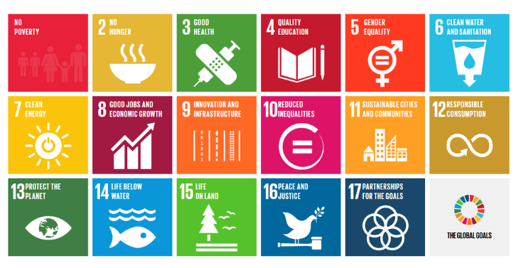
Toward a Global Common Good
See also UNESCO (2015a). Rethinking education: Towards a global common good? Paris: UNESCO.
UNESCO (2015b). Global citizenship education. Topics and learning objectives. Paris: UNESCO.
UNESCO (2016). Schools in action. Global citizens for sustainable development. A guide for teachers. Paris: UNESCO. UNESCO (2018). Long walk of peace. Towards a culture of prevention. Paris: UNESCO. Available at http://unesdoc.unesco.org/images/0026/002628/262885e.pdf

Slide 8

Teaching Culture
There is a difference between:
  Teaching people what that culture is (or should be) currently by teaching them about existing and valued artifacts, behaviours and attitudes, and
  Teaching people how to value and respect the differences between cultures, and
  Teaching people how to contribute to a culture through the creation and fostering of artifacts, behaviours and attitudes, and

Slide 9
A Learning Culture
“Culture is a socially constructed phenomenon – it exists in a relational space (how we interact with one another) and is formed in the values we espouse, the beliefs we carry, the actions we take, and the stories we tell.”
Two ways of thinking about culture:
  the traditional Edgar Schein-like definition that speaks of culture as “a pattern of shared basic assumptions”
  The culture that is found in a petri dish where ‘culture’ is understood as the growth produced in that environment.
Vs. David Berke who says “I would like to believe “we can grow the kind of learning cultures we need to thrive,” but I don’t think that’s how business works.”
Catherine Lombardozzi https://learningsolutionsmag.com/articles/cultivate-a-learning-culture-for-better-business-performance See also https://l4lp.com/cultivating-a-learning-culture/

Slide 10
A New Culture of Learning
“When play happens within a medium for learning—much like a culture in a petri dish—it creates a context in which information, ideas, and passions grow.
“The new culture of learning actually comprises two elements:
  The first is a massive information network that provides almost unlimited access and resources to learn about anything.
  The second is a bounded and structured environment that allows for unlimited agency to build and experiment with things within those boundaries.”
Douglas Thomas and John Seely Brown http://www.newcultureoflearning.com/newcultureoflearning.pdf

Slide 11
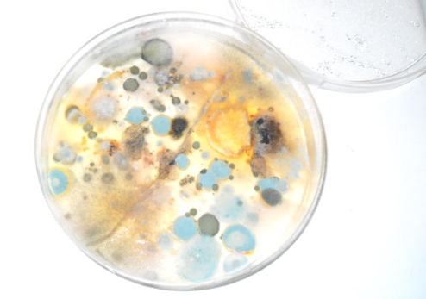
What Are Cultures of Learning?
What these authors are describing is the Petri dish, not the culture.
What are cultures of learning? What we do, what we model, what we share, what we create…
https://www.downes.ca/post/52664 https://www.downes.ca/presentation/326

Slide 12
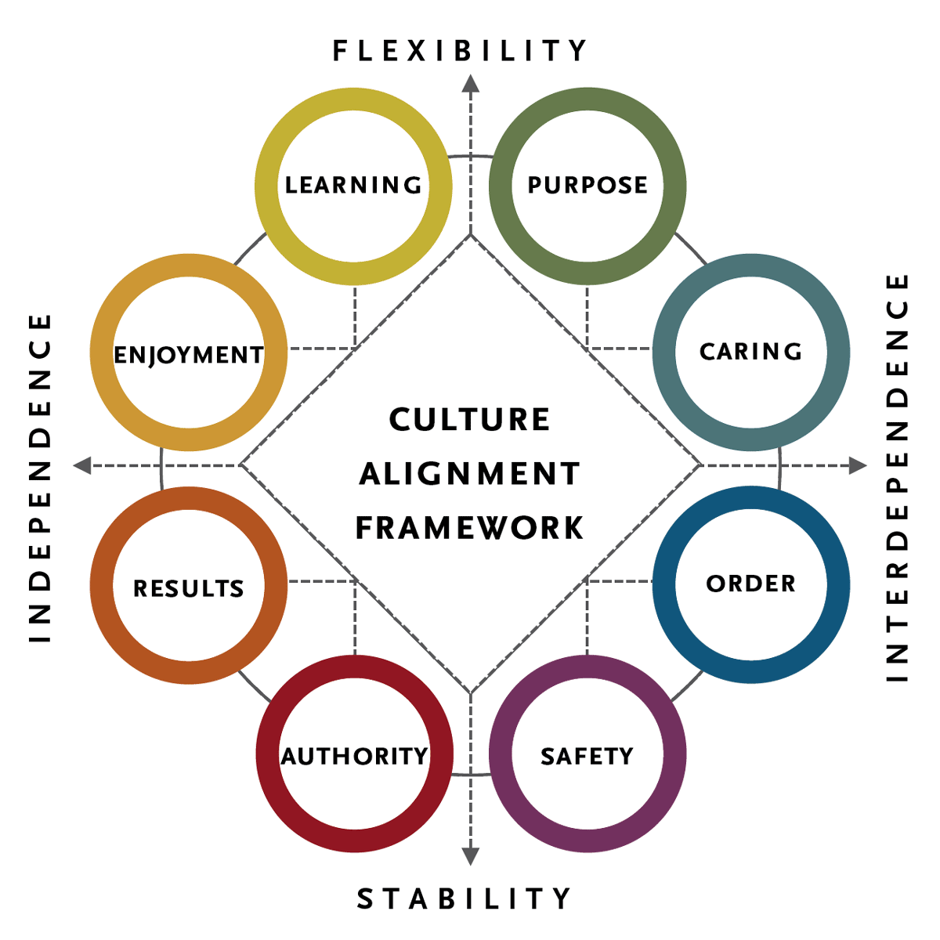
Organizational Culture
“An organization's culture is based on values derived from basic assumptions about the following:
  Human nature. Are people inherently good or bad, mutable or immutable, proactive or reactive?
  The organization's relationship to its environment. How does the organization define its business and its constituencies?
  Appropriate emotions. Which emotions should people be encouraged to express, and which ones should be suppressed?
  Effectiveness. What metrics show whether the organization and its individual components are doing well?”
https://www.shrm.org/resourcesandtools/tools-and-samples/toolkits/pages/understandinganddevelopingorganizationalculture.aspx
https://www.spencerstuart.com/what-we-do/our-capabilities/leadership-consulting/organizational-culture

Slide 13
Organizational Culture and Ethics
OECD: Organizational culture drives ethics; “Culture is a complex and multi-system framework that must be aligned to encourage ethical behavior” (Trevino & Nelson, 2018)
  formal elements “include the official communications of executives, the internal policies and codes of conduct, training programs, employee selection systems (hiring, firing) as well as systems for managing performance and goal-setting.”
  informal elements “include norms of daily behavior, rituals that help members understand the organization’s identity and its values, the myths and stories people tell about the organization, and the language people use in daily behavior.”
https://www.oecd.org/corruption/integrity-forum/academic-papers/Filabi.pdf

Slide 14
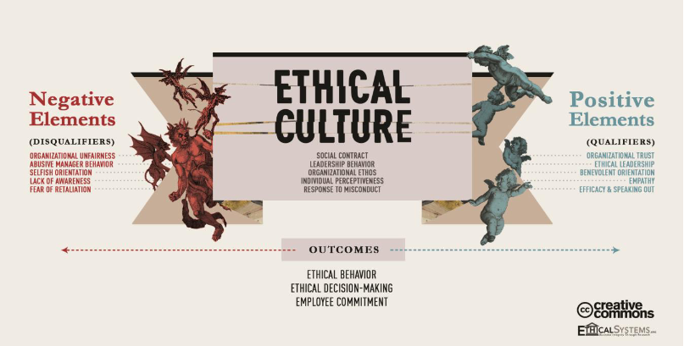

Slide 15
A Culture of Data Governance
“A strong data culture typically encompasses the following components:
  Access to quality and trustworthy data
  High levels of data literacy
  Consistent and constructive cross-functional collaboration around Data Intelligence
  Clearly defined and embraced data roles and responsibilities, such as data owner and data consumer
  Adoption of technology that facilitates data use and analysis
  Data citizens who feel empowered to make critical decisions based on data”
https://www.collibra.com/us/en/blog/building-a-data-culture

