Slide 1
Practices and Culture
Stephen Downes
December 23, 2021

Slide 2
Culture and Ethics

Slide 3

Design
Architectures of Control
Dark Patterns
  “a user interface that has been carefully crafted to trick users into doing things, such as buying overpriced insurance with their purchase or signing up for recurring bills.”
Design Justice
  “an approach to design that is led by marginalized communities and that aims explicitly to challenge, rather than reproduce, structural inequalities.”
Dan Lockton - http://www.danlockton.co.uk/research/Architectures_of_Control_v1_01.pdf https://architectures.danlockton.co.uk/2005/11/16/welcome/
Harry Brignull - https://www.darkpatterns.org/
Sasha Costanza-Chock https://mitpress.mit.edu/books/design-justice

Slide 4
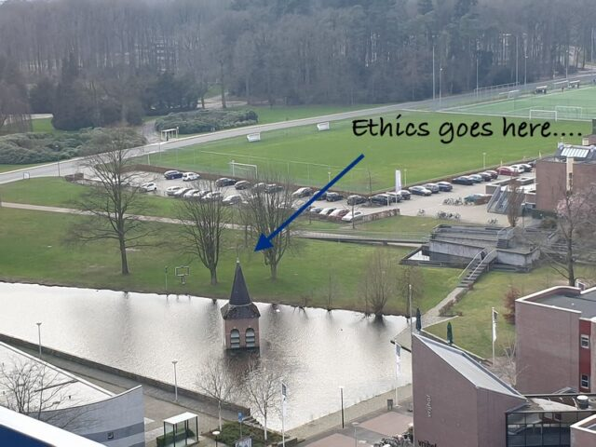
Beyond Design
Ton Zylstra: two things that I have a certain dislike for,:
  “The first concerns treating the philosophy of technology, information and data ethics in general as a purely philosophical and scientific debate. It… then has no immediate bearing on the things organisations… do in practice”
  “The second concerns seeing ‘Ethics by design’ as a sufficient fix.”
Ton Zylstra, Ethics as a practice #GlobalEthicsDay2020 : Ethics as a Practice (EaaP) (all quoted) https://www.zylstra.org/blog/2020/10/globalethicsday2020-ethics-as-a-practice-eaap/

Slide 5
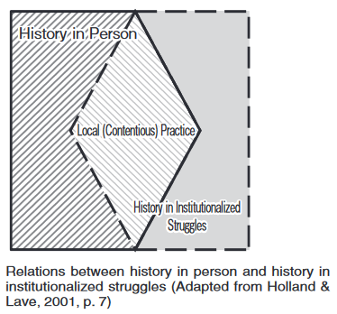
Social Practice Theory
Social practice theory (quoted Holland & Lave, 2009)
  E.g. environmentalists, wine merchants in Porto
  attends to the integration of emotion, motivation and agency into cultural-historical activity theory
  incorporates careful attention to tension, conflict and difference in participation in cultural activities
  calls for the close study of the relations of cultural activities to both local and trans-local institutional arrangements and practice
Holland and Lave: https://kansai-u.repo.nii.ac.jp/?action=repository_action_common_download&item_id=783&item_no=1&attribute_id=19&file_no=1 Via https://wiobyrne.com/building-ethical-communities/

Slide 6
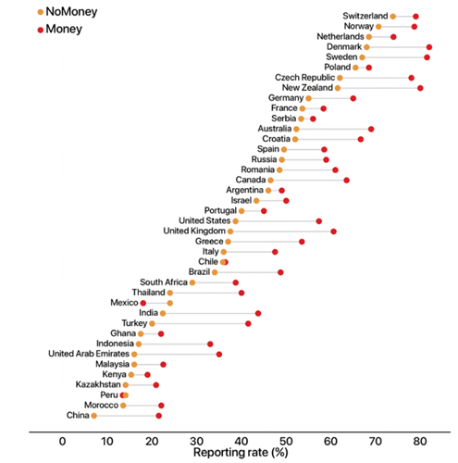
Culture and Ethics?
Max Weber
  In capitalism, all that matters is the increased acquisition of wealth. “God helps those who help themselves.” (p. 115)
  “Emancipation from economic traditionalism” (p.36) requires “definite and highly developed ethical qualities”, e.g. “scrupulous honesty” (p. 69)
  This allows specialization, which leads to skills, and an increase in quality (p. 161)
Avadon: dual morality thesis
  So morality is a pre-condition of capitalism…?
Max Weber, 1904: https://archive.org/details/protestantethics00webe
Avadon: https://www.classicalethics.com/

Slide 7
Culture

Slide 8
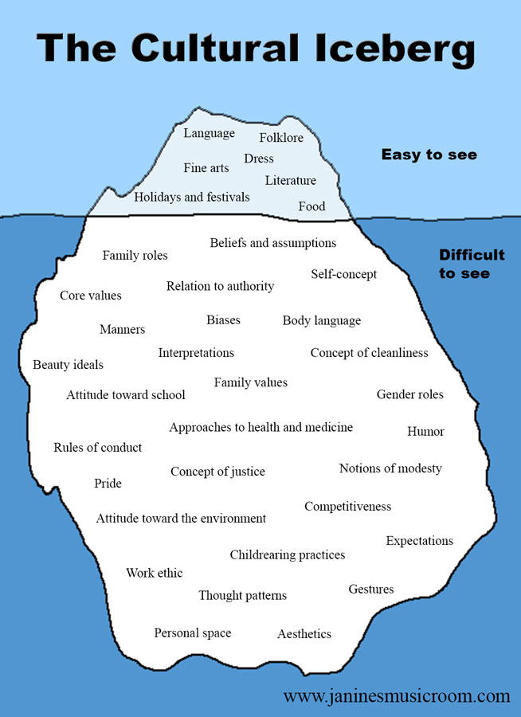
Culture
“the characteristics and knowledge of a particular group of people, encompassing language, religion, cuisine, social habits, music and arts”
“shared patterns of behaviors and interactions, cognitive constructs and understanding that are learned by socialization”
“a way of life of a group of people--the behaviors, beliefs, values, and symbols that they accept, generally without thinking about them”
https://www.livescience.com/21478-what-is-culture-definition-of-culture.html
https://carla.umn.edu/culture/definitions.html
http://people.tamu.edu/~i-choudhury/culture.html
https://www.janinesmusicroom.com/the-rest-of-the-iceberg.html

Slide 9
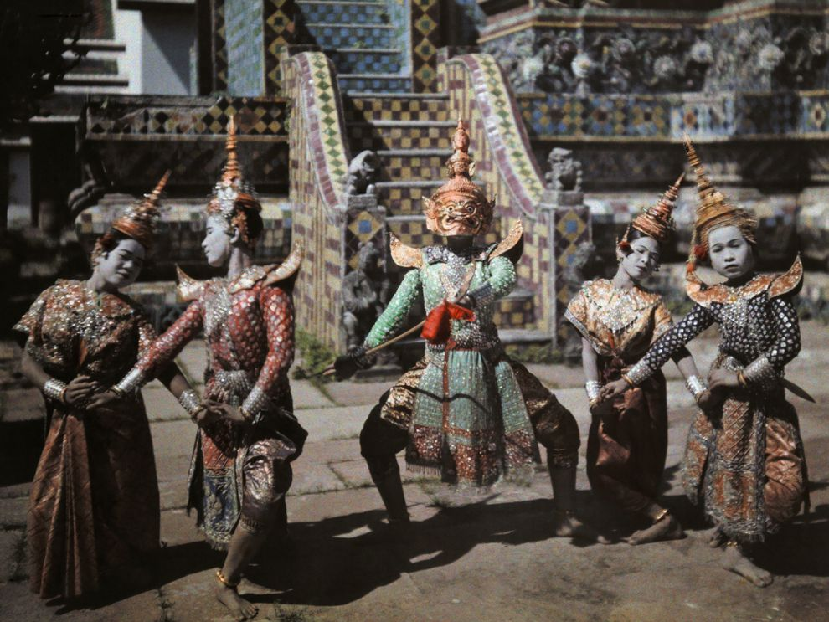
Aspects of Culture
Distinctions may be drawn between:
  the material, social and subjective aspects of culture, that is, between the material artefacts that are commonly used by the members of a cultural group (e.g. the tools, foods, clothing, etc.)
  the social institutions of the group (e.g. the language, the communicative conventions, folklore, religion, etc.)
  the beliefs, values, discourses and practices that group members commonly use as a frame of reference for thinking about and relating to the world
https://www.oecd.org/education/Global-competency-for-an-inclusive-world.pdf (Barrett et al., 2014; Council of Europe, 2016a).
https://www.nationalgeographic.org/media/cultural-richness/

Slide 10

Culture of This, Culture of That
Culture of innovation’
  Eg. “More concrete signs that your organisation isn’t nurturing a culture of innovation. [...] include teams working in siloes, and decisions not being driven by data” blah blah blah
Culture of hospitality
  Pierre Levy - An Ethics of Collective Intelligence (a society of the just)
https://www.jisc.ac.uk/news/moving-past-the-tyranny-of-innovation-26-feb-2020
https://pierrelevyblog.com/2020/04/11/an-ethics-of-collective-intelligence/

Slide 11
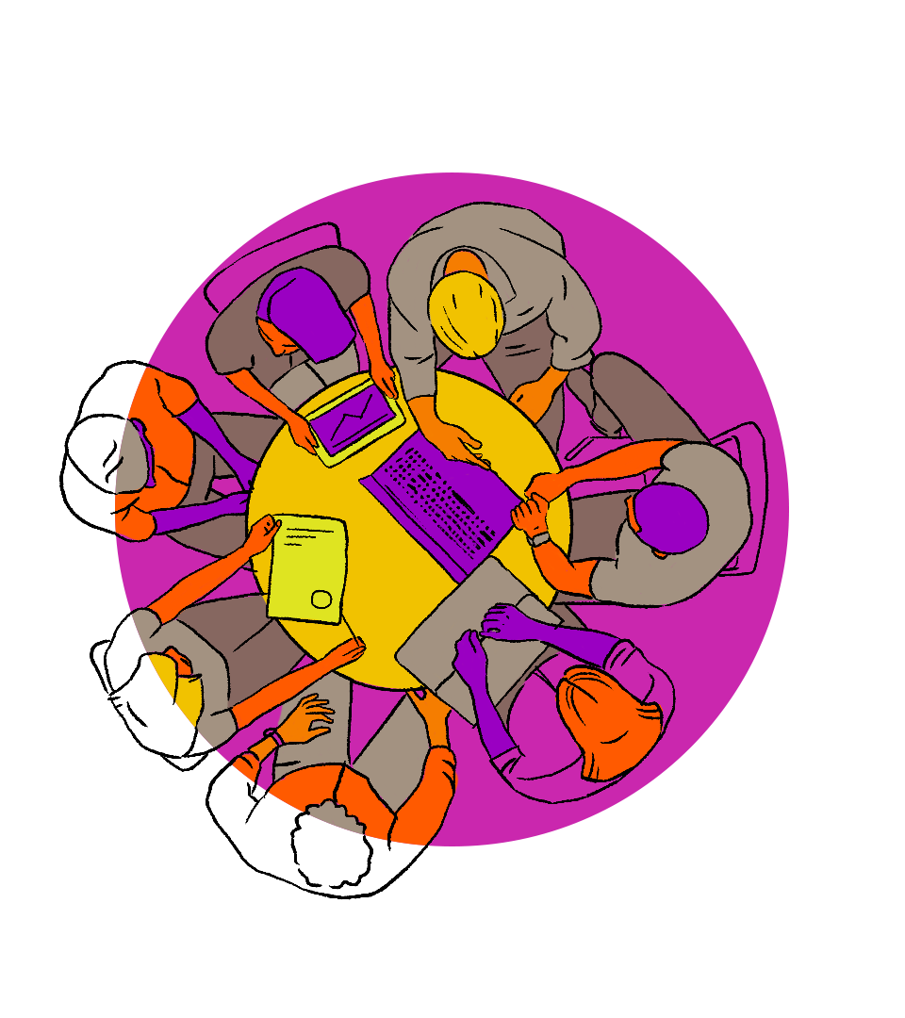
UNESCO: Culture of Global Citizenship
Cognitive:
  To acquire knowledge, understanding and critical thinking about global, regional, national and local issues and the interconnectedness an interdependency of different countries and populations.
Socio-emotional:
  To have a sense of belonging to a common humanity, sharing values and responsibilities, empathy, solidarity and respect for differences and diversity.
Behavioural:
  To act effectively and responsibly at local, national and global levels for a more peaceful and sustainable world.
UNESCO, 2015b, p. 15. Also: https://aspnet.unesco.org/en-us/Pages/Global-Citizenship-Education.aspx and http://gaml.uis.unesco.org/indicator-4-7-4/
Image: https://www.creativityculturecapital.org/blog/2021/09/13/global-citizenship-education-powered-by-art/

Slide 12
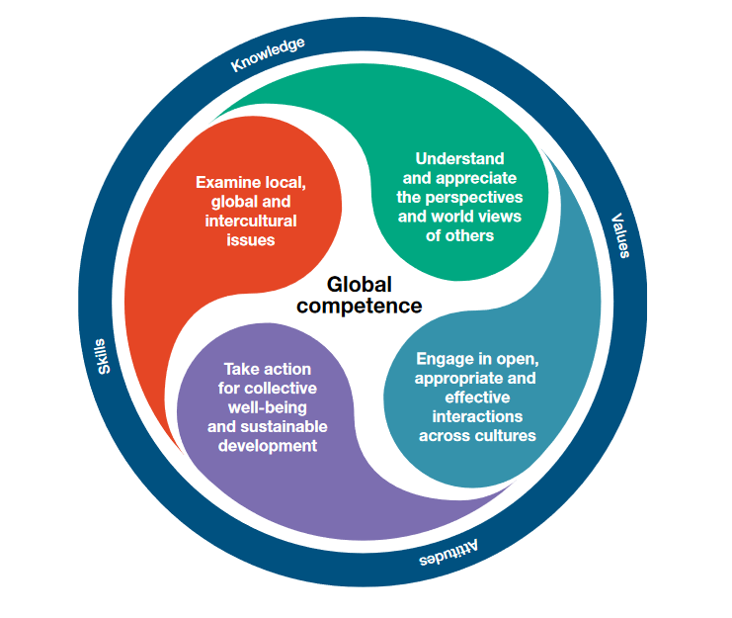
OECD: Dimensions of Global Competence
Global competence is the capacity to examine local, global and intercultural issues, to understand and appreciate the perspectives and world views of others, to engage in open, appropriate and effective interactions with people from different cultures, and to act for collective well-being and sustainable development. (PISA, 2018)
https://www.oecd.org/education/Global-competency-for-an-inclusive-world.pdf

Slide 13
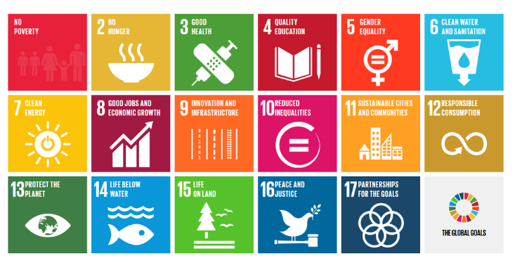
Toward a Global Common Good
See also UNESCO (2015a). Rethinking education: Towards a global common good? Paris: UNESCO.
UNESCO (2015b). Global citizenship education. Topics and learning objectives. Paris: UNESCO.
UNESCO (2016). Schools in action. Global citizens for sustainable development. A guide for teachers. Paris: UNESCO. UNESCO (2018). Long walk of peace. Towards a culture of prevention. Paris: UNESCO. Available at http://unesdoc.unesco.org/images/0026/002628/262885e.pdf

Slide 14

Teaching Culture
There is a difference between:
  Teaching people what that culture is (or should be) currently by teaching them about existing and valued artifacts, behaviours and attitudes, and
  Teaching people how to value and respect the differences between cultures, and
  Teaching people how to contribute to a culture through the creation and fostering of artifacts, behaviours and attitudes, and

Slide 15
A Learning Culture
“Culture is a socially constructed phenomenon – it exists in a relational space (how we interact with one another) and is formed in the values we espouse, the beliefs we carry, the actions we take, and the stories we tell.”
Two ways of thinking about culture:
  the traditional Edgar Schein-like definition that speaks of culture as “a pattern of shared basic assumptions”
  The culture that is found in a petri dish where ‘culture’ is understood as the growth produced in that environment.
Vs. David Berke who says “I would like to believe “we can grow the kind of learning cultures we need to thrive,” but I don’t think that’s how business works.”
Catherine Lombardozzi https://learningsolutionsmag.com/articles/cultivate-a-learning-culture-for-better-business-performance See also https://l4lp.com/cultivating-a-learning-culture/

Slide 16
A New Culture of Learning
“When play happens within a medium for learning—much like a culture in a petri dish—it creates a context in which information, ideas, and passions grow.
“The new culture of learning actually comprises two elements:
  The first is a massive information network that provides almost unlimited access and resources to learn about anything.
  The second is a bounded and structured environment that allows for unlimited agency to build and experiment with things within those boundaries.”
Douglas Thomas and John Seely Brown http://www.newcultureoflearning.com/newcultureoflearning.pdf

Slide 17
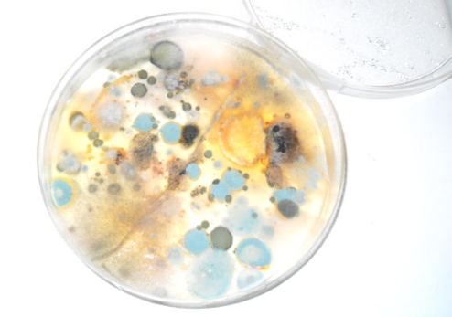
What Are Cultures of Learning?
What these authors are describing is the Petri dish, not the culture.
What are cultures of learning? What we do, what we model, what we share, what we create…
https://www.downes.ca/post/52664 https://www.downes.ca/presentation/326

Slide 18
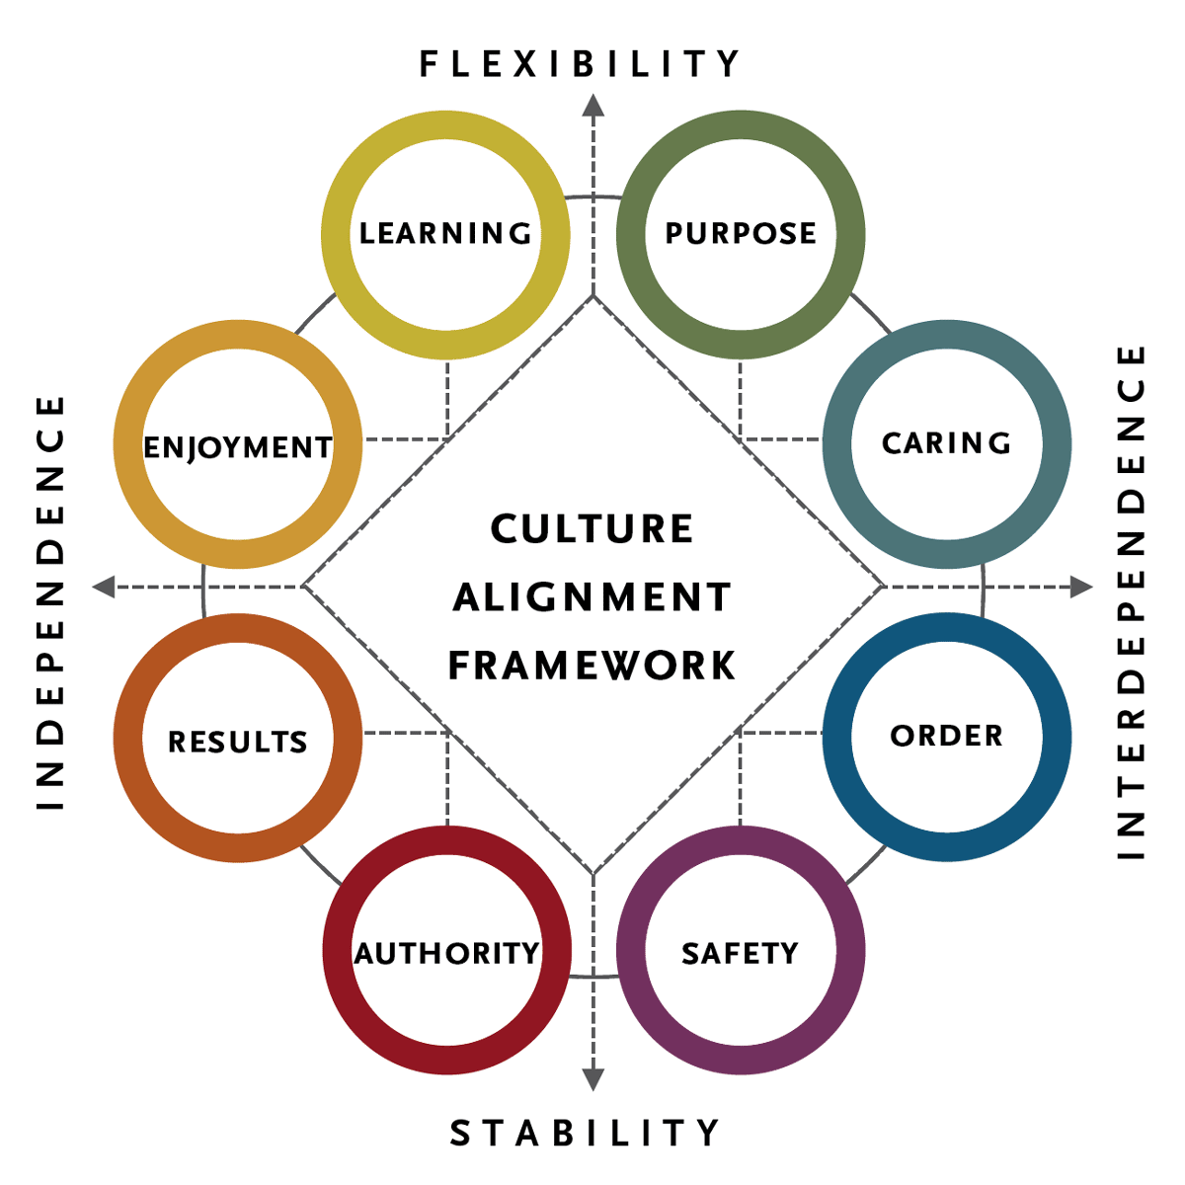
Organizational Culture
“An organization's culture is based on values derived from basic assumptions about the following:
  Human nature. Are people inherently good or bad, mutable or immutable, proactive or reactive?
  The organization's relationship to its environment. How does the organization define its business and its constituencies?
  Appropriate emotions. Which emotions should people be encouraged to express, and which ones should be suppressed?
  Effectiveness. What metrics show whether the organization and its individual components are doing well?”
https://www.shrm.org/resourcesandtools/tools-and-samples/toolkits/pages/understandinganddevelopingorganizationalculture.aspx
https://www.spencerstuart.com/what-we-do/our-capabilities/leadership-consulting/organizational-culture

Slide 19
Organizational Culture and Ethics
OECD: Organizational culture drives ethics; “Culture is a complex and multi-system framework that must be aligned to encourage ethical behavior” (Trevino & Nelson, 2018)
  formal elements “include the official communications of executives, the internal policies and codes of conduct, training programs, employee selection systems (hiring, firing) as well as systems for managing performance and goal-setting.”
  informal elements “include norms of daily behavior, rituals that help members understand the organization’s identity and its values, the myths and stories people tell about the organization, and the language people use in daily behavior.”
https://www.oecd.org/corruption/integrity-forum/academic-papers/Filabi.pdf

Slide 20
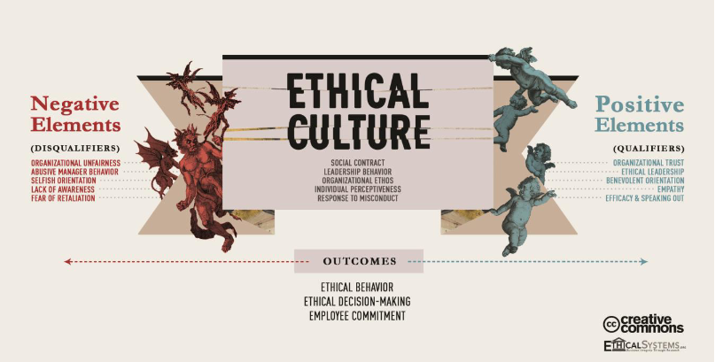

Slide 21
A Culture of Data Governance
“A strong data culture typically encompasses the following components:
  Access to quality and trustworthy data
  High levels of data literacy
  Consistent and constructive cross-functional collaboration around Data Intelligence
  Clearly defined and embraced data roles and responsibilities, such as data owner and data consumer
  Adoption of technology that facilitates data use and analysis
  Data citizens who feel empowered to make critical decisions based on data”
https://www.collibra.com/us/en/blog/building-a-data-culture

Slide 23
Citizenship

Slide 24
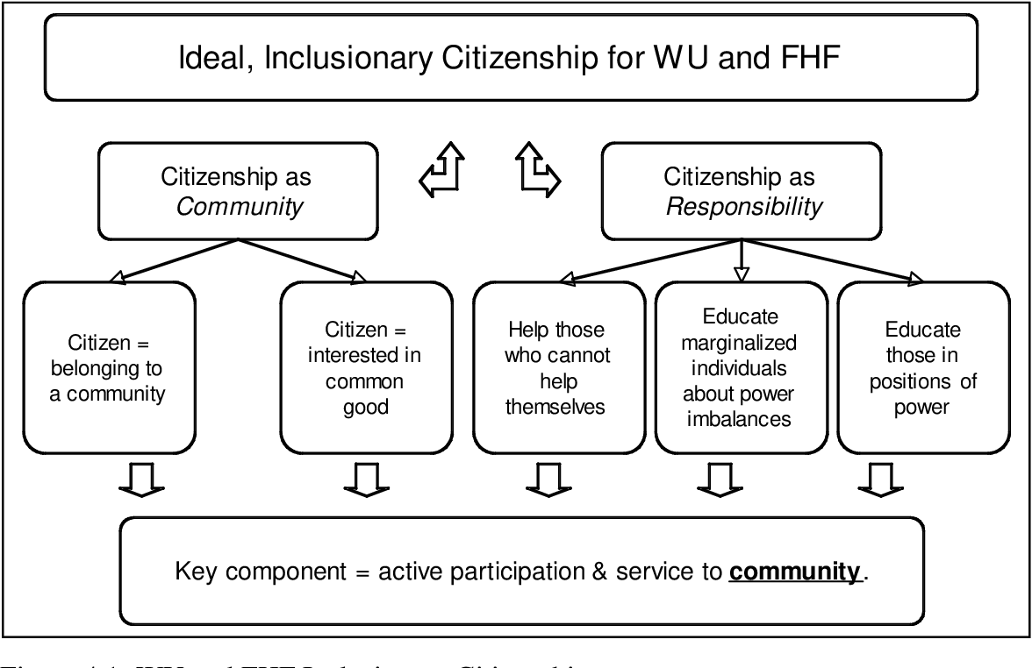
Community and Responsibility
Stacia L. Kock , 2011, https://www.semanticscholar.org/paper/TOWARDS-INCLUSION%3A-EXPANDING-AND-CHALLENGING-Kock/769716d26f0fb251cbe8f082d05cd39906385da5

Slide 25
Political and Economic Participation…
Lockean liberalism: “pursue the good life and be free from unreasonable government interference”
  Prior belief, described by de Tocqueville, that all are “born equal”
  Based on competition, with presumption of fairness
Republicanism: widespread participation of citizenry
  Basis of participation is a duty toward the community
  Jefferson: public education necessary to develop the means and the skill
Mossberger, Tolbert & McNeal, 2008. Digital Citizenship. MIT. pp. 6-7

Slide 26

The Digital Nation
Wired, 1997: The Digital Citizen and Birth of a Digital Nation, Jon Katz
  “blends the humanism of liberalism with the economic vitality of conservatism.”
  “reject both the interventionist dogma of the left and the intolerant ideology of the right”
  “embrace rationalism, revere civil liberties and free-market economics”
Buzzfeed, 2019: We were promised community, civics, and convenience. Instead, we found ourselves dislocated, distrustful, and disengaged.
https://www.buzzfeednews.com/article/josephbernstein/in-the-2010s-decade-we-became-alienated-by-technology
http://www.csun.edu/~vcspc00g/454/digitalcitizen1.html

Slide 27

The Idea of Citizenship
“Citizenship as an idea of its own is both crucial and crucially misunderstood, often reduced to political notions (Be heard–Vote!) or those ecological (Always Recycle!). Consider how infrequently many adults consider how the work they do, the things they buy, or the food they eat affects national or global citizenship.
“This is all big picture thinking that is, somehow, easy to miss.”
https://www.teachthought.com/the-future-of-learning/digital-leadership-2/
Image: https://giteshtrivedi.wordpress.com/2019/01/30/politics-or-citizenship-learning-in-school/

Slide 28
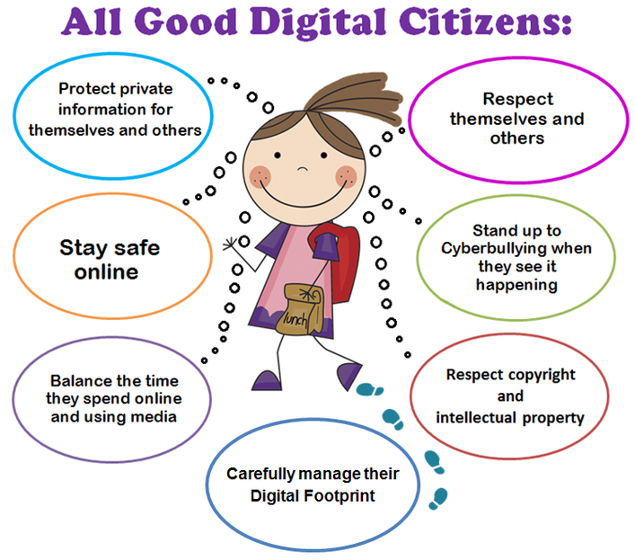
Digital Citizenship…
Terry Heick:
  Citizenship: “consists of self-knowledge, interaction, and intimate knowledge of a place, its people, and its cultural history.”
  Digital Citizenship: “Self-monitored participation that reflects conscious interdependence with all (visible and less visible) community members… (and) The quality of habits, actions, and consumption patterns that impact the ecology of digital content and communities.”
https://www.merriam-webster.com/dictionary/citizenship
https://www.teachthought.com/the-future-of-learning/definition-digital-citizenship/
https://www.virtuallibrary.info/digital-citizenship.html

Slide 29
Upstairs Downstairs
Mike Ribble: nine themes of digital citizenship
Back Upstairs
Duties
Commerce
Collaboration
Law
Rights & Responsibility
Security & privacy
Access
Communication
Etiquette
Fluency
Health & Welfare
Virtues
On Downstairs
Ribble, Mike. Digital citizenship in schools: Nine elements all students should know. International Society for Technology in Education, 2015.
https://files.eric.ed.gov/fulltext/EJ1018088.pdf

Slide 30
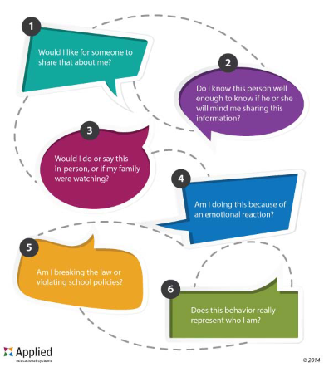
Teaching Digital Citizenship
Pulling in the direction of duties and virtues…
For example, seven key concepts from Chris Zook:
  Empathy
  How the Internet works
  Understanding user data
  Practicing digital literacy
  Acknowledging the digital divide
  Practicing digital wellness
  Securing digital devices
https://www.aeseducation.com/blog/what-is-digital-citizenship

Slide 31
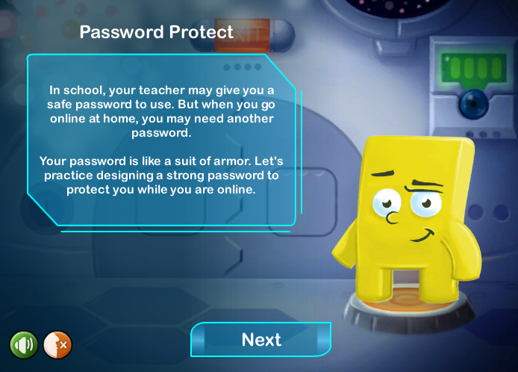
Teaching Digital Citizenship
Pulling in the direction of duties and virtues…
For example, areas of focus from Common Sense Education
  Media balance and well-being
  Privacy and security
  Digital footprint and identity
  Relationship and communication
  Cyberbullying, drama, hate speech
  News and media literacy
https://www.commonsense.org/education/digital-citizenship/curriculum?grades=3%2C4%2C5

Slide 32

Ethical Digital Citizens (as Duties)
What is an ethical digital citizen…?
  Take Care of Technology Equipment
  Explore Appropriate and Safe Sites
  Copyright Law, Fair Use…
  Help Prevent Cyberbullying
  Self-image Is Important
  Make Use of Netiquette
  Always Give Credit to Original Source
  Remember to Be Effective, Thoughtful, and Ethical Digital Creators
  Think
https://www.educationworld.com/a_tech/responsible-student-technology-use.shtml

Slide 33
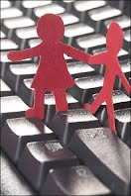
Ethical Digital Citizens (as Virtues)
Jason Ohler:
“Schools have already started unofficially addressing digital character education in the form of acceptable Internet use agreements that specify virtual behavior standards for students.”
“We need to create formal digital citizenship programs that deal with character education in the digital age deeply, directly, and comprehensively.”
https://www.tandfonline.com/doi/abs/10.1080/00228958.2011.10516720?journalCode=ukdr20
http://sshspd.pbworks.com/w/file/fetch/59899315/Character%20Education%20in%20the%20Digital%20Age.pdf

Slide 34

What Constitutes the Digital Citizen?
If a defining characteristic of a nation is that it embraces diversity of opinion, then you cannot define membership in that nation according to the opinions held by its citizens.
By analogy: Americans identify with "life, liberty and the pursuit of happiness". That is, most Americans, if asked, would embrace these values. However, embracing these values is not what defines an American. Rather, what defines an American is being born in the United States (or having legally immigrated).
https://www.downes.ca/post/117

Slide 35
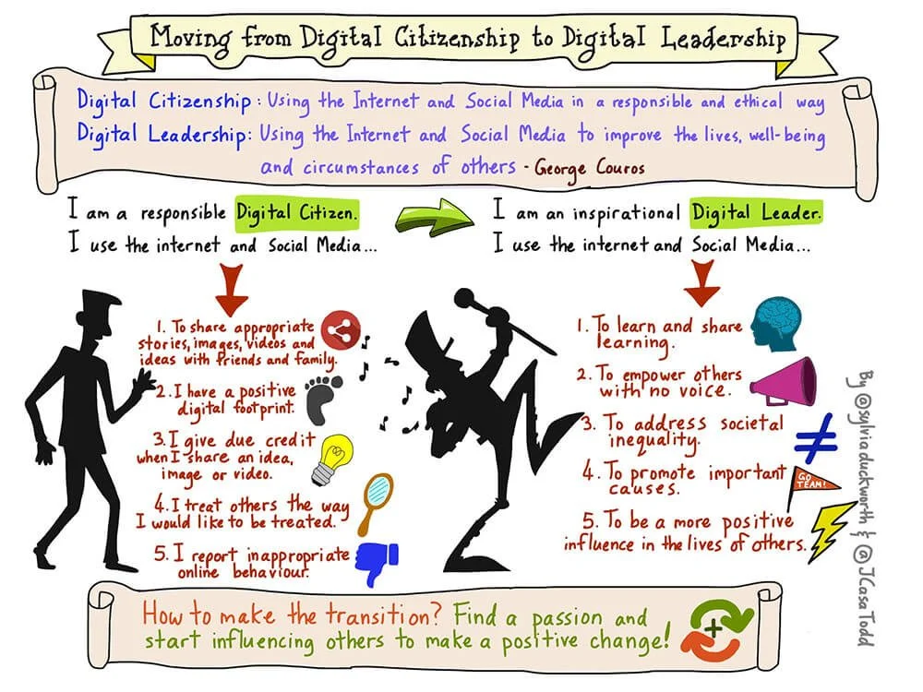
From Digital Citizenship to Digital Leadership
https://www.teachthought.com/the-future-of-learning/digital-leadership-2/

Slide 36
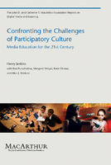
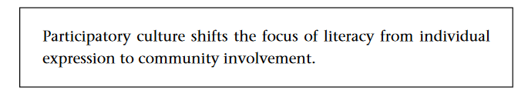
Participatory Culture
Henry Jenkins
  relatively low barriers to artistic expression and civic engagement,
  strong support for creating and sharing creations with others,
  some type of informal mentorship whereby what is known by the most experienced is passed along to novices,
  members who believe that their contributions matter, and
  members who feel some degree of social connection with one another (at the least, they care what other people think about what they have created).
https://library.oapen.org/handle/20.500.12657/26083

Slide 37
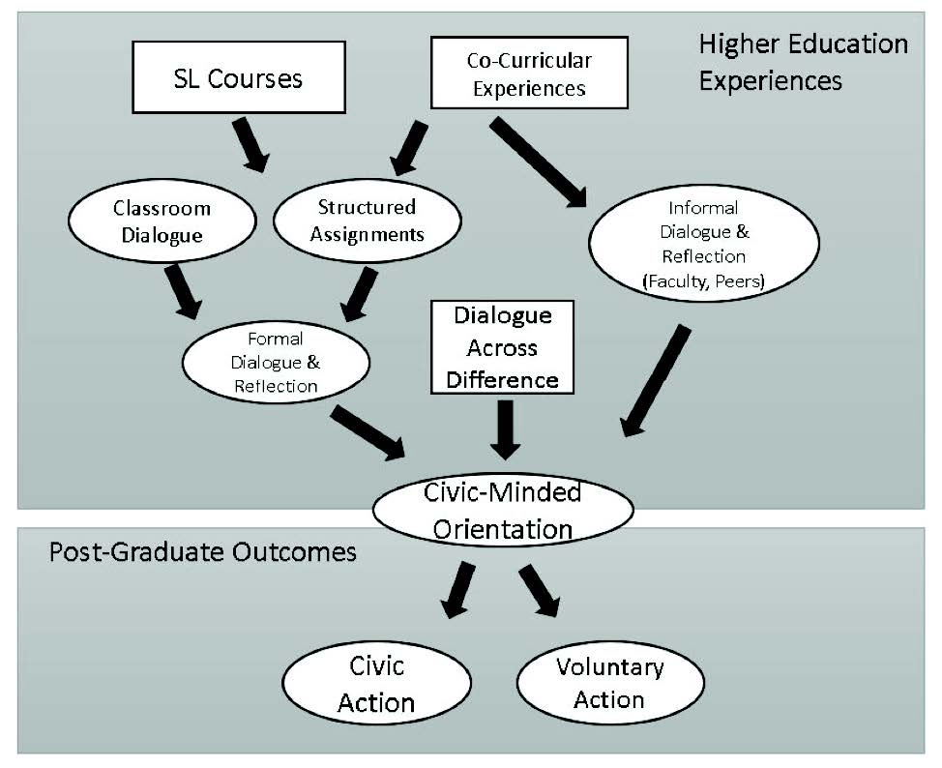
Refining Objectives…
“argues for a narrower focus on (1) respectful behavior online and (2) online civic engagement.”
“Both online respect and civic engagement were negatively related to online harassment perpetration and positively related to helpful bystander behaviors, after controlling for other variables.”
Jones & Mitchel, 2016 https://journals.sagepub.com/doi/abs/10.1177/1461444815577797
Image: https://quod.lib.umich.edu/cgi/t/text/text-idx?cc=mjcsloa;c=mjcsl;c=mjcsloa;idno=3239521.0023.105;g=mjcslg;rgn=main;view=text;xc=1

Slide 38
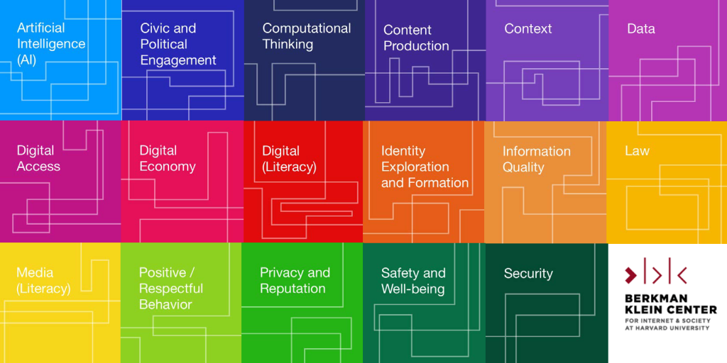
Digital Citizenship+
Digital Citizenship+ is defined as “the skills needed for youth to fully participate academically, socially, ethically, politically, and economically in our rapidly evolving digital world.”
https://cyberbullying.org/digital-citizenship-research

Slide 39
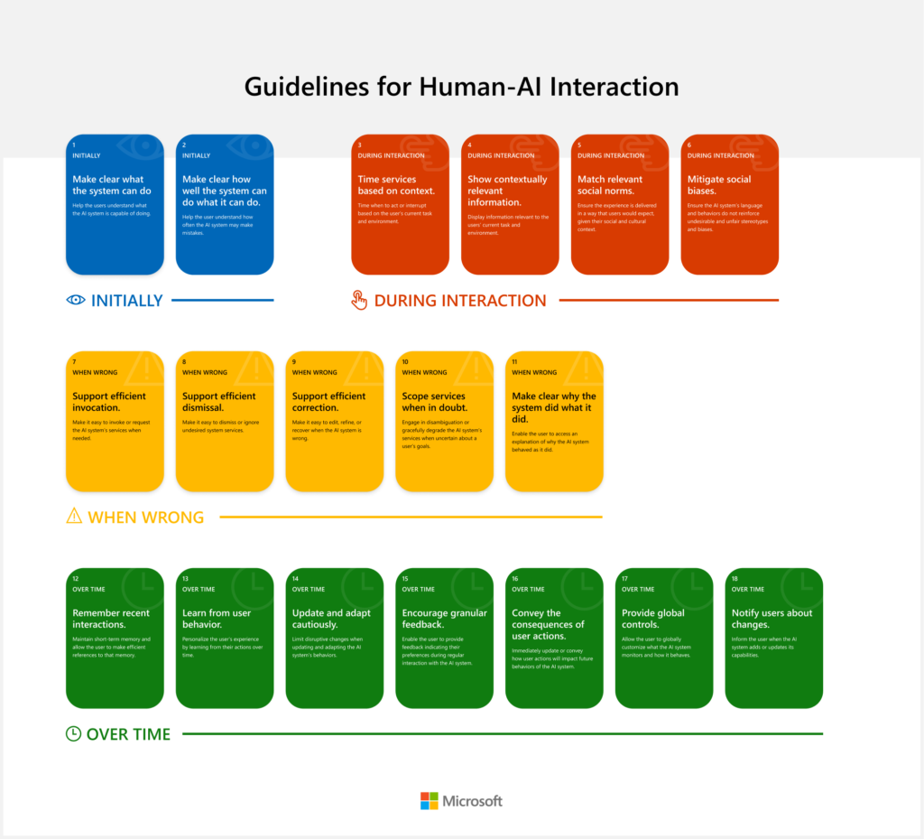
Human-AI Interaction
The concept of ethical AI is going to come down to something like describing AI as an ethical citizen
We have a tendency to describe this in terms of virtues and duties
But ultimately, it comes down to how well AI and humans can interact with each other
Microsoft: Guidelines for Human-AI Interaction - https://www.microsoft.com/en-us/research/project/guidelines-for-human-ai-interaction/ Report: https://www.microsoft.com/en-us/research/publication/guidelines-for-human-ai-interaction/

Slide 40
Democracy

Slide 41
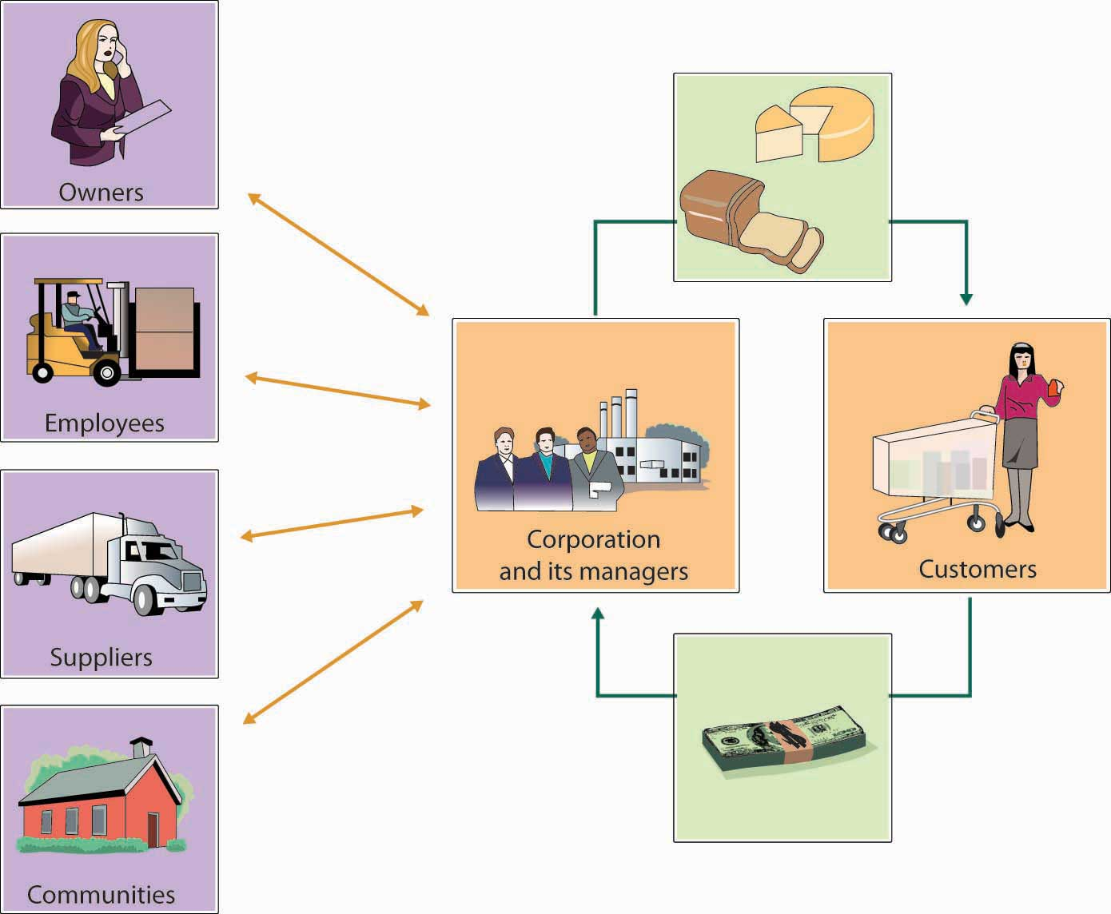
Corporate Citizenship
Right now, most AI is produced by, and represents the interests of, corporations
But corporations (especially digital corporations) haven’t been very good citizens
That’s why we fear their AIs won’t be either
https://saylordotorg.github.io/text_exploring-business-v2.0/s06-05-corporate-social-responsibilit.html

Slide 42
Corporations as Bad Citizens
“The power of corporations is frequently misused, usually to the advantage of the financial and managerial elite. Employees, communities, consumers, the environment, and the public interest in general are elbowed aside in corporate decision-making, unless the corporation can make money by taking them into account. Corporations are managed aggressively to maximize shareholder return. As a result, the risks they run—whether of oil spills in the Gulf or of financial crises erupting from Wall Street—are often unrecognized until too late. The executives who run American corporations do not generally think of themselves as having obligations to the public. The social contract of American corporations is pretty thin.”
Kent Greenfield , 2015, The Atlantic https://www.theatlantic.com/politics/archive/2015/02/if-corporations-are-people-they-should-act-like-it/385034/

Slide 43
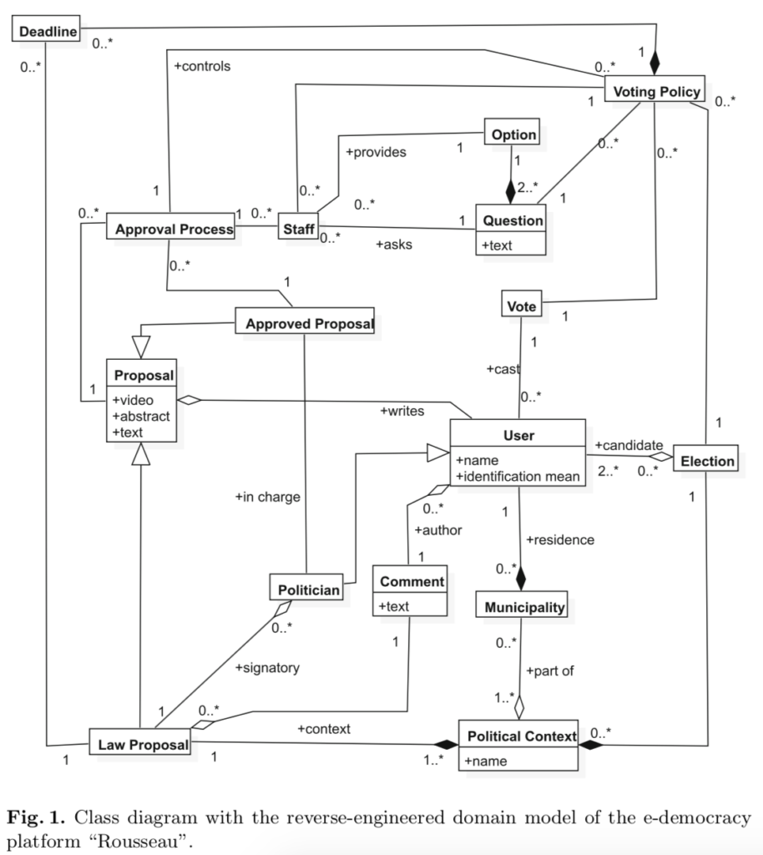
Towards Platform Democracy
“Platforms working with governments, civil society, can have experienced and neutral facilitators deploy these new processes for the toughest policy questions.”
“Policy decisions will then be made by the impacted populations and informed by key stakeholders, often leading to a strong public mandate (which may even help defend against partisan or authoritarian overreach).”
Aviv Ovadya, Oct. 18, 2021, Towards Platform Democracy: Policymaking Beyond Corporate CEOs and Partisan Pressure https://www.belfercenter.org/publication/towards-platform-democracy-policymaking-beyond-corporate-ceos-and-partisan-pressure Image: https://arielsheen.com/index.php/2019/04/15/review-of-democratic-process-and-digital-platforms-an-engineering-perspective/

Slide 44
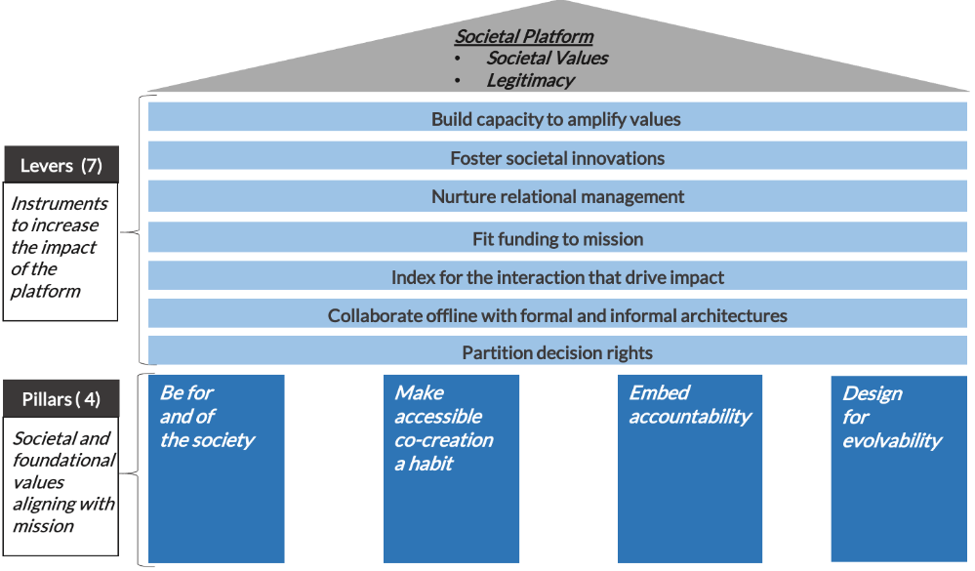
Platform Governance
Bias interactions to deliver impact
Embed accountability
Design for evolvability
https://networkweaver.com/principles-for-ecosystem-governance/

Slide 45

Design as Participation
Kevin Slavin says in Design as Participation, "You're Not Stuck In Traffic--You Are Traffic.“
Joi Ito: “Instead of trying to control or design or even understand systems, it is more important to design systems that participate as responsible, aware and robust elements of even more complex systems.”
https://jods.mitpress.mit.edu/pub/design-as-participation/release/1
https://joi.ito.com/weblog/2017/12/20/resisting-reduction.html

Slide 46
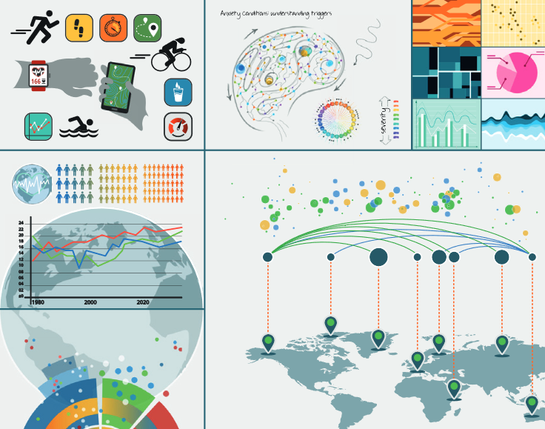
Access and Inequality
From OLDaily: “We've been engaged recently in a project to define and assess data literacy, and topics related to this were in my mind as I attended the AI Policy Community of Practice (AIPCoP) discussion this afternoon. These topics overlap in the concept of data feminism, a "way of thinking about data science and data ethics that is informed by the ideas of intersectional feminism." This open access book provides one way of approaching the topic; it's a collection of 26 papers discussing data literacy, the role of data visualization in media, and its relation to inequality in society.”
Data Visualization in Society - https://www.downes.ca/post/71408
Martin Engebretsen, Helen Kennedy, Amsterdam University Press, 2020/09/25

Slide 47
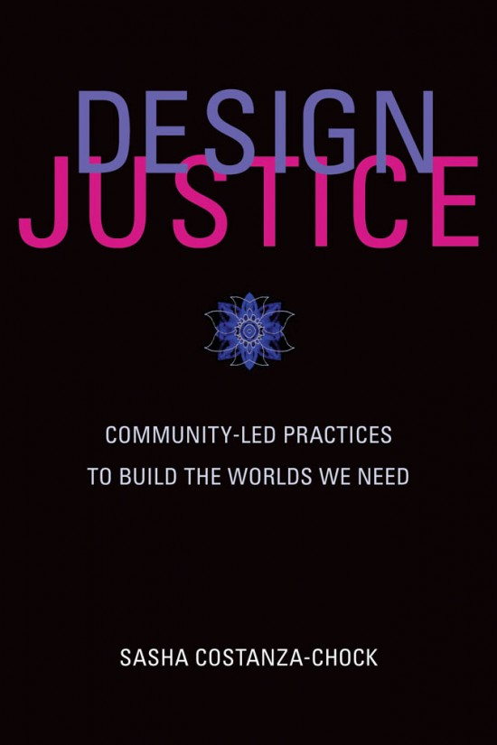
Community Leadership & Design Justice
“Universalist design principles and practices erase certain groups of people—specifically, those who are intersectionally disadvantaged or multiply burdened”
Proposes platform design led by marginalized communities to “dismantle structural inequality, and advance collective liberation and ecological survival.”
https://library.oapen.org/bitstream/handle/20.500.12657/43542/external_content.pdf?sequence=1
https://designjustice.org/

Slide 48
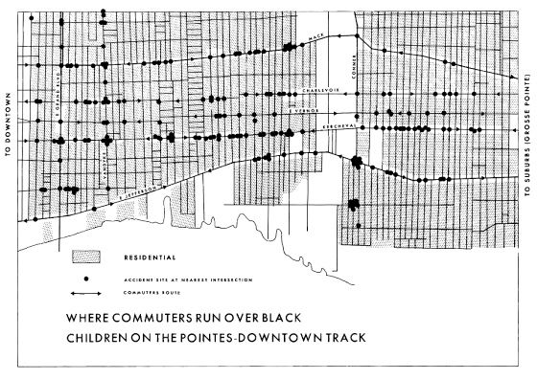
Data Feminism
“The most complete knowledge comes from synthesizing multiple perspectives, with priority given to local, Indigenous, and experiential ways of knowing.”
https://data-feminism.mitpress.mit.edu/ By Catherine D'Ignazio and Lauren F. Klein
Amy Collier, EDUCAUSE Review - Inclusive design https://er.educause.edu/articles/2020/10/inclusive-design-and-design-justice-strategies-to-shape-our-classes-and-communities
Care being taken not to create experiences that harm people https://www.kqed.org/mindshift/58698/how-to-fend-off-educational-numbness-with-experiential-learning

Slide 49
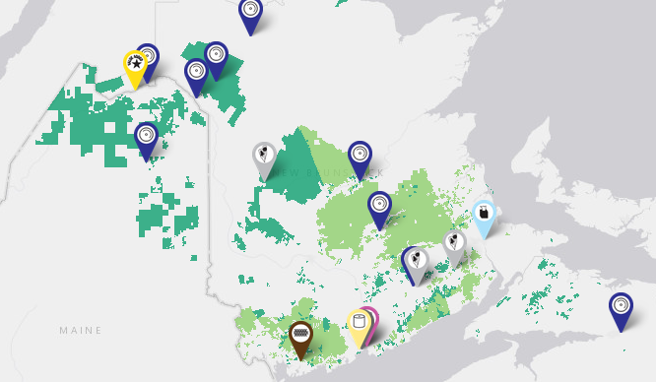
Algorithmic Justice
“Give members of communities most impacted by algorithmic bias more direct democratic power over crucial decisions”
  not merely after its deployment, but also at the design stage.
  meaningful opportunities for bottom-up democratic deliberation about, and democratic contestation of, algorithmic tools ideally before they are deployed.”
https://www.irvingwoodlands.com/jdi-woodlands-map-of-operations.aspx
(Zimmerman, et.al., 2020)

Slide 50
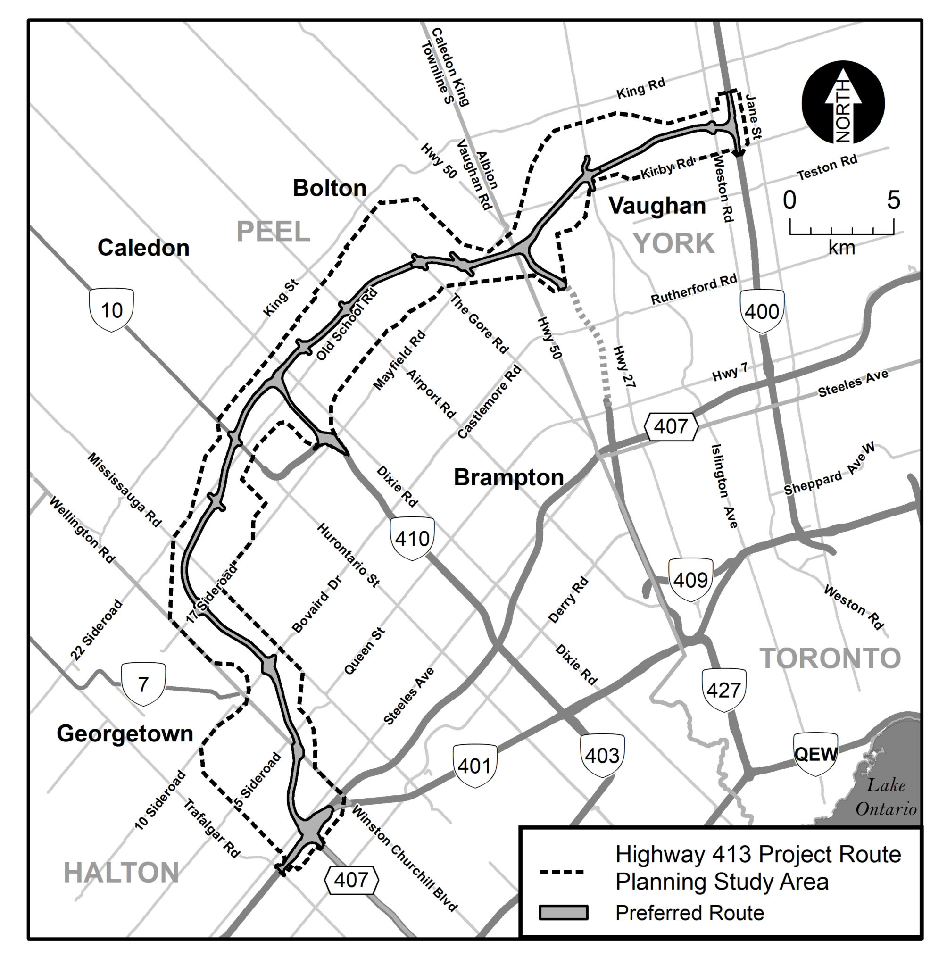
Algorithmic Injustice
“Highway 413 could save you up to 30 minutes.”
“We need to first make it possible for society as a whole, not just tech industry employees, to ask the deeper ex ante questions
“Changing the democratic agenda is a prerequisite to tackling algorithmic injustice, not just one policy goal among many.”
https://www.highway413.ca/
(Zimmerman, et.al., 2020)

Slide 51
Digital Citizenship Frameworks
The Algorithmic Fairness and Opacity Group (AFOG) at Berkeley has written an open letter to Google executives supporting fired ethics researcher Timnit Gebru and the response of AI researchers inside Google.
The telling point is this: "Ultimately change requires that dominant groups cede power. Institutional commitment must be embodied in practices and processes to enact meaningful change."
In this letter dominant groups are defined in terms of position and race, but the same basic equation applies no matter how power is defined, whether it be by income, ethnicity, religion, language, or whatever. Change requires that dominant groups cede power.
And what this means is that no single group or individual has ultimate power - it means moving from a hierarchy to something different. I'm not sure Google has the skills, capacities, or even the legal right to do this. But it's the only way to replace rapaciousness with ethical behaviour. https://www.downes.ca/post/71772
https://uploads-ssl.webflow.com/5f2876f679889c3267ee6dee/5fdd9622618da2c43dd7fffb_support_gebru_ethical_ai.pdf

Slide 52
Agency

Slide 53
Resilience
UNICEF suggests:
https://www.unicef.org/eap/press-releases/build-resilience-children-help-them-stay-safe-social-media
The report makes several recommendations for the family, school, community and service providers, including:
Improve support for digital parenting, and parenting in a digital age: digital parenting should be integrated into evidence-based parenting programmes and should consider differing levels of digital literacy amongst female and male caregivers, as well as differing levels of access to technology.
Foster online and offline resilience in children: Resilient children—those equipped with skills in areas such as communication, conflict resolution and self-efficacy—are more likely to make appropriate choices when using social media, be better equipped to manage conflict that they may encounter through the platforms that they use and take better measures to keep themselves safe online.
Ensure that messaging and responses by teachers and adults are based on evidence of patterns of use, and what works: Greater emphasis must be placed on evidence-based approaches within schools, and in homes, that equip children with the skills required to keep themselves safe online, to promote appropriate and positive decision-making skills, and that also support the opportunities that present through an increase in digital skills.
Three steps for technology companies: Technology companies should make profiles private by default; the default options for new contacts is most commonly ‘everyone’; this could be changed to ‘friends of friends.’; and finally, social media apps can relatively easily be designed to block photos being sent by people outside contact lists.

Slide 54
Power
There is a need to revise and redefine existing power structures while advocating for ethics and empathy in digital and hybrid spaces. Members of the community need to problematize the complexities of these interactions, and prepare all children to participate in complex democratic discourses using diverse digital tools.
https://wiobyrne.com/building-ethical-communities/

Slide 55
This is a theme that will sound familiar to educators. "Data ethics is not only about power—it also is power: 'Power for governments, companies, self-proclaimed experts and advisors and even academic disciplines to point out the problems and their solutions, to set the priorities for what role data technologies should play in our human lives and in society.'" It means that what we mean by data ethics has to be more than sets of rules and principles - it needs to be something that, as the article says, puts a human face on the subject. But what does that mean? https://dataethics.eu/data-ethics-of-power-a-human-approach-to-big-data-and-ai/ https://www.downes.ca/post/72249
https://www.nature.com/articles/d41586-020-02003-2
Don’t ask if artificial intelligence is good or fair, ask how it shifts power
Those who could be exploited by AI should be shaping its projects.

Slide 56
Small Power
Social Media: Time for a Break?
Stefanie Panke, AACE Review, 2021/12/21
When it first started social media was great. Blogs and the blogosphere were so much fun. Places like Mastodon today are like that. This article makes it clear what the problem is with the rest. To quote Jaron Lanier: "The problem is not the Internet or social media in a broad sense but rather specifically the use of the algorithms... anytime anybody connected with somebody else it was financed by third party whose motivation was to manipulate what happened. Then the whole business model was about how to manipulate more and more. What that results in is people being directed rather than exploring and that makes the world small." Small. That's a really good word for it. Like, when I'm looking for something to watch on YouTube, I feel the walls of the algorithm closing in on me.

Slide 57
Self-Determination
https://www.sciencedirect.com/topics/social-sciences/self-determination-theory

Slide 58
Identity
Identity
Sally Haslanger: Autonomy, Identity, and Social Justice (pdf, 3718 words)
The Lies that Bind is a moving and humbling book.

Slide 59
Biology
New biological data and knowledge in education
Ben Williamson, Code Acts in Education, 2021/09/08
There's a lot going on in this article as Ben Williamson describes two new research projects that are fraught with risk. The first is "a data-intensive, bioinformatics-driven approach to education remains in development" - basically, using a person's genome to identify their learning needs and potential. The second is a set of "'affect-aware" technologies to gauge and respond to student emotional states" that "aims to make ‘emotional life machine-readable, and to control, engineer, reshape and modulate human behaviour’". Writes Williamson, "New biologized knowledge, produced through complex technical apparatuses by new experts of both the data and life sciences, is being treated as increasingly authoritative."
https://www.downes.ca/post/72721

Slide 60
Ethics as a Way of Life
In speaking here of a “way of life [Lebensform]” Mollenhauer does not mean one’s personal, ethical values and commitments as much as he does a way or form of life sensu Wittgenstein, who famously asserted that “to imagine a language means to imagine a form of life.”6 In these terms—in terms of the implicit patterns and values we embody, articulate and act out every day—engaging in education in the broadest sense is all but unavoidable. As parents and educators, even simply as adults in public life, we embody and exemplify a way of living to children and young people, we perform a tacit affirmation of certain values, arrangements and relationships. “Even the most radical” critic of education and society, Mollenhauer argues, “cannot avoid embodying an adult way of life in front of children; like any adult, he or she powerfully exemplifies one way of life or another for a child.”7 We cannot not affirm for others a way of life much as we “cannot not communicate.”8
-- From Norm Friesen - https://www.researchgate.net/publication/320290102_Towards_a_Pedagogical_Hermeneutics_A_Response_to_the_Manifesto_for_a_Post-Critical_Pedagogy p. 2

