Slide 1

Ethical Practices: Part Two
Stephen Downes
December 22, 2021

Slide 2

Some Types of Framework
Management Framework for Ethics
Data Governance Framework
IT Governance Framework
Human rights
Title image: https://news.yahoo.com/implement-actionable-data-ethics-framework-184121318.html

Slide 3

Management Frameworks for Ethics
A management framework for ethics might suggest a series of steps to be taken. The Markkula Center for Applied Ethics at Santa Clara University offers a typical example (Velasquez, et.al., 2009):
  Recognize an ethical issue
  Get the facts
  Evaluate alternative actions
  Make a decision and test it
  Act and reflect on the outcome
https://www.scu.edu/ethics/ethics-resources/ethical-decision-making/

Slide 4

Digital Catapault
Anat Elhalal​​: ​Digital Catapult​ was developed to help AI companies design and deploy ethical AI products. It consists of seven concepts:
  Be clear about the benefits of your product or service
  Know and manage your risks
  Use data responsibly
  Be worthy of trust
  Promote diversity, equality and inclusion
  Be open and understandable in communications
  Consider your business model
(deBruijn, et.al., 2020) Also, see: https://migarage.digicatapult.org.uk/ethics/
https://migarage.digicatapult.org.uk/ethics/ethics-framework/#

Slide 5
Management Frameworks
Another framework for learning analytics is developed using the SHEILA Framework, an initiative using the Rapid Outcome Mapping Approach (ROMA), which was, according to proponents, specifically designed for policy-making derived from scientific evidence (Young, et.al., 2014).
  Identify the problem
  Develop a strategy
  Develop a monitoring and learning plan
Where RONA differs is in the specific recognition of varying influences and interests (p.14), identifying various dimensions of complexity (p.16), and consideration of the wider political and institutional environment (p.20).
https://sheilaproject.eu/sheila-framework/create-your-framework/overview/
https://moodle.org/mod/forum/view.php?id=8044

Slide 6
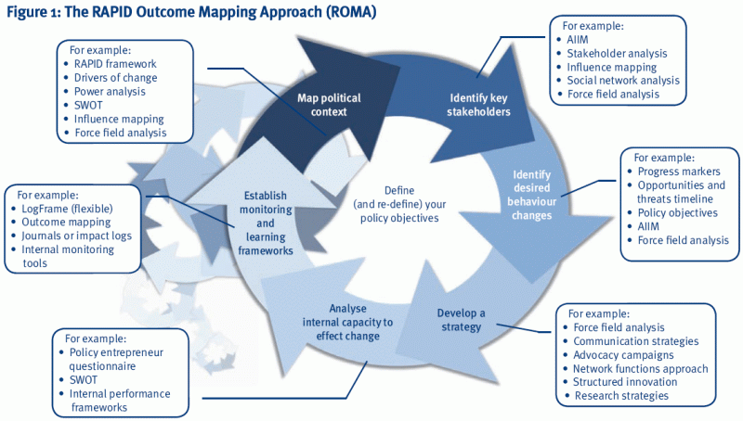
https://www.comminit.com/global/content/rapid-outcome-mapping-approach-roma

Slide 7

Failure at the First Step
Ethical issues are often viewed in hindsight, as in, “how could they not have known this was unethical?”
  The Santa Clara guide looks at three sorts of questions that might arise: could someone be harmed? Could the action be considered ‘good’ or ‘bad’? Is the question about more than just what is legal? But the answers “yes”, “yes”, and “yes” could be applied to just about any situation.
Image: https://www.vox.com/first-person/2019/3/27/18514886/50-years-wrong-side-of-history-future-prediction-hindsight

Slide 8
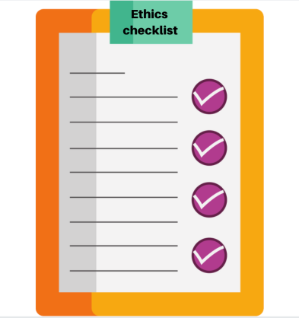
Framework = Checklist?
These frameworks are essentially checklists:
  What are the relevant facts of the case?
  What individuals and groups have an important stake in the outcome?
  Have all the relevant persons and groups been consulted?
  Have I identified creative options?
Each of these questions involves a judgement that could be made incorrectly, for example, identifying ‘relevance’, ‘importance’, and ‘creative’.

