Slide 1

Ethical Practices: Part One
Stephen Downes
December 22, 2021

Slide 2
Ethical Practices
Managing for risk
The need for practices, not principles
Some simple practices
Frameworks:
Ethical practices frameworks
Data governance frameworks
IT governance frameworks
Human Rights Frameworks
Activation of Ethical Practices
Title Image: https://www.shrm.org/resourcesandtools/hr-topics/behavioral-competencies/ethical-practice/pages/ethical-and-legal-responsibilities-for-hr-professionals.aspx

Slide 3
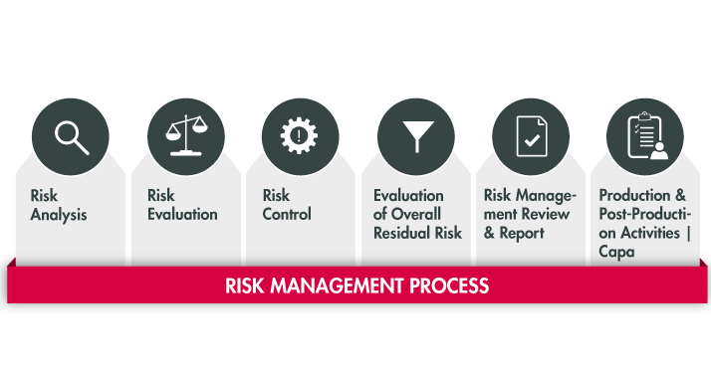
Managing for Risk
Re: the regulations
These are focused on reducing risks
Managing for risk is not ethics
  Sometimes the most ethical route is the most ethical
  Sometimes the safest path is the least ethical
  Risks measure some parameters (like cost) but not others
https://www.plato-e1ns.com/products/e1ns-solution-packages/e1ns-solution-package-medical-technology/plato-risk-management-14971/

Slide 4

The Fog of War
It is a truism that systems of rules and principles are compromised the moment they are applied in practice. A common expression, “the fog of war”, captures the uncertainty that results when complex real-life situations are encountered.
https://www.everedgeglobal.com/news/2017-2-19-lifting-the-ip-fog-of-war/

Slide 5


Down the Staircase
Fear
Focused on the good
More personal
Less formal
Regulation
Practices
More formal
More institutional
Focused on wrongs
Culture
Joy

Slide 6
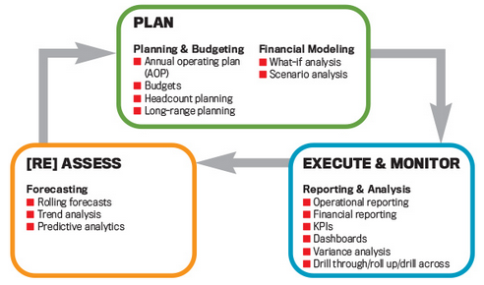
Practices, Not Principles
Thus many approaches supporting professional conduct focus on common practices rather than principles. The idea is that while the actual outcome and best decision cannot be predicted, following a standard will lead to an optimal outcome in the given situation (Courtney, Lovallo & Clarke, 2013).
https://sfmagazine.com/post-entry/november-2017-12-principles-of-best-practice-fpa/

Slide 7
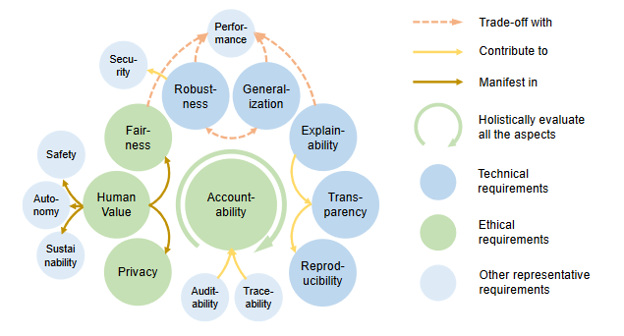
The Elements of AI Practices
https://arxiv.org/pdf/2110.01167.pdf p.3

Slide 8
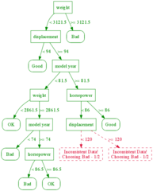
Decision Trees
poses a series of questions, user answers
points to a recommended course of action.
example, such a tree may ask:
  whether an action is legal
  whether it adds value
  whether it is ethical. (Bagley, 20013)
however, a decision tree is essentially an application of a set of rules or principles
  we can see this through the processes used to generate decision trees (Azad-Manjiri, 2014)
https://alliance.seas.upenn.edu/~cis520/wiki/index.php?n=Lectures.DecisionTrees

Slide 9
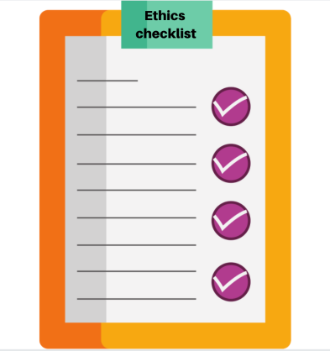
Checklists
used in the management of complicated technology
  flying an aircraft
  performing surgery
ensure that proponents do not omit essential steps or procedures
in ethics, a checklist might be used to ask whether all ethical matters have been considered. (University of Leicester, 2019)
they are not decision-making tools
  they ensure completeness, but not accuracy.
https://reillytop10.com/previous-lists/2020-list/the-corruption-of-tech-ethics/

Slide 10
Frameworks
For more complex environments, a process-based approach is used, such as a management framework:
  identify the things that ought to be done
  name issues to be considered
  identify people involved in considering them
  note the resources to be consulted.
But the actual consideration, and the outcome of the consideration, is determined by the process.
“It’s the ability to organize thoughts into a formal framework that allows ethics to move forward instead of whirl around as a series of open-ended questions.”
Jessica Baron, https://reillytop10.com/previous-lists/2020-list/the-corruption-of-tech-ethics/

Slide 11
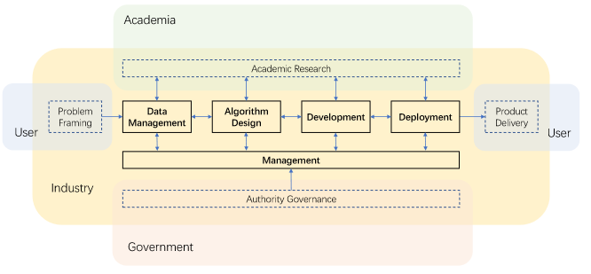
Organizing Multidisciplinary Practitioners
The AI industry holds a connecting position to organize multidisciplinary practitioners, including
users, academia, and government in the establishment of trustworthy AI. https://arxiv.org/pdf/2110.01167.pdf p. 20

Slide 12
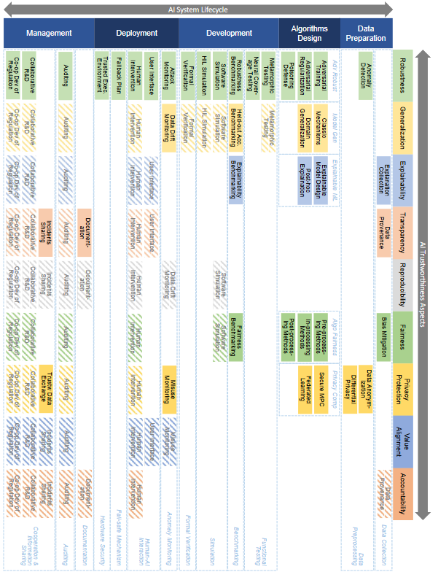
Elements of Good Practice
https://arxiv.org/pdf/2110.01167.pdf p.22

Slide 13
Process
Example: Fournier–Sylvester (2013) classroom conversation model:
Establish open respectful environment
Help students move beyond opinions and emotions
Help students learn to identify a weak argument (see Brown & Keeley, 2010)
Establish ground rules (see Oxfam, 2006)
Anticipate the social and political issues your students will find interesting and react to
Let all members have a voice
Decide on the role of the teacher:
  Committed: Teacher expresses own view while attempting to be balanced
  Objective or Academic: Teacher presents all possible viewpoints
  Devil’s Advocate: Teacher adopts most controversial viewpoints, forcing students to justify their own (see Wales & Clarke, 2005)
Close the discussion; evaluate and debrief.
https://en.ccunesco.ca/-/media/Files/Unesco/Resources/2018/10/GlobalCitizenshipEducationASPnetSchools-compressed.pdf p. 12

Slide 14
Process
Example: Canadian Code of Ethics for Psychologists p.5
Identification of the individuals and groups potentially affected by the decision.
Identification of ethically relevant issues and practices, including the moral rights, values, well-being, best interests, cultural, social, historical, economic, institutional, legal or political context
Consideration of one’s own biases, external pressures, personal needs, self-interest, or cultural, etc
Development of alternative courses of action.
Analysis of likely short-term, ongoing, and long-term risks and benefits of each course of action
Choice of course of action after conscientious application of existing principles, values, and standards
Action, with a commitment to assume responsibility for the consequences of the action.
Evaluation of the results of the course of action.
Assumption of responsibility for consequences of action.
Appropriate action, as warranted and feasible, to prevent future occurrences of the dilemma
(CPA, 2017:5) https://cpa.ca/docs/File/Ethics/CPA_Code_2017_4thEd.pdf

Slide 15
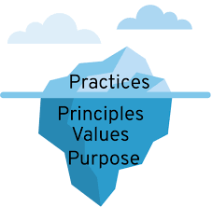
Some Types of Framework
Management Framework for Ethics
Data Governance Framework
IT Governance Framework
Human rights

