Slide 1

Explainable AI
Stephen Downes
December 15, 2021

Slide 2
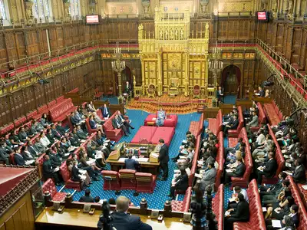
Explainable AI
UK Parliament AI committee “We believe it is not acceptable to deploy any artificial intelligence system which could have a substantial impact on an individual’s life, unless it can generate a full and satisfactory explanation for the decisions it will take.”
“AI in the UK: ready, willing and able?,” UK Parliament (House of Lords) Artificial
Intelligence Committee. https://publications.parliament.uk/pa/ld201719/ldselect/ldai/100/10002.htm
Cover image: https://www.softwebsolutions.com/resources/explainable-ai-for-business.html

Slide 3
What Is An Explanation?
Causality (An explanation is an assignment of causal responsibility)
  Internal and external causes
  Causal chains
  Necessary and sufficient conditions
Product (an explanation is an answer to a why–question (van Fraassen))
  Based on presuppositions and alternative possibilities
Abduction (inference to the best explanation (Pierce, Harman))
  Various criteria employed to choose among hypotheses
Justification
  Observers can understand the reason for (e.g.) a decision
Miller, 2018 https://arxiv.org/pdf/1706.07269.pdf

Slide 4
The Need for Explainable AI
Transparency: we need explanations in terms, format and language we can understand
Causality: can the model also provide us with some explanation for underlying phenomena?
Bias: How can we ensure that the AI system isn’t biased?
Fairness: Can we verify that decisions were made fairly?
Safety: Can we be confident in the reliability of our AI system?
Hagras, 2018 https://www.researchgate.net/publication/328088140_Toward_Human-Understandable_Explainable_AI

Slide 5
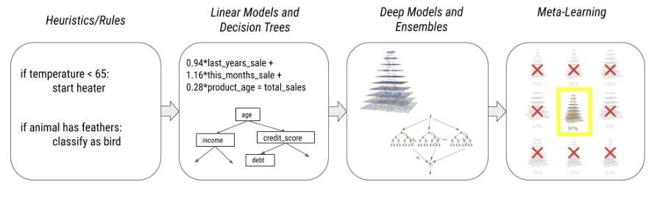
The Evolution of Machine Learning
As machine learning evolves, it moves further and further away from Explainability, but the public perception of Explainability hasn’t shifted
https://storage.googleapis.com/cloud-ai-whitepapers/AI%20Explainability%20Whitepaper.pdf

Slide 6
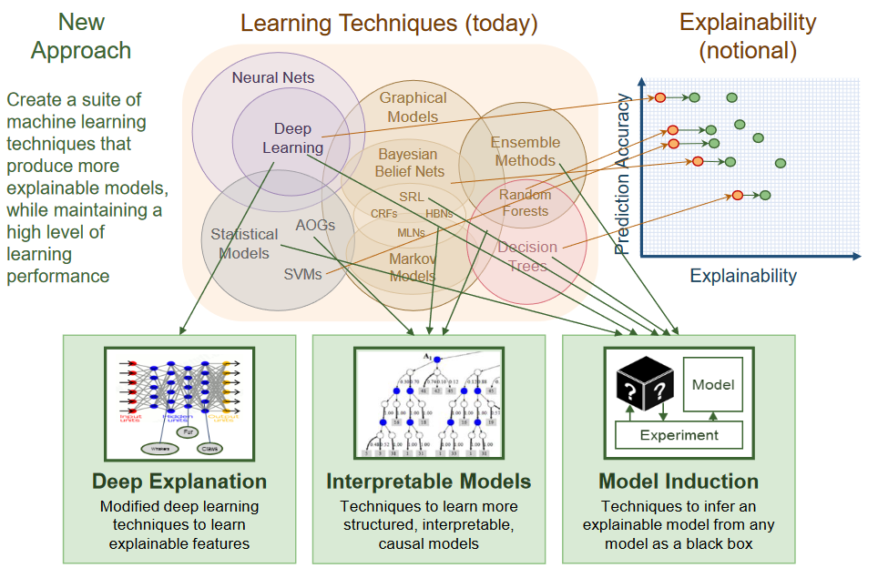
What Is Explainability?
Gunning, 2017, Explainable AI https://www.cc.gatech.edu/~alanwags/DLAI2016/(Gunning)%20IJCAI-16%20DLAI%20WS.pdf

Slide 7
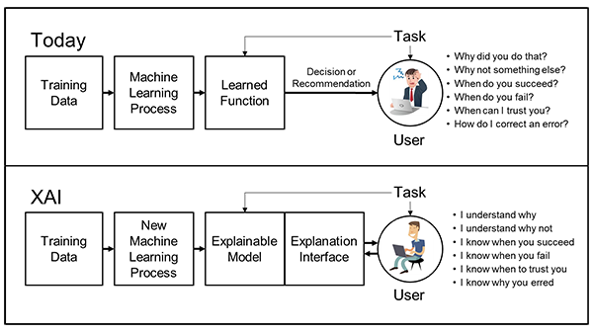
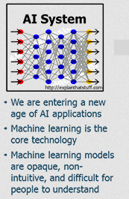
DARPA XAI
eXplainable AI intended to address weaknesses of machine learning
https://www.darpa.mil/program/explainable-artificial-intelligence

Slide 8
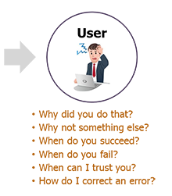
Explainable AI
“Explainable artificial intelligence (XAI) is a set of processes and methods that allows human users to comprehend and trust the results and output created by machine learning algorithms.” It describes:
  The model
  The expected impact
  Potential biases
https://www.ibm.com/watson/explainable-ai
https://www.darpa.mil/program/explainable-artificial-intelligence

Slide 9
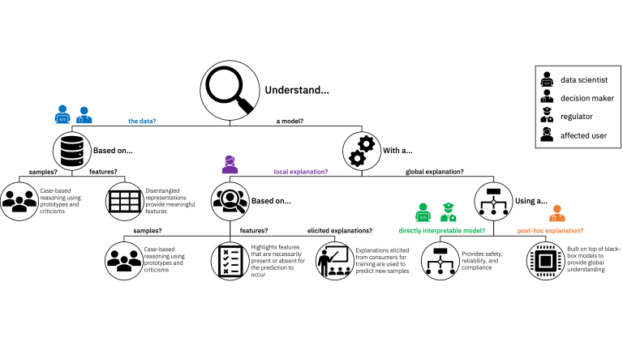
Process
https://www.ibm.com/blogs/research/2019/08/ai-explainability-360/

Slide 10
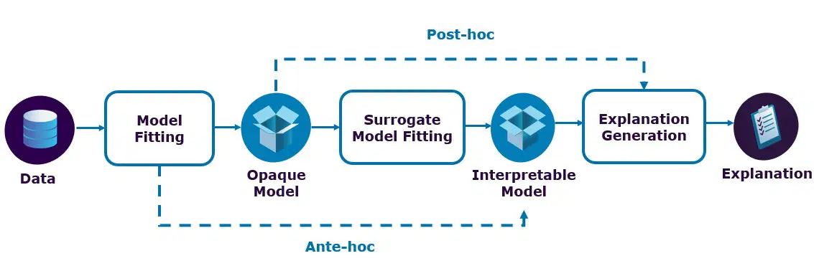
Post-Hoc Systems
“provide local explanations for a specific decision and (make)
it reproducible on demand”
  E.g. LIME (Local Interpretable Model-Agnostic Explanations) developed by Ribeiro et al. (2016) based on “a class of potentially interpretable models, such as linear models, decision trees, or rule lists”
  E.g. BETA (Black Box Explanations through Transparent Approximations) “optimizing for fidelity to the original model and in-
  terpretability of the explanation”
Holzinger, et.al., 2017 https://arxiv.org/pdf/1712.09923.pdf
Marco Tulio Ribeiro, Sameer Singh, and Carlos Guestrin. 2016. Why should I trust you?

Slide 11
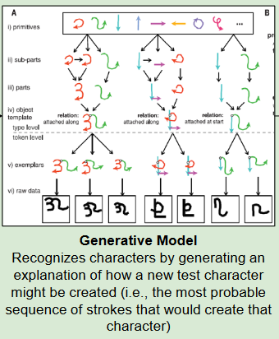
Ante-Hoc Systems
‘Glass-box’ approaches (Holzinger et al., 2017); “typical examples include linear regression, decision trees and fuzzy inference systems”
https://arxiv.org/pdf/1712.09923.pdf
Image: Gunning, 2017

Slide 12

Boolean Classification Rules
“Boolean Classification Rules via Column Generation, is an accurate and scalable method of directly interpretable machine learning” - IBM
The predictive decision rule for Federer defeat-
ing Murray in the 2013 Australian Open was:
• Win more than 59% of 4 to 9 shot rallies; and
• Win more than 78% of points when serving at
30-30 or Deuce; and
• Serve less than 20% of serves into the body.
https://www.ibm.com/blogs/research/2019/08/ai-explainability-360/
Dmitry M. Malioutov & Kush R. Varshney , 2013, Exact Rule Learning via Boolean Compressed Sensing http://proceedings.mlr.press/v28/malioutov13.pdf

Slide 13
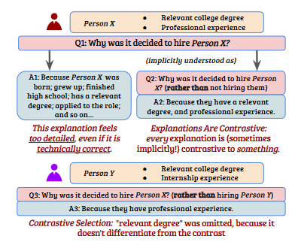
Contrastive Explanations Method
“Addresses the most important consideration of explainable AI that has been overlooked by researchers and practitioners: explaining why an event happened not in isolation, but why it happened instead of some other event.” - IBM
https://www.ibm.com/blogs/research/2019/08/ai-explainability-360/
Jacovi, et.al., 2021 https://arxiv.org/pdf/2103.01378.pdf

Slide 14
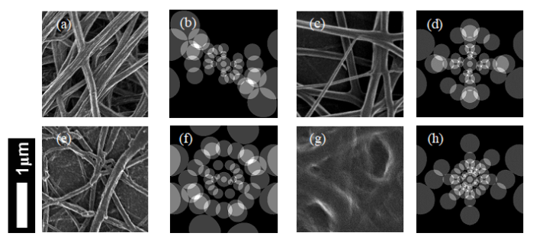
Interpreting Deep Neural Networks
Annotated data is extremely difficult to obtain
Montavon et al. (2017) – based on interpreting the input layer
Gr ́egoire Montavon, Wojciech Samek, and Klaus-Robert M ̈uller. Methods for interpreting
and understanding deep neural networks. arXiv:1706.07979, 2017
Holzinger, et.al., 2017 https://arxiv.org/pdf/1712.09923.pdf

Slide 15
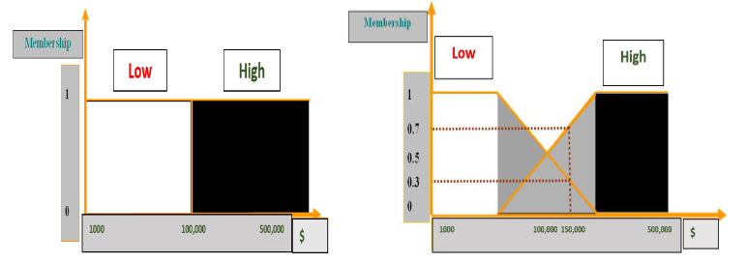
Fuzzy Logic Approaches
The focus is on how humans think in an approximate rather than an precise way.
  E.g. “if the distance to the car ahead is low and the road is slightly slippery Then slow down. The numerical meanings of ‘low’, ‘close’ and ‘slow down’ will differ between drivers.”
Hagras, 2018 https://www.researchgate.net/publication/328088140_Toward_Human-Understandable_Explainable_AI

Slide 16
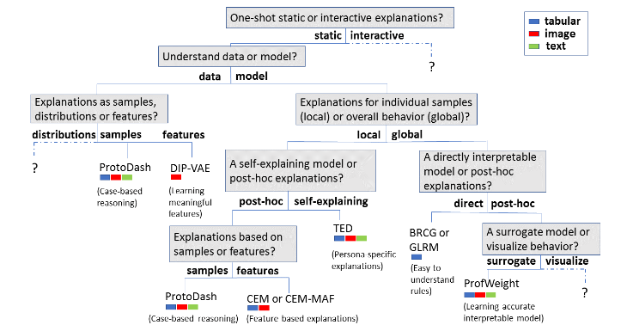
AI Explainability Taxonomy
https://arxiv.org/abs/1909.03012

Slide 17
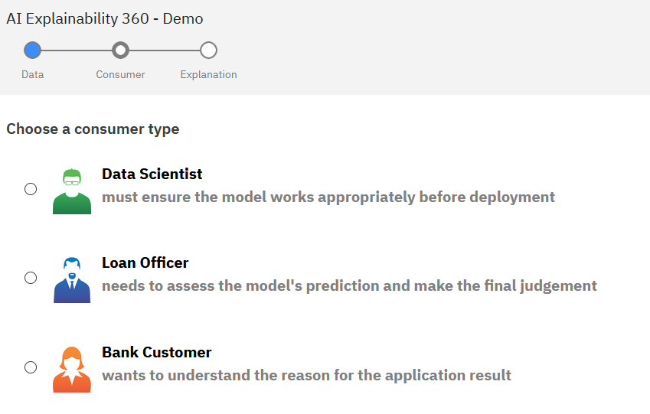
Example From IBM
https://aix360.mybluemix.net/consumer

Slide 18
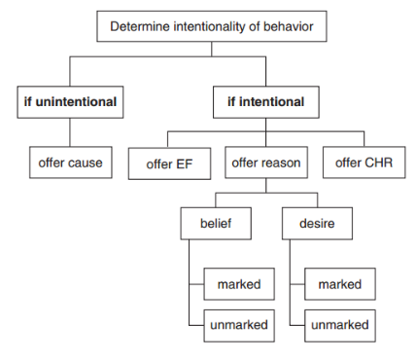
Insights from the Social Sciences
How do we explain behaviours?
  Intentions and intentionality – “person perception”
  Folk psychology – beliefs, desires, etc.
Reason expectations
  Norms and morals
  Collective intelligence
  Malle’s Models
    Information requirements, information access, pragmatics goals, functional capacities
Miller, 2018 https://arxiv.org/pdf/1706.07269.pdf
B. F. Malle, How the mind explains behavior: Folk explanations, meaning, and social interaction, MIT Press, 2004.

Slide 19
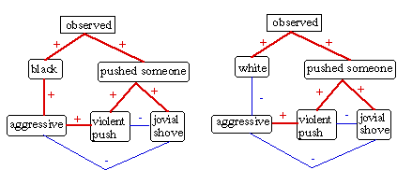
Factors in Explanation
Abnormality
Temporality
Controllability and intent
Social norms
Facts and Foils
Responsibility
Coherence, simplicity and generality
Truth and probability
Paul Thagard and Ziva Kunda, 1997 Making sense of people: coherence mechanisms http://cogsci.uwaterloo.ca/Articles/Pages/Making.Sense.html

Slide 20

Explanation as Conversation
Two stages:
  the diagnosis of causality in which the explainer determines why an action/event occurred; and
  the explanation, which is the social process of conveying this to someone.
The problem is then to “resolve a puzzle in the explainee’s mind about why the event happened by closing a gap in his or her knowledge”
Miller, 2018 https://arxiv.org/pdf/1706.07269.pdf
D. J. Hilton, Conversational processes and causal explanation, Psychological Bulletin 107 (1) (1990) 65–81.

Slide 21
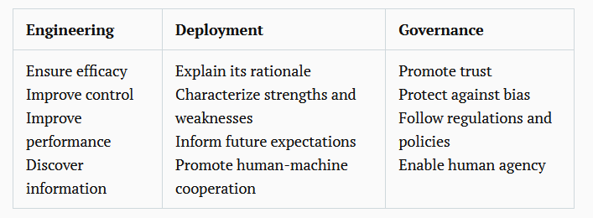
Domains of Discourse
Ultimately, what will count as an explanation will depend more on who is doing the asking and explaining than on any inherent property of the system
https://www.brookings.edu/techstream/explainability-wont-save-ai/

