Slide 1

Testing and Application
Stephen Downes
December 13, 2021

Slide 2
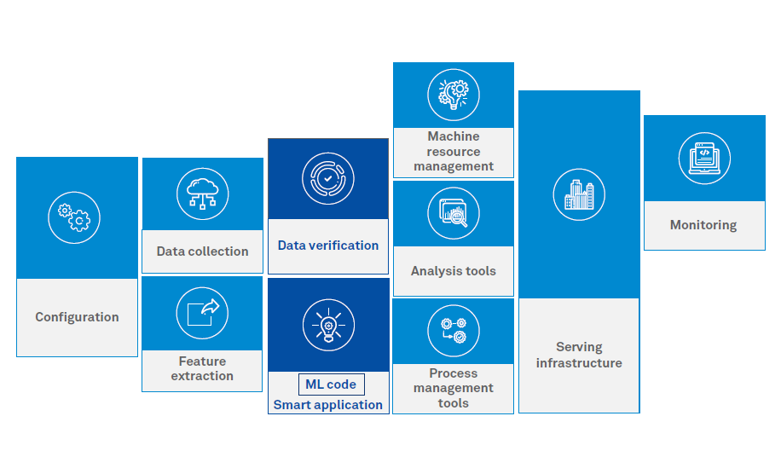
Testing and Application
https://www.wipro.com/holmes/testing-of-ai-ml-based-systems/

Slide 3
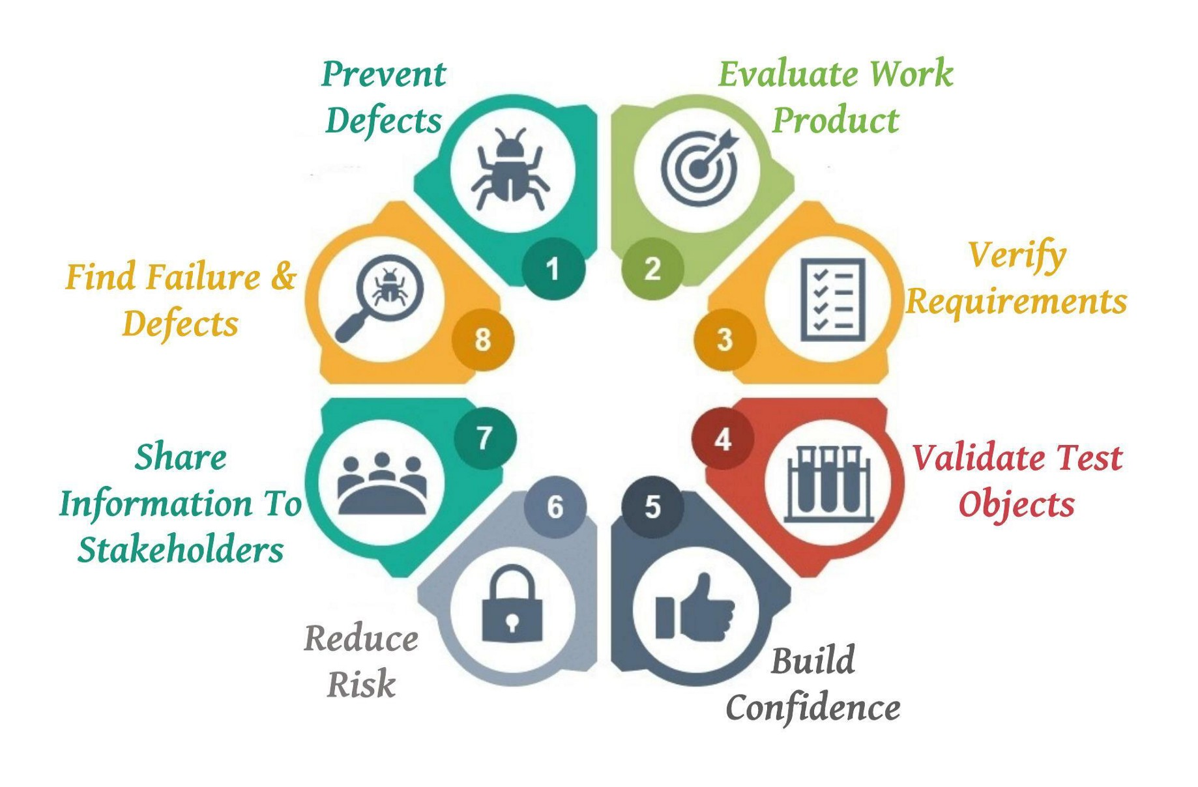
Testing: Objectives
Define goals
Identify KPIs
Collect data
Analyze data
Perform test alternatives
Implement changes
https://www.360logica.com/blog/web-analytics-testing-process-importance/
Image: Senuri Samindi https://senuri.medium.com/objectives-of-testing-4832858f6f7d

Slide 4
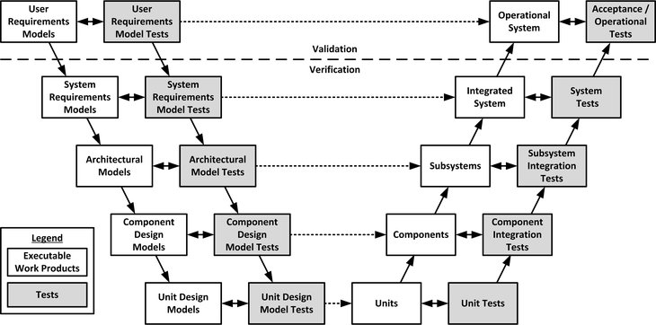
V Models for Testing
Takes the waterfall model and adds a verification step to each element
https://insights.sei.cmu.edu/blog/using-v-models-for-testing/

Slide 5
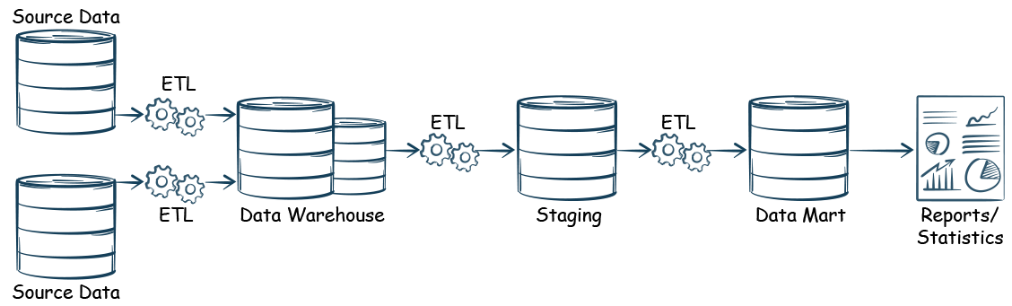
Data Testing
The 6 Vs:
  Data Volumes (Test for Semantics, Distributed processing, and scalability)
  Data Variety (Test for visualization, schemas, and data federation)
  Data Velocity (Test real-time, on the fly integration and on-demand storage)
  Validity of data (apply rules and remove invalid data)
  Variability in data (Inconsistency)
  Veracity of data (Quality/Accuracy)
Quoted from https://www.capgemini.com/2016/01/testing-analytics-applications-what-has-changed-in-smac-world/

Slide 6
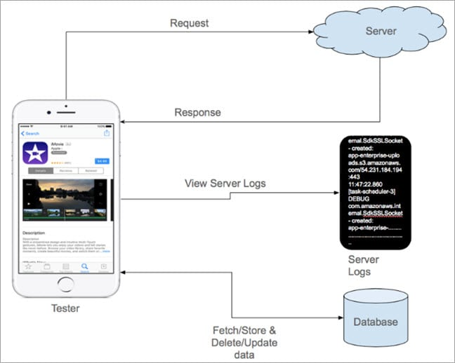
Request testing
Ensuring that:
  the correct data is being collected
  the request to the AI is correct
  The request is properly sent
Validate:
  Dynamic data, as in query parameters
  For duplicate requests
  Missing requests
  Cross-browser functionality
https://applitools.com/blog/guide-testing-automating-data-analytics-events-web-mobile/#h-different-ways-to-test-analytics-events
Image: https://www.softwaretestinghelp.com/beginners-guide-to-mobile-application-testing/

Slide 7
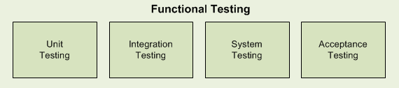
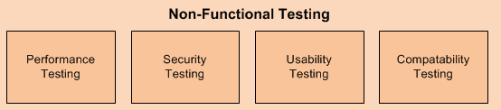
Application Testing
Analytics solutions should be tested for common testing techniques:
Security Testing – authorization and authentication, availability of data
Performance Testing – accuracy of data, and performance under high load
Usability Testing – e.g. whether the application is providing right information
Failover – to ensure data is available during critical failures
Quoted from https://www.capgemini.com/2016/01/testing-analytics-applications-what-has-changed-in-smac-world/ Image: https://www.inflectra.com/ideas/topic/testing-methodologies.aspx

Slide 8
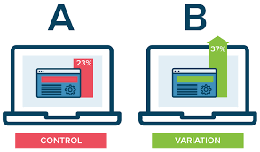
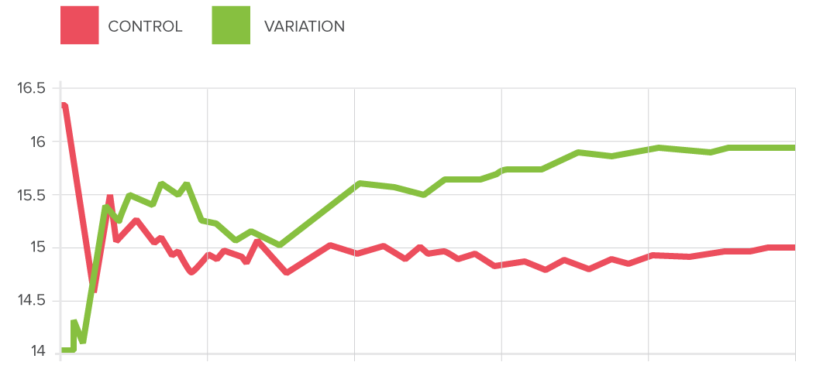
Testing: A/B and Multivariate Testing
“This testing tells you about the performance of clickable elements of your web page. This testing approach allows gauging performance like rotating between two images or tweaking an important call to action and then acting on the results. This helps in getting a website with continuous performance improvement.”
https://www.360logica.com/blog/web-analytics-testing-process-importance/
Image: https://www.optimizely.com/optimization-glossary/ab-testing/

Slide 9
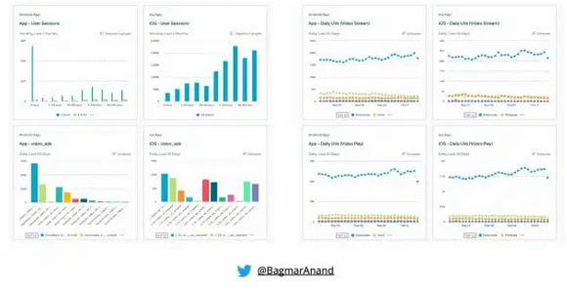
Testing: End Report
By the time you’re here, it’s a bit too late
https://applitools.com/blog/guide-testing-automating-data-analytics-events-web-mobile/#h-different-ways-to-test-analytics-events

Slide 10
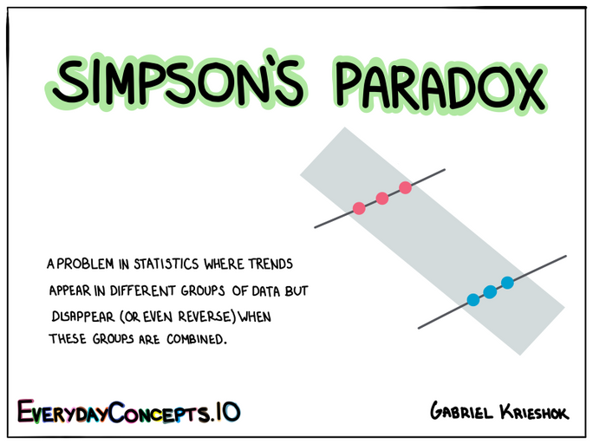
Simpson’s Paradox
https://imgur.com/gallery/WQ6Pxy7

Slide 11
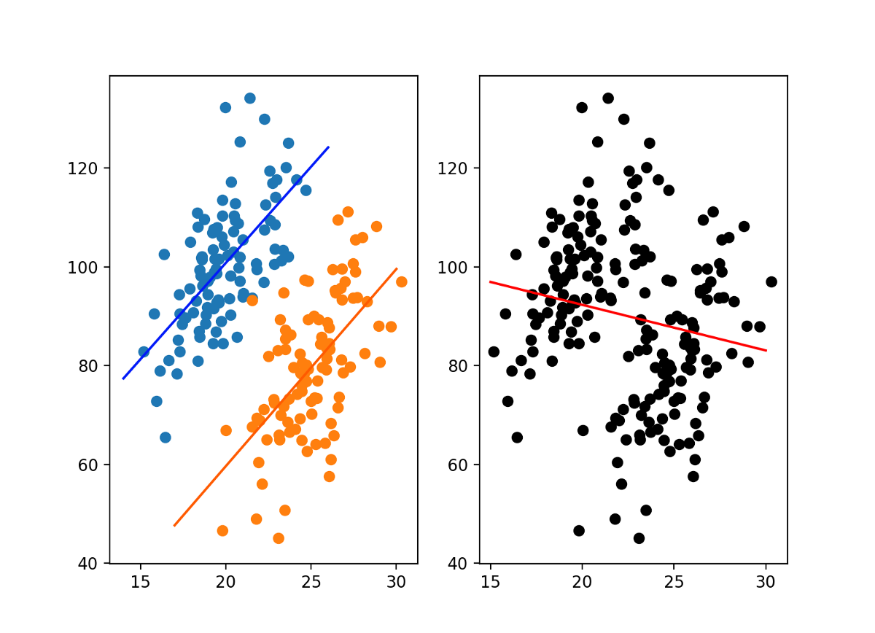
Scatterplots
https://imgur.com/gallery/WQ6Pxy7

Slide 12
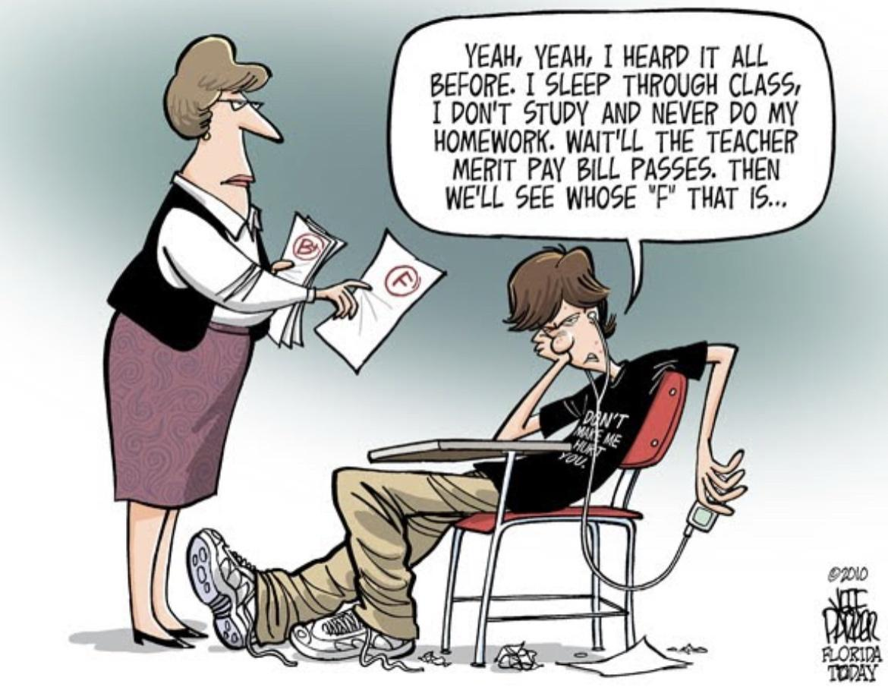
Whose ‘F’ That Is
https://imgur.com/gallery/WQ6Pxy7

Slide 13
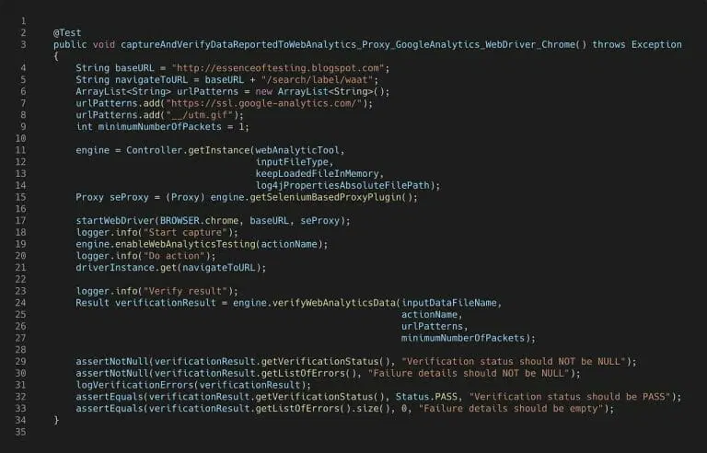
Testing: Automated Testing
Automated testing helps support agile development
https://applitools.com/blog/guide-testing-automating-data-analytics-events-web-mobile
https://medium.com/usa-today-network/automating-analytics-testing-25aa824c2e61
Video: https://www.youtube.com/watch?v=al-_r8hVHmo

Slide 14
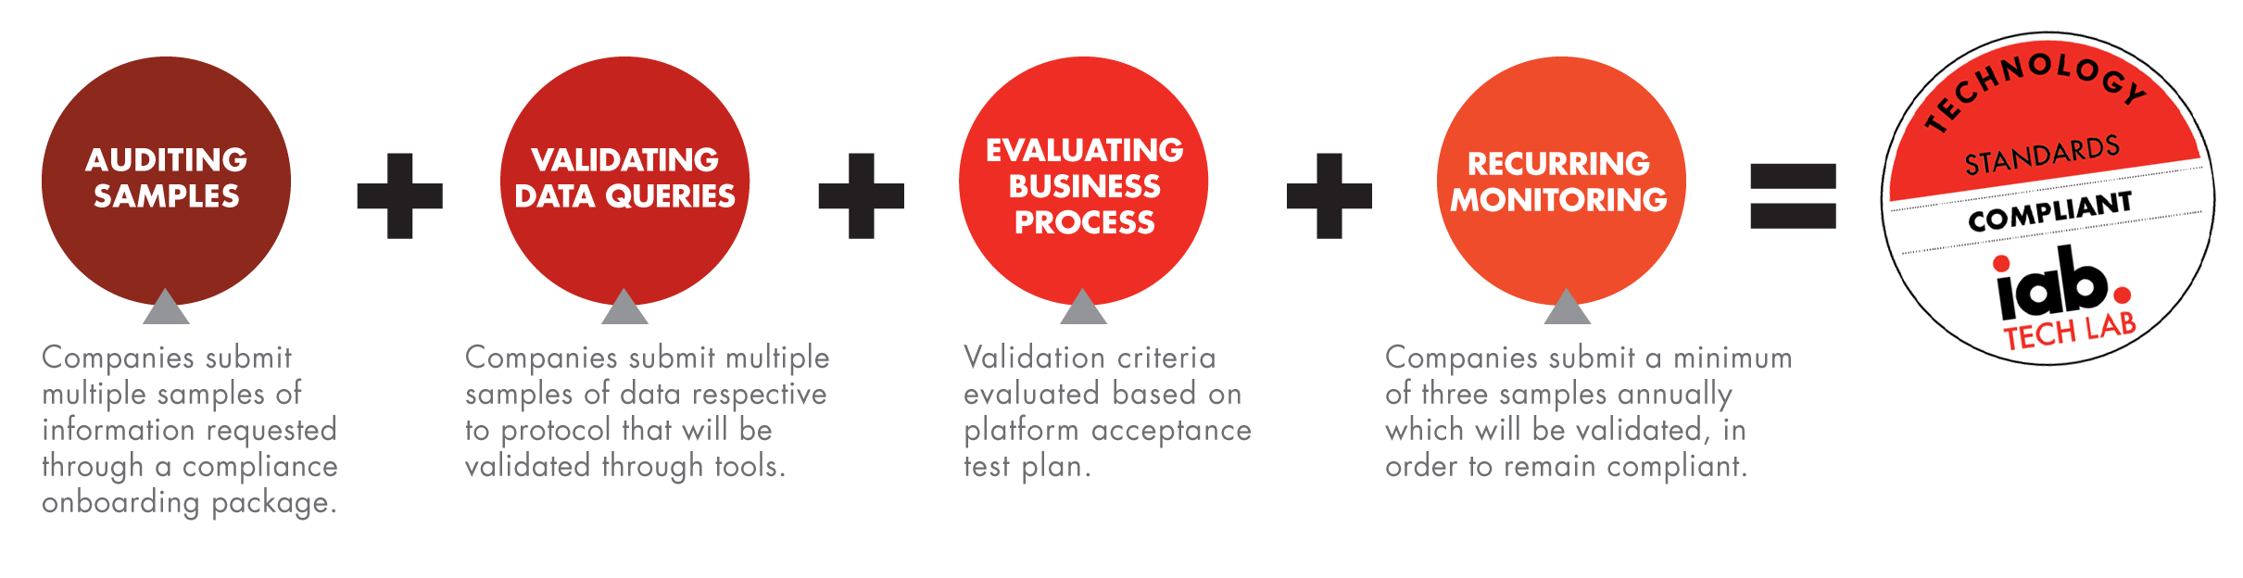
Standards For Validation And Transparency
Rigor of the standards varies with the risks involved
Data may be shared but identifiable data must be withheld
Transparency key: “variables, such as age, sex, primary payer, inpatient utilization, and blood pressure, should be described.”
Because of potential conflict of interest, “scientific peer review and independent validation are desirable”
https://www.healthaffairs.org/doi/10.1377/hlthaff.2014.0048 https://iabtechlab.com/compliance-programs/

Slide 15
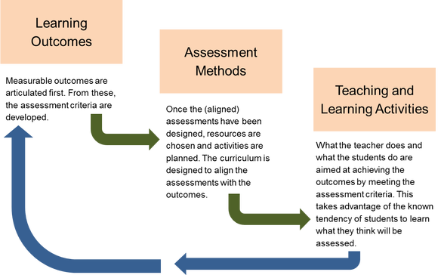
Outcomes Assessment
Outcomes assessed should include:
  ‘hard’ end points (readmissions, failures)
  Secondary outcomes, such as care, trust, anxiety and activation
  Provider-centered outcomes such as workflow and job satisfaction
https://www.healthaffairs.org/doi/10.1377/hlthaff.2014.0048
Image: https://onedisruptiveeducator.com/2018/09/16/aligning-outcomes-assessments-and-activities/

Slide 16
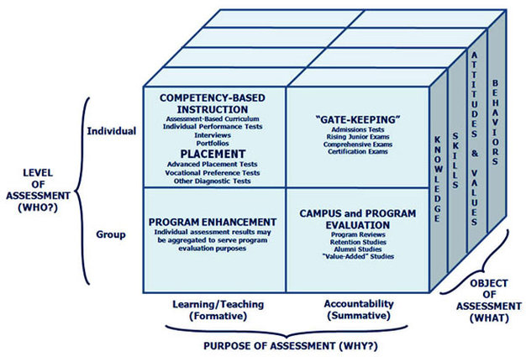
Multiple Outcomes
Collect multiple outcomes
  Each one may tell a different story
    Can/should the model be localized, i.e. “monitored, refined, and reconfigured to local contexts”? (deBruijn, 2020)
  Models may be valuable in one setting and process, but not others
  Ensure student and instructor voices are heard
http://jeandowns.weebly.com/module-1.html
https://www.healthaffairs.org/doi/10.1377/hlthaff.2014.0048

Slide 17
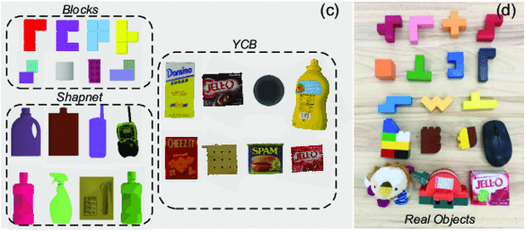
Conditions for Testing: Settings
Testing The Model In Real-World Settings - the model would be tested under real-world conditions with adequate protections and precautions
https://www.researchgate.net/figure/Experimental-Setting-and-Testing-Objects-ab-Simulation-and-real-world-experimental_fig1_351289429
I. Glenn Cohen;Ruben Amarasingham;Anand Shah;Bin Xie;Bernard Lo, 2014. The Legal And Ethical Concerns That Arise From Using Complex Predictive Analytics In Health Care. Health Affairs Vol. 33, No. 7: Using Big Data To Transform Care. https://www.healthaffairs.org/doi/10.1377/hlthaff.2014.0048

Slide 18
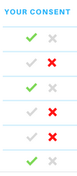
Conditions for Testing: Consent
“It is unclear whether explicit consent to the use of personal data in predictive analytics is legally or ethically required.” Why?
    patients are generally unaware if their physicians are using computerized decision aids
    if people could opt out of existing allocation systems, their decisions might unfairly give them priority over other patients.
    “the institutions under consideration should be required to explain whatever predictive analytics development and evaluation they are undergoing and the likely benefits and risks.”
https://www.healthaffairs.org/doi/10.1377/hlthaff.2014.0048

Slide 19
Knowledge Mobilization
Knowledge translation
  coined by the Canadian Institutes of Health Research (CIHR) in 2000
  "the exchange, synthesis and ethically-sound application of knowledge—within a complex system of interactions among researchers and users”
Knowledge mobilization
  “activities relating to the production and use of research results, including knowledge synthesis, dissemination, transfer, exchange, and co-creation or co-production by researchers and knowledge users”
  “a term used to define the connection between academic research or creative works and organizations, people, and government”
https://ktdrr.org/ktlibrary/articles_pubs/ktmodels/
https://www.sshrc-crsh.gc.ca/funding-financement/policies-politiques/knowledge_mobilisation-mobilisation_des_connaissances-eng.aspx
https://www.uwinnipeg.ca/knowledge-mobilization/what-is-knowledge-mobilization.html

Slide 20
Application: Access
Equitable Access
There’s a risk that not all benefit equally from the models
    This is especially the case if there are licensing fees and other costs
    Also, hat is the impact of fees, costs, patents and other factors restricting access to the model (even in some cases for people who provided some of the data) (deBruijn, 2020)
“As a matter of fairness, those who contribute most to developing a model, including the patients who contribute their data, should proportionally enjoy its benefits”
https://www.healthaffairs.org/doi/10.1377/hlthaff.2014.0048
Also: https://medium.com/@AINowInstitute/ai-in-2018-a-year-in-review-8b161ead2b4e

Slide 21

Access and Power
‘When you have near omniscience, how you choose to apply that becomes a matter of importance’ - Stacy Higginbotham, TWIG, January 22, 2020. Eg. all the police resources will be applied to solve a robbery of a white well-off woman, but not the poor black woman.
I would add - consider the case of missing and murdered indigenous women, where the police simply chose not to pursue the cases.

Slide 22
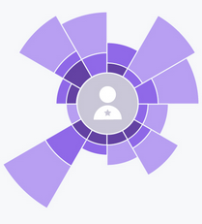
Application: The Human Element
James Clay (2020) writes, “We must not forget the human element of data and analytics. It’s not enough to deliver accurate analysis, predictions, and visualisations. Staff and students in universities and colleges need to be data literate to enable them to understand and act on that data. Appropriate and effective interventions will only be possible if staff and students are able to understand what is being presented to them and know what and how they could act as a result.”
Effective Learning Analytics: Using data and analytics to support students
Data does matter, and so does ethics
By James Clay January 24, 2020

Slide 23
Application: Implemetation
Concern about flawed implementation
  May be caused by zeal or pressure to cut costs
May result from:
  poorly constructed workflows
  Insufficient consideration of client preferences
  Inadequate checks and balances on machine decision-making
  Used for ‘off-label’ and unproven uses
Mark Liberman observes, "End-to-end techniques, which eliminate human-defined layers like words, so that speech-to-text systems learn to map directly between sound waveforms and letter strings, are especially brittle." What this means is that AI is still (and for the foreseeable future) limited to specific context-insensitive domains.
Arun Narayanan et al., Recognizing Long-Form Speech Using Streaming End-To-End Models. https://arxiv.org/abs/1910.11455
https://www.healthaffairs.org/doi/10.1377/hlthaff.2014.0048

Slide 24

Application: Choice Architecture
Choice architecture - “To help the consumers of the model—both providers and patients—the model must present them with choices.”
Choice architecture is a concept of behavioral economics developed by Cass Sunstein and Richard Thaler, presented in their book [2]. The theory developed by them says that the decision-making process is impacted by how the options are shown.
https://www.healthaffairs.org/doi/10.1377/hlthaff.2014.0048
https://towardsdatascience.com/machine-learning-and-the-architecture-of-choice-2cc69072a45b

