Slide 1
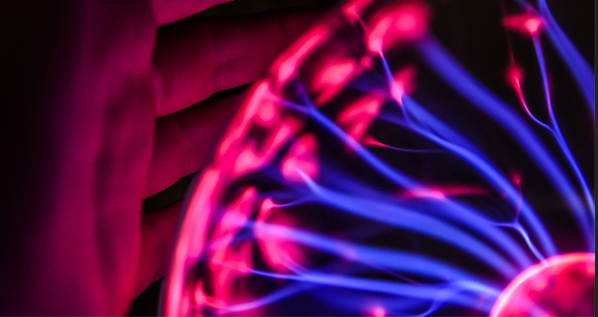
Tools and Algorithms
Stephen Downes
December 7, 2021

Slide 2

Tools and Algorithms
Developers cannot just ask, “What do I need to do to fix my algorithm?” They must rather ask: “How does my algorithm interact with society at large, and as it currently is, including its structural inequalities?” (Zimmerman, et.al., 2020)
Title Image: https://ethicstoolkit.ai/
https://www.pewresearch.org/internet/2017/02/08/code-dependent-pros-and-cons-of-the-algorithm-age/

Slide 3
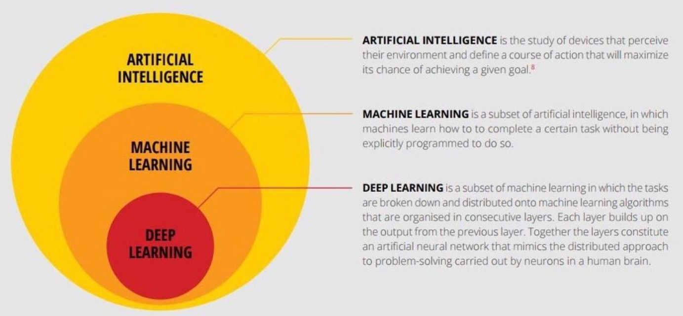
Artificial Intelligence
https://medium.com/intro-to-artificial-intelligence/deep-learning-series-1-intro-to-deep-learning-abb1780ee20

Slide 4
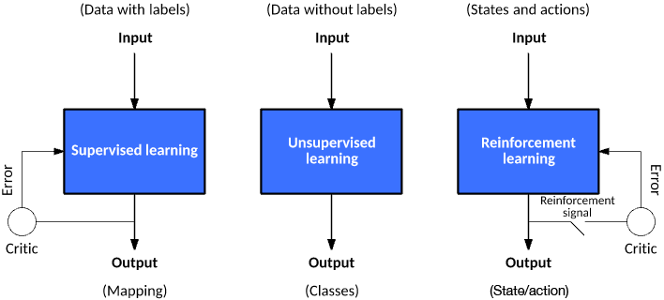
Types of Machine Learning
Supervised
  Uses labeled datasets to train algorithms
Unsupervised
  Discover hidden patterns in unlabeled data without human intervention
Reinforcement
  Applied within a context and uses environment states as input
https://www.ibm.com/cloud/learn/supervised-learning
https://www.ibm.com/cloud/learn/unsupervised-learning
https://developer.ibm.com/articles/cc-models-machine-learning/#reinforcement-learning

Slide 5
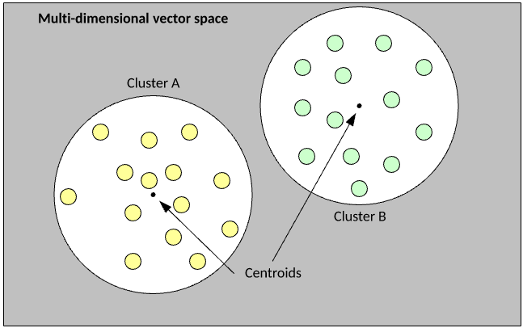
K-Means Clustering
This is an example of an unsupervised algorithm
“The goal of the algorithm is to partition examples from a data set into k clusters. Each example is a numerical vector that allows the distance between vectors to be calculated as a Euclidean distance.”
https://developer.ibm.com/articles/cc-models-machine-learning/#reinforcement-learning
https://towardsdatascience.com/understanding-k-means-clustering-in-machine-learning-6a6e67336aa1
https://www.analyticsvidhya.com/blog/2019/08/comprehensive-guide-k-means-clustering/

Slide 6
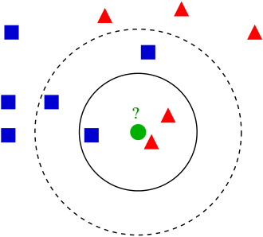
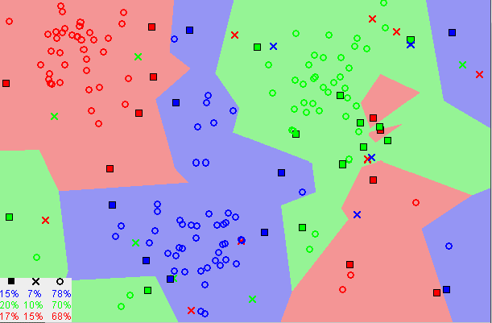
K-Nearest Neighbors
Clusters data into groups based on similarity or proximity
Example of k-NN classification. The test sample (green dot) should be classified either to blue squares or to red triangles. If k = 3 (solid line circle) it is assigned to the red triangles because there are 2 triangles and only 1 square inside the inner circle. If k = 5 (dashed line circle) it is assigned to the blue squares (3 squares vs. 2 triangles inside the outer circle).
https://www.codecademy.com/learn/introduction-to-supervised-learning-skill-path/modules/k-nearest-neighbors-skill-path/cheatsheet
https://en.wikipedia.org/wiki/K-nearest_neighbors_algorithm

Slide 7
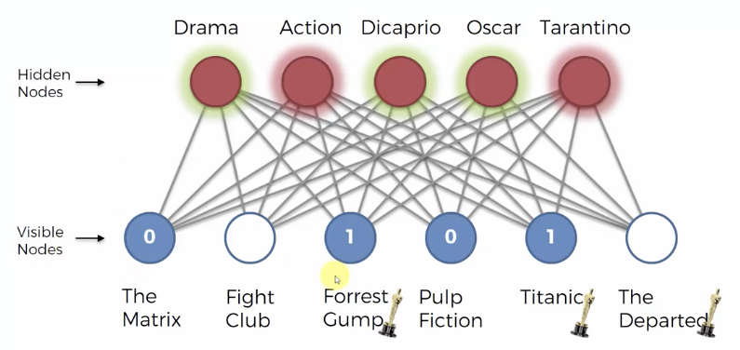
Learning Algorithms
A learning algorithm is a method or system used to update the weights between connections
Image: https://demyank.tistory.com/351

Slide 8
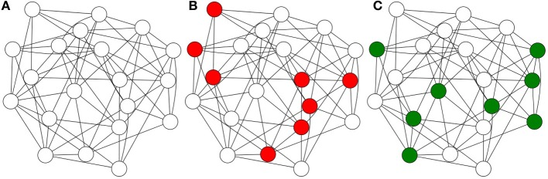
Hebbian Learning
Often summarized as "Cells that fire together wire together."
https://en.wikipedia.org/wiki/Hebbian_theory
Image:https://www.researchgate.net/publication/262150025_Sparse_Distributed_Memory_understanding_the_speed_and_robustness_of_expert_memory

Slide 9
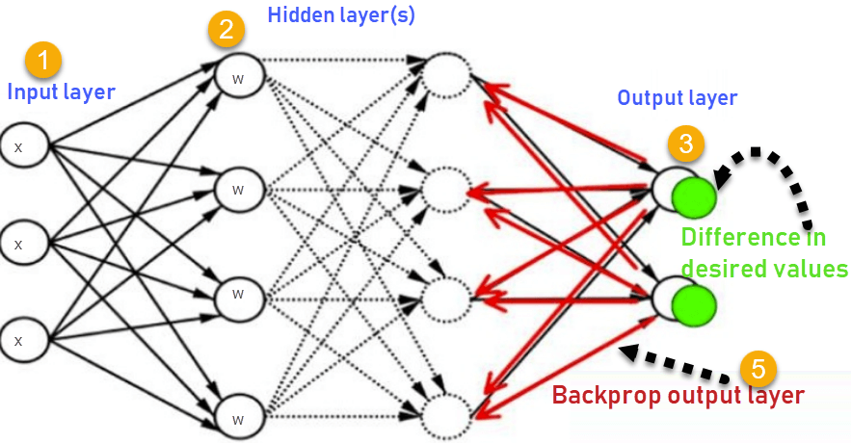
Backpropagation
Described previously (https://ethics.mooc.ca/presentation/59)
Errors are measured and correction sent back through the network
https://www.guru99.com/backpropogation-neural-network.html

Slide 10
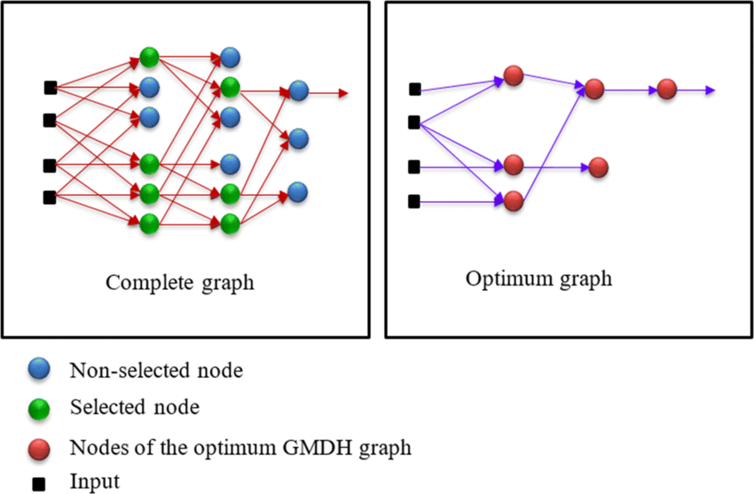
Group Method of Data Handling (GMDH)
“The algorithm develops neurons for all possible combinations of two inputs to the layer. It then continues to choose only those neurons that supply the best possible MSE.”
https://en.wikipedia.org/wiki/Group_method_of_data_handling
http://www.gmdh.net/
https://www.researchgate.net/publication/315684693_Neural_Network_Training_Using_a_GMDH_Type_Algorithm

Slide 11
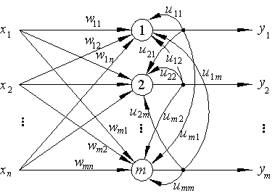
Competitive Learning
“Nodes compete for the right to respond to a subset of the input data. The individual neurons of the network learn to specialize on ensembles of similar patterns and in so doing become 'feature detectors' for different classes of input patterns.”
https://neuron.eng.wayne.edu/tarek/MITbook/chap3/3_4.html https://archive.org/details/paralleldistribu00rume/page/151/mode/2up
https://en.wikipedia.org/wiki/Competitive_learning

Slide 12
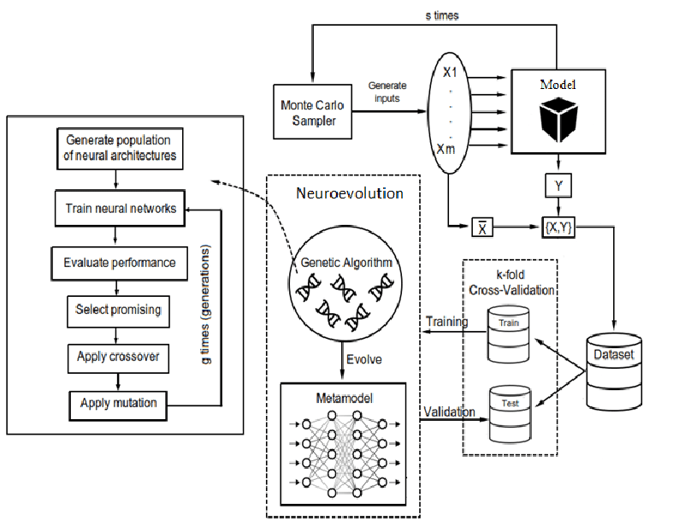
Neuroevolution
Evolutionary algorithms generate neural networks, parameters, topology and rules.
https://www.researchgate.net/publication/349150012_Neuroevolutionary_Approach_to_Metamodel-Based_Optimization_in_Production_and_Logistics
https://en.wikipedia.org/wiki/Neuroevolution
https://www.nature.com/articles/s42256-018-0006-z
https://towardsdatascience.com/a-primer-on-the-fundamental-concepts-of-neuroevolution-9068f532f7f7
Vid: https://www.youtube.com/watch?v=lu5ul7z4icQ

Slide 13
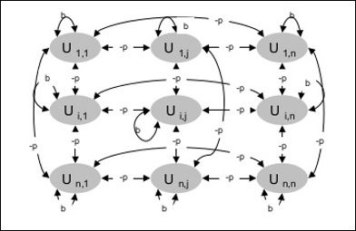
Restricted Boltzmann Machine
“While RBMs are occasionally used, most practitioners in the machine-learning community have deprecated them in favor of generative adversarial networks or variational autoencoders. RBMs are the Model T’s of neural networks – interesting for historical reasons, but surpassed by more up-to-date models.”
https://wiki.pathmind.com/restricted-boltzmann-machine
https://www.tutorialspoint.com/artificial_neural_network/artificial_neural_network_boltzmann_machine.htm

Slide 14
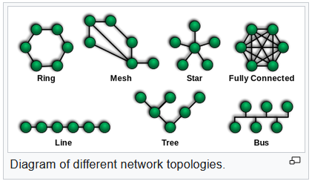
Network Topology
Physical topology is the placement of network components
Logical topology shows how data flows within a network
https://en.wikipedia.org/wiki/Network_topology

Slide 15
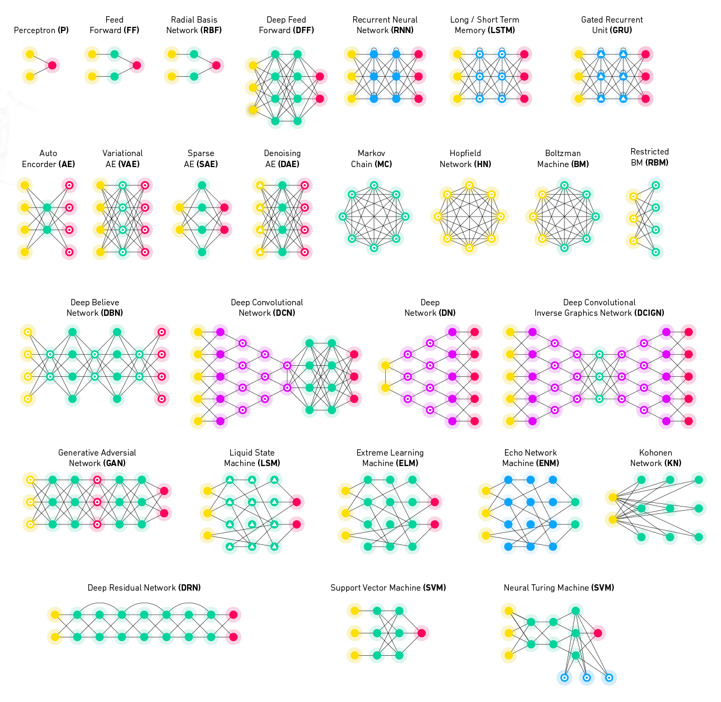
Topologies
There is a rich array of machine learning and AI designs. We’ll look at only a few classic ones in this presentation.
https://docs.paperspace.com/machine-learning/wiki/machine-learning-models-explained

Slide 16
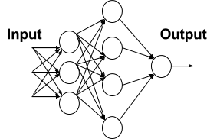
Feedforward Neural Networks
Example: the perceptron and multi-layer perceptron
Data flows from input to output (ie., it feeds forward)
https://en.wikipedia.org/wiki/Feedforward_neural_network
https://towardsdatascience.com/deep-learning-feedforward-neural-network-26a6705dbdc7

Slide 17
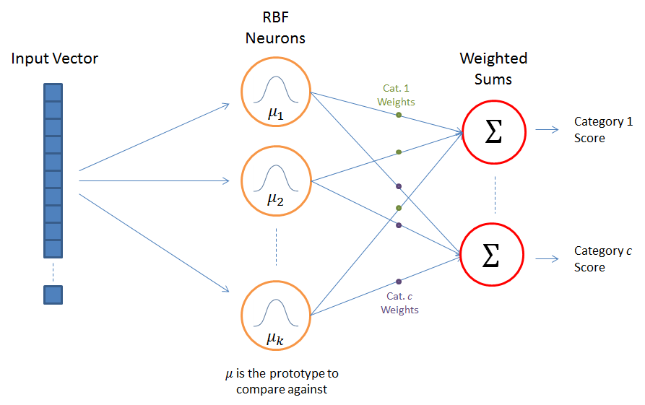
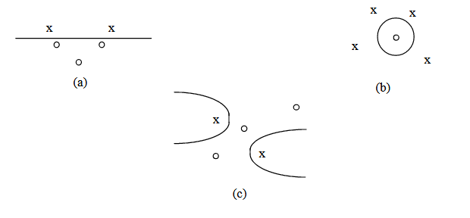
Radial Basis Networks
Radial Basis Function network was formulated by Broomhead and Lowe in 1988.
These are non-linear classifiers (ie., they draw circles in data).
https://vtechworks.lib.vt.edu/bitstream/handle/10919/36847/Ch3.pdf?sequence=5
https://www.cc.gatech.edu/~isbell/tutorials/rbf-intro.pdf

Slide 18
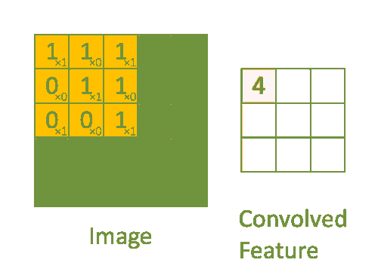
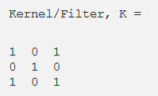
Convolutional Neural Network
A CNN samples different parts of the input data using a filter. These filters can be thought of as feature detectors.
The convolution layer is usually followed with a pooling layer, which reduces the overall size of the matrix. It is then fed into (e.g.) a perceptron.
Convoluting a 5x5x1 image with a 3x3x1 kernel to get a 3x3x1 convolved feature
https://towardsdatascience.com/a-comprehensive-guide-to-convolutional-neural-networks-the-eli5-way-3bd2b1164a53

Slide 19
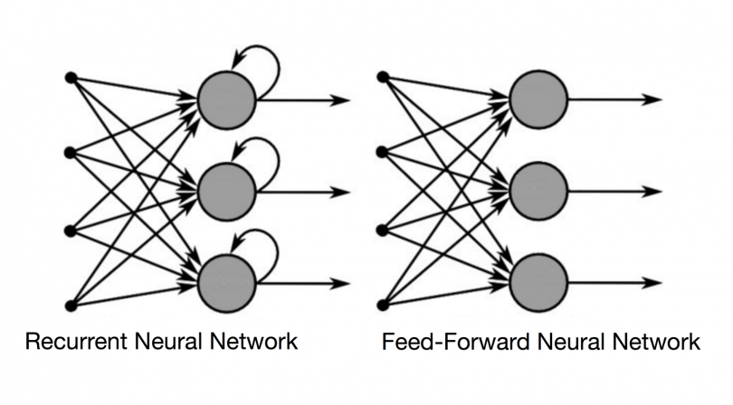
Recurrent Neural Networks
In RNNs the output from one neuron becomes the input for other neurons.
Fully recurrent neural networks (FRNN) connect all neurons to each other.
In simple recurrent networks (SRN) context units feed back into other units in a 3-layer network.
https://en.wikipedia.org/wiki/Recurrent_neural_network
https://builtin.com/data-science/recurrent-neural-networks-and-lstm

Slide 20
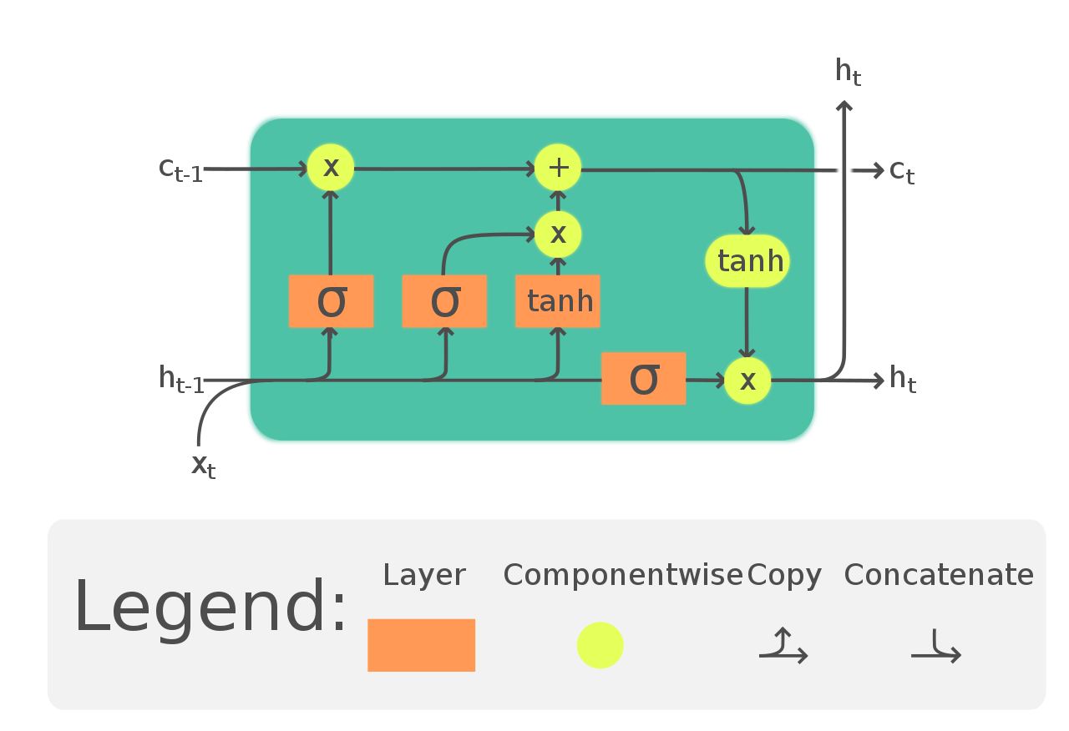
Long short-term memory (LSTM)
“The Long Short-Term Memory (LSTM) cell can process data sequentially and keep its hidden state through time… LSTM is applicable to tasks such as unsegmented, connected handwriting recognition, speech recognition and anomaly detection”
https://en.wikipedia.org/wiki/Long_short-term_memory

Slide 21
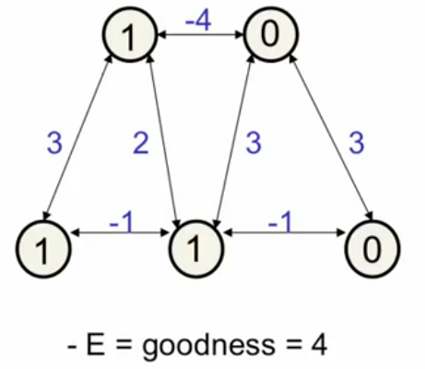
Hopfield Networks
Hopfield (1982): memories could be energy minima of a neural net. “The purpose of a Hopfield net is to store 1 or more patterns and to recall the full patterns based on partial input.”
https://towardsdatascience.com/hopfield-networks-are-useless-heres-why-you-should-learn-them-f0930ebeadcd
Vid: https://www.youtube.com/watch?v=DS6k0PhBjpI

Slide 22
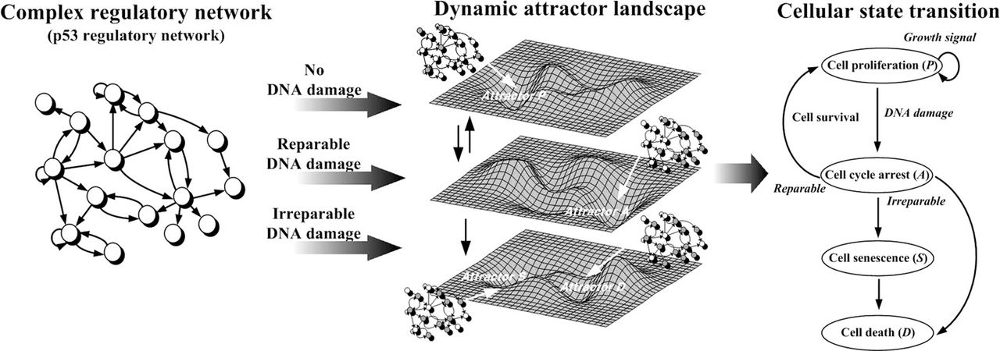
Attractor Networks
“An attractor network is a type of recurrent dynamical network that evolves toward a stable pattern over time”
https://en.wikipedia.org/wiki/Attractor_network
http://www.scholarpedia.org/article/Attractor_network

Slide 23
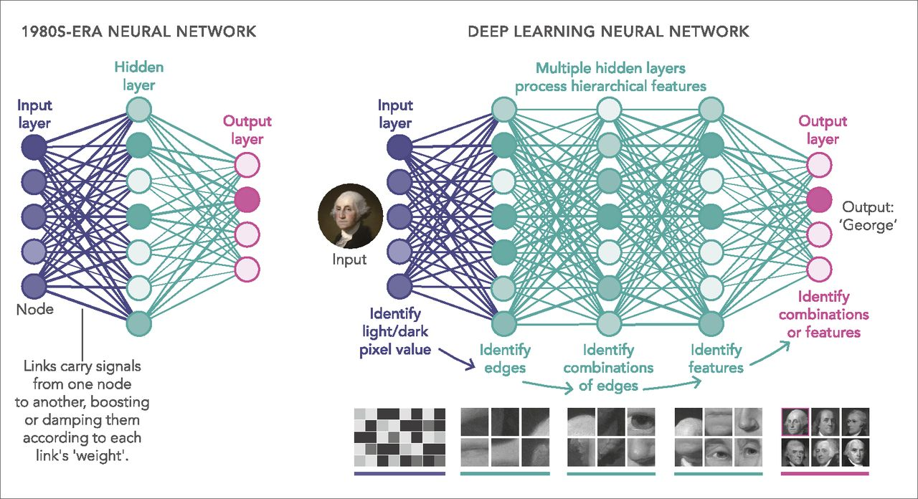
Deep Learning
Deep learning is a term used to describe neural networks with multiple hidden layers (hence, ‘deep’)
https://en.wikipedia.org/wiki/Deep_learning https://www.pnas.org/content/116/4/1074

Slide 24
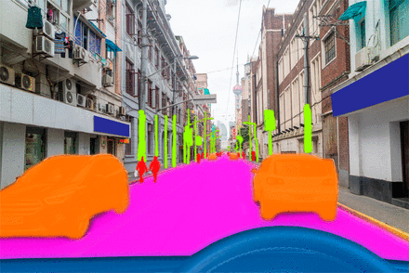
Frameworks
Scikit Learn
TensorFlow
Theano
Caffe
MxNet
Keras
PyTorch
CNTK
Auto ML
OpenNN
Google ML Kit

