Slide 1
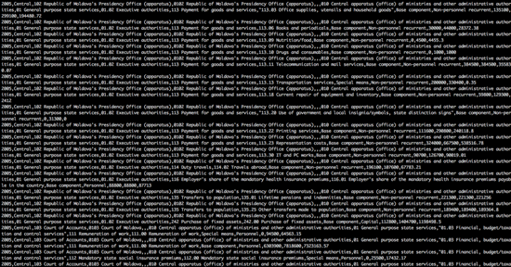
Working With Data
Stephen Downes
December 4, 2021

Slide 2
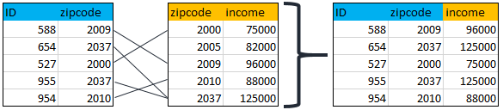
Combining Data
Data seldom stands alone – data is linked to other data, and can reveal more than was intended (e.g. criminal caught by sister’s DNA) (Cohen, et.al., 2018)
Data on travel may be used for discovering things far beyond mere travel patterns; data on purchases are not solely relevant to purchases; and so on. (Hand, 2019)
https://www.displayr.com/what-is-data-merging/

Slide 3
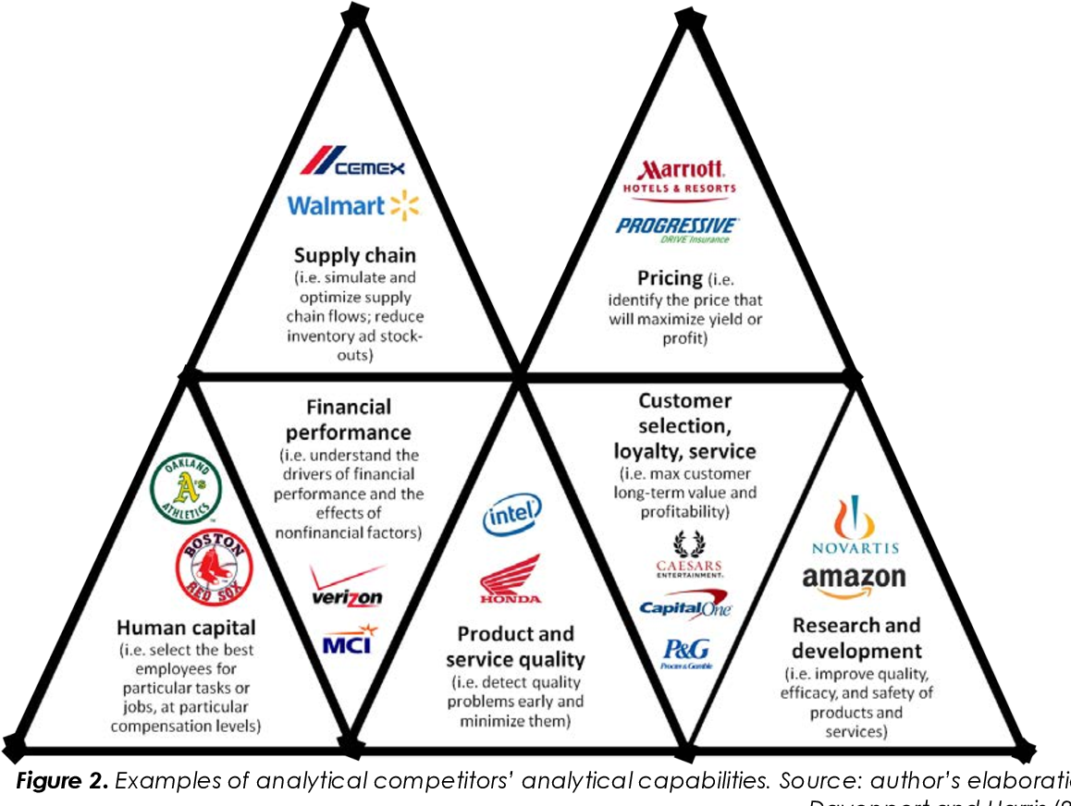
Unpacking Implications
CDS unpacks “the work these data assemblages do in the context of dataveillance, the attrition and loss of privacy, the impact of profiling and social sorting, and the downstream use of data, to mention but a few.”
Prinsloo 2019 https://epress.lib.uts.edu.au/journals/index.php/JLA/article/view/6589/7307
https://www.semanticscholar.org/paper/When-big-data-meets-dataveillance%3A-the-hidden-side-Esposti/11aed548023909f4efd4c9b6d7d27d0cf70ae8af

Slide 4
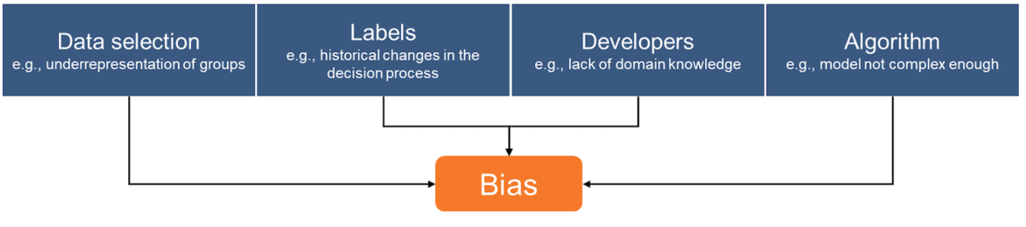
Bias (Causes)
An incomplete or skewed training dataset
Labels used for training: training data is labeled in order to teach the model how to behave, and humans create these labels…
Features and modeling techniques - the measurements used as inputs for machine-learning models, or the actual model training itself
Josh Feast. (2019). 4 Ways to Address Gender Bias in AI. Harvard Business Review Online. November 20, 2019. https://hbr.org/2019/11/4-ways-to-address-gender-bias-in-ai

Slide 5
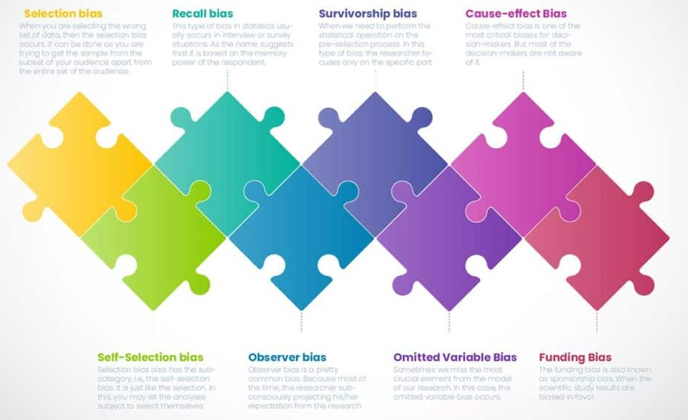
Bias (Types)
https://statanalytica.com/blog/bias-in-statistics/

Slide 6
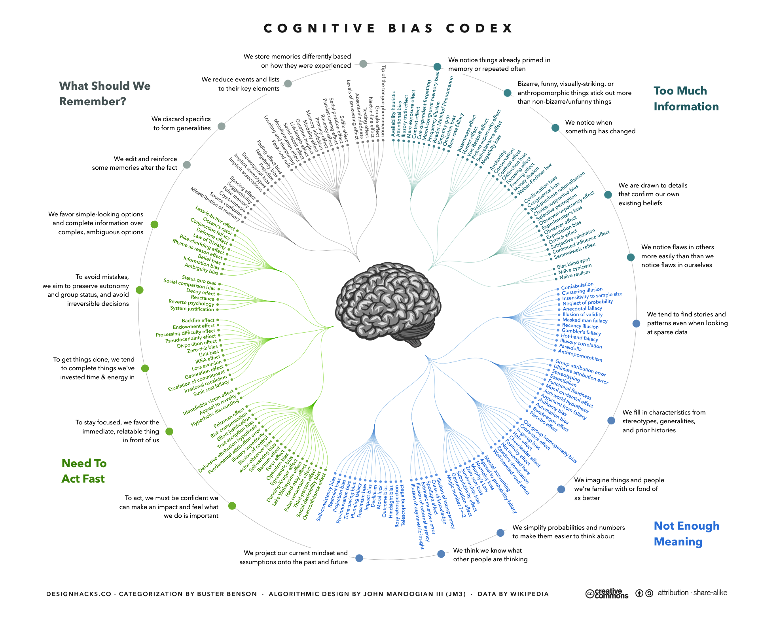
Cognitive Bias Codex
https://greatminds.consulting/insight/cognitive-bias-a-mental-shortcut-that-causes-a-mistake-in-reasoning
https://greatminds.consulting/wp-content/uploads/2019/08/The_Cognitive_Bias_Codex_-_180_biases_designed_by_John_Manoogian_III_jm3.png

Slide 7
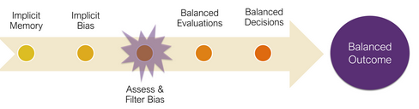
Bias (Remedies)
Ensure diversity in the training samples
Ensure that humans labeling come from diverse backgrounds.
Measure accuracy levels separately for different demographic categories to identify when one category is being treated unfavorably.
Solve for unfairness by collecting more training data associated with sensitive groups.
Josh Feast. (2019). 4 Ways to Address Gender Bias in AI. Harvard Business Review Online. November 20, 2019. https://hbr.org/2019/11/4-ways-to-address-gender-bias-in-ai

Slide 8
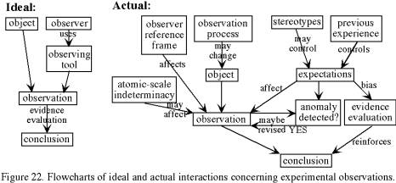
Data and Objectivity
Data should never be accepted on faith
There is no such thing as context-free data; data cannot manifest the kind of perfect objectivity that is sometimes imagined.
Lisa Gitelman and Virginia Jackson point out in the introduction to the aptly titled “Raw Data Is an Oxymoron“ (2013)
  All from Radan, 2019: 16
Eugenia Lee https://slideplayer.com/slide/14962871/
https://emotionalcompetency.com/sci/sm6.htm

Slide 9

Data Risks
The danger of stale and outdated data (Cohen, et.al., 2014)
Sensitive files subject to regulations like GDPR, HIPAA and PCI (Varonis, 2019)
Lack of space, time, and social context limitation on scope of data (Hand, 2018)
Use for unexpected purposes and to reveal unexpected information
Risk of exceptional intrusiveness since
Potential for misuse, privacy breach, blackmail, and other crimes.
Ghost users and accounts
We need to be clear about who benefits and who incurs the risk
https://www.varonis.com/blog/data-risk-report-highlights-2019/

Slide 10
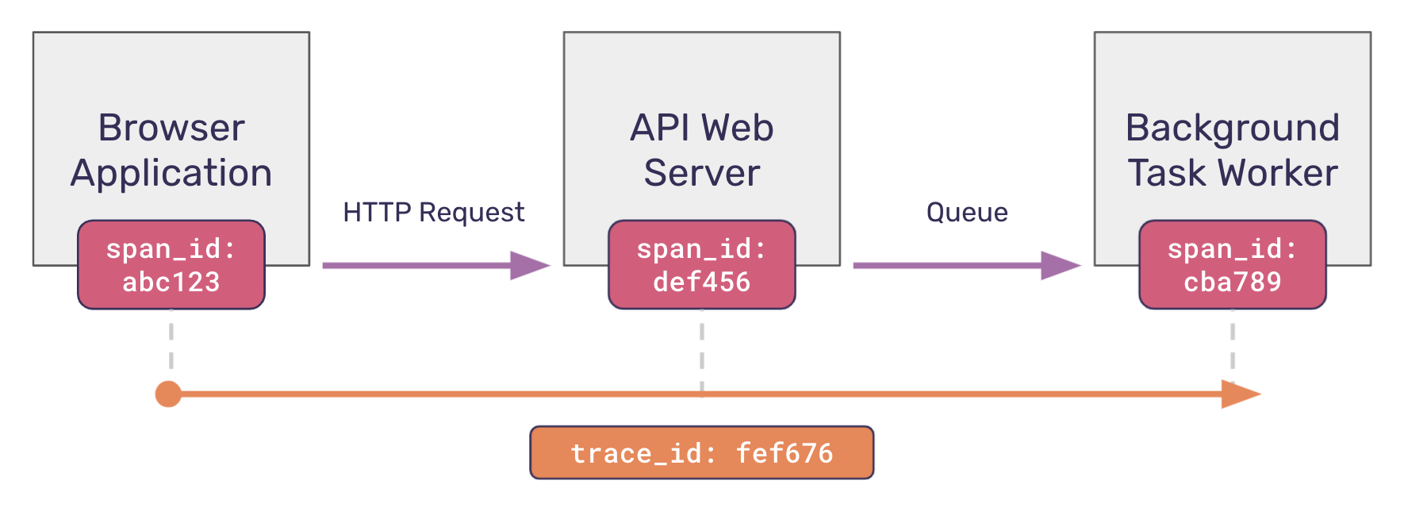
Data Tracing
Using markers or signs to track the flow of data through a network
“We call this new verification method ‘radioactive’ data because it is analogous to the use of radioactive markers in medicine.”
Examples: watermarks, embedded metadata, hash addressing
Alexandre Sablayrolles, Matthijs Douze, Hervé Jégou. (2020). Using ‘radioactive data’ to detect if a data set was used for training. Facebook Artificial Intelligence. February 05, 2020. https://ai.facebook.com/blog/using-radioactive-data-to-detect-if-a-data-set-was-used-for-training/

Slide 11
Data Ownership
Data ownership refers to both the possession of and responsibility for information. Ownership implies power as well as control.
  Who owns the data?
  Who owns the information the data is about?
Loshin (2002) identifies a list of parties laying a potential claim to data:
Creator – The party that creates or generate data
Consumer – The party that uses the data owns the data
Compiler - This is the entity that selects and compiles information from different information sources
Enterprise - All data that enters the enterprise or is created within the enterprise is completely owned by the enterprise
Funder - the user that commissions the data creation claims ownership
Decoder - In environments where information is “locked” inside particular encoded formats, the party that can unlock the information becomes an owner of that information
Packager - the party that collects information for a particular use and adds value through formatting the information for a particular market or set of consumers
Reader as owner - the value of any data that can be read is subsumed by the reader and, therefore, the reader gains value through adding that information to an information repository
Subject as owner - the subject of the data claims ownership of that data, mostly in reaction to another party claiming ownership of the same data
Purchaser/Licenser as Owner – the individual or organization that buys or licenses data may stake a claim to ownership
https://ori.hhs.gov/education/products/n_illinois_u/datamanagement/dotopic.html

