Slide 1
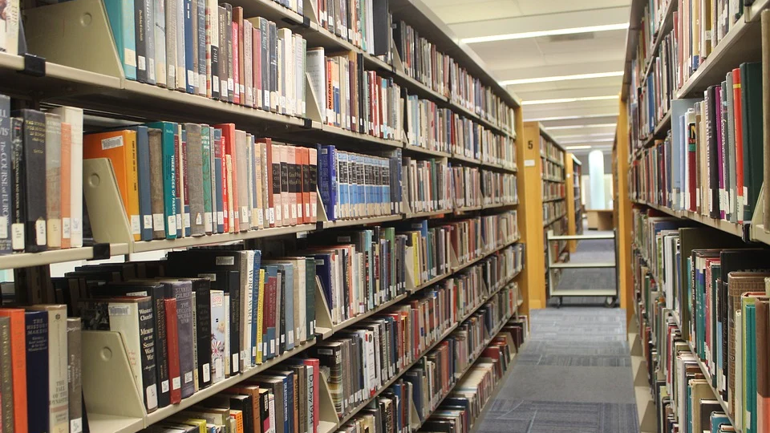
Organizing Data
Stephen Downes
December 4, 2021

Slide 2
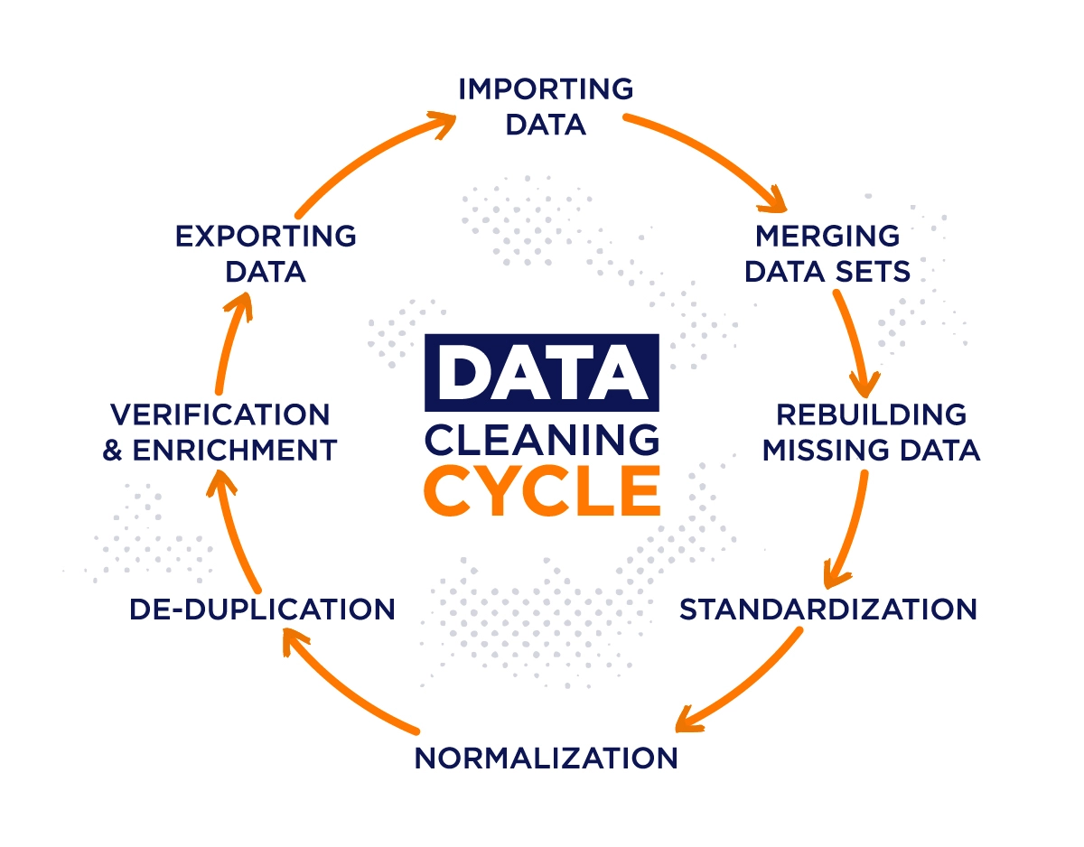
Data Cleaning
“Data cleaning is the process of identifying, deleting, and/or replacing inconsistent or incorrect information from the database.”
https://www.iteratorshq.com/blog/data-cleaning-in-5-easy-steps/

Slide 3
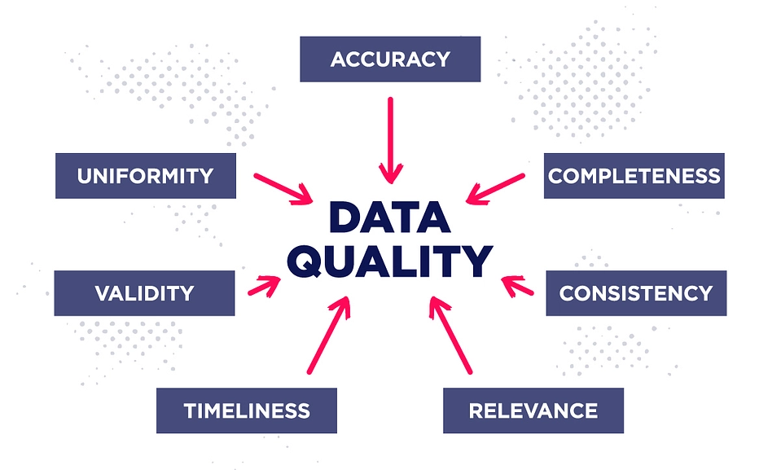
Data Quality Revisited
Now we see data quality not as an attribute of source data, but as an output of data cleaning
https://www.iteratorshq.com/blog/data-cleaning-in-5-easy-steps/

Slide 4
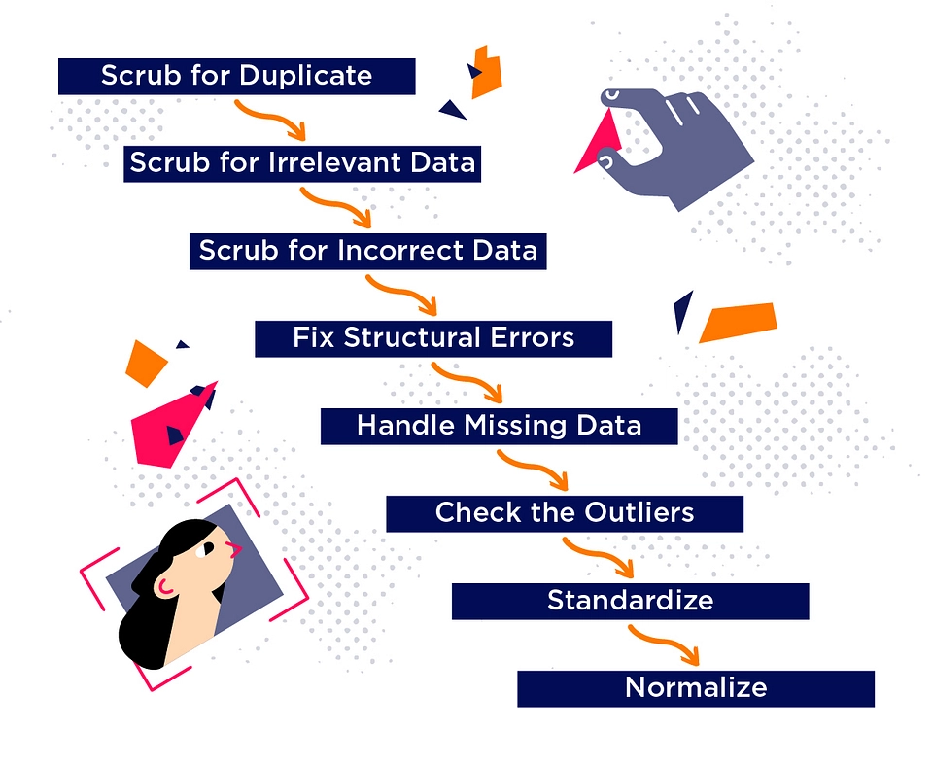
Data Cleaning Workflow
“An example of a typical data cleaning workflow, featuring a series of operations performed on the data repeatedly until reaching sufficient data quality.”
https://www.iteratorshq.com/blog/data-cleaning-in-5-easy-steps/

Slide 5
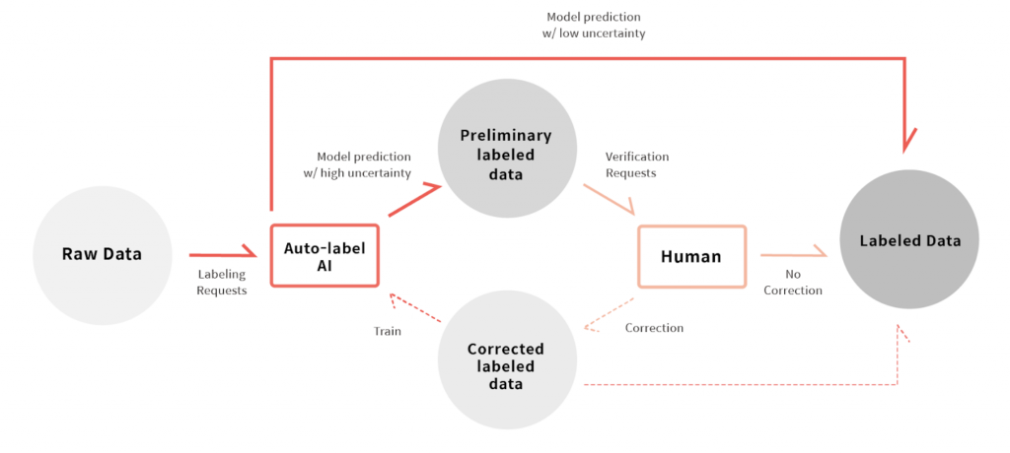
Classification and Naming
Classification and naming are essentially operations performed as a part of labeling in AI, that is, using human-readable signs that interpret a specific piece of data.

Slide 6
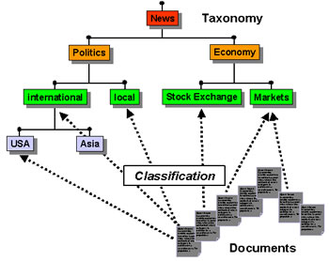



Taxonomies, Ontologies and Natural Kinds
Is there a ‘right’ way to label data? Do we all agree on what kinds of things there are in the world?
https://www.differencebetween.info/difference-between-taxonomy-and-ontology

Slide 7
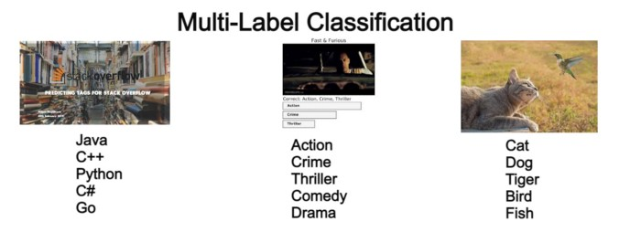
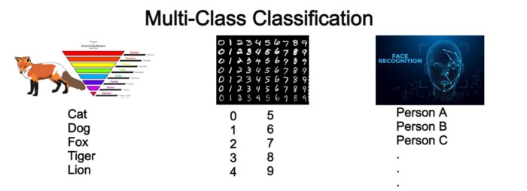
Classification Algorithms
Binary classification
Multiclass classification
Multilabel classification
Popular Classification Algorithms:
Logistic Regression
Naive Bayes
K-Nearest Neighbors
Decision Tree
Support Vector Machines
https://medium.com/swlh/3-types-of-classification-problems-in-machine-learning-1cffd3765ca1
https://monkeylearn.com/blog/classification-algorithms/

