Slide 1

Data
Stephen Downes
December 4, 2021

Slide 2
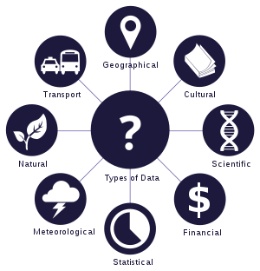
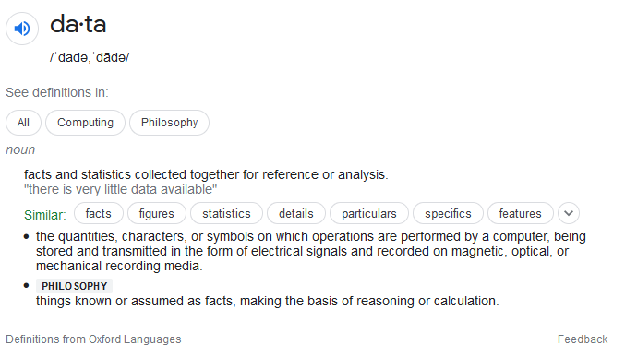
Data
https://www.google.com/search?q=what+is+data
https://en.wikipedia.org/wiki/Data

Slide 3
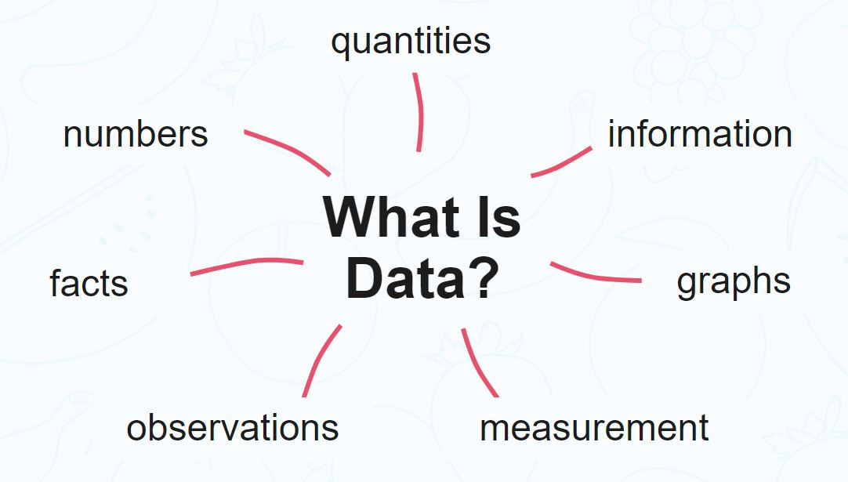
Data for Computation
data is information that has been translated into a form that is efficient for movement or processing.
data is information converted into binary digital form
Raw data is a term used to describe data in its most basic digital format.
Jack Vaughan https://searchdatamanagement.techtarget.com/definition/data
https://www.analyticsvidhya.com/blog/2021/04/statistics-and-probability-concepts-for-data-science/

Slide 4
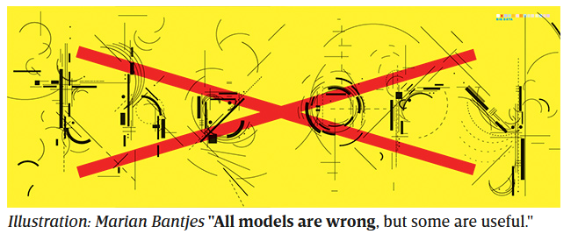
Data and the End of Theory
“This is a world where massive amounts of data and applied mathematics replace every other tool that might be brought to bear. Out with every theory of human behavior, from linguistics to sociology. Forget taxonomy, ontology, and psychology.”
Chris Anderson, 06.23.2008, The End of Theory: The Data Deluge Makes the Scientific Method Obsolete, Wired https://www.wired.com/2008/06/pb-theory/

Slide 5

Critical Questions for Big Data
better tools, services, and public goods?
  Or privacy incursions and invasive marketing?
understand online communities and political movements?
  Or track protesters and suppress speech?
transform how we study human communication and culture
  or narrow the palette of research options
  alter what ‘research’ means?
danah boyd & Kate Crawford - Critical Questions for Big Data
https://www.dhi.ac.uk/san/waysofbeing/data/communication-zangana-boyd-2012.pdf

Slide 6
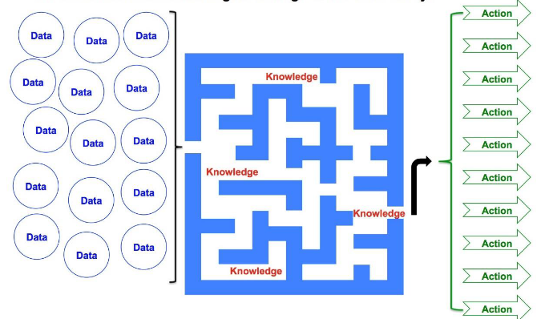
Critical Questions for Big Data
Big Data as a cultural, technological, and scholarly phenomenon that rests on the interplay of:
Technology
Analysis
Mythology
https://www.odni.gov/files/PE/Documents/2---2017-AEP_Community-Resilience.pdf
the widespread belief that large data sets offer a higher form of intelligence and knowledge that can generate insights that were previously impossible, with the aura of truth, objectivity, and accuracy.
danah boyd & Kate Crawford - Critical Questions for Big Data
https://www.dhi.ac.uk/san/waysofbeing/data/communication-zangana-boyd-2012.pdf

Slide 7
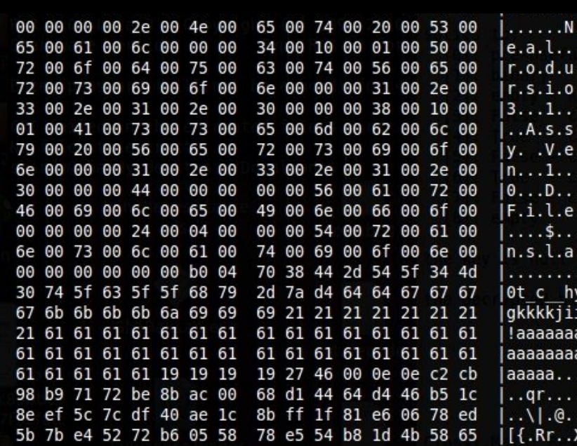
Critical Data Studies
Seven provocations:
  Situating ‘big data’ in time and space
  Technology is never as neutral as it appears
  ‘Big data’ does not determine social forms
  Data is never raw
  Big isn’t everything
  Counter-Data
  What is our praxis?
Craig Dalton and Jim Thatcher, May 12, 2014, What Does A Critical Data Studies Look Like, And Why Do We Care? https://www.societyandspace.org/articles/what-does-a-critical-data-studies-look-like-and-why-do-we-care

Slide 8
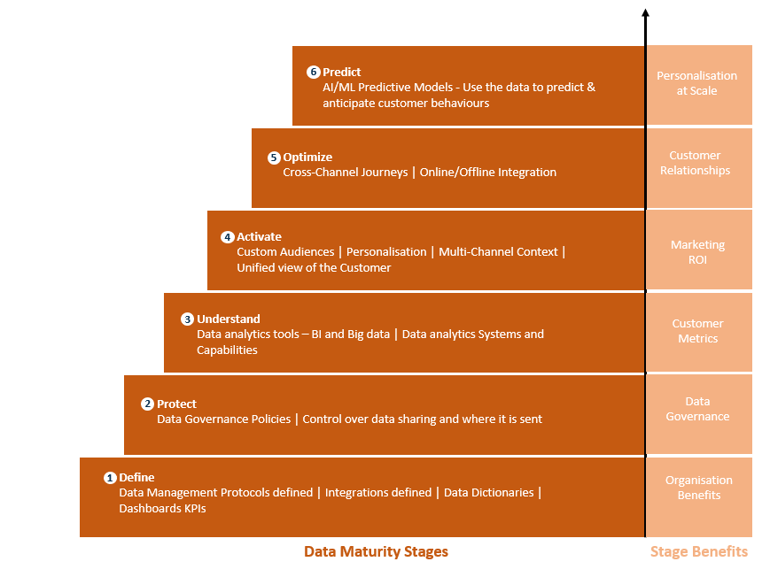
The Context of Critical Data Studies
CDS asks questions about:
  how we define data
  what data are not considered
  how data are produced
  How data are conceptualized
  How data are employed.
Prinsloo 2019 https://epress.lib.uts.edu.au/journals/index.php/JLA/article/view/6589/7307
https://gunjan-aggarwal.medium.com/six-steps-to-data-maturity-a-maturity-model-for-data-management-while-adopting-a-cdp-52575663fbd6

Slide 9

Data Sources
Data from LMSs (e.g. Instructure: Hill, 2019; Stein, 2019)
  Engagement Statistics
  Performance Statistics
Student interactions and discussion forum posts (Seufert, et.al., 2019)
Social media and sources outside the learning context
Data resulting from active intervention (Hand, 2018)
https://elearningindustry.com/sources-of-learning-analytics-should-collecting
Ackermann https://www.chapters.indigo.ca/en-ca/books/data-instruments-and-theory-a/9780691611884-item.html

