Slide 1

Classifying Data
Stephen Downes
December 4, 2021

Slide 2
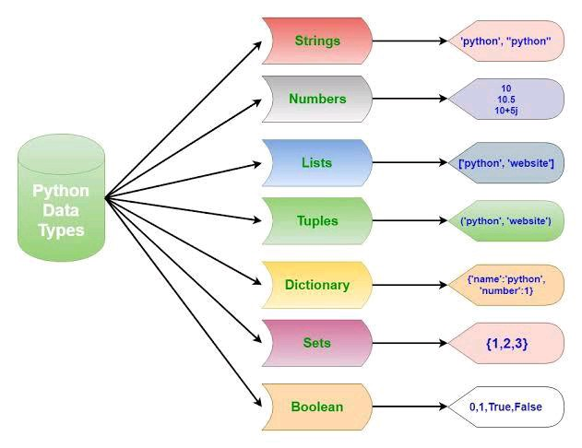
Data Types
Personal Data
  Pentland in 2007 suggested to the World Economic Forum16 that individuals might have control over their personal data, so that “a person's data would be equivalent to their ‘money.
Multimodal
  not only logs of activities completed on a computer or mobile devices, but also by employing such technologies as biosensors, eye tracking, infrared imaging, or wearable cameras (Blikstein & Worsley, 2016)
http://www3.weforum.org/docs/WEF_ITTC_PersonalDataNewAsset_Report_2011.pdf

Slide 3
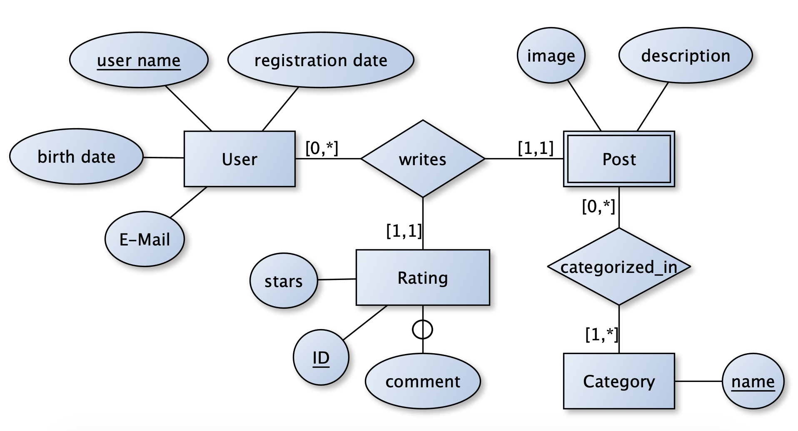
Entities
https://stackoverflow.com/questions/64726931/does-my-er-diagram-properly-represent-a-basic-website

Slide 4
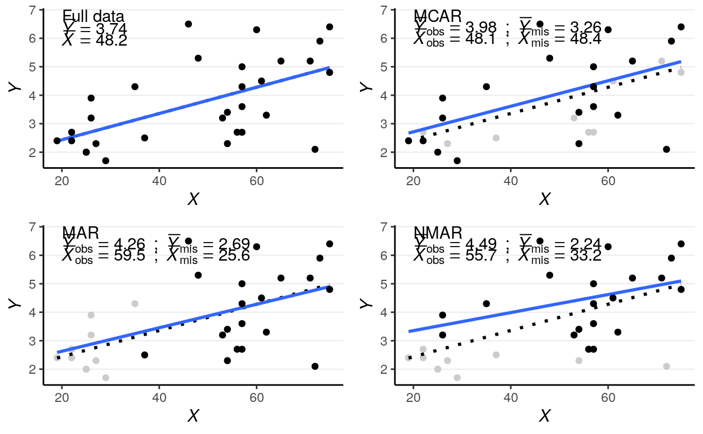
Omitted Data
“Omitted variable bias occurs when an algorithm lacks sufficient input information to make a truly informed prediction about someone, and learns instead to rely on available but inadequate proxy variables.” (Eckersley, et.al., 2017)
https://bookdown.org/marklhc/notes_bookdown/missing-data.html

Slide 5
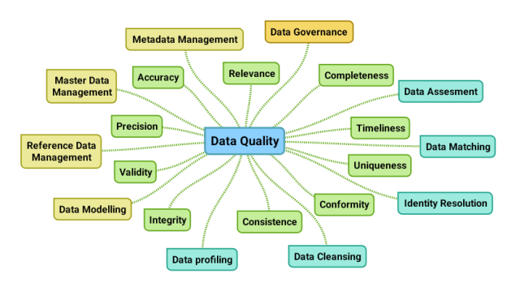
Data Quality
“The principle of ‘representative and high quality data,’ driven by what is colloquially referred to as the ‘garbage in, garbage out’ problem, is defined as the use of appropriate inputs to an AI system.” (Fjeld, et.al., 2020:49)
A Data Quality Mind Map
20th April 2019, Henrik Gabs Liliendahl https://liliendahl.com/2019/04/20/a-data-quality-mind-map/

Slide 6
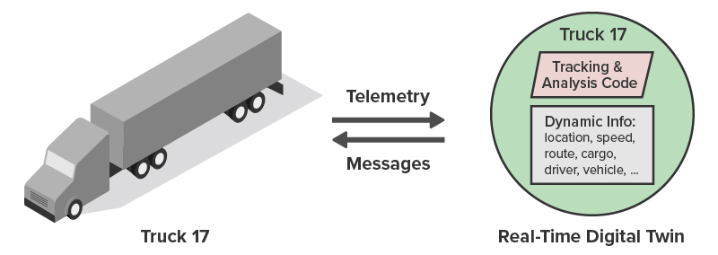
Real-Time and Dynamic Data
Dynamic: data sets often evolve and accumulate, so they may permit discoveries in the future that they do not permit today.
Real-time: online analysis and decision-making as data arrive post additional challenges
David J. Hand. (2018). Aspects of Data Ethics in a Changing World: Where Are We Now? Big Data, Vol. 6, No. 3. Published Online:17 Sep 2018 https://doi.org/10.1089/big.2018.0083
https://www.scaleoutsoftware.com/technology/why-use-real-time-digital-twins-for-streaming-analytics/

Slide 7
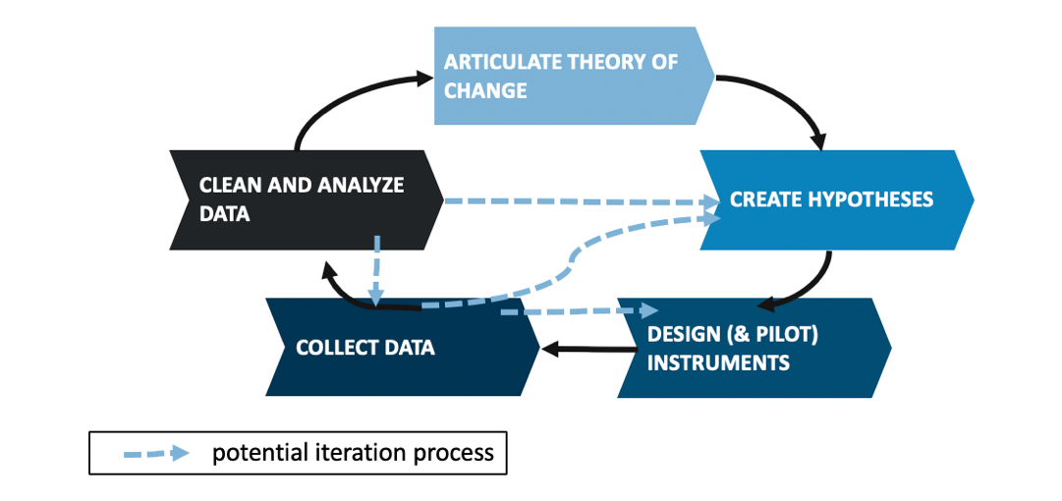
Data Assemblage
CDS asks us to consider the notion of the data assemblage, which “encompasses all of the technological, political, social and economic apparatuses and elements that constitutes and frames the generation, circulation and deployment of data” Ackermann
Prinsloo 2019 https://epress.lib.uts.edu.au/journals/index.php/JLA/article/view/6589/7307
https://medium.com/idinsight-blog/the-case-for-iteration-in-qualitative-research-design-e07ed1314756

