Slide 1

How AI Works
Stephen Downes
December 3, 2021

Slide 2
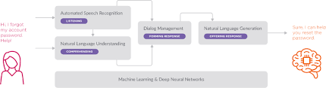
How AI Works
There are many good introductory videos for this subject:
  https://www.youtube.com/watch?v=L_9OluD0nqw
  https://www.youtube.com/watch?v=JrXazCEACVo
  https://www.youtube.com/watch?v=aircAruvnKk

Slide 3
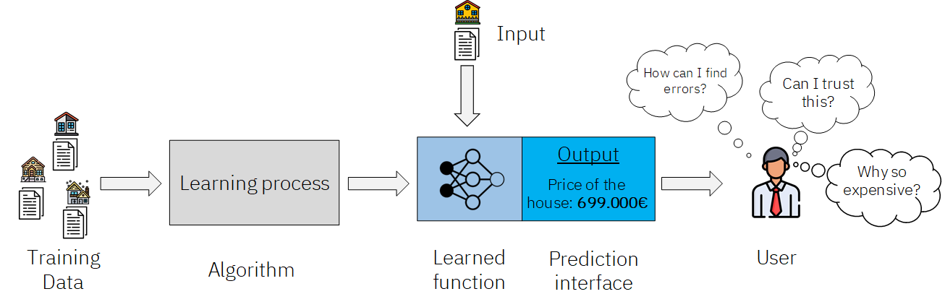
What Does AI Do?
A neural network is ultimately a statistical function, but one that manages tens of thousands of input variables
This presentation is about those values: what they are, and how they’re determined
Regression
Feature detection
Clustering
Prediction

Slide 4
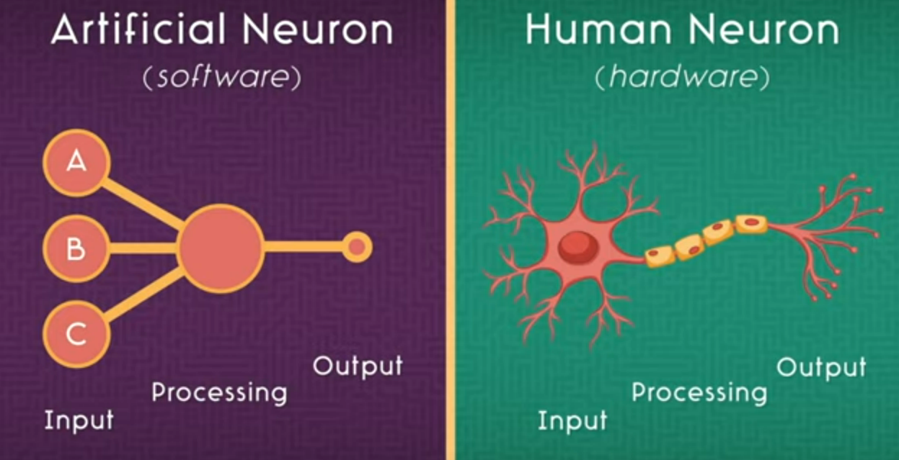
Perceptrons
A.k.a. an artificial neuron
https://www.youtube.com/watch?v=JrXazCEACVo

Slide 5
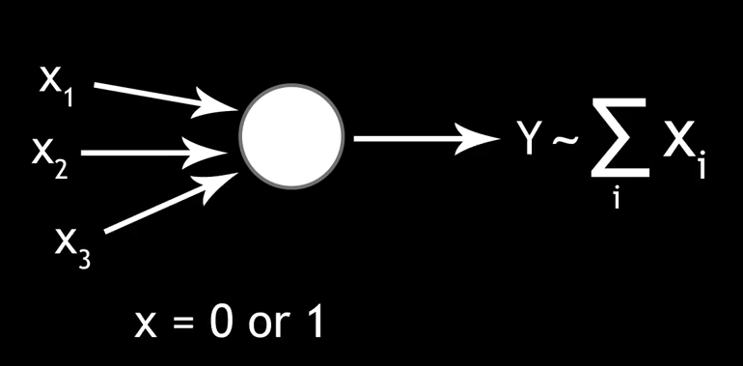
Perceptrons
A.k.a. an artificial neuron
output value y, which depends on the sum of the input values
input values x
https://www.youtube.com/watch?v=L_9OluD0nqw

Slide 6
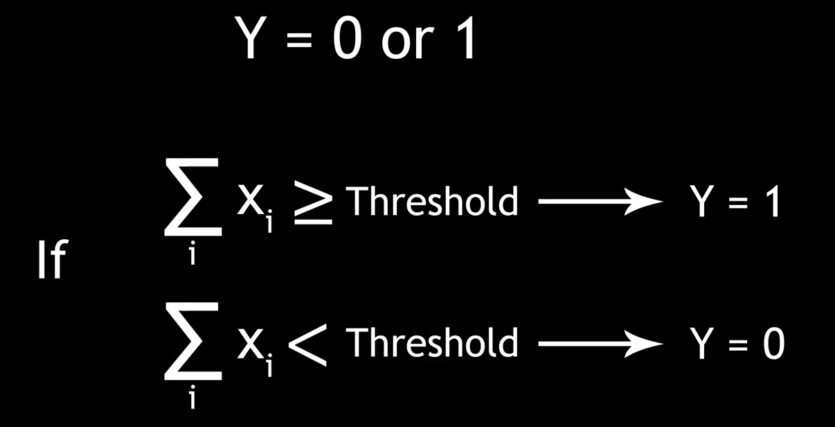
Threshholds
The threshold determines whether or not an input value will trigger an output value
https://www.youtube.com/watch?v=L_9OluD0nqw

Slide 7
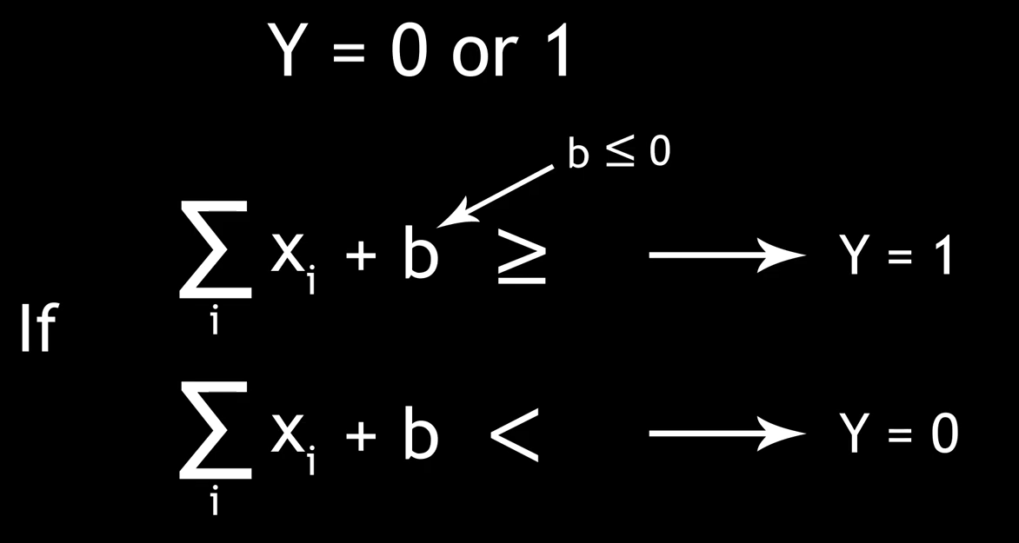
Threshholds, or Bias Values
The threshold is expressed as a bias, which is a negative number added to the sum of the input values
bias b
https://www.youtube.com/watch?v=L_9OluD0nqw

Slide 8
Activation Value
The activation value of a neuron is a number generated from the input to the neuron. In the case of the perceptron, the activation is 0 or 1
An activation function is the algorithm a neuron uses to generate its activation value from the input

Slide 9
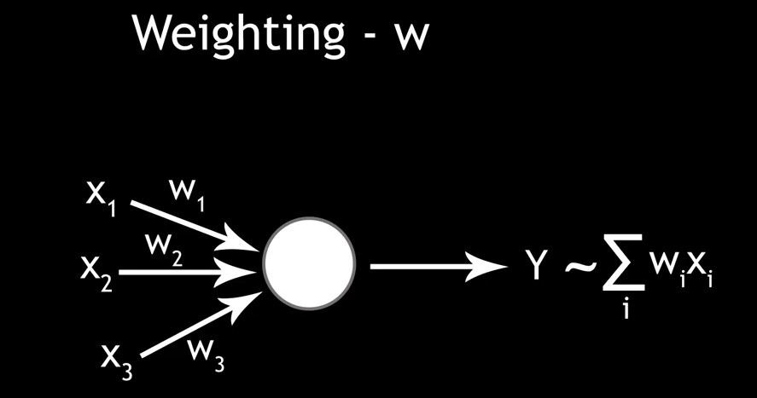
Weights
Weights alter how much influence each input value has on the neuron
weight w

Slide 10
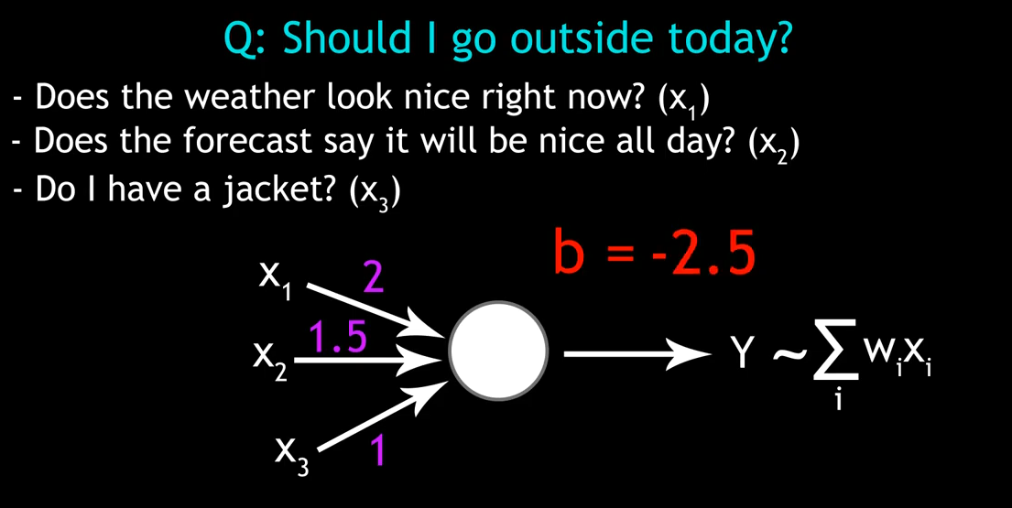
Calculating
See how the weight measures how important each factor is to me?

Slide 11
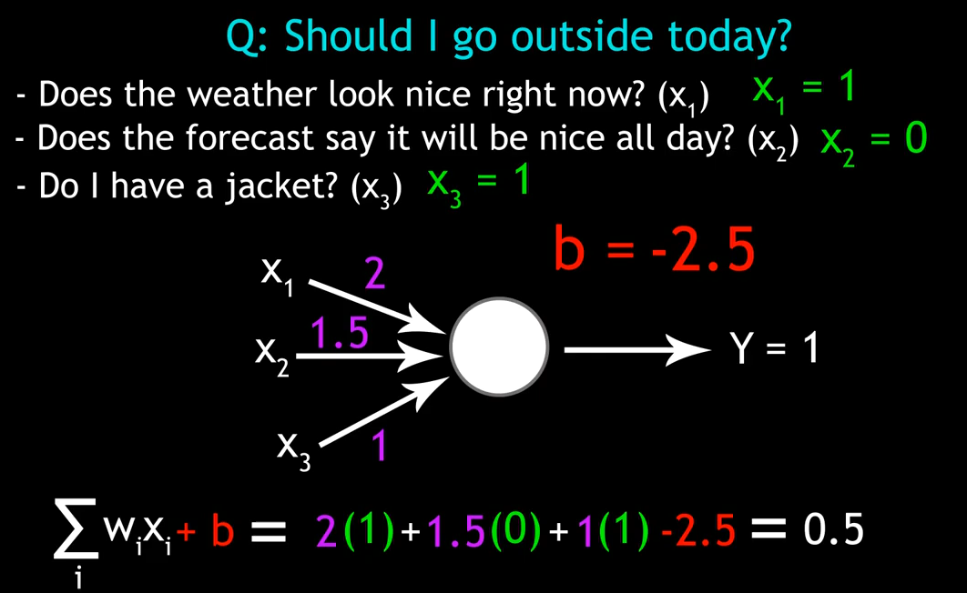
Calculating
We collect the sum of the weight*value for each input and add the bias to produce the output.

Slide 12
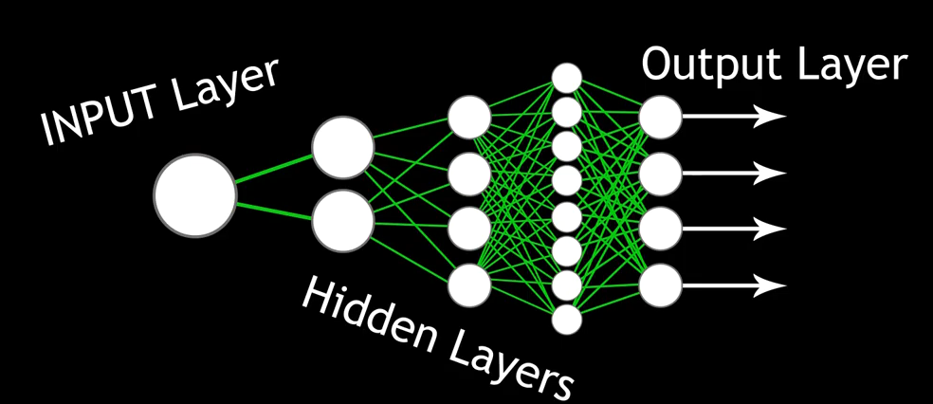
Networks of Perceptrons
These networks use the output from one set of neurons (called a layer) as the input for the next set of neurons.

Slide 13
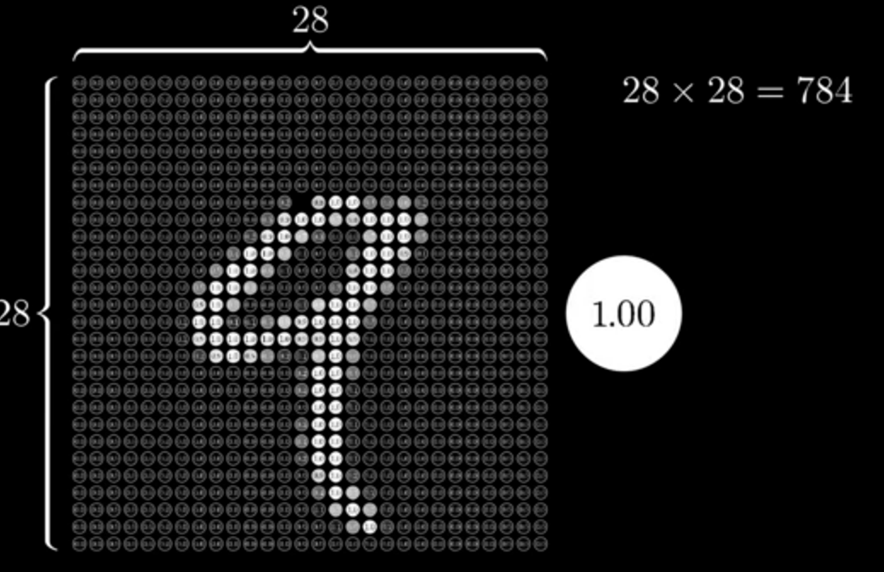
Recognition Tasks
Example
The input here is a layer of 781 neurons
https://www.youtube.com/watch?v=aircAruvnKk

Slide 14
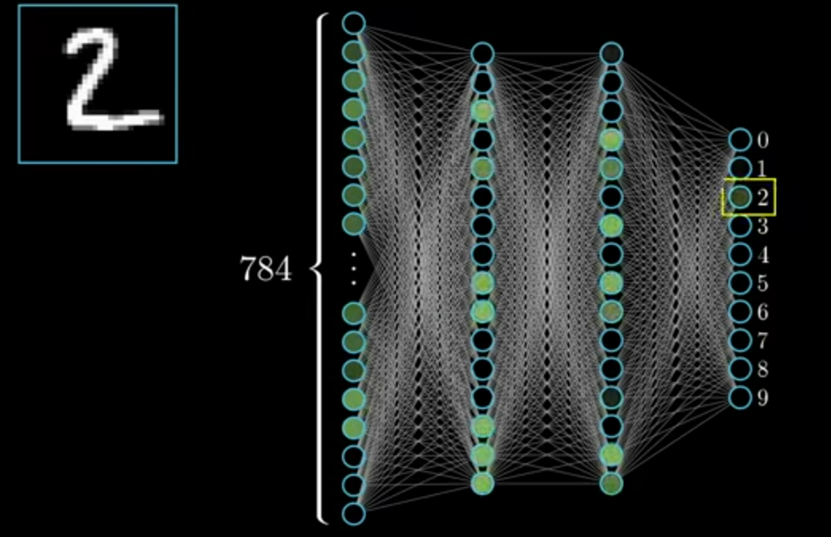
Recognition Tasks
Activations are sent from layer to layer to produce a set of values in the output layer.
In this case we have an image as input, and a set of digits as an output.
https://www.youtube.com/watch?v=aircAruvnKk

Slide 15
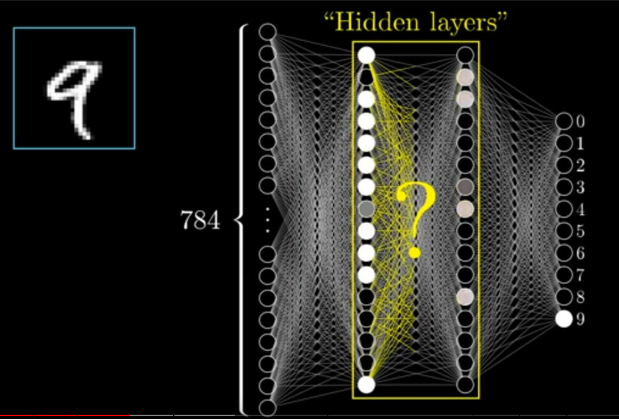
Layers
In a network, activations (ie, the values of individual neurons) in one layer determine the activations in the next layer
Notice the sizes of the layers are a bit arbitrary

Slide 16
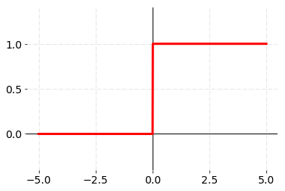
Two Problems With Perceptrons
They jump from 0 to 1, which is a big jump
The weights have to be calculated manually
Your basic activation function has a value of 1 or 0. This is a binary step activation function.
https://towardsdatascience.com/getting-to-know-activation-functions-in-neural-networks-125405b67428

Slide 17
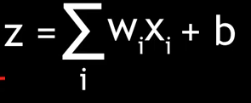
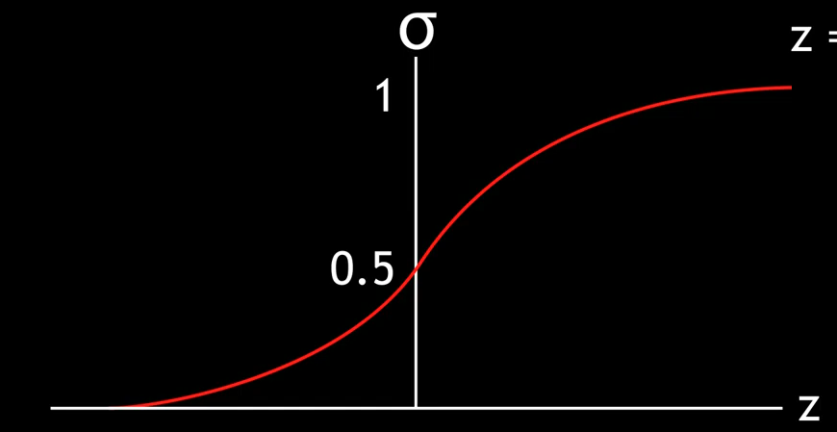
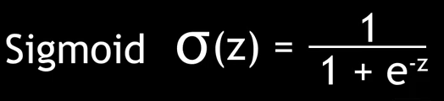
Sigmoid Neuron
Replaces perceptron neurons
Output is calculated in the same way
Then used in the sigmoid function
The result, instead of being 1 or 0, is a smooth slope

Slide 18
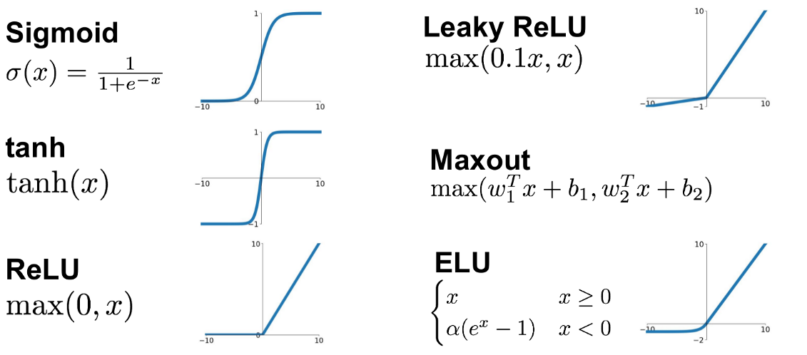
Other Activation Functions
https://en.wikipedia.org/wiki/Activation_function
https://medium.com/@shrutijadon10104776/survey-on-activation-functions-for-deep-learning-9689331ba092
https://mlfromscratch.com/activation-functions-explained/

Slide 19
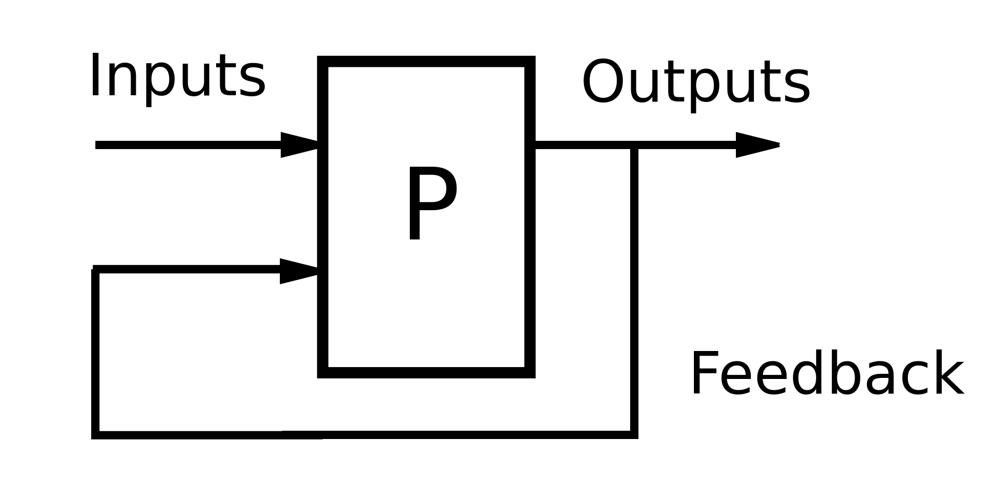
Backpropagation
Adjusts the weights of a neural network
Uses training examples to ‘train’ the network
The result is then used to make predictions
https://en.wikipedia.org/wiki/Feedback

Slide 20
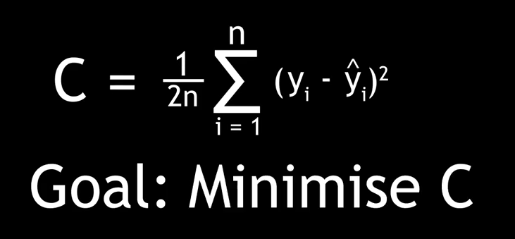
Cost Function
Is a measure of the difference between the desired outcome and the prediction

Slide 21

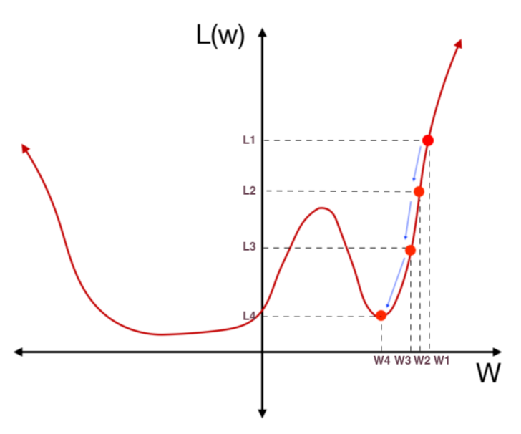
Optimizing weights
Reduce the value of C (the cost function) by adjusting weights
  Calculate the gradient of C
https://towardsdatascience.com/step-by-step-the-math-behind-neural-networks-490dc1f3cfd9

Slide 22
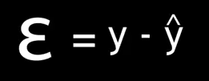
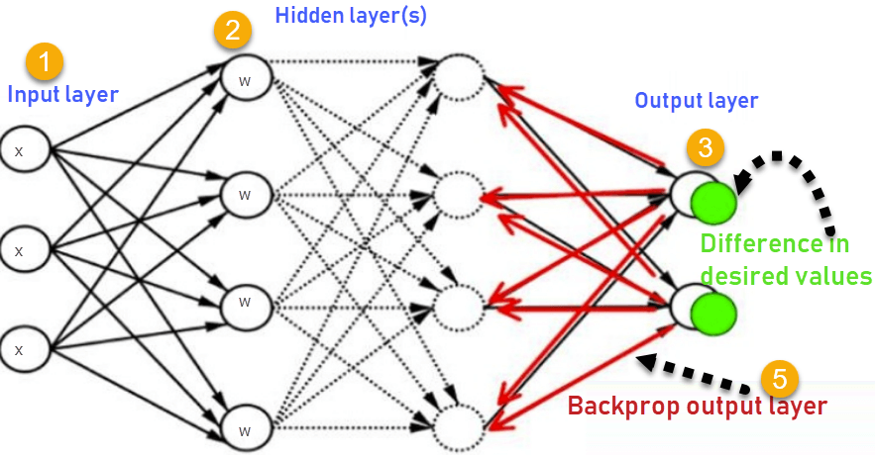
Propagation
Guess the weights
Provide input
Identify the error

Slide 23
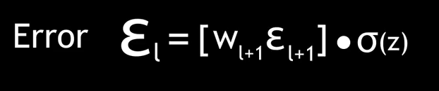
Back-Propagation
The error for neurons in any particular error can be calculated as a function of the errors the next layer up

Slide 24
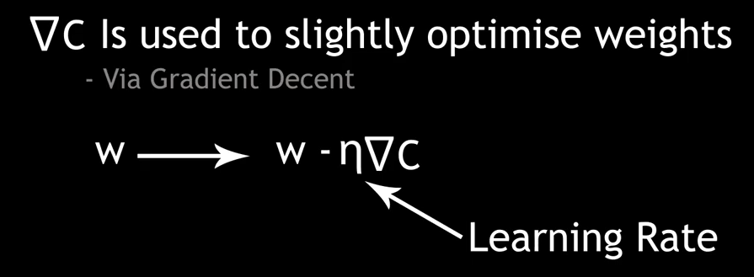
Adjusting Weights
Calculate the gradient of C , as before

Slide 25
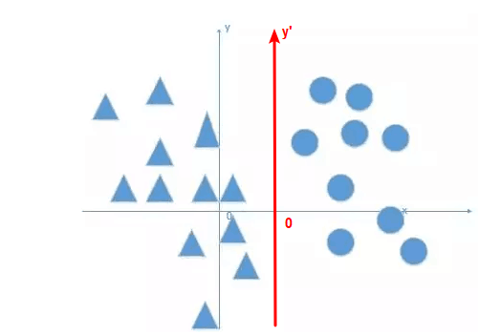
Adjusting Biases
You can also adjust the bias
This establishes how active a neuron needs to be before it has an activation value
https://stackoverflow.com/questions/3775032/how-to-update-the-bias-in-neural-network-backpropagation
https://www.geeksforgeeks.org/effect-of-bias-in-neural-network/
https://www.tutorialexample.com/understand-bias-in-neural-network-why-using-bias-in-neural-network/

Slide 26
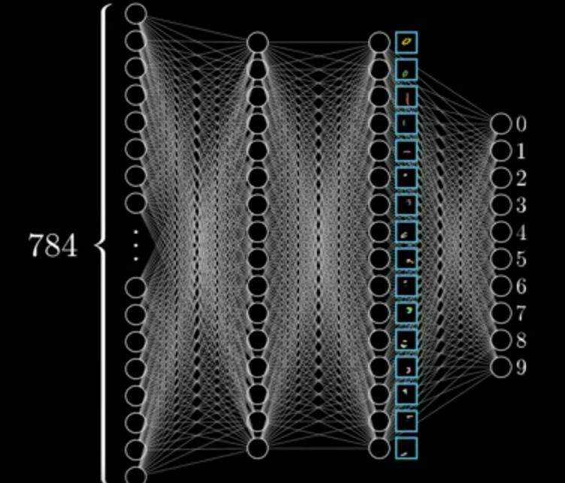
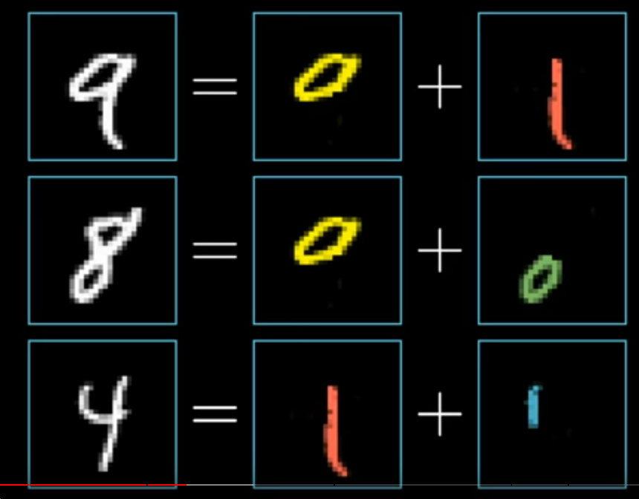
Feature Detection
What do the layers do?

Slide 27

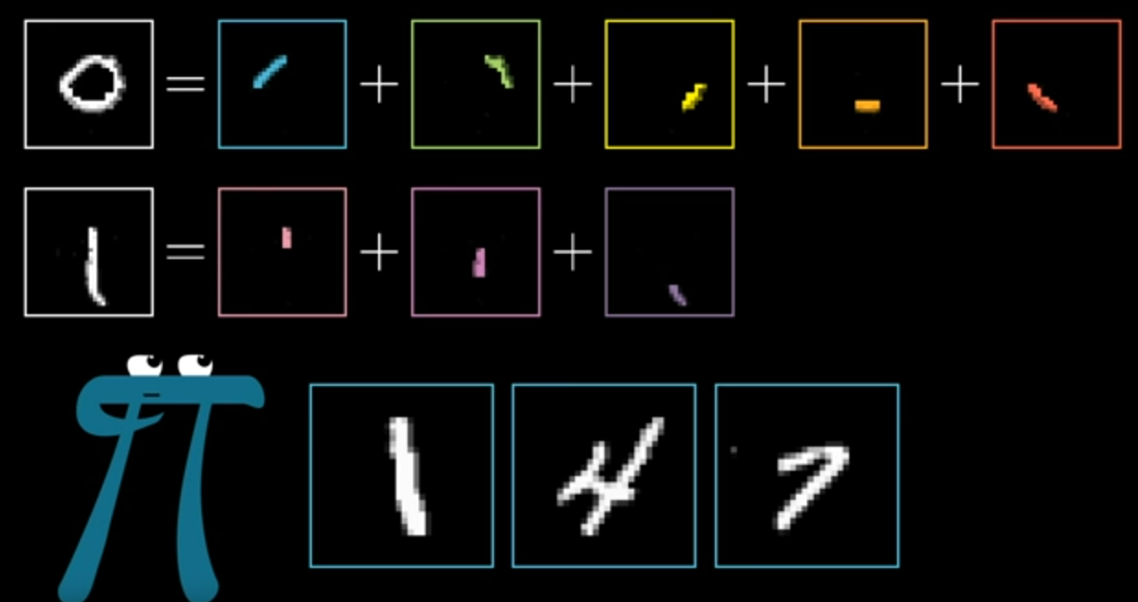
Edge Detection
Features are made of smaller parts

Slide 28
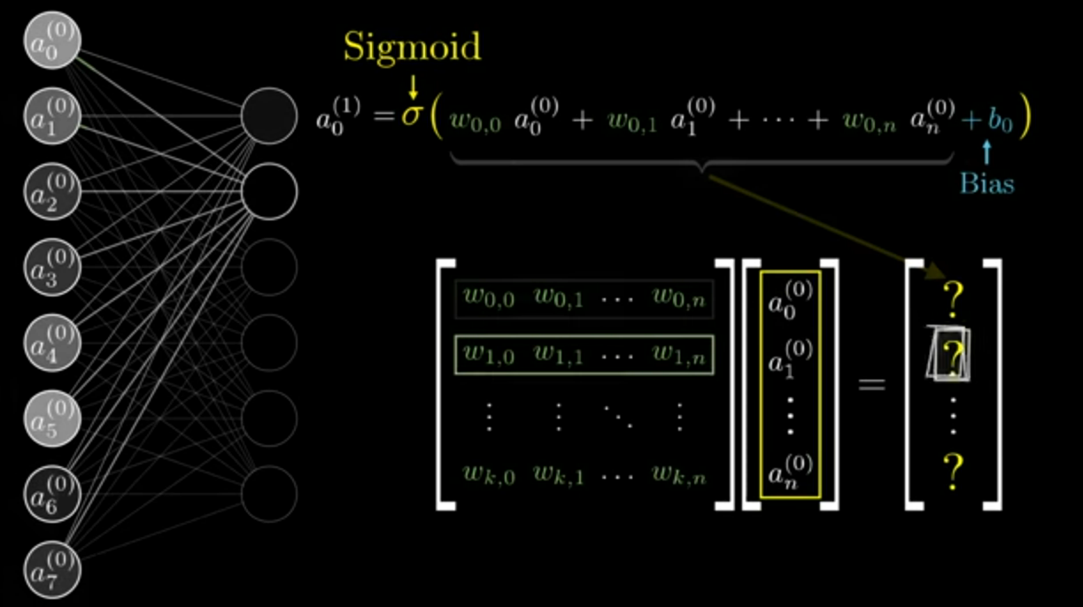
Calculations
matrix of weights of connections between layers
Calculations of the weights and values can be described using matrix algebra
matrix vector product as next layer values
vector of input values

Slide 29
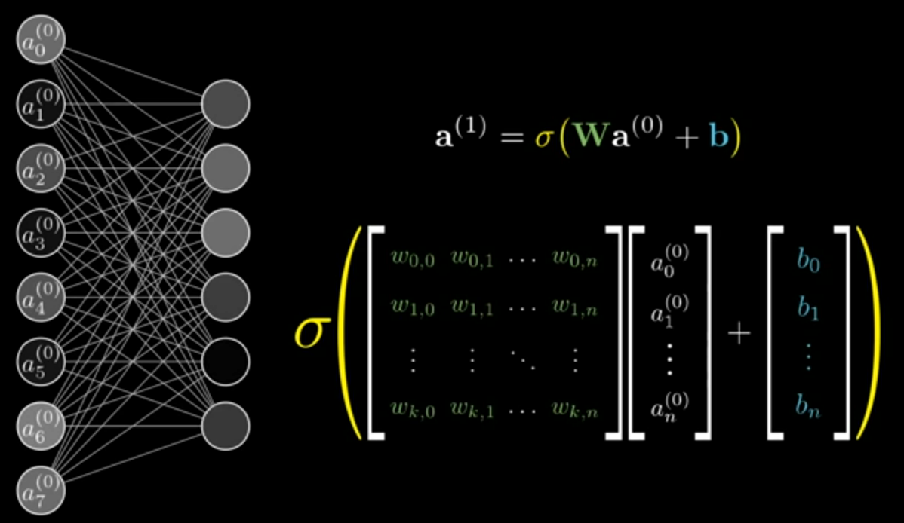
Expressions
Adding the bias…

Slide 30
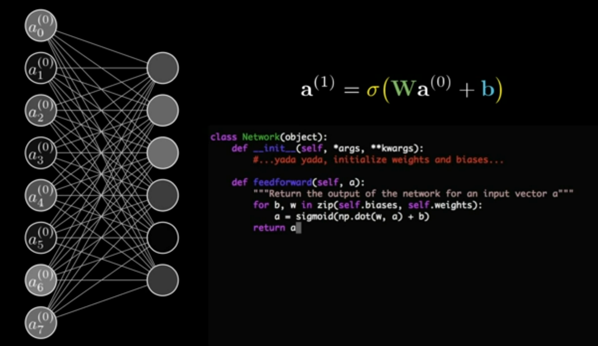
Code
Code libraries are optimized for matrix multiplication
https://www.youtube.com/watch?v=aircAruvnKk

Slide 31
Iterations
Each time we adjust all the weights, we call that an epoch.
This is too large to do all at once, so it’s broken down into batches.
The number of iterations is the number of batches needed to complete an epoch.

