Slide 1

Moral Sentiment
Stephen Downes
November 30, 2021

Slide 2
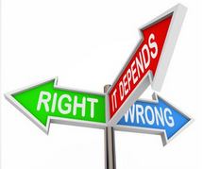
Moral Sentiment
The idea of a moral sense (as opposed to moral reasoning)
Methods of ethics and experience
Moral sentiments v. moral judgements
Learning ethics
Title Image: https://www.vox.com/future-perfect/2019/4/25/18291925/human-rationality-science-justin-smith

Slide 3
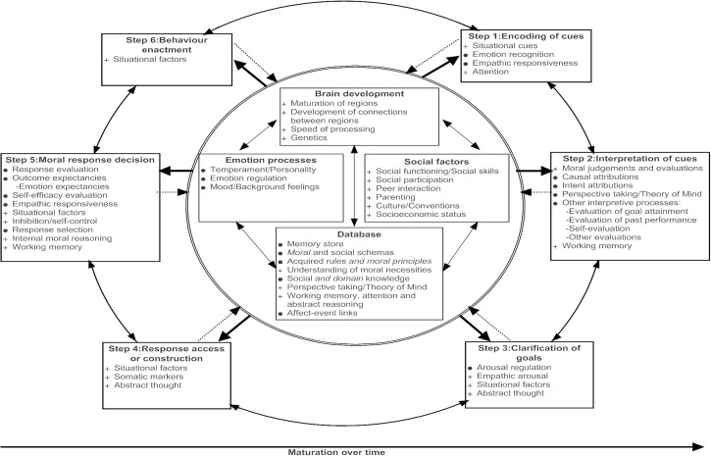
Moral Judgements?
Moral principles are necessary but not sufficient for moral behaviour, (Kohlberg, 1984a) https://www.sciencedirect.com/science/article/pii/S027322971830025X

Slide 4
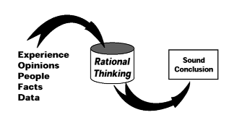
Personal Knowledge
“Feminine moral theory deals a blow to the exclusively rational systems of thought, which have as their grounding an inherent disregard for the inherently personal—and sometimes gender-biased—nature of knowledge construction.”
Image: https://www.ascd.org/books/analytic-processes-for-school-leaders?chapter=rational-thinking-as-a-process
Craig P. Dunn Brian K. Burton. Ethics of care. Encyclopedia Britannica. https://www.britannica.com/topic/ethics-of-care

Slide 5
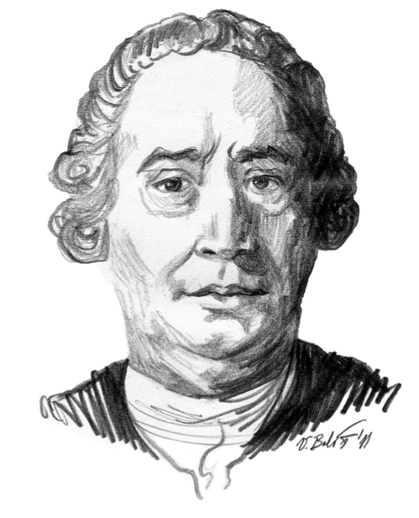
Hume’s Scepticism
“We cannot be motivated to act morally through reason alone, because reason is only concerned with determining truths about objects already existing in the world.”
Hume: “There is no view of human life, or of the condition of mankind, from which, without the greatest violence, we can infer the moral attributes....” (Hume, Dialogues, part 10)
Rayner, Sam (2005) "Hume's Moral Philosophy," Macalester Journal of Philosophy: Vol. 14: Iss. 1, Article 2.
http://digitalcommons.macalester.edu/philo/vol14/iss1/2
http://www.timothyministry.com/2014/11/david-hume-and-problem-of-evil.html
https://www.sparknotes.com/philosophy/dialogues/full-text/part-10/

Slide 6
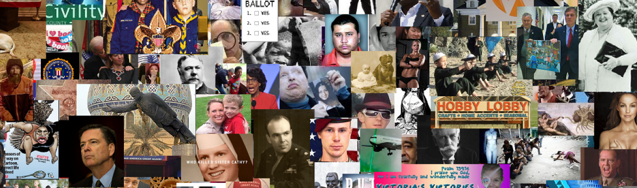
Ethics Alarms
“Ethics alarms are the feelings in your gut, the twinges in your conscience, and the sense of caution in your brain when situations involving choices of right and wrong are beginning to develop, fast approaching, or unavoidable.”
Jack Marshall, https://ethicsalarms.com/about/
https://cdn.ymaws.com/www.saimeche.org.za/resource/collection/BFA070FF-C69A-4A96-8106-47BBF81920CE/044-081-PDP-Outcome_8-Conduct_activities_ethically_MJRev0-04112013.pdf

Slide 7
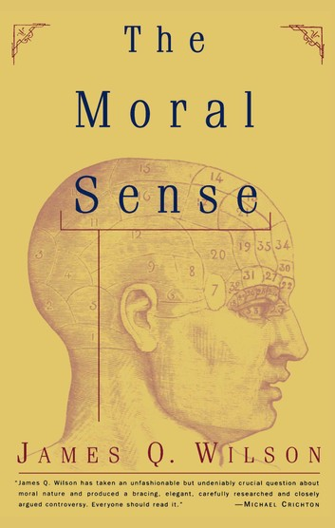
Moral Sense
“Our moral distinctions depend on our experiencing sentiments or feelings: we do not rely exclusively on the employment of reason to make our moral discernments.”
Note that this is not a theory of innateness or natural morality – the idea is that we learn ethics, but we learn them in such a way that we feel or experience a moral sense, rather than fully formed general principles
Elizabeth S. Radcliffe. (2013). Moral Sentimentalism and the Reasonableness of Being Good
Dans Revue internationale de philosophie 2013/1 (n° 263), pages 9 – 27. https://www.cairn.info/revue-internationale-de-philosophie-2013-1-page-9.htm https://www.kobo.com/gr/en/ebook/the-moral-sense

Slide 8
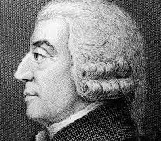
Reference to Sentiment
“To be amiable and to be meritorious; that is, to deserve love and to deserve reward, are the great characters of virtue; and to be odious and punishable, of vice. But all these characters have an immediate reference to the sentiments of others.”
Adam Smith, The Theory of Moral Sentiments, Part III, Chapter 1.
See also https://www.oxonianreview.org/wp/adam-smith-a-moral-philosopher/

Slide 9
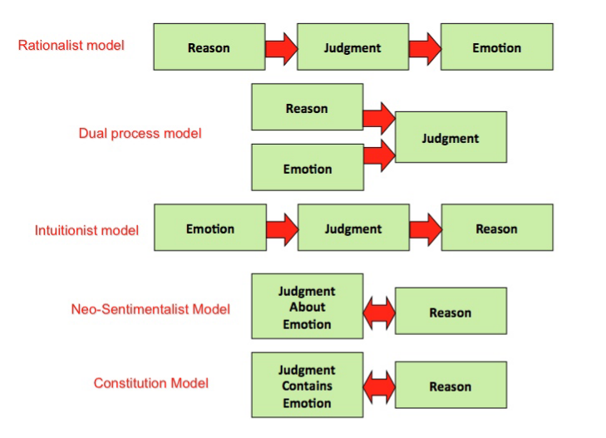
Moral Sentimentalism
E.g. Jonathan Haidt (2012): moral judgments are for the most part intuitions proximally caused by gut reactions, quick and automatic flashes of affect.
  people are easily dumbfounded when challenged on their moral views
  they cannot (Haidt claims) give reasons for why they disapprove
Image: http://www.mit.edu/~shaslang/mprg/PrinzCS.pdf
All quoted from https://plato.stanford.edu/entries/moral-sentimentalism/

Slide 10
Ethics as Sentiment
Hume’s position has been termed “sentimentalism” because he believes that morality arises from human sentiments. Hume firmly states this position in many areas of this treatise, such as when he says “When you pronounce any action or character to be vicious, you mean nothing, but that from the constitution of your nature you have a feeling or sentiment of blame from the contemplation of it.” (Treatise 3.1.1.26, SBN 468-9)
  “Ethical Sentimentalism promises a conception of morality that is grounded in a realistic account of human psychology, which, correspondingly, acknowledges the central place of emotion in our moral lives.”
https://digitalcommons.macalester.edu/cgi/viewcontent.cgi?article=1013&context=philo
https://www.chapters.indigo.ca/en-ca/books/ethical-sentimentalism/9781107461307-item.html

Slide 11
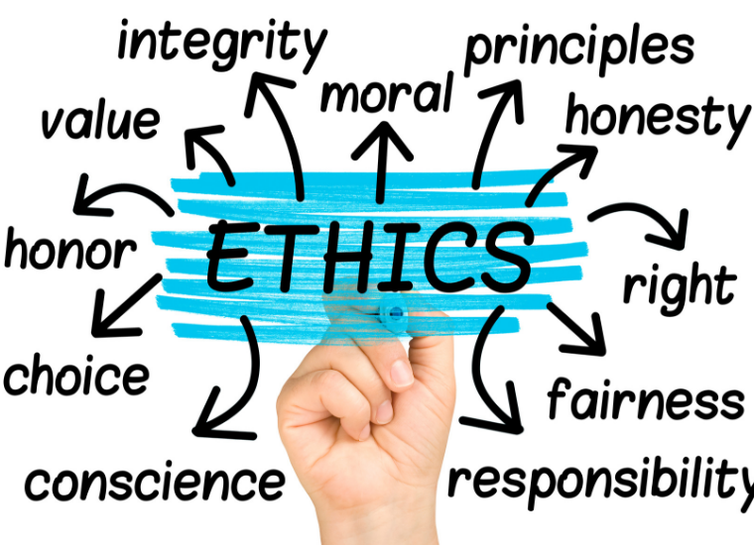
Ethics and Experience
This (in my view) is a perspective of an ethics that is learned through experience:
  Similar to Hume’s moral sentiment
  Often experienced at a subsymbolic level - ethics is not (contra Kant) not a matter of rationality but rather one of sympathy - cf. the post ‘The Failure of Reason’ I wrote last June
  How we react in a particular case depends on our ethical background and is the result of multiple simultaneous factors, not large-print key statements
https://halfanhour.blogspot.com/2019/06/the-failure-of-reason.html

Slide 12

Sympathy
“Hume sees what he calls sympathy as the underlying foundation of the interpersonal nature of human morality. By sympathy Hume is referring to the human ability to convey our moral sentiments to one another and, upon observing the outward effects of someone else’s internal moral sentiments, our ability to actually feel those sentiments as though they were our own.” E.g. Treatise 2.1.11.8, SBN 319-20)
https://digitalcommons.macalester.edu/cgi/viewcontent.cgi?article=1013&context=philo

Slide 13
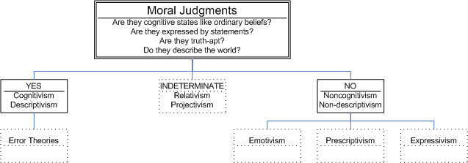
Moral Sentiments v. Moral Judgements
Glossop makes a very relevant distinction between moral sentiments and moral judgments. Glossop states that sentiments arise from actual sympathy, and by correcting them through reflecting on them with an imagined impartiality we can attempt to make appropriate moral judgments, by adopting the sentiments afforded by the resultant ideal sympathy.
https://digitalcommons.macalester.edu/cgi/viewcontent.cgi?article=1013&context=philo
R. Glossop, “The Nature of Hume's Ethics,” Philosophy and Phenomenological Research, 27 (1967): 527-536.
IEP, ‘Moral Realism’, https://iep.utm.edu/moralrea/

Slide 14
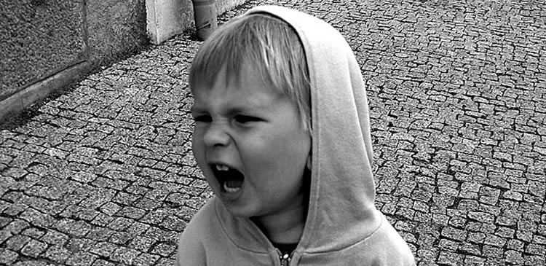
Expressing Judgements
“Take away the very concept of power - of a capacity to produce or prevent outcomes – and there is nothing left to base a distinctively moral responsibility. But nor is there anything left of something very much part of our conception of rationality – a power of justifications to move us.” (Pink, 2020)

Slide 15
Learning Ethics
“Hume says that our sense of humanity allows us to form general views about the useful and agreeable (to which the relativist does not subscribe), and that we do so on the basis of conversations and debates in which we must make ourselves mutually intelligible to one another.”
To borrow a phrase, we might say “it takes a community to learn ethics” – all we do, all we experience, is the ‘data’ from which a person develops an ethical sense
Jacqueline Taylor. (2013). Hume on the Importance of Humanity. Revue internationale de philosophie, 2013/1 (No 263). 81-97. https://www.cairn-int.info/focus-E_RIP_263_0081--hume-on-the-importance-of-humanity.htm

Slide 16
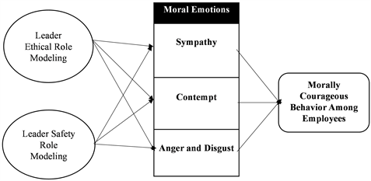
Modeling Ethics
“…the mediation of moral sympathy, moral contempt and moral anger and disgust, in the relationship between leader ethical role modeling and morally courageous behaviors”
https://www.scirp.org/journal/paperinformation.aspx?paperid=110279

Slide 17

It takes a Community
It’s a matter of a community as an entire system, rather than one individual making a decision
We need to keep in mind how we’re all connected
What’s important here is how we learn to be ethical in the first place (as opposed to the specific statement of a set of rules defining what it is to be ethical)

Slide 18
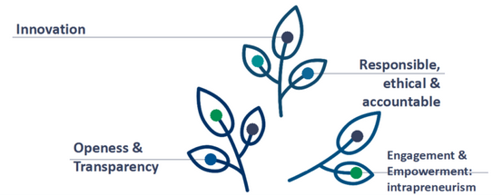
The Ethical Mind
A person’s mind is at least as complex as social networks
  What they learn is going to be based on the data - ie., the totality of the input
  This isn’t something that can be corrected simply by rote and by rules
We need to provide an ethical culture (rather than emphasis on following the rules)
  Diversity of perspective to create a wider sense of community
  Encouragement of openness and interaction (art, drama, etc) to develop empathy and capacity to see from the perspective of others

