Slide 1
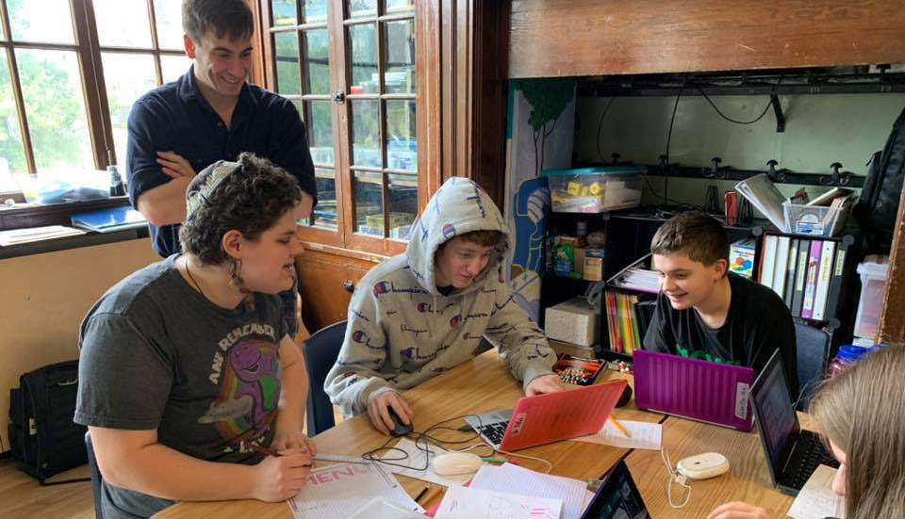
Caring and Pedagogy
Stephen Downes
November 28, 2021

Slide 2
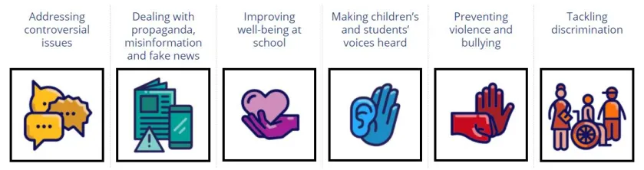
Democratic Education
“Educators who challenge themselves to teach beyond the classroom setting, to move into the world sharing knowledge, learn a diversity of styles to convey information.” (bell hooks, teaching community, p. 43)
“Authoritarianism in the classroom dehumanizes and thus shuts down the “magic” that is always present when individuals are active learners.” (p.43)
Reference Framework of Competences for Democratic Culture, Council of Europe, 2021 https://www.coe.int/en/web/campaign-free-to-speak-safe-to-learn/reference-framework-of-competences-for-democratic-culture

Slide 3
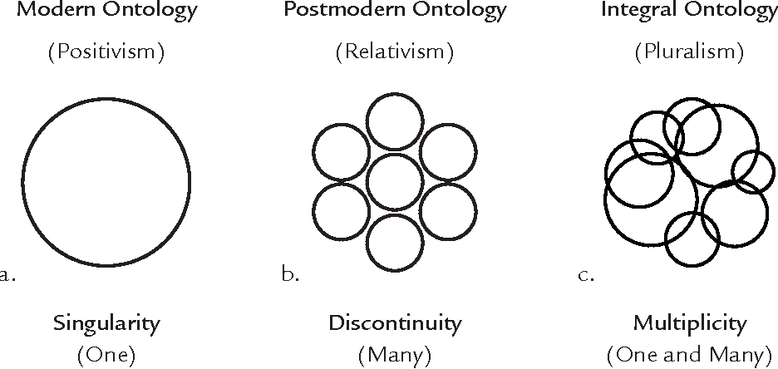
Diversity and Pluralism
“Pluralism is not diversity. Pluralism… is a response to the fact of diversity. In pluralism, we commit to engage with the other person or the other community. Pluralism is a commitment to communicate with and relate to the larger world.”
- The problem of embracing diversity but resisting pluralism
(bell hooks, teaching community, p. 47, citing Commitment and Openness: A Contemplative Approach to Pluralism,” Judith Simmer-Brown)
https://www.semanticscholar.org/paper/AN-ONTOLOGY-OF-CLIMATE-CHANGE-Integral-Pluralism-of-Esbj%C3%B6rn-Hargens/a16c17166a85ad93da8449adbaf3e75be7390896
Frans Boas – Plurality of Cultures https://www.studocu.com/en-gb/document/the-chancellor-masters-and-scholars-of-the-university-of-cambridge/anthropological-theory-and-methods/san3-psychological-anthropology-yael-navaro/15672771

Slide 4
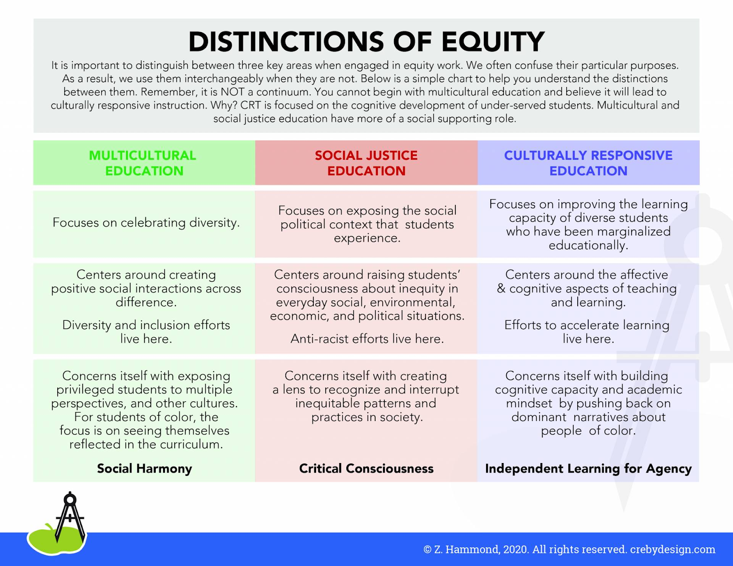
Cultural Responsiveness
“Culturally responsive instruction should:
Focus on improving the learning capacity of students who have been marginalized educationally because of historical inequities in our school systems.
Center around both the affective and cognitive aspects of teaching and learning.
Build cognitive capacity and academic mindset by pushing back on dominant narratives about people of color.“
https://www.kqed.org/mindshift/55941/how-to-develop-culturally-responsive-teaching-for-distance-learning

Slide 5
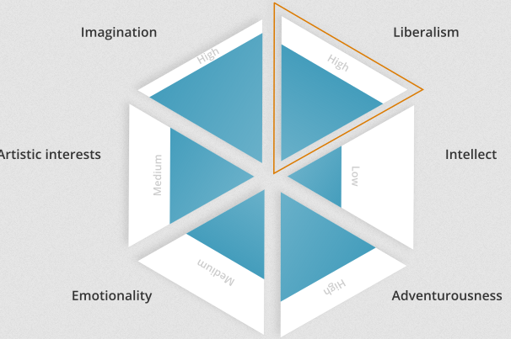
Openness
“One of the most positive outcomes is a commitment to “radical openness,” the will to explore different perspectives and change one’s mind as new information is presented.” (hooks, teaching community, p. 48)
“Competitive education rarely works for students who have been socialized to value working for the good of the community.” (p. 49)
https://go-gn.net/gogn_outputs/openness-and-education-a-beginners-guide/
Title Image: https://lead-prep.org/2020/07/embodying-a-pedagogy-of-care/

Slide 6
Against Method
Noddings: “The desire to reduce all teaching and learning to one well-defined method is part of a larger pattern in science, epistemology, and ethics. It has been criticized by many contemporary theorists.
“Feminist theologian Mary Daly (1973) has called the pursuit ‘methodolatry,’ the worship of method. Philosophers, scientists, ethicists, and many other thinkers have tried since the time of Descartes to substitute fool-proof method for the situated, living human being who must think and decide. Method became all-important.”
https://en.wikipedia.org/wiki/Against_Method

Slide 7
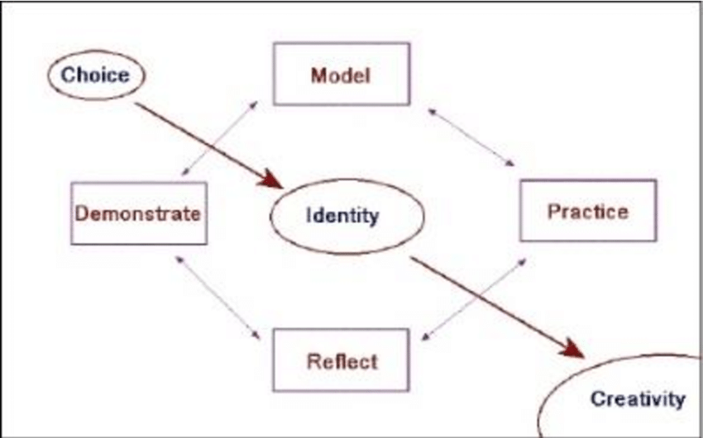
Moral Education
“The ethical ideal is to be one-caring and to meet the other morally.”
Noddings: Moral education from the perspective of an ethic of caring has four major components: modeling, dialogue, practice, and confirmation
Compare with:
https://jennymackness.wordpress.com/2021/06/08/nel-noddings-a-feminine-approach-to-ethics-and-moral-education-notes/

Slide 8
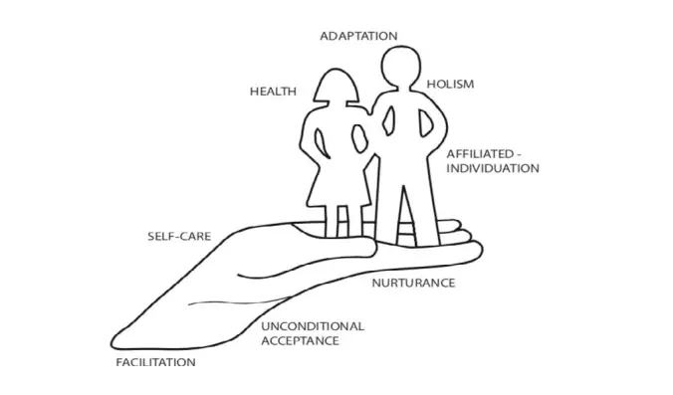
Modeling
“we do not tell our students to care; we show them how to care by creating caring relations with them.” (p.22)
“the capacity to care may be dependent on adequate experience in being cared for.” (p.23)
http://mehrmohammadi.ir/wp-content/uploads/2020/09/The-Challenge-to-Care-in-School-Nel-Noddings.pdf
https://nursology.net/nurse-theories/modeling-and-role-modeling/

Slide 9
Dialogue
Noddings: Not just talk or conversation, not presentation, but open-ended
  A common search for understanding, empathy or appreciation
  “Dialogue is implied in the criterion of engrossment. To receive the other is to attend fully and openly.” (p. 23)
“To engage in dialogue is one of the simplest ways we can begin as teachers, scholars, and critical thinkers to cross boundaries.” (bell hooks, p. 130)
“Conversation is the central location of pedagogy for the democratic educator.” hooks, teaching community, p. 44
http://mehrmohammadi.ir/wp-content/uploads/2020/09/The-Challenge-to-Care-in-School-Nel-Noddings.pdf
https://academictrap.files.wordpress.com/2015/03/bell-hooks-teaching-to-transgress.pdf

Slide 10

Critical Digital Pedagogy
Critical:
as in mission-critical;
as in literary criticism
as in reflective and nuanced
as in criticizing impediments
as a disciplinary approach
“A Critical Digital Pedagogy perspective on MOOCs involves… generating collaborative spaces for intrinsically motivated co-intentional education, online learning, and critical practice (and) demands that open educational environments be more than content repositories, therefore, a MOOC cannot simply be a delivery device, but must first be aimed at building empowered communities, making MOOCs a space for dialogue, openness and change.”
https://www-jime.open.ac.uk/articles/10.5334/jime.657/
Jesse Stommel https://hybridpedagogy.org/critical-digital-pedagogy-definition/

Slide 11
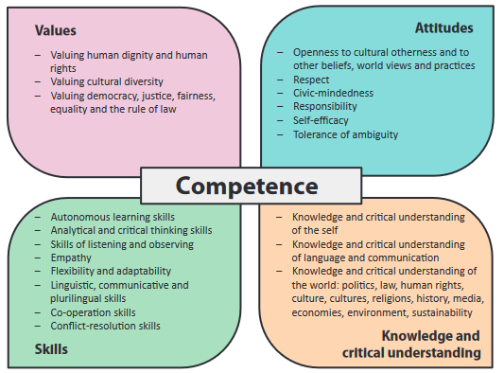
Practice
Attitudes and mentalities are shaped by experience – there’s lots of evidence for this
Training programs don’t just teach knowledge or skills, but “shape minds”
E.g. community service, but “with people who can demonstrate caring.”
https://rm.coe.int/prems-008318-gbr-2508-reference-framework-of-competences-vol-1-8573-co/16807bc66c

Slide 12

Confirmation
Martin Buber (1965) describes confirmation as an act of affirming and encouraging the best in others. (Noddings, 2005, p. 25)
“We do not set up a single ideal or set of expectations for everyone to meet, but we identify something admirable, or at least acceptable, struggling to emerge in each person we encounter.” (p.25)
Image: https://www.innerrainbowproject.com/108-positive-affirmations-empower-girls/

Slide 13
Thinking With Care
Relations of thinking and knowing require care and affect how we care. C.f. Donna Haraway’s relational ontology:
  Thinking-with: thinking with many people, beings, and things; it is thinking in a populated world. “the embeddedness of thought in the worlds one cares for.”
    in the late 1990s… Haraway surprised a room’s expectant audience by articulating her keynote around stories of personal care for her dog Cayenne. P. 77
  Dissenting-Within: “Relationality is all there is, but this does not mean a world without conflict or dissension.” p. 78
  Thinking-for: “a commitment to value knowledge generated through any context of subjugation.” p. 84
María Puig de la Bellacasa (2017) Matters of Care. https://syllabus.pirate.care/library/Maria%20Puig%20de%20La%20Bellacasa/Matters%20of%20Care%20(171)/Matters%20of%20Care%20-%20Maria%20Puig%20de%20La%20Bellacasa.pdf

Slide 14
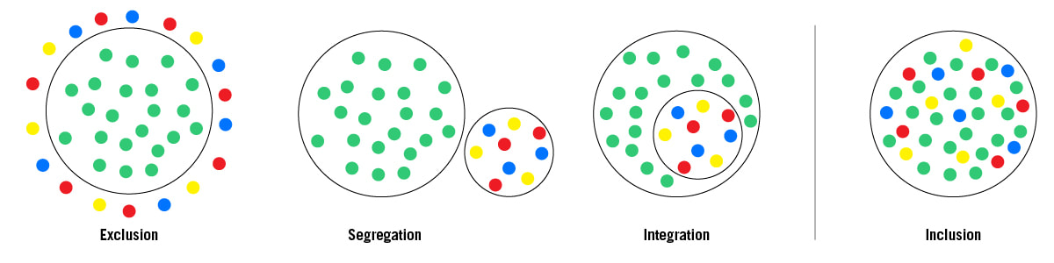
Inclusion
Social inclusion is defined as “the process of improving the terms on which individuals and groups take part in society—improving the ability, opportunity, and dignity of those disadvantaged on the basis of their identity” (World Bank 2019).
Ontario: Statement of Inclusion Principles https://www.inclusionontario.ca/what-is-inclusion.html

Slide 15
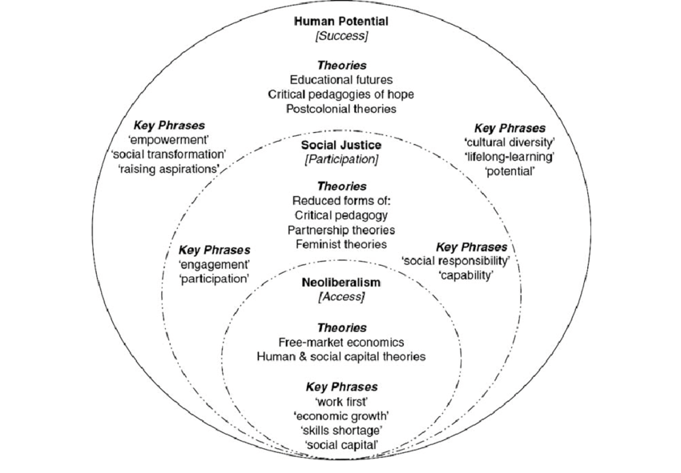
And Exclusion
Disadvantaged groups are potentially excluded because of their “socio-economic status, culture (including indigenous cultures), linguistic group, religion, geography (rural and remote/isolated), gender, sexual orientation, age (including youth and old age), physical and mental health/ability, and status with regard to unemployment, homelessness and incarceration” (Gidley et al. 2010: 1).
https://www.researchgate.net/publication/228674646_From_Access_to_Success_An_Integrated_Approach_to_Quality_Higher_Education_Informed_by_Social_Inclusion_Theory_and_Practice
Exclusion, Gender and Education https://www.cgdev.org/sites/default/files/9781933286228-Lewis-Lockheed-exclusion.pdf

Slide 16
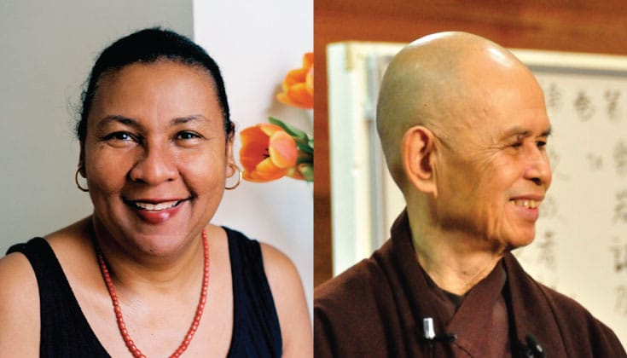
Love
“Without an ethic of love shaping the direction of our political vision and our radical aspirations, we are often seduced, in one way or the other, into continued allegiance to systems of domination—imperialism, sexism, racism, classism.” (hooks, 1994)
https://uucsj.org/wp-content/uploads/2016/05/bell-hooks-Love-as-the-Practice-of-Freedom.pdf
https://www.lionsroar.com/bell-hooks-and-thich-nhat-hanh-on-building-a-community-of-love/

Slide 17
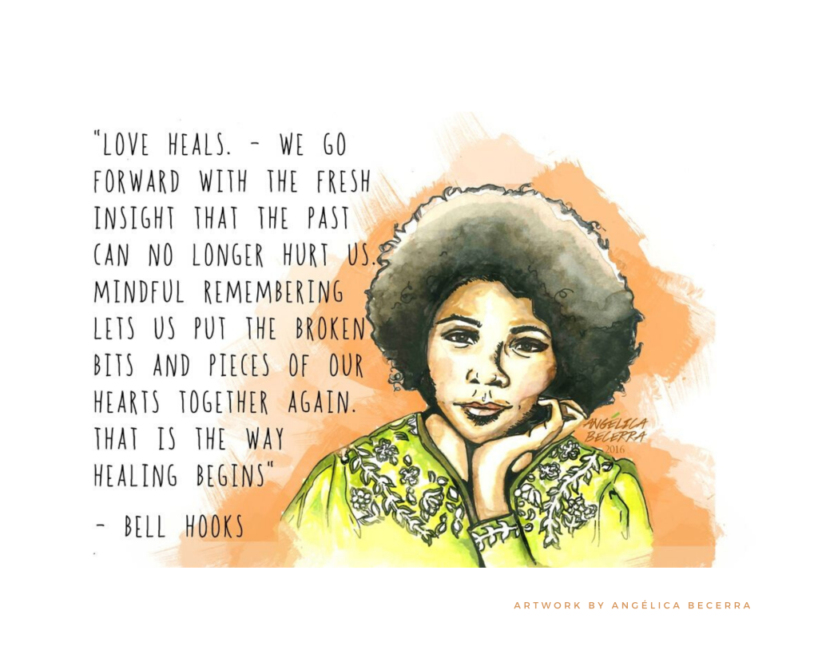
And Danger
“When we talk about loving our students, these same voices usually talk about exercising caution. They warn us about the dangers of getting ‘too’ close.” (hooks, teaching community, p. 127)
“when we teach with love we are better able to respond to the unique concerns of individual students while simultaneously integrating those of the classroom community”. (p. 133)

Slide 18

Pedagogy of Care
“Sometimes, the most valuable thing we can offer our students is genuine care for them, their well-being, their happiness. Not just their grades. Not just their learning. But their whole selves.” Maha Bali
Caring involves sharing and empathy
“If you want students to share of themselves, to make themselves vulnerable, you need to start with yourself, as bell hooks suggests.”
https://hybridpedagogy.org/pedagogy-of-care-gone-massive/

Slide 19
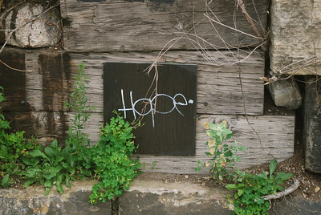
A Pedagogy of Hope
“In the last twenty years, educators who have dared to study and learn new ways of thinking and teaching so that the work we do does not reinforce systems of domination, of imperialism, racism, sexism or class elitism have created a pedagogy of hope.” bell hooks, Teaching Community, p. xiv

Slide 20
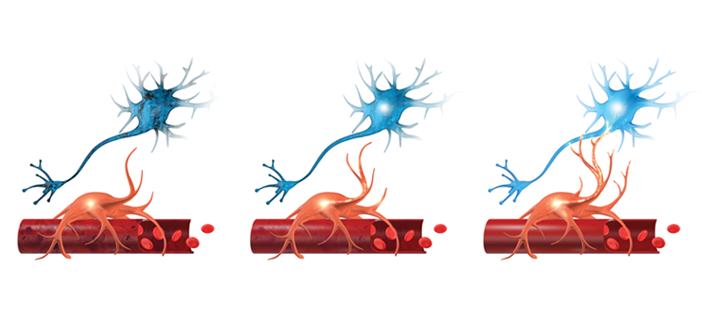
Whence Care?
We can begin with some questions…
How can neurons care?
Is caring driven by evolution?
Cultural evolution or biological evolution?
Does caring depend on rules and rationality?
Does caring require attachment?

