Slide 1
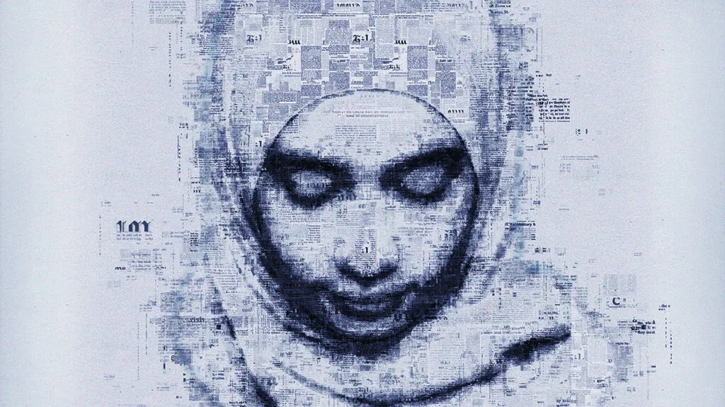
The Ethical Concept of Care
Part One
Stephen Downes
November 24, 2021

Slide 2
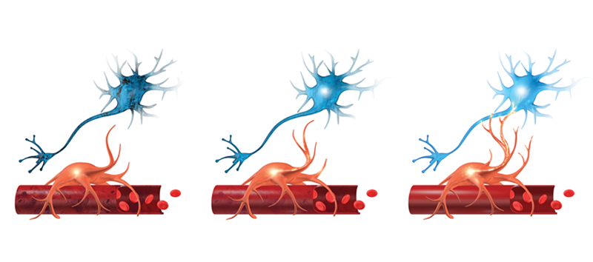
Caveats
American
Western
Male
Interpretive
Image: https://www.cognitivefxusa.com/blog/neuroplasticity-treatment-for-concussions

Slide 3
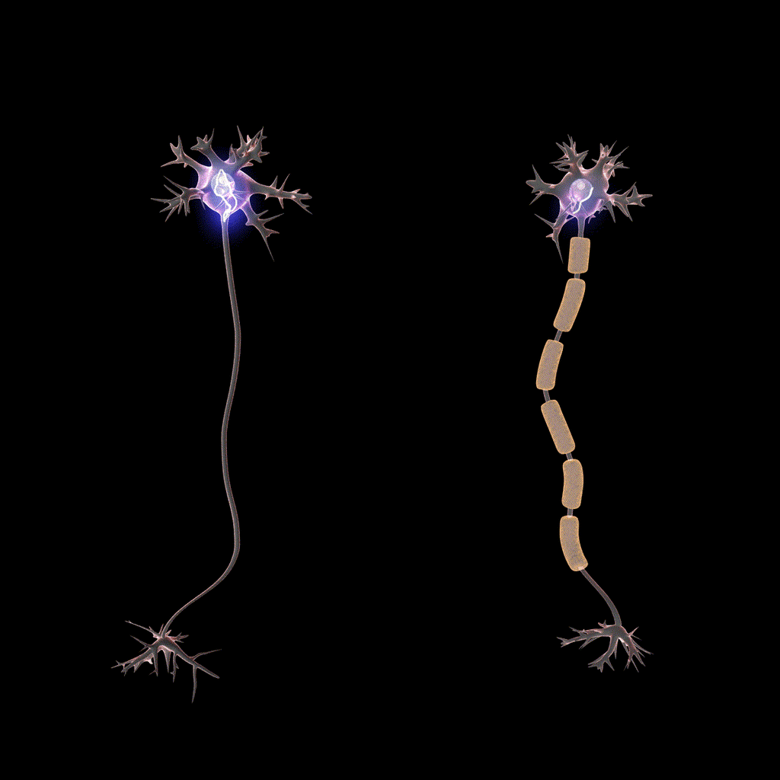
Whence Care?
We can begin with some questions…
How can neurons care?
Is caring driven by evolution?
Cultural evolution or biological evolution?
Does caring depend on rules and rationality?
Does caring require attachment?
Cover image: https://www.medicalnewstoday.com/articles/320289

Slide 4
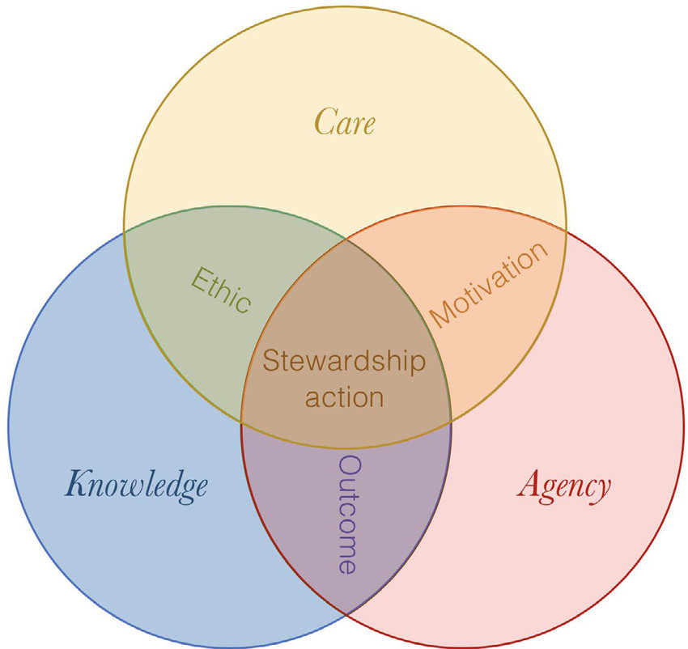
The Many Meanings of Care
Care has many meanings: when we say “cares and woes,” “care” denotes a burden; when we say “I care for you,” we express love. Care always expresses an action or a disposition, a reaching out to something. When we use it to refer to ourselves, as in “I take good care of myself,” we are in that instant thinking of ourselves as both the doer and that toward which we are reaching out. Care expresses relationships. It is used to express our deepest convictions, as when we say, “I care about dolphins”; it is used by advertisers in banal ways to make us like a company and perhaps continue to buy its products, as when we hear advertisers say, “McDonald’s cares.”
Joan Tronto, 2013, Caring Democracies, p. x https://we.riseup.net/assets/448799/Joan+C.+Tronto+Caring+Democracy+Markets%2C+Equality%2C+and+Justice+%282013%2C+NYU+Press%29.pdf
https://www.researchgate.net/publication/326587484_Stewardship_as_a_boundary_object_for_sustainability_research_Linking_care_knowledge_and_agency (Image)

Slide 5
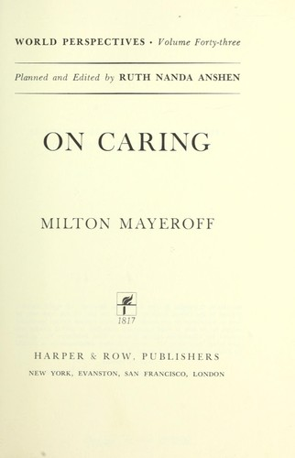
On Caring
Milton Mayeroff, 1971
  “To care for another person, in the most significant sense, is to help him grow and actualize himself.”
  “Caring, as helping another grow and actualize himself, is a process, a way of relating to someone that involves development, in the same way that friendship can only emerge in time through mutual trust and a deepening and qualitative transformation of the relationship.”
  “In the context of a man’s life, caring has a way or ordering his other values and activities around it… there is a basic stability in his life; he is ‘in place’ in the world, instead of being out of place, or merely drifting or endlessly seeking his place.”
https://openlibrary.org/books/OL5758563M/On_caring.

Slide 6
Domains of Care Ethics
Practices and principles of care have been explored in the domains of:
critical psychology (Noddings 1984)
political theory (Tronto 1993)
justice (Engster 2009)
citizenship (Kershaw 2005; Sevenhuijsen 1998)
migration and labor studies (Boris and Rhacel 2010)
care in business ethics and economics Gatzia 2011)
scientific choices for development (Nair 2001)
health work and sciences (Latimer 2000; Mol 2008)
disability studies and activism (Sánchez Criado, Rodríguez- Giralt, and Mencaroni, 2016)
accountability procedures (Jerak-Zuiderent 2015)
food politics (Abbots, Lavis, and Attala 2015)
animal rights (Donovan and Adams 2010)
farming practices (Singleton and Law 2013)
grassroots activism (Barbagallo and Federici 2012)
social and health work, and policy (Hankivsky 2004)
knowledge and science (Muller 2012; Suzuki 2015)
politics in technoscience (Martin, Myers, and Viseu 2015)
ecology (Curtin 1993)
Human-nonhuman relations (Haraway 2011).
María Puig de la Bellacasa (2017) Matters of Care. https://syllabus.pirate.care/library/Maria%20Puig%20de%20La%20Bellacasa/Matters%20of%20Care%20(171)/Matters%20of%20Care%20-%20Maria%20Puig%20de%20La%20Bellacasa.pdf
https://www.researchgate.net/publication/325218986_Maria_Puig_de_la_Bellacasa_2017_Matters_of_Care_Speculative_Ethics_in_More_Than_Human_Worlds_Minneapolis_and_London_University_of_Minnesota_Press_265_pages_ISBN_978-1-5179-0065-6

Slide 7
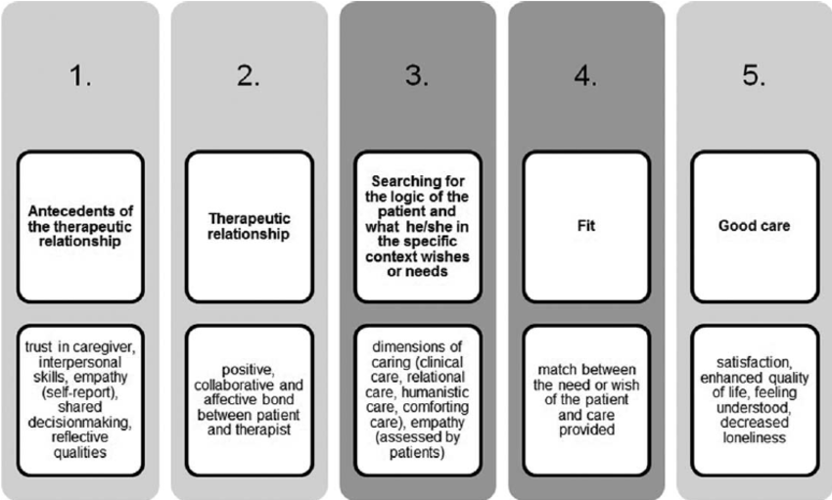
(Some) Dimensions of Care
Empathy
Social Justice
Equity
Cultural Responsiveness
Inclusion
Empowerment
Kuis, Hesselink, Goossensen, 2013 https://www.researchgate.net/publication/257535862_Can_quality_from_a_care_ethical_perspective_be_assessed_A_review

Slide 8

Types of Care
Different types of care:
  For ideas, for objects
  For other people, for animals
  For ourselves, what happens to us
  As protection, production (Tronto, 2013, ch. 3)
    (The work ethic vs the care ethic)
Joan Tronto: “what it means to be a citizen in a democracy is to care for citizens and to care for democracy itself.” p. x

Slide 9
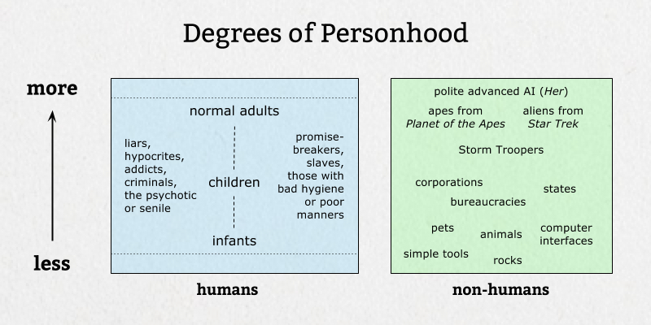
A Mark of Personhood
“If we decide that the capacity to care is as much a mark of personhood as reason or rationality, then we will want to find ways to increase this capacity.” (Noddings, 1992, p. 24)
- the experience of caregiving, both as carer and recipient, is essential for this
https://meltingasphalt.com/personhood-a-game-for-two-or-more-players/

Slide 10
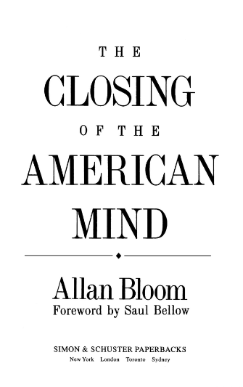
Felt Need
“Allan Bloom… writes: ‘For there is no real education that does not respond to felt need’ (1987, p. 19). Where he differs dramatically from the alternative offered in this book is in his way of identifying those needs; he insists that they must be ‘the permanent concerns of mankind’ (p. 19). He claims to know what the needs are before he meets his students, because he knows the unchanging quality of human nature.” - Nel Noddings
http://mehrmohammadi.ir/wp-content/uploads/2020/09/The-Challenge-to-Care-in-School-Nel-Noddings.pdf

Slide 11
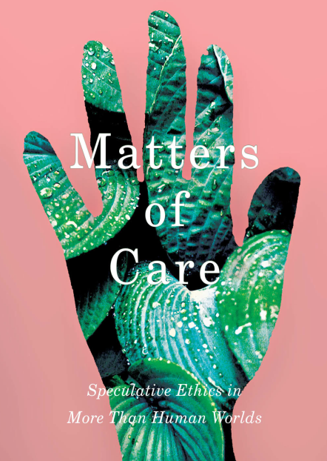
Solving Problems
“Matters of Care encourages us to confidently resist the rhetoric of playing the game of ‘solving problems’ by responding to any question – be it academic malpractice, poverty, racism, ecological crisis like climate change, wars – in standard ways or by pretending that our particular research is not directly related to the textures of more than human worlds it is situated in.”
Sonja Jerak-Zuiderent, 2018, review of María Puig de la Bellacasa (2017) Matters of Care. https://www.researchgate.net/publication/325218986_Maria_Puig_de_la_Bellacasa_2017_Matters_of_Care_Speculative_Ethics_in_More_Than_Human_Worlds_Minneapolis_and_London_University_of_Minnesota_Press_265_pages_ISBN_978-1-5179-0065-6

Slide 12
The Ethical Concept of Care
Wikipedia: “The ethics of care is a normative ethical theory that holds that moral action centers on interpersonal relationships and care or benevolence as a virtue.”
Some assumptions of the theory are basic:
  Persons are understood to have varying degrees of dependence and interdependence on one another.
  Other individuals affected by the consequences of one's choices deserve consideration in proportion to their vulnerability.
  Situational details determine how to safeguard and promote the interests of those involved.
https://en.wikipedia.org/wiki/Ethics_of_care

Slide 13
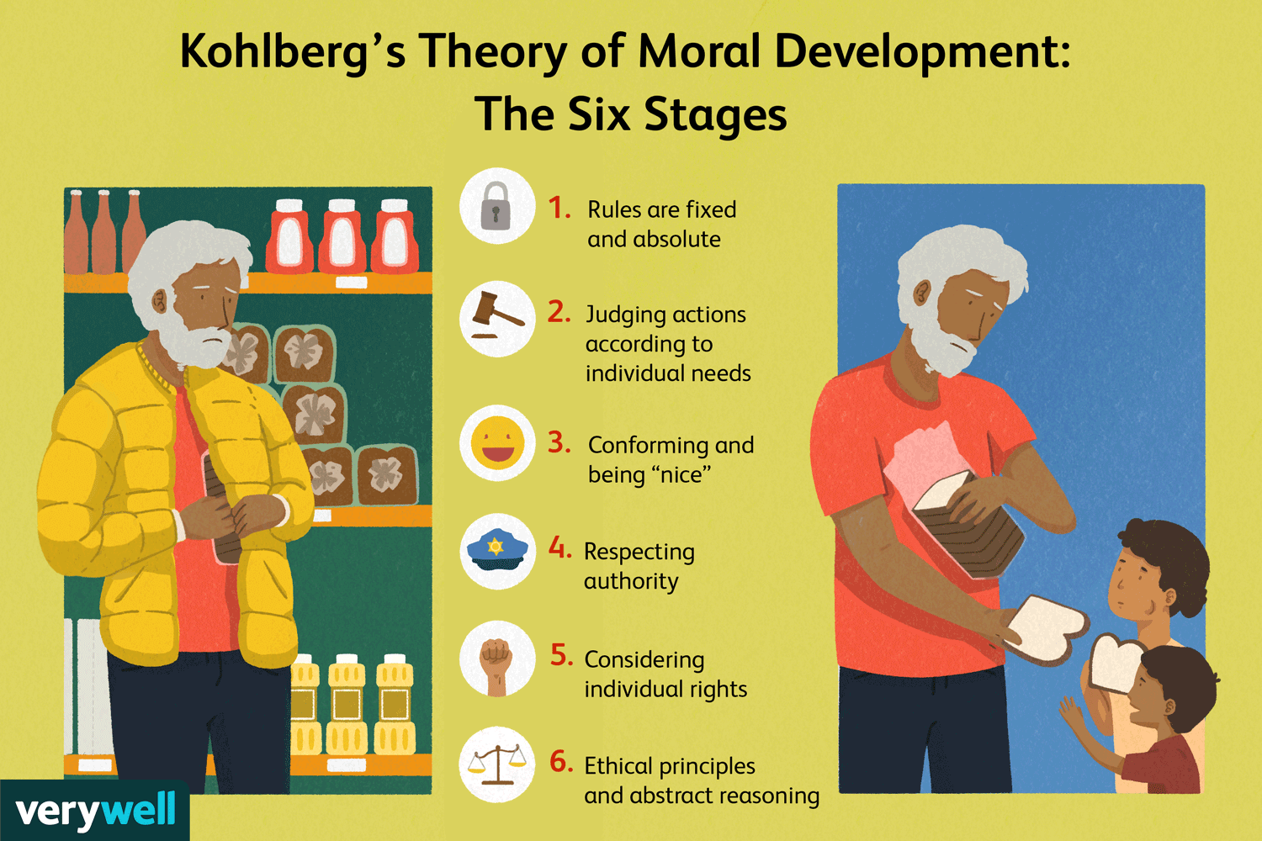
Kohlberg’s Six Stages of Moral Development
https://www.verywellmind.com/kohlbergs-theory-of-moral-development-2795071

Slide 14

In a Different Voice
“In In a Different Voice: Psychological Theory and Women’s Development (1982), Carol Gilligan identified a kind of moral reasoning that was based on an ethic of care rather than an ethic of justice.”
  Developed “primarily” through a woman’s voice (v. Kohlberg)
  Stages of care: for the self, for the other, both (balanced) based on a criticism of Kohlberg’s six stages (that advance to e.g. deontology or social contract)
  “Women are more likely to make moral decisions based on issues of care, inclusion, and personal connection, rather than on a more abstract and distant notion of justice.”
https://www.encyclopedia.com/people/history/historians-miscellaneous-biographies/carol-gilligan

Slide 15
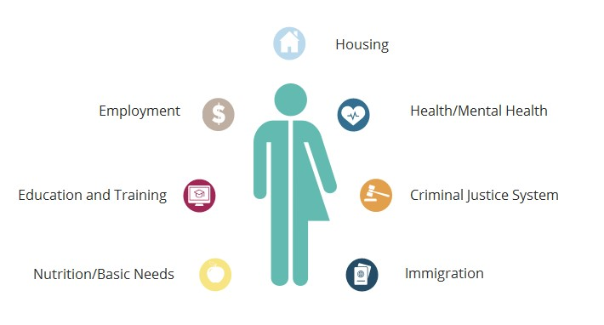
Felt Need (2)
Noddings: “Gilligan described a morality based on the recognition of needs, relation, and response. Women who speak in the different voice refuse to leave themselves, their loved ones, and connections out of their moral reasoning.”
http://mehrmohammadi.ir/wp-content/uploads/2020/09/The-Challenge-to-Care-in-School-Nel-Noddings.pdf
https://nhttac.acf.hhs.gov/soar/eguide/observe/trauma_related_responses

