Slide 1

Introduction to the Duty of Care
Stephen Downes
November 22, 2021

Slide 2

Data Ethics of Power
“a data ethics of power can be described as a type of post-modernist, or in essence vitalist, call for a specific kind of “ethical action” to free the living/human being from the constraints of the practices of control embedded in the technological infrastructures of modernity that at the same time reduce the value of the human being.”
As one Danish minister said at the launch of a national data ethics expert group: “This is about what society we want” (Holst, 11 March 2018).
Gry Hasselbalch, 2019 https://policyreview.info/articles/analysis/making-sense-data-ethics-powers-behind-data-ethics-debate-european-policymaking

Slide 3
The Failure of Argument
The argumentative approach is based what Robert Nozick called 'coercive philosophy': "arguments are powerful, and best when they are knockdown, arguments force you to a conclusion.“
This just feeds into the ethos of sites like Parler; it draws us into engagement and battle with the beast.
We as ordinary citizens living in a free and open society can recognize Parler for what it is, and we deplatform the site because it is repugnant and offensive, and we have no obligation to convince them of anything.
https://www.vox.com/recode/2020/11/24/21579357/parler-app-trump-twitter-facebook-censorship

Slide 4

Ethics of Care
“instead thinking about morality in terms of relationships with distinct and particular individuals to whom we owe some responsibility of care; it takes as its fundamental and grounding moral behavior the caring of a mother for a child.”
https://www.hyperorg.com/blogger/2021/01/11/parler-and-the-failure-of-moral-frameworks/

Slide 5

Professional Duty of Care
“For a health care professional, there is not only the legal duty of care (which we will discuss below) but the moral, ethical and professional duties of care as well.”
the ‘snail in a bottle’ case, 1932
http://oro.open.ac.uk/49091/3/Duty%20of%20care%20-%20Cornock.pdf
https://www.canadianunderwriter.ca/features/cc-donoghue-v-stevenson/
https://www.ticliblaxland.com.au/snail-in-the-bottle/

Slide 6

Tort Law
“In tort law, a duty of care is a legal obligation which is imposed on an individual requiring adherence to a standard of reasonable care while performing any acts that could foreseeably harm others.”
https://www.youtube.com/watch?v=zmjll4eyJXM
https://en.wikipedia.org/wiki/Duty_of_care

Slide 7

A Duty to Whom?
“As a representative of the company, you have one set of responsibilities. As a concerned private citizen, you have other responsibilities. It's nice when those converge, but that's not always the case.” (Feffer. (2017)
https://mangahub.io/chapter/scarlet-empire/chapter-10

Slide 8
Whence Care?
How can neurons care?
animals clearly care for themselves, social animals care for others. These develop evolutionarily
attachment = dispositions to extend care to others
placenta releases hormones, these act on neurons (creates a nesting urge)
'protect myself' tactics feel the same as 'protect mine' tactics

Slide 9
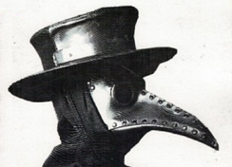
Ethics as Empathy
“This whole thing is not about heroism, it’s about decency.”
https://www.openculture.com/2020/04/what-is-albert-camus-the-plague-about-an-introduction.html

Slide 10

Dimensions of Care
Empathy
Social Justice
Equity
Cultural Responsiveness
Inclusion
Empowerment

Slide 11
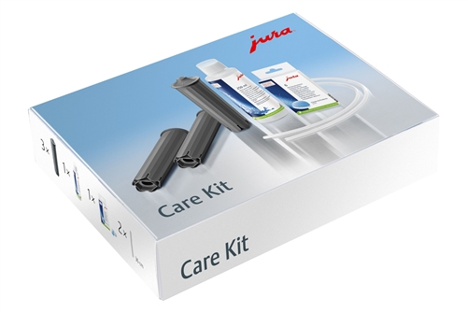
Machines that Care?
In Matters of Care, María Puig “contests the view that care is something only humans do, and argues for extending to non-humans the consideration of agencies and communities that make the living web of care by considering how care circulates in the natural world.”
https://www.amazon.ca/Matters-Care-Speculative-Ethics-Worlds/dp/1517900654

Slide 12
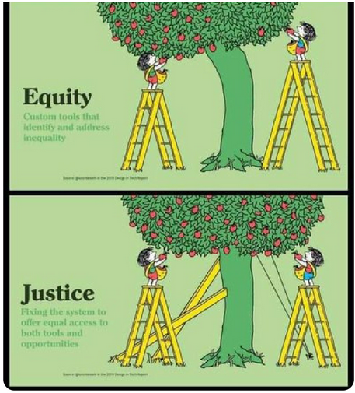
Pedagogy of Care
“One of the most empowering ways to redress injustice is to put power of decision making in the hands of those farthest from justice, but ensure they have enough knowledge and tools to make a well-informed choice, and know how much leeway they have to design their own path.”
https://blog.mahabali.me/educational-technology-2/pedagogy-of-care-covid-19-edition/
https://ecampusontario.pressbooks.pub/onlineteaching/chapter/pedagogies-of-care/

