Slide 1

The End of Ethics
Stephen Downes
November 19, 2021

Slide 2
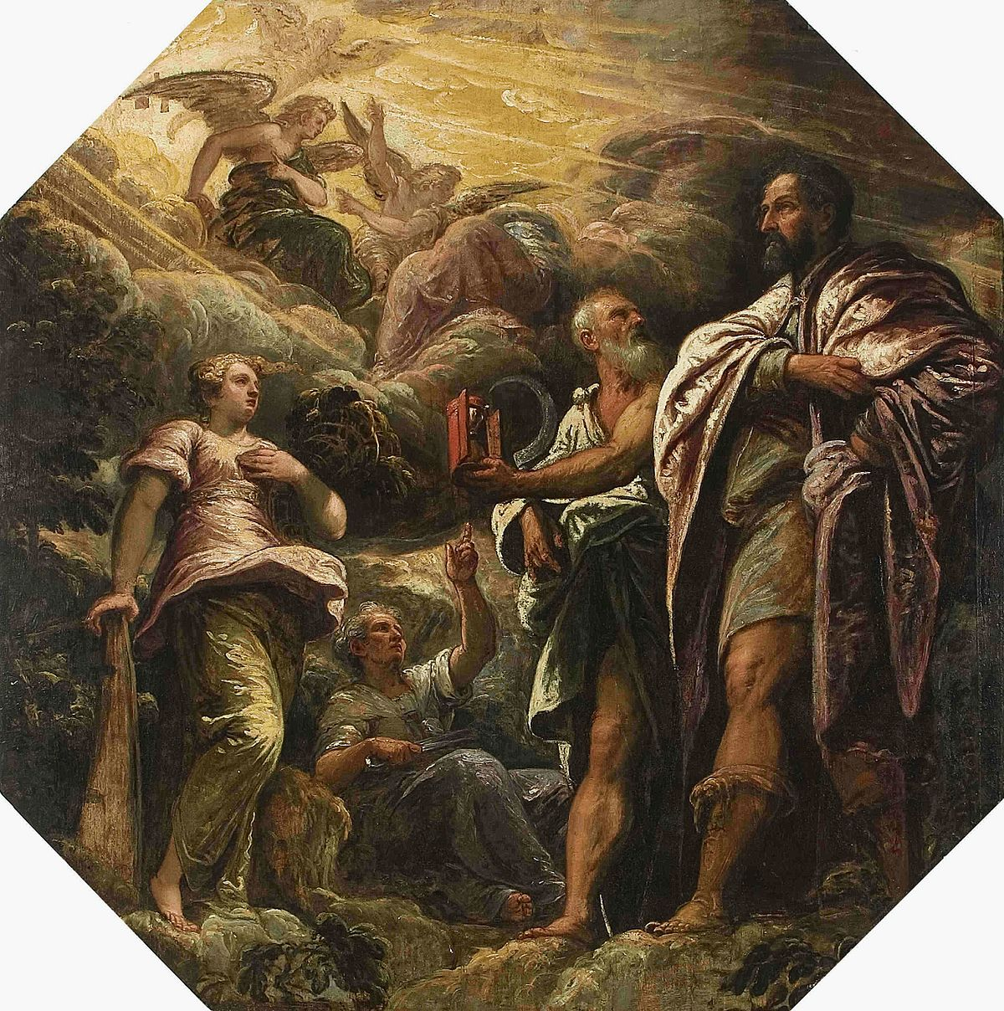
The End of Ethics
What is the goal or objective of ethics?
How or why do we conclude our discussion of ethics?
https://en.wikipedia.org/wiki/Morality
Title image: https://aeon.co/essays/our-world-is-a-black-box-predictable-but-not-understandable

Slide 3
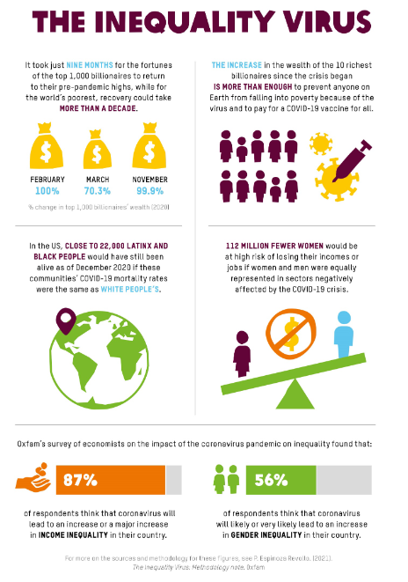
One Ethics to Rule them All?
“Universalist arguments apply across lines of social and economic class, but their generality is not well suited to combating unequal and particular harms. Members of our most disadvantaged communities have long asserted that they fall under heavier and more hostile scrutiny, and empirical research supports them.” (Gellman and Adler-Bell, 2017 )
https://oxfamilibrary.openrepository.com/bitstream/handle/10546/621149/bp-the-inequality-virus-250121-en.pdf

Slide 4
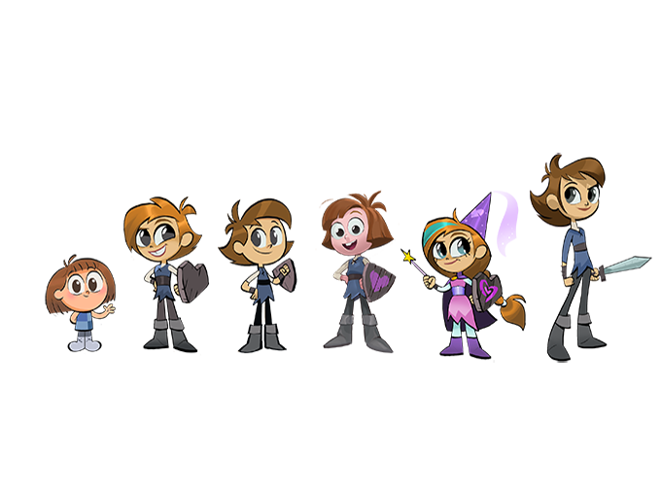
Character?
The 12 Guiding Principles of Exceptional Character
  adaptability, compassion, contemplation, courage, honesty, initiative, loyalty, optimism, perseverance, respect, responsibility, and trust-worthiness
    developed by the International Center for Leadership in Education www.leadered.com/guiding_princ.html
The Seven Universal Ethical Attributes
  courage, loyalty, justice, respect, hope, honesty, and love
    developed by the Heartwood Institute http://heartwoodethics.org/1-approach/framework.asp
https://kidscreen.com/2020/08/21/in-photos-how-to-create-a-character/
Character Education for the Digital Age, Jason Ohler, 2011, ASCD http://www.ascd.org/publications/educational-leadership/feb11/vol68/num05/Character-Education-for-the-Digital-Age.aspx

Slide 5
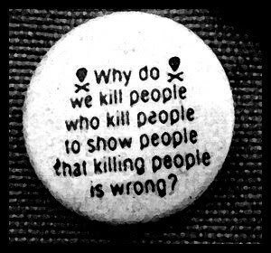

Killing
Vs murder
For self-defense
In war
Euthanasia
https://www.scopeproject.org/is-murder-wrong-issue-11

Slide 6
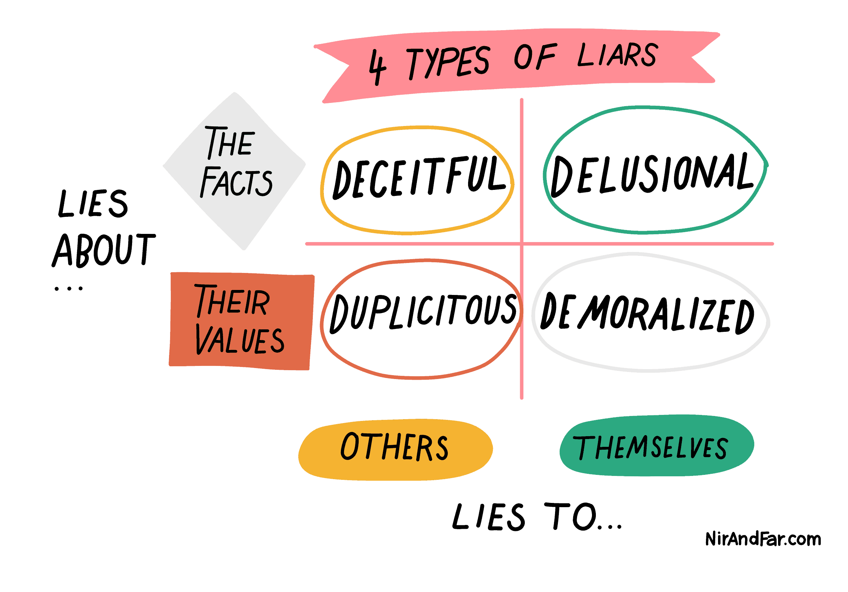
Lying
https://www.nirandfar.com/types-of-liars/
https://daily-philosophy.com/is-lying-ethical/
https://journals.sfu.ca/jalt/index.php/jalt/article/view/293/253

Slide 7
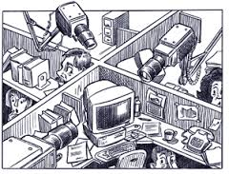
Spying
"If you haven't done anything wrong, you have nothing to fear.“
“Covert activity aimed at protecting yourself from others' wrongdoing is often both lawful and ethical.”
https://archive.law.upenn.edu/institutes/cerl/conferences/cyberwar/papers/reading/Allen.pdf
https://cs.stanford.edu/people/eroberts/cs181/projects/ethics-of-surveillance/ethics.html

Slide 8

Axiology
Axiology (from Greek ἀξία, axia: "value, worth"; and -λογία, -logia: "study of") is the philosophical study of value. It includes questions about the nature and classification of values and about what kinds of things have value. ...
  intrinsic and extrinsic value
  Substantive theories of value try to determine which entities have intrinsic value – monist vs pluralist
  Nihilists – nothing has value
https://www.slideshare.net/robertfarrow/research-methods-in-open-education-insights-from-the-global-oer-graduate-network

Slide 9
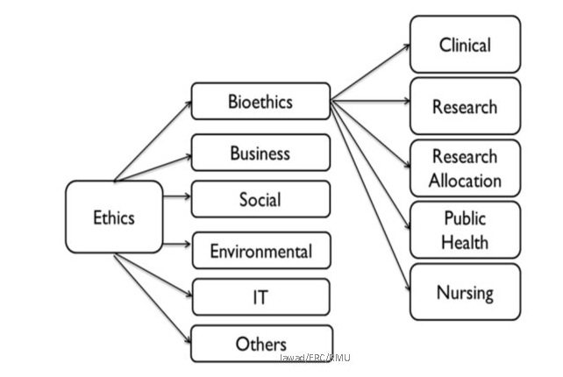
Ethics as a Branch of…
By analogy – ‘natural philosophy’ was eventually resolved into physics, chemistry, biology, etc.
https://slidetodoc.com/ethical-review-committee-erc-prof-dr-md-jawadul/

Slide 10
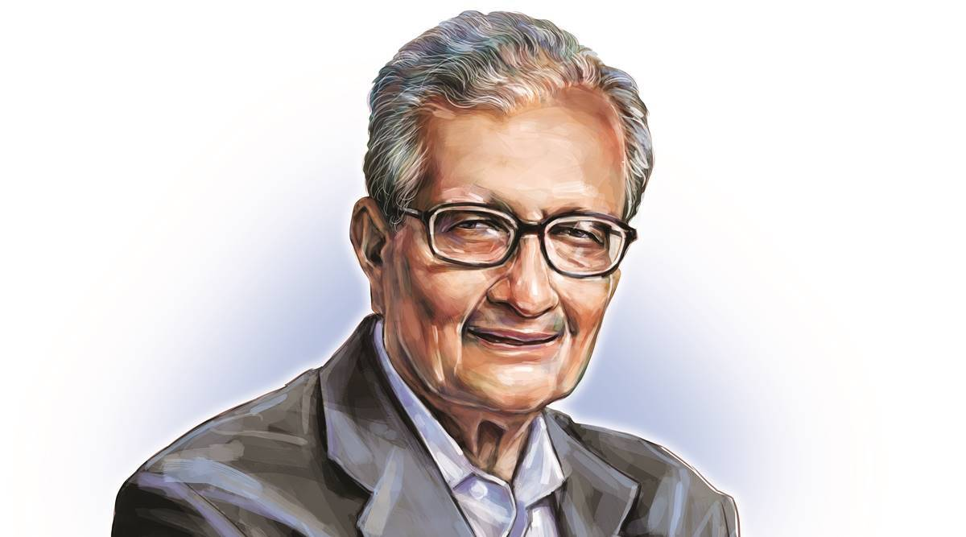
Social Development
Amartya Sen - governments should be measured against the concrete capabilities of their citizens
  “a theory that is both comparative and realisations-oriented (instead of being transcendental and institutional).”
  e.g. citizens must have ‘functionings’ to have a capacity to vote
  e.g. ‘capabilities approach’ in Martha Nussbaum's Women and Human Development.
https://en.wikipedia.org/wiki/Amartya_Sen

Slide 11
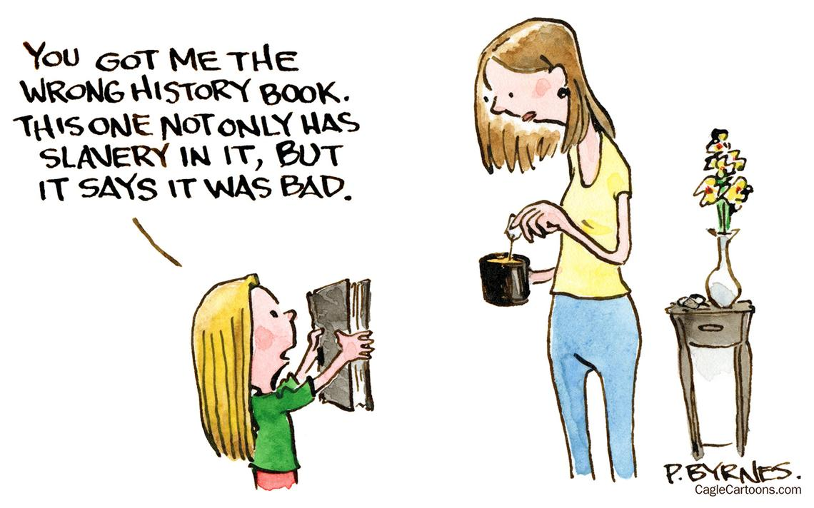
Critical Theory
E.g. Roy L. Brooks defined critical race theory in 1994 as "a collection of critical stances against the existing legal order from a race-based point of view".
  more specifically, race is a social construct
  racism is neither an individual bias nor prejudice, but rather embedded in the legal system
  Racism is supplemented with policies and procedures

Slide 12
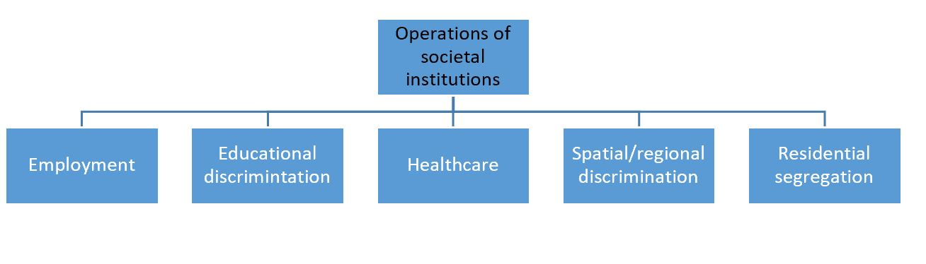
Structural Discrimination
E.g. “You need to be liked: by people at your level, by people above you and by people below you.”
E.g. “Military leaders saw pandemic as unique opportunity to test propaganda techniques on Canadians.”
https://www.bbc.com/worklife/article/20210921-why-hard-work-alone-isnt-enough-to-get-ahead
https://ottawacitizen.com/news/national/defence-watch/military-leaders-saw-pandemic-as-unique-opportunity-to-test-propaganda-techniques-on-canadians-forces-report-says

Slide 13

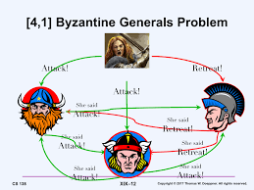
The Joker Problem
“Some men just want to watch the world burn.” (The Dark Knight, Nolan & Nolan, 2008)
Byzantine Generals Problem
http://cs.brown.edu/courses/cs138/s17/lectures/19consen-notes.pdf

Slide 14
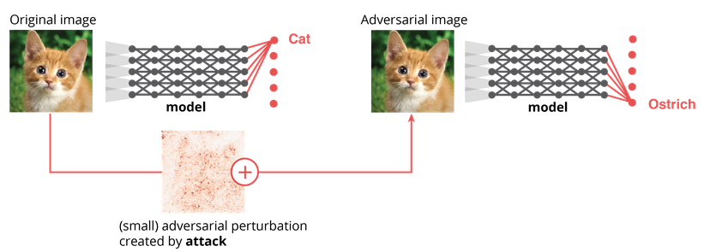
Maybe Ethics is a Technical Problem
“Competition has historically had a great impact on bringing the attention of the research community to a particular problem and in attracting new researchers to the areas.” (deBruijn, et.al., 2020)
​https://www.kaggle.com/c/gendered-pronoun-resolution
​https://www.crowdai.org/challenges/adversarial-vision-challenge
​https://www.kaggle.com/c/inclusive-images-challenge/
https://competitions.codalab.org/competitions/17751

Slide 15
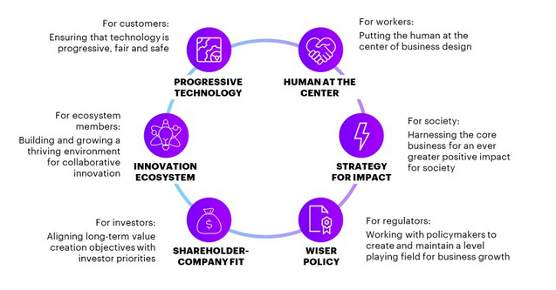
Or a Commercial Market Waiting to Develop?
E.g. “​Caryn Tan, Digital Strategy Consultant from Accenture, demonstrated the Accenture Fairness Tool, which enables a user to identify and fix some of the problems that result in unfair outcomes by analysing both training data and models.” (deBruijn, et.al., 2020)
https://www.accenture.com/us-en/blogs/blogs-rebooting-responsibility

Slide 16

Complexity
“In the cry ‘We don’t know how machine learning works!’ we hear that these models do indeed work”
“MLMs work because they’re better at reading the world than we are”
“Our encounter with MLMs doesn’t deny that there are generalisations, laws or principles. It denies that they are sufficient for understanding what happens in a universe as complex as ours.”
David Weinberger - https://aeon.co/essays/our-world-is-a-black-box-predictable-but-not-understandable

Slide 17
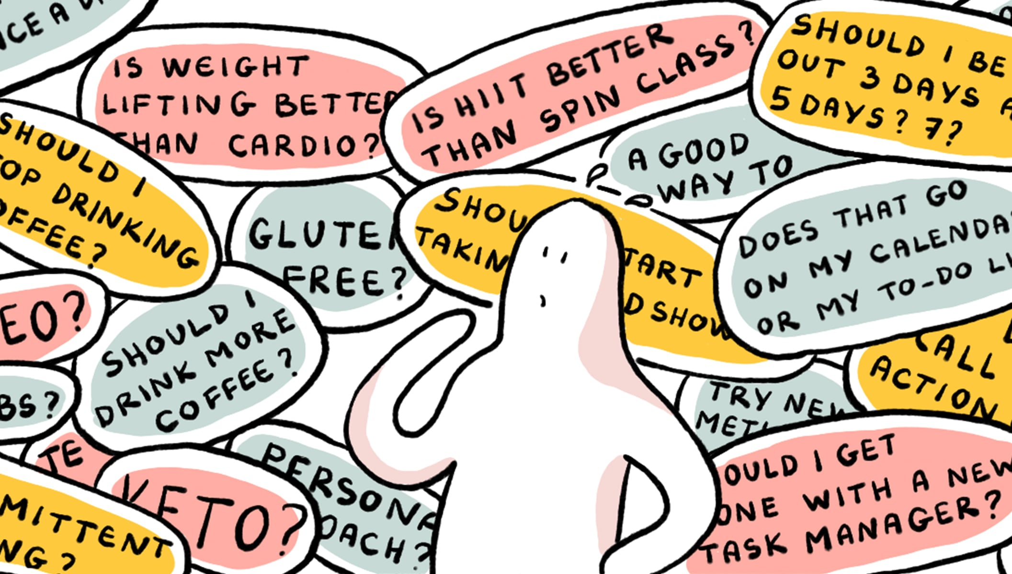
Simple Universal Solutions
Simple universal principles are not sufficient to address complex problems.
  As Jones (2011) writes, “Implementation must deal with interdependent problems, navigating nonlinear and often unpredictable change processes, involving a diverse range of stakeholders.”
    “the capacities to tackle complex problems are often distributed among actors.”
    “the outcomes of complex systems are unpredictable.”
    “complex problems often involve conflicting goals.”
https://blog.doist.com/complexity-bias-comic/

Slide 18

The End of Ethics
Ethics are not abstract. Though we can derive universal principles based on abstract values or calculations, we shouldn’t.
“The only real weapon against the fearful vision of a cold siber-Cyberia is joy. Appreciation of the space gives the surfer his bearings and balance in Cyberia.” (Rushkoff, 1994:180-182).

