Slide 1
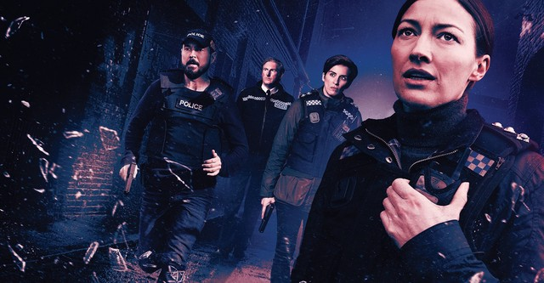
Duty
Stephen Downes
November 11, 2021

Slide 2

Duty
Duty is a requirement to moral action
The word 'deontological' comes from the Greek word deon, which means 'duty’.
Duty-based ethics teaches that some acts are right or wrong because of the sorts of things they are
https://www.nytimes.com/2019/09/02/opinion/should-work-be-passion-or-duty.html
https://www.bbc.co.uk/ethics/introduction/duty_1.shtml
Cover image: https://www.justwatch.com/us/tv-show/line-of-duty

Slide 3
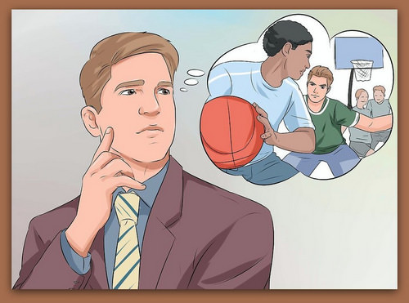
Deontology
“Deontologists argue that you can never know what the results will be so it doesn’t make sense to decide whether something is ethical based on outcomes.”
“Deontology is also concerned with intentions. If you intended good through your action, then the action is good, no matter what actually happened as a result.”
https://lcubbison.pressbooks.com/chapter/core-202-ethical-reasoning/
https://k12.libretexts.org/Bookshelves/Philosophy/08%3A_Chapter_8/8.05%3A_Section_5-

Slide 4
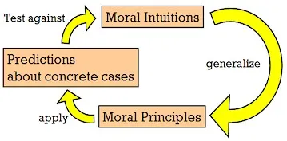
Moral Intuitions
Derived from the ‘natural law theory’ of the Middle Ages
E.g. Aquinas: “every substance seeks the preservation of its own being, according to its nature: and by reason of this inclination, whatever is a means of preserving human life, and of warding off its obstacles, belongs to the natural law.” (Q94:2)
Act intuitionism, rule-intuitionism
https://epublications.marquette.edu/cgi/viewcontent.cgi?referer=https://www.google.com/&httpsredir=1&article=1380&context=phil_fac
https://theelectricagora.com/2015/11/04/a-discussion-on-moral-intuition/

Slide 5
Natural Law Theory
From John Finnis, Germain Grisez, and others, a set of seven basic, self-evident values from which moral norms could be safely derived
  Life, health, and safety
  Knowledge of reality and appreciation of beauty
  Some degree of excellence in work and play
  Living at peace with others, neighborliness, friendship
  Aesthetic experience as harmony and inner peace
  Harmony between one’s choices, judgements and performances
  Religion and pursuit of ultimate questions of meaning and value
https://scholarship.law.nd.edu/cgi/viewcontent.cgi?article=1855&context=law_faculty_scholarship

Slide 6
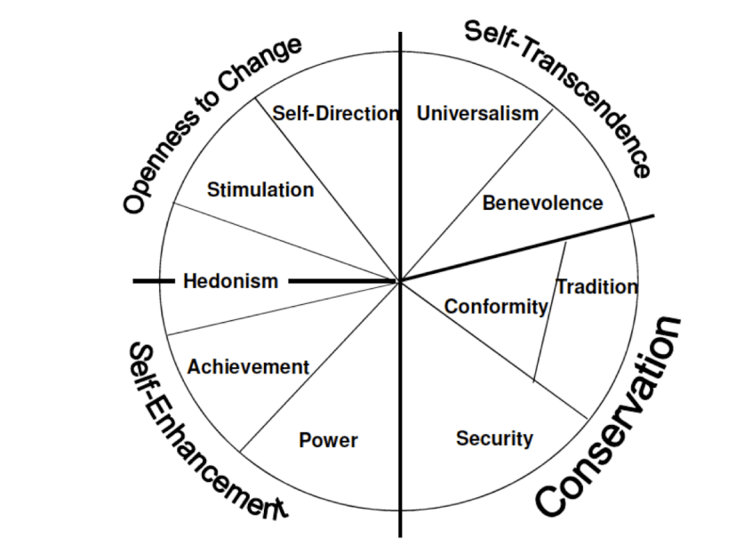
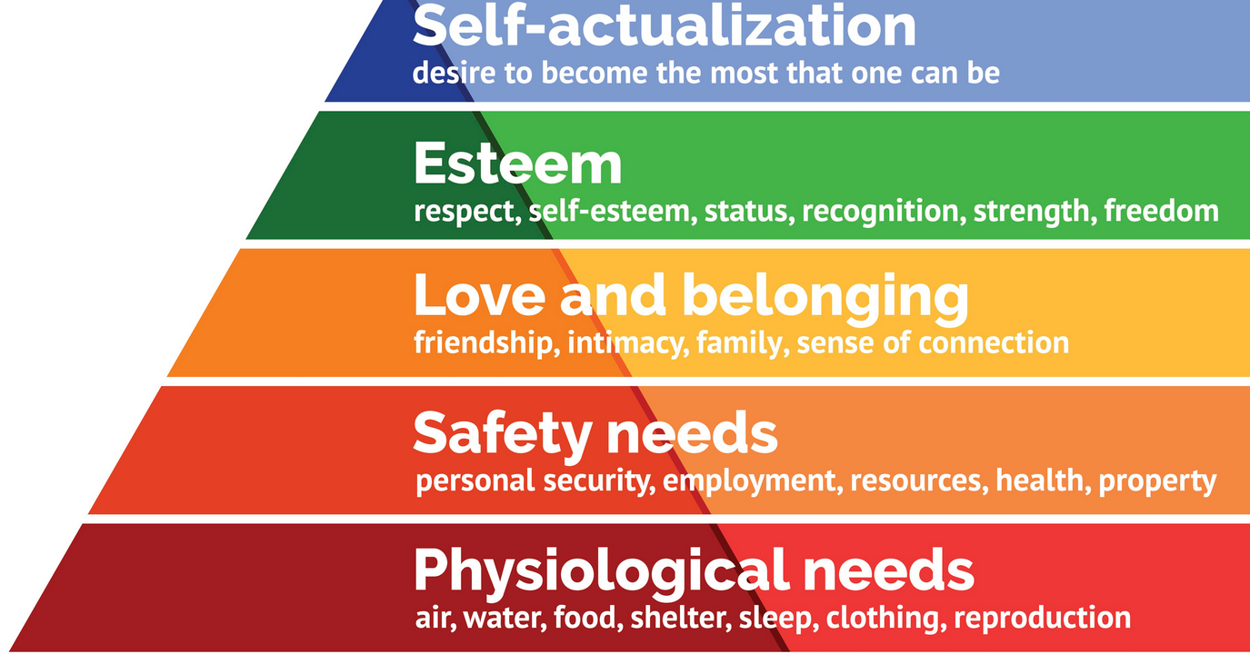
Value Theory
Schwartz – Value Theory Maslow - Hierarchy
https://scholarworks.gvsu.edu/cgi/viewcontent.cgi?article=1116&context=orpc
https://www.bbc.com/news/magazine-23902918

Slide 7
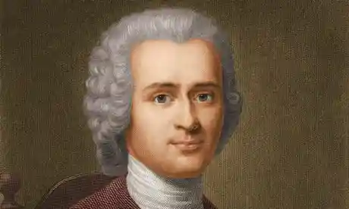
Rousseau on Human Freedom
The meaning and importance of human dignity
The primacy of freedom and autonomy
The intrinsic worth of human beings
“The hope of creating a stable and just political society on the basis of narrow self-interest is a soul-shrinking and self-destructive dogma masquerading as a science of politics.” (p.19)
https://library.oapen.org/bitstream/handle/20.500.12657/30072/650028.pdf?sequence=1&isAllowed=y
https://www.theguardian.com/commentisfree/belief/2014/jan/20/rousseau-compassionate-intense-relevant-philosopher

Slide 8
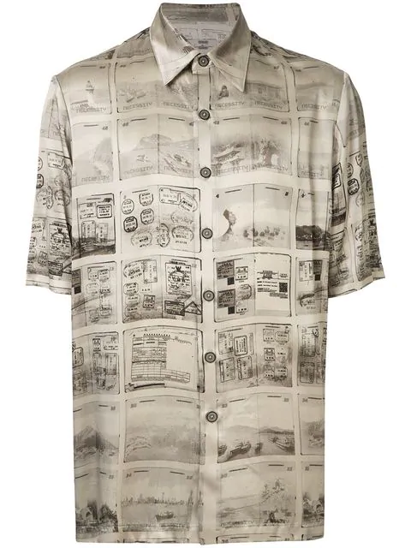
Duty and Necessity
Kant:
  “Nothing in the world—or out of it!—can possibly be conceived that could be called ‘good’ without qualification except a good will.”
  “Good will is good because of how it wills
    i.e. it is good in itself.
  Morality should not depend on human nature and hence be subject to the fortune of change and the luck of empirical discovery
Yes but: :the road to Hell is paved with good intentions” (Pojman & Fieser, 2012, p. 127)
https://www.earlymoderntexts.com/assets/pdfs/kant1785.pdf

Slide 9
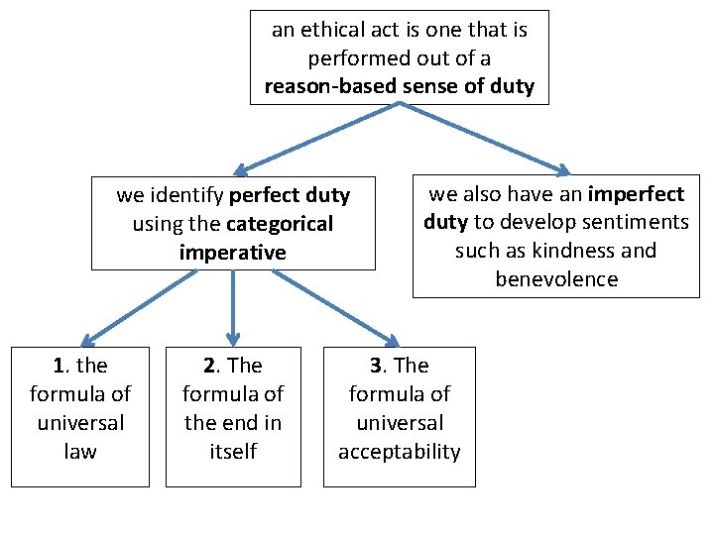
The Categorical Imperative (CI)
Hypothetical Imperative: If you want A, you must do B
Categorical Imperative: Do B
“Act only according to the maxim by which you can at the same time will that it would become a universal law.”
All specific duties can be derived from this one imperative
https://slidetodoc.com/ethics-theory-and-business-practice-3-2-kantian/
https://www.britannica.com/topic/categorical-imperative

Slide 10
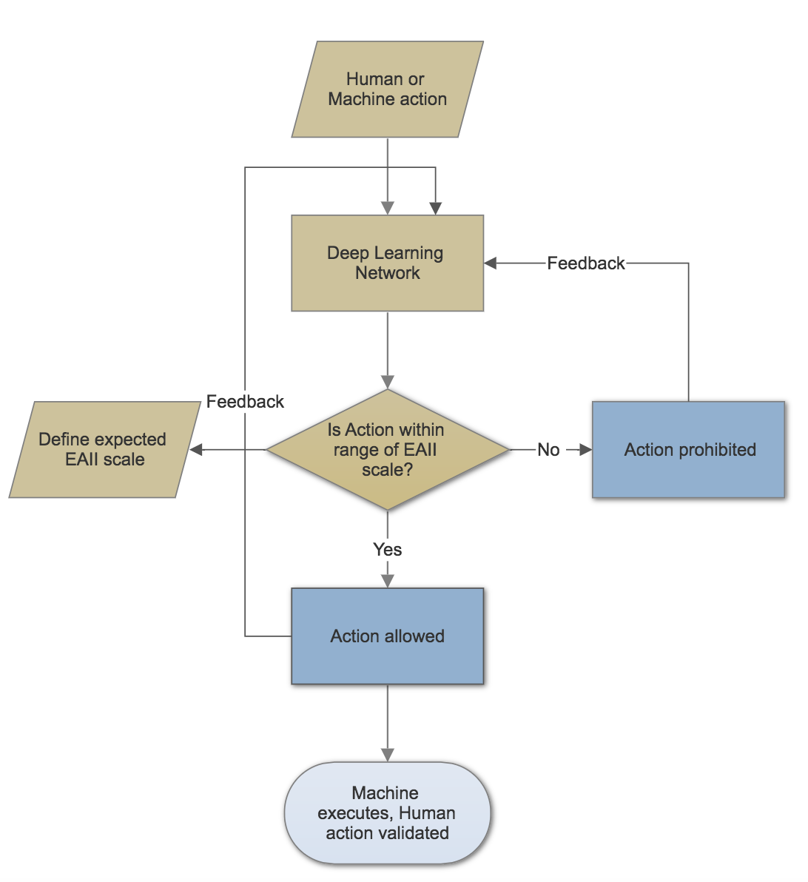
Additional Versions of the CI
“Act only according to the maxim by which you can at the same time will that it would become a universal law of nature.”
“Act as to treat humanity, whether in your own person or in that of any other, in every case as an end and never merely as a means”
“Act that your will can regard itself at the same time as making universal law through its maxims.”
https://towardsdatascience.com/ai-and-ethics-7d860c7f352d

Slide 11
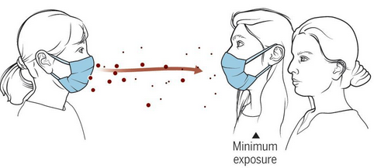
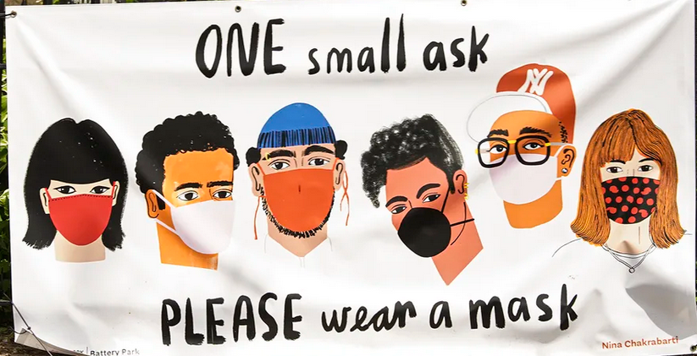
Contradiction
What would prevent something from becoming a universal law?
  logical contradiction?
  teleological contradiction (contrary to a purposeful and organized system of nature)?
  practical contradiction (would be ineffective for achieving my purpose if everybody did it)?

Slide 12
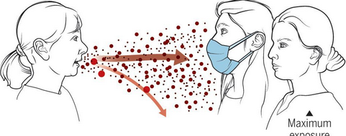
The Categorical and the Contingent
Sokol writes, "Religion, financial gain, reputation, personal character, social context, geographical location, severity and nature of disease, the climate of fear - these are all influential factors in doctors' decision to treat, perhaps more so than in any other historical period."
Sokol D. 2004. Healthcare Workers' Duty to Care and Severe Infectious Diseases. www.medicalethicist.net/Thesis3.doc

Slide 13
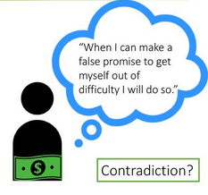
Examples
Making a lying promise
Committing suicide
Neglecting one’s talent
Refraining from helping others
http://people.tamu.edu/~g-varner/bioethics/ethicaltheory/kantsfourexamples.html
https://slideplayer.com/slide/14053938/

Slide 14
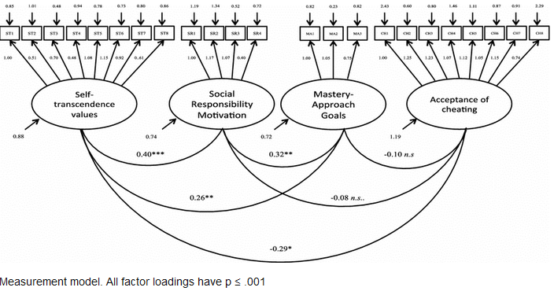
Criticisms
Mandating trivial actions
Endorsing cheating
Prohibiting permissible actions
Mandating genocide
https://www.researchgate.net/publication/284338562_When_and_why_people_don't_accept_cheating_Self-transcendence_values_social_responsibility_mastery_goals_and_attitudes_towards_cheating

Slide 15

The Inhumanity of Duty
Duty ethics allows little room for context. In Les Misérables, was Jean Valjean wrong to steal bread to feed his starving sister’s children? Would it have been wrong to lie to a Gestapo officer asking where Jews were hidden or to slave-catchers in pursuit of runaways in the pre-war South? Some would say that the answers depend upon the circumstances and options available to us, rather than on it being the case that certain types of actions are always and necessarily wrong.
Radford University Core Handbook: Core 202- Ethical Reasoning and Analysis
https://lcubbison.pressbooks.com/chapter/core-202-ethical-reasoning/

Slide 16
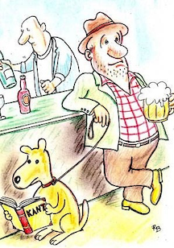
Treating People as Ends
For a moral principle:
  Does it involve violating the dignity of human beings?
  Can the maxim be universalized?
But: what does it actually tell us about how we should treat them?
https://plato.stanford.edu/entries/persons-means/

Slide 17

The Golden Rule
The Golden Rule is the principle of treating others as one wants to be treated. It is a maxim that is found in most religions and cultures.
How does one know how others want to be treated?
What if their tastes are not the same as yours?
What about hypothetical situations?
https://en.wikipedia.org/wiki/Golden_Rule
https://www.goldenruleproject.org/

Slide 18
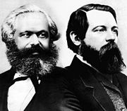
The Socialist Principle
"From each according to his ability, to each according to his needs"
https://en.wikipedia.org/wiki/From_each_according_to_his_ability,_to_each_according_to_his_needs

Slide 19
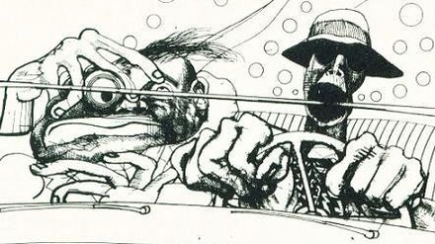
Defining the Good as Reason
Are those who have more reason than others intrinsically better?
  Are we intrinsically better than animals?
  Would super-galacticans be intrinsically better than us?
https://www.empireonline.com/movies/news/ralph-steadman-good-reason/

Slide 20
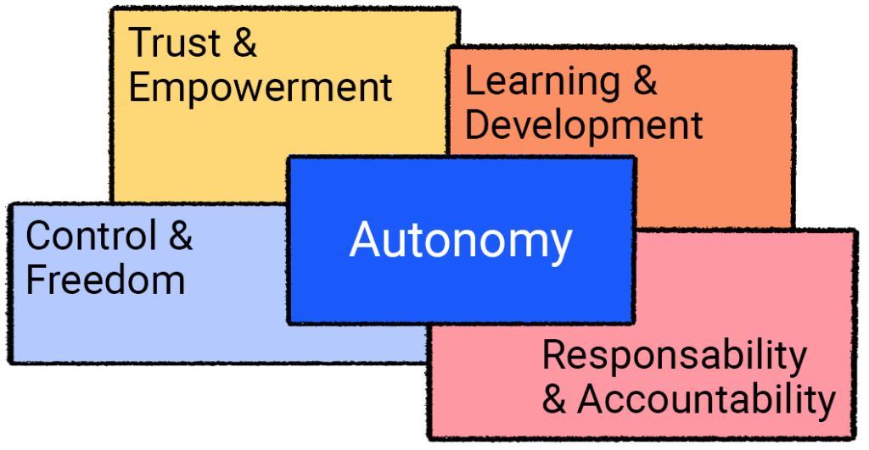
Autonomy
What’s important in Kat’s dictum is that we do not depend on an external moral authority to unveil moral law – we discover it for ourselves
But how autonomous are we, really? (c.f. the Stanley Milgram shocking experiment in the 1960s)
https://officevibe.com/blog/employee-autonomy-workplace

Slide 21
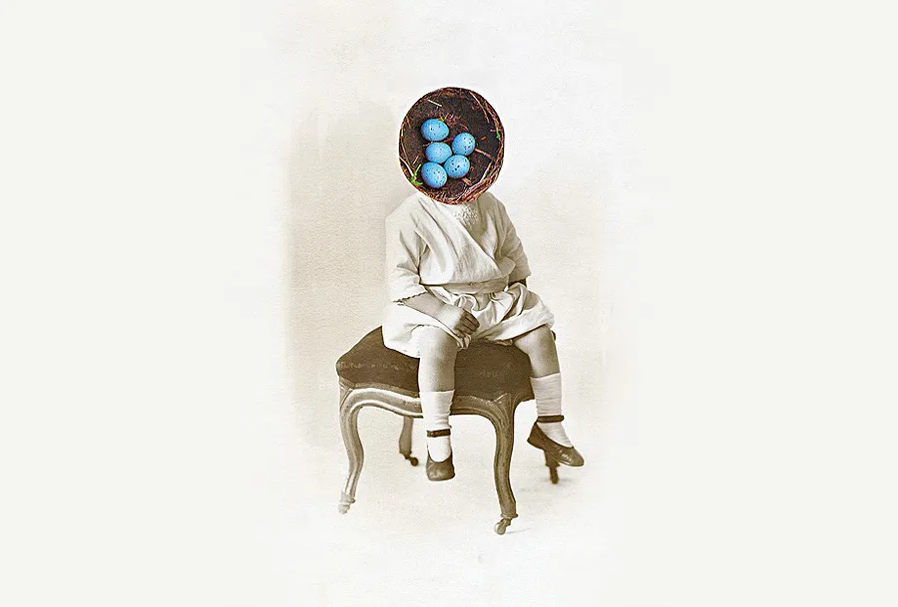
Prima Facie Duties
The problem of exceptionless rules
W.D. Ross – ‘prima facie duties’:
  Moral principles are self-evidence to any normal person on reflection
  But there is a plurality of principles, in no particular order
    E.g. keeping promises, fidelity, gratitude, beneficience, justice, self-improvement, non-maleficience
  Any principle can be over-ridden by others in particular situations
https://www.mvorganizing.org/what-are-the-prima-facie-duties-according-to-wd-ross/
https://www.lecturesbureau.gr/1/prima-facie-duties-lou-marinoff-1449/?lang=en

Slide 22
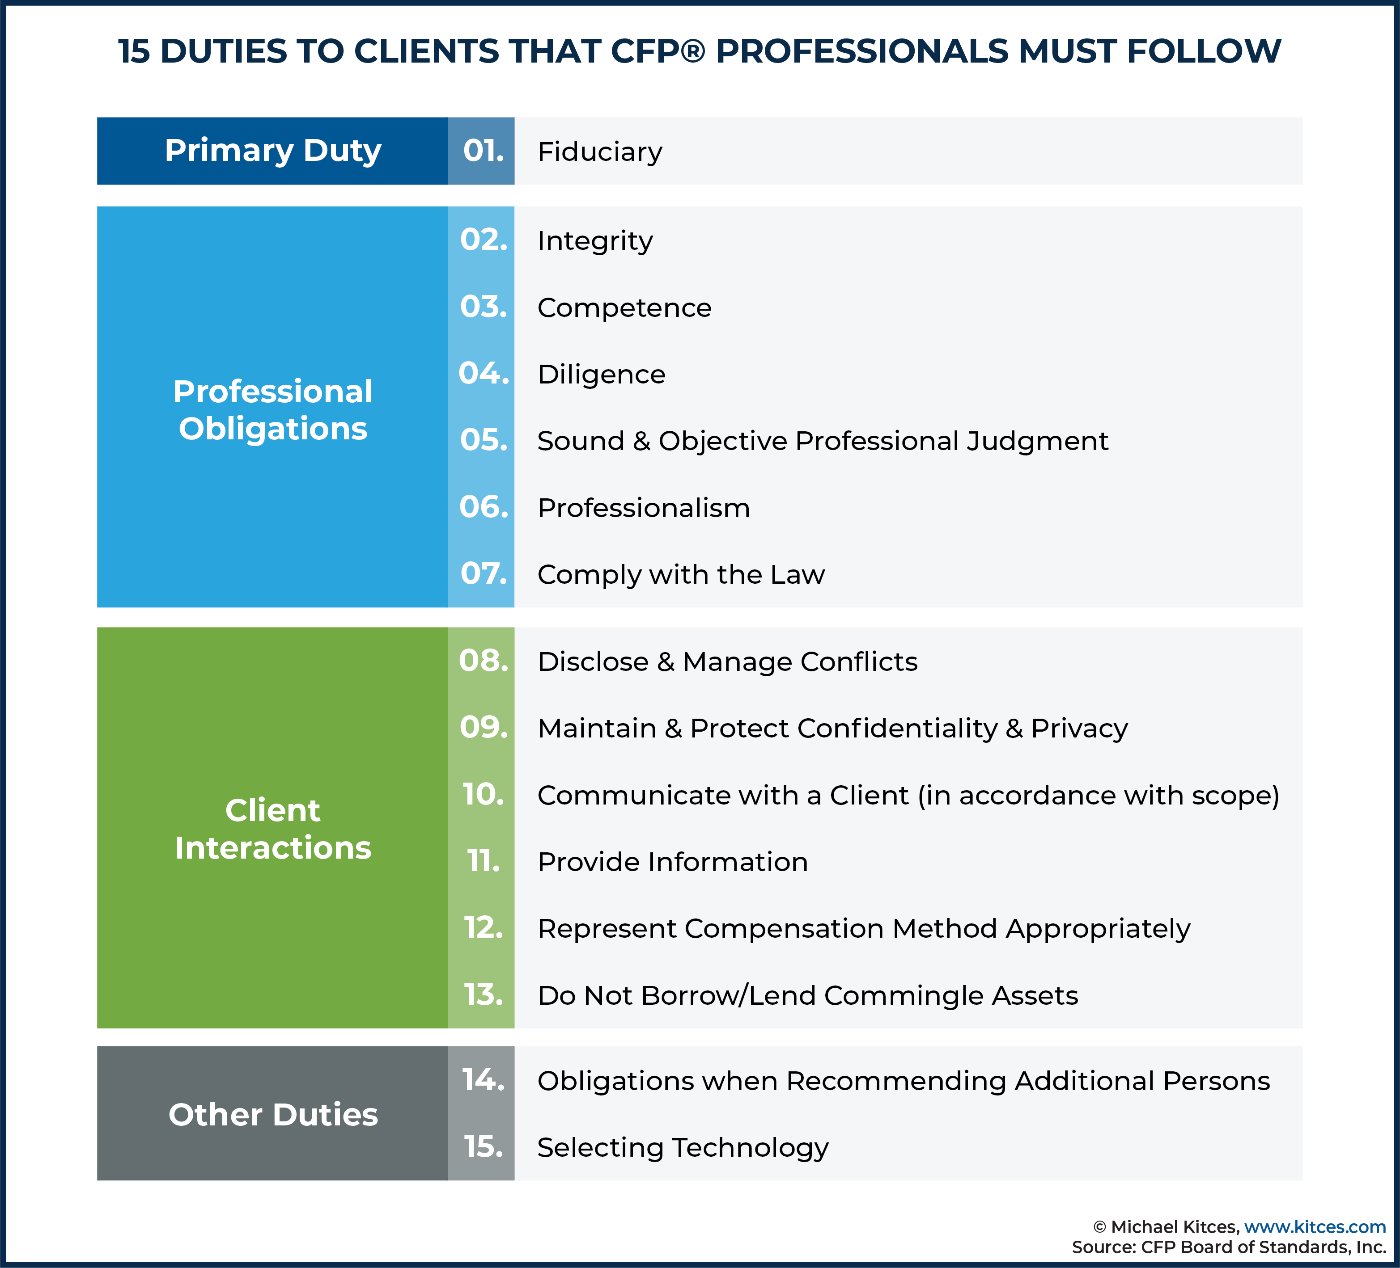
Professional Duties
“Duty to care for a patient by physician is a duty of virtue. A person who decides to become a physician takes on the promise of using his or her abilities to the best advantage. Such a promise can be explicit (e.g., taking an oath) or implicit, but there is no denying its existence.”
https://www.longwoods.com/content/17389/law-and-governance/clinicians-duty-to-care-a-kantian-analysis
https://www.kitces.com/blog/the-15-fiduciary-duties-to-clients-that-cfp-professionals-must-comply-with/

Slide 23
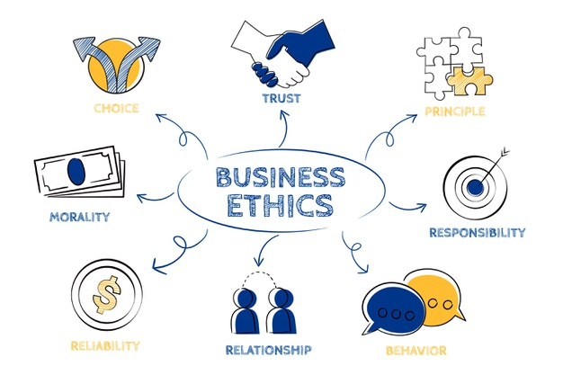
The Emptiness of Rules
Morality doesn’t seem to simply be a matter of following the rules. “If right action were determined by rules that any clever adolescent could apply correctly, how could this be so? Why are there not moral whiz-kids, the way there are mathematical (or quasi-mathematical) whiz-kids?” (Hursthouse, 1998)
https://finance-notes.com/10-examples-of-business-ethics-and-why-they-are-important-for-your-business/

Slide 24
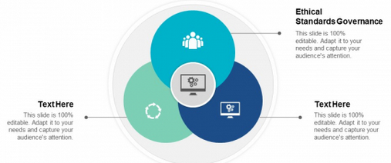
The End of Principles?
“The concept of ‘ethical principles’ for AI has encountered pushback both from ethicists, some of whom object to the imprecise usage of the term in this context, as well as from some human rights practitioners, who resist the recasting of fundamental human rights in this language.” (Fjeld, et.al., 2020)
https://www.slidegeeks.com/business/product/ethical-standards-governance-ppt-powerpoint-presentation-summary-example-cpb

