Slide 1
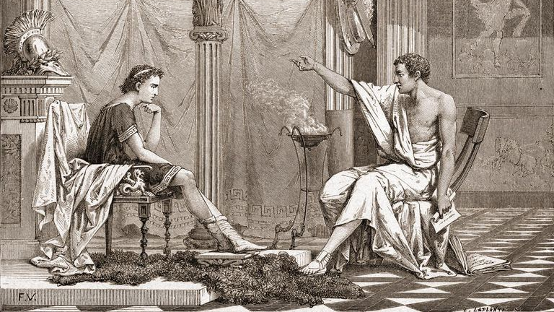
Virtue and Character
Stephen Downes
November 9, 2021

Slide 2
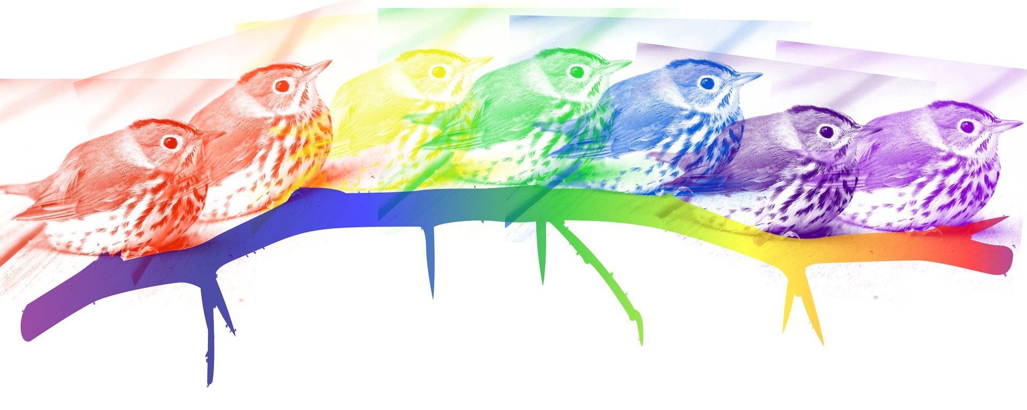
Virtue and Character
Ethics is in the first instance the study of virtue in a person, in a person’s actions, or in a society. But what is a virtue? The SEP says, “A virtue is an excellent trait of character. It is a disposition, well entrenched in its possessor—something that, as we say, goes all the way down, unlike a habit such as being a tea-drinker—to notice, expect, value, feel, desire, choose, act, and react in certain characteristic ways.” (SEP, 2017)
https://plato.stanford.edu/entries/ethics-virtue/
https://medium.com/publishous/if-patience-is-a-virtue-what-is-tolerance-7fa385225046

Slide 3
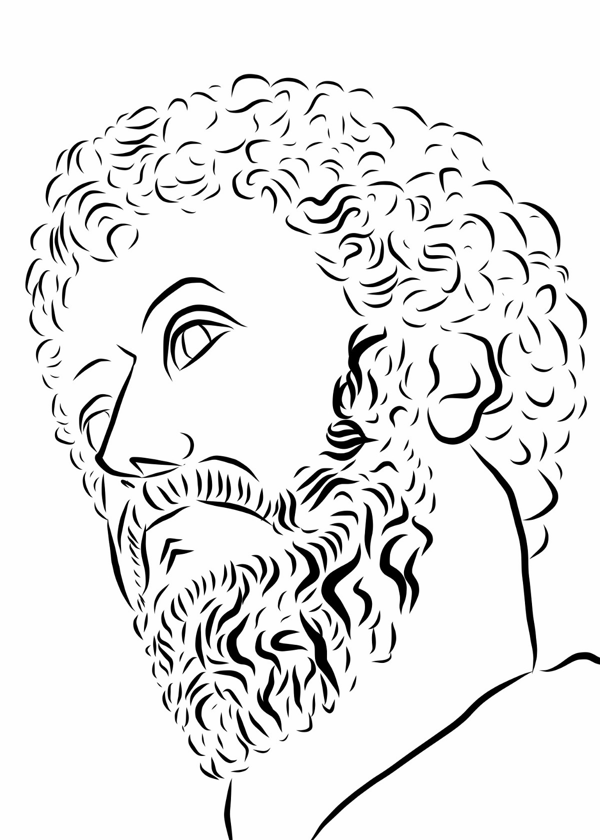
The Nature of Virtue
While we typically characterize virtue by means of various traits - honesty, frugality, piety, humility, caring, courage, generosity, moderation - the concept of virtue is not defined by those traits. It might be derived from some sense of ideals or perfection, as Plato might say, or it might be derived from the Greek notion of arete (ἀρετή) - “be all that you can be”.

Slide 4
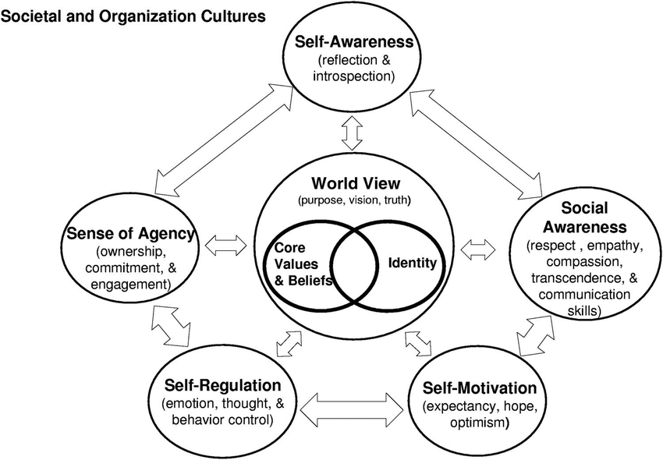
The Achievement of Virtue
The achievement of virtue is essentially tied up with the development of character. As Aristotle says, the achievement of virtue might be a lifetime task. Virtue is the opposite of what might be termed the “weakness of the will” - our succumbing to the temptation to indulge, to become intemperate, dishonest, or violent.
https://www.researchgate.net/publication/254734223_Character_development_through_spiritual_leadership

Slide 5
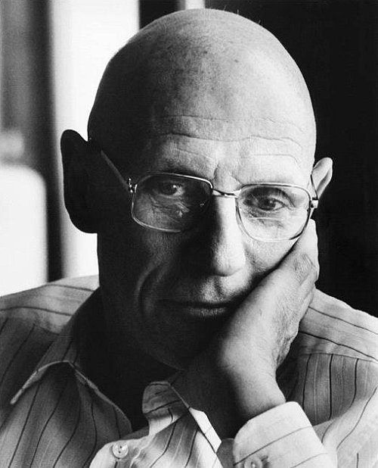
Self-Formation
We see this perspective reflected in modern ethics by writers such as Michael Foucault (1985). In The Use of Pleasure he talks of morality as “self-formation as an ‘ethical subject,’ a process in which the individual delimits that part of himself that will form the object of his moral practice, defines his position relative to the precept he will follow, and decides on a certain mode of being that will serve as his moral goal.”
https://iep.utm.edu/fouc-eth/

Slide 6

Working On Myself
“If you are working on yourself, are you considering these points when you say ‘I am working on me’? Are you working on yourself? Or are you maintaining your happiness? Are you somewhere in the middle or you just do not know? It doesn’t matter where you are in your journey.”
https://tenipascal.com/is-the-term-i-am-working-on-myself-a-trend/

Slide 7
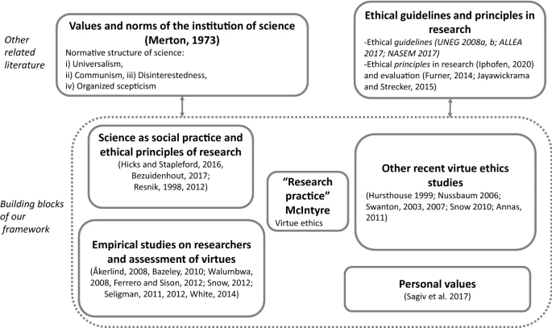
Virtue as Normative
Virtue ethics teaches
  An action is only right if it is an action that a virtuous person would carry out in the same circumstances.
  A virtuous person is a person who acts virtuously
  A person acts virtuously if they "possess and live the virtues“
  A virtue is a moral characteristic that a person needs to live well.
https://link.springer.com/article/10.1007/s11192-020-03658-4
Introduction to Virtue Ethics - BBC
https://www.bbc.co.uk/ethics/introduction/virtue.shtml

Slide 8
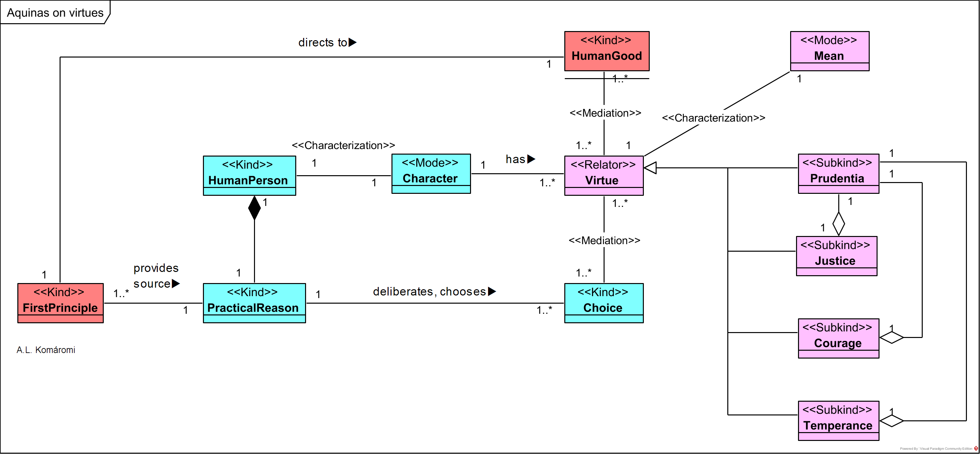
What Are The Virtues?
https://philosophy-models.blog/2020/12/03/st-thomas-aquinas-on-virtues/

Slide 9
The Cardinal Virtues
The cardinal virtues are four virtues of mind and character in both classical philosophy and Christian theology.
  Prudence (φρόνησις, phrónēsis; Latin: prudentia; also Wisdom, Sophia, sapientia)
  Justice (δικαιοσύνη, dikaiosýnē; Latin: iustitia): also considered as fairness or righteousness
  Fortitude (ἀνδρεία, andreía; Latin: fortitudo): also termed courage
  Temperance (σωφροσύνη, sōphrosýnē; Latin: temperantia): also known as restraint, the practice of self-control

Slide 10
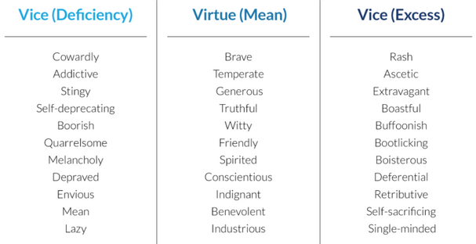
The Moral Virtues
The ideal lies between deficiency and excess
https://kevinhabits.com/aristotles-12-virtues-from-courage-to-magnificence-patience-to-wit/

Slide 11
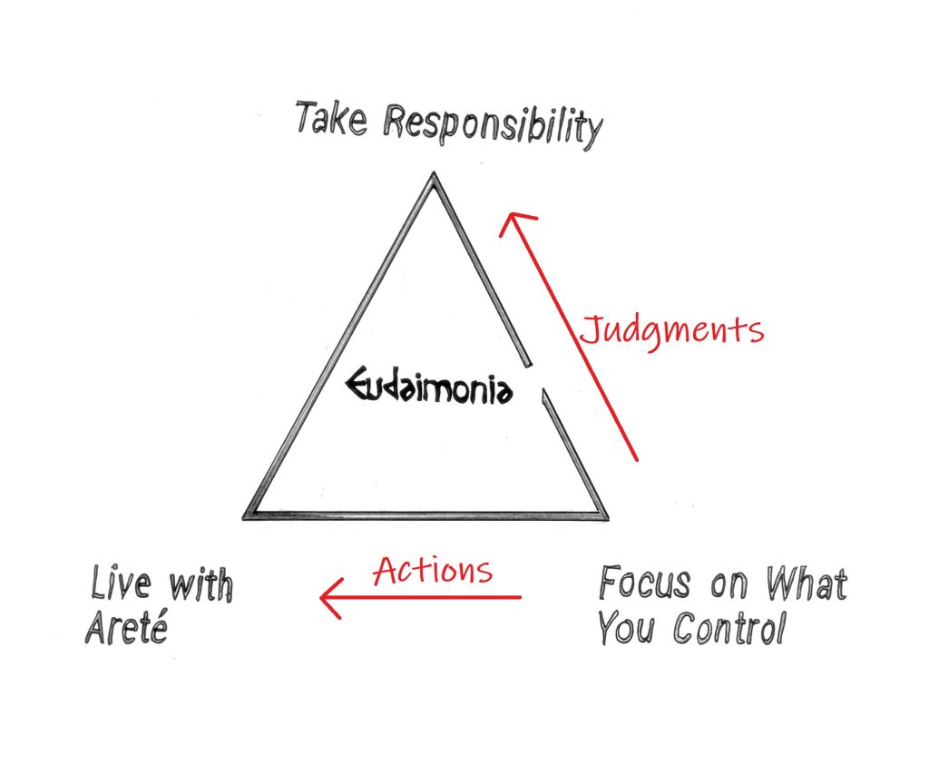
Stoicism
Express the highest version of yourself moment to moment to moment
Focus on the things we control, and accept the rest as it happens
Take responsibility - it’s not an external situation that makes us happy or miserable, but our interpretation of that situation
https://www.reddit.com/r/Stoicism/comments/bq1njj/easy_way_to_explain_stoicism_the_stoic_happiness/

Slide 12
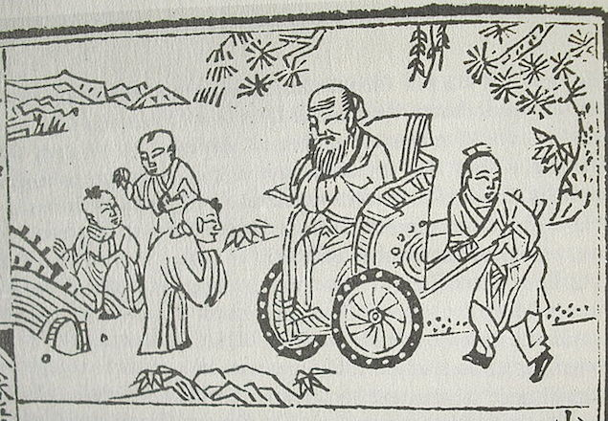
Confucianism
Within Confucianism there are five constant virtues or wu chang (五常):
benevolence or ren (仁)
righteousness or yi (义)
propriety or li (理)
wisdom or zhi (智)
fidelity or xin (信).
https://www.sciencedirect.com/topics/psychology/confucius

Slide 13
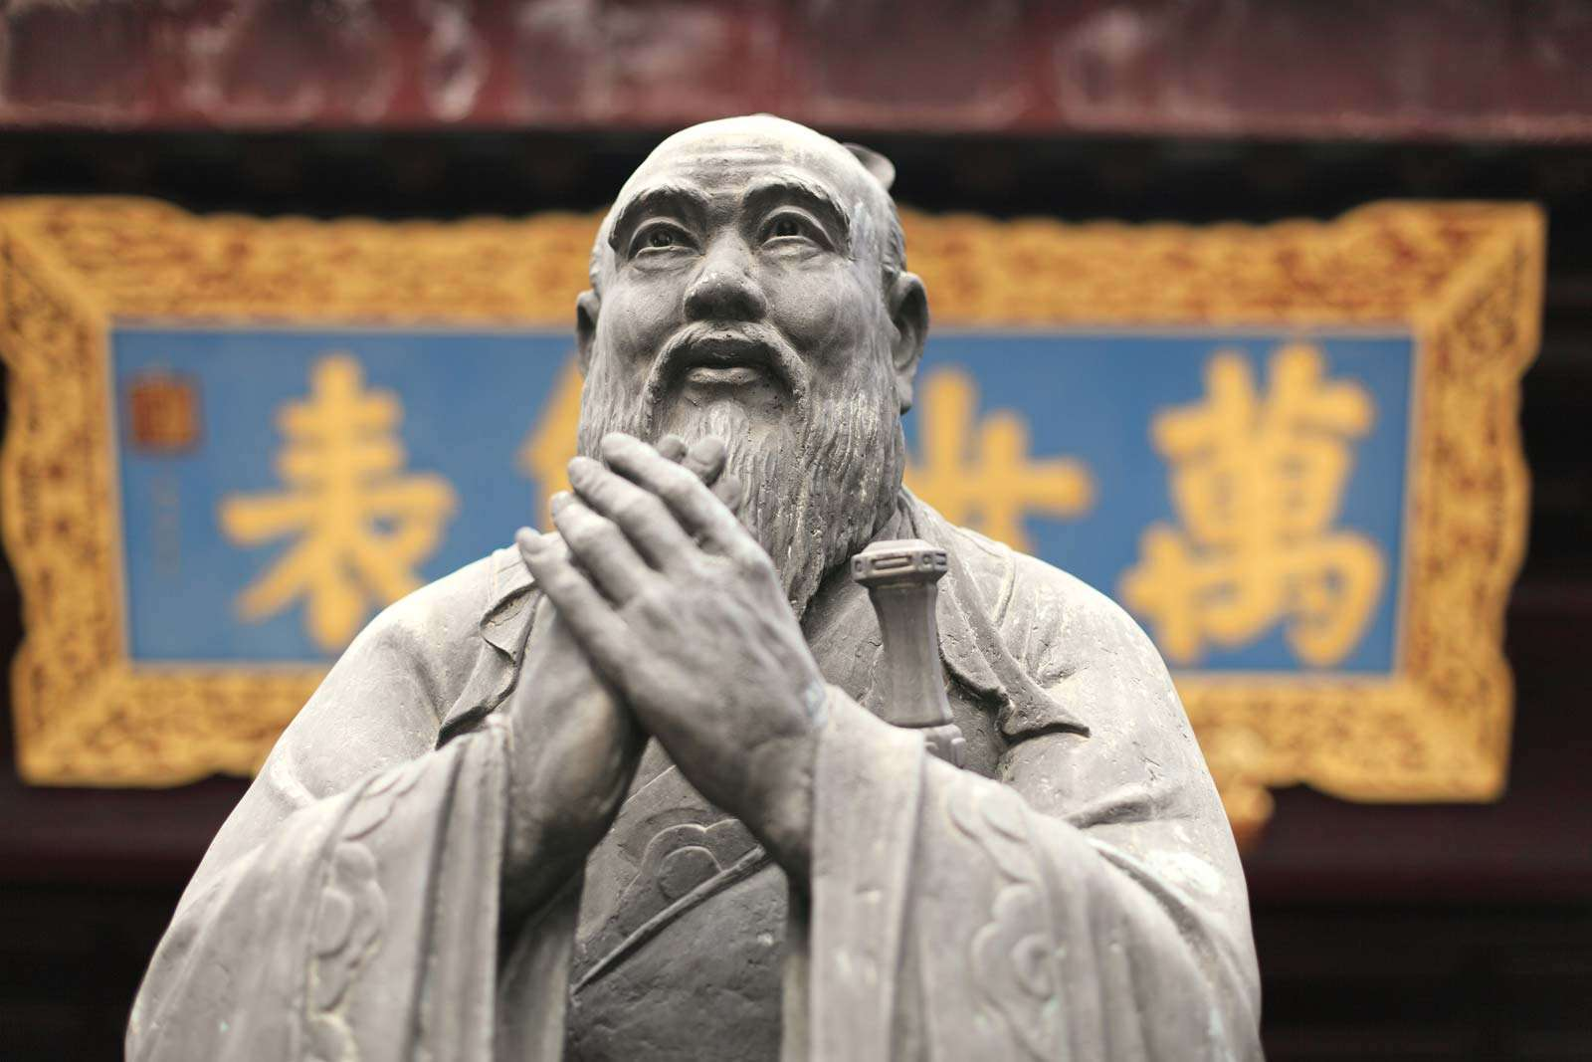
Taoism
“Daoist sagehood, however, is internal (neisheng), although it can become manifest in an external royalty (waiwang) that brings the world back to the Way by means of quietism: variously called “non-intervention” (wuwei), “inner cultivation” (neiye), or “art of the heart and mind” (xinshu).”
https://www.britannica.com/topic/Daoism/Concepts-of-human-being-and-society

Slide 14
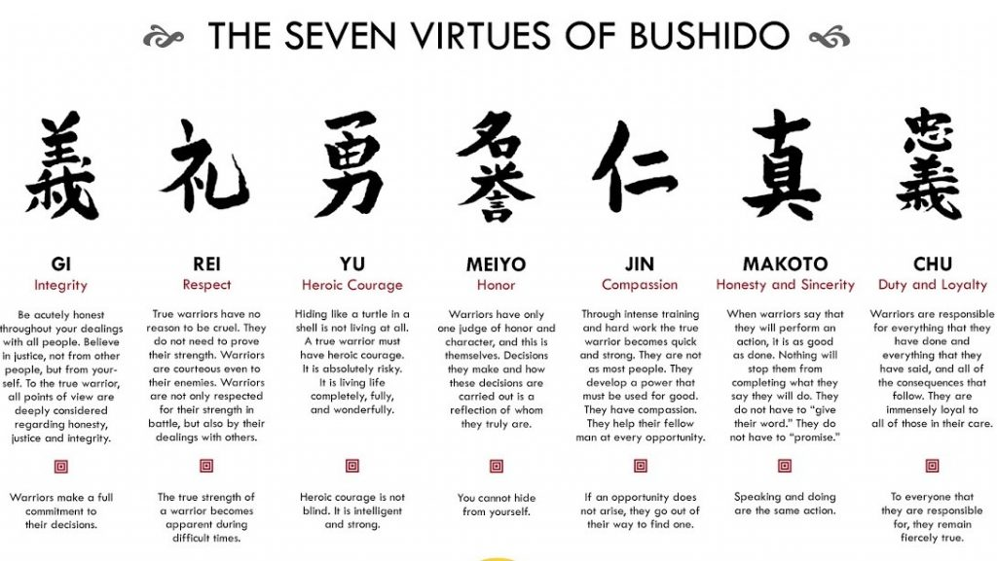
Bushido
https://brewminate.com/a-history-of-virtue-as-a-philosophy-since-the-ancient-world/

Slide 15
A Contemporary List
Justice - requires us to treat all human beings equally and impartially.
Fidelity - requires that we treat people closer to us with special care.
Self-care - a unique responsibility to care for ourselves, affectively, mentally, physically, and spiritually.
Prudence - we must always consider Justice, Fidelity and Self-care.
Keenan, 1995, pp. 723-724. http://cdn.theologicalstudies.net/56/56.4/56.4.5.pdf

Slide 16
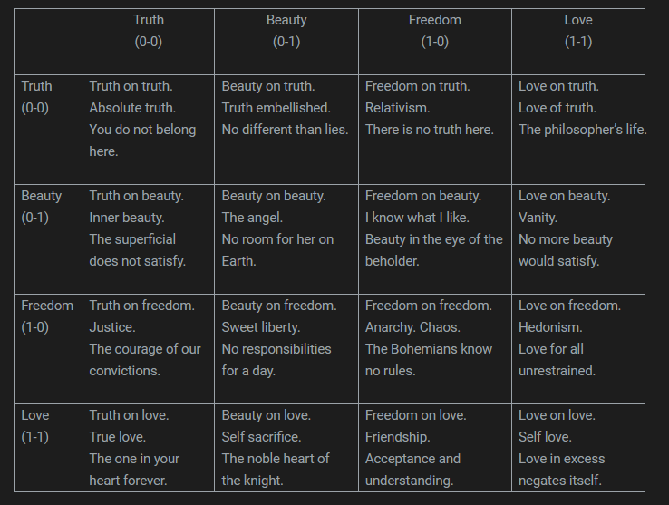
Moulin Rouge
Truth
Beauty
Freedom
Love
All life is encompassed in
Truth, Beauty, Freedom and Love
To play this game of life,
Toss the coin four times
The first two coins are the left
The last two coins are the top
https://letsmakesomeartdammit.blogspot.com/2014/10/moulin-ching.html

Slide 17
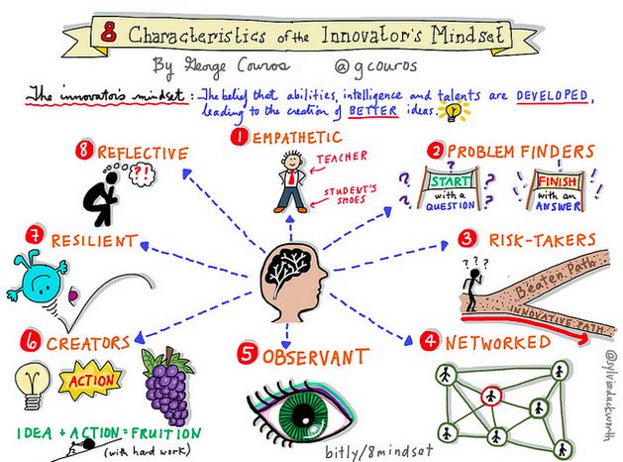
Character and Mindset
Modern adaptations of virtue theory
https://georgecouros.ca/blog/archives/4783

Slide 18
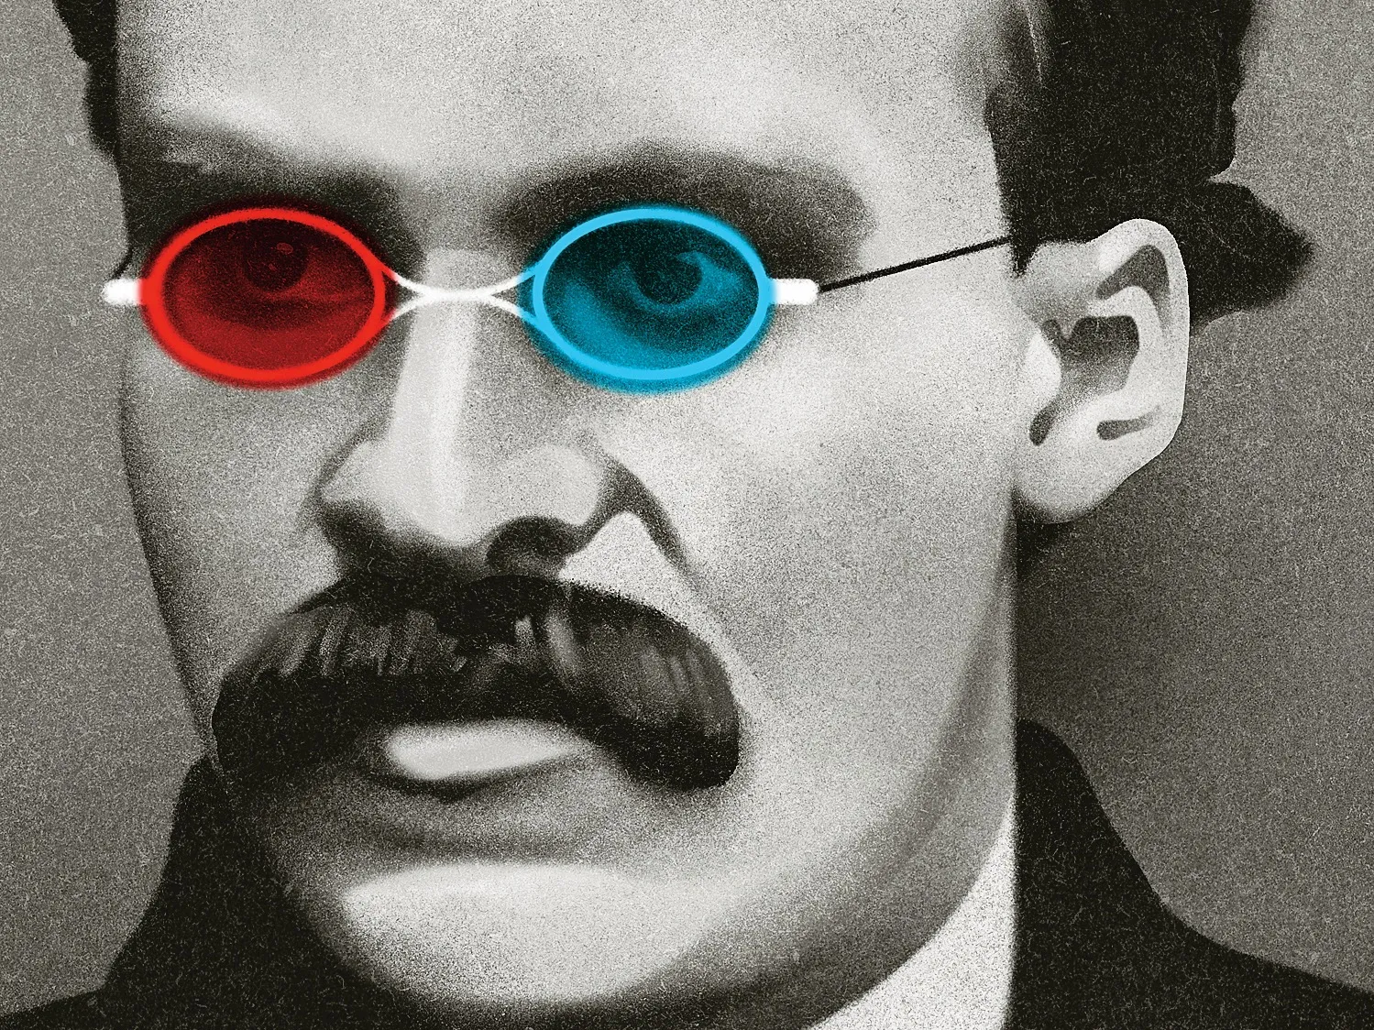
Man and Superman
Nietzsche
  Beyond Good and Evil
  Man and Superman
“The Man of Steel’s new motto — ‘Truth, Justice and a Better Tomorrow’ — is meant to inspire ‘people from around the world’”
https://www.newyorker.com/magazine/2019/10/14/nietzsches-eternal-return
https://philpapers.org/browse/nietzsche-character-and-virtue-ethics
https://chicago.suntimes.com/entertainment-and-culture/2021/10/18/22732108/superman-slogan-american-way-new-truth-justice-better-tomorrow-dc-comics
https://en.wikipedia.org/wiki/Superman

Slide 19
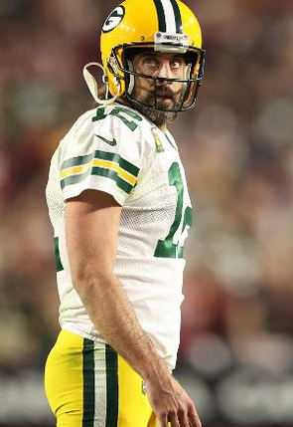
Role Models
“A role model is a person whose behaviour, example, or success is or can be emulated by others, especially by younger people. The term role model is credited to sociologist Robert K. Merton, who hypothesized that individuals compare themselves with reference groups of people who occupy the social role to which the individual aspires, an example of which is the way young fans may idolize and imitate professional athletes or entertainment artists.”
https://www.cnn.com/2021/11/08/opinions/aaron-rodgers-covid-accountability-obeidallah/index.html
https://en.wikipedia.org/wiki/Role_model

Slide 20
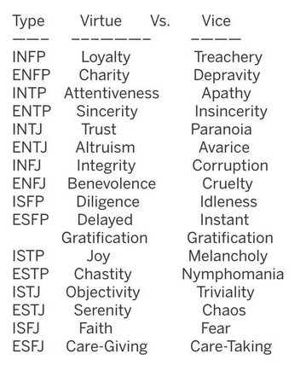
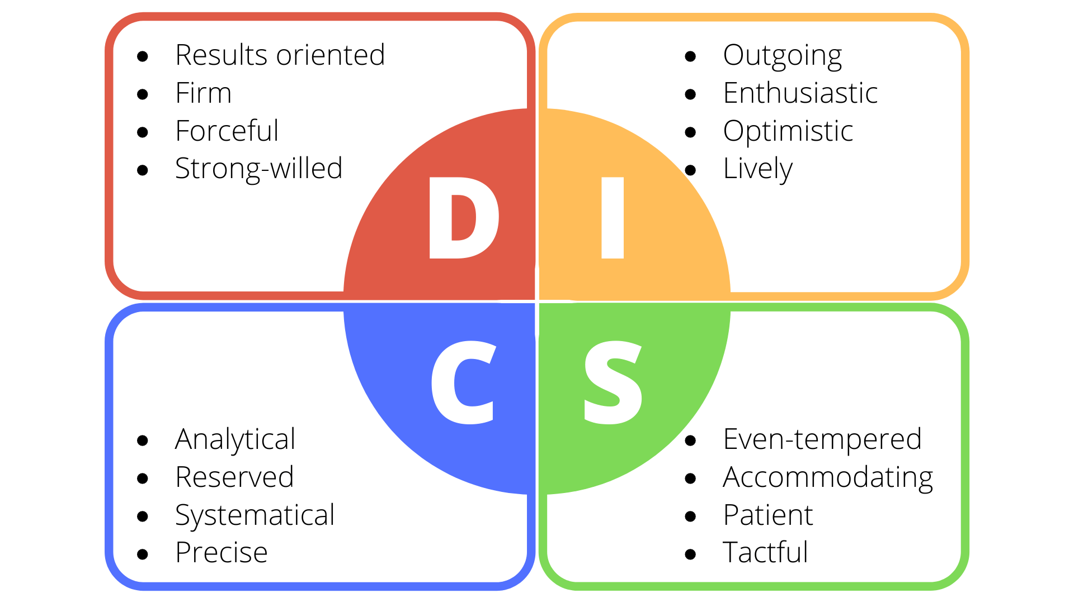
Personality Types
https://www.reddit.com/r/mbti/comments/c2qu1b/virtue_vice_of_each_16_mbti_personality_type/
“Conservatives who also scored low on conscientiousness engaged in such behavior to a greater extent—they were more likely than liberals or more conscientious conservatives to share misleading information, the research finds.” https://www.futurity.org/personality-type-fake-news-chaos-2653532-2/
https://speakoutinc.com/how-to-persuade-the-four-different-personality-types-in-your-business-and-nonprofit-life/

Slide 21
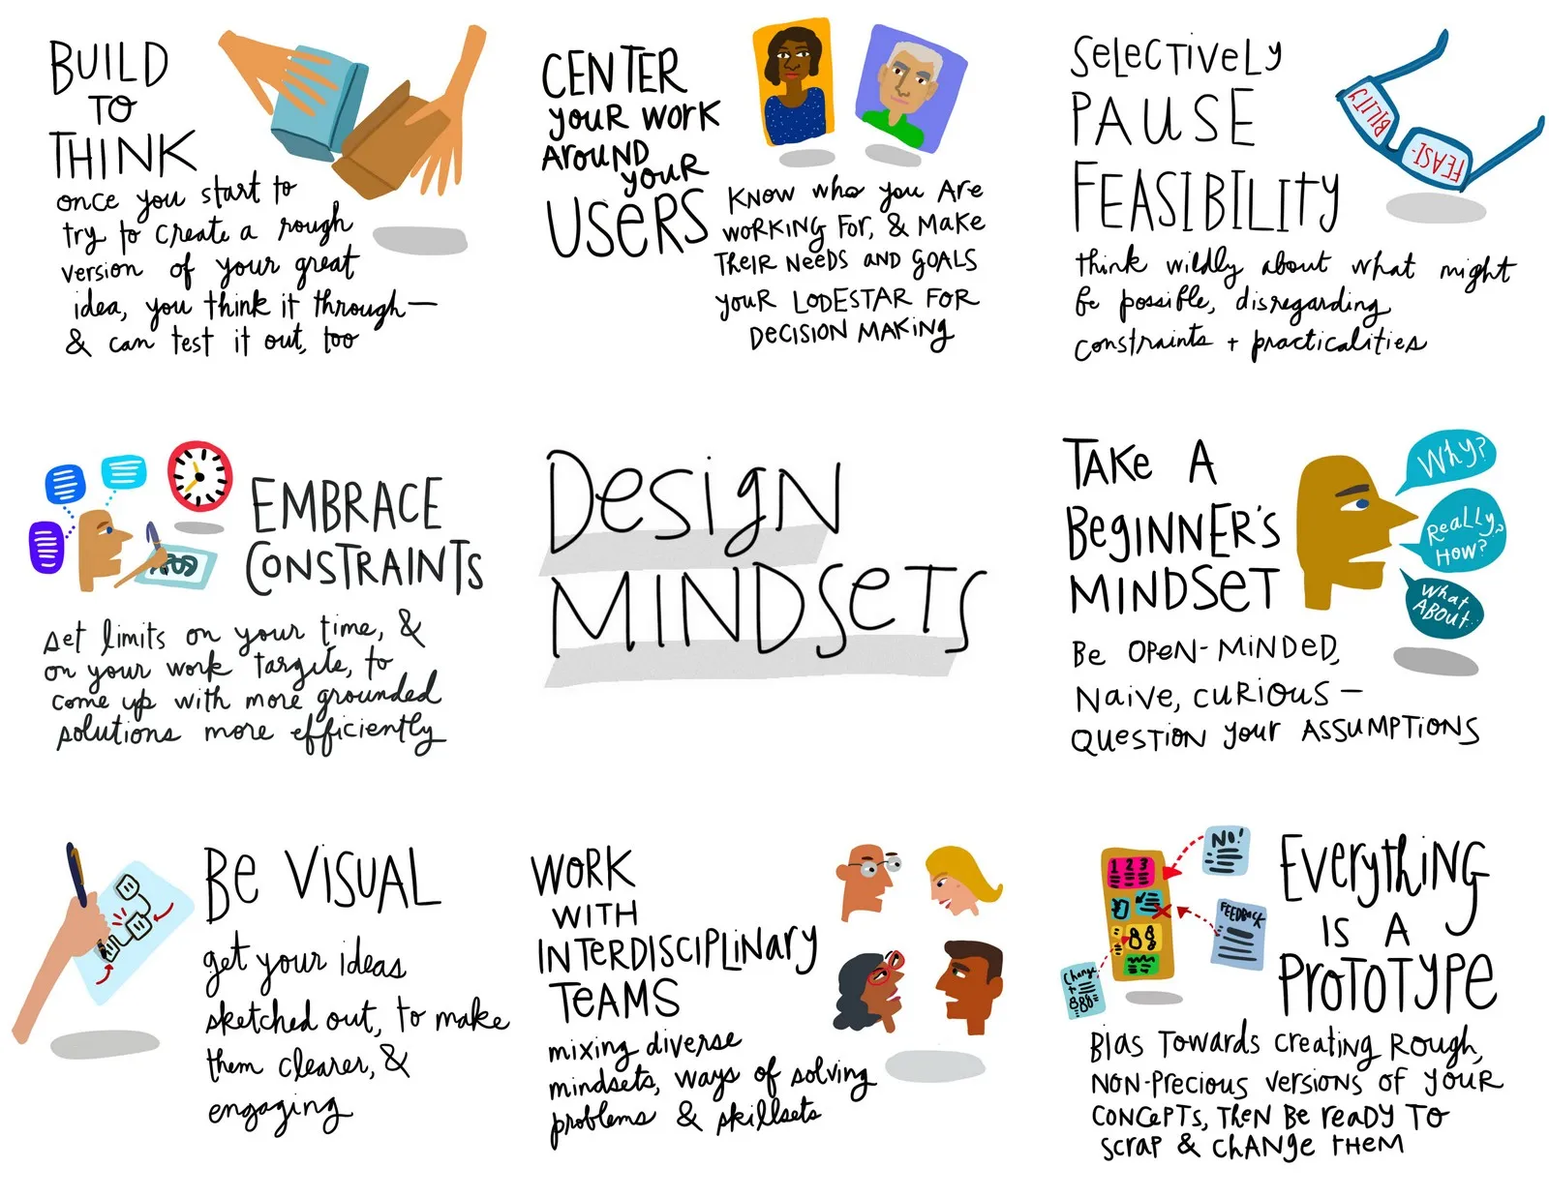
Mindsets
Your mindset is a set of beliefs that shape how you make sense of the world and yourself.
Growth mindset
Innovator’s mindset
Design mindset
Grit, resilience
https://lawbydesign.co/design-mindsets/

