Slide 1

Approaches to Ethics
Stephen Downes
November 8, 2021

Slide 2
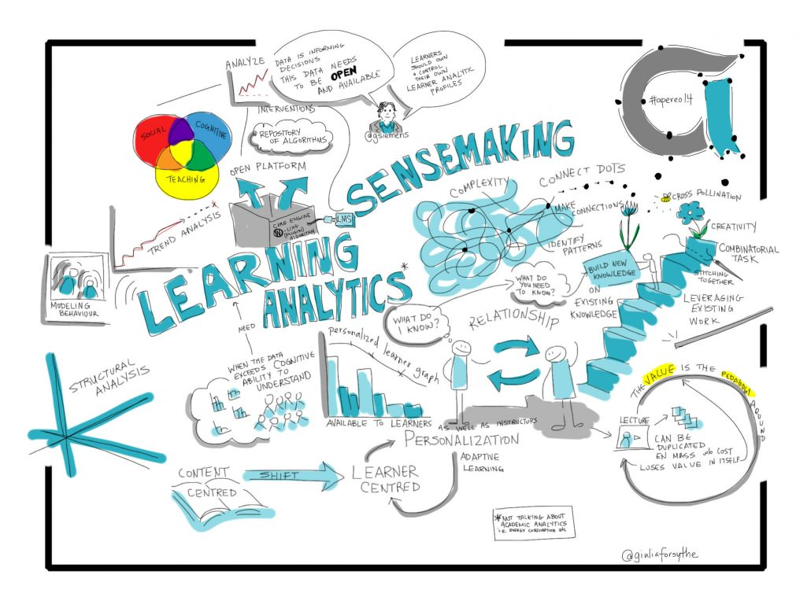
Starting Points
What is the basis for statements about the ethics of learning analytics?
Giulia Forsythe https://www.e-learningmatters.com/new-emerging-tech-part-2-learning-analytics-adaptive-learning/
Cover image: https://www.smithsonianmag.com/history/extraordinary-500-year-old-shipwreck-rewriting-history-age-discovery-180978825/?utm_source=pocket-newtab

Slide 3

Starting Points
“To satisfy expectations of the ‘born digital’ / ‘born social’ generations, there is a likely requirement to take on ethical considerations, which may run contrary to the sensibilities of previous generations, especially in respect of the trade-off between privacy and service.” (Kay, D., Korn, N. & Oppenheim, C., 2012)
Really? Is that why we’re doing it?
Kay, D., Korn, N. & Oppenheim, C., 2012. Legal, Risk and Ethical Aspects of Analytics in Higher Education, Available at: http://publications.cetis.org.uk/2012/500

Slide 4
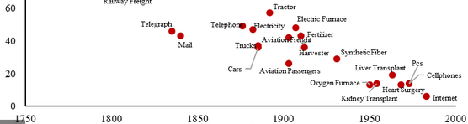
Starting Points
Drew (2016) states that “people think that it would be irresponsible not to use data science in certain cases, and that we should not lag behind other countries.”
Are we to draft our ethical principles based on “what people think” or on whether we “lag behind” other countries? If not, why not?
https://www.brookings.edu/blog/future-development/2020/01/17/whoever-leads-in-artificial-intelligence-in-2030-will-rule-the-world-until-2100/ Brookings
Drew, 2016: https://royalsocietypublishing.org/doi/10.1098/rsta.2016.0119

Slide 5
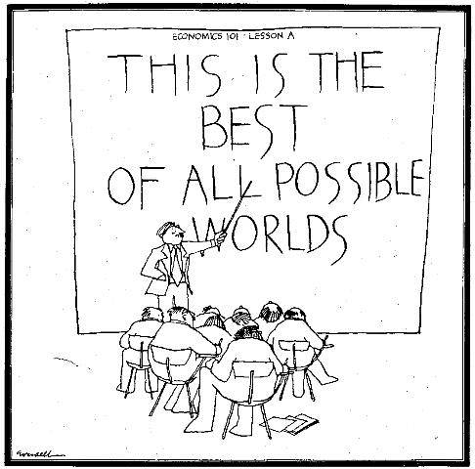
The Best of…
As Voltaire’s Candide might have reflected, we are faced with the imperative to seek out the ‘best of all possible worlds’ (Kay, D., Korn, N. & Oppenheim, C., 2012)
Is this the best of all possible worlds?
https://independentaustralia.net/politics/politics-display/capitalism-the-best-of-all-possible-worlds,4303
Candide summary: https://theconversation.com/guide-to-the-classics-voltaires-candide-a-darkly-satirical-tale-of-human-folly-in-times-of-crisis-157131

Slide 6
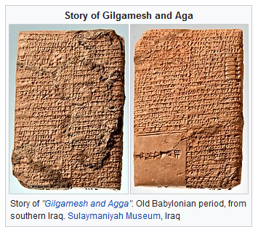
Approaches to Ethics
Human interest in ethics goes back at least 3,000 years and probably further
  “such as the Mesopotamian Epic of Gilgamesh, Homer's Iliad and the Icelandic Eddas, portray a set of values that suit the strong leader of a small tribe.
  “The Sumerian Farmer's Almanac and the Egyptian Instruction of Amenemope both advise farmers to leave some grain for poor gleaners” (Wikipedia)
https://en.wikipedia.org/wiki/History_of_ethics
History of Ethics from a very western perspective: https://www.encyclopedia.com/humanities/encyclopedias-almanacs-transcripts-and-maps/ethics-history

Slide 7
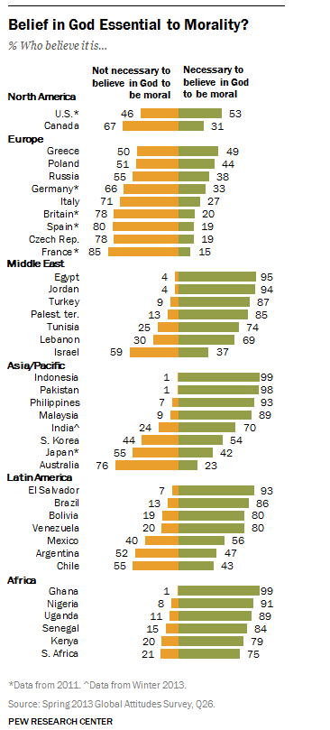
Approaches to Ethics
Ethics has a long history of association with religious belief, but this is waning
  Miguel Guhlin shares his summary of Greg Epstein's book, Good Without God, and I thought I'd include it here as complexion and nuance for my upcoming MOOC. It follows a path well trodden by people like Kai Nielson and J.L. Mackie. https://www.downes.ca/post/72711
https://www.pewresearch.org/global/2014/03/13/worldwide-many-see-belief-in-god-as-essential-to-morality/
History of Ethics from a very western perspective: https://www.encyclopedia.com/humanities/encyclopedias-almanacs-transcripts-and-maps/ethics-history

Slide 8
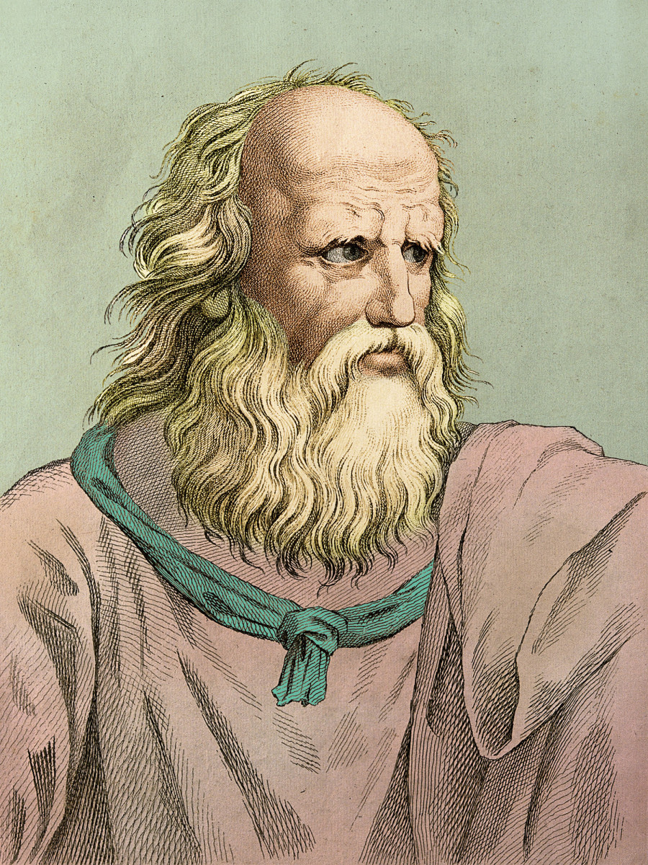
Approaches to Ethics
Ethics as philosophy developed within the Greek tradition
  "Justice is the rule of the stronger" (Thrasymachus) and "Man is the measure of all things" (Protagoras) – Socrates – the difficulties of such theories
  Plato – idealism - the Form of the Good, in relation to which all other objects of knowledge must be defined
  Aristotle - the exercise of natural human faculties in accordance with virtue.
History of Ethics from a very western perspective: https://www.encyclopedia.com/humanities/encyclopedias-almanacs-transcripts-and-maps/ethics-history

Slide 9
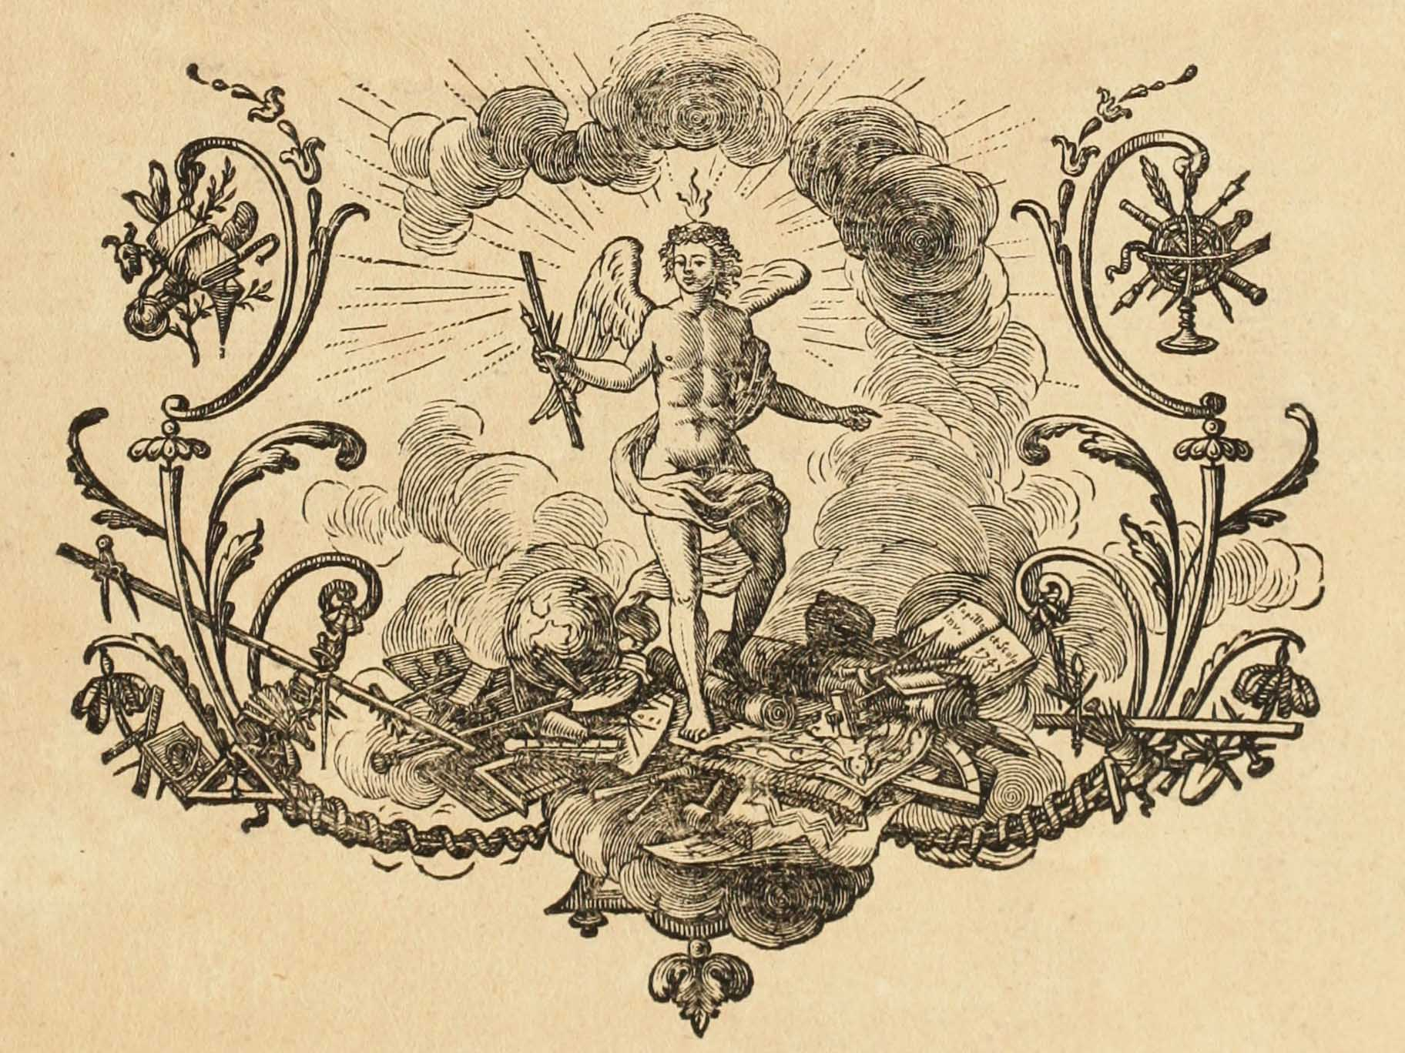
Approaches to Ethics
Since the Enlightenment ethics has also been associated with reason
History of Ethics from a very western perspective: https://www.encyclopedia.com/humanities/encyclopedias-almanacs-transcripts-and-maps/ethics-history

Slide 10
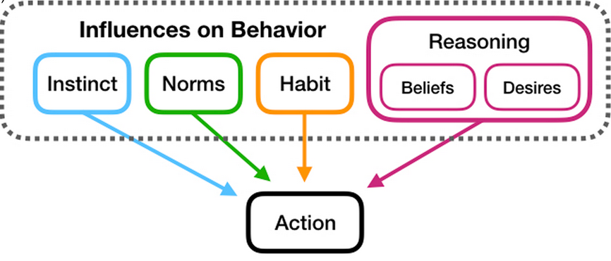
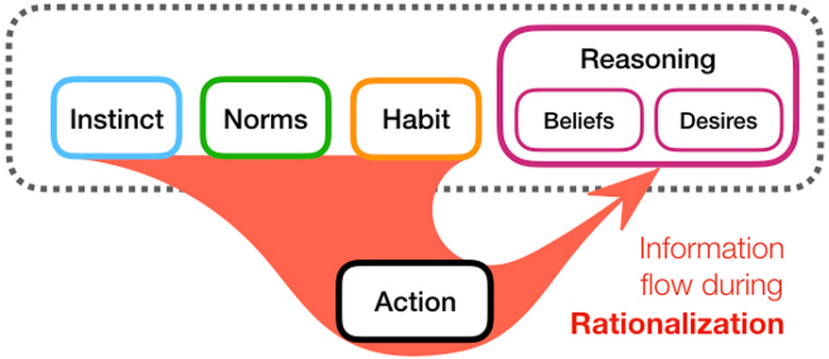
Ethics of Belief
Why we have a moral obligation to believe responsibly:
  false beliefs about physical or social facts lead us into poor habits of action
  poor practices of belief-formation turn us into careless, credulous believers.
  we have the moral responsibility not to pollute the well of collective knowledge. (Clifford ‘The Ethics of Belief’, 1877)
https://www.cambridge.org/core/journals/behavioral-and-brain-sciences/article/abs/rationalization-is-rational/2A13B99ED09BD802C0924D3681FEC55B
Francisco Mejia Uribe. (2018). Believing without evidence is always morally wrong. Aeon (Weblog). November 5, 2018. https://aeon.co/ideas/believing-without-evidence-is-always-morally-wrong

Slide 11

Too Big a Word?
“Compliance, legal risk, corporate values, and moral justice are all sometimes described as ‘ethics,’ and at times work in parallel to pursue common goals, and at other times come into tension with each other.” (Moss & Metcalfe, 2020)
https://points.datasociety.net/too-big-a-word-13e66e62a5bf

Slide 12
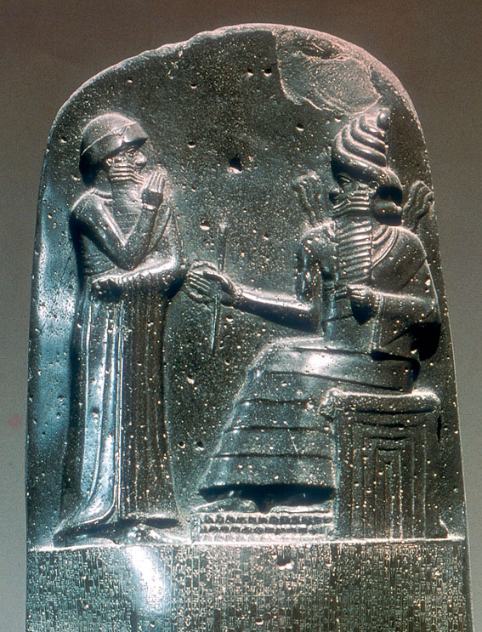
Ethical…
“The adjective ‘ethical’ can describe both an outcome, a process, or a set of values” (Moss & Metcalfe, 2020) or requirements…
https://www.britannica.com/topic/ethics-philosophy

Slide 13
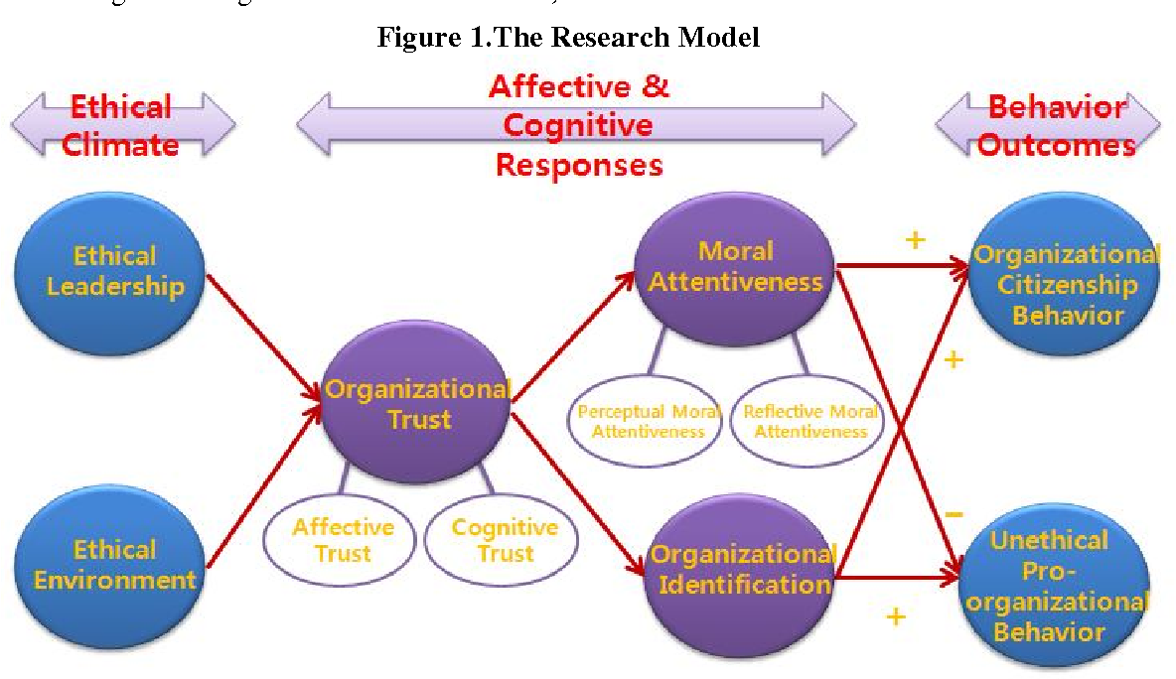
Ethical Outcomes
An outcome might consist of a cloud services company declining a contract with an abusive government or agency, or equalizing error rates across protected classes in an automated hiring system.
https://www.semanticscholar.org/paper/Exploring-the-Relationship-between-Ethical-Climate-Kim-Miao/a32e4bc35ed4212e5b76a09748126ca635446557

Slide 14
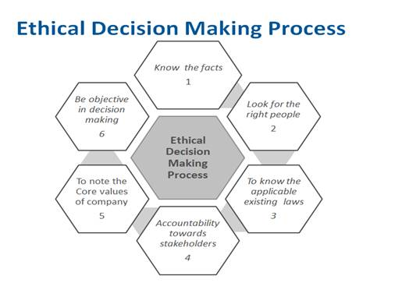
Ethical process
A rigorously ethical process can look like a committee of stakeholders convening to develop a plan for addressing potential harms of a new product or a review team analyzing an engineering requirements document.
https://www.inhousecommunity.com/article/ethical-decision-making-process-manish-asarkar/

Slide 15
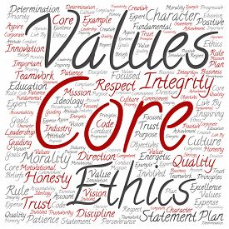
Ethical Values
Values describe states’, humans’ (or any moral being’s) desires, such as beauty, justice, or wealth, and are expressed as ethical principles

Slide 16
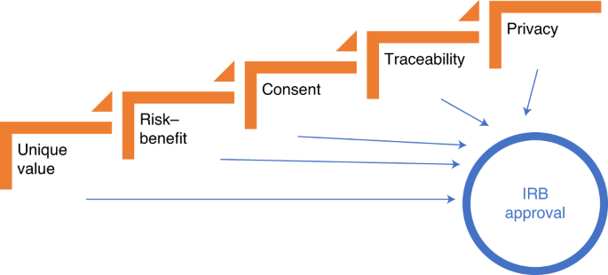
Ethical Requirements
“Ethical requirements are requirements for AI systems derived from ethical principles or ethical codes (norms)” (Guizzardi, et.al., 2020)
https://www.nature.com/articles/s42256-021-00389-w

Slide 17
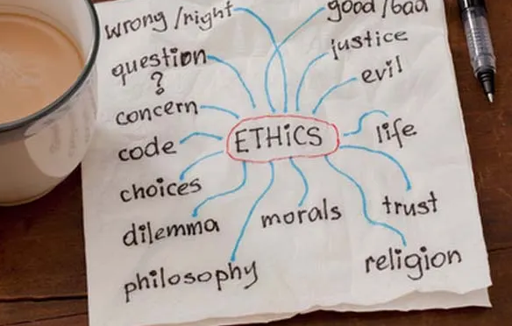
Five Approaches to Ethics
The Utilitarian Approach
The Rights Approach
The Fairness or Justice Approach
The Common Good Approach
The Virtue Approach
Velasquez, et.al., 2009. https://www.scu.edu/ethics/ethics-resources/ethical-decision-making/a-framework-for-ethical-decision-making/

Slide 18
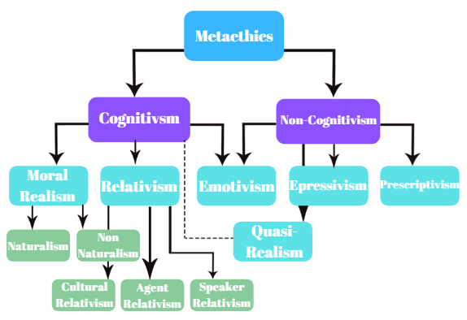
Metaethics
What is the basis for ethical reasoning?
Does might make right?
Do ethics describe duties?
Are ethics based in rights?
Do ethics require agency?
Relativism vs Universality
https://conscientthoughts.wordpress.com/2019/06/10/lets-get-meta-about-metaethics/

