Slide 1


Ethical Codes
Stephen Downes
November 1, 2021

Slide 2
Why Ethical Codes?
There is the concern that without a statement of ethics, unethical conduct will abound.
Others are less concerned about good behaviour per se than they are about the bottom line.
Some services and institutions that require professional ethics in order to function (e.g. accounting, law)
Certain disciplines see ethical codes as essential to being recognized as a profession.
Practitioners need them.

Slide 3
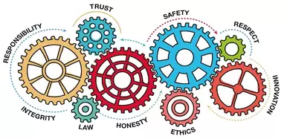
Standards of Conduct
Professional ethics can be characterized as imposing a higher standard of conduct
Codes are normative (ie., they carry penalties) but the intent is usually to remind professionals of their duties
Ethical codes are related to, but distinct from, legal obligations

Slide 4
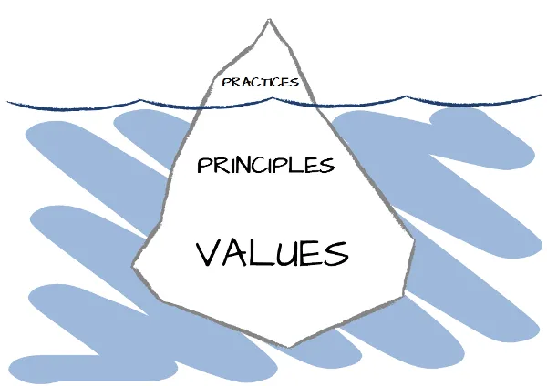
Values and Principles
Codes are divided by:
  Values – general moral values, such as ‘honesty’ and ‘trustworthiness’
  Principles – the ethical conditions or behaviors we expect
    “An ethical principle is a statement concerning the conduct or state of being that is required for the fulfillment of a value; it explicitly links a value with a general mode of action.” (Cooper, 1998)
https://www.infoq.com/articles/change-practices-principles-values/

Slide 5
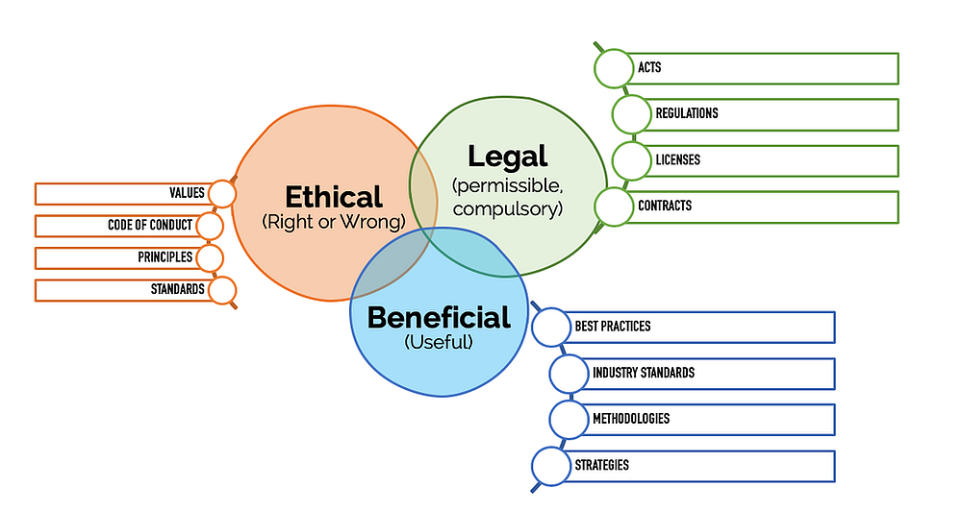
Questions to Ask
Why writes the codes?
How do they differ?
  Motivation, purpose, interests, burden, enforcement
https://www.leancompliance.ca/post/motivations

Slide 6
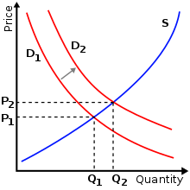
Values and Priorities
Later in this module, we will consider the set of values and principles informing ethical codes
We will also look at the bases for these values and principles
https://en.wikipedia.org/wiki/Economics

Slide 7

Research Subjects
Ethical codes vary a lot regarding who the research subject or client may be considered to be. For example:
  Employer or funder
  Colleagues, union or professional association
  Stakeholders
  Publishers or content providers
  Society
  Law and country
  The environment

Slide 8
Commonality?
The Canadian Psychologists’ Code asserts that “all human beings have a moral right to have their innate worth as human beings appreciated and that this inherent worth is not dependent on a human being’s culture, nationality, ethnicity, colour, race, religion, sex, gender, marital status, sexual orientation, physical or mental abilities, age, socio-economic status, or any other preference or personal characteristic, condition, or status” (CPA, 2017:11)
No other code lists all these factors.
Many codes list none of them.

Slide 9
The Ethical Codes Reader
https://ethics.mooc.ca/post/An Ethical Codes Reader
  The first section is composed of short summaries of the more than 70 ethical codes considered
  The second section is a longer presentation of the code, sometimes reproducing it in full

