Slide 1
Ethics and Analytics: What
We Mean By Ethics
Stephen Downes
October 14, 2021

Slide 2
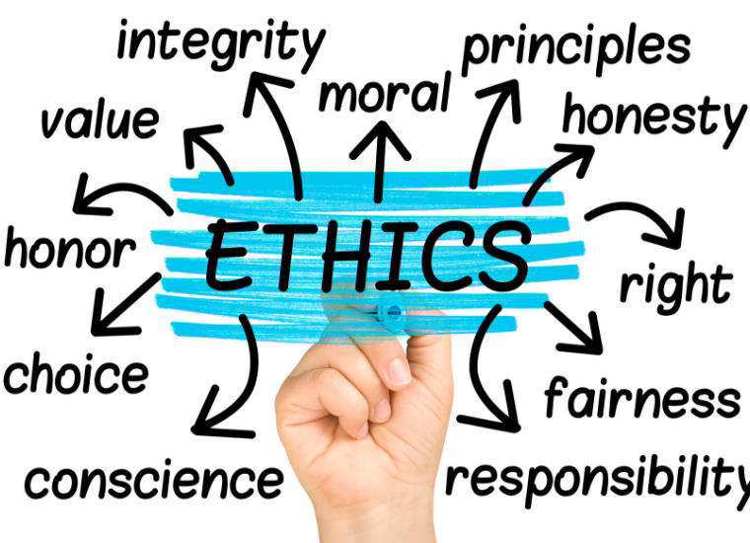
By ‘Ethics’ We Mean…
We all think we know what ethics is.
Each of us feels we have an
understanding of ethics and the role
it plays in life, but where there is a
history of deep and often
contentious discussion.
https://www.scu.edu/mobi/resources--tools/blog-posts/ethics-in-life-and-business/ethics-in-life-and-business.html

Slide 3
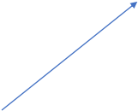
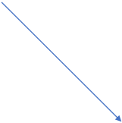
By ‘Ethics’ We Mean…
The adjective ‘ethical’ can describe both an
outcome, a process, or a set of values, any
of which has different connotations. (Moss
outcome
& Metcalf, 2020)
ethical…
process
values

Slide 4
By ‘Ethics’ We Mean…
Ethics, at first glance,
appears to be about how
we know what is ‘right’
and ‘wrong’, perhaps as
discovered (Pojman,
1990), perhaps as
invented (Mackie, 1983),
or ‘revealed (Sproul,
2011).
discovered
ethics as..
invented
revealed

Slide 5
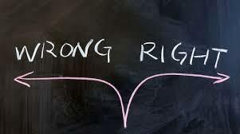
By ‘Ethics’ We Mean…
Maybe it’s about the nature of right and wrong, which might be
found in biology, rights, fairness, religion, or any number of other
sources, depending on who is asked.
rights
biology
fairness
religion
https://lifehopeandtruth.com/change/sin/deadly-sins/wrong-choice/

Slide 6
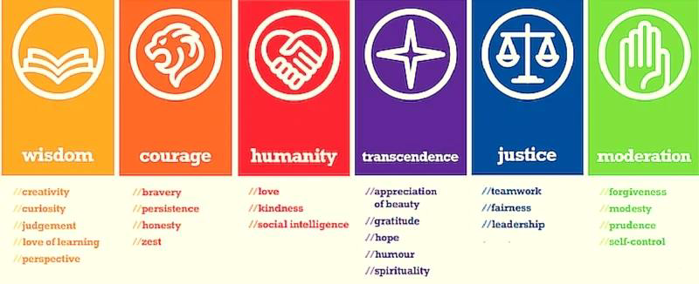
By ‘Ethics’ We Mean…
Or instead, ethics may be based in virtue and character, as
described by Aristotle (2014) in ancient Greece.
https://positivepsychology.com/classification-character-strengths-virtues/

Slide 7
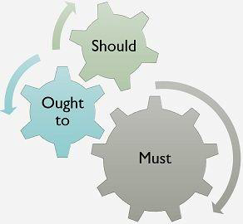
By ‘Ethics’ We Mean…
Ethics is generally thought of as
speaking to what actions we
‘should’ or ‘ought’ to take (or
‘should not’ or ‘ought not’ take).
https://keydifferences.com/difference-between-should-ought-
to-and-must.html

Slide 8
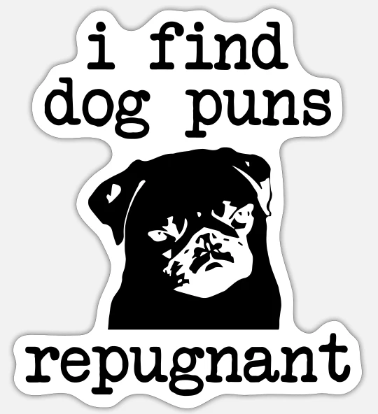
What Ethics Is Not
Ethics is not the same as feeling.
So, for example, we would not say
that the word ‘unethical’ means the
same as the word ‘repugnant’ or
‘offensive’. These describe our
reactions to an action, not the action
itself.
(All these cases after Velasquez,
et.al., 2009)
https://www.spreadshirt.ca/

Slide 9

What Ethics Is Not
While religion may offer a basis for
ethical choices, ethics is not the
same as religion.
•Maybe we can be ethical without religion
(Nielson, 1973)
•Maybe we can be religious but unethical
•Maybe the domain of ethics extends beyond
religion (eg, copyright?)

Slide 10

What Ethics Is Not
While cultural norms may influence our ethical decisions, it is
arguable that different cultures define ethics differently.
•E.g., example, a compliance-oriented perspective as opposed to a value-
oriented perspective (Eisenbeiß and Brodbeck, 2014).
•Some cultural practices may appear obviously wrong (Velasquez, et.al.
(2009) mention slavery) other differences are much more subtle.
https://study.com/academy/lesson/cultural-norms-definition-values-quiz.html

Slide 11
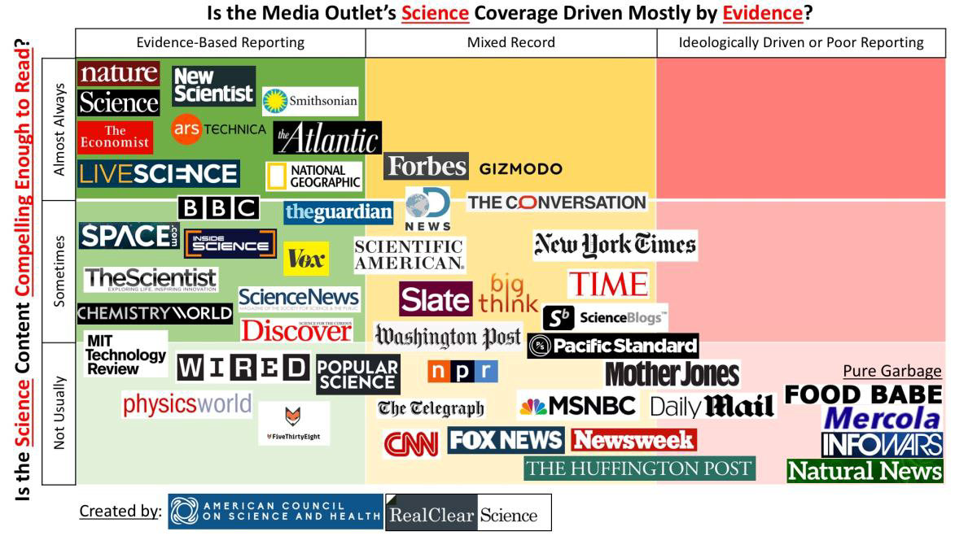
What Ethics Is Not
While science may help us make ethical choices, science does
not define right and wrong.
•some argue that ‘ought’ does not follow from ‘is’ (Hudson, 1969)
•but evidence matters…
https://www.acsh.org/news/2017/03/
05/infographic-best-and-worst-
science-news-sites-10948

Slide 12
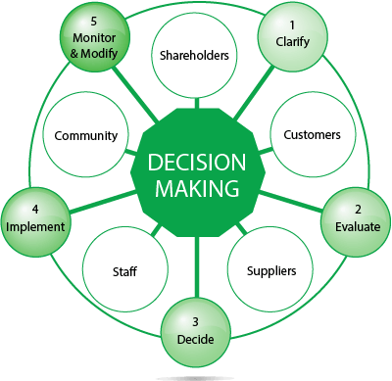
Ethics Might Be…
A framework for making
decisions. The idea of analytics
and related technology posing
dilemmas requiring practitioners
to make the right choice
(whatever that may be).
https://www.chris-elgood.com/ethical-
decision-making-9-steps/

Slide 13
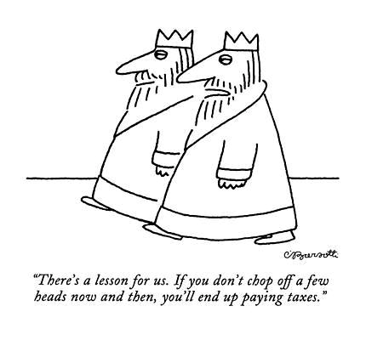
Ethics Might Be…
Inherently political (Selwyn, 2019).
But it does not follow that all political
aspects of analytics are also ethical
aspects.
https://fineartamerica.com/art/pragmatic

Slide 14
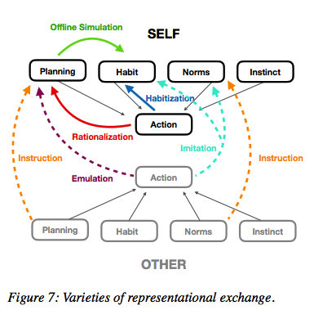
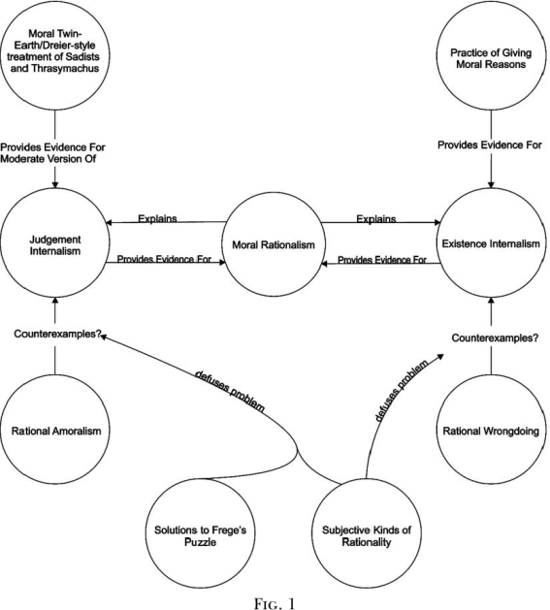
Ethics Might Be…
Rational, or at least, include some sense of rationality and
decision-making. As Zawacki-Richter, et. al. (2019:4) write, “the
concept of rational agents is central to AI…”
https://www.semanticschol
ar.org/paper/Moral-
Rationalism-and-Rational-
Amoralism-
Roojen/f5ee34057fe5a5c6a
f3698a3a4c3e7af0e5ff583
https://www.ethicalpsychology.com/2018/
08/rationalization-is-rational.html

